Slide 1
Security Strategies in Web Applications and Social Networking
Lesson 12
Performing a Web Site Vulnerability and Security Assessment

Slide 2
Learning Objective and Key Concepts
Learning Objective
Explain the value and importance of vulnerability and security assessments for Web applications.
Key Concepts
Difference between audit, testing, and assessment
Main steps in security assessments
Techniques and best practices in security assessments

Slide 3
Web Software Testing, Auditing, and Assessing
Testing
Ensures business requirements are met
Operates as expected
Integrates well with other software
Security testing is typically a subset

Slide 4
Web Software Testing, Auditing, and Assessing (Continued)
Audit
Ensures proper controls are documented as policy
Ensures the documented controls are in place
Security assessment

Slide 5
Security Assessment: What to Test?
Operating System
Web Server
Database Server
Web Application Software

Slide 6
Security Assessment: Vulnerability Scan
Uses a variety of tools (open source and commercial)
Combination of manual and security tools
Servers vulnerabilities
Web application vulnerabilities

Slide 7
Security Assessment: How to Test?
Discovery
Perform a vulnerability scan
Planned attacks
Reporting

Slide 8
Security Assessment: Discovery
Fingerprinting
Ping sweeping
Operating system detection
Port scanning

Slide 9


Security Assessment
Discovery
Nmap
Vulnerability Scanning
Nessus
H
Planned Attacks
Webscarab
Reporting
Remediation

Slide 10
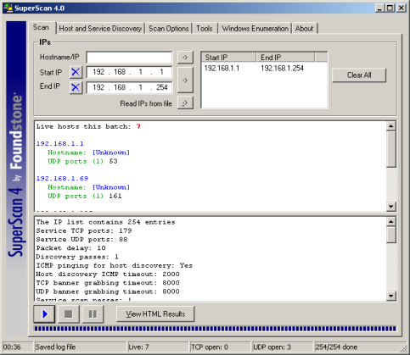
Example of Ping Sweep Tool

Slide 11
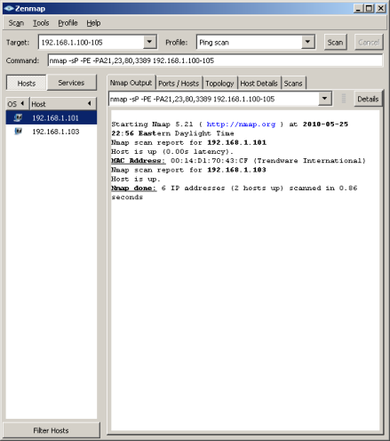
Example of Port Scanning Tool

Slide 12
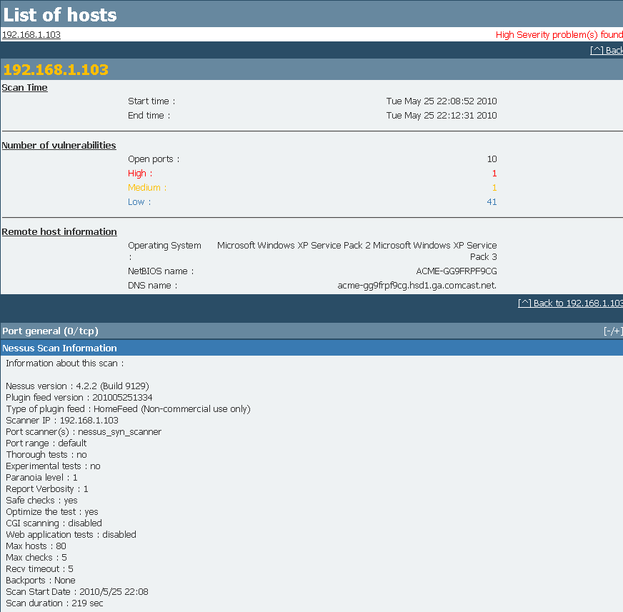
Nessus Vulnerability Scan

Slide 13
Single Server Web Site Components
Web server OS
Web server application
Web server front end
Web site forms
The operating system of the hardware server that the components reside on
The application that collects, uses, and/or provides data
The Web server software that presents the application to users in the form of HTTP pages
The input fields, or forms, that are used to gather data from users

Slide 14
Security Assessment: When to Test?
Frequently
Payment Card Industry Data Security Standard (PCI DSS) requires at least quarterly scans for all merchant levels

Slide 15
Web Security Assessment for PCI DSS Compliance
QSA discovery/recommendations
Scanning performed
Planned attacks performed
QSA submits report to management
Remediation begins
Notes:
Organization engages a security company with a Qualified Security Assessor (QSA).
QSA enters discovery phase.
QSA recommends a SaaS, external organization, or internal process for vulnerability scanning.
Scanning is performed and quarterly scanning schedule is implemented.
Planned attacks are performed by a skilled Web application security engineer by using manual processes and tools.
QSA compiles a comprehensive report for management and Web security team.
Remediation

Slide 16
Security Assessment: Planned Attacks
Front-end Web forms and servers
Back-end database and file servers

Slide 17
Security Assessment: Reporting
Executive summary
Summary of findings
Details of the vulnerability scan
Details of the security assessment
Recommended remediation

Slide 18
Remediation
Management
System administrator
Misconfigured servers
Security updates

Slide 19
Remediation (Continued)
Firewall or security administrator
Misconfigured firewalls
Security patches
Web developer
Insecure Web application code

Slide 20
Best Practices
Choose the Right Tools
Test Inside and Out
Think Outside the Box
Research! Research! Research!

Slide 21
Summary
Web software testing, auditing, and assessing
Main steps in security assessments
Techniques and best practices in security assessments
Web security assessment for PCI DSS compliance

Slide 22
Virtual Lab
Performing an IT and Web Application Security Assessment
Notes:
If your educational institution included the Jones & Bartlett labs as part of the course curriculum, use this script to introduce the lab:
“In this lesson, you explored vulnerability and security assessments of Web applications. You learned the difference between audits, tests, and assessments, and you were introduced to the major phases of a security assessment: discovery, vulnerability scanning, planned attacks and penetration testing, and reporting. Finally, you picked up techniques and best practices for performing security assessments.
In the lab for this lesson, you will apply the research you conducted on the Open Web Application Security Project (OWASP), in the Applying OWASP to a Web Security Assessment lab, to analyze the skipfish and RATS reports generated in the Performing Dynamic and Static Quality Control Testing lab. You will identify the security issues identified by both tools and research remediations for them. You also will map your research findings to specific recommendations and best practices suggested by the OWASP and Open SAMM models.”

