Slide 1
EAI

Slide 2
Historical View
1990
s and beyond
ERP and EAI
Data Warehousing
Internet Applications
menting
[2]
1980
s
Traditional Decision Support Systems
Group Decision Support Systems
1970
s
Management Information Systems
Database Management Systems
In
1960
s
Transaction Processing Systems

Slide 3
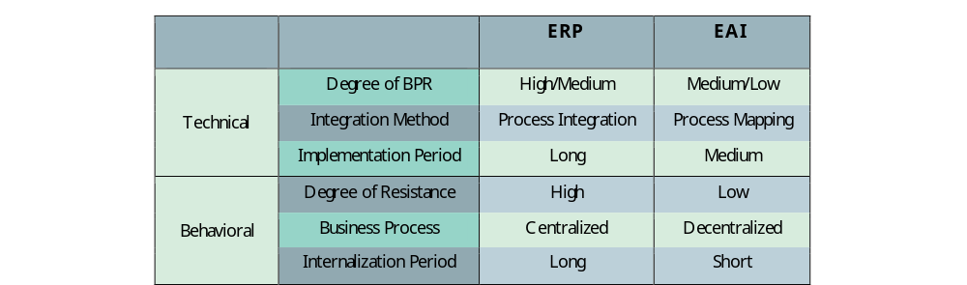
ERP vs EAI

Slide 4
Example: a simple supply chain
Ordering System
purchase
order
Business Process
Management
CRM System
document
customer-contact
Warehouse
Controlsystem
check
availability
not
available
available
ERP System
order atricle
Financial System
write invoice
Manufacturing
System
deliver goods
<number>/31

Slide 5
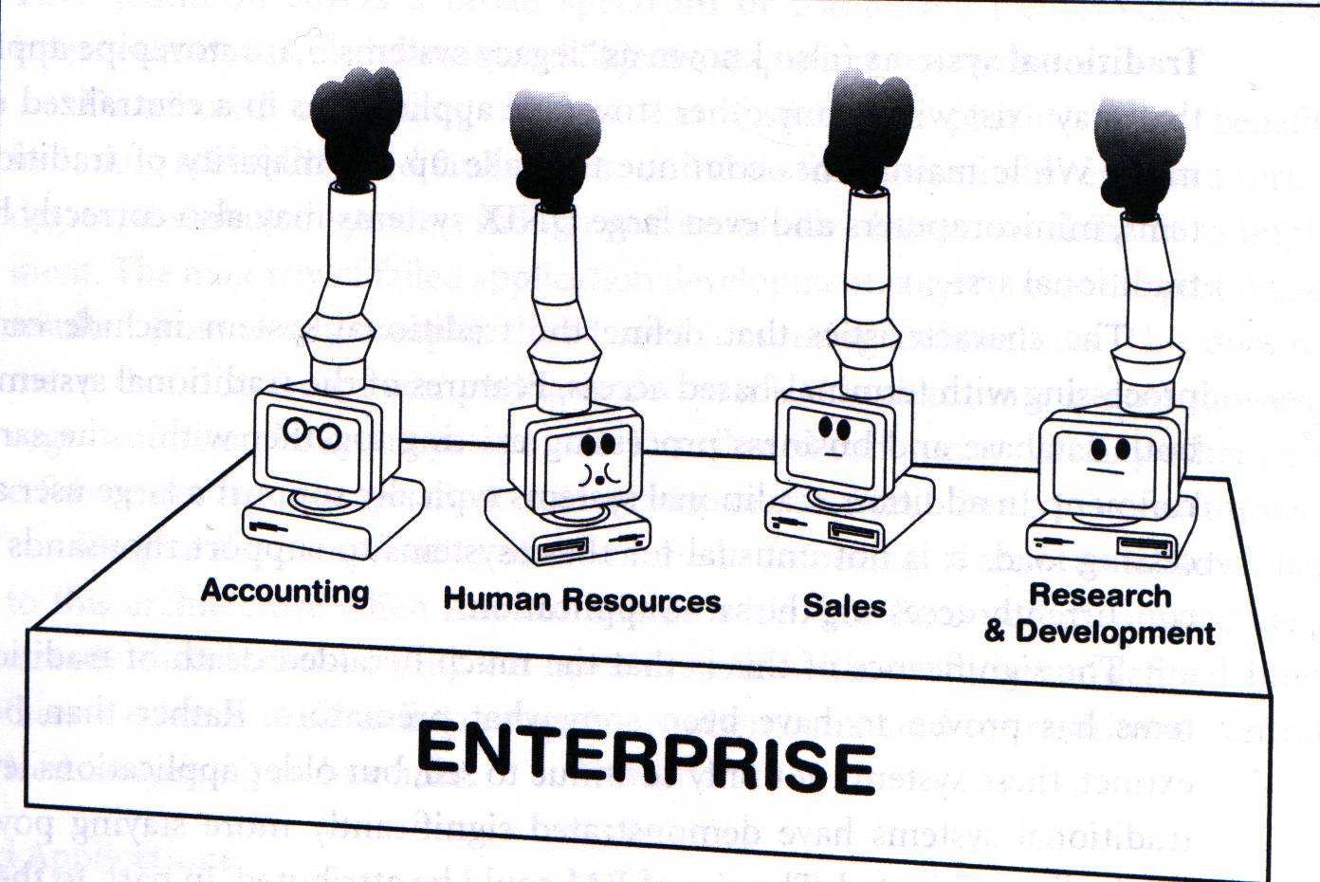
Defining EAI
Evolution of Stovepipes
  Systems tend to support single organizations with little initial incentive to integrate with other departments
  Failure of mainframes to solve problems, provide features to users, etc. tend to act as an incentive to stovepipes
  Organizations tend to protective of their systems and are unwilling to compromise

Slide 6
Example
eCom
Site
Order
System
Inventory
Shipping
Courier
One solution – custom Interfaces
Issues?

Slide 7
Example
eCom
Site
Order
System
EAI
Inventory
Shipping
Courier
Alternative – employ EAI solution

Slide 8
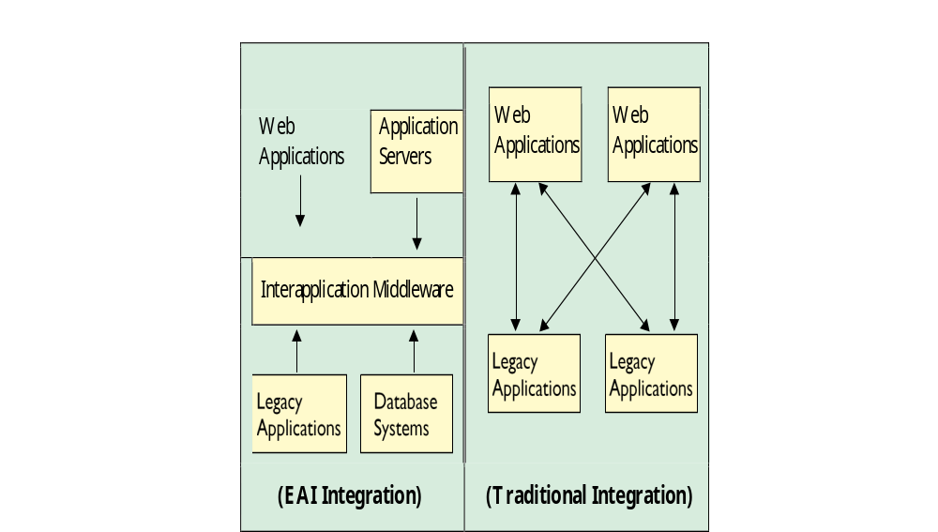

Slide 9
Enterprise Application Integration (EAI)
Provides the means to share data between different applications without writing custom interfaces.
Example:
  Consider a company that wants to do build an eCommerce portal.
  Has a number of legacy applications (or even an ERP solution in place)
  Need build the web-based eCommerce infrastructure and link with systems that do functions like process orders, manage inventory, ship products
  The company decides to use a major courier service for delivery of products ordered from the web site.
  The company wants an ODS for analysis of transactions taking place on the site

Slide 10
ERP System
Internal Applications
(Java,C,C++)
CRM System
EAI
Enterprise Portal
Application
Databases
Financial System
Legacy System
SCM System
<number>/31

Slide 11
Defining EAI
Why EAI?
  Wouldn’t it be great if everyone used the same servers with the same operating system with the same clients, etc?
  Reality is very diverse. We can expect a mix of mainframes, Windows, UNIX, Linux, as well as many other systems
  Getting them to work/share data together is the issue!

Slide 12
Defining EAI
What is EAI?
  The market is stocked with legacy systems designed to support single users without thought to integrating them into a larger whole.
  Many of these systems still provide value to the organization.
  Packaged applications often create their own set of issues and problems

Slide 13
Defining EAI
Traditional Systems
  Generally referred to as ‘legacy’ systems
  May consist of anything from PC’s to minicomputers, even large mainframes
  While the architecture of these systems may be obsolete, they still contain functionality that must be maintained by the organization in order to do it’s job.

Slide 14
Defining EAI
Microcomputer Systems
  Personal computers
  A wide range of hardware, operating system and applications make it difficult to integrate these systems with each other or legacy systems

Slide 15
Defining EAI
Distributed Systems
  Some number of systems tied together by a network that supports applications run across the network
  May comprise the range of computer sizes
  A wide range of system types exist: client/server, Internet, intranet, etc.

Slide 16
Defining EAI
Packaged Applications
  Off-the-shelf software
  Software that is purchased rather than designed
  Most are natural stovepipes, since they haven’t been designed with integration in mind and are closed systems

Slide 17
Defining Enterprise Application Integration (EAI)
Why EAI?
  System development over the last 20 years has tended to emphasize core functionality as opposed to integration
  Many systems are highly stovepiped and difficult to integrate with other similar systems
  Ultimately, it comes down to a cost issue. Building a system with integration in mind reduces the amount of money spent on further system development

Slide 18
Defining EAI
Applying Technology
  The traditional solution to integration issues has been the introduction of ‘middle-ware’.
  Middle-ware acts as a transport mechanism to perform integration typically on client/server based systems.
  Many flavors/standards of middle-ware exist:
    Remote Procedure Calls (RPC)
    Sockets
    Common Object Reuse Broker Architecture (CORBA)
    Distributed Computing Environment (DCE)
    Java’s Remote Method Invocation (RMI)

Slide 19
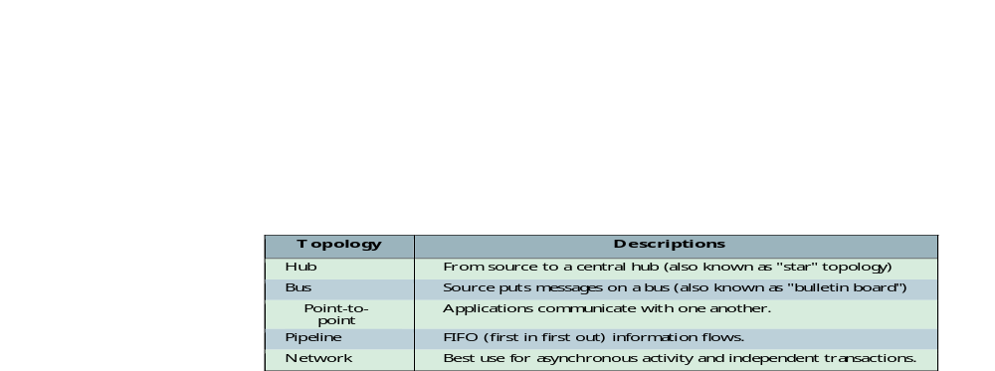
Data passing

Slide 20
Defining EAI
Applying Technology
  While middle-ware can be a solution, problems exist:
    Changes are typically required to existing systems to incorporate middle-ware
    No centralized management typically exists, so complex systems rapidly grow unmanageable
    Technological advances tend to make middle-ware based systems look like an ill-planned highway system composed of small integration projects instead of a single over-reaching standard

Slide 21
Defining EAI
How is EAI different?
  EAI focuses on the integration of both business-level processes and data whereas the traditional middleware approach is data oriented.
  EAI includes the notion of reuse as well as distribution of business processes and data.
  EAI allows users who understand very little about the details of the applications to integrate them.

Slide 22
Advantages of EAI
Cost effectiveness
Time to market
Scalability
Ability to deal with complex environments

Slide 23
EAI
Issues

Slide 24
Management Cost Issue
The implementation of EAI is expensive and more complex than expected.
The nature of EAI is dynamic and requires dynamic project managers to manage these changes.
The cost of EAI project could be 5 to 7 times higher than other IS projects.
Top management often does not understand what exactly the cost of integration is.
Management by magazine where the decisions are made without performing an appropriate analysis.
The need to obtain and maintain sponsorship and financial commitment at all levels of the organization for the duration of a potentially lengthy project.

Slide 25
Planning Issue
At the initial implementation of Integration Project, the entitlements are often not considered. EAI integrate multiple existing applications, each of which supports its own security, a suitable entitlements system must be in place in the beginning of implantation.
Change is constant; the frequent change requires changes in different components that spread across different companies.
Inflexible plan for changing within the implantation.
Management usually does not understand that integration is not a onetime activity or a singular success.
The lack of appropriate change plan repeatedly leads to rejection of the EAI strategies.

Slide 26
Scope of Project
Scope creep.
The scope for the integration effort is not adequately defined.

Slide 27
Communication Issues
Bad communication between Business units in drafting /documenting the endto-end Business Processes.
Some departments do not wish to share their information which leads to conflicting redundancy of data.

