Slide 1
Information Technology Project Management – Fifth Edition
By Jack T. Marchewka
Northern Illinois University
4-<number>
Copyright 2015 John Wiley & Sons, Inc.

Slide 2
Project Planning: The Project Infrastructure
Chapter 4
4-<number>
Copyright 2015 John Wiley & Sons, Inc.

Slide 3
Chapter 3 - Review
A project that enhances business process effectiveness would impact the _____area of an organization.
a) strategic
b) customer
c) financial
d) operational
e) social
Copyright 2010 John Wiley & Sons, Inc.

Slide 4
Chapter 3 - Review
A project that increases growth of our smartphone app increases from 3 percent to 6 percent by the end of next quarter.
a) strategic
b) customer
c) financial
d) operational
e) social
Copyright 2010 John Wiley & Sons, Inc.

Slide 5
Chapter 3 - Review
All of the following are steps in developing the project MOV except:
a) Identify the desired organizational value.
b) Identify the desired impact area.
c) Develop an appropriate metric.
d) Set a cost frame for achieving MOV.
e) Verify and get agreement from project stakeholders.
Copyright 2010 John Wiley & Sons, Inc.

Slide 6
Learning Objectives
Describe the planning phase of the project life cycle (PLC)
Define the project’s infrastructure.
Describe project governance and its role.
Understand the roles of the project manager and how the project team is selected.
Understand how a project acquires both internal and external resources.
Understand and describe the project environment.
Describe three general categories for procurement-type contracts.
Develop a project charter and understand its relationship to the project plan.
4-<number>
Copyright 2015 John Wiley & Sons, Inc.

Slide 7
Introduction
A project is undertaken for a specific purpose, and that purpose must be to create tangible value to the organization.
The business case documents the MOV and several project alternatives that are researched, analyzed, and compared in terms of the costs and benefits as well as economic, organizational, and technical feasibility.
Go/No Go decision to next phase of PLC
The planning phase generally requires more time, effort, and resources than was invested in developing the business case.
4-<number>
Copyright 2015 John Wiley & Sons, Inc.

Slide 8
Introduction
The Project Planning Phase Attempts to Answer the Following Questions:
  What work needs to be done?
  Who will do the work?
  What resources will be needed to do the work?
  When will they do the work?
  How long will it take?
  How much will it cost?
  Does the time, money, and resources invested support the project’s MOV?
4-<number>
Copyright 2015 John Wiley & Sons, Inc.

Slide 9
Introduction (continued)
Project’s have…
  An Infrastructure
  A Governance structure
  Required Resources (must be obtained)
  A Project Charter
4-<number>
Copyright 2015 John Wiley & Sons, Inc.

Slide 10
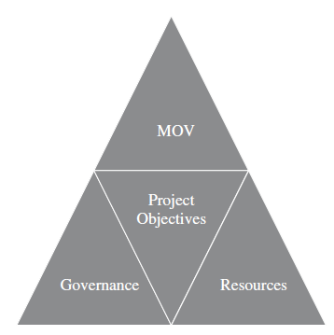
Figure 4.1 – The Project Infrastructure
4-<number>
Copyright 2015 John Wiley & Sons, Inc.

Slide 11
Project Governance
A project governance structure provides a framework to guide all of the project decisions.
Governance Committee is responsible and accountable for ensuring that the project aligns with the organization’s strategy and meets its intended MOV
4-<number>
Copyright 2015 John Wiley & Sons, Inc.

Slide 12
Project Governance
It provides the project manager and team with structure, processes, and decision-making models and tools for managing the project and ensuring its success.
It includes a framework for making project decisions, defines roles, responsibilities, and accountabilities for the success of the project, and determines the effectiveness of the project manager.
It also involves stakeholders as well as documented policies, procedures, standards, responsibilities, and authorities.
4-<number>
Copyright 2015 John Wiley & Sons, Inc.

Slide 13
Project Governance
Should flow from organizational governance
  Set organizational strategy and objectives
  Provide resources (people, processes, tools, and technology) to achieve the organizational strategy and objectives
  Monitor and control activities to ensure that the organizational resources are used efficiently and effectively
4-<number>
Copyright 2015 John Wiley & Sons, Inc.

Slide 14
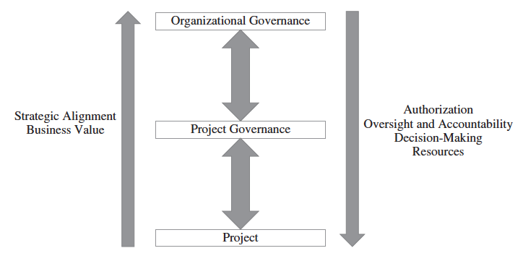
Figure 4.2 Project Governance
4-<number>
Copyright 2015 John Wiley & Sons, Inc.

Slide 15
Project Governance
Structure—The governance of a project requires structure.
Many organizations have created a project management office (PMO), which is a group or department within the organization that oversees all of the project management standards, methods, and policies
Steering Committee
Project Board
4-<number>
Copyright 2015 John Wiley & Sons, Inc.

Slide 16
Project Governance
Authorization—Project stakeholders must have a clear understanding of their authority.
Who will authorize the acceptance of project deliverables
Give approval for the project to continue to the next phase
4-<number>
Copyright 2015 John Wiley & Sons, Inc.

Slide 17
Project Governance
Oversight and Accountability—If the project stakeholders know their own role and responsibilities, as well as everyone else’s, then people can be held accountable.
A communication system must be in place that allows for the governing board to monitor and evaluate the project’s progress.
4-<number>
Copyright 2015 John Wiley & Sons, Inc.

Slide 18
Project Governance
Decision Making—With clearly defined roles and responsibilities, a reporting system must be in place so that project stakeholders can assess the current status of the project and forecast projected outcomes.
Corrective actions
Preventive actions
4-<number>
Copyright 2015 John Wiley & Sons, Inc.

Slide 19
Project Governance
Resources—Adequate resources.
Project Manager
Project team
Technology
Facilities
4-<number>
Copyright 2015 John Wiley & Sons, Inc.

Slide 20
The Project Team
The Roles of the Project Manager
  Managerial role
  Leadership role
Attributes of a successful project manager
  ability to communicate with people
  ability to deal with people
  ability to create and sustain relationships
  ability to organize
4-<number>
Copyright 2015 John Wiley & Sons, Inc.

Slide 21
The Project Team
The Project Team
Technology Skills - engineers, programmers, systems analysts, network specialists, and so forth
Business/organization knowledge - expertise within a specific domain (e.g., compensation planning) as well as knowledge of a particular organization or industry (e.g., health care)
Interpersonal skills- creativity, a tolerance for ambiguity, acceptance of diversity, flexibility in adapting to different roles, and the capacity to take calculated risks.
4-<number>
Copyright 2015 John Wiley & Sons, Inc.

Slide 22
The Formal Organization
Formal groupings & specializations
Published Lines of
  Authority
  Responsibilities
  Reporting Relationships
  Communication
  Decision-Making
4-<number>
Copyright 2015 John Wiley & Sons, Inc.

Slide 23
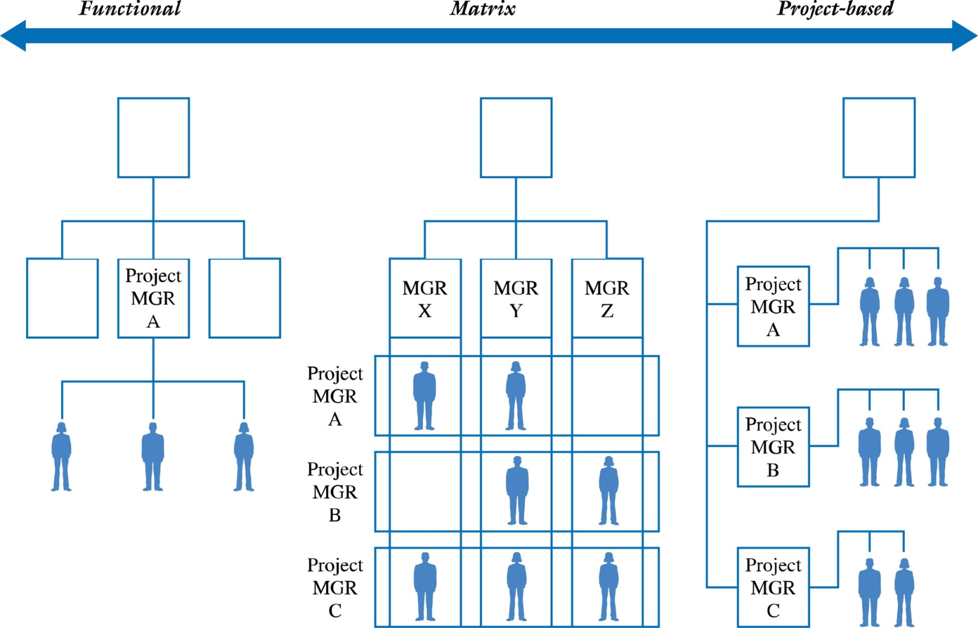
Figure 4.3 – The Organization and Project Resources
4-<number>
Copyright 2015 John Wiley & Sons, Inc.

Slide 24
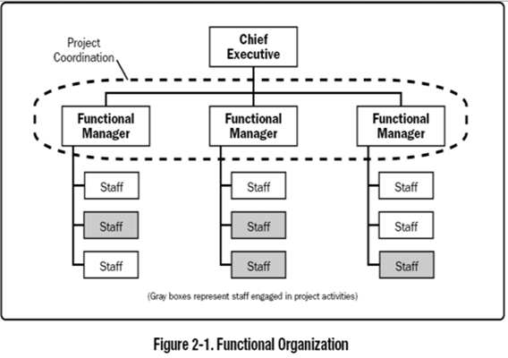
The Functional Organization
The classic functional organization is a hierarchy where each employee has one clear superior.
Staff members are grouped by specialty, such as production, marketing, engineering, and accounting at the top level.
4-<number>
Copyright 2015 John Wiley & Sons, Inc.

Slide 25
The Functional Organization
Advantages
  Increased Flexibility
  Breadth & Depth of Knowledge & Experience
  Less Duplication
Disadvantages
  Determining Authority & Responsibility
  Poor Response Time
  Poor Integration
4-<number>
Copyright 2015 John Wiley & Sons, Inc.

Slide 26
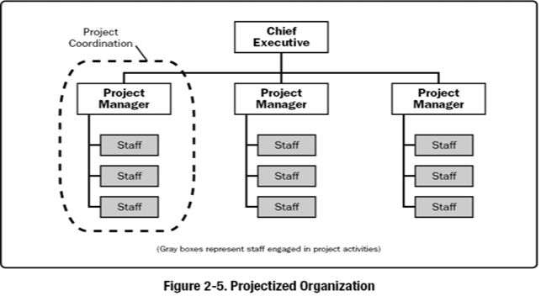
The Project-Based Organization
In a projectized organization, team members are often colocated.
Most of the organization's resources are involved in project work, and project managers have a great deal of independence and authority.
4-<number>
Copyright 2015 John Wiley & Sons, Inc.

Slide 27
The Project-Based Organization
Advantages
  Clear Authority & Responsibility
  Improved Communication
  High Level of Integration
Disadvantages
  Project Isolation
  Duplication of Effort
  “Projectitis”
4-<number>
Copyright 2015 John Wiley & Sons, Inc.

Slide 28
The Matrix Organization
A blend of functional and projectized characteristics.
4-<number>
Copyright 2015 John Wiley & Sons, Inc.

Slide 29
The Matrix Organization
Advantages
  High Level of Integration
  Improved Communication
  Increased Project Focus
Disadvantages
  Higher potential for conflict
    Team members may wonder “Who’s my boss?”
  Poorer Response Time
4-<number>
Copyright 2015 John Wiley & Sons, Inc.

Slide 30
Procuring External Project Resources
Project resources can be internal or externally acquired.
The decision depends on
  The project scope
  Availability of the products and services in the marketplace
  Cost
  Quality
  Terms and Conditions
  Experience and skills of the project team
Similar to a “make” or “buy” decision
Business process outsourcing, including offshoring, is one option for acquiring external resources
4-<number>
Copyright 2015 John Wiley & Sons, Inc.

Slide 31
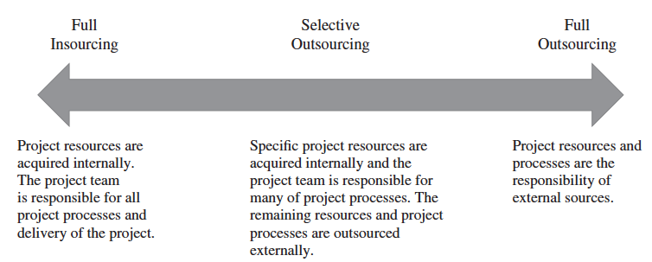
Figure 4.4 – The Project Outsourcing Model
4-<number>
Copyright 2015 John Wiley & Sons, Inc.

Slide 32
Procurement Planning
Begins by determining which project needs can be fulfilled internally or externally by the project team
Focuses on not only what can best be filled internally or externally, but
  How
  When
  How Many
  And Where these products or services will be acquired
A Request for Proposal (RFP) may be developed and used to solicit bids, quotes, or proposals for services or goods from prospective sellers.
4-<number>
Copyright 2015 John Wiley & Sons, Inc.

Slide 33
Contracts Between Sellers and Buyers
Once a seller is selected, the buyer may enter into contract negotiations so that a mutual agreement can be reached
A contract is a document signed by the buyer and seller that defines the terms and conditions of the buyer-seller relationship. IT serves as a legally binding agreement that obligates seller to provide specific products, services, or even results, while obligating the buyer to provide specific monetary or other consideration.
4-<number>
Copyright 2015 John Wiley & Sons, Inc.

Slide 34
General Categories of Procurement-type Contracts
Fixed-Price or Lump-Sum Contracts
A total or fixed price is negotiated or set as the final price for a product or service with well-defined specifications or requirements.
  May include incentives for meeting certain performance objectives or penalties if those objectives are not met
4-<number>
Copyright 2015 John Wiley & Sons, Inc.

Slide 35
General Categories of Procurement-type Contracts
Contract = $1,100,000
Contract= $1,100,000. For every month early the project
is finished, an additional $10,000 is paid to the seller.
4-<number>
Copyright 2015 John Wiley & Sons, Inc.

Slide 36
Categories for Procurement-Type Contracts
Cost-Reimbursable Contracts
  Payment or reimbursement is made to the seller to cover the seller’s actual direct costs (i.e., labor, materials, etc.) and indirect costs (i.e., admin. salaries, rent, utilities, etc.)
  May include incentives for meeting certain objectives or penalties if those objectives are not met
  Types
    Cost-Plus- Fee (CPF) or Cost-Plus-Percentage (CPPC)
    Cost-Plus-Fixed-Fee (CPFF)
    Cost-Plus-Incentive-Fee (CPIF)
4-<number>
Copyright 2015 John Wiley & Sons, Inc.

Slide 37
Types of Cost-Reimbursable Contracts
Cost-Plus-Fee (CPF) or Cost-Plus-Percentage Cost (CPPC)
  The seller is paid for the costs incurred in performing the work as well as a fee based upon an agreed on percentage of the costs
  Example
  Cost plus 10% of the cost as fee.
4-<number>
Copyright 2015 John Wiley & Sons, Inc.

Slide 38
Types of Cost-Reimbursable Contracts
Cost-Plus-Fixed-Fee (CPFF)
  The seller is reimbursed for the total direct and indirect costs of doing the work, but receives a fixed amount that does not change unless the project’s scope changes
  Example
  Cost plus a fee 0f $100,000
4-<number>
Copyright 2015 John Wiley & Sons, Inc.

Slide 39
Types of Cost-Reimbursable Contracts
Cost-Plus-Incentive-Fee (CPIF)
  The seller is reimbursed for the costs incurred in doing the work and receives a predetermined fee plus an incentive bonus for meeting certain objectives
  Example
Contract = $500,000 target cost plus $50,000 target fee. The buyer and seller share any cost savings or overruns at 80% to the buyer and 20% to the seller.
4-<number>
Copyright 2015 John Wiley & Sons, Inc.

Slide 40
Categories for Procurement-Type Contracts
Time and Materials (T&M) Contracts
  A hybrid of cost-reimbursable and fixed-price contracts
  The buyer pays the seller for both the time and materials required to complete the work
    Resembles a cost-reimbursable contract because it is open-ended and full cost of project is not predetermined
    But can resemble a fixed-price contract if unit rates are set
Example
Contract = $100 per hour plus expenses or materials at cost.
4-<number>
Copyright 2015 John Wiley & Sons, Inc.

Slide 41
The Project Environment
A place to call home
Technology
Office supplies
Culture
  What is expected from each team member?
  What role will each team member play?
  How will conflicts be resolved?
4-<number>
Copyright 2015 John Wiley & Sons, Inc.

Slide 42
The Project Charter
Serves as an agreement and as a communication tool for all of the project stakeholders
Documents the project’s MOV
MOV be clearly defined and agreed upon before developing or executing the project plan.
Once agreed upon, the MOV for a project should not change.
4-<number>
Copyright 2015 John Wiley & Sons, Inc.

Slide 43
The Project Charter
Defines the project’s infrastructure
  people,
  resources,
  technology,
  methods,
  project management processes, and
  knowledge areas
4-<number>
Copyright 2015 John Wiley & Sons, Inc.

Slide 44
The Project Charter
Summarizes the details of the project plan
  scope,
  schedule,
  budget,
  quality objectives,
  deliverables, and
  milestones
4-<number>
Copyright 2015 John Wiley & Sons, Inc.

Slide 45
The Project Charter
Defines the project’s governance structure
project sponsor,
project manager, and
project team
Lines of reporting
Decision making
Escalation process
Changes to scope, schedule and budget
4-<number>
Copyright 2015 John Wiley & Sons, Inc.

Slide 46
The Project Charter
Shows explicit commitment to the project
Resource provision
Ownership of the project’s product
4-<number>
Copyright 2015 John Wiley & Sons, Inc.

Slide 47
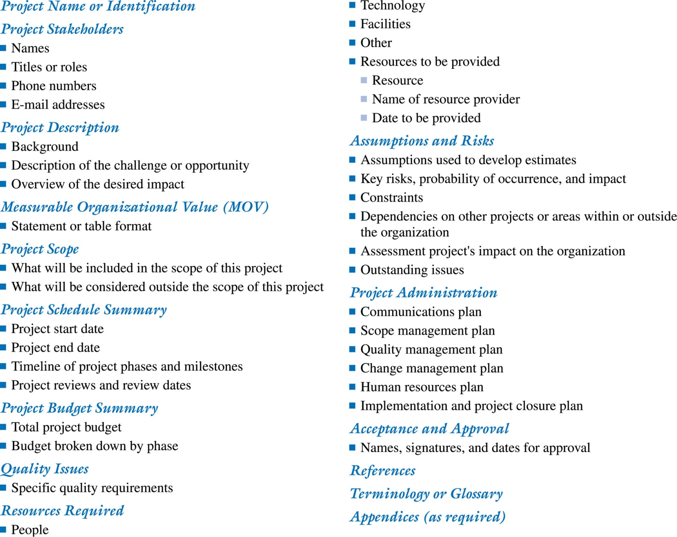
Figure 4.5 A Project Charter Template
4-<number>
Copyright 2015 John Wiley & Sons, Inc.

