Slide 1
Information Technology Project Management – Fifth Edition
By Jack T. Marchewka
Northern Illinois University

Slide 2
Project Planning: Scope and the Work Breakdown Structure
Chapter 5

Slide 3
Learning Objectives
Understand and describe the relationship among scope, schedule, and budget.
Understand the processes and apply several tools for defining and managing the scope of a project.
Understand the difference between project scope (i.e. project deliverables) and product scope (i.e. features and functionality of the product or system).
Develop a Work Breakdown Structure (WBS).
Differentiate between an deliverable and a milestone.
Describe and apply several project estimation methods.

Slide 4
Introduction
Scope –
defines the work boundaries and deliverables of the project so what needs to get done, gets done – and only what needs to get done, gets done.
is determined directly by the project’s MOV.
Defines all the work, activities, and deliverables that the project team much provide for the project to achieve its MOV
Work Breakdown Structure – a project management tool that provides a hierarchical structure that acts as a bridge, or link, between the project’s scope and the detailed project plan that will be created.

Slide 5
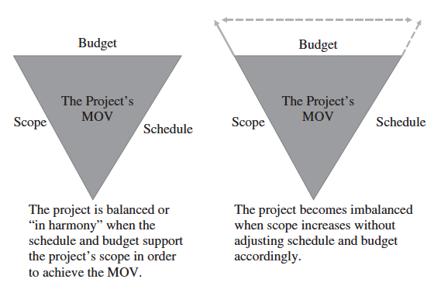
Figure 5.1 – The Triple Constraint

Slide 6
Scope Management Processes
Plan Scope Management
Defines and Documents how the project and product scope will be defined, verified, and changed if necessary.
Collect Requirements
Defining and documenting the customer, sponsor, or stakeholder needs and expectations. This may be a formal document.
Define Scope
A detailed description of the product, service, or information system to be designed, built and implemented. A detailed scope statement defines what work will and will not be part of the project and will serve as a basis for all future project decisions
Create the Work Breakdown Structure
The decomposition or dividing of the major project deliverables (i.e., scope) into smaller and more manageable components
Validate Scope
Confirmation and formal acceptance that the project’s scope is accurate, complete, and supports the project’s MOV. The project team and sponsor must agree to all deliverables
Control Scope
Ensuring that controls are in place to manage proposed scope changes once the project’s scope is set. Must be communicated to all project stakeholders.

Slide 7
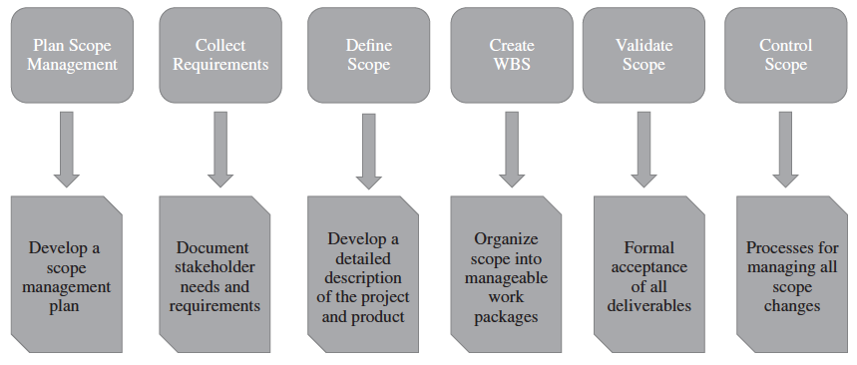
Figure 5.2 – Scope Management Plan

Slide 8
Figure 5.3 – Scope Boundary

Slide 9
Statement of Work (SOW)
Narrative description of the product, service, or information system.
For internal projects, this is tied to the business need
For external projects,
this would include specifications, quantities, quality standards, and performance requirements for prospective bidders and
The SOW is often included in a document that may be called a request for proposal (RFP), request for information (RFI), or request for bid (RFB).

Slide 10
Scope Statement
A scope statement is another way to define the scope boundary; it is a detailed documentation of the sponsor’s needs and expectations.
Examples of Scope Statements
Develop a proactive electronic commerce strategy that identifies the processes, products and services to be delivered through the World Wide Web.
Develop an application system that supports all of the processes, products, and services identified in the electronic commerce strategy.
The application system must integrate with the bank’s existing enterprise resource planning system.

Slide 11
Scope
Project-Oriented Scope
Support the project management processes defined by the Project Life Cycle (PLC) and the chosen project methodology.
Deliverable Structure Chart (Figure 5.4 – DSC) – a tool used by the project manager and team.
Product-Oriented Scope
Specific features and functionality of the application system
First cut of requirements definition
Use Case Diagram (Figure 5.5) – a system modeling tool used for refining the scope boundary and defining what the system must do.

Slide 12
Out of Scope
Technology and organizational assessment of the current environment
Customer resource management and data mining components

Slide 13
Project Scope Definition
The scope boundary and scope statement provide a useful first step
The project’s scope must now be defined in more detail in terms of specific deliverables that provide a basis for developing the project’s work breakdown structure (WBS)
Tools:
Deliverable Definition Table
Deliverable Structure Chart
Context Level Data Flow Diagram
Use Case Diagram

Slide 14
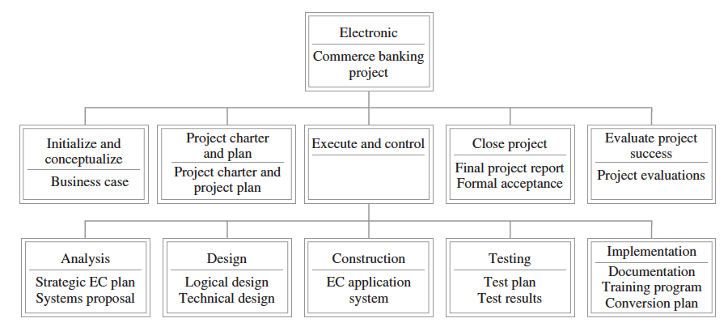
Figure 5.4 – Deliverable
Structure Chart

Slide 15
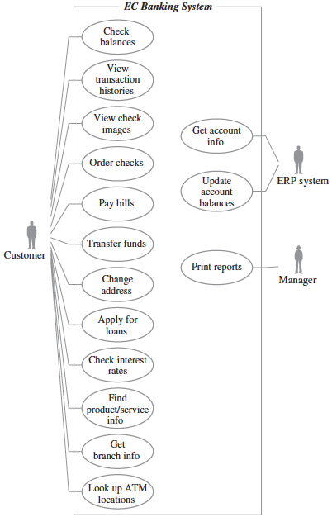
Figure 5.5 – Use Case
Diagram

Slide 16
Validate Scope
Verification of the MOV
Has the project’s MOV been clearly defined and agreed upon?
Documentation of All Deliverables
Are the deliverables tangible and verifiable?
Do they support the project’s MOV?
Specification of Quality Standards
Are controls in place to ensure that the work was not only completed but completed to meet specific standards?
Identification of Milestones
Are milestones defined for each deliverable?
Review and Acceptance
Are both sides clear in their expectations?

Slide 17
Control Scope and Scope Change Control Procedures
Concerned with managing changes to the project’s scope and to ensure that these changes are beneficial when they occur
Potential Issues:
Scope Grope
Scope Creep
Scope Leap
Procedures:
Scope Change Request Form (Figure 5.6)
Scope Change Request Log (Figure 5.7)

Slide 18
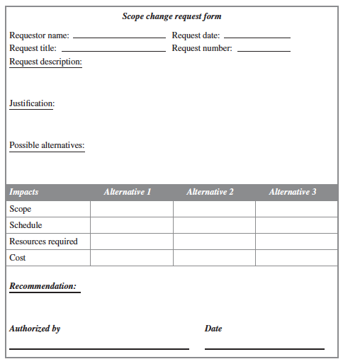
Figure 5.6 – Scope Change Request Form

Slide 19
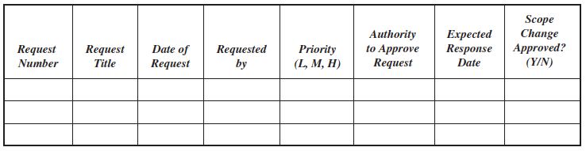
Figure 5.7 – Scope Change Request Log

Slide 20
Work Breakdown Structure (WBS)
The PMBOK® Guide states that the WBS represents a logical decomposition of the work to be performed and focuses on how the product, service, or result is naturally subdivided. It is an outline of what work is to be performed.

Slide 21
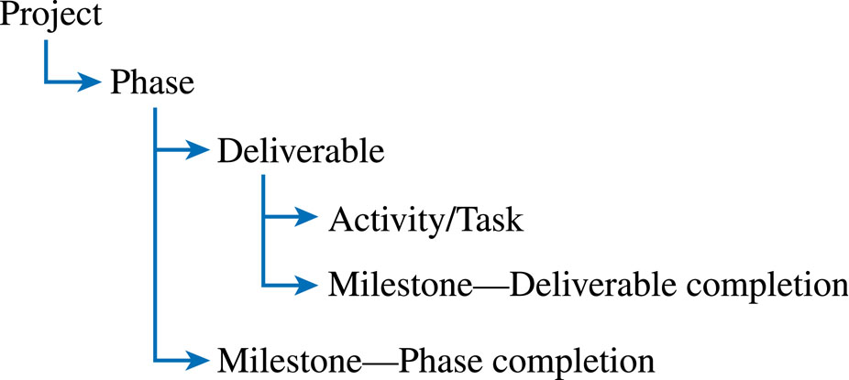
Figure 5.8 – Work Package

Slide 22
Deliverables versus Milestones
Deliverables
Tangible, verifiable work products
Reports, presentations, prototypes, etc.
Milestones
Significant events or achievements
Acceptance of deliverables or phase completion
Cruxes (proof of concepts)
Quality control
Keeps team focused

Slide 23
Developing the WBS (Figure 5.4 repeated)
A work package is developed for each of the phases and deliverables defined in the Deliverable Structure Chart (DSC)

Slide 24
Deliverable: Test Results Report
Logical Activities:
Review the test plan with the client so that key stakeholders are clear as to what will be tested, how the tests will be conducted, and when the tests will be carried out.
Carry out the tests as outlined in the plan.
Once the test results are collected, we need to analyze them.
The results should be summarized in the form of a report and presentation to the client.
If all goes well, the client will sign-off or approve the test results and then we can move on to the implementation phase of the project. If not, then we need to address and fix any problems.
What are the deliverables? Milestones?

Slide 25
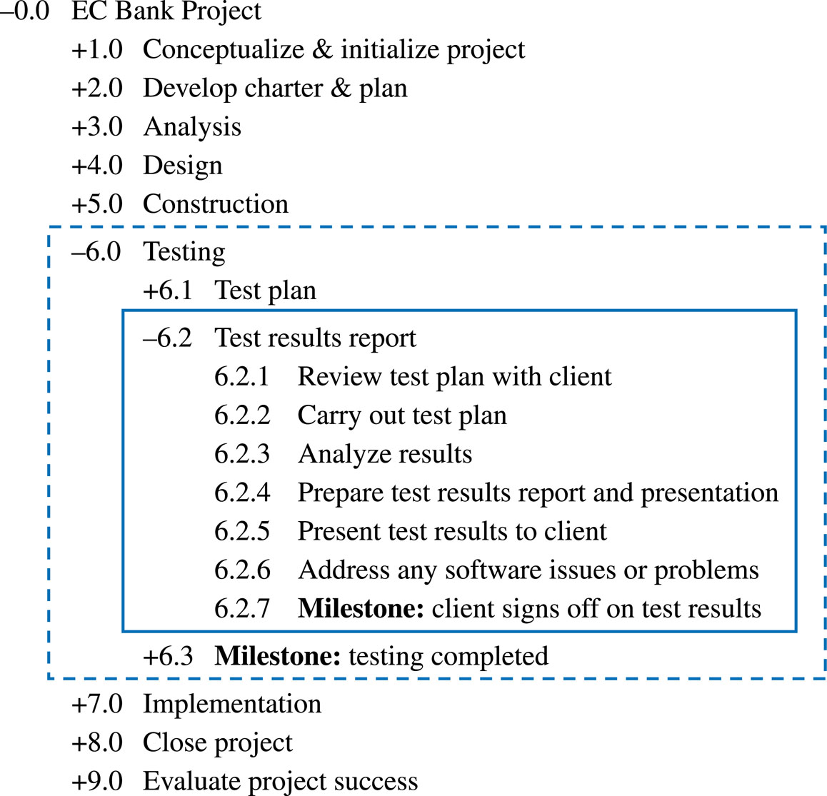
Example Work Breakdown Schedule

Slide 26
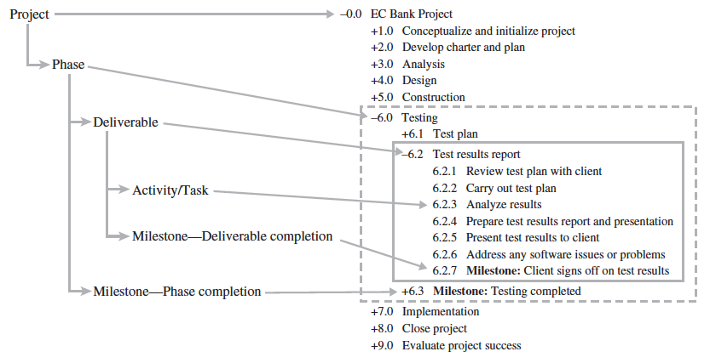
Figure 5.9 – Work Package and Work Breakdown Structure

Slide 27
Things to Keep in Mind When developing the WBS…
Should support the project’s MOV
Should be “deliverable-oriented”
The level of detail should support planning and control
Developing the WBS should involve those who will be doing the work

Slide 28
Estimation Questions
What are you going to estimate?
Where do you start?
How do you estimate?

Slide 29
Estimation Techniques - Traditional Project Management Approaches
Guesstimating
Delphi Technique
Time Boxing
Top-Down
Bottom-Up
Poker Planning

Slide 30
Guestimating
Estimation by guessing or just picking numbers out of the air is not the best way to derive a project’s schedule and budget. Unfortunately, many inexperienced project managers tend to guesstimate, or guess at the estimates, because it is quick and easy.

Slide 31
Delphi Technique
Involves multiple, anonymous experts
Each expert makes an estimate
Estimates compared
If close, can be averaged
If not, do another iteration until consensus is reached

Slide 32
Time Boxing
Often used on Agile projects
A “box” of time is allocated for a specific activity, task, or deliverable
Can focus a team if used effectively
Can demoralize a team if not used effectively

Slide 33
Top-Down
Top & middle managers determine overall project schedule &/or cost
Lower level managers are expected to breakdown schedule/budget estimates into specific activities (WBS)

Slide 34
Bottom-Up
Schedules & budgets are constructed from WBS
Starts with people who will be doing the work
Schedules & budgets are the aggregate of detailed activities & costs
May use analogous estimation – developing estimates based on one’s opinion that there is a significant similarity between the current project and others.

Slide 35
Poker Planning
Variation of Delphi Technique
Uses a deck of cards that represents an estimate in days
Moderator describes particular task, feature, deliverable, or user story to be estimated.
Attempts to reach consensus in a few rounds of “play”

