Slide 1

Machine Translation
Computational Linguistics;
Ling 409;
Spring 2013

Slide 2
Some strange terminology…
If translating French to English, we’re going to call the English the source and the French the target.
  Why?

Slide 3
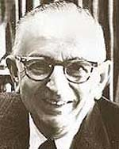
Warren Weaver (1947)
When I look at an article in Russian, I say to myself: This is really written in English, but it has been coded in some strange symbols. I will now proceed to decode.
[emphasis mine]

Slide 4
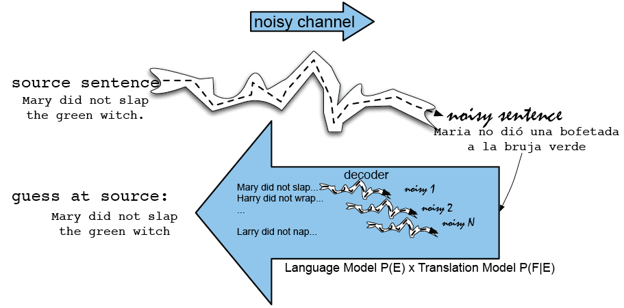
Noisy Channel

Slide 5
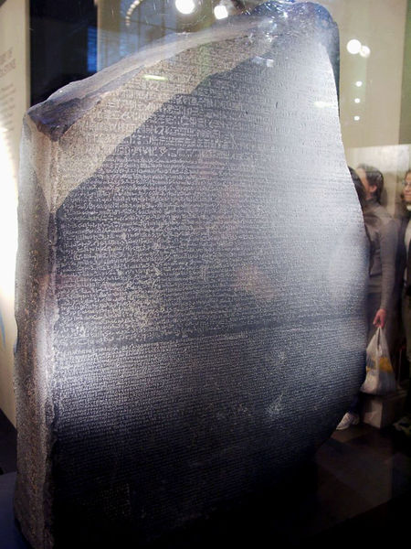
What is this?
The Rosetta Stone

Slide 6
Training Data!
Egyptian hieroglyphs
Demotic
Greek

Slide 7
Centauri/Arcturan (Knight 1997)
Your assignment, translate this to Arcturan: farok crrrok hihok yorok clok kantok ok-yurp
1a. ok-voon ororok sprok .
1b. at-voon bichat dat .
7a. lalok farok ororok lalok sprok izok enemok .
7b. wat jjat bichat wat dat vat eneat .
2a. ok-drubel ok-voon anok plok sprok .
2b. at-drubel at-voon pippat rrat dat .
8a. lalok brok anok plok nok .
8b. iat lat pippat rrat nnat .
3a. erok sprok izok hihok ghirok .
3b. totat dat arrat vat hilat .
9a. wiwok nok izok kantok ok-yurp .
9b. totat nnat quat oloat at-yurp .
4a. ok-voon anok drok brok jok .
4b. at-voon krat pippat sat lat .
10a. lalok mok nok yorok ghirok clok .
10b. wat nnat gat mat bat hilat .
5a. wiwok farok izok stok .
5b. totat jjat quat cat .
11a. lalok nok crrrok hihok yorok zanzanok .
11b. wat nnat arrat mat zanzanat .
6a. lalok sprok izok jok stok .
6b. wat dat krat quat cat .
12a. lalok rarok nok izok hihok mok .
12b. wat nnat forat arrat vat gat .

Slide 8
Centauri/Arcturan [Knight, 1997]
Your assignment, translate this to Arcturan: farok crrrok hihok yorok clok kantok ok-yurp
1a. ok-voon ororok sprok .
1b. at-voon bichat dat .
7a. lalok farok ororok lalok sprok izok enemok .
7b. wat jjat bichat wat dat vat eneat .
2a. ok-drubel ok-voon anok plok sprok .
2b. at-drubel at-voon pippat rrat dat .
8a. lalok brok anok plok nok .
8b. iat lat pippat rrat nnat .
3a. erok sprok izok hihok ghirok .
3b. totat dat arrat vat hilat .
9a. wiwok nok izok kantok ok-yurp .
9b. totat nnat quat oloat at-yurp .
4a. ok-voon anok drok brok jok .
4b. at-voon krat pippat sat lat .
10a. lalok mok nok yorok ghirok clok .
10b. wat nnat gat mat bat hilat .
5a. wiwok farok izok stok .
5b. totat jjat quat cat .
11a. lalok nok crrrok hihok yorok zanzanok .
11b. wat nnat arrat mat zanzanat .
6a. lalok sprok izok jok stok .
6b. wat dat krat quat cat .
12a. lalok rarok nok izok hihok mok .
12b. wat nnat forat arrat vat gat .
04/09/13
Speech and Language Processing - Jurafsky and Martin

Slide 9
Centauri/Arcturan [Knight, 1997]
Your assignment, translate this to Arcturan: farok crrrok hihok yorok clok kantok ok-yurp
1a. ok-voon ororok sprok .
1b. at-voon bichat dat .
7a. lalok farok ororok lalok sprok izok enemok .
7b. wat jjat bichat wat dat vat eneat .
2a. ok-drubel ok-voon anok plok sprok .
2b. at-drubel at-voon pippat rrat dat .
8a. lalok brok anok plok nok .
8b. iat lat pippat rrat nnat .
3a. erok sprok izok hihok ghirok .
3b. totat dat arrat vat hilat .
9a. wiwok nok izok kantok ok-yurp .
9b. totat nnat quat oloat at-yurp .
4a. ok-voon anok drok brok jok .
4b. at-voon krat pippat sat lat .
10a. lalok mok nok yorok ghirok clok .
10b. wat nnat gat mat bat hilat .
5a. wiwok farok izok stok .
5b. totat jjat quat cat .
11a. lalok nok crrrok hihok yorok zanzanok .
11b. wat nnat arrat mat zanzanat .
6a. lalok sprok izok jok stok .
6b. wat dat krat quat cat .
12a. lalok rarok nok izok hihok mok .
12b. wat nnat forat arrat vat gat .
04/09/13
Speech and Language Processing - Jurafsky and Martin

Slide 10
Centauri/Arcturan [Knight, 1997]
Your assignment, translate this to Arcturan: farok crrrok hihok yorok clok kantok ok-yurp
1a. ok-voon ororok sprok .
1b. at-voon bichat dat .
7a. lalok farok ororok lalok sprok izok enemok .
7b. wat jjat bichat wat dat vat eneat .
2a. ok-drubel ok-voon anok plok sprok .
2b. at-drubel at-voon pippat rrat dat .
8a. lalok brok anok plok nok .
8b. iat lat pippat rrat nnat .
3a. erok sprok izok hihok ghirok .
3b. totat dat arrat vat hilat .
9a. wiwok nok izok kantok ok-yurp .
9b. totat nnat quat oloat at-yurp .
4a. ok-voon anok drok brok jok .
4b. at-voon krat pippat sat lat .
10a. lalok mok nok yorok ghirok clok .
10b. wat nnat gat mat bat hilat .
5a. wiwok farok izok stok .
5b. totat jjat quat cat .
11a. lalok nok crrrok hihok yorok zanzanok .
11b. wat nnat arrat mat zanzanat .
???
6a. lalok sprok izok jok stok .
6b. wat dat krat quat cat .
12a. lalok rarok nok izok hihok mok .
12b. wat nnat forat arrat vat gat .
04/09/13
Speech and Language Processing - Jurafsky and Martin

Slide 11
Centauri/Arcturan [Knight, 1997]
Your assignment, translate this to Arcturan: farok crrrok hihok yorok clok kantok ok-yurp
1a. ok-voon ororok sprok .
1b. at-voon bichat dat .
7a. lalok farok ororok lalok sprok izok enemok .
7b. wat jjat bichat wat dat vat eneat .
2a. ok-drubel ok-voon anok plok sprok .
2b. at-drubel at-voon pippat rrat dat .
8a. lalok brok anok plok nok .
8b. iat lat pippat rrat nnat .
3a. erok sprok izok hihok ghirok .
3b. totat dat arrat vat hilat .
9a. wiwok nok izok kantok ok-yurp .
9b. totat nnat quat oloat at-yurp .
4a. ok-voon anok drok brok jok .
4b. at-voon krat pippat sat lat .
10a. lalok mok nok yorok ghirok clok .
10b. wat nnat gat mat bat hilat .
5a. wiwok farok izok stok .
5b. totat jjat quat cat .
11a. lalok nok crrrok hihok yorok zanzanok .
11b. wat nnat arrat mat zanzanat .
6a. lalok sprok izok jok stok .
6b. wat dat krat quat cat .
12a. lalok rarok nok izok hihok mok .
12b. wat nnat forat arrat vat gat .
04/09/13
Speech and Language Processing - Jurafsky and Martin

Slide 12
Centauri/Arcturan [Knight, 1997]
Your assignment, translate this to Arcturan: farok crrrok hihok yorok clok kantok ok-yurp
1a. ok-voon ororok sprok .
1b. at-voon bichat dat .
7a. lalok farok ororok lalok sprok izok enemok .
7b. wat jjat bichat wat dat vat eneat .
2a. ok-drubel ok-voon anok plok sprok .
2b. at-drubel at-voon pippat rrat dat .
8a. lalok brok anok plok nok .
8b. iat lat pippat rrat nnat .
3a. erok sprok izok hihok ghirok .
3b. totat dat arrat vat hilat .
9a. wiwok nok izok kantok ok-yurp .
9b. totat nnat quat oloat at-yurp .
4a. ok-voon anok drok brok jok .
4b. at-voon krat pippat sat lat .
10a. lalok mok nok yorok ghirok clok .
10b. wat nnat gat mat bat hilat .
5a. wiwok farok izok stok .
5b. totat jjat quat cat .
11a. lalok nok crrrok hihok yorok zanzanok .
11b. wat nnat arrat mat zanzanat .
6a. lalok sprok izok jok stok .
6b. wat dat krat quat cat .
12a. lalok rarok nok izok hihok mok .
12b. wat nnat forat arrat vat gat .
04/09/13
Speech and Language Processing - Jurafsky and Martin

Slide 13
Centauri/Arcturan [Knight, 1997]
Your assignment, translate this to Arcturan: farok crrrok hihok yorok clok kantok ok-yurp
1a. ok-voon ororok sprok .
1b. at-voon bichat dat .
7a. lalok farok ororok lalok sprok izok enemok .
7b. wat jjat bichat wat dat vat eneat .
2a. ok-drubel ok-voon anok plok sprok .
2b. at-drubel at-voon pippat rrat dat .
8a. lalok brok anok plok nok .
8b. iat lat pippat rrat nnat .
3a. erok sprok izok hihok ghirok .
3b. totat dat arrat vat hilat .
9a. wiwok nok izok kantok ok-yurp .
9b. totat nnat quat oloat at-yurp .
4a. ok-voon anok drok brok jok .
4b. at-voon krat pippat sat lat .
10a. lalok mok nok yorok ghirok clok .
10b. wat nnat gat mat bat hilat .
5a. wiwok farok izok stok .
5b. totat jjat quat cat .
11a. lalok nok crrrok hihok yorok zanzanok .
11b. wat nnat arrat mat zanzanat .
6a. lalok sprok izok jok stok .
6b. wat dat krat quat cat .
12a. lalok rarok nok izok hihok mok .
12b. wat nnat forat arrat vat gat .
04/09/13
Speech and Language Processing - Jurafsky and Martin

Slide 14
Centauri/Arcturan [Knight, 1997]
Your assignment, translate this to Arcturan: farok crrrok hihok yorok clok kantok ok-yurp
1a. ok-voon ororok sprok .
1b. at-voon bichat dat .
7a. lalok farok ororok lalok sprok izok enemok .
7b. wat jjat bichat wat dat vat eneat .
2a. ok-drubel ok-voon anok plok sprok .
2b. at-drubel at-voon pippat rrat dat .
8a. lalok brok anok plok nok .
8b. iat lat pippat rrat nnat .
3a. erok sprok izok hihok ghirok .
3b. totat dat arrat vat hilat .
9a. wiwok nok izok kantok ok-yurp .
9b. totat nnat quat oloat at-yurp .
4a. ok-voon anok drok brok jok .
4b. at-voon krat pippat sat lat .
10a. lalok mok nok yorok ghirok clok .
10b. wat nnat gat mat bat hilat .
???
5a. wiwok farok izok stok .
5b. totat jjat quat cat .
11a. lalok nok crrrok hihok yorok zanzanok .
11b. wat nnat arrat mat zanzanat .
6a. lalok sprok izok jok stok .
6b. wat dat krat quat cat .
12a. lalok rarok nok izok hihok mok .
12b. wat nnat forat arrat vat gat .
04/09/13
Speech and Language Processing - Jurafsky and Martin

Slide 15
Centauri/Arcturan [Knight, 1997]
Your assignment, translate this to Arcturan: farok crrrok hihok yorok clok kantok ok-yurp
1a. ok-voon ororok sprok .
1b. at-voon bichat dat .
7a. lalok farok ororok lalok sprok izok enemok .
7b. wat jjat bichat wat dat vat eneat .
2a. ok-drubel ok-voon anok plok sprok .
2b. at-drubel at-voon pippat rrat dat .
8a. lalok brok anok plok nok .
8b. iat lat pippat rrat nnat .
3a. erok sprok izok hihok ghirok .
3b. totat dat arrat vat hilat .
9a. wiwok nok izok kantok ok-yurp .
9b. totat nnat quat oloat at-yurp .
4a. ok-voon anok drok brok jok .
4b. at-voon krat pippat sat lat .
10a. lalok mok nok yorok ghirok clok .
10b. wat nnat gat mat bat hilat .
5a. wiwok farok izok stok .
5b. totat jjat quat cat .
11a. lalok nok crrrok hihok yorok zanzanok .
11b. wat nnat arrat mat zanzanat .
6a. lalok sprok izok jok stok .
6b. wat dat krat quat cat .
12a. lalok rarok nok izok hihok mok .
12b. wat nnat forat arrat vat gat .
04/09/13
Speech and Language Processing - Jurafsky and Martin

Slide 16
Centauri/Arcturan [Knight, 1997]
Your assignment, translate this to Arcturan: farok crrrok hihok yorok clok kantok ok-yurp
1a. ok-voon ororok sprok .
1b. at-voon bichat dat .
7a. lalok farok ororok lalok sprok izok enemok .
7b. wat jjat bichat wat dat vat eneat .
2a. ok-drubel ok-voon anok plok sprok .
2b. at-drubel at-voon pippat rrat dat .
8a. lalok brok anok plok nok .
8b. iat lat pippat rrat nnat .
3a. erok sprok izok hihok ghirok .
3b. totat dat arrat vat hilat .
9a. wiwok nok izok kantok ok-yurp .
9b. totat nnat quat oloat at-yurp .
4a. ok-voon anok drok brok jok .
4b. at-voon krat pippat sat lat .
10a. lalok mok nok yorok ghirok clok .
10b. wat nnat gat mat bat hilat .
process of
elimination
5a. wiwok farok izok stok .
5b. totat jjat quat cat .
11a. lalok nok crrrok hihok yorok zanzanok .
11b. wat nnat arrat mat zanzanat .
6a. lalok sprok izok jok stok .
6b. wat dat krat quat cat .
12a. lalok rarok nok izok hihok mok .
12b. wat nnat forat arrat vat gat .
04/09/13
Speech and Language Processing - Jurafsky and Martin

Slide 17
Centauri/Arcturan [Knight, 1997]
Your assignment, translate this to Arcturan: farok crrrok hihok yorok clok kantok ok-yurp
1a. ok-voon ororok sprok .
1b. at-voon bichat dat .
7a. lalok farok ororok lalok sprok izok enemok .
7b. wat jjat bichat wat dat vat eneat .
2a. ok-drubel ok-voon anok plok sprok .
2b. at-drubel at-voon pippat rrat dat .
8a. lalok brok anok plok nok .
8b. iat lat pippat rrat nnat .
3a. erok sprok izok hihok ghirok .
3b. totat dat arrat vat hilat .
9a. wiwok nok izok kantok ok-yurp .
9b. totat nnat quat oloat at-yurp .
4a. ok-voon anok drok brok jok .
4b. at-voon krat pippat sat lat .
10a. lalok mok nok yorok ghirok clok .
10b. wat nnat gat mat bat hilat .
5a. wiwok farok izok stok .
5b. totat jjat quat cat .
11a. lalok nok crrrok hihok yorok zanzanok .
11b. wat nnat arrat mat zanzanat .
cognate?
6a. lalok sprok izok jok stok .
6b. wat dat krat quat cat .
12a. lalok rarok nok izok hihok mok .
12b. wat nnat forat arrat vat gat .
04/09/13
Speech and Language Processing - Jurafsky and Martin

Slide 18
Centauri/Arcturan [Knight, 1997]
Your assignment, put these words in order: { jjat, arrat, mat, bat, oloat, at-yurp }
1a. ok-voon ororok sprok .
1b. at-voon bichat dat .
7a. lalok farok ororok lalok sprok izok enemok .
7b. wat jjat bichat wat dat vat eneat .
2a. ok-drubel ok-voon anok plok sprok .
2b. at-drubel at-voon pippat rrat dat .
8a. lalok brok anok plok nok .
8b. iat lat pippat rrat nnat .
3a. erok sprok izok hihok ghirok .
3b. totat dat arrat vat hilat .
9a. wiwok nok izok kantok ok-yurp .
9b. totat nnat quat oloat at-yurp .
4a. ok-voon anok drok brok jok .
4b. at-voon krat pippat sat lat .
10a. lalok mok nok yorok ghirok clok .
10b. wat nnat gat mat bat hilat .
5a. wiwok farok izok stok .
5b. totat jjat quat cat .
11a. lalok nok crrrok hihok yorok zanzanok .
11b. wat nnat arrat mat zanzanat .
zero
fertility
6a. lalok sprok izok jok stok .
6b. wat dat krat quat cat .
12a. lalok rarok nok izok hihok mok .
12b. wat nnat forat arrat vat gat .
04/09/13
Speech and Language Processing - Jurafsky and Martin

Slide 19
Spanish/English text
Translate: Clients do not sell pharmaceuticals in Europe.
1a. Garcia and associates .
1b. Garcia y asociados .
7a. the clients and the associates are enemies .
7b. los clients y los asociados son enemigos .
2a. Carlos Garcia has three associates .
2b. Carlos Garcia tiene tres asociados .
8a. the company has three groups .
8b. la empresa tiene tres grupos .
3a. his associates are not strong .
3b. sus asociados no son fuertes .
9a. its groups are in Europe .
9b. sus grupos estan en Europa .
4a. Garcia has a company also .
4b. Garcia tambien tiene una empresa .
10a. the modern groups sell strong pharmaceuticals .
10b. los grupos modernos venden medicinas fuertes .
5a. its clients are angry .
5b. sus clientes estan enfadados .
11a. the groups do not sell zenzanine .
11b. los grupos no venden zanzanina .
6a. the associates are also angry .
6b. los asociados tambien estan enfadados .
12a. the small groups are not modern .
12b. los grupos pequenos no son modernos .
04/09/13
Speech and Language Processing - Jurafsky and Martin

Slide 20
The Point
No dictionary for either language
No grammar
No meaning
No broader meaning context
Just text pairs and a bunch of dubious assumptions
04/09/13
Speech and Language Processing - Jurafsky and Martin

Slide 21
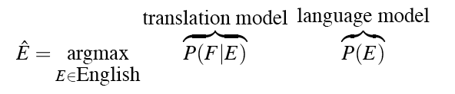
Stat MT
Current statistical MT systems are based on maximizing P(E|F)
  E is the target language, F is the source
We’ll start as usual by using Bayes
04/09/13
Speech and Language Processing - Jurafsky and Martin

Slide 22
Three Sub-Problems of Statistical MT
Language model
  Given an English string e, assigns P(e) by the usual methods
  good English string -> high P(e)
  random word sequence -> low P(e)
Translation model
  Given a pair of strings <f,e>, assigns P(f | e) by formula
  <f,e> look like translations -> high P(f | e)
  <f,e> don’t look like translations -> low P(f | e)
Decoding algorithm
  Given a language model, a translation model, and a new sentence f … find translation e maximizing P(e) * P(f | e)
04/09/13
Speech and Language Processing - Jurafsky and Martin

Slide 23
Three Problems
For the language model, just use normal language models.
For the translation model there are lots of choices
    Word-based
    Phrase-based
    Syntactic
For the decoding model we’ll focus on A* like methods (heuristic search methods with a beam)
04/09/13
Speech and Language Processing - Jurafsky and Martin

Slide 24
Word-Based Stat MT
The basic premise in word-based MT is that the texts consists of words that
  Need to be (1) translated
  And (2) moved around
The green witch is at home this week
Diese Woche ist die grune Hexe zu Hause
04/09/13
Speech and Language Processing - Jurafsky and Martin

Slide 25
Word-Based Stat MT
So in our Bayesian scheme...
Given the German sentence we need argmax over the English possibilities
04/09/13
Speech and Language Processing - Jurafsky and Martin

Slide 26
Ok but
I indicated that we didn’t have any resources other than the bilingual texts
  In particular, no dictionaries, no bilingual dictionaries, and no probabilities
  Fortunately, we can get all that from the bitexts
04/09/13
Speech and Language Processing - Jurafsky and Martin

Slide 27
Word Alignments
Let’s start with a simple alignment type. From E to F with a 1 to 1 assumption
  Each word in E aligns with 1 word in F
… la maison … la maison bleue … la fleur …
… the house … the blue house … the flower …
This is one possible alignment.
04/09/13
Speech and Language Processing - Jurafsky and Martin

Slide 28
Word Alignments
Let’s start with a simple alignment type. From E to F with a 1 to 1 assumption.
… la maison … la maison bleue … la fleur …
… the house … the blue house … the flower …
Here’s another
04/09/13
Speech and Language Processing - Jurafsky and Martin

Slide 29
Word Alignments
1 to 1 is not the only possible or useful type.
Based on the language pairs, 1 to many, many to 1, 1 to none, etc. are all likely.
  1 to many is a word aligned to a phrase
  Many to 1 is a phrase aligning to a word
  1 to none is a word that just isn’t there in the other text
04/09/13
Speech and Language Processing - Jurafsky and Martin

Slide 30
Alignment Probabilities
… la maison … la maison bleue … la fleur …
… the house … the blue house … the flower …
Assume that all word alignments equally likely.
That is, that all P(french-word | english-word) are equal
Recall that we want P(f|e)
04/09/13
Speech and Language Processing - Jurafsky and Martin

Slide 31
Word Alignment
… la maison … la maison bleue … la fleur …
… the house … the blue house … the flower …
Assume we’re interested in P(la|the). ”the” can co-occur with (aligns) with 4 distinct french words. If we make each of those equally likely then the P(la | the) is .25.
 | La | Maison | Bleue | Fleur
the | .25 | .25 | .25 | .25
04/09/13
Speech and Language Processing - Jurafsky and Martin

Slide 32
Word Alignment
… la maison … la maison bleue … la fleur …
… the house … the blue house … the flower …
But “la” and “the” are observed to co-occur more frequently than expected so P(la | the) should be higher. Meaning the others P(x |the) need to be lower (to still sum to 1).
04/09/13
Speech and Language Processing - Jurafsky and Martin

Slide 33
Word Alignment
… la maison … la maison bleue … la fleur …
… the house … the blue house … the flower …
04/09/13
Speech and Language Processing - Jurafsky and Martin

Slide 34
Word Alignment
… la maison … la maison bleue … la fleur …
… the house … the blue house … the flower …
04/09/13
Speech and Language Processing - Jurafsky and Martin

Slide 35
Word Alignment
… la maison … la maison bleue … la fleur …
… the house … the blue house … the flower …
04/09/13
Speech and Language Processing - Jurafsky and Martin

Slide 36
What?
What was that?
EM
Start with equiprobable 1-1 word alignments
The P() of an alignment is the product of the probability of the word alignments that make it up
Count the 1-1 word alignments and prorate by the P() of the alignment from which they’re gathered
Use those recomputed discounted scores to recompute the P() of the alignments
Go to 3
04/09/13
Speech and Language Processing - Jurafsky and Martin

Slide 37
MT Evaluation
Traditionally difficult because there is no single “right answer”.
20 human translators will translate the same sentence 20 different ways.
04/09/13
Speech and Language Processing - Jurafsky and Martin

Slide 38
Evaluation Metric (BLEU)
Reference (human) translation:
The U.S. island of Guam is maintaining a high state of alert after the Guam airport and its offices both received an e-mail from someone calling himself the Saudi Arabian Osama bin Laden and threatening a biological/chemical attack against public places such as the airport .
N-gram precision (score is between 0 & 1)
  What percentage of machine n-grams can be found in the reference translation?
    An n-gram is an sequence of n words
  Not allowed to use same portion of reference translation twice (can’t cheat by typing out “the the the the the”)
Brevity penalty
  Can’t just type out single word “the” (precision 1.0!)
Amazingly hard to “game” the system (i.e., find a way to change machine output so that BLEU goes up, but quality doesn’t)
  Contra doesn’t hold. Can find perfectly good improvements that hurt, or don’t help, BLEU
Machine translation:
The American [?] international airport and its the office all receives one calls self the sand Arab rich business [?] and so on electronic mail , which sends out ; The threat will be able after public place and so on the airport to start the biochemistry attack , [?] highly alerts after the maintenance.
04/09/13
Speech and Language Processing - Jurafsky and Martin

Slide 39
Multiple Reference Translations
Reference translation 1:
The U.S. island of Guam is maintaining a high state of alert after the Guam airport and its offices both received an e-mail from someone calling himself the Saudi Arabian Osama bin Laden and threatening a biological/chemical attack against public places such as the airport .
Reference translation 2:
Guam International Airport and its offices are maintaining a high state of alert after receiving an e-mail that was from a person claiming to be the wealthy Saudi Arabian businessman Bin Laden and that threatened to launch a biological and chemical attack on the airport and other public places .
Machine translation:
The American [?] international airport and its the office all receives one calls self the sand Arab rich business [?] and so on electronic mail , which sends out ; The threat will be able after public place and so on the airport to start the biochemistry attack , [?] highly alerts after the maintenance.
Reference translation 3:
The US International Airport of Guam and its office has received an email from a self-claimed Arabian millionaire named Laden , which threatens to launch a biochemical attack on such public places as airport . Guam authority has been on alert .
Reference translation 4:
US Guam International Airport and its office received an email from Mr. Bin Laden and other rich businessman from Saudi Arabia . They said there would be biochemistry air raid to Guam Airport and other public places . Guam needs to be in high precaution about this matter .
04/09/13
Speech and Language Processing - Jurafsky and Martin

Slide 40
BLEU in Action
枪手被警方击毙。 (Foreign Original)
the gunman was shot to death by the police . (Reference Translation)
System Outputs
the gunman was police kill . #1
wounded police jaya of #2
the gunman was shot dead by the police . #3
the gunman arrested by police kill . #4
the gunmen were killed . #5
the gunman was shot to death by the police . #6
gunmen were killed by police #7
al by the police . #8
the ringer is killed by the police . #9
police killed the gunman . #10
04/09/13
Speech and Language Processing - Jurafsky and Martin

Slide 41
BLEU in Action
枪手被警方击毙。 (Foreign Original)
the gunman was shot to death by the police . (Reference Translation)
System Outputs
the gunman was police kill . #1
wounded police jaya of #2
the gunman was shot dead by the police . #3
the gunman arrested by police kill . #4
the gunmen were killed . #5
the gunman was shot to death by the police . #6
gunmen were killed by police #7
al by the police . #8
the ringer is killed by the police . #9
police killed the gunman . #10
green = 4-gram match (good!)
red = word not matched (bad!)
04/09/13
Speech and Language Processing - Jurafsky and Martin

Slide 42
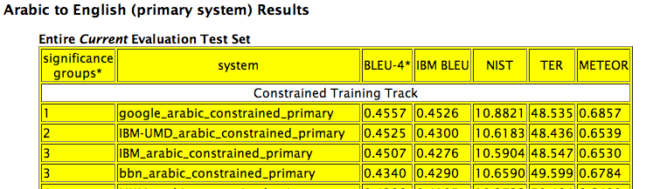
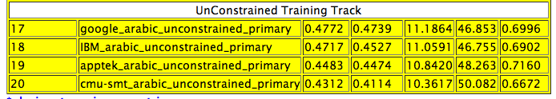
NIST 2008 Results
04/09/13
Speech and Language Processing - Jurafsky and Martin

Slide 43
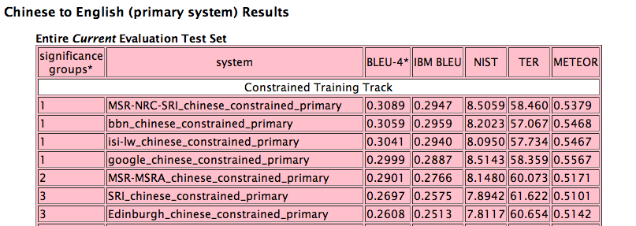
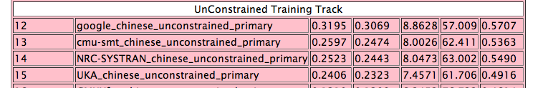
NIST 2008 Results
04/09/13
Speech and Language Processing - Jurafsky and Martin

Slide 44
Question
What does the use of BLEU suggest as a strategy for the construction of these statistical systems?
04/09/13
Speech and Language Processing - Jurafsky and Martin

Slide 45
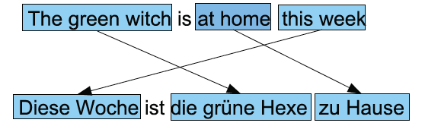
Phrase-Based Stat MT
Turns out that word-based approaches don’t work all that well.
The basic premise in phrase-based MT is that the texts consists of phrases that
  Need to be (1) translated
  And (2) moved around
04/09/13
Speech and Language Processing - Jurafsky and Martin

Slide 46
Phrase-Based MT
The probability of such a translation is the product of the individual phrase translation probabilities and the the movement/dislocations probabilities.
04/09/13
Speech and Language Processing - Jurafsky and Martin

Slide 47
Discovering Phrases
Ok so now we have a good idea of which words translate to which other words.
Now we need to use that to get phrases and phrase translation probabilities
Lots of (ad hoc?) schemes for doing this...
Symmetrizing alignments works by first aligning twice (E, F) and (F,E).
04/09/13
Speech and Language Processing - Jurafsky and Martin

Slide 48
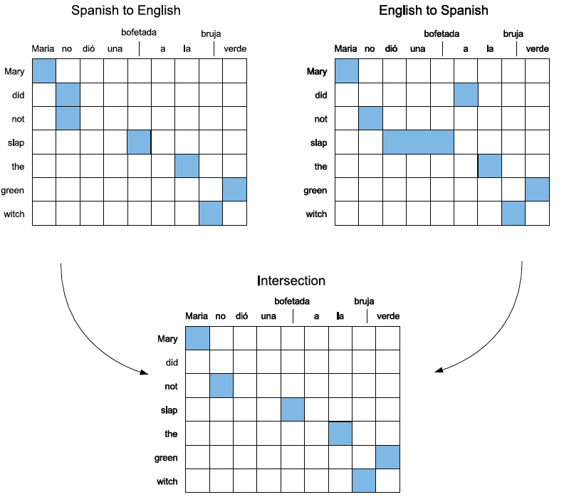
Discovering Phrases (1)
Align both ways, then intersect to get high precision alignments.
04/09/13
Speech and Language Processing - Jurafsky and Martin

Slide 49
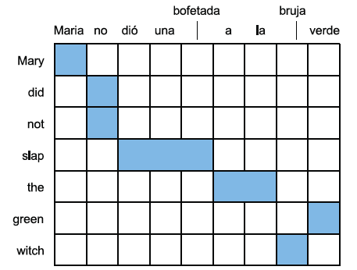
Discovering Phrases (2)
From these high precision points, add word alignments from the union of the original alignments.
+
+
+
+
04/09/13
Speech and Language Processing - Jurafsky and Martin

Slide 50
Discovering Phrases (3)
These initial alignments phrase alignments can then be grown by fusing the word alignments such that...
  Each proposed phrase alignment includes all the words in the component phrase alignments on each side (i.e. don’t split adjacent alignment pairs).
    Including words as necessary that were not in the original set.
04/09/13
Speech and Language Processing - Jurafsky and Martin

Slide 51
Discovering Phrases (3)
04/09/13
Speech and Language Processing - Jurafsky and Martin

Slide 52
Discovering Phrases (3)
04/09/13
Speech and Language Processing - Jurafsky and Martin

Slide 53
Discovering Phrases (3)
04/09/13
Speech and Language Processing - Jurafsky and Martin

Slide 54
Discovering Phrases (3)
04/09/13
Speech and Language Processing - Jurafsky and Martin

Slide 55
Discovering Phrases (3)
04/09/13
Speech and Language Processing - Jurafsky and Martin

Slide 56
Discovering Phrases (3)
04/09/13
Speech and Language Processing - Jurafsky and Martin

Slide 57

Phrase Translation
Given such phrases we can get the required counts for our translation model from
04/09/13
Speech and Language Processing - Jurafsky and Martin

Slide 58
Next Time
  The gory details...
04/09/13
Speech and Language Processing - Jurafsky and Martin

