Slide 1
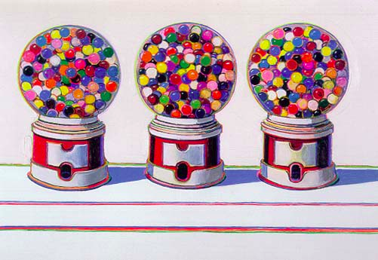
Statistical Parsing
Computational Linguistics, Ling 409, Spring 2013

Slide 2
Probabilistic CFG Parsing
CFG parsing (CKY) left us with the problem of selecting the “right” parse out of all the possible parses...
Now if we recast“right” parse as “most probable parse” we get our old friend:
  Argmax P(Parse tree | String of words)

Slide 3
Probabilistic CFGs
1 The framework (Model)
  How to assign probabilities to parse trees
2 Training the model (Learning)
  How to acquire estimates for the probabilities specified by the model
3 Parsing with probabilities (Decoding)
  Given an input sentence and a model how can we efficiently find the best (or N best) tree(s) for that input

Slide 4
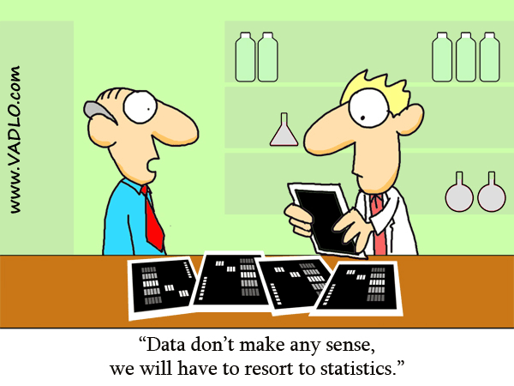
No Relevant XKCD!!!
(so this was the best I could do)

Slide 5
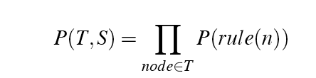
Simple Probability Model
A derivation (tree) consists of the collection of grammar rules that are in the tree
  The probability of a tree is therefore the product of the probabilities of the rules in the derivation.
  What assumptions are we making?

Slide 6
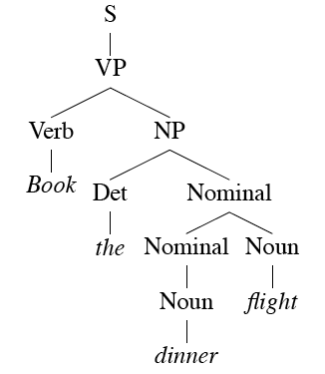
Example
How many “rules” are in this derivation?

Slide 7
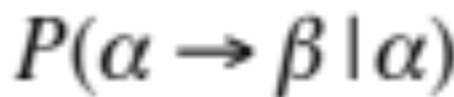
Rule Probabilities
So... What’s the probability of a rule?
Start at the top...
  A tree should have an S at the top. So given that we know we need an S, we can ask about the probability of each particular S rule in the grammar.
    That is P(particular S rule | S is what I need)
So in general we need
For each rule in the grammar
Notes:
P (RHS|LHS)

Slide 8

Training the Model
We can get the estimates we need from an annotated database (i.e., a treebank)
  For example, to get the probability for a particular VP rule, just count all the times the rule is used in your treebank and divide by the number of VPs overall.

Slide 9
Parsing (Decoding)
So to get the best (most probable) parse for a given input
  Enumerate all the trees for a sentence
  Assign a probability to each using the model
  Return the best (argmax)

Slide 10
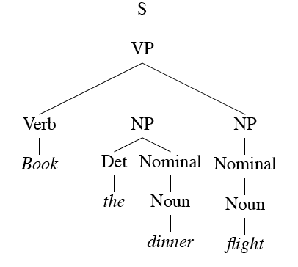
Example
Consider...
  Book the dinner flight

Slide 11
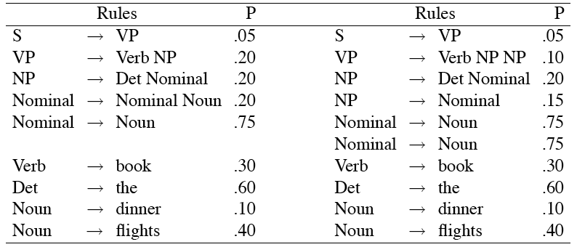
Examples
These trees consist of the following rules.
Notes:
Also a language model: sum probabilities over all parses of S --- but more syntactic info.

Slide 12
PCFGs: So why did the best parse win?

Slide 13
Dynamic Programming
Of course, we still want to avoid the repeated work problem.
So we will still use dynamic programming
  Both for the parsing (as with CKY)
  And for computing the probabilities and returning the best parse (as with Viterbi and HMMs)

Slide 14
Probabilistic CKY
Alter CKY so that the probabilities of constituents are stored in the table as they are derived
  Probability of a new constituent A derived from the rule: A → B C :
    P(A → B C | A) * P(B) * P(C)
    Where P(B) and P(C) are already in the table given the way that CKY operates
    What we store is the MAX probability over all the A rules.

Slide 15
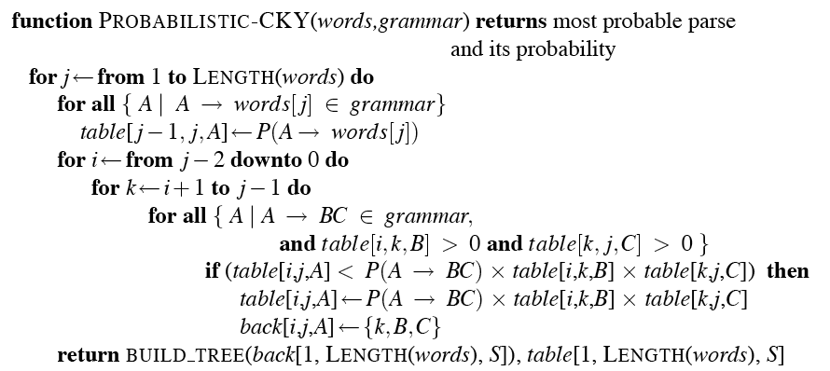
Probabilistic CKY

Slide 16
Problems with PCFGs
The probability model we’re using is just based on the bag of words in the derivation…
  Doesn’t take the actual words into account in any useful way.
  Doesn’t take into account where in the derivation a rule is used
  Doesn’t work terribly well
    That is, the most probable parse isn’t usually the right one (the one in the treebank test set).

Slide 17
Specific problems
Attachment ambiguities
  PP attachment
  Coordination problems

Slide 18
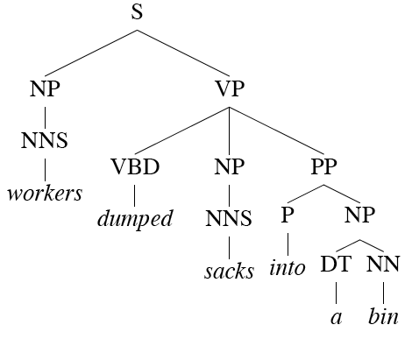
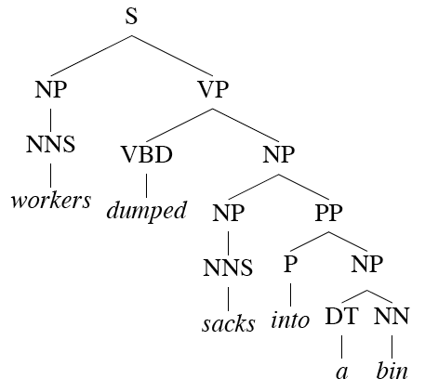
Reminder: PP Attachment

Slide 19
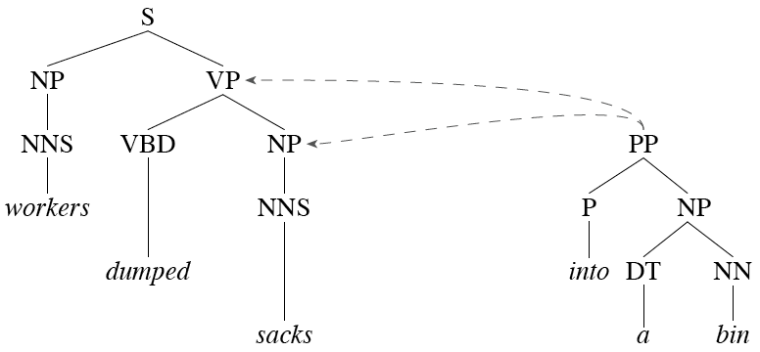
Reminder: PP Attachment
Another view.

Slide 20
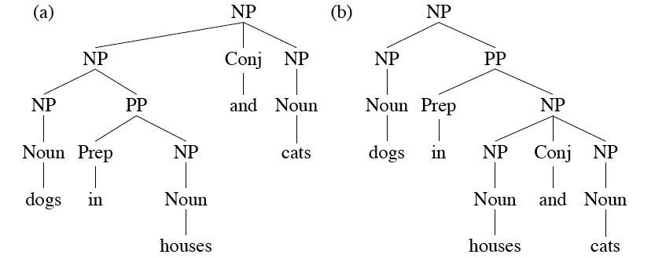
Reminder: Coordination Ambiguity
Most grammars have a rule (implicitly) of the form X -> X and X.

Slide 21
Improved Approaches to
Statistical Parsing
We’ll look at two approaches to overcoming these shortcomings
  Rewrite the grammar to better capture the dependencies among rules
  Integrate lexical dependencies into the model
    And come up with the independence assumptions needed to make it work.

Slide 22
Solution 1: Rule Rewriting
The grammar rewriting approach attempts to capture local tree information by rewriting the grammar so that the rules capture the regularities we want.
  By splitting and merging the non-terminals in the grammar.
    Example: split NPs into different classes…

Slide 23
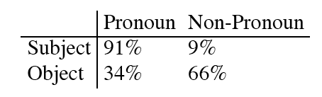
Example: NPs
Our CFG rules for NPs don’t condition on where in a tree the rule is applied
But we know that not all the rules occur with equal frequency in all contexts.
  Consider NPs that involve pronouns vs. those that don’t.

Slide 24
Other Examples
There are lots of other examples like this in any treebank
  Many at the part of speech level
  Recall that many decisions made in annotation efforts are directed towards improving annotator agreement, not towards doing the right thing.
    Often this involves conflating distinct classes into a larger class
      TO, IN, Det, etc.

Slide 25
Rule Rewriting
Three approaches
  Use linguistic knowledge to directly rewrite rules by hand
    NP_Obj and the NP_Subj approach
  Automatically rewrite the rules using context to capture some of what we want
    Ie. Incorporate context into a context-free approach
  Search through the space of rewrites for the grammar that maximizes the probability of the training set

Slide 26
Local Context Approach
Condition the rules based on their parent nodes
  This splitting based on tree-context captures some of the linguistic intuitions

Slide 27
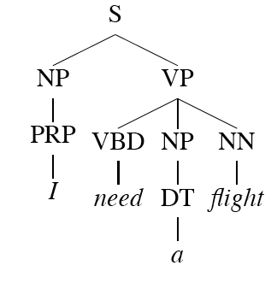
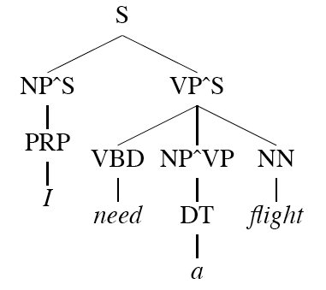
Parent Annotation
Now we have non-terminals NP^S and NP^VP that should capture the subject/object and pronoun/full NP cases. That is...
  The rules are now
    NP^S -> PRP
    NP^VP -> DT
    VP^S -> NP^VP

Slide 28
Parent Annotation
Recall what’s going on here. We’re in effect rewriting the treebank, thus rewriting the grammar.
And changing the probabilities since they’re being derived from different counts…
  And if we’re splitting what’s happening to the counts?

Slide 29
Auto Rewriting
If this is such a good idea we may as well apply a learning approach to it.
Start with a grammar (perhaps a treebank grammar)
Search through the space of splits/merges for the grammar that in some sense maximizes parsing performance on the training/development set.

Slide 30
Auto Rewriting
Basic idea…
  Split every non-terminal into two new non-terminals across the entire grammar (X becomes X1 and X2).
  Duplicate all the rules of the grammar that use X, dividing the probability mass of the original rule almost equally.
  Run EM to readjust the rule probabilities
  Perform a merge step to back off the splits that look like they don’t really do any good.

Slide 31
Solution 2:
Lexicalized Grammars
Lexicalize the grammars with heads
Compute the rule probabilities on these lexicalized rules
Run Prob CKY as before
Notes:
Charniak & collins
Associate non-terminals with their lexical head AND
Associate head tag (POS) with the non-terminal symbols

Slide 32
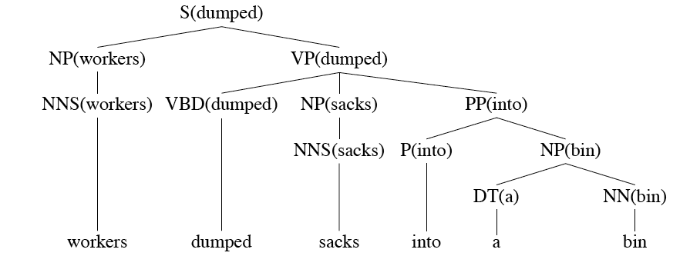
Dumped Example

Slide 33
How?
We used to have
  VP -> V NP PP P(rule|VP)
    That’s the count of this rule divided by the number of VPs in a treebank
Now we have fully lexicalized rules...
  VP(dumped)-> V(dumped) NP(sacks)PP(into)
  P(r|VP ^ dumped is the verb ^ sacks is the head of the NP ^ into is the head of the PP)
  To get the counts for that…

Slide 34
Declare Independence
When stuck, exploit independence and collect the statistics you can…
There are a larger number of ways to do this...
Let’s consider one generative story: given a rule we’ll
  Generate the head
  Generate the stuff to the left of the head
  Generate the stuff to the right of the head

Slide 35
Example
So the probability of a lexicalized rule such as
  VP(dumped) → V(dumped)NP(sacks)PP(into)
Is the product of the probability of
  “dumped” as the head
  With nothing to its left
  “sacks” as the head of the first right-side thing
  “into” as the head of the next right-side element
  And nothing after that

Slide 36

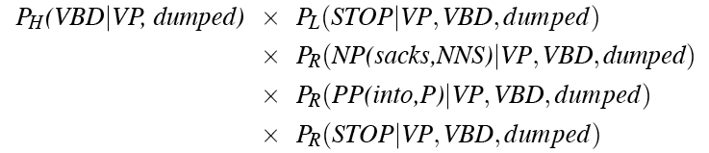
Example
That is, the rule probability for
is estimated as

Slide 37
Framework
That’s just one simple model
  Collins Model 1
You can imagine a gazzillion other assumptions that might lead to better models
You just have to make sure that you can get the counts you need
And that it can be used/exploited efficiently during decoding

