Slide 1
Natural Language Processing
Lecture 13—10/11/2012
Jim Martin

Slide 2
Today 10/11/12
Finish CKY
03/27/13
Speech and Language Processing - Jurafsky and Martin

Slide 3
Dynamic Programming
DP search methods fill tables with partial results and thereby
  Avoid doing avoidable repeated work
  Solve exponential problems in polynomial time (well, no not really)
  Efficiently store ambiguous structures with shared sub-parts.
We’ll cover two approaches that roughly correspond to top-down and bottom-up approaches.
  CKY
  Earley
03/27/13
Speech and Language Processing - Jurafsky and Martin

Slide 4
Bottom-Up Parsing
We want trees that cover the input words. So we might start with trees that link up with the words in the right way.
Then we work our way up from there to larger and larger trees.
03/27/13
Speech and Language Processing - Jurafsky and Martin

Slide 5
Bottom-Up Search
03/27/13
Speech and Language Processing - Jurafsky and Martin

Slide 6

Bottom-Up Search
03/27/13
Speech and Language Processing - Jurafsky and Martin

Slide 7
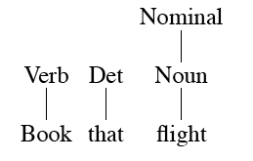
Bottom-Up Search
03/27/13
Speech and Language Processing - Jurafsky and Martin

Slide 8
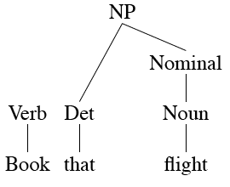
Bottom-Up Search
03/27/13
Speech and Language Processing - Jurafsky and Martin

Slide 9
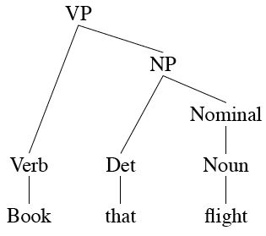
Bottom-Up Search
03/27/13
Speech and Language Processing - Jurafsky and Martin

Slide 10
CKY Parsing
First we’ll limit our grammar to epsilon-free, binary rules (more on this later)
Consider the rule A → BC
  If there is an A somewhere in the input generated by this rule then there must be a B followed by a C in the input.
  If the A spans from i to j in the input then there must be some k st. i<k<j
    Ie. The B splits from the C someplace.
03/27/13
Speech and Language Processing - Jurafsky and Martin

Slide 11
CKY
Let’s build a table so that an A spanning from i to j in the input is placed in cell [i,j] in the table.
  So a non-terminal spanning an entire string will sit in cell [0, n]
    Hopefully it will be an S
Now we know that the parts of the A must go from i to k and from k to j, for some k
  Which k? Check them all.
03/27/13
Speech and Language Processing - Jurafsky and Martin

Slide 12
CKY
Meaning that for a rule like A → B C we should look for a B in [i,k] and a C in [k,j].
In other words, if we think there might be an A spanning i,j in the input… AND
A → B C is a rule in the grammar THEN
There must be a B in [i,k] and a C in [k,j] for some i<k<j
03/27/13
Speech and Language Processing - Jurafsky and Martin

Slide 13
CKY
So to fill the table, loop over the cell[i,j] values in some systematic way
  For each cell, loop over the appropriate k values to search for things to add.
03/27/13
Speech and Language Processing - Jurafsky and Martin

Slide 14
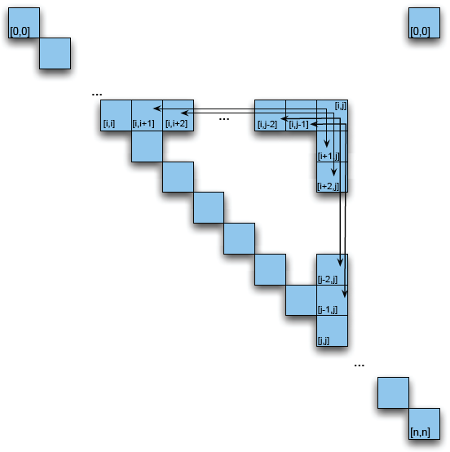
CKY Table
03/27/13
Speech and Language Processing - Jurafsky and Martin

Slide 15
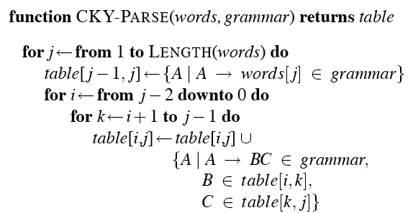
CKY Algorithm
03/27/13
Speech and Language Processing - Jurafsky and Martin

Slide 16
CKY Algorithm
Looping over the columns
Filling the bottom cell
Filling row i in column j
Looping over the possible split locations between i and j.
Check the grammar for rules that link the constituents in [i,k] with those in [k,j]. For each rule found store the LHS of the rule in cell [i,j].
03/27/13
Speech and Language Processing - Jurafsky and Martin

Slide 17
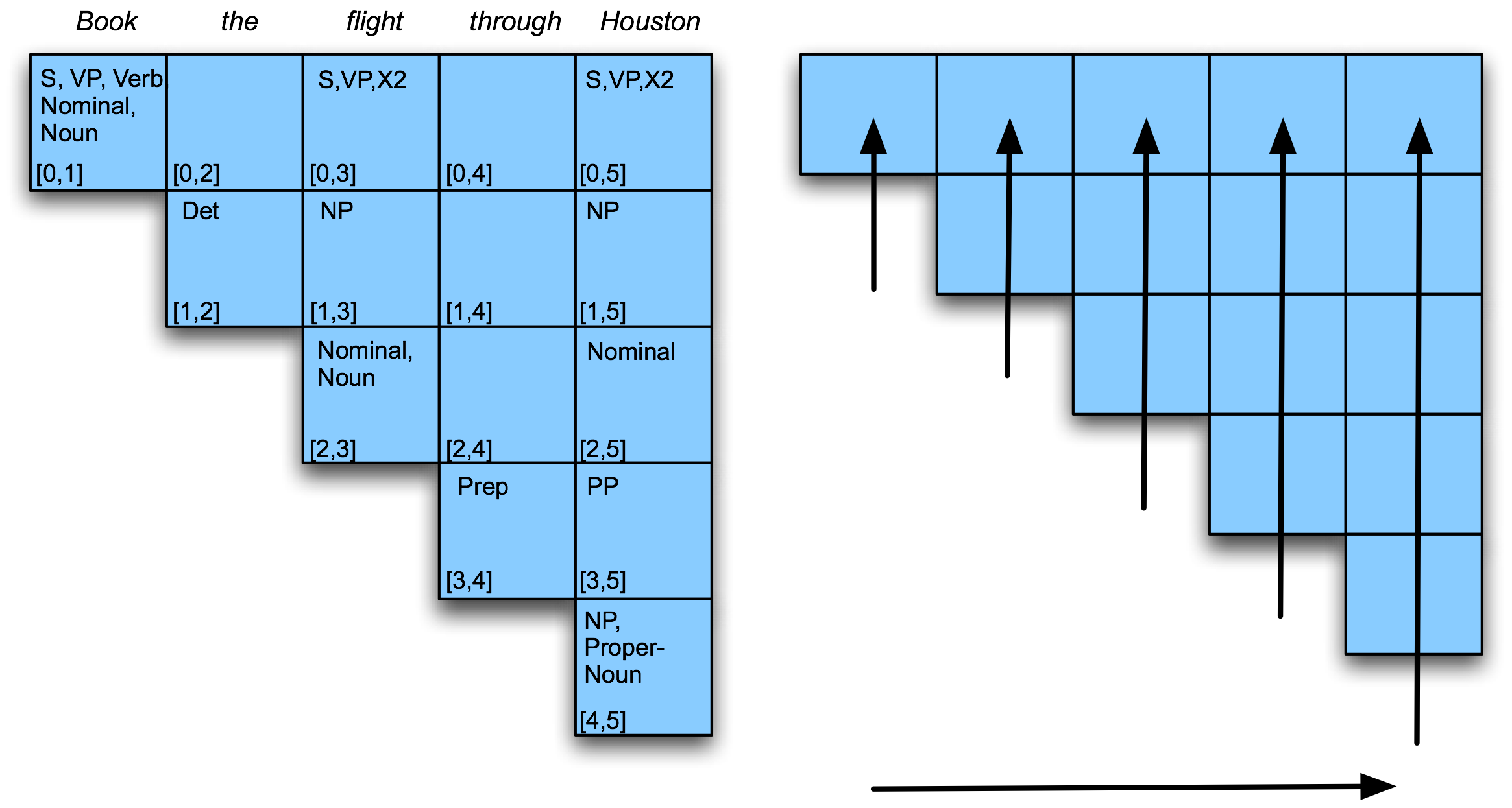
Example
03/27/13
Speech and Language Processing - Jurafsky and Martin

Slide 18
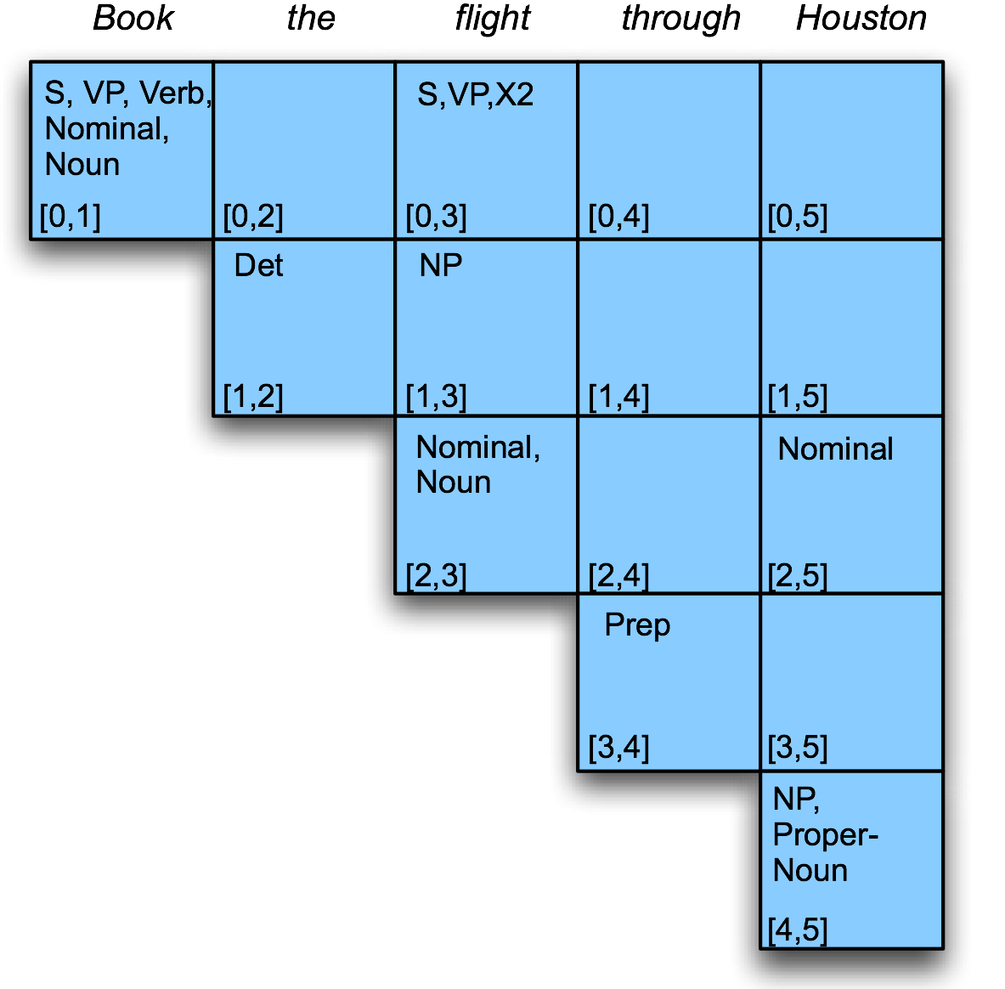
Example
Filling column 5
03/27/13
Speech and Language Processing - Jurafsky and Martin

Slide 19
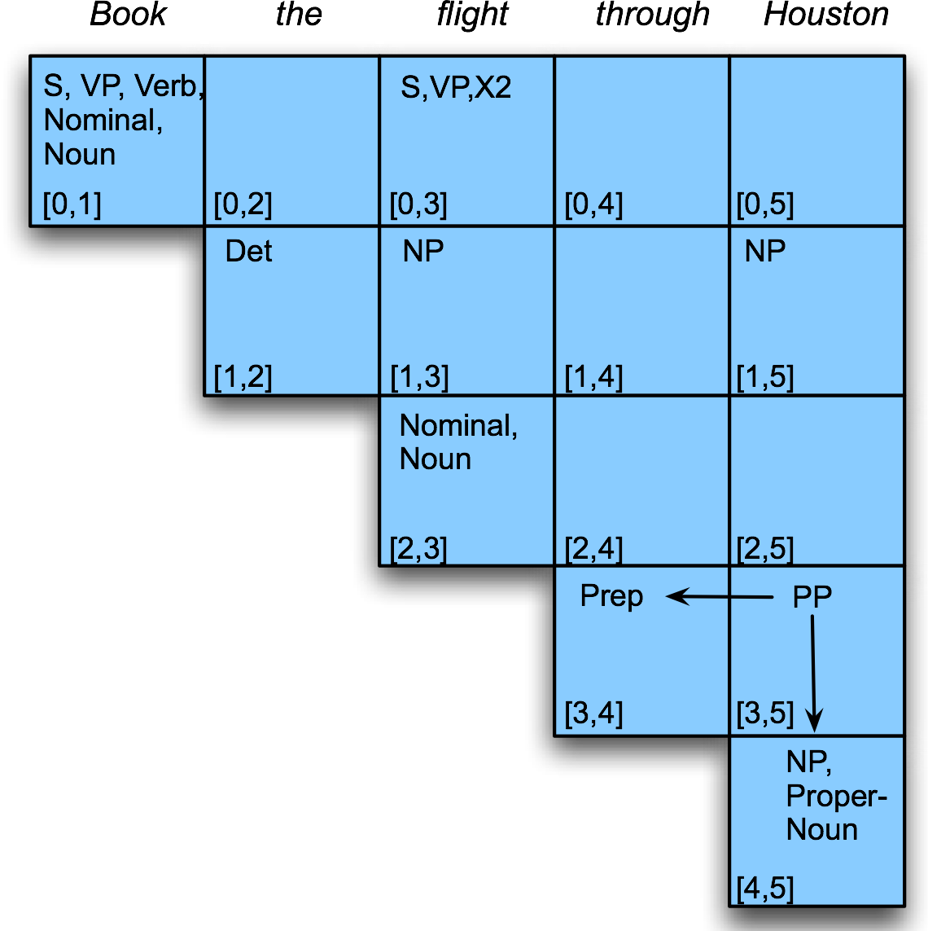
Example
03/27/13
Speech and Language Processing - Jurafsky and Martin

Slide 20
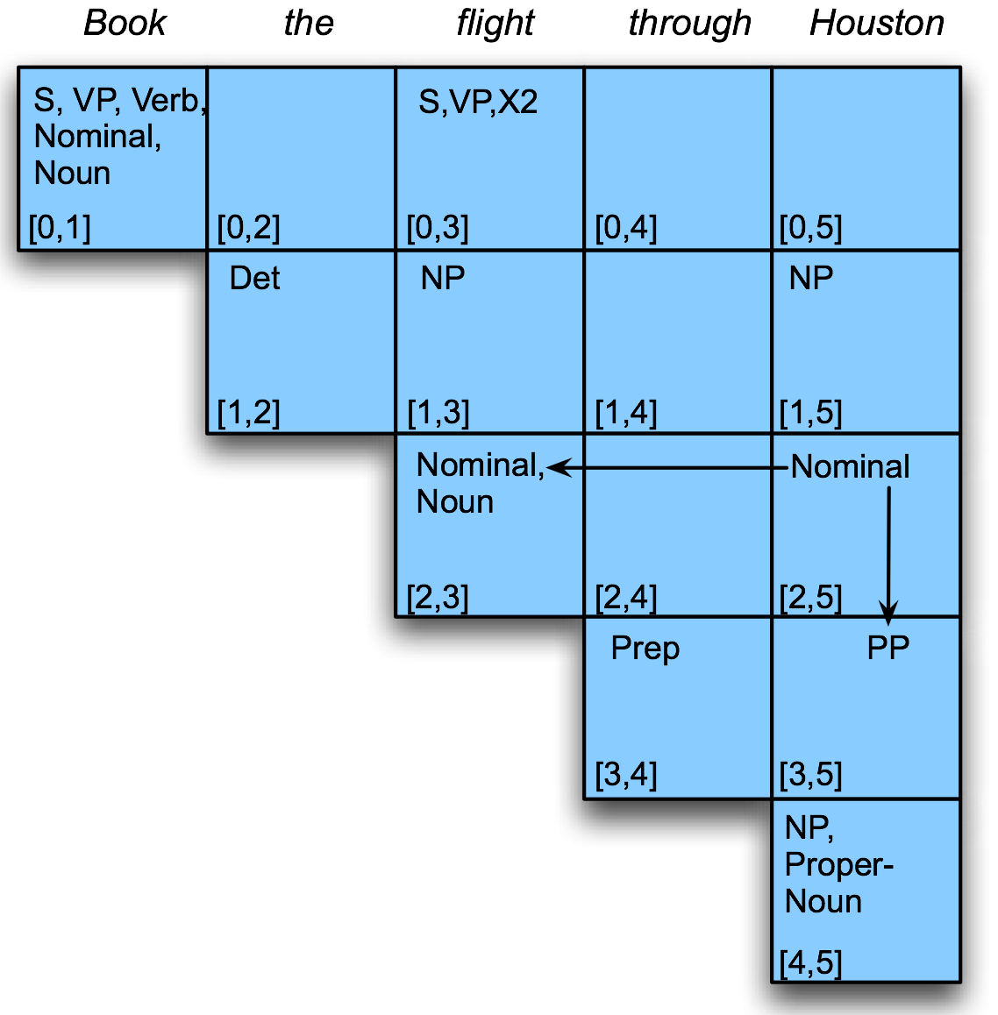
Example
03/27/13
Speech and Language Processing - Jurafsky and Martin

Slide 21
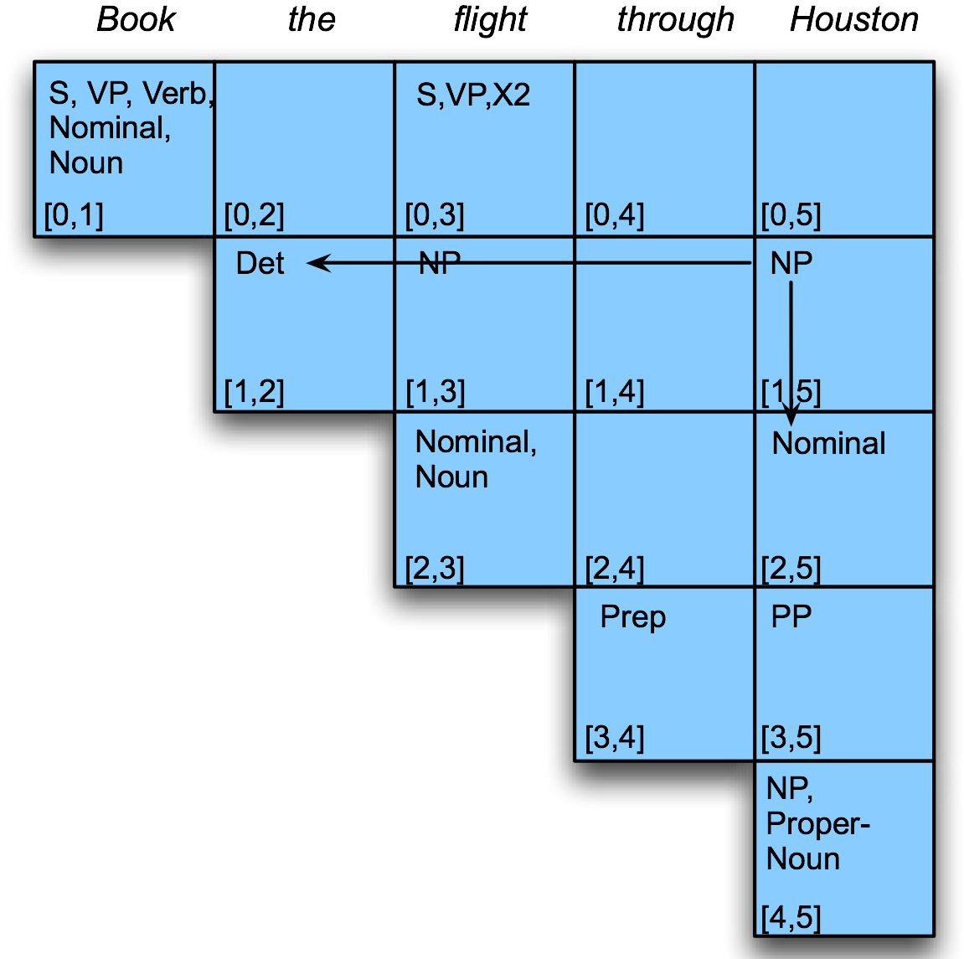
Example
03/27/13
Speech and Language Processing - Jurafsky and Martin

Slide 22
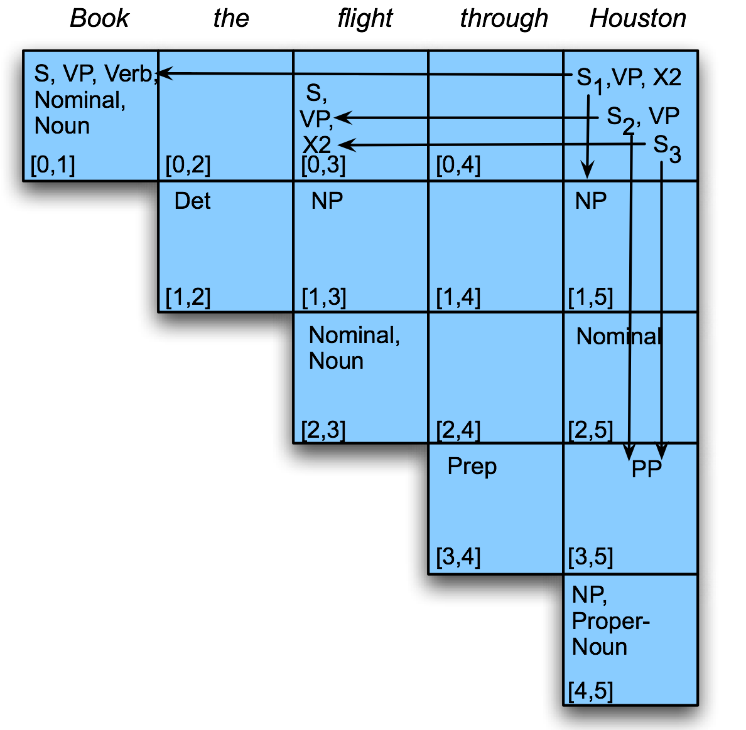
Example
03/27/13
Speech and Language Processing - Jurafsky and Martin

Slide 23
CKY Parsing
Is that really a parser?
Not without a backtrace.
03/27/13
Speech and Language Processing - Jurafsky and Martin

Slide 24
Note
We arranged the loops to fill the table a column at a time, from left to right, bottom to top.
  This assures us that whenever we’re filling a cell, the parts needed to fill it are already in the table (to the left and below)
  It’s somewhat natural in that it processes the input a left to right a word at a time
    Known as online processing
03/27/13
Speech and Language Processing - Jurafsky and Martin

Slide 25
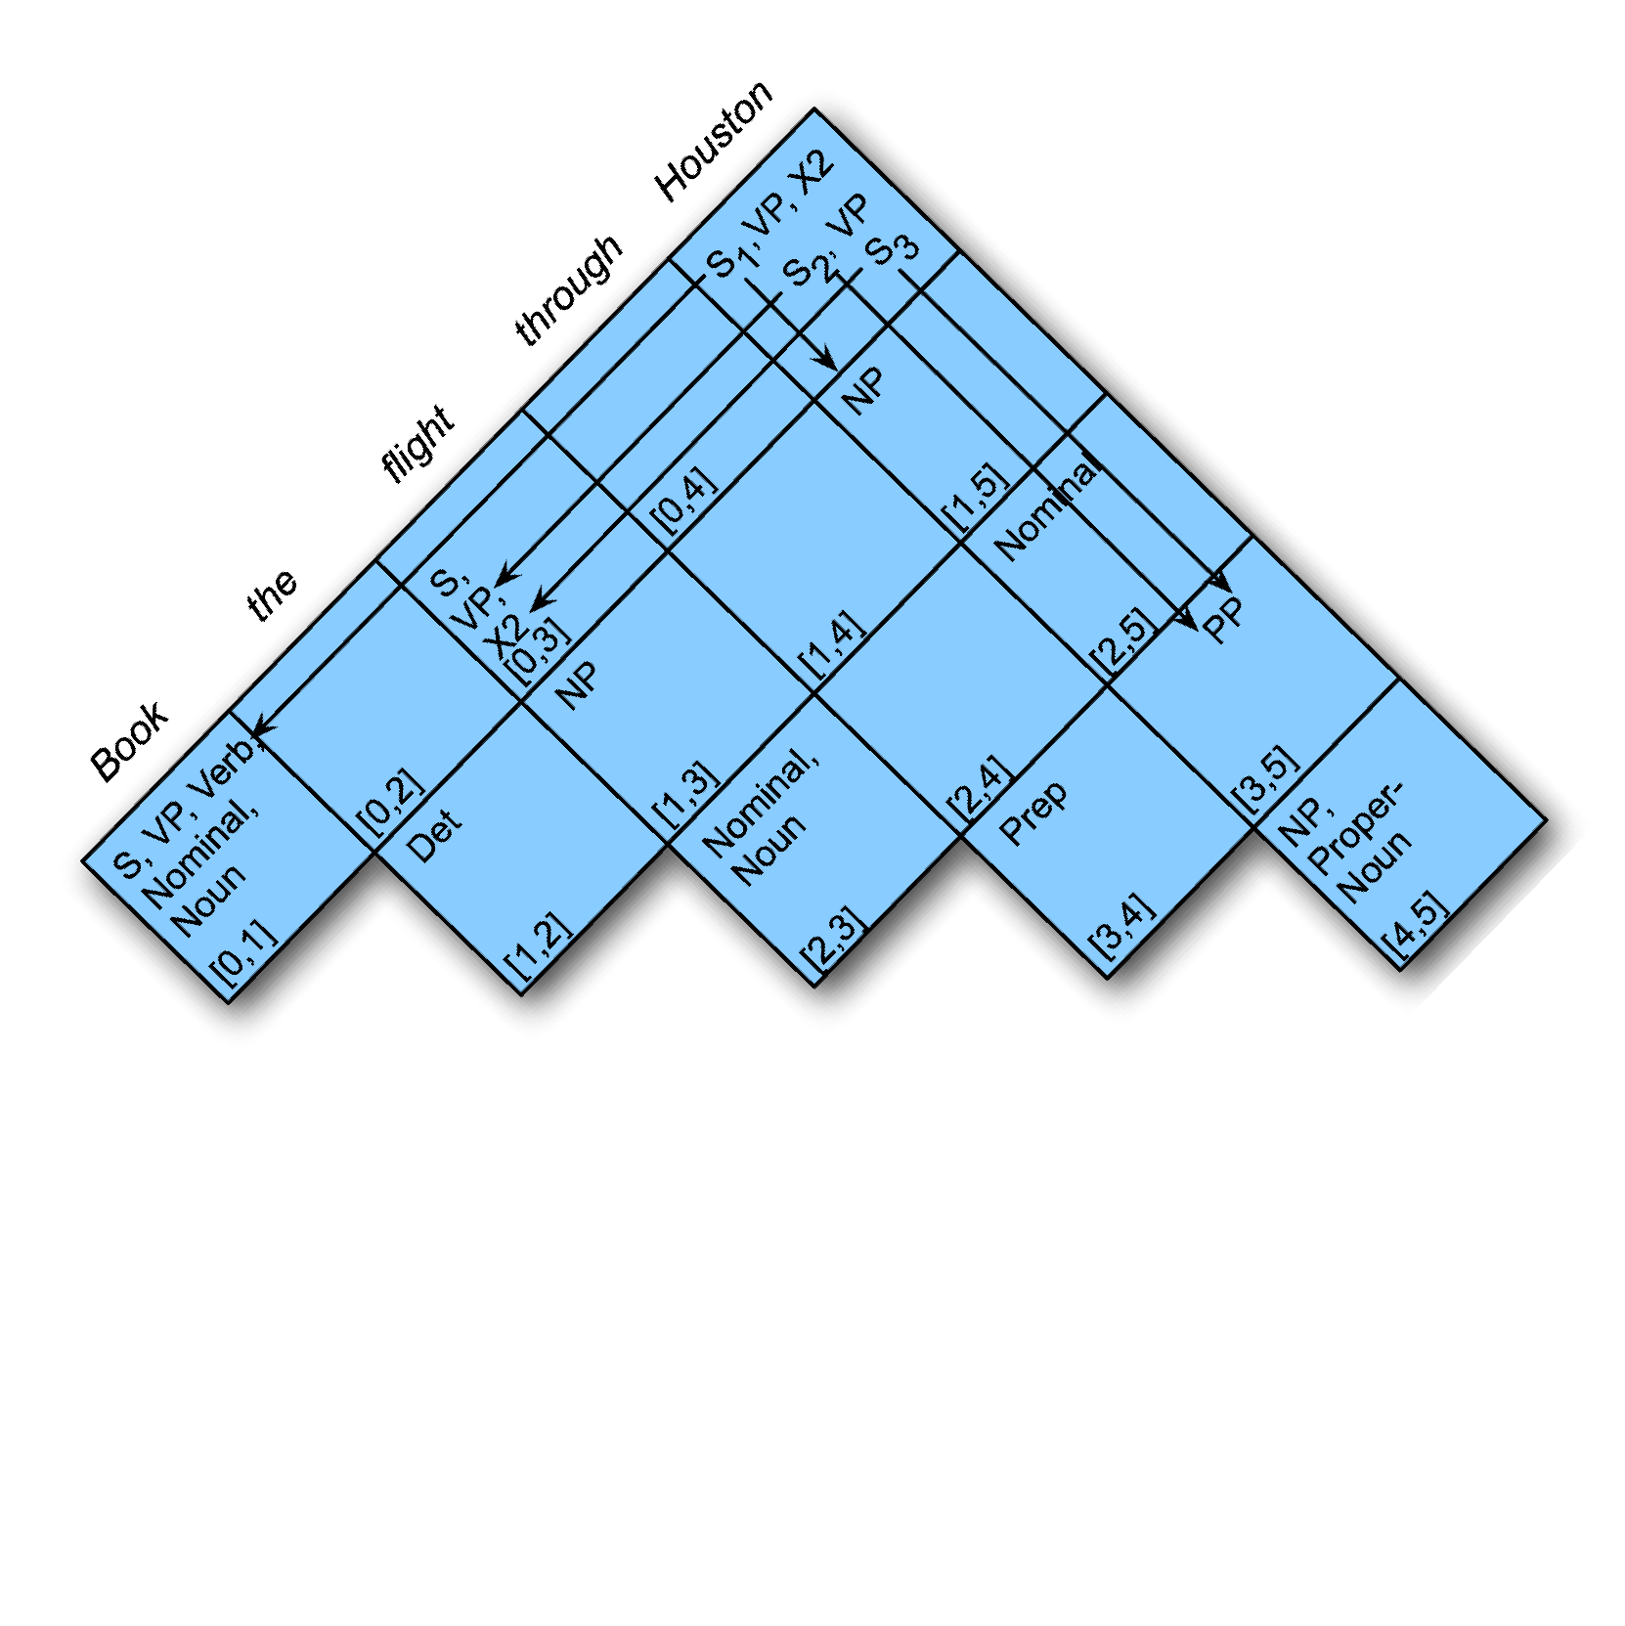
Note
An alternative is to fill a diagonal at a time.
  That still satisfies our requirement that the component parts of each constituent/cell will already be available when it is filled in.
  Filling a diagonal at a time corresponds naturally to what task?
03/27/13
Speech and Language Processing - Jurafsky and Martin

Slide 26
CKY Notes
Since it’s bottom up, CKY populates the table with a lot of phantom constituents.
  Segments that by themselves are constituents but cannot really occur in the context in which they are being suggested.
  To avoid this we can switch to a top-down control strategy
  Or we can add some kind of filtering that blocks constituents where they can not happen in a final analysis.
03/27/13
Speech and Language Processing - Jurafsky and Martin

Slide 27
Back to Ambiguity
Did we solve it?
03/27/13
Speech and Language Processing - Jurafsky and Martin

Slide 28
Ambiguity
No…
  Given an ambiguous input CKY will result in multiple S structures for the [0,N] table entry.
  But sub-parts are shared between multiple parses
  And they obviously avoid re-deriving those sub-parts.
  But there’s no way to tell which one is right.
03/27/13
Speech and Language Processing - Jurafsky and Martin

Slide 29
Next Time
Partial parsing
  Chunking
Dependency parsing
Start on probabilistic parsing
03/27/13
Speech and Language Processing - Jurafsky and Martin

