Slide 1
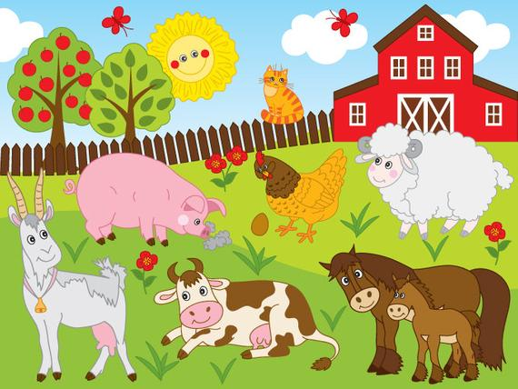
Welcome to the Farm!

Slide 2
The animals are hungry, and we need you to feed them!
BAHH!!
Oink Oink!!
MOO!!
Walk up to the animal to feed them! When you feed them, they will thank you with a sound!

Slide 3

To move around the environment use the mouse to look around and the press the left mouse button to move forward

Slide 4

When your ready hold the mouse and press the spacebar!
SPACE BAR

Slide 5
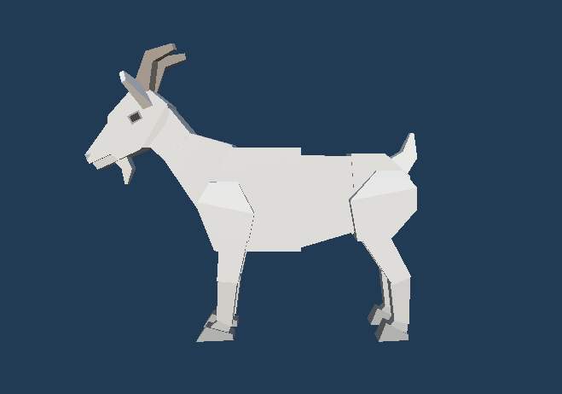
Feed the Goat!

Slide 6
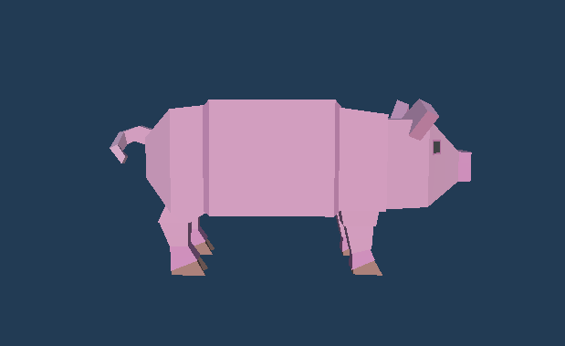
Feed the Pig!

Slide 7
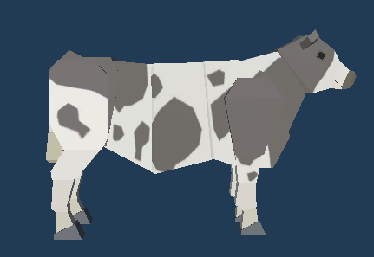
Feed the cow!

Slide 8
Great job! You fed all the animals!

