Slide 1
Section 2: BONUS PAY!
V1
In this section you will use what you learned in the practice section to collect as much money as possible in a new environment!
All the money you collect during this section will be added to your bonus pay which you’ll receive upon completing all 3 sessions of the experiment.
Do you have any questions?

Slide 2
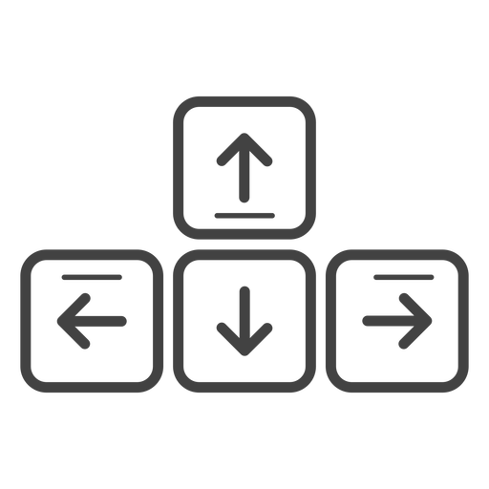
Movement Controls
The movement controls are the same as before!
You’ll use the Up-Arrow to move forward, and the left and right arrow-keys to rotate.
Move Forward
Rotate
Left
Rotate
Right
Do you have any questions?

Slide 3
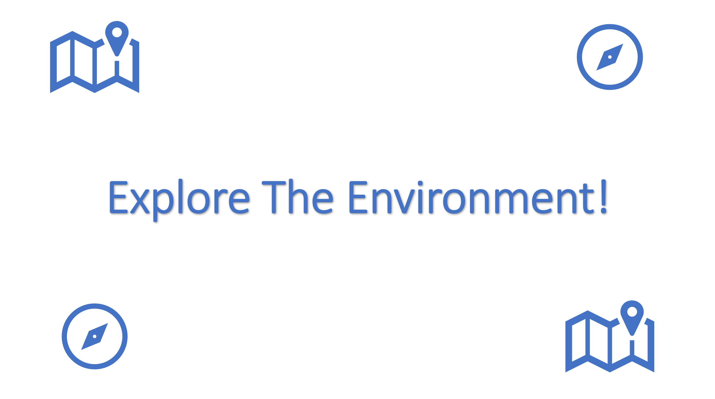
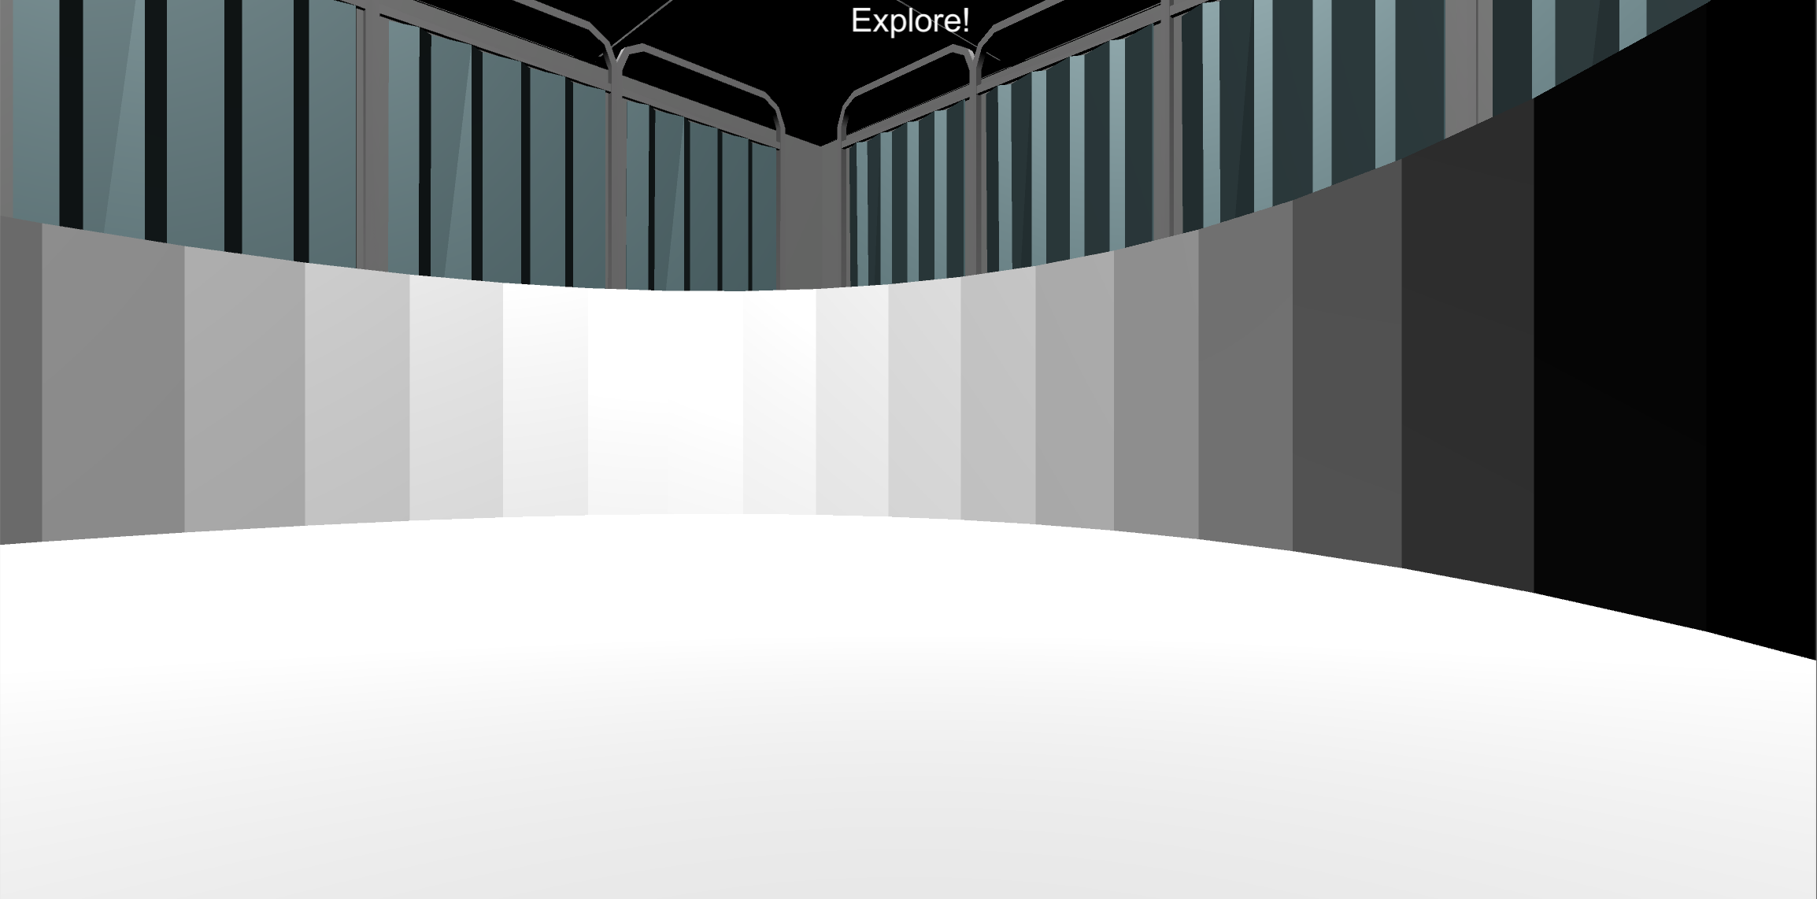
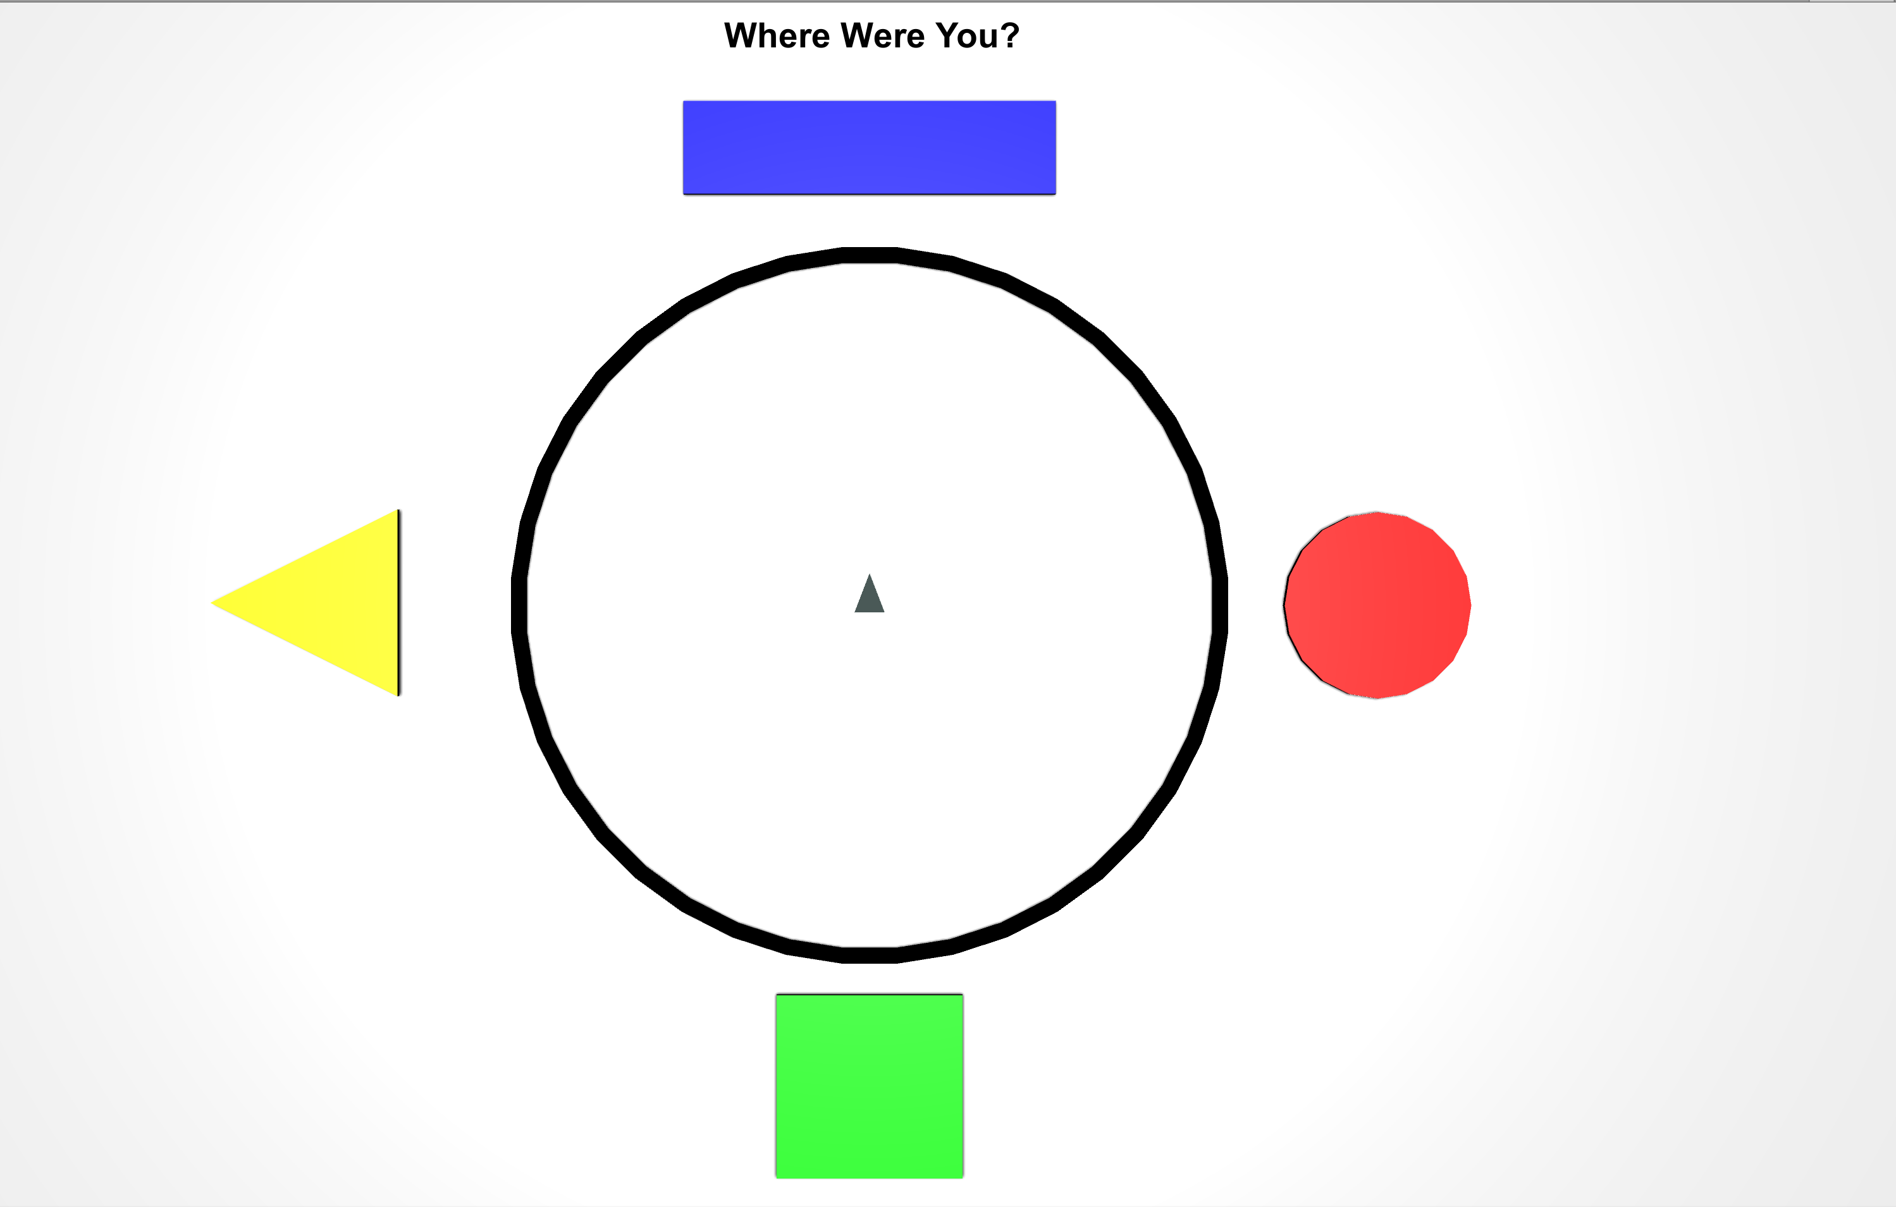
EXPLORE THE ENVIRONMENT
Let’s practice moving around the new environment by doing some Explore Rounds (There is no hidden money in these rounds!).
At the start of each round you will see the Explore The Environment screen. Then you will have 30 seconds to explore the 3D Environment. After 30 seconds a Top-Down Map will appear. Move the gray triangle on the map to where you think you were using the same controls. then press the Spacebar to begin the next round!
3D Environment (30 Seconds)
Top-Down Map
Do you have any Questions?

Slide 4

Ready?
When you’re ready, place your right hand on the arrow keys and press the Spacebar with your left to continue!
Spacebar

Slide 5


Explore The Environment!

Slide 6
Great Work!
Notify the Experimenter that you’ve completed this section

Slide 7
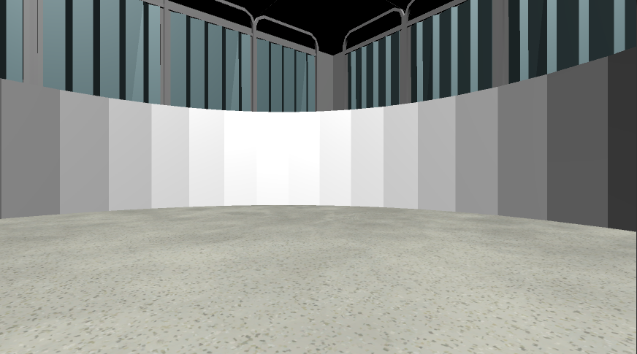

Collecting Money
Now let’s collect money!! Just like in the practice section, the money will be invisible but when you find it you will hear a collection sound and it will be added to the Money Collected at the top of the screen.
Money Collected: 0¢
Do you have any Questions?

Slide 8

Please make sure your headphones or speakers are on. You should hear a coin sound every time you collect money.
Let’s make sure everything is still working correctly! Keep moving around the environment until you collect 10¢ worth of money! Adjust the volume as necessary!
Do you have any questions?

Slide 9


Money Collection Rounds
Your next task is to collect as much as possible in each of the following Money Collection Rounds. On each round, you will be placed into the environment at a random location.
Once you’re in the environment you will have 1-minute to collect as much money as possible!!
1 Minute
Do you have any questions?

Slide 10
Earning Bonus Pay
To earn Bonus Pay in each round, you must collect at least 10¢. If you do not reach 10¢ by the end of the round the money you collected will not be added to your TOTAL BONUS PAYMENT.
Money Collected: 9¢ (or less)
Money Collected NOT Added to Total Bonus Payment
Money Collected: 10¢ (or more)
Money Collected Added to Total Bonus Payment
On each round you should try to collect as much as possible. You will find out your TOTAL BONUS PAYMENT at the end of the Bonus Section.
Do you have any questions?

Slide 11

FEEDBACK ROUNDS
At the start of most rounds you will see the “Search For Money” screen.
During these rounds you will hear a coin sound every time you collect money and you will be able to see how much you collected at the top of the screen.
Less than 10¢
10¢ or more
Search For Money!
Money Collected: 2¢
BONUS UNLOCKED!
Bonus Collected: 12¢
When you reach 10¢ the text will change from Red to Green and will display BONUS UNLOCKED. If you have collected more than 10¢ by the end of the round the money will be added to your Total Bonus Payment.
Do you have any questions?

Slide 12

NO FEEDBACK ROUNDS
At the start of some rounds you will see the “Search For Money! NO FEEDBACK” screen.
During these rounds you will NOT hear a coin sound when you collect money and you will NOT be able to see how much you’ve collected!
Less than 10¢
10¢ or more
Search For Money!
No Feedback Round
Search For Money!
No Feedback Round
When you reach 10¢ the text will not change color and will remain Red. This means that you will not know whether you have collected more than 10¢. However, if you do collect more than 10¢ by the end of the round the money will be added to your Total Bonus Payment.
HINT: Use what you’ve learned from the Feedback Rounds to guide your search!
Do you have any questions?

Slide 13
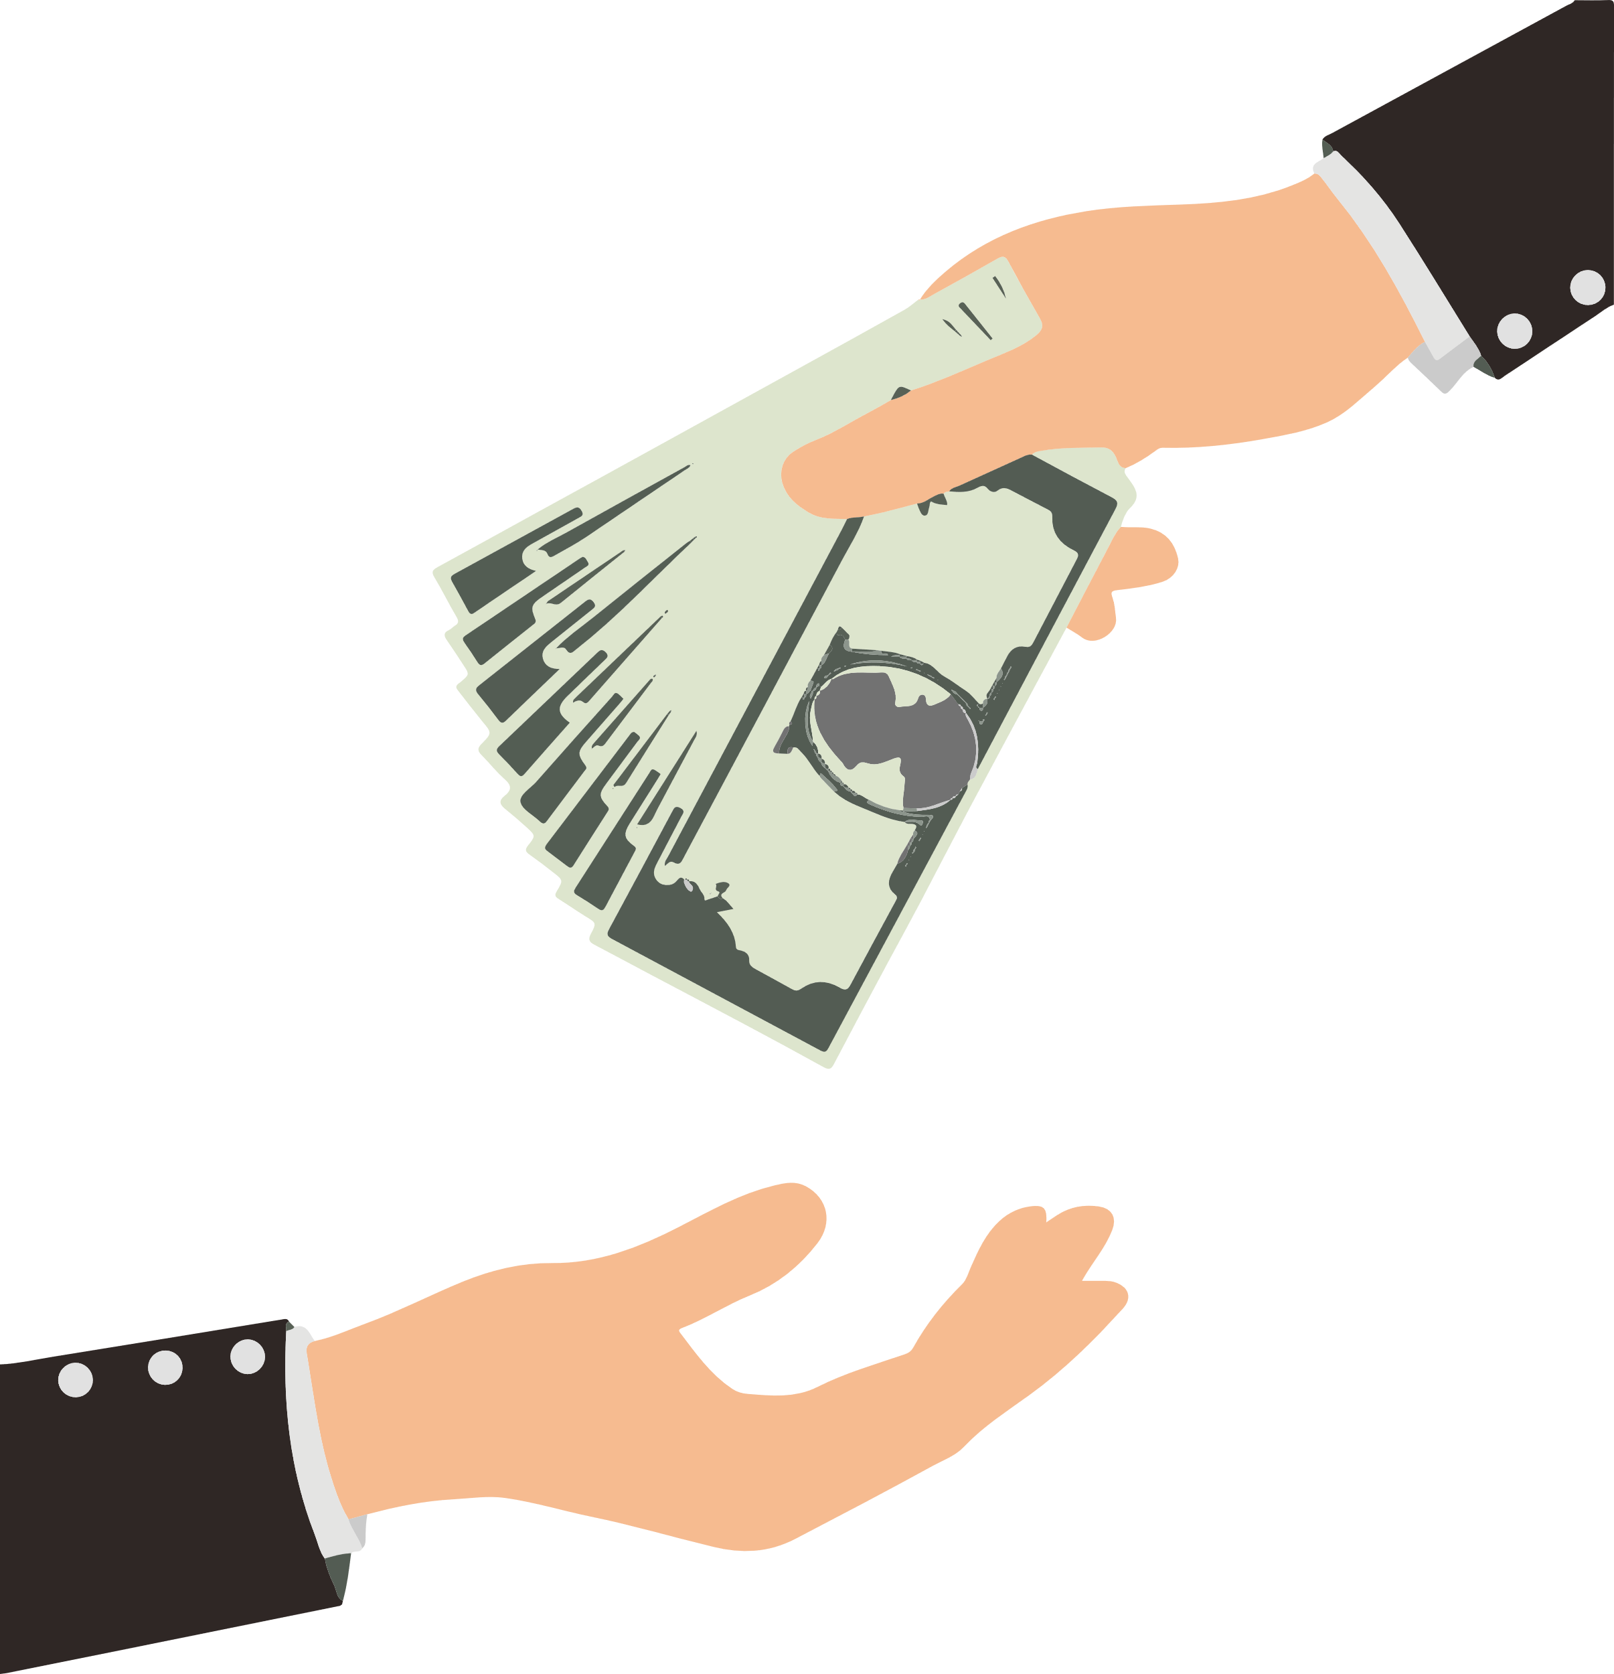
Good Luck!!
You will now complete the rest of the Bonus Section on your own. Remember There is an UNLIMITED amount of money to collect in each round. Stay focused and keep moving to receive the largest Bonus Payment you can! You will be given breaks periodically.
Do you have any questions?

Slide 14


Search For Money!

Slide 15
Search For Money! NO FEEDBACK

Slide 16
Break Time!
Feel free to take a break if you need to.
When you’re ready, place your right hand on the arrow keys and press the spacebar with your left to continue!
Spacebar

Slide 17
Great job!
You’ve completed Session 1!
Before pressing the Upload Data button please confirm the date and time of your next session with the experimenter.

Slide 18
Session 2 Overview
In this session your task is to collect as much money as possible in a new environment!
All the money you collect during this session will be added to your Bonus Pay which you will receive upon completing all 3 sessions of the experiment.
Please make sure to listen to each instruction carefully and wait for the experimenter to instruct you to proceed to the next instruction.
Don’t be afraid to ask questions if you need clarification!
Do you have any questions?

Slide 19
Great job!
You’ve completed Session 2!
Before pressing the Upload Data button please confirm the date and time of your next session with the experimenter.

