Slide 1
Section 3: Find The Trophy!
Press Spacebar to continue …

Slide 2
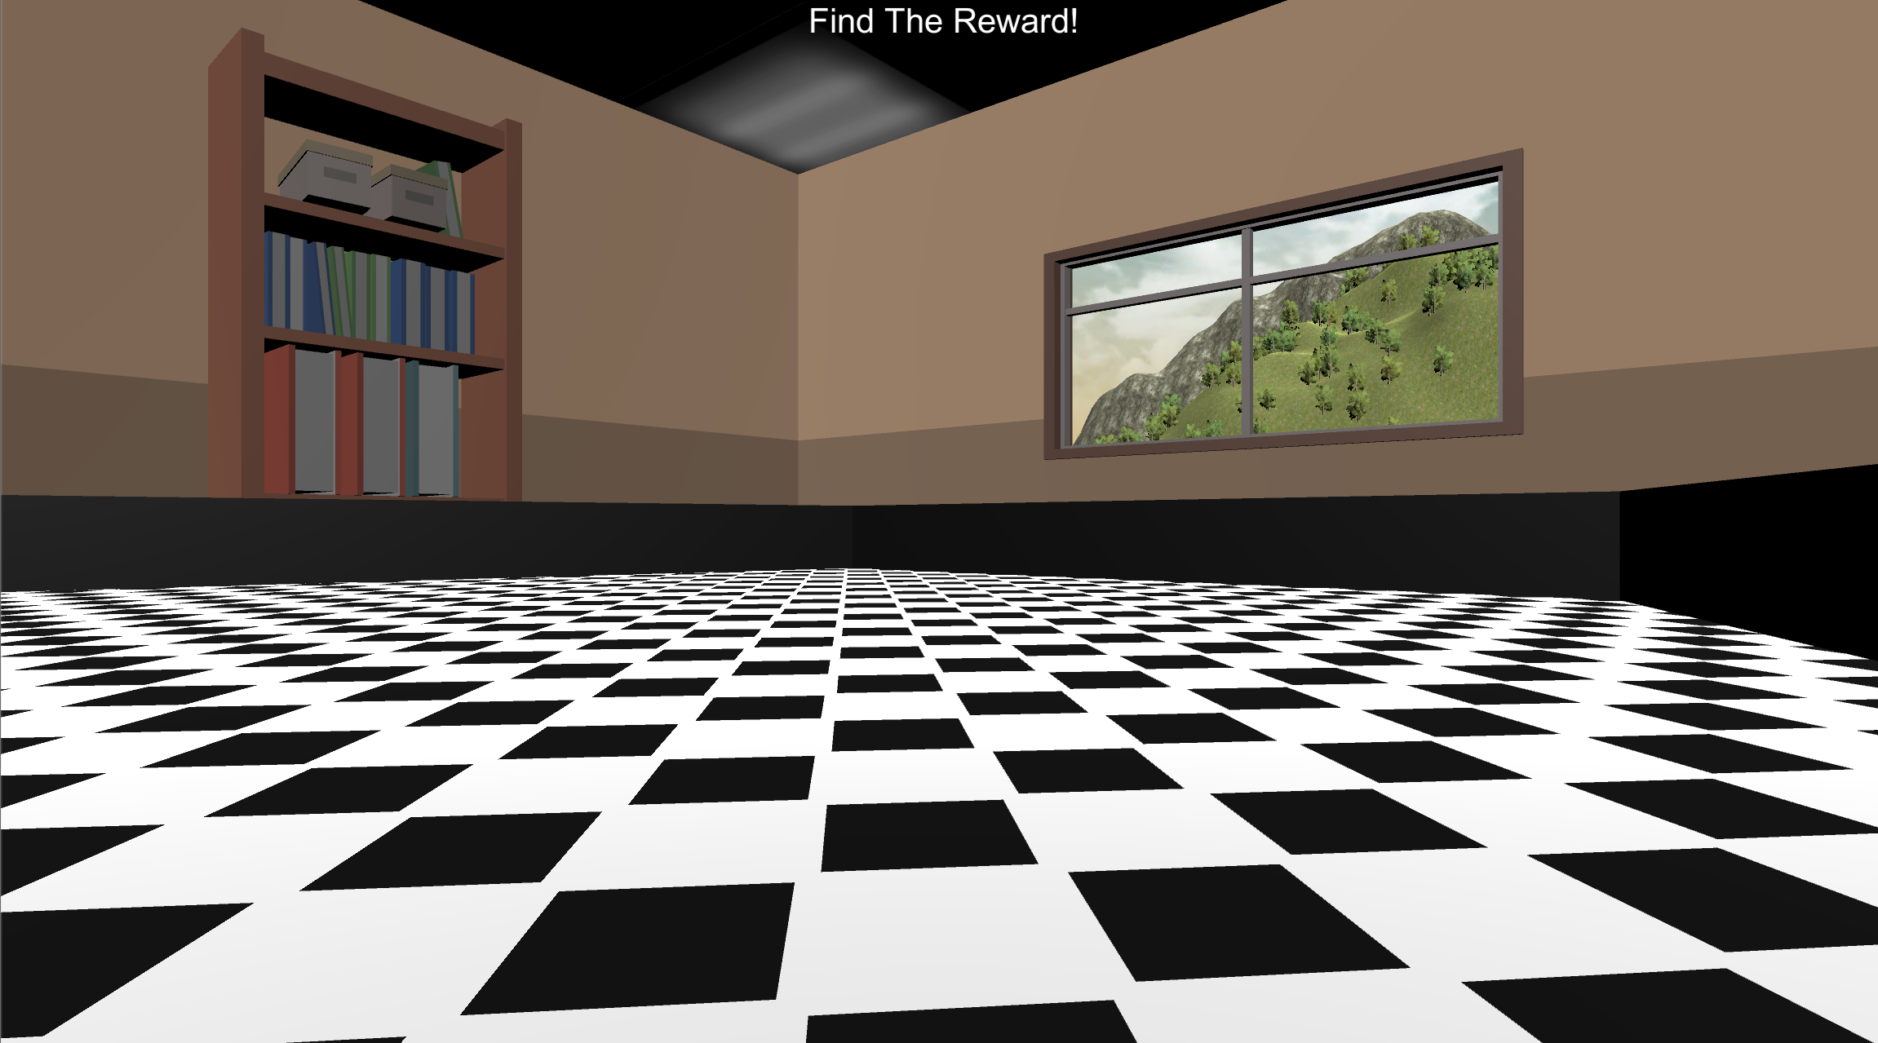
FIND THE TROPHY!
In this task, your job is to navigate the environment pictured below and Find The Trophy as fast as you can!
Press Spacebar to continue …

Slide 3

MOVEMENT CONTROLS
The controls are the same as previous sections: use the Up-Arrow to move forward, and the left and right arrow-keys to rotate.
Move Forward
Rotate
Left
Rotate
Right
Press Spacebar to continue …

Slide 4

FIND THE TROPHY!
In this round, you will see the “Find The Trophy!” Screen and then you will be placed into the environment at a random location. Your job is to collect the trophy as fast as you can by running into it!
Press Spacebar to continue …

Slide 5
FIND THE TROPHY: INVISIBLE ROUNDS
Now that you know where the trophy can be found you will need to locate it when it's invisible. On each round, you will first see the “Find The Trophy!” screen and then you will be placed into the environment at a random location.
When you find it you will hear a sound and the round will end.
The goal on each round is to find the trophy as fast as possible!!
Press Spacebar to continue …

Slide 6

FIND THE TROPHY!

Slide 7

Place your right hand on the arrow keys and press the Spacebar with your left to continue!
Spacebar

Slide 8
GREAT JOB!!
You’ve completed the FIND THE TROPHY section!
PLEASE NOTIFY THE EXPERIMENTER!!!
Practice
Bonus Pay
Find The Trophy
Experiment Survey

Slide 9
Great Work! You have completed the task. The final part of the experiment is a questionnaire. Please Press the button below to open the

