Slide 1
Welcome to experiment!
The experiment will take you 1.5 – 2 hours, including multiple breaks.
IMPORTANT before starting, make sure:
You will NOT be distracted within the next 2 hours
Your cell phone is turned off
Please confirm with the experimenter that you have entered the correct participant ID before pressing the Start Experiment button.

Slide 2
Experiment Overview
The experiment has 4 main sections:
Practice – Learn how to navigate in a virtual environment and collect money
Bonus Pay – All money collected in this round you will keep
Find The Trophy – Locate the trophy as fast as you can
Experiment Survey – Tell us what you thought about the experiment
To earn the most bonus pay, make sure to listen to each instruction carefully and don’t be afraid to ask questions if you need clarification!
Press Spacebar to continue …

Slide 3
Section 1: Practice!
In this section you will learn how to navigate a virtual environment and how to find money within it.
Use this Practice Section to learn as much as possible about collecting money. This will help you to earn the most Bonus Pay in the next Section!
Press Spacebar to continue …

Slide 4
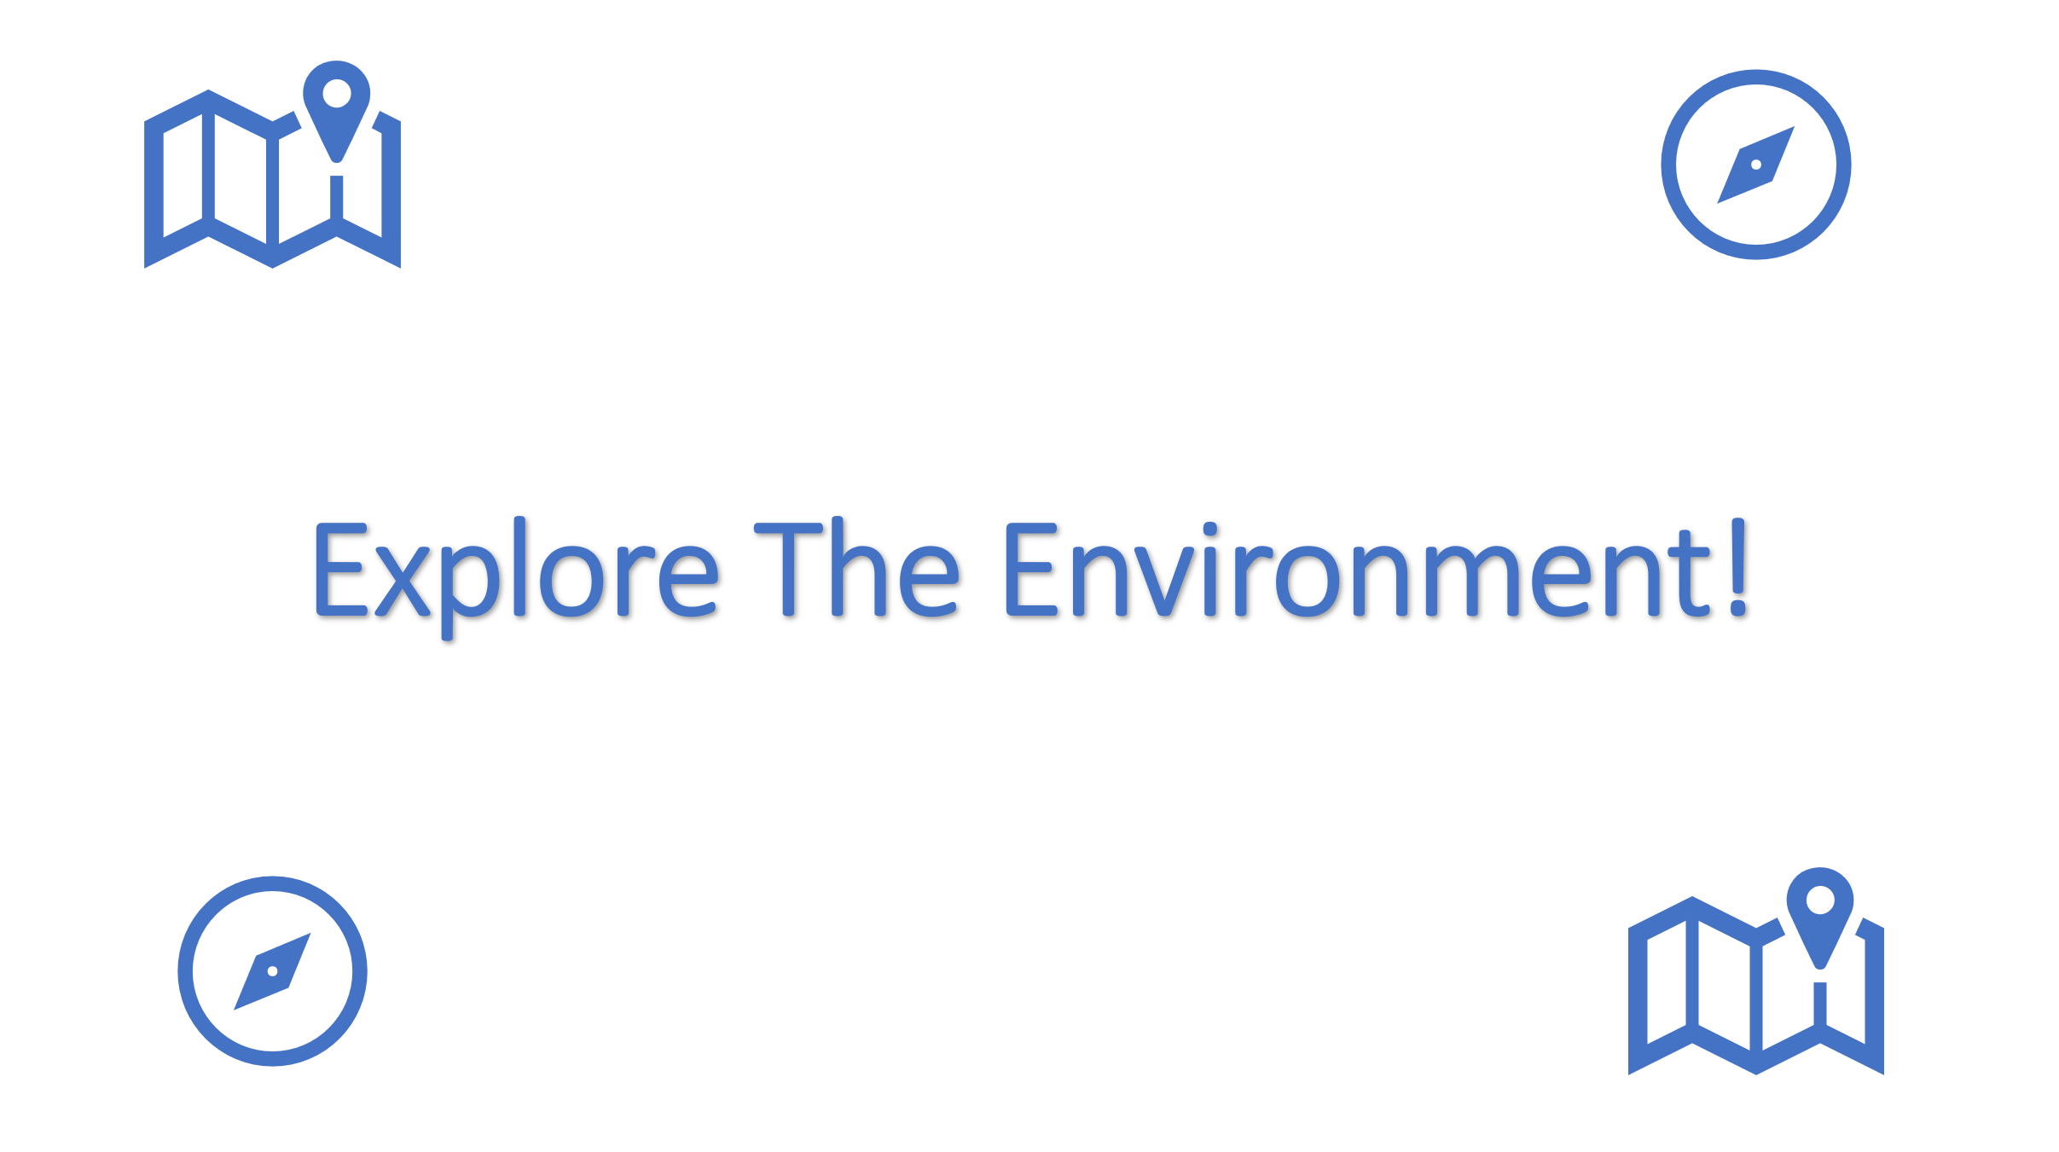
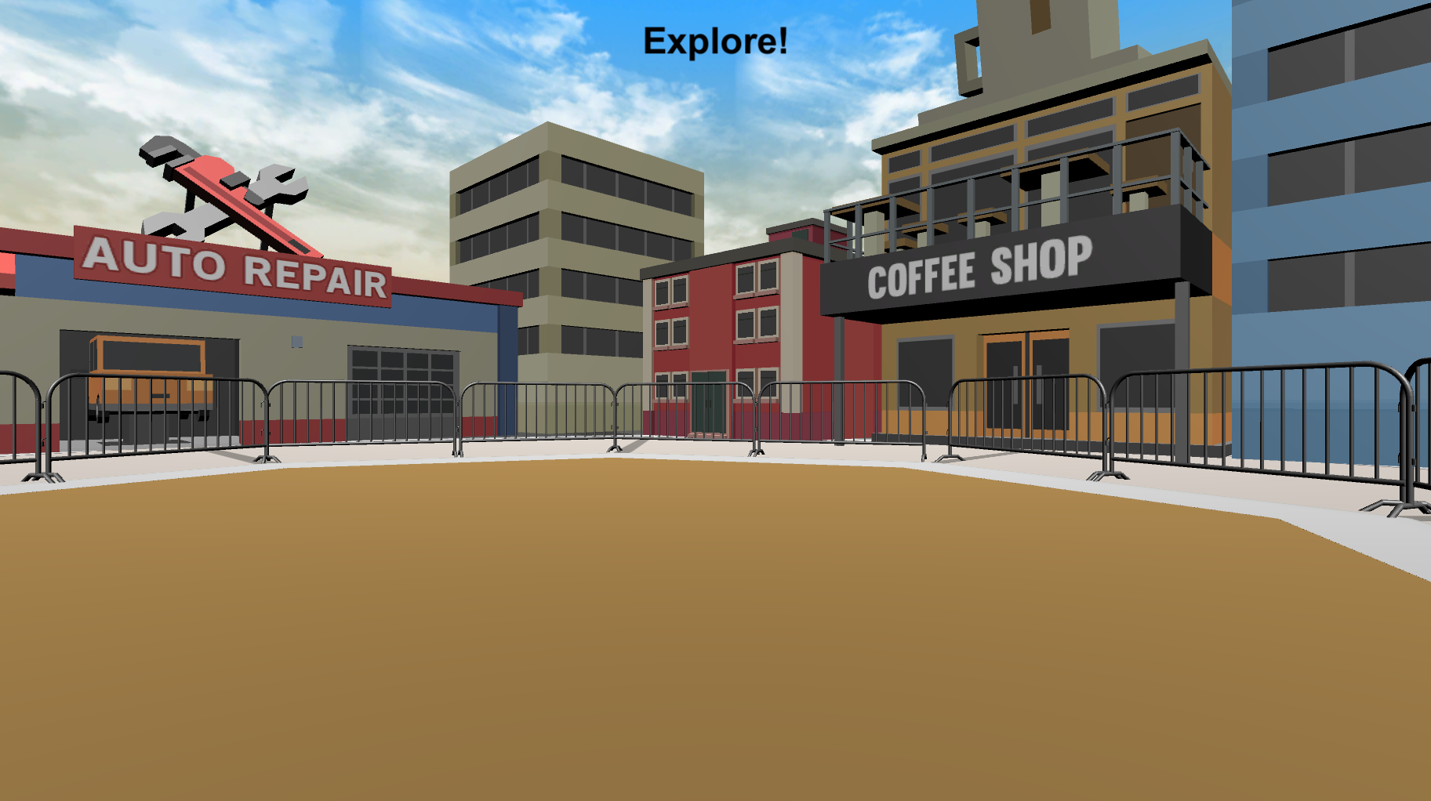
Practice: Exploring the Environment
Before looking for money, you will have the opportunity to explore the environment. On each Explore Round you will see the Explore The Environment screen (left bottom) and then you will be placed into the environment at a random location (right bottom). There is no money to collect in these rounds, so just move around and learn as much as you can about the environment.
Press Spacebar to continue …

Slide 5
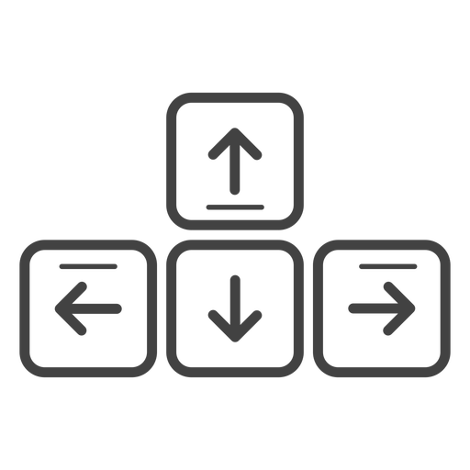
MOVEMENT CONTROLS
To move around the environment, you can ONLY use the Up-Arrow to move forward, and the left and right arrow-keys to rotate.
Move Forward
Rotate
Left
Rotate
Right
Press Spacebar to continue …

Slide 6
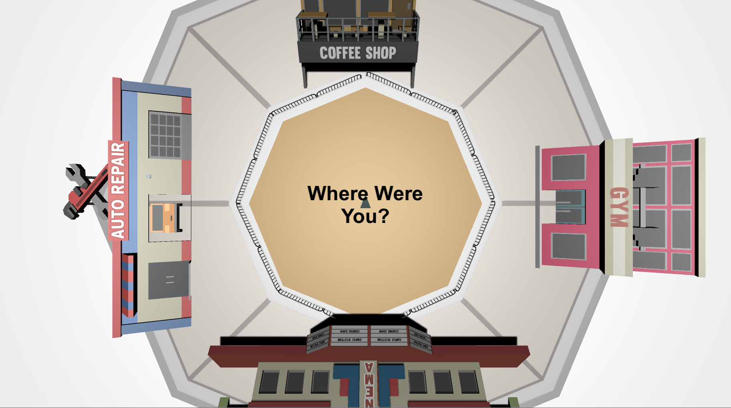
TOP-DOWN VIEW
While exploring the environment, you will be asked periodically to locate where you were from a top-down viewpoint like the picture below.
The grey triangle in the middle shows the direction that you’re facing, and the controls are the same as the 3D environment. Move the grey triangle to the last position you were in, in the 3D environment, and then press the Spacebar. This might be difficult at first, but you will get better at it each time!
Press Spacebar to continue …

Slide 7

When you’re ready, place your right hand on the arrow keys and press the Spacebar with your left to continue!
Spacebar

Slide 8


Explore The Environment!

Slide 9
Great Work!
Press Spacebar to continue …

Slide 10
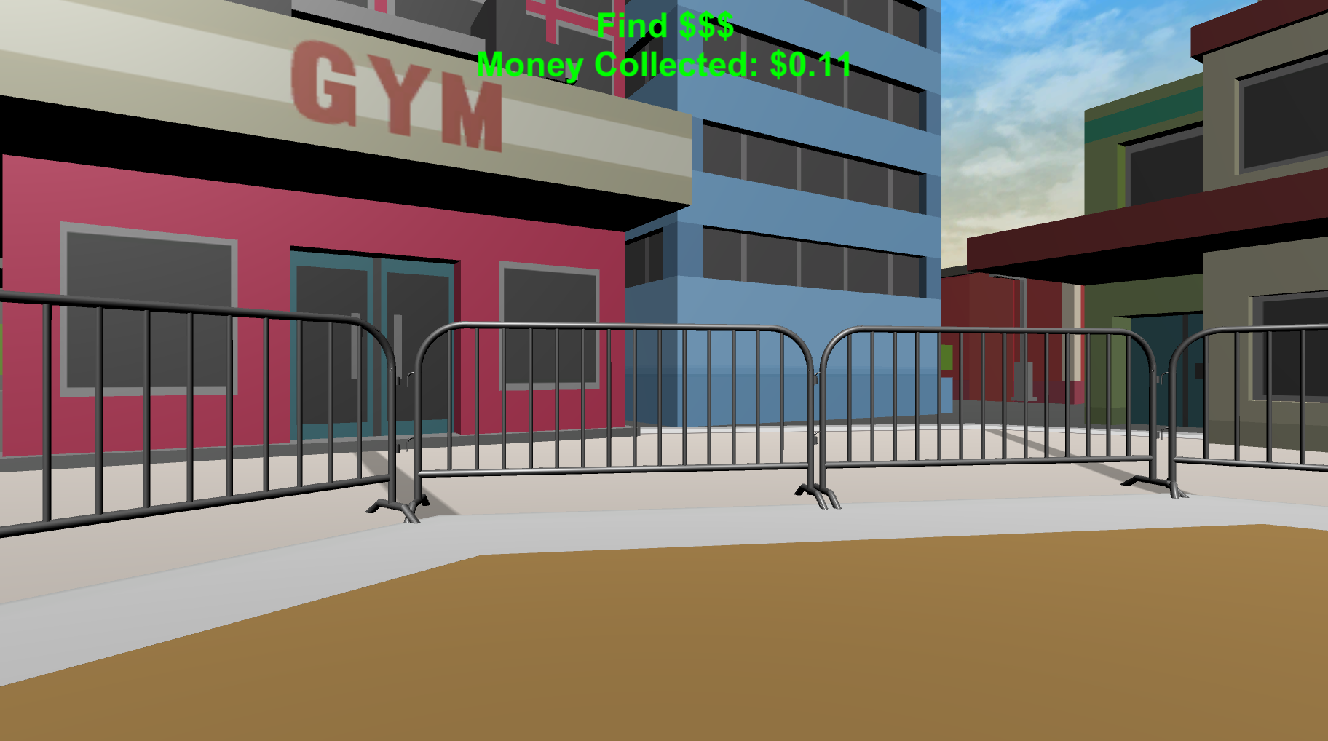

PRACTICE: FINDING MONEY
Now you will practice finding money! The money will be invisible but when you find it you will hear a collection sound and it will be added to your Money Collected for each round which you’ll see at the top of your screen.
Press Spacebar to continue …

Slide 11

You should hear a coin sound every time you collect money.
Let’s make sure everything is working correctly! Keep moving around the environment until you collect $0.25 worth of money! Feel free to adjust your volume as necessary!
Press Spacebar to continue …

Slide 12
PRACTICE: MONEY COLLECTION ROUNDS
Now that you know how to find money, you next task is to collect as much as possible in each of the following Money Collection Rounds.
On each round, you will be placed into the environment at a random location and will have 1-minute to collect as much money as possible!!
Press Spacebar to continue …

Slide 13

PRACTICE: MONEY COLLECTION ROUNDS
Before the start of most rounds you will see the “Search For Money” screen.
During these rounds you will hear a coin sound every time you collect money and you will be able to see how much you’ve collected at the top of the screen!
Note: There is an UNLIMITED amount of money to collect in each round,
so try to collect as much as possible!
Press Spacebar to continue …

Slide 14

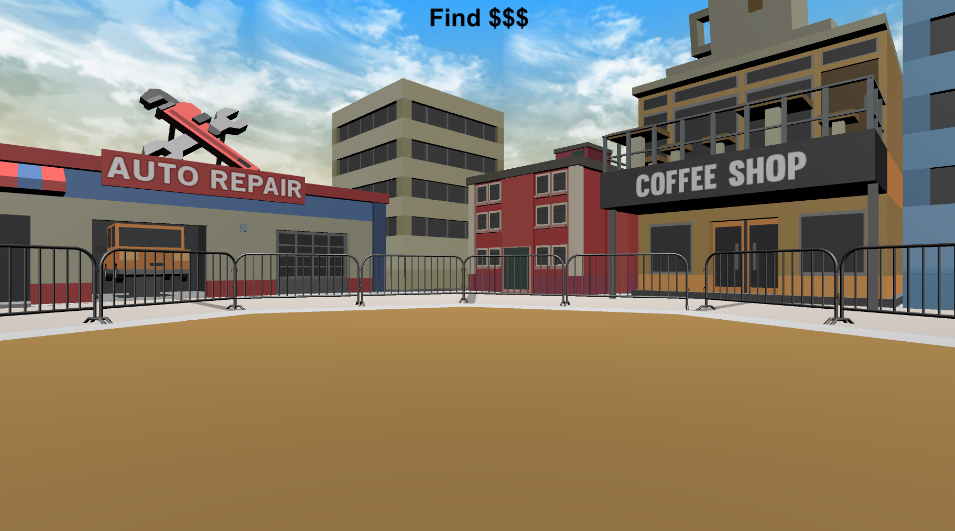
PRACTICE: MONEY COLLECTION ROUNDS
Before the start of some rounds you will see the “Search For Money! NO FEEDBACK” screen.
During these rounds you will NOT hear a coin sound when you collect money and you will NOT be able to see how much you’ve collected!
You will still be collecting money, but you won’t know how much you collected on these rounds until the end of the Experiment!
HINT: Use what you’ve learned from the Feedback Rounds to guide your search!
Press Spacebar to continue …

Slide 15
Let’s try doing a Feedback Round and a No Feedback Round together!
When you’re ready, place your right hand on the arrow keys and press the Spacebar with your left to continue!
Spacebar

Slide 16

Practice on your own!
Do you have any questions about the Feedback and No Feedback rounds?
You will now complete several Feedback and No Feedback rounds on your own. Remember, the better you do during these PRACTICE rounds, the better you will do in BONUS PAY section where you’ll get to keep all the money you collect!
At the end of this section you will be instructed to notify the experimenter, any last questions?
Press Spacebar to continue …

Slide 17


Search For Money!

Slide 18
Search For Money! NO FEEDBACK

Slide 19
Great job!
You’ve completed the PRACTICE section!
PLEASE NOTIFY THE EXPERIMENTER!!!
let’s move on to the BONUS PAY section!
Practice
Bonus Pay
Find The Trophy
Experiment Survey
press Spacebar to continue …

Slide 20
The three slides below are for the version with threshold. You can ignore them for now.

Slide 21

BONUS PAYMENT
There is an UNLIMITED amount of money to collect in each round. You need to collect XXX in at least 3 out of 12 rounds to proceed to the next phase of the experiment. The money you collect you will receive as a BONUS PAYMENT at the end of the experiment! So try to collect as much as possible on each round!

Slide 22
You reached the threshold!
Please notify the Experimenter.

Slide 23

Unfortunately, you didn't reach threshold.
Please notify the Experimenter.

