Slide 1
Session 1 Overview
C
This session has 2 main sections:
Practice – Learn how to navigate in a virtual environment and collect money
Bonus Pay – All the money you collect in this section you will keep
Please make sure to listen to each instruction carefully and wait for the experimenter to instruct you to proceed to the next instruction.
Don’t be afraid to ask questions if you need clarification!
Do you have any questions?

Slide 2
Section 1: Practice
In this section you will explore a 3D environment and learn how to find hidden money!
Do you have any questions?

Slide 3
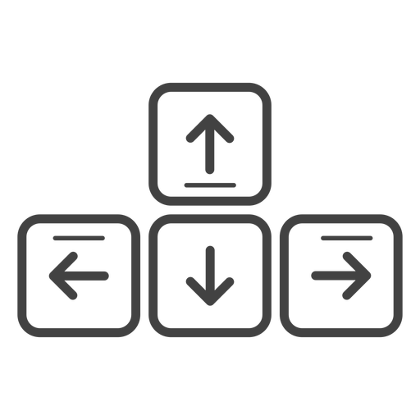
Movement Controls
The movement controls are very easy!
You’ll use the Up-Arrow to move forward, and the left and right arrow-keys to rotate.
Move Forward
Rotate
Left
Rotate
Right
Do you have any questions?

Slide 4
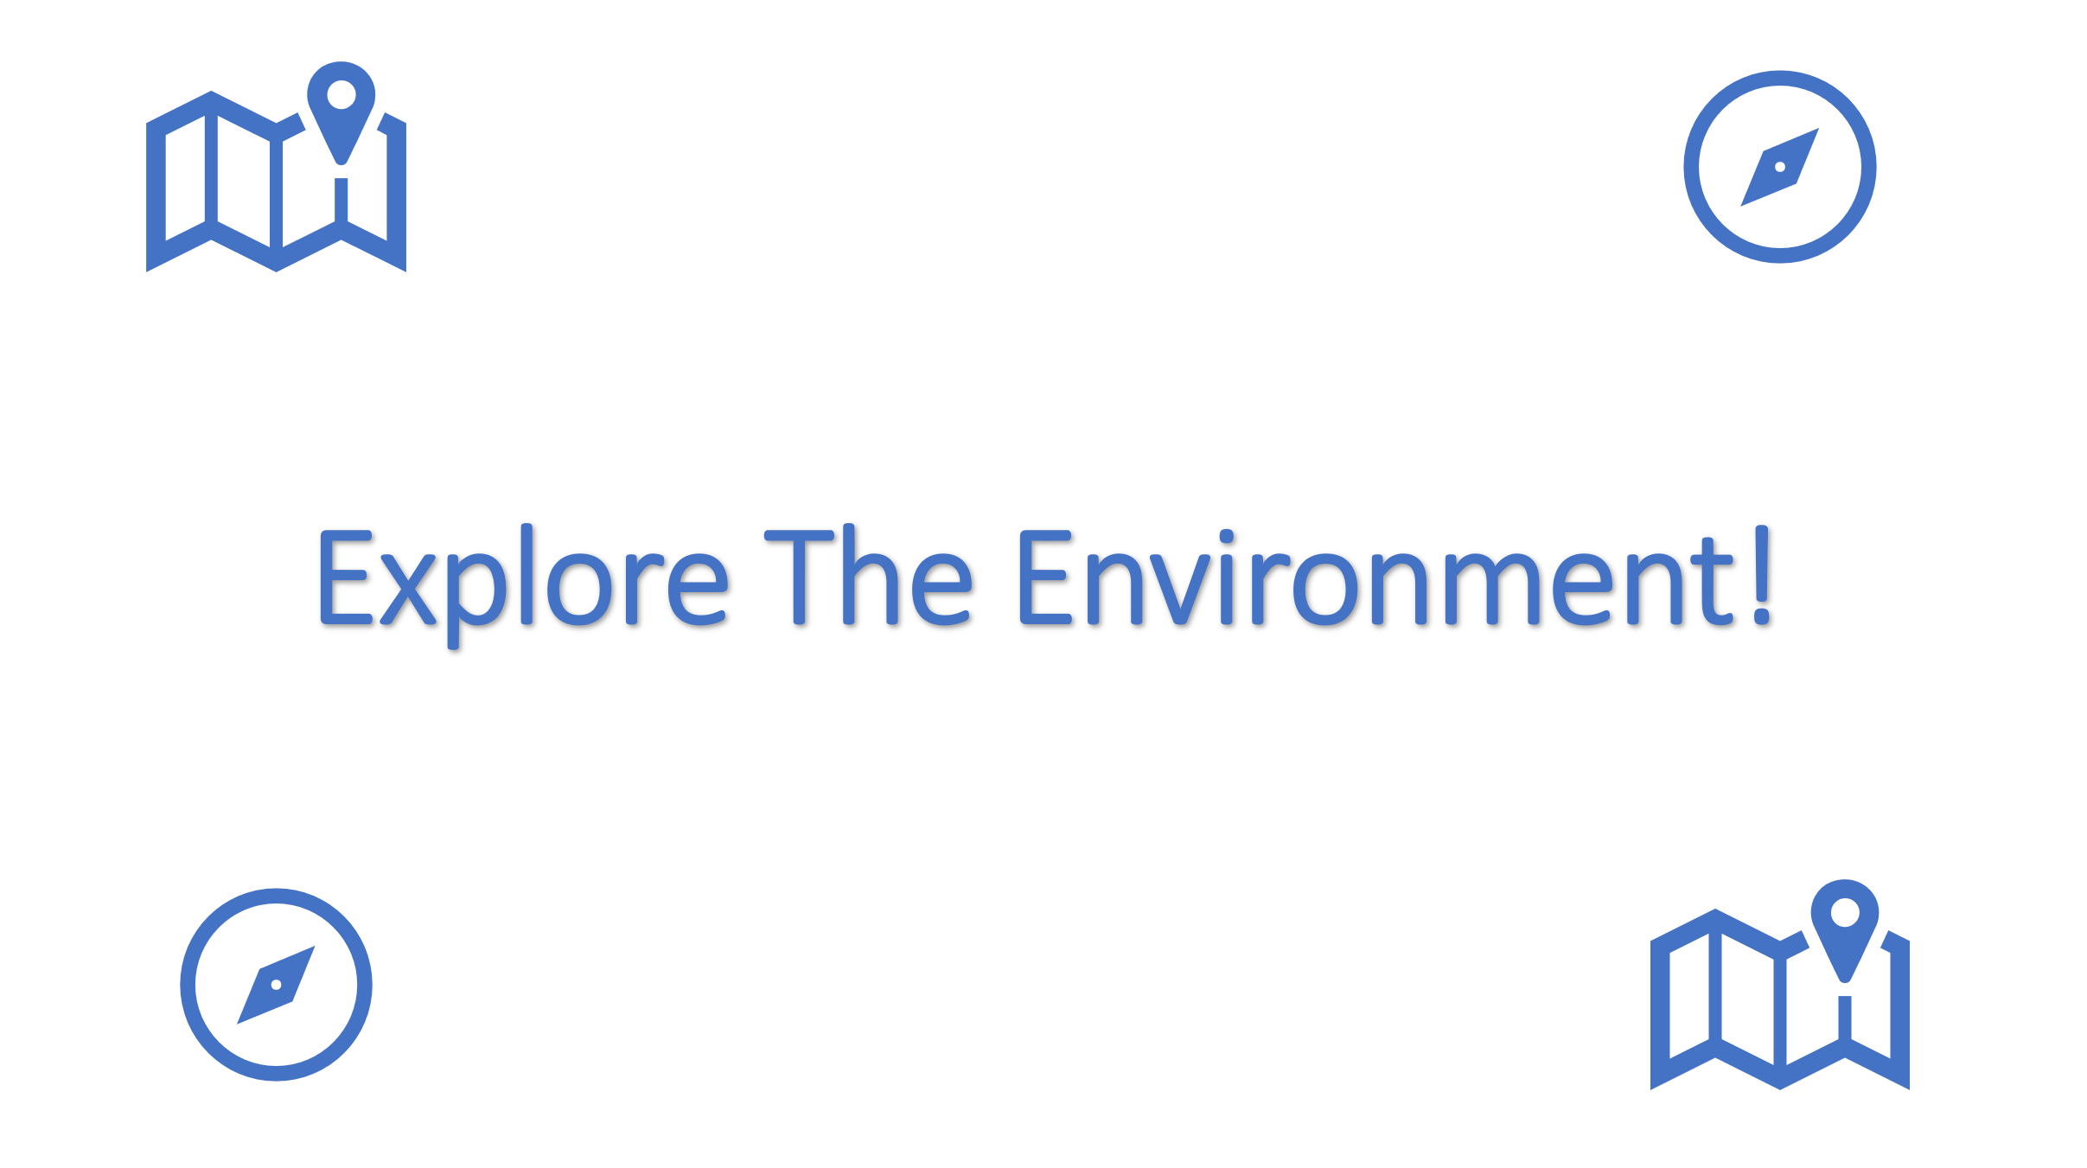
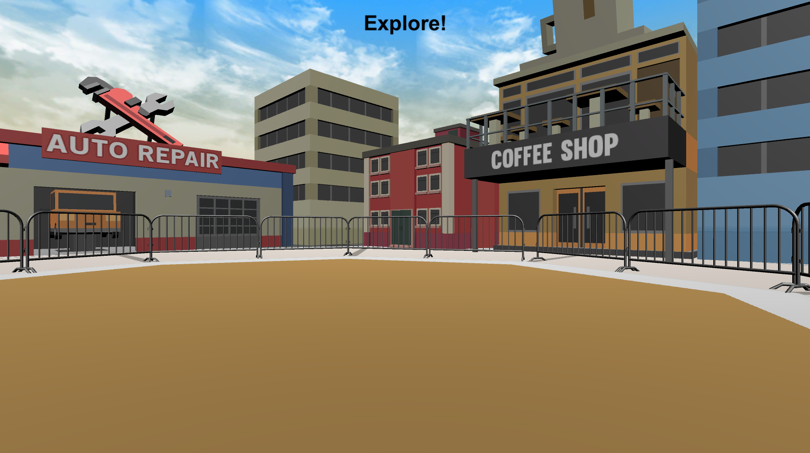
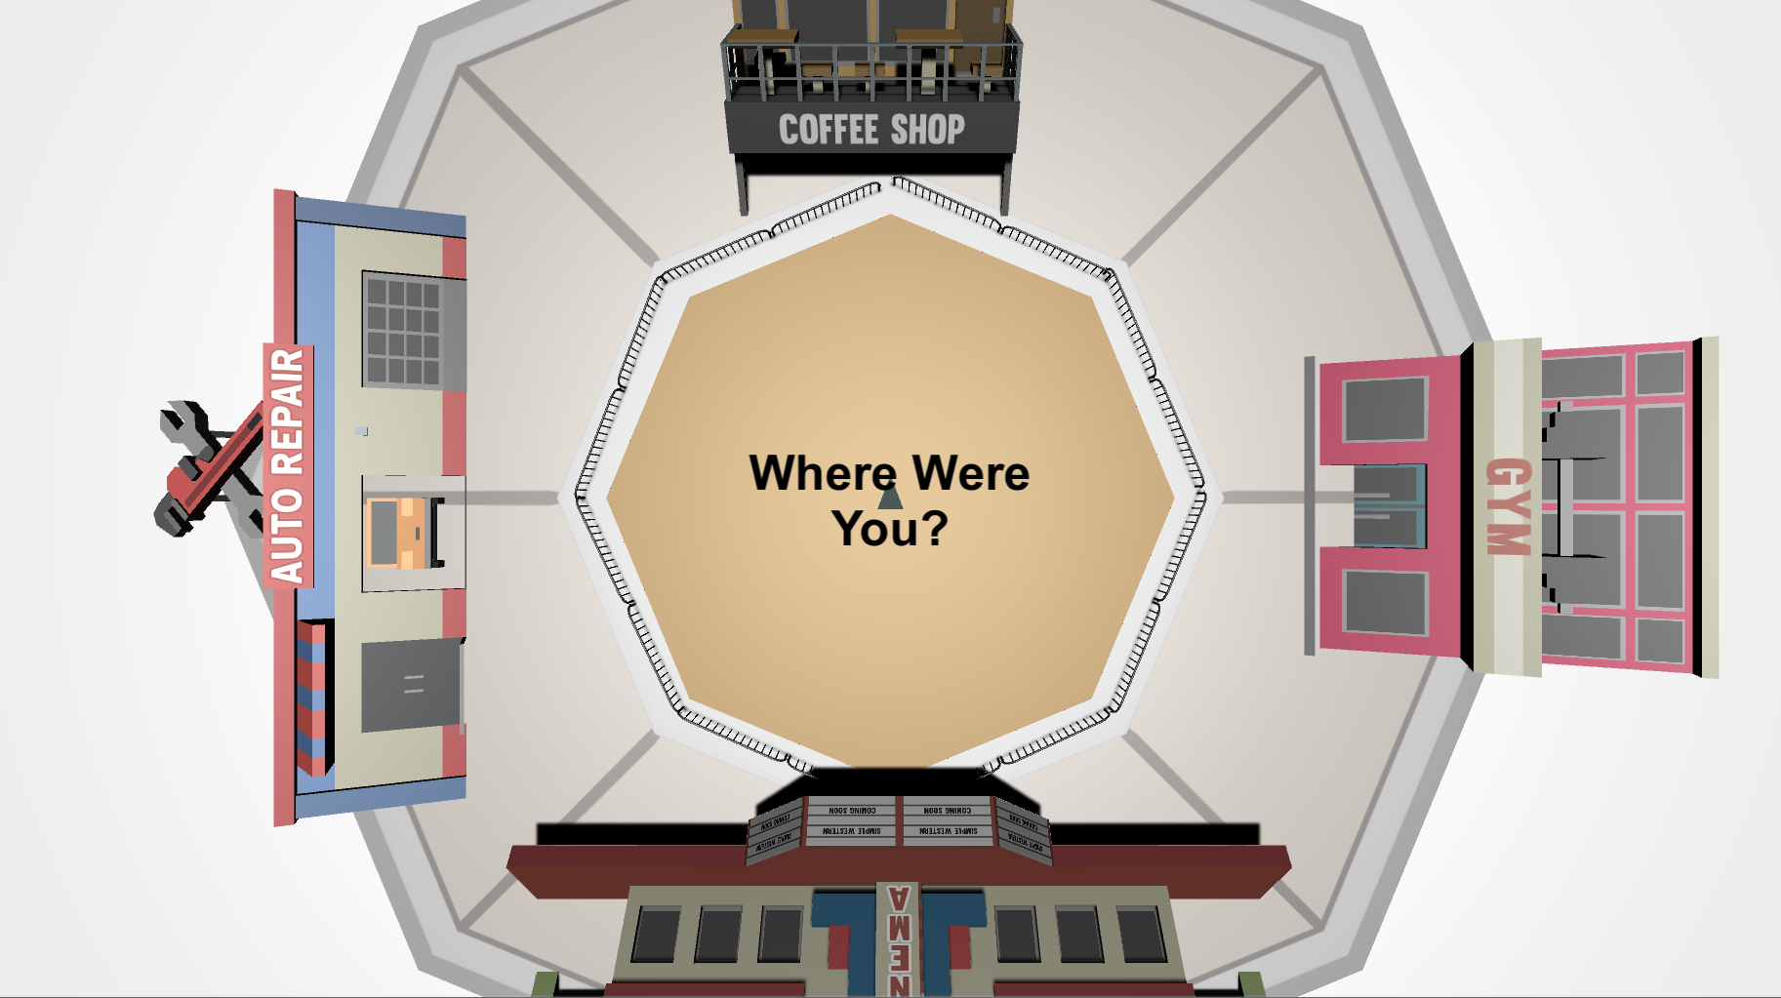
EXPLORE THE ENVIRONMENT
Let’s practice moving around the environment by doing some Explore Rounds (There is no hidden money in these rounds!).
At the start of each round you will see the Explore The Environment screen. Then you will have 30 seconds to explore the 3D Environment. After 30 seconds a Top-Down Map will appear. Move the gray triangle on the map to where you think you were using the same controls. then press the Spacebar to begin the next round!
3D Environment (30 Seconds)
Top-Down Map
Do you have any Questions?

Slide 5
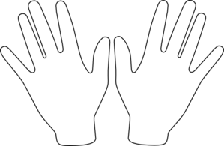
Ready?
When you’re ready, place your right hand on the arrow keys and press the Spacebar with your left to continue!
Spacebar

Slide 6


Explore The Environment!

Slide 7
Great Work!
Notify the Experimenter that you’ve completed this section

Slide 8
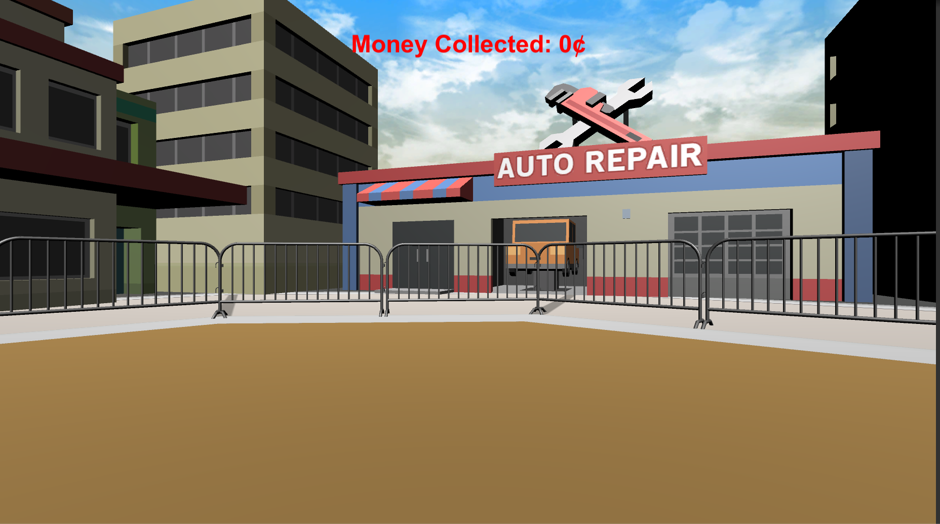

Collecting Money
Now you will practice collecting money! The money will be invisible but when you find it you will hear a coin sound and it will be added to your Money Collected at the top of the screen
Do you have any questions?

Slide 9

Please make sure your headphones or speakers are on. You should hear a coin sound every time you collect money.
Let’s make sure everything is working correctly! Keep moving around the environment until you collect 10¢
Do you have any questions?

Slide 10


Money Collection Rounds
Your next task is to collect as much as possible in each of the following Money Collection Rounds. On each round, you will be placed into the environment at a random location.
Once you’re in the environment you will have 1-minute to collect as much money as possible!!
1 Minute
Do you have any questions?

Slide 11
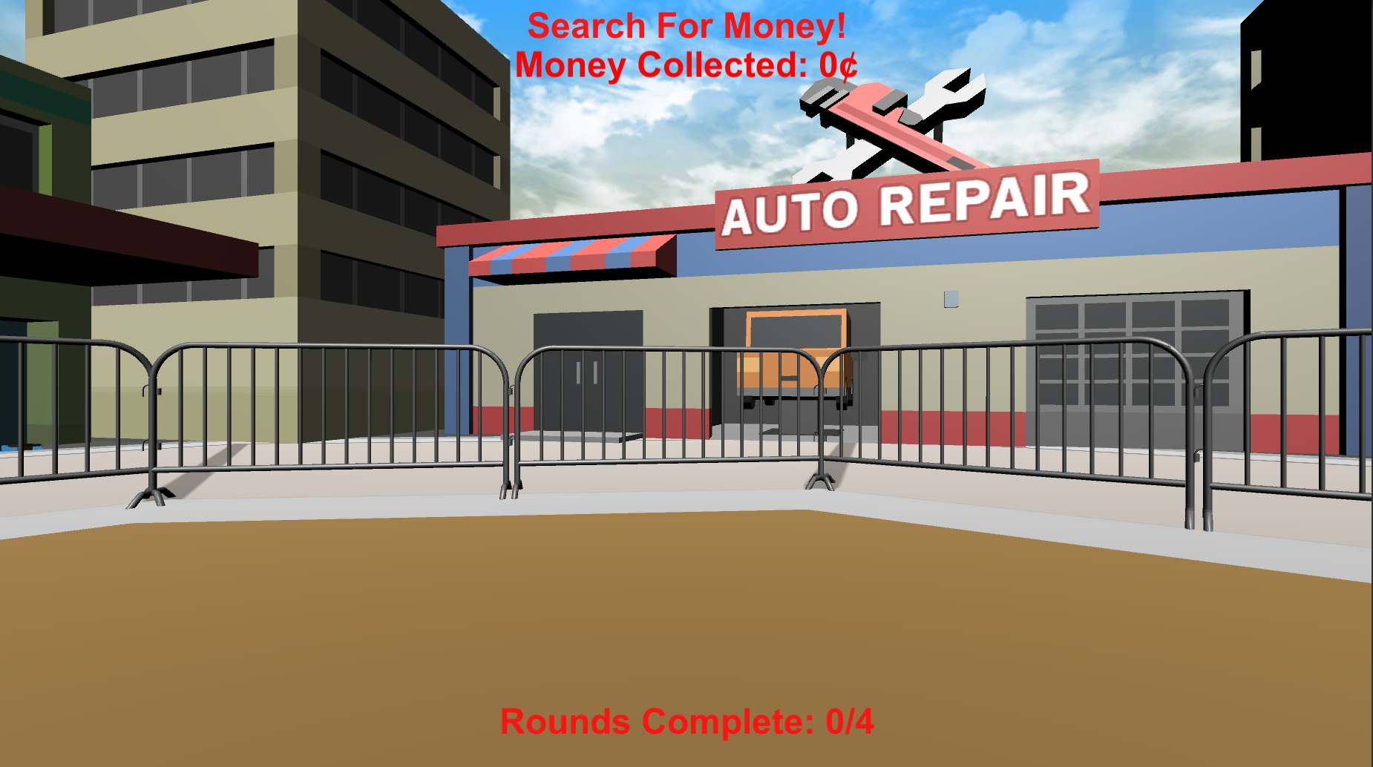
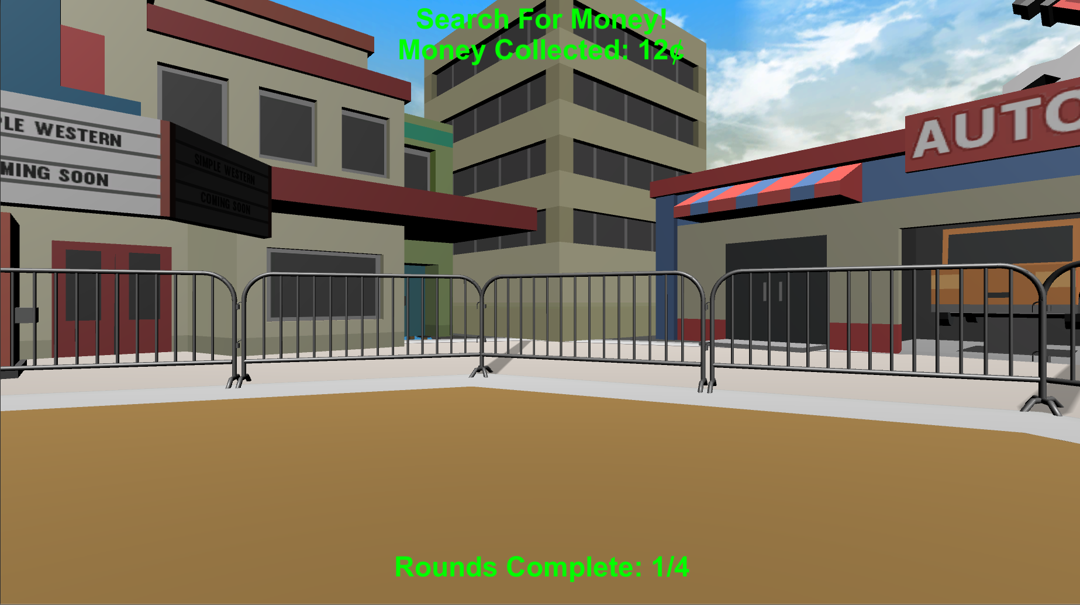
Your Goal
In order to move on to the Bonus Section, you will need to find at least 10¢ in 4 of the next 16 rounds. Whenever you reach 10¢ during a round a point will be added to your Rounds Complete total at the bottom of the screen, and the text will change from Red to Green
Less than 10¢
10¢ or more
Do you have any questions?

Slide 12

Feedback Rounds
At the start of most rounds you will see the “Search For Money” screen.
During these rounds you will hear a coin sound every time you collect money and you will see your Money Collected at the top of the screen. When you reach 10¢ on these rounds the Money Collected text will change from Red to Green and you will receive a Rounds Complete point.
Less than 10¢
10¢ or more
Do you have any questions?

Slide 13

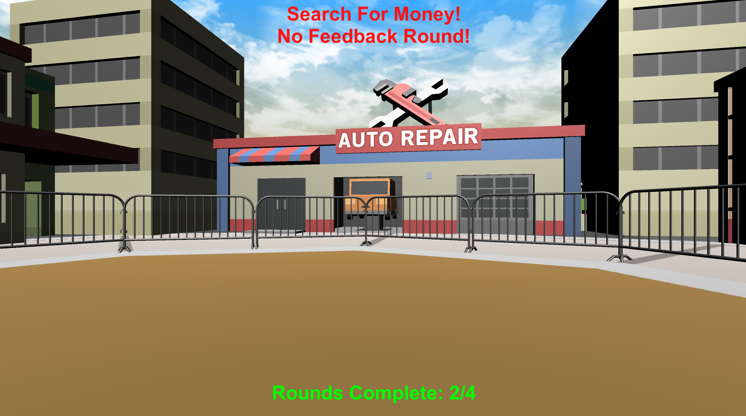


No Feedback Rounds
At the start of some rounds you will see the “Search For Money! NO FEEDBACK” screen.
During these rounds you will NOT hear a coin sound when you collect money and you will NOT be able to see how much you’ve collected! When you reach 10¢ on these rounds the Money Collected text will remain Red and a point will be added to your Rounds Complete total.
Less than 10¢
10¢ or more
HINT: Use what you’ve learned from the Feedback Rounds to guide your search!
Do you have any questions?

Slide 14
Let’s try doing a Feedback Round and a No Feedback Round together!
When you’re ready, place your right hand on the arrow keys and press the Spacebar with your left to continue!
Spacebar

Slide 15

Do you have any questions about the Feedback and No Feedback rounds?
You will now complete the remaining rounds on your own. Remember, you must collect at least 10¢ on 4 rounds in order to move on to the Bonus Section of the experiment.
However, there is an unlimited amount of money in each round so try to collect as much as possible! the better you do during this Practice Section, the better you will do in the Bonus Section.
At the end of this section you will be instructed to notify the experimenter
Do you have any questions?

Slide 16
Great job!
You’ve completed the PRACTICE section!
PLEASE NOTIFY THE EXPERIMENTER!!!
let’s move on to the BONUS PAY section!
Practice
Bonus Pay

Slide 17

Unfortunately, you did not complete enough rounds to move on to the Bonus Section
Please notify the Experimenter

Slide 18


Search For Money!

Slide 19
Search For Money! NO FEEDBACK

Slide 20
Welcome!
Please make sure:
You will Not be distracted for the entire duration of the session
Your cell phone is turned off
Your computer is plugged in
Please confirm your Participant ID and Session # with the experimenter before pressing the Start Experiment button.

Slide 21
Session 1 Overview
S
This session has 2 main sections:
Practice – Learn how to navigate in a virtual environment and collect money
Bonus Pay – All the money you collect in this section you will keep
Please make sure to listen to each instruction carefully and wait for the experimenter to instruct you to proceed to the next instruction.
Don’t be afraid to ask questions if you need clarification!
Do you have any questions?

