Slide 1
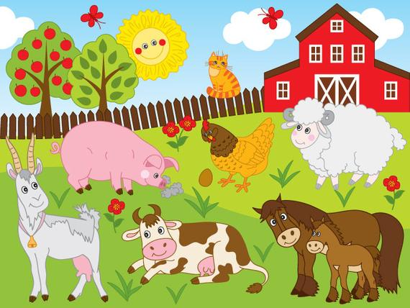
Welcome to the Farm!
PRESS SPACE TO CONTINUE

Slide 2
The animals are hungry, and we need you to feed them! Walk up to the animal to feed them! When you feed them, they will thank you with a sound!
BAHH!!
Oink Oink!!
MOO!!
PRESS SPACE TO CONTINUE

Slide 3

To move around the environment use the mouse to look around and the press the left mouse button to move forward
PRESS SPACE TO CONTINUE

Slide 4

When your ready hold the mouse and press the spacebar!
SPACE BAR

Slide 5
10 Second Rounds

Slide 6
15 Second Rounds

Slide 7
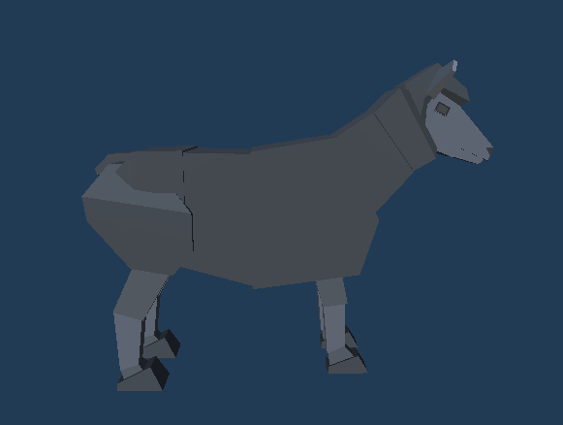
Feed the Sheep!

Slide 8
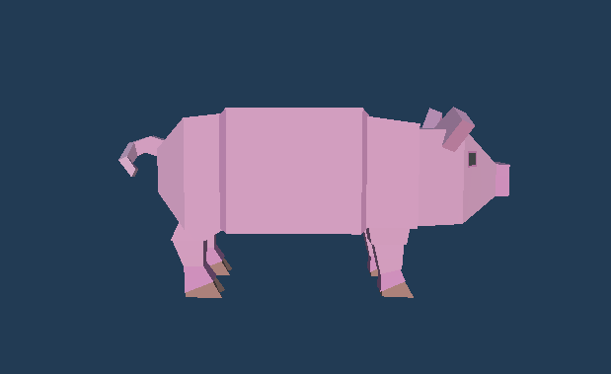
Feed the Pig!

Slide 9
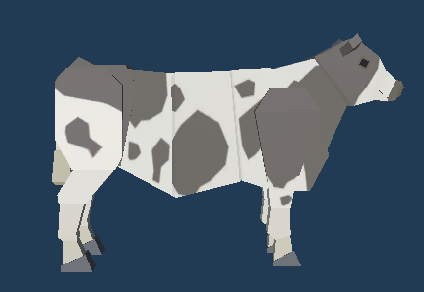
Feed the cow!

Slide 11
Great job! You fed all the animals!

