Slide 1
Section 2: BONUS PAY!
In this section you will use what you learned in the practice section to collect as much money as possible in a new environment!
The money you collect during this section will be counted towards your bonus payment!!
Do you have any questions?

Slide 2
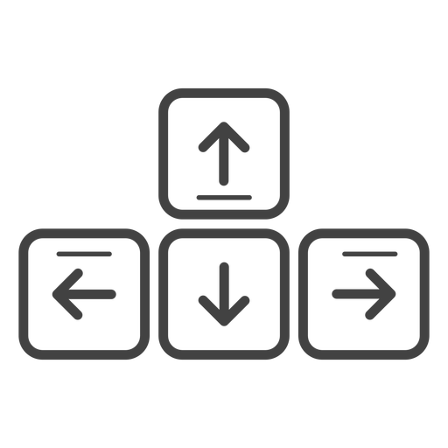
The movement controls are very easy!
You’ll use the Up-Arrow to move forward, and the left and right arrow-keys to rotate.
Move Forward
Rotate
Left
Rotate
Right
Do you have any questions?

Slide 3

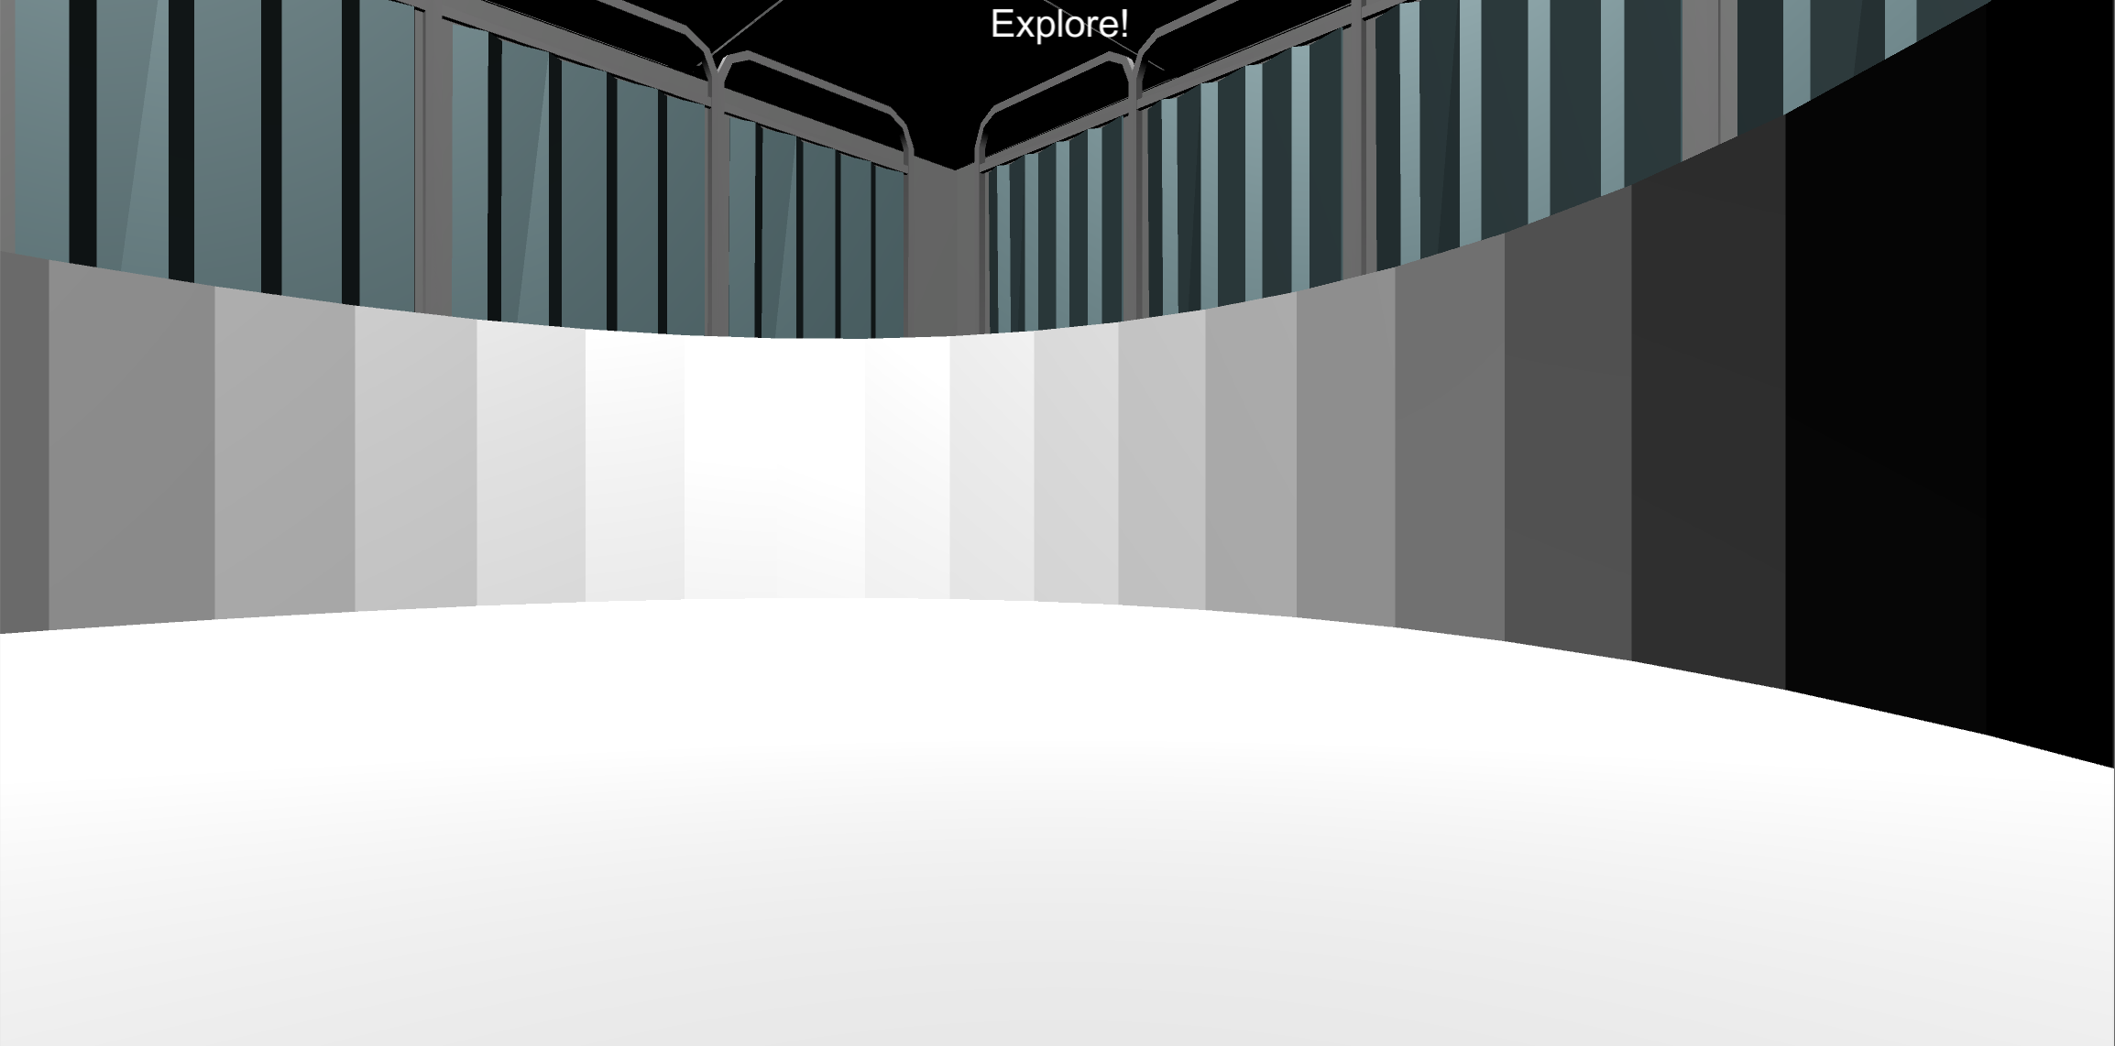
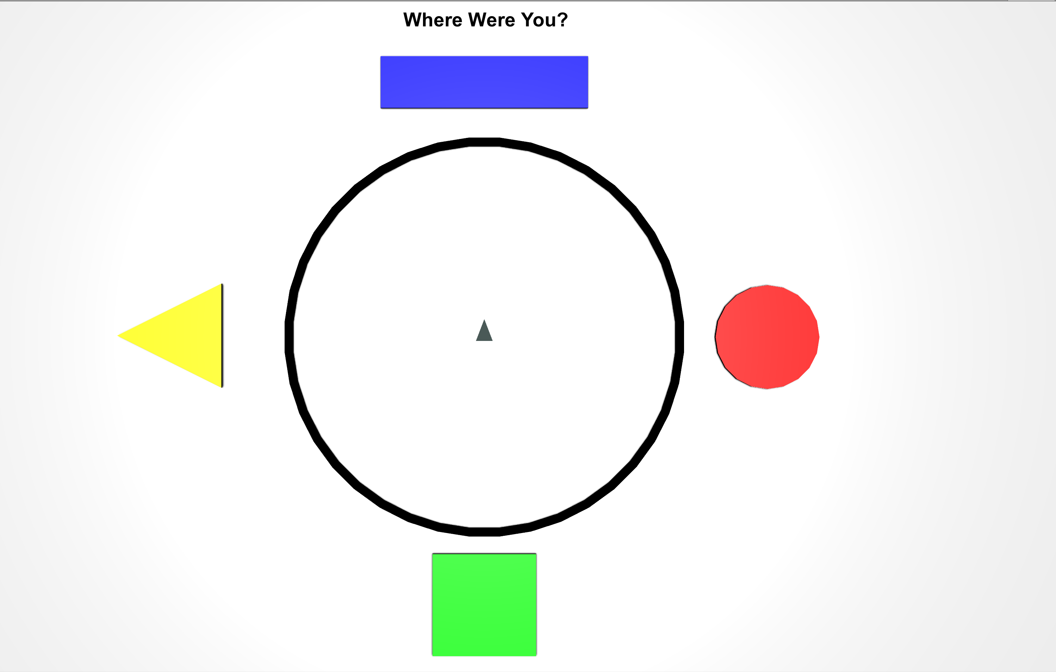
Let’s practice moving around the environment by doing some Explore Rounds (There is no hidden money in these rounds!).
At the start of each round you will see the Explore The Environment screen. Then you will have 30 seconds to explore the 3D Environment. After 30 seconds a Top-Down Map will appear. Move the gray triangle on the map to where you think you were using the same controls. then press the Spacebar to begin the next round!
3D Environment (30 Seconds)
Top-Down Map
Do you have any Questions?

Slide 4
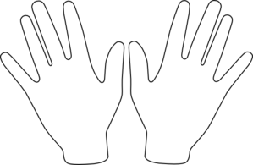
When you’re ready, place your right hand on the arrow keys and press the Spacebar with your left to continue!
Spacebar

Slide 5


Explore The Environment!

Slide 6
Great Work!
Notify the Experimenter that you’ve completed this section

Slide 7
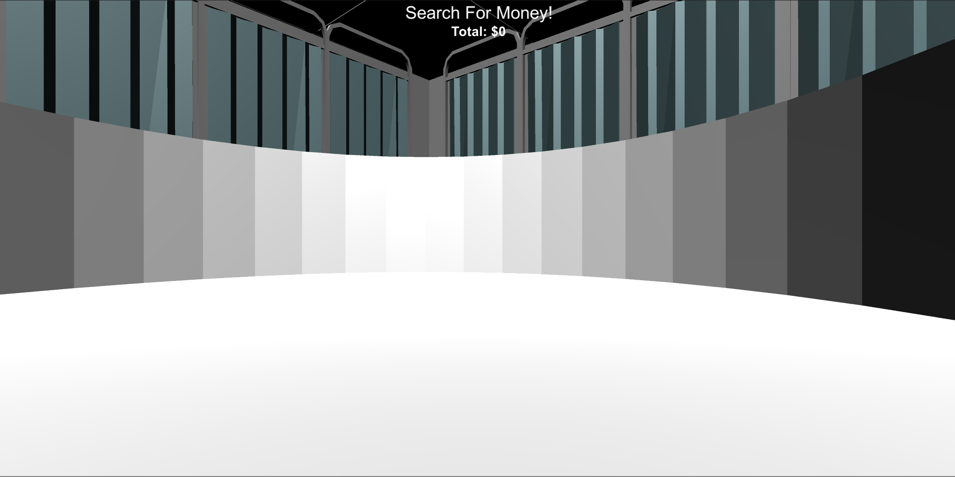

BONUS PAY: FINDING MONEY
Now let’s collect money!! Just like in the practice section, the money will be invisible but when you find it you will hear a collection sound and it will be added to the Money Collected total at the top of the screen.
Money Collected
Find 10¢
Money Collected: $ 0
Do you have any Questions?

Slide 8

Please make sure your headphones or speakers are on. You should hear a coin sound every time you collect money.
Let’s make sure everything is still working correctly! Keep moving around the environment until you collect 10¢ worth of money! Adjust the volume as necessary!
Do you have any questions?

Slide 9
BONUS PAY: MONEY COLLECTION ROUNDS
You next task is to collect as much as possible in each of the following Money Collection Rounds. On each round, you will be placed into the environment at a random location.
Once you’re in the environment you will have 1-minute to collect as much money as possible!!
Find $$$
Money Collected: $ 0
Do you have any questions?

Slide 10
BONUS PAY: MONEY COLLECTION ROUNDS
You next task is to collect as much as possible in each of the following Money Collection Rounds. On each round, you will have 1-minute to collect as much money as possible!!
Find $$$
Money Collected: $ 0
For each round, you will need to collect at least 10¢ to have the amount from the round added to your final BONUS PAYMENT at the end of the experiment! So try to collect as much as possible on each round!
Do you have any questions?

Slide 11

BONUS PAY: FEEDBACK ROUNDS
Before the start of most rounds you will see the “Search For Money” screen.
During these rounds you will hear a coin sound every time you collect money and you will be able to see how much you’ve collected at the top of the screen!
Finding $$$
Money Collected: $ 0
Do you have any questions?

Slide 12

BONUS PAY: NO FEEDBACK ROUNDS
Before the start of some rounds you will see the “Search For Money! NO FEEDBACK” screen.
During these rounds you will NOT hear a coin sound when you collect money and you will NOT be able to see how much you’ve collected!
You will find out how much you collected on these rounds at the very end of the experiment!
HINT: On these rounds, use what you’ve learned from previous rounds to guide your search!
Do you have any questions?

Slide 13
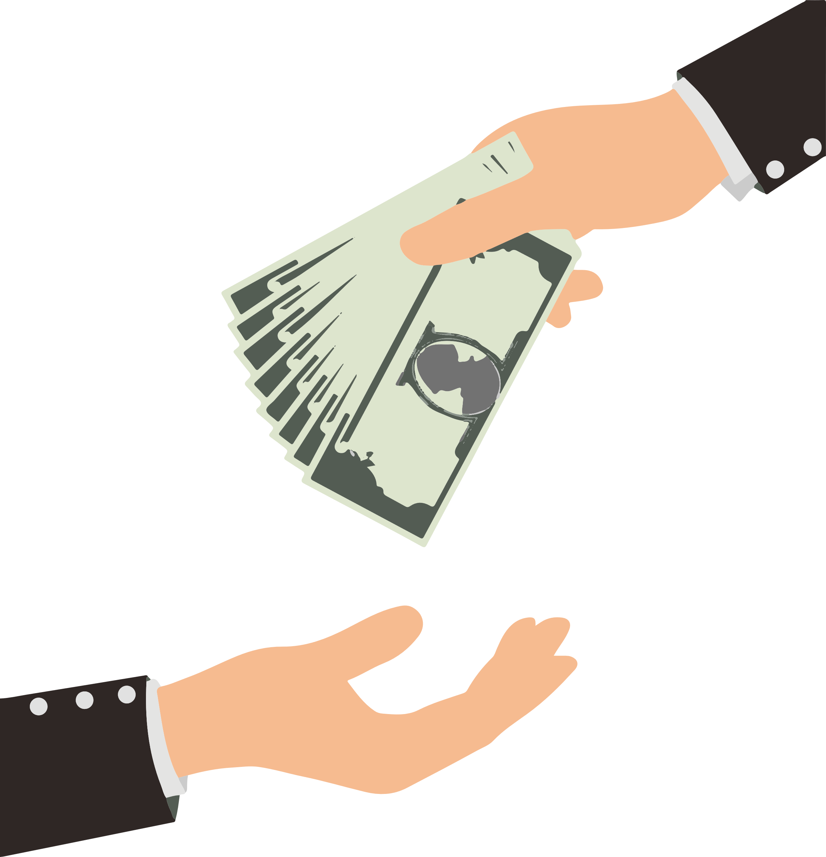
BONUS PAYMENT
There is an UNLIMITED amount of money to collect in each round. The money you collect in each round will be counted towards your BONUS PAYMENT! The more you collect the more bonus you will receive!!!
Do you have any questions?

Slide 14


Search For Money!

Slide 15
Search For Money! NO FEEDBACK

Slide 16
Break Time!
Feel free to take a break if you need to.
When you’re ready, place your right hand on the arrow keys and press the spacebar with your left to continue!
Spacebar

Slide 17
Great job!
You’ve completed the BONUS PAY section!
Practice
Bonus Pay
Find The Trophy
Survey
Next, you’ll complete the Find The Trophy task! Feel free to take a quick break before moving on!
Do you have any questions?

Slide 18
Ignore the last slide: for threshold bonus only

Slide 19
BONUS PAYMENT
There is an UNLIMITED amount of money to collect in each round. However, for each round, you will need to collect at least 10¢ to have the amount from the round added to your final BONUS PAYMENT at the end of the experiment! So try to collect as much as possible on each round!
Do you have any questions?

