Slide 1
Section 2: Find The Trophy!

Slide 2
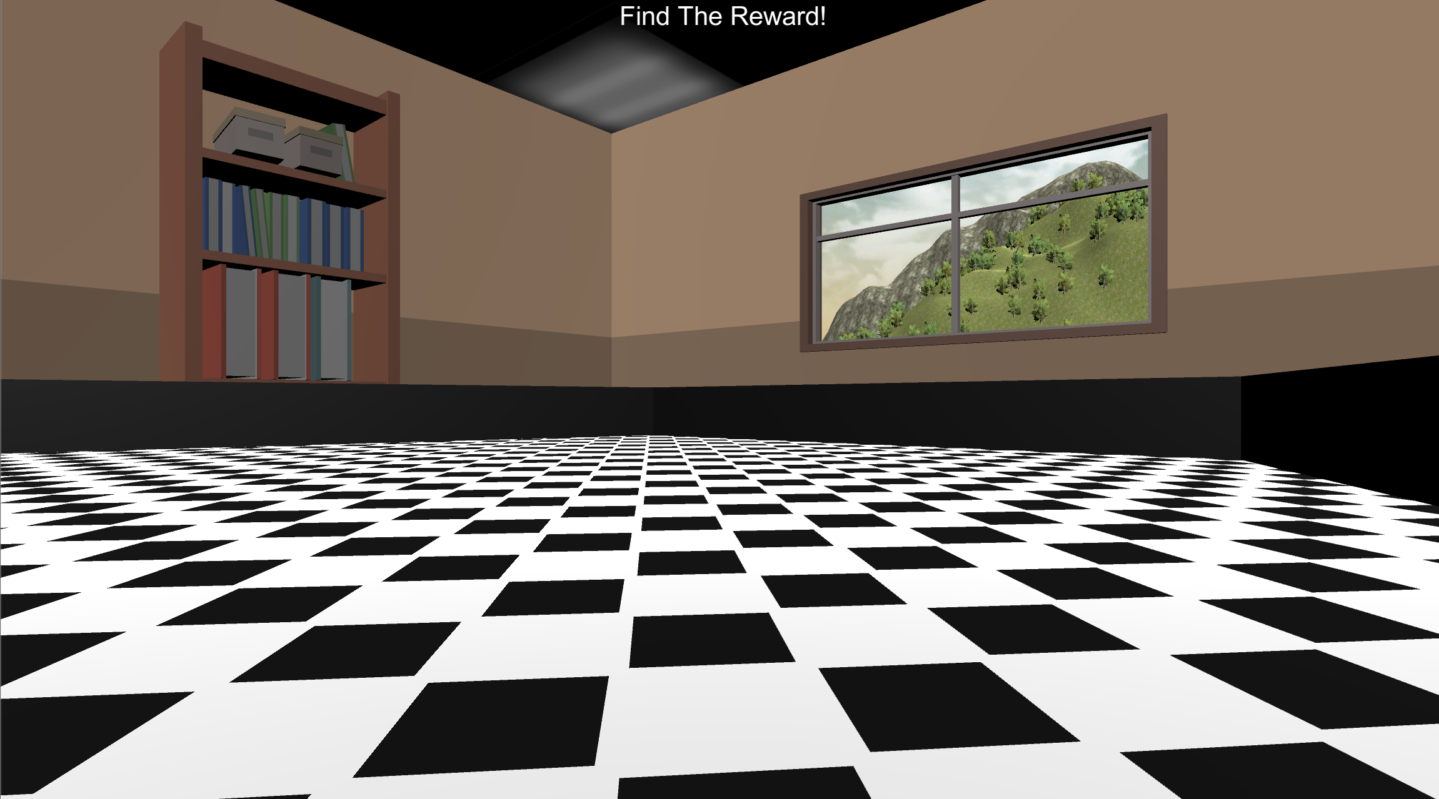
FIND THE TROPHY!
In this task, your job is to navigate the environment pictured below and Find The Trophy as fast as you can!
Do you have any questions?

Slide 3

MOVEMENT CONTROL
The movement controls are the same as before.
You’ll use the Up-Arrow to move forward, and the left and right arrow-keys to rotate.
Move Forward
Rotate
Left
Rotate
Right
Do you have any questions?

Slide 4

FIND THE TROPHY!
In this round, you will see the “Find The Trophy!” Screen and then you will be placed into the environment at a random location. Your job is to collect the trophy as fast as you can by running into it!
Do you have any questions?

Slide 5

Ready?
Place your right hand on the arrow keys and press the Spacebar with your left to continue!
Spacebar

Slide 6
INVISIBLE ROUNDS
Now that you know where the trophy can be found you will need to locate it when it's invisible. On each round, you will first see the “Find The Trophy!” screen and then you will be placed into the environment at a random location. When you find the trophy you will hear a sound and the round will end.
The faster you find the Trophy, the more Bonus Pay you’ll earn! You’ll find out how much Bonus you’ve earned at the end of the experiment!
Do you have any questions?

Slide 7
GREAT JOB!!
You earned $5 in Bonus Payment this Session!!
Bonus Pay
Find The Trophy
Survey
Please notify the experimenter!
Do not press the survey button below until the experimenter instructs you to.

Slide 8

FIND THE TROPHY!

