Slide 1
Section 2: BONUS PAY!
In this section you will use what you learned in the practice section to collect as much money as possible in a new environment!
The money you collect during this section will be counted towards your bonus payment!!
Press Spacebar to continue …

Slide 2
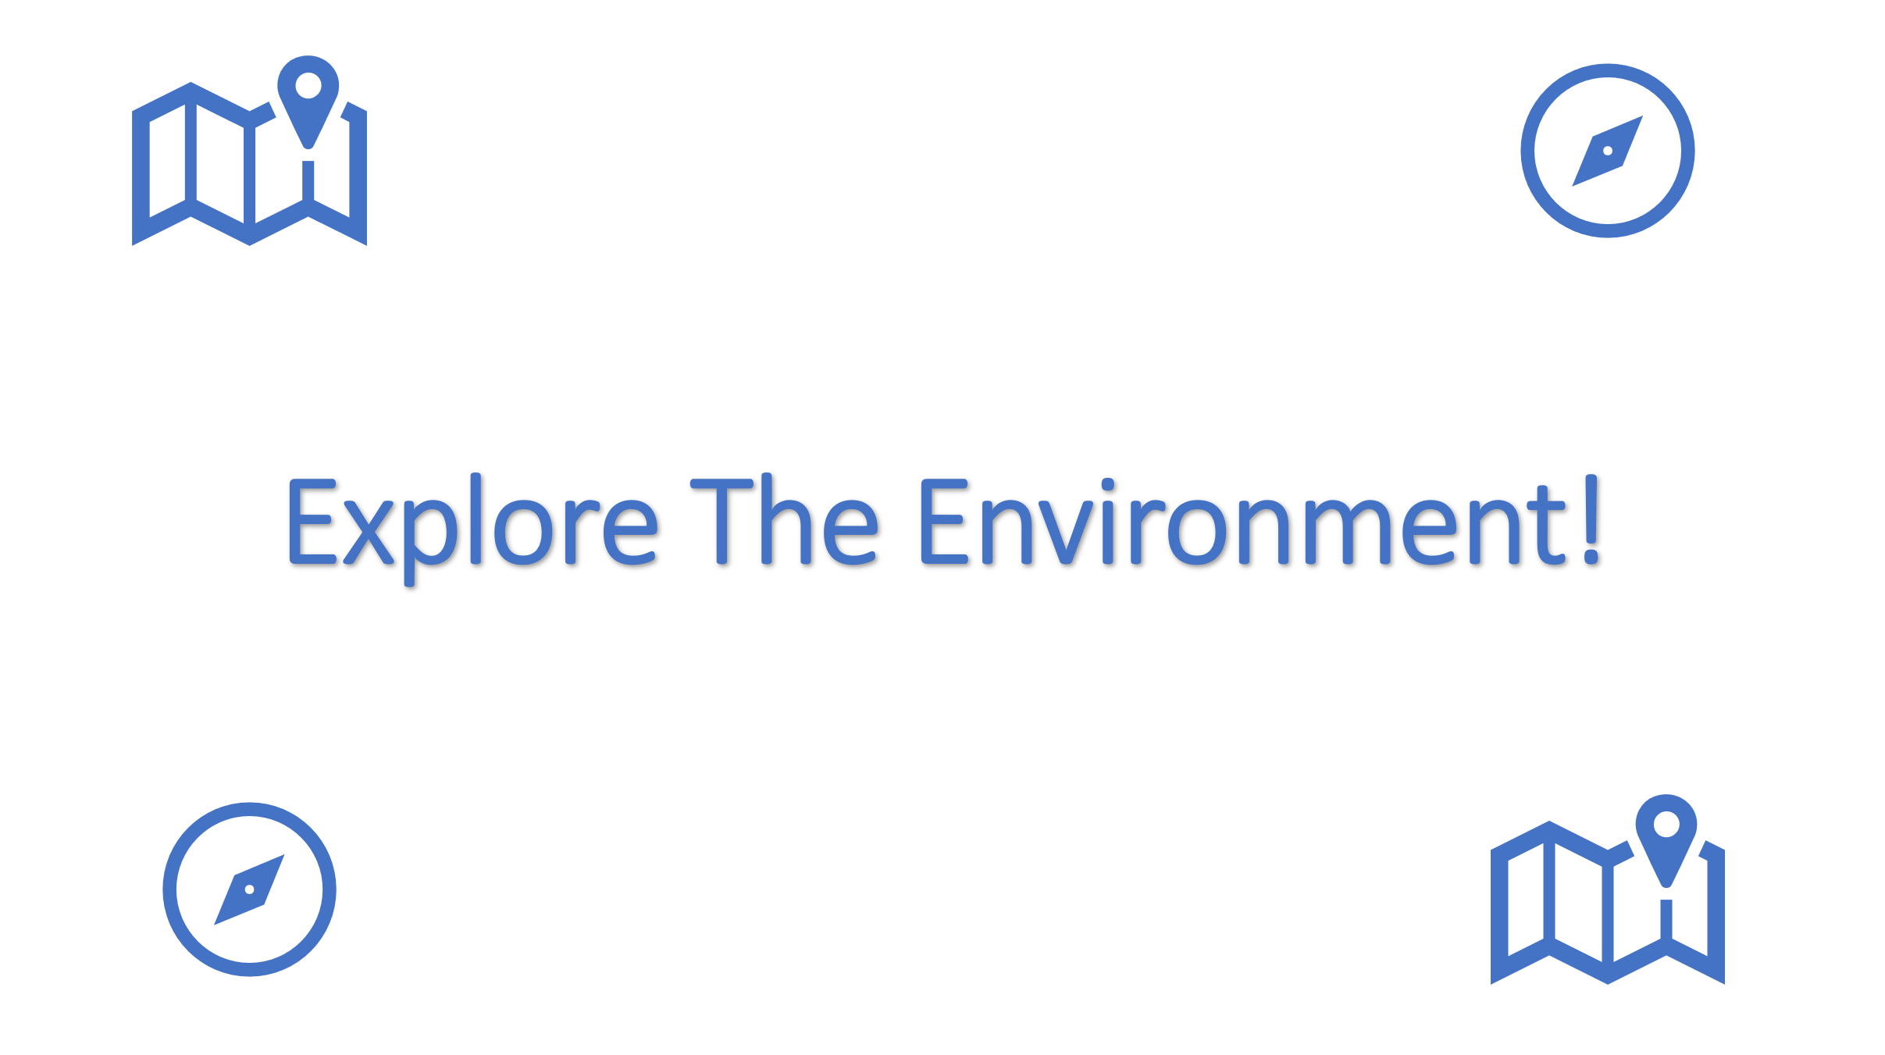
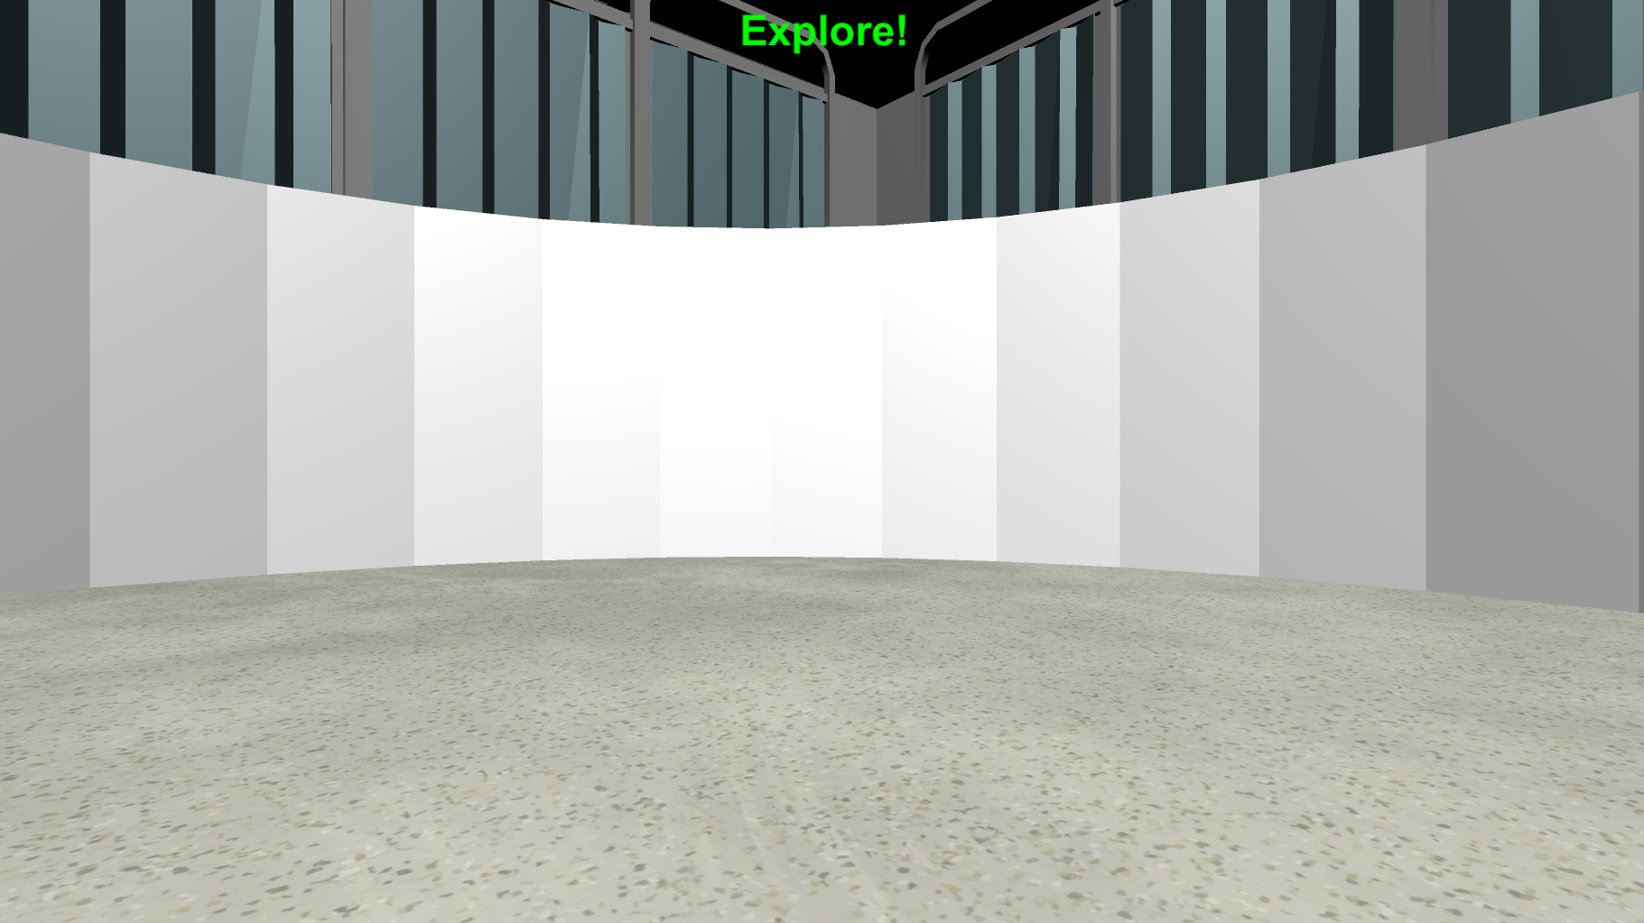
BONUS PAY: Explore the Environment
Before looking for money, you will have the opportunity to explore the environment. On each Explore Round you will see the Explore The Environment screen (left bottom) and then you will be placed into the environment at a random location (right bottom). There is no money to collect in these rounds, so just move around and learn as much as you can about the environment.
Press Spacebar to continue …

Slide 3
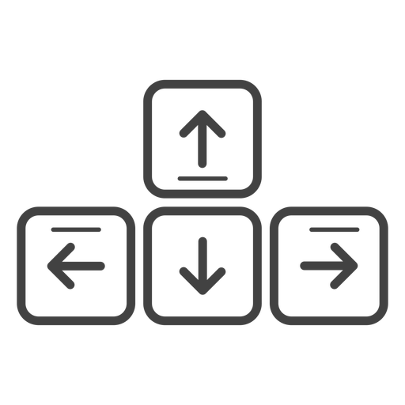
MOVEMENT CONTROLS
The movement controls are the same as in the practice round. Use the Up-Arrow to move forward, and the left and right arrow-keys to rotate.
Move Forward
Rotate
Left
Rotate
Right
Press Spacebar to continue …

Slide 4
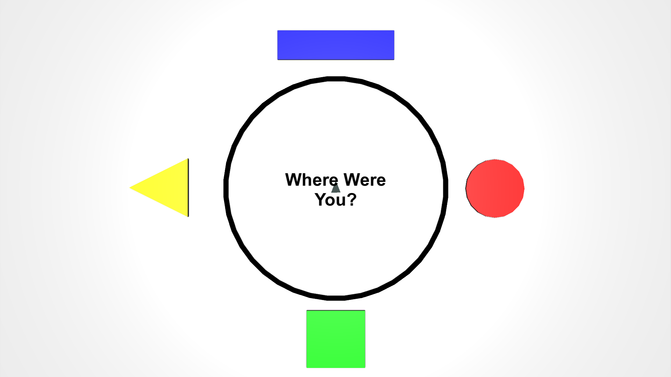
TOP-DOWN VIEW
While exploring the environment, you will be asked periodically to locate where you were from a top-down viewpoint like the picture below.
The grey triangle in the middle shows the direction that you’re facing, and the controls are the same as the 3D environment. Move the grey triangle to the last position you were in, in the 3D environment, and then press the Spacebar.
Press Spacebar to continue …

Slide 5

When you’re ready, place your right hand on the arrow keys and press the Spacebar with your left to continue!
Spacebar

Slide 6


Explore The Environment!

Slide 7
Great Work!
Press Spacebar to continue …

Slide 8
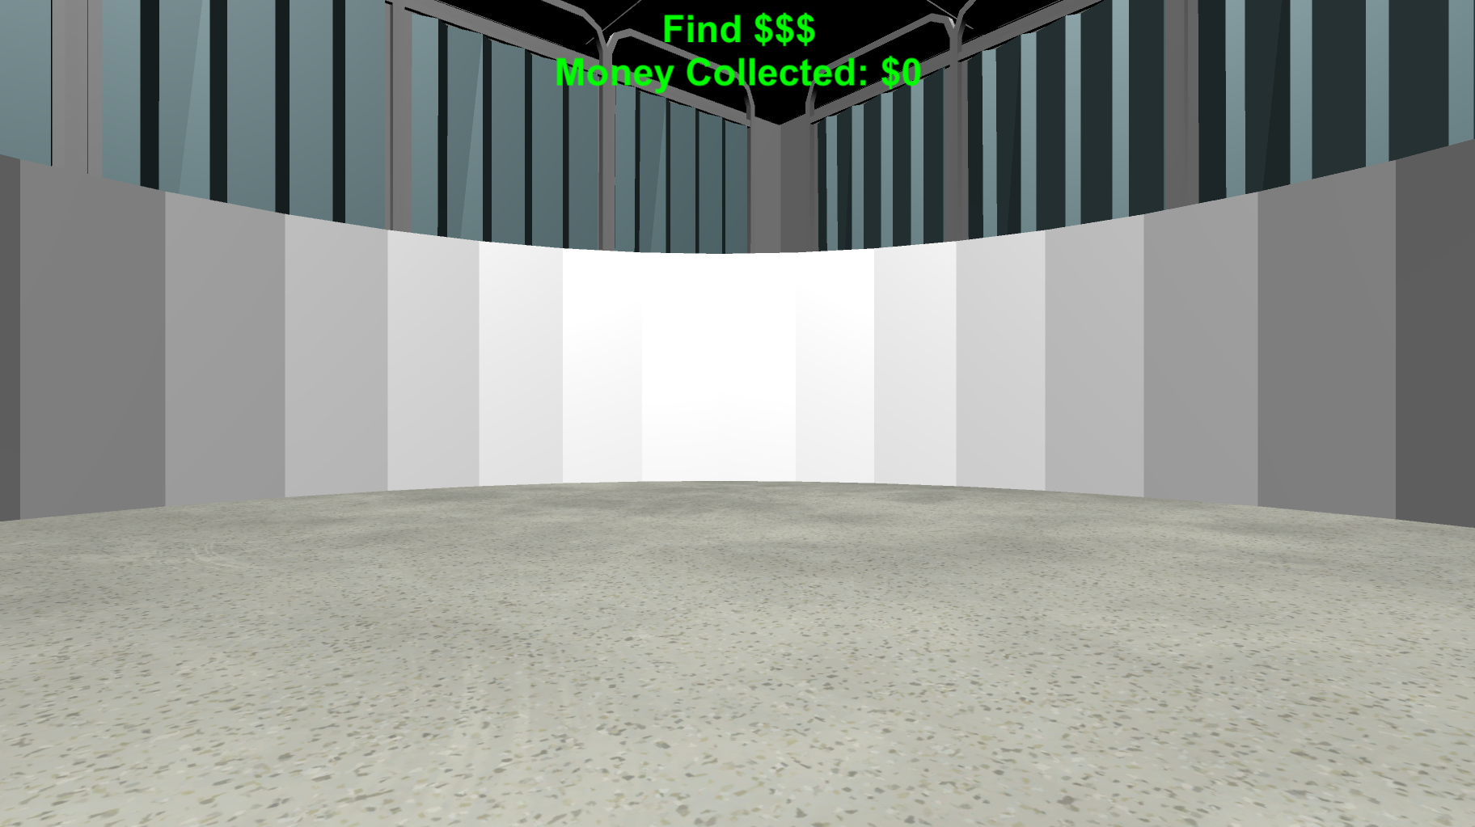

BONUS PAY: FINDING MONEY
Now let’s collect money!! Just like in the practice section, the money will be invisible but when you find it you will hear a collection sound and it will be added to the Money Collected total at the top of the screen.
Press Spacebar to continue …

Slide 9

Please make sure your headphones or speakers are on. You should hear a coin sound every time you collect money.
Let’s make sure everything is still working correctly! Keep moving around the environment until you collect $0.25 worth of money! Adjust the volume as necessary!
Press Spacebar to continue …

Slide 10
BONUS PAY: MONEY COLLECTION ROUNDS
You next task is to collect as much as possible in each of the following Money Collection Rounds. On each round, you will be placed into the environment at a random location.
Once you’re in the environment you will have 1-minute to collect as much money as possible!!
Press Spacebar to continue …

Slide 11

BONUS PAY: FEEDBACK ROUNDS
Before the start of most rounds you will see the “Search For Money” screen.
During these rounds you will hear a coin sound every time you collect money and you will be able to see how much you’ve collected at the top of the screen!
Press Spacebar to continue …

Slide 12


BONUS PAY: NO FEEDBACK ROUNDS
Before the start of some rounds you will see the “Search For Money! NO FEEDBACK” screen.
During these rounds you will NOT hear a coin sound when you collect money and you will NOT be able to see how much you’ve collected!
You will find out how much you collected on these rounds at the very end of the experiment!
HINT: On these rounds, use what you’ve learned from previous rounds to guide your search!
Press Spacebar to continue …

Slide 13

BONUS PAYMENT
There is an UNLIMITED amount of money to collect in each round. The money you collect in each round will be counted towards your BONUS PAYMENT! The more you collect the more bonus you will receive!!!
Press Spacebar to continue …

Slide 14


Search For Money!

Slide 15
Search For Money! NO FEEDBACK

Slide 16
Break Time!
Feel free to take a break if you need to.
When you’re ready, place your right hand on the arrow keys and press the spacebar with your left to continue!
Spacebar

Slide 17
Great job!
You’ve completed the BONUS PAY section!
Practice
Bonus Pay
Find The Trophy
Finish Survey
Next, you’ll complete the Find The Trophy task! Feel free to take a quick break before moving on!
When you are ready, press Spacebar to continue …

Slide 18
Ignore the last slide: for threshold bonus only

Slide 19
BONUS PAYMENT
There is an UNLIMITED amount of money to collect in each round. However, for each round, you will need to collect at least XXX to have the amount from the round added to your final BONUS PAYMENT at the end of the experiment! So try to collect as much as possible on each round!

