Slide 1
Welcome to experiment!
The experiment will take you 1.5 – 2 hours, including multiple breaks.
IMPORTANT before starting, make sure:
You will NOT be distracted within the next 2 hours
Your Speakers or Headphones are working!
Please enter your Prolific ID and press the Start Experiment button to begin

Slide 2
Welcome to experiment!
The experiment has 4 main sections:
Practice – Learn how to navigate in a virtual environment and collect money
Bonus Pay – Collect as much money as possible
Find The Trophy – Find the trophy as fast as possible
Finish Survey – Complete the remainder of Google Survey.
The money you collect during the Bonus Pay section will be counted towards your bonus payment! To earn the most bonus pay, make sure to follow each instruction carefully.
Press Spacebar to continue …

Slide 3
Section 1: Practice!
In this section you will learn how to navigate a virtual environment and how to find money within it.
The better you do in this Practice Section, the more you will be able to collect in the Bonus Pay Section!
Press Spacebar to continue …

Slide 4
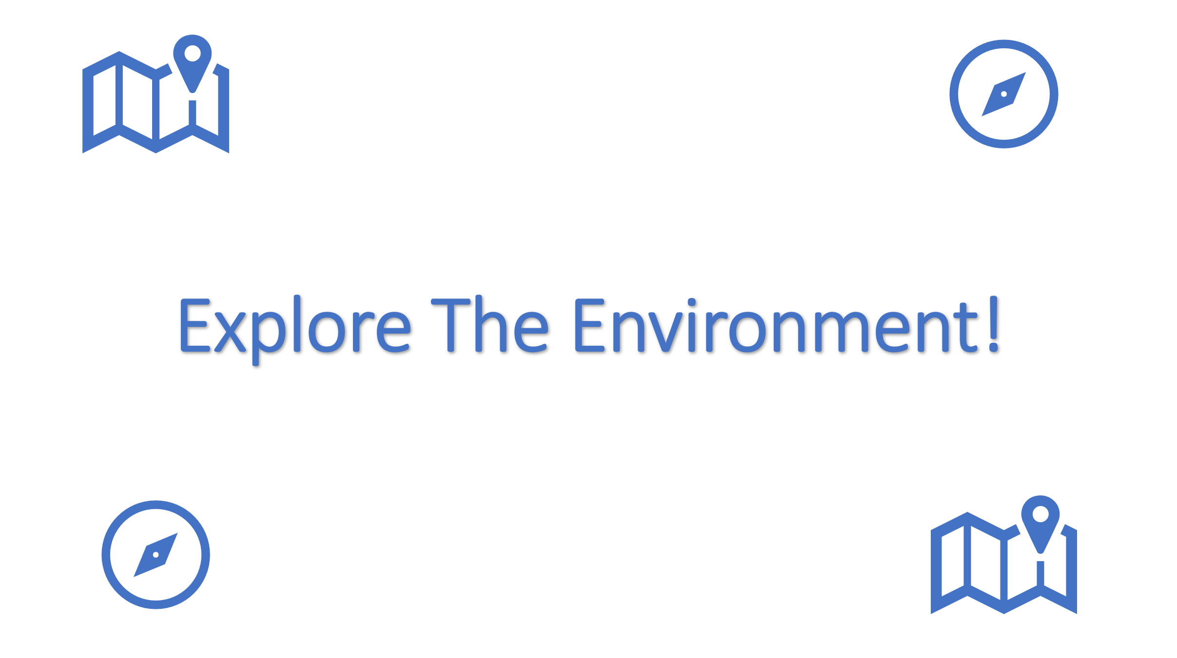
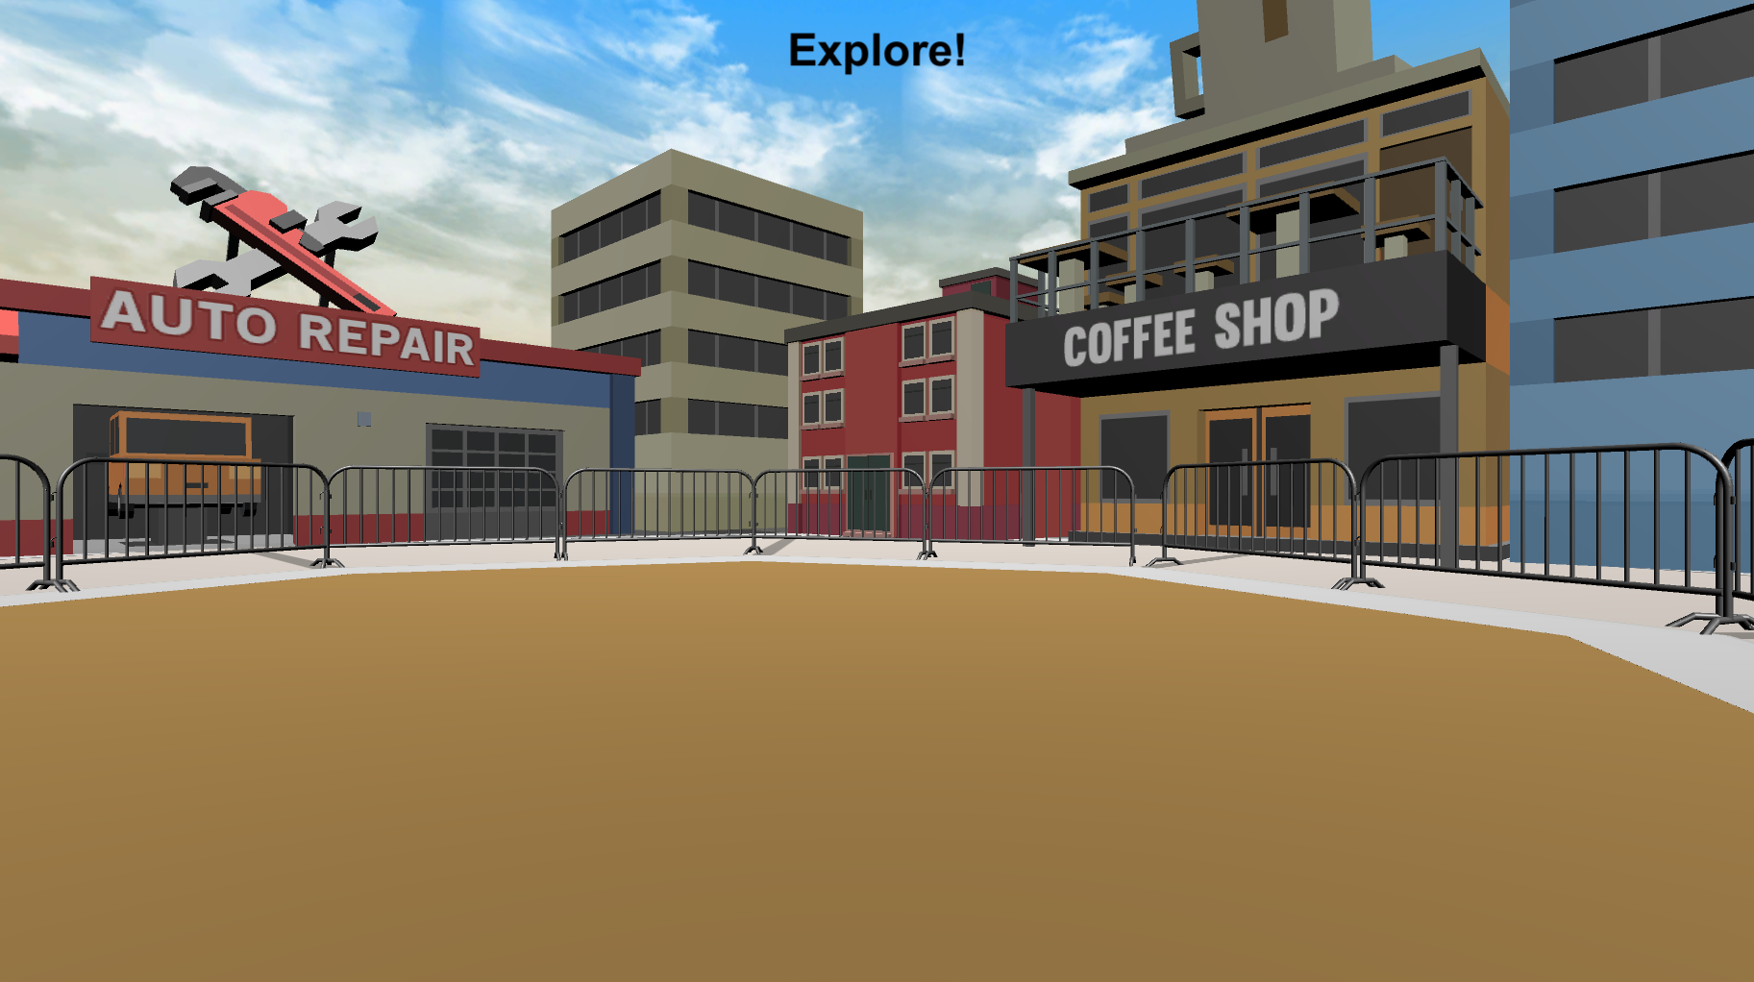
Practice: Exploring the Environment
Before looking for money, you will have the opportunity to explore the environment. On each Explore Round you will see the Explore The Environment screen (left bottom) and then you will be placed into the environment at a random location (right bottom). There is no money to collect in these rounds, so just move around and learn as much as you can about the environment.
Press Spacebar to continue …

Slide 5
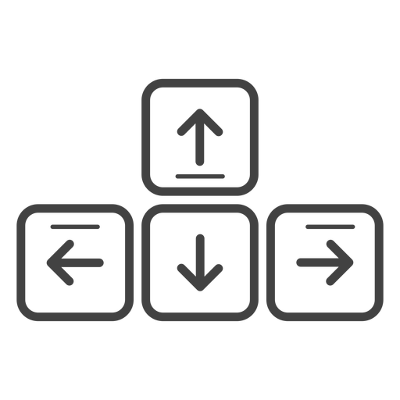
MOVEMENT CONTROLS
To move around the environment, you can ONLY use the Up-Arrow to move forward, and the left and right arrow-keys to rotate.
Move Forward
Rotate
Left
Rotate
Right
Press Spacebar to continue …

Slide 6
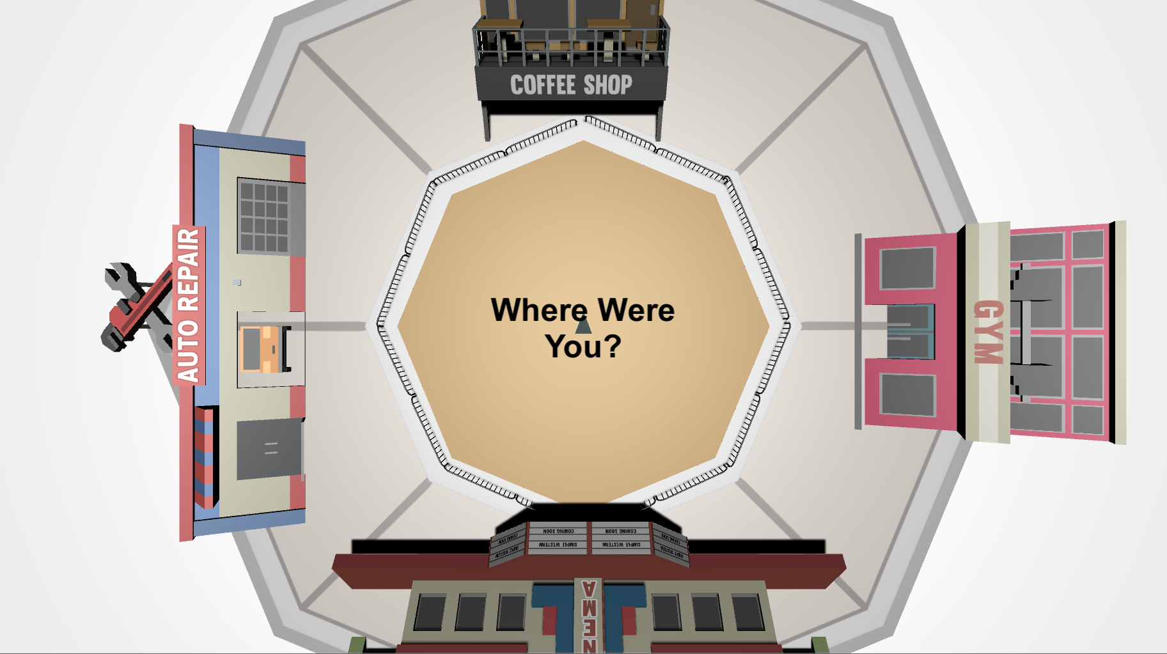
TOP-DOWN VIEW
While exploring the environment, you will be asked periodically to locate where you were from a top-down viewpoint like the picture below.
The grey triangle in the middle shows the direction that you’re facing, and the controls are the same as the 3D environment. Move the grey triangle to the last position you were in, in the 3D environment, and then press the Spacebar. This might be difficult at first, but you will get better at it each time!
Press Spacebar to continue …

Slide 7

When you’re ready, place your right hand on the arrow keys and press the Spacebar with your left to continue!
Spacebar

Slide 8


Explore The Environment!

Slide 9
Great Work!
Press Spacebar to continue …

Slide 10
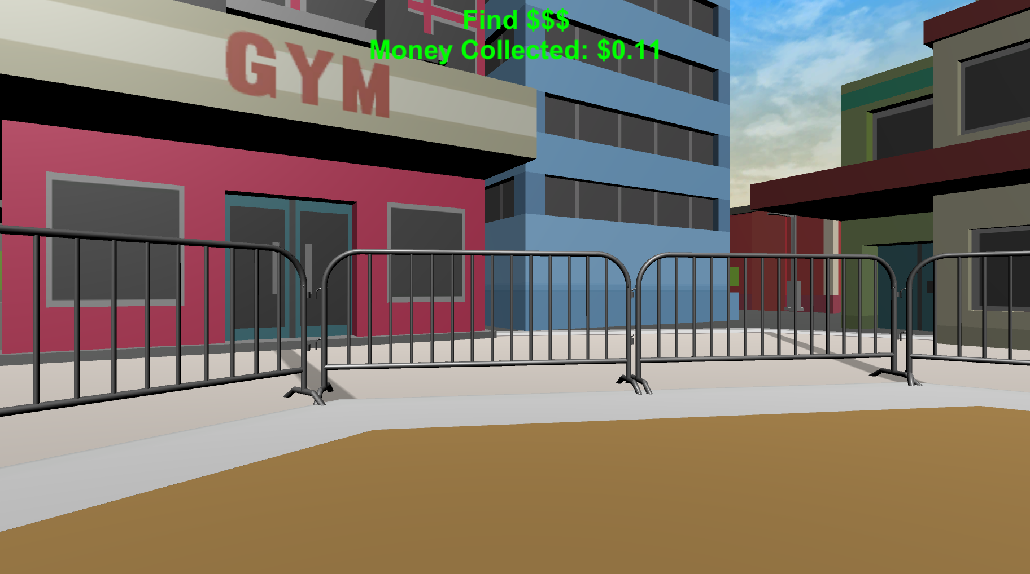

PRACTICE: FINDING MONEY
Now you will practice finding money! The money will be invisible but when you find it you will hear a collection sound and it will be added to your Money Collected for each round which you’ll see at the top of your screen.
Press Spacebar to continue …

Slide 11

Please make sure your headphones or speakers are on. You should hear a coin sound every time you collect money.
Let’s make sure everything is working correctly! Keep moving around the environment until you collect $0.25 worth of money! Adjust the volume as necessary!
Press Spacebar to continue …

Slide 12
PRACTICE: MONEY COLLECTION ROUNDS
Now that you know how to find money, you next task is to collect as much as possible in each of the following Money Collection Rounds. On each round, you will be placed into the environment at a random location.
Once you’re in the environment you will have 1-minute to collect as much money as possible!!
Press Spacebar to continue …

Slide 13

PRACTICE: MONEY COLLECTION ROUNDS
Before the start of most rounds you will see the “Search For Money” screen.
During these rounds you will hear a coin sound every time you collect money and you will be able to see how much you’ve collected at the top of the screen!
Press Spacebar to continue …

Slide 14

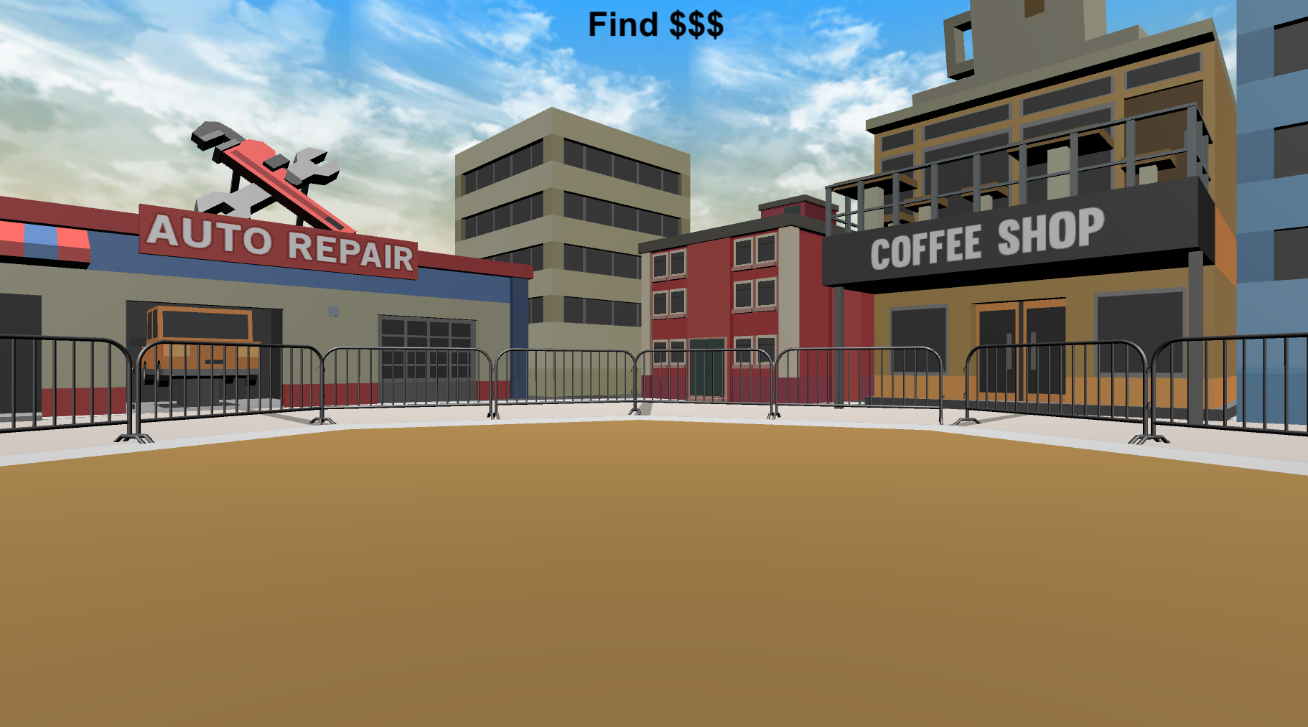
PRACTICE: MONEY COLLECTION ROUNDS
Before the start of some rounds you will see the “Search For Money! NO FEEDBACK” screen.
During these rounds you will NOT hear a coin sound when you collect money and you will NOT be able to see how much you’ve collected!
You will find out how much you collected on these rounds at the very end of the experiment!
HINT: On these rounds, use what you’ve learned from previous rounds to guide your search!
Press Spacebar to continue …

Slide 15


Search For Money!

Slide 16
Search For Money! NO FEEDBACK

Slide 17

COLLECT AS MUCH AS YOU CAN!!
There is an UNLIMITED amount of money to collect in each round, so try to collect as much as possible!
Remember!! The better you do during these PRACTICE rounds, the better you will do in BONUS PAY section where you’ll get to keep all the money you collect!
Press Spacebar to continue …

Slide 18
Great job!
You’ve completed the PRACTICE section!
Practice
Bonus Pay
Find The Trophy
Finish Survey
let’s move on to the BONUS PAY section where you’ll get to keep all the money you collect!! Feel free to take a quick break before moving on.
When you are ready, press Spacebar to continue …

Slide 19
The three slides below are for the version with threshold. You can ignore them for now.

Slide 20

BONUS PAYMENT
There is an UNLIMITED amount of money to collect in each round. You need to collect XXX in at least 3 out of 12 rounds to proceed to the next phase of the experiment. The money you collect you will receive as a BONUS PAYMENT at the end of the experiment! So try to collect as much as possible on each round!

Slide 21
You reached the threshold!
Please notify the Experimenter.

Slide 22

Unfortunately, you didn't reach threshold.
Please notify the Experimenter.

