Slide 1
Tracing Football Players from Video
CSE6442-01 Multimedia Project
220160023 김보배

Slide 2
Contents
Introduction
Overall Workflow
Implementation
Demo
Conclusion

Slide 3
Introduction
Goal: Tracing football players from Videos
To trace moving objects(football players), 2 main techniques are needed [1]
Detection
Tracking
In this project, we implemented a tracing tool using OpenCV, C/C++

Slide 4
Overall Workflow
Classification of the scene
Player detection
Classification of detected players
Tracking player movements
Displaying results

Slide 5
Implementation
Segmentation
Classify the video scene into 2 category
Field region
Audience region
Detecting with Audience region results in some error
Field region can be distinguished by the dominant green color
If a pixel position(x, y) is desired color(using HSV), that position has a white
Otherwise, has a black pixel at a mask image
Easily Masking out the Audience region

Slide 6
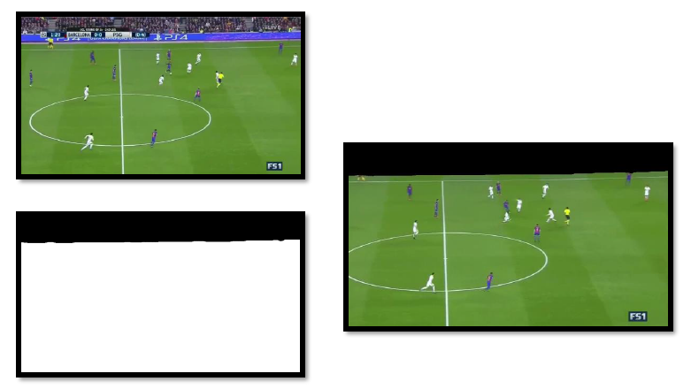
Implementation

Slide 7
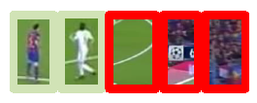
Implementation
Player Detection
Using “Cascade Classifier Training” as detection method proposed by Viola-Jones
To make this classifier, we needed a dataset composed of negative and positive of players.
OpenCV provides training model of cascade classifier
http://docs.opencv.org/2.4.13.2/doc/user_guide/ug_traincascade.html
We sampled the negative and positive of player images from video
After the Cascade Classifier training, we can detect the player using function detectMultiScale() provided by OpenCV

Slide 8
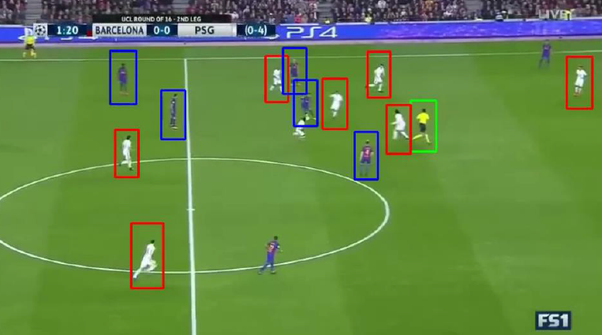
Implementation
Classification of Detected Players
Perfectly corresponds to a clustering problem
Each team’s player has a dominant color with their jersey, shorts, and boots
Using this feature, We can easily classify detected objects into their teams
We use a Expectation – Maximum (EM) method to cluster
OpenCV provides EM training model
http://docs.opencv.org/2.4/modules/ml/doc/expectation_maximization.html
Notes:
Masking out the ground region at a first!

Slide 9
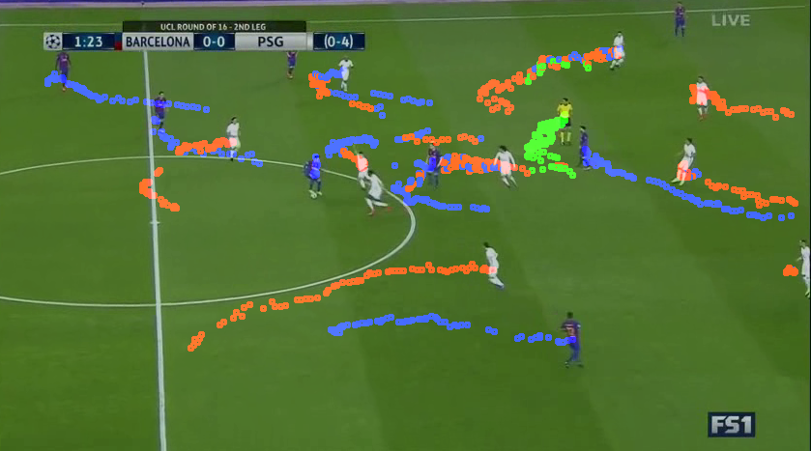
Implementation
Tracking player movements
Once players are detected, make a group with distance between objects
Find a min-distance objects from previous detected objects in same group
We use a K-Means algorithm as a clustering algorithm
OpenCV provides a K-means clustering cv2.kmeans()
http://docs.opencv.org/3.0-beta/doc/py_tutorials/py_ml/py_kmeans/py_kmeans_opencv/py_kmeans_opencv.html
Notes:
Masking out the ground region at a first!

Slide 10
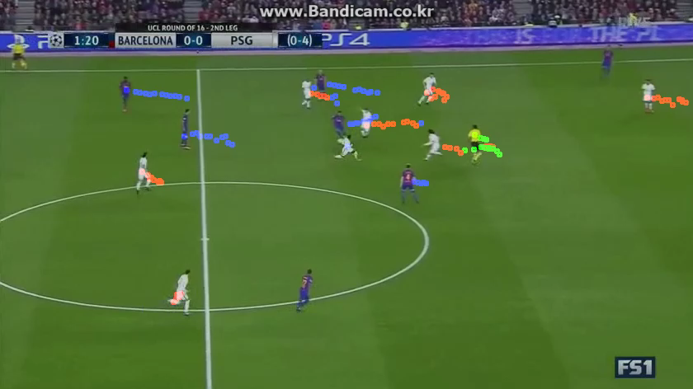
Demo
Notes:
Masking out the ground region at a first!

Slide 11
Conclusion
Detecting and Classifying
To realize the detection and classification, convert RGB to HSV
Segmentation as a pre-process
Detecting players using Cascading Classifier
Classifying players into 2 teams using EM clustering algorithm
Tracking
Tracking using K-Means Clustering with minimum distance
We don’t consider the speed, direction of the object
Inaccurate results due to a simple feature and consideration
Tracing
Some traces are weird due to no camera-work consideration
Tracing is captured without real movements
Tracing results is in-accuracy
Notes:
Masking out the ground region at a first!

