Slide 1
Preparing for Statistics Graduate School
These slides are downloadable from
http://statweb.calpoly.edu/jdoi/web/research/index.htm
Kelly Bodwin & Hunter Glanz
Department of Statistics
Cal Poly San Luis Obispo

Slide 2
Outline
Why grad school? Qualifications?
Applying to programs
Selecting a program
The grad school experience
Helpful Web Links
Most important piece of advice
Planning Your Schedule

Slide 3
Why Grad School?
Is grad school important?
Advice over the years: “You cannot get by in life without a …”
What you can do with a BA/MS/Ph.D.
A graduate degree opens more doors

Slide 4
Why STATISTICS Grad School?
Statistics versus Pure Mathematics
Job Availability
Statistics versus Applied Mathematics
Job Availability
Demand for Statisticians is booming
Our Cal Poly alumni are having great success
Due to our department’s rigorous program (semi master’s)
Due to the breadth of classes/exposure

Slide 5
Why STATISTICS Grad School?
Best Jobs of 2018 | Median Income
Genetic Counselor | $74,120
2. Mathematician | $81,950
3. University Professor | $75,430
4. Occupational Therapist | $81,910
5. Statistician | $84,060
6. Medical Services Manager | $96,540
7. Data Scientist | $111,840
8. Information Security Analyst | $92,600
9. Operations Research Analyst | $79,200
10. Actuary | $100,610
 | CareerCast’s 2018 Jobs Rated Report

Slide 6
Who can go to stat grad school?
Certain basic requirements
Minimum GPA (often 3.0)
Adequate GRE scores (good math, ok verbal/writing)
Satisfaction of prerequisite courses
MATH: Linear algebra, calculus/analysis
Several STAT classes
MYTH: You need to be the 4.0 GPA wonder to enter grad school …

Slide 7
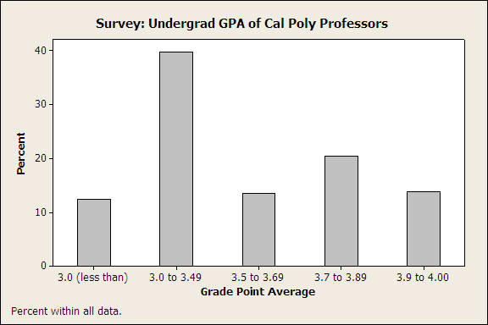

Slide 8
When should you go to grad school?
Many continue to grad school right after graduating with a Bachelor’s degree
Some want to get work experience first
Admission committee: No penalty for working in industry for 1-3 years (most appreciate the more mature students).
Down side … you won’t remember as much of the math/stat foundation you learned.

Slide 9
Applying to Programs
Obtain a list of all programs
(see web links)
Visit department websites
With list in hand, talk to our faculty to learn about various programs
Tier 1, 2, 3 (just like applying for jobs)
Tier 1 – may be tough to survive
Stanford, UC Berkeley, UWash, Harvard…

Slide 10
Applying to Programs
Statistics Graduate Program Rankings
Can be useful, but don’t rely on this information obsessively/excessively
Better to rely on alumni feedback
Better to rely on faculty input (esp. recent graduates)

Slide 11
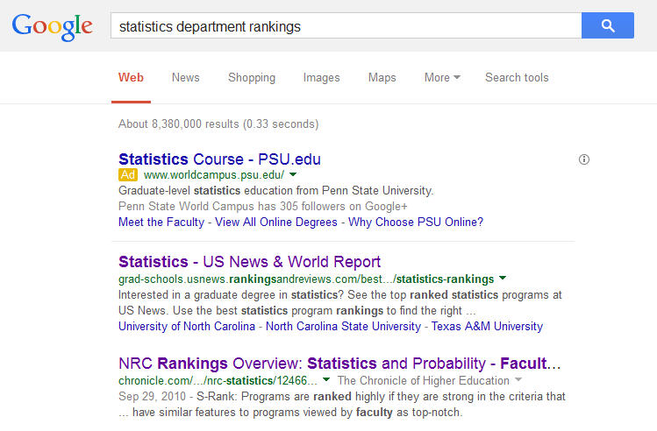

Slide 12
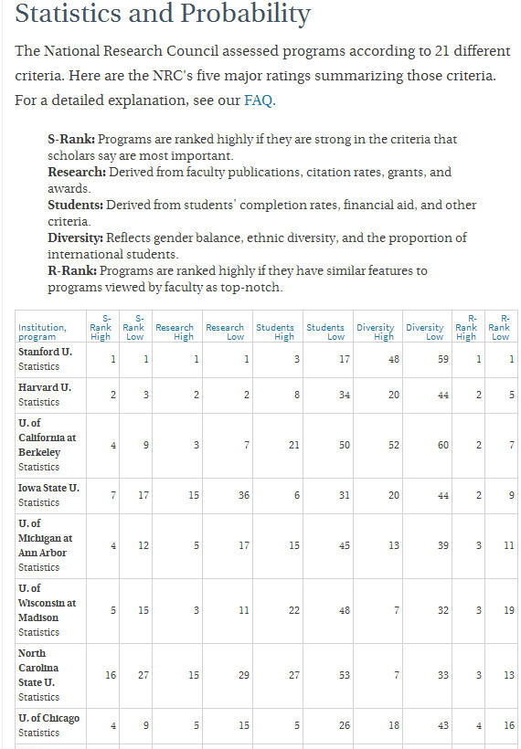
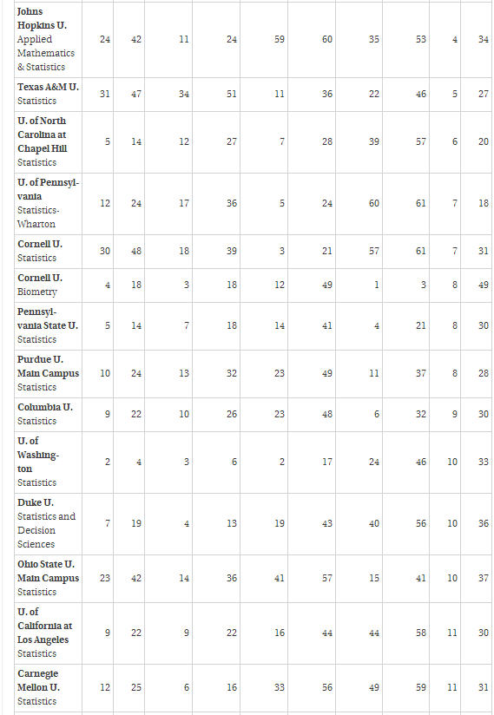

Slide 13
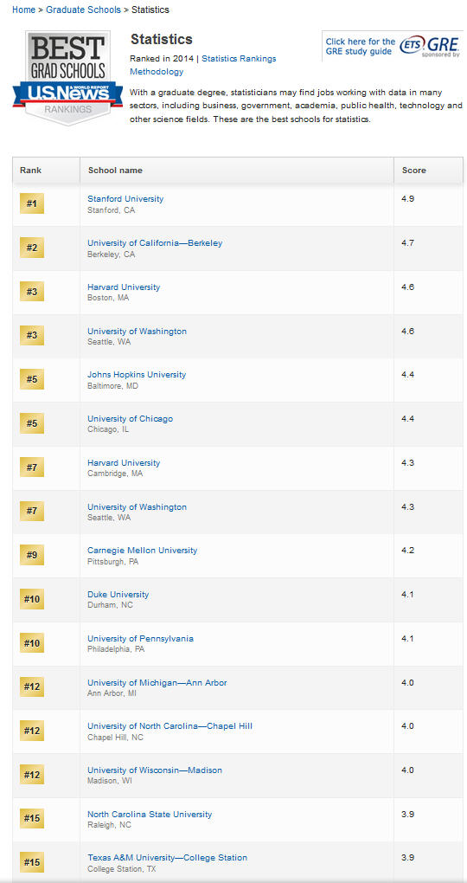

Slide 14
Links to Programs
List of Gradute Programs in Statistics
www.sci.csueastbay.edu/~mwatnik/statlist/
Contact info for the Director of Graduate Programs (DGP)

Slide 15
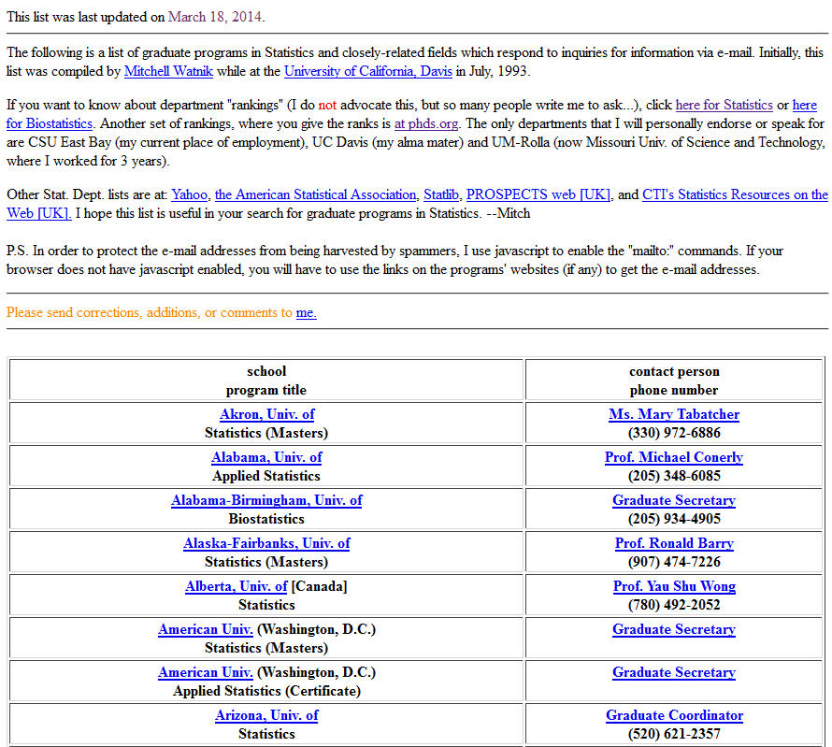

Slide 16
Links to Programs
List of Gradute Programs in Statistics
www.sci.csueastbay.edu/~mwatnik/statlist/
Peterson’s Guide
www.petersons.com
Grad School Bound  Step 1 (choose degrees of interest)  Step 2 (program: type “statistics” and select related fields such as applied stats, biostats, stats)  Step 3 (select region or skip to select all)

Slide 17
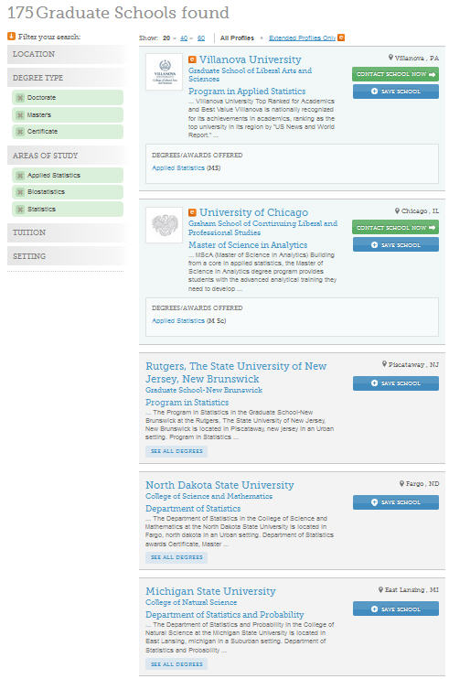

Slide 18
Links to Programs
List of Gradute Programs in Statistics
www.sci.csueastbay.edu/~mwatnik/statlist/
Petersen’s Guide
www.petersens.com
Quick Links  Graduate Schools  Statistics  Doctorate or Master’s or Undecided  United States
Over 200 graduate programs
StatLib
lib.stat.cmu.edu/modules.php?op=modload&name=Web_Links&file=index

Slide 19
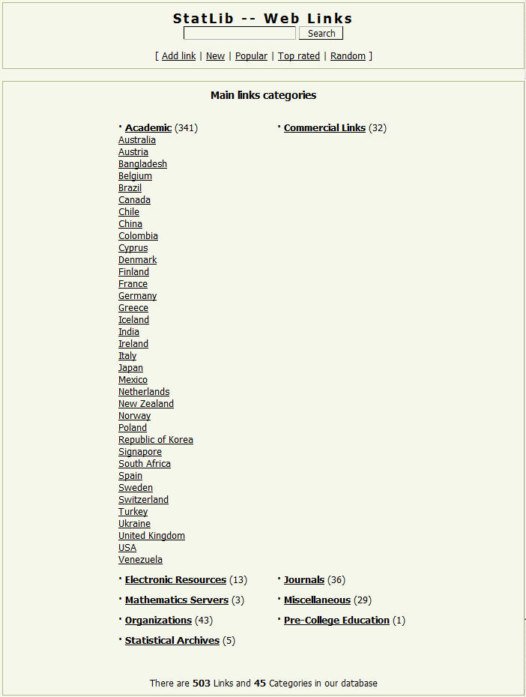
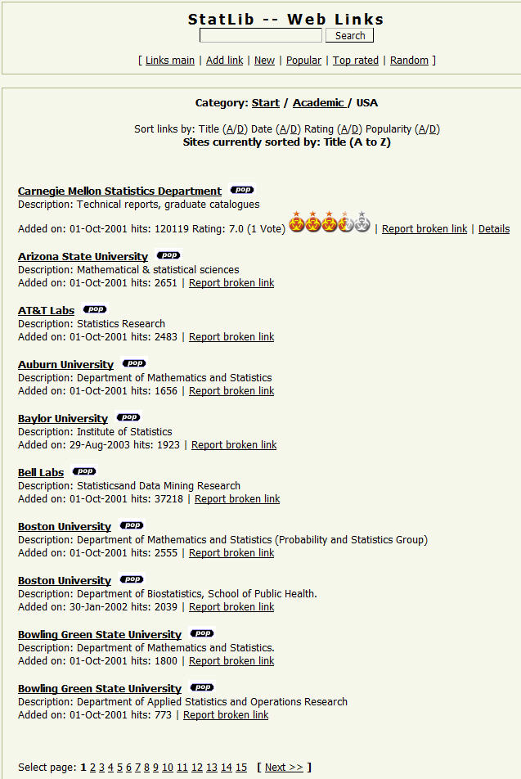

Slide 20
Dr. Bodwin’s totally ad hoc list
Tier 1: Very hard to get in, lots of theory
Stanford, UC Berkeley, Harvard
Tier 1.5: WashU, Duke*, Carnegie Mellon, UChicago, U of Michigan
Tier 2: Tough to get in; beware of different cultures (theory vs applied)
More theory: UNC, U of Florida, Iowa State, Cornell*, UPenn, U of Wisconsin, U of Georgia
More applied-ish: NC State, Ohio State, UCLA, Colorado Fort Collins, UC Davis
Tier 3: Great programs, a little more accessible
UC Santa Cruz*, Yale, Columbia, U Connecticut, Purdue, U of Arizona, Arizona State, Utah State, UCSD**, Boston University**, George Washington University, UIUC, Oregon State, UCSB, Texas A&M, U of Minnesota, UC Riverside, ….?
Take this all with an enormous grain of salt! It is not exhaustive, and I am outdated now.
* = Bayesian cult, ** = Stat & Math dept

Slide 21
If you don’t know where to start…
Ask faculty (esp. recent hires) about their recommendations on good schools to consider (will depend on what you want to specialize in)
Ask recent alumni who’ve gone on to grad school about their experiences
Check out some of the stat grad school rankings and consider the top half of the list. Don’t worry so much about the order of ranking in this top half.
Once you’ve compiled a master list of programs, ask faculty about their feedback as they may know some inside information that a pamphlet/website won’t reveal

Slide 22
Keeping your options open
Dr. Doi says:
Don’t restrict your future by ONLY considering schools close to home
You’ll be busy with school
Less chances to visit home (compared to your undergrad experience)
Taking a flight: 1 hour, 2 hours, … 5 hours
Not much difference (1, 2, … 5 states away)
Dr. Bodwin says:
Location matters MUCH more for grad school
Flexible schedule
Where you make professional connections and put down roots
Your community is less campus-centric
A 1 hour flight is not a 5 hour flight

Slide 23
Our Faculty/Grad School
Institution Faculty Boston Univ. Glanz Carnegie Mellon Rossman Cornell Chance, Walker
Emory Pileggi Florida State Smith Kansas State McGaughey NC State Doi
Ohio State Roy
Temple Afriyie U. Penn Hughes UC Berkeley Rein
UCLA Carlton
U of Minnesota Sabbag UC Riverside Peck UCSB Frame, Lund, Sklar UNC, Chapel Hill Bodwin, Ross
USC Ottesen Stanford Devore, Sun, D. Wright* (H. Smith’s Husband) Washington Shaffner
Wyoming Smidt

Slide 24
CP Alumni at Grad Schools
Where some of our students have gone (contact them!)
CSU East Bay – Several students
Long Beach State – Several students
NC State – Logan Lossing, Neal Grantham (+ more)
Ohio State – Several students
Oregon State – Katie Eng, Michael Dumelle
Stanford – Rudy Angeles, Tiffany Russell
U. Connecticut – Patrick Harrington
U. Pittsburgh – Jenna Colavincenzo
U. Washington – Tommy Garrison
UC Davis – Several students
UC Riverside – Rebecca Gan
UCLA – Debbie Huang
UCSB – Several students
UCSC – Chelsea Lofland

Slide 25
CP Alumni at Grad Schools
Recent/Current Students (contact them!)
Univ. of San Francisco – Isabell Litton (Master’s in Analytics)
Univ. of Georgia – Jeremy Mulcahey (Master’s in Envir. Stats)
Univ. of Illinois (Urbana-Champaign) – Robin Tu (Ph.D. in Stats)
Univ. of Michigan – Tom Edwards (Master’s in Biostatistics)
BYU – Helen Totterdell (Master’s in Epidemiology)
San Diego State – Chelsea Obrochta (Master’s in Public Health)
UCLA – John Shamshoian (Ph.D. in Biostatistics)
NC State – Chris Yim (Master’s in Analytics)

Slide 26
Dr. B’s number one resource:
thegradcafe.com

Slide 27
Application Fees
Each application: $50 ~ $75 (paid to the “Graduate School”)
Adds up quickly!
Tip #1: You might contact DGP directly go on forums online, mention your GRE scores/GPA, and find out what your chances are.
Tip #2: If receiving financial aid, some schools offer an application fee waiver … ask about it!
Check out Committee on Institutional Cooperation www.cic.net

Slide 28
Applying to Grad School: Letters of Recommendation
Typically, three letters are requested
Obtain a good mixture addressing:
(1) math abilities* (2) stat theory abilities* (3) applied stat abilities
Ask your professors EARLY, and check on progress (people will forget)
Provide copy of your resume and a personal statement gives good background info
It’s perfectly OK to ask professor to focus comments on specific areas math/applied stat/stat theory

Slide 29
Applying to Grad School: Letters of Recommendation
OPTIONAL Extra Letter: addressing other traits such as other academic abilities or your personal character (e.g. a non-math/stat professor, employer, pastor)
Sometimes committees ONLY WANT THREE LETTERS
They might randomly choose 3, a valuable letter may be lost
If including an extra letter, make note of that in your cover letter
“NOTE: If the selection committee will only consider three letters of reference, please ignore the letter from person XXX.”
Cover Letter – If you have a lower GPA, but high upper division GPA, explain in letter. Leave nothing to speculation.

Slide 30
Letters of Rec summary
Letter 1 = Cal Poly professor, ideally STAT, who knows you best
Letter 2 = Cal Poly professor, probably also STAT, who can speak to different skills
Letter 3 = Cal Poly prof OR possibly work/internship/research supervisor
(Letter 4 = only if specifically offered in application)
Ask before September, follow up frequently!

Slide 31
Applying: GRE and Subject GRE
Graduate Record Examination (GRE)
Take over the summer if possible
Inconvenient to take GRE during academic year
Can lead to lower performance for GRE AND/OR your classes
Verbal/quantitative reasoning, critical thinking and analytical writing skills
Scholarship/fellowship considerations
English ability important for TAship
Subject GRE (mathematics)
Only for top tier institutions or math & stat combos
http://www.ets.org/gre/
Cal Poly Assessment & Testing Center - (805)756-1551
Call about deadlines and when scores can be sent

Slide 32
GRE Summary
Take early just in case
Study via
Courses at Poly?
Courses elsewhere
Online resources
You need to do well on math, and not terrible on the other two.

Slide 33
Factors to Consider in Selecting a Graduate Program
Funding Opportunities
Typical class size
% of American and Int’l Students
Avg. # of years to completion (MS/Ph.D.)
Where do their graduates land? Industry? Academics?
Other IMPORTANT issues:
Weather, Culture, Stuff to do, personal comfort
You may be there 5+ years … be comfy!

Slide 34
Factors to Consider in Selecting a Graduate Program
Find out about the qualifying exams and route to graduate degrees:
Master’s: Thesis? Final Test?
Ph.D.: Thesis
Qualifying exam policy
Pass rate data available?

Slide 35
Funding
Teaching Assistantship (TAship)
Grading papers/quizzes
Teaching your own class
Research Assistantship (RAship)
Assisting profs on their research

Slide 36
Funding
Determine how your stipend will cover your essential costs (rent, bills, food)
If going to a new state, will dept cover “out-of-state” tuition/fees?
Ask Director of Graduate Programs (DGP) to offer email addresses of handful of students, send them questions
Rent? Bills? Stuff to do?

Slide 37
Industry Sponsored Funding
If you are currently working for a company, ask about any programs to sponsor an employee’s graduate education
Often, it’s 100% forgivable (free ride)
Contracted to work for the company for n years

Slide 38
External Fellowships
National Science Foundation – Graduate Research Fellowship Program (NSF GRFP)
Apply in senior year, before grad school, or in 1st or 2nd year of grad school
Submit project proposal – but you don’t have to actually pursue the project
Last year: 7 fellowships in Statistics, 2 in probability
Provides “no strings attached” stipend for 3 years of grad school
https://www.nsfgrfp.org/

Slide 39
External Fellowships
National Defense Science and Engineering Graduate Fellowship (NDSEG)
Provides “no strings attached” stipend for 3 years of grad school
Very competitive, no stat subfield
US Citizens only
http://www.ndsegfellowships.org

Slide 40
External Fellowships
Applying can boost your application, even if you don’t get it
Allows for more freedom during grad years
(can still TA and RA if you want)
Many more options:
https://grad.ncsu.edu/students/fellowships-and-grants/national/nationally-competitive-graduate-fellowships/

Slide 41
Selecting Programs
Don’t be surprised if they offer to fly you out for a visit (they have set aside a budget for this)
Be careful not to burn yourself out and visit too many programs
Schools I visited …
Be proactive and check progress often (my story at BU)
If waitlisted, contact for visit (KB stories)
If visiting a school, notify any adjacent schools (Duke story) … may be happy to split costs

Slide 42
Selecting Programs
Go to a diverse department
If securing a Ph.D., choose a program that offers a Master’s along the way
At least 2-3 profs whose research you like (advisor options)
Bayesian vs. Frequentist
UCSC, Duke, Harvard = Bayesian
Applied vs. Theoretical
Check first year required courses

Slide 43
The Experience: A New World
Your classmates will be SMART
My linear models Exam #1
Grades don’t matter as much
Course Load
9 units of grad classes ≠ 9 units of ugrad
Research != coursework, new skills

Slide 44
You’ve arrived, now what?
Before arriving, if interested, ask DGP to send message to other incoming/current students about being your roommate
Get to know faculty (same advice for Cal Poly!)
Chances are, you will not have every faculty member as an instructor … but that should not inhibit an office visit
Ask about research interests
Ask about ongoing projects

Slide 45
You’ve arrived, now what?
For your classes …
Do visit office hours
Do network with students
Do participate in study groups (or form them!)
It’s not as easy to fly solo through grad school … build a good support network

Slide 46
Resources for Grad School
… especially OURS
Do NOT sell back your stat/math books
Do NOT set ablaze your course notes
Your notes/books will be valuable resources

Slide 47
More Links
Cal Poly Graduate Education
http://grad.calpoly.edu/resources/index.html
CSU Doctoral Incentive Program (Forgivable loan of up to $30,000)
Thegradcafe.com: forum for discussing schools, getting advice, etc.

Slide 48
Succeeding in Graduate School
Reminder: Our Cal Poly alumni are having great success (you can do this!)
Success in grad school means different things to different people
Most important piece of advice … it starts with you …

Slide 49

BELIEVE IN YOURSELF!

Slide 50
Succeeding in Graduate School
Marathon

Slide 51
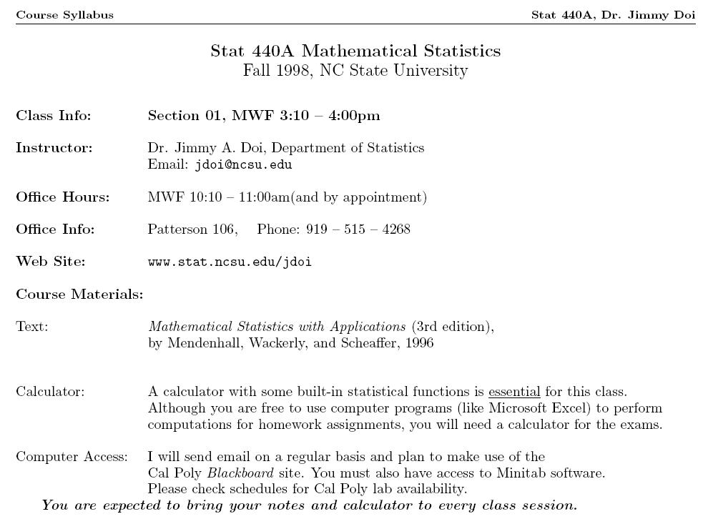
Setting a goal …

Slide 52
Succeeding in Graduate School
Most important piece of advice … it starts with you … and it ends with you
If you firmly affix the goal of your dreams in your mind’s eye, there will be nothing that can stop you.

Slide 53
To Do List (for Fall Admission)
Spring (window shopping)
Contact professors about various schools
Get a sense of the school rankings (high/moderate/low)
Visit school websites
Summer (planning)
Plan for GRE (take it in summer?)
Investigate potential schools (road trip?)
Area aspects: cost of living, weather, recreation
Start working on application (e.g. personal statement)
Think about who to ask for letters of recommendation
Fall (final steps)
Request letters of recommendation
Take GRE if not taken in summer (check deadlines)
(let’s meet again at the beginning of fall and check your progress)
It is possible to start a graduate program in Spring term

