Slide 1

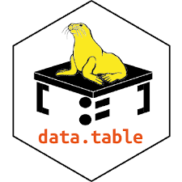
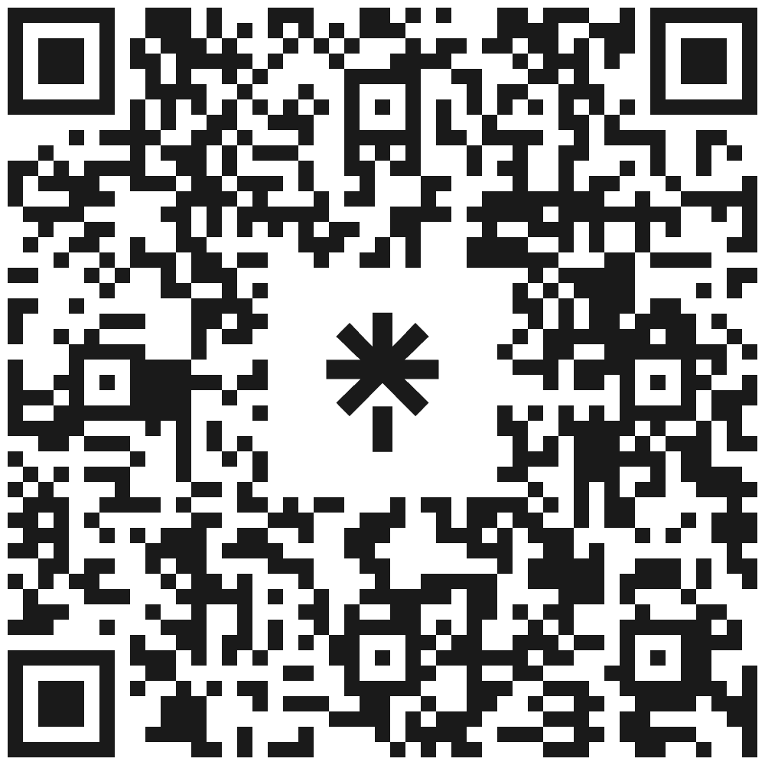
The User Community
How does an open-source project ecosystem remain engaging,
enduring,
and evolving?
Kelly Bodwin, California Polytechnic State University
NSF POSE Grant #1005559
“Building a sustainable ecosystem for data.table"
PI: Toby Hocking, Northern Arizona University
Co-Author: Tyson Barrett, Utah State University
The Developer Team
Online Engagement
Enduring Support
🔅 Access to social connections with other data.table users
→ 🦣 fosstodon.org/@r_data_table
→ ⛅ rdatatable.bsky.social
→ 🐦 twitter.com/r_data_table
🔅 Regular fresh content about data.table
→ Blog: The Raft
🔅 Support them with appreciation.
→ Reach out, say thank you!
🔅 Support them with professional recognition
→ Cite your packages
→ Vote for awards and promotions
🔅 Support them with money
→ Github, Patreon, or donations
→ Open-source meta groups:
ROpenSci, The Linux Foundation, The R Foundation, NumFocus, etc.
→ Future idea: Fundraising drives for specific features.
Community Evolution
🔅Clear bridges and partnerships to other communities.
→ data.table + tidyverse = 💛
🔅 An educational path forward to more advanced use.
🔅 Broader accessibility of content.
→ Grant-funded Translation Project
Guidelines for Engagement
🔅 A governance structure outlining responsibilities
→ A new governance document
🔅 Ability to test new code without breaking the package
→ A new testing infrastructure
Enduring Connections
🔅 Continued relevance of data.table to their work
→ Coming Soon: Seal of Approval
🔅 Existence of resources and references
→ Coming Soon: Online class
→ Coming Later: A data.table textbook.
🔅 Creation of personal connections and friendships and fun traditions in the community
→ Travel grant for contributors
→ Talks, meetups, and giveaways!
Pathways of Evolution
🔅 A welcoming atmosphere for new contributors
🔅 Developer-side education and
documentation.
🔅 User engagement for feature requests and bug reports
Linktree for project work and websites:
linktr.ee/rdatatable

