Slide 1


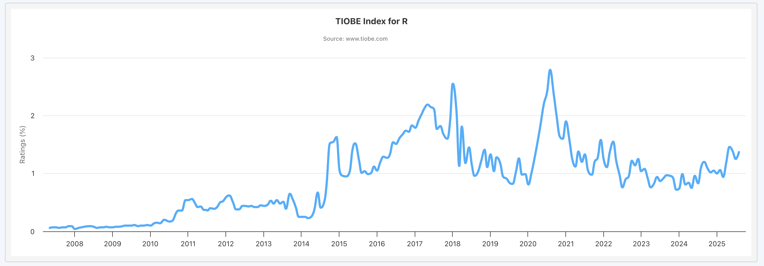
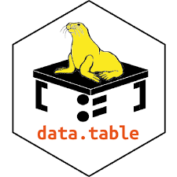

Where we going?
Reach
Resources
How an open-source project achieves reach, relevance, and resources.
Kelly Bodwin, California Polytechnic State University
Community
Supporting Developers
🔅 Access to social connections with other users
→ 🦣 fosstodon.org/@r_data_table
→ ⛅ rdatatable.bsky.social
→ 🐦 twitter.com/r_data_table
🔅 Regular new content via blogs, etc.
→ Blog: The Raft
→ RWeekly blog roundup
🔅 Creation of personal connections and traditions in the community
→ Travel grants for contributors
→ Conferences and meetups.
🔅 Clear bridges and partnerships to other communities.
→ Connections to python/Julia
→ Multilingual conferences
🔅 The R Core Group maintains and updates Base R.
→ Donate to The R Foundation
→ Contribute to Base R
🔅 Individual developers create R packages
→ Github, Patreon, or donations
→ Donate to open-source meta groups:
ROpenSci
The Linux Foundation
NumFocus
Relevance
How you can help
🔅 Industry:
→ Make a meaningful donation
→ Support employee time for open- source development
→ Release software freely
🔅 Academia: Support open-source work with professional recognition
→ Cite your packages
→ Vote for awards for open-source research
→ Hire and promote contributors
🔅 Individual:
→ Contribute suggestions or bug fixes to packages.
→ Share your open-source code. → Create public blogs or tutorials
→ Engage with the wonderful R community.
🔅 R is the 14th most used language [tiobe.com]
🔅 R leads data science in:
- Statistical tests and models
- Data wrangling (tidyverse, data.table, arrow)
- Data communication (Shiny, Quarto, ggplot2)
- Domain-specific tasks (e.g. pharma reporting)
Education and Access
🔅 Free and open-source educational resources like online textbooks.
🔅 Broader accessibility of content.
→ Grant-funded Translation Project
→ Online meetups and workshops
🔅 Prioritizing inclusivity and diversity.
→ Travel grants and scholarships
→ Accessible materials and events
NSF POSE Grant #1005559
“Building a sustainable ecosystem for data.table"
PI: Toby Hocking, Université de Sherbrooke;
Tyson Barrett, Highmark Health and Utah State University
Linktree for project work and websites: linktr.ee/rdatatable

