Slide 1


Member vs. Casual Rider Usership
By: Kyle Boekhout

Slide 2


Goals
Discover how causal and member riders use the service differently.
Find ways to encourage more people to become members.

Slide 3
Process
Ran data by looking at number of rides and average ride time for members and casual riders by each day of the week

Slide 4
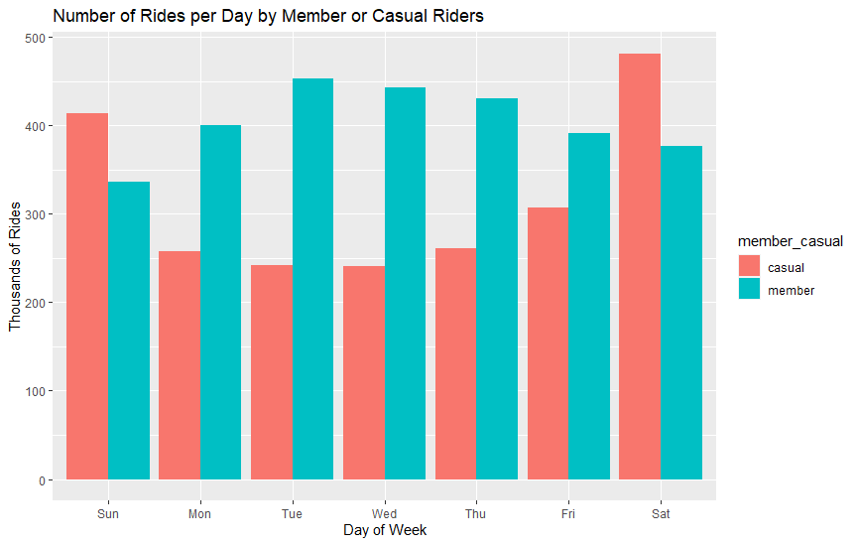
Number of Rides
Members use more frequently on weekdays
Casual riders use more often on weekends

Slide 5
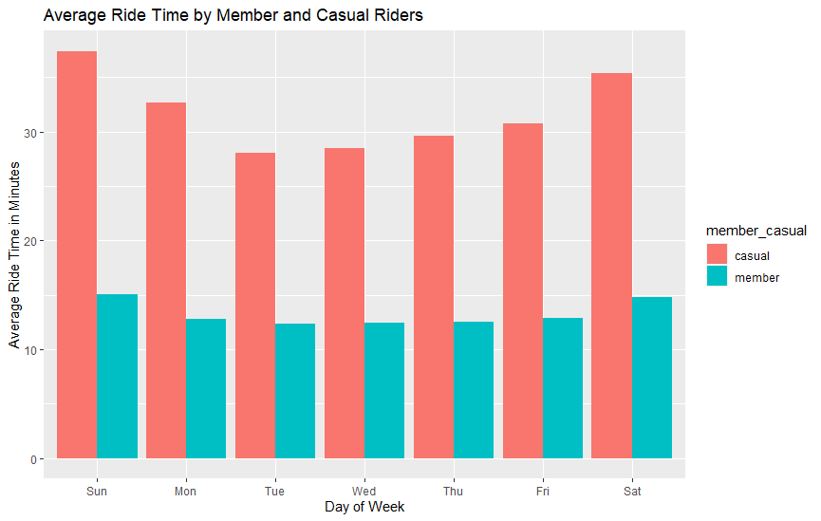
Average Ride Time
Casual riders are using the bikes for much longer on average than members

Slide 6
Recommendations
Charge per minute after a flat rate to start a ride for a casual rider to capitalize on casual riders taking much longer rides.
Have set subscription price for members in order to make payments easier to track.
Increase ride costs on weekends for casual riders since most riders on weekends are casual riders.

Slide 7
Data Sources
Cyclistic Inc. (Motivate Internation Inc.) - https://divvy-tripdata.s3.amazonaws.com/index.html
Using data from June, 2021 through May, 2022

