Slide 1


Neural Networks for Negation Cue Detection in Chinese
Hangfeng He¹, Federico Fancellu² and Bonnie Webber²
¹School of Electronics Engineering and Computer Science, Peking University
²ILCC, School of Informatics, University of Edinburgh
hangfenghe@pku.edu.cn, f.fancellu@sms.ed.ac.uk, bonnie@inf.ed.ac.uk
Notes:
Good afternoon, everyone. I am Hangfeng He from Peking University. Today I am going to present our work about neural networks for negation cue detection in Chinese. This is joint work with Federico Fancellu and Prof. Bonnie Webber at University of Edinburgh.

Slide 2
Outline
Introduction
Model
Experiments
Error Analysis
Conclusion
Notes:
Let’s look at the introduction.

Slide 3
The task
Negation Cue Detection
Recognize the tokens (words, multi-word units or morphemes) inherently expressing negation
A prerequisite for detecting negation scope
An Example
所有住客均表示不会追究酒店的这次管理失职。
(All of guests said that they would not investigate the dereliction of hotel.)
Negation Cue “不(not)”:
Indicate the clause is negative
Notes:
As for the task, we need to recognize the tokens which can express negation. Negation cue detection is a prerequisite for negation scope detection. For example, In the sentence “All of guests said that they would not investigate the dereliction of hotel” , we need to recognize the “not” in Chinese.

Slide 4
Goal
Previous Work
[Zou et al. 2015]
sequential classifier
Lexical features (word n-grams)
Syntactic features (PoS n-grams)
Morphemic features (whether a character has appeared in training data as part of a cue)
Chinese-to-English word-alignment.
Notes:
However, previous work usually uses highly-engineered features. For example, Zou et al adopted a sequential classifier which used many features such as lexical features, syntactic features, morphemic features and even Chinese-to-English word alignment.

Slide 5
This work
Question:
Can we detect negative cues without highly-engineered features ?
Notes:
So we are wondering whether we can detect negative cues without highly-engineered features.

Slide 6
Challenges
Challenges
Homographs (e.g. “非常(very)” → “非(not)”).
False negation cue (e.g.“非要(can’t help)” -> “非(not)”).
High combinatory power of negation affixes
(e.g. “够(sufficient)”-> “不够(insufficient)”).
Notes:
Detecting negation cues in Chinese texts is difficult. There are many challenges. First, character cues can be homographs of or contained within words not expressing negation. For example, the left one contains negative character ‘not’, but it has a positive meaning. Second, as the example shown, “can’t help” contains negative cue but not correspond to clause-level negation . Finally, negation cues can become integral part with the word they modify. For example, “sufficient” can be modified by “in”. Then it will be a negative cue. The high combinatory power of negation affixes leads to issues of data sparsity.

Slide 7
Outline
Introduction
Model
Experiments
Error Analysis
Conclusion
Notes:
Now, Let’s look at the model.

Slide 8
Model
Sequence Tagging
Given a sentence ch = ch₁…ch_{|c|}. (We do not do segmentation and the input is a sequence of character.)
We represent each character ch_{i}∈ch as a d-dimensional character embedding
The goal of automatic cue detection is to predict a vector
s ∈ {O,I}^{|n|} s.t. s_{i} = I if ch_{i} is part of the cue or otherwise.
Notes:
We treat negation cue detection as a sequence tagging task. For a sequence of character, we need to determine whether a character is part of the cue or otherwise. We use character embedding to represent every character in our model.

Slide 9
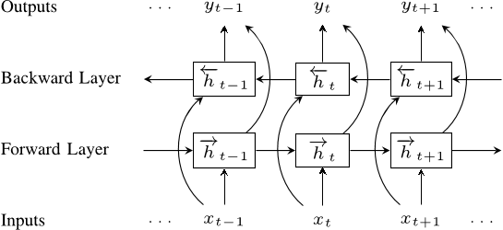
Character Based BiLSTM Neural Network
Notes:
As for character based bidirectional LSTM, we concatenate the hidden states of forward and backward pass.

Slide 10
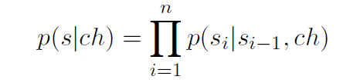
Transition Probability
The predictions made are independent from each other
A new joint model
Add a 4-parameter transition matrix to create the dependency on the previous input s_{i-1.}
Notes:
Because the predictions made are independent from each other, we add a sequential model on top of BiLSTM to consider transition probability between tags.

Slide 11
Outline
Introduction
Model
Experiments
Error Analysis
Conclusion
Notes:
Let’s look at the experiments.

Slide 12
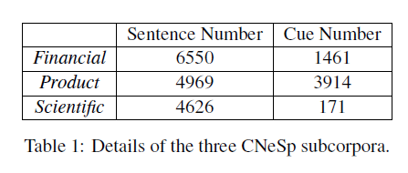
Experiments
Data
Chinese Negation and Speculation (CNeSp) corpus [Zou et al., 2015]
CNeSp is divided into three sub-corpora: Product reviews (product), Financial Articles (financial) and Scientific literature (scientific).
Although [Zou et al. 2015] used 10-fold cross-validation. We use a fixed 70%/15%/15% split of these in order to define a fixed development set for error analysis.
Notes:
As for the dataset, we use the same corpus Chinese Negation and Speculation (CNeSp) as Zou et al. The corpus is composed of three sub-corpora: Product reviews, Financial Articles and Scientific literature. The details can be found in the Table 1. We need to notice that although zou used 10-fold cross-validation, we still used a fixed split to do error analysis in development set.

Slide 13
Baselines
Negation cues in training data:
Such as “不(not)”,“非(not)”...
An Example
Ground truth
…,受经济不景气影响 ,…
(…,influenced by the economic depression,…)
Baseline-Char
…,受经济不景气影响 ,…
Baseline-Word
…,受 经济 不景气 影响 ,… (segment first)
Notes:
We have two baselines in our experiments. For both baselines, we first collect the negation cues in training data. Baseline-Char will predict every subsequence in the list of training cues as a negation cue. Baseline-word will segment first and then predict the words that contain cues in training data as a negation cue. For example, in the sentence “influenced by the economic depression”, baseline-char will predict the exact cue “not” as underlined and baseline-word will segment first and then predict the word that contain negative cue as underlined.

Slide 14
Results
Notes:
In the chart, the green one is previous work, the blue one is a baseline and the red one is our model. we can see: 1. The baseline achieves low precision compared to a higher recall => Challenge lies in not overpredicting the negation cue span. 2.Neural network model with minimal feature engineering perform par on or better than highly-engineered sequential model (Zou et al. 2015).

Slide 15
Results
Notes:
Poor performance on the scientific set: there are only 171 cues in 4262 sentences and only 12 in the 463 test sentences. So the cues are too few.

Slide 16
Outline
Introduction
Model
Experiments
Error Analysis
Conclusion
Notes:
Let’s move to error analysis. We do a detailed error analysis for every sub corpora. Because there are few cues in scientific, we mainly focus on financial and product.

Slide 17
Financial Articles
Error
most of the errors are under-prediction errors.
An Example
…,受经济不景气影响 ,…
(…,influenced by the economic depression,…)
Notes:
As for financial corpora, we find that most of the errors are under-prediction errors. For example, in the sequence “influenced by the economic depression”, our model predicts the underlined character as the negation cue, while “the red one (depression)” is the gold one.

Slide 18
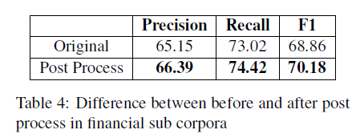
Financial Articles
Method
We first used the NLPIR toolkit to segment the sentence and if the detected cue is part of a word, then the whole word is considered as cue.
Improvement
Notes:
To alleviate this problem, we design a post process. We first segment the sentence and then predict the whole word as cue if the detected cue is part of a word. The improvement is shown in Table 4.

Slide 19
Product Reviews
Error
Our models predict more negative cues than gold one. These errors concern the most frequent negative cues such as “不(not)”and “没(not)”.
An Example
房间设施一般，网速不仅慢还经常断网。
(The room facilities are common and the network not only is slow but also often disconnect.)
Notes:
As for product review, the results are good enough. But we find that our models predict more negative cues than gold one. Our predictions are easily biased by frequent negative cues such as ” not”. For example, in the sentence “The room facilities are common and the network not only is slow but also often disconnect”. Our model predicted the “not” as cue while there is no cue in gold annotation. So we may need to use more information to alleviate this problem.

Slide 20
Outline
Introduction
Model
Experiments
Error Analysis
Conclusion
Notes:
At last, we shortly conclude our paper.

Slide 21
Conclusions
We confirm that character-based neural networks are able to achieve on par or better performance than previous highly-engineered sequence classifiers.
Future Work
Given the positive results obtained for Chinese, future work should focus on testing the method in other language as well.
Notes:
We confirm that character-based neural networks are able to achieve on par or better performance than previous highly-engineered sequence classifiers.
As for future work, we may consider testing our model in other language.

Slide 22
Thank you!
Any question?

