Slide 1
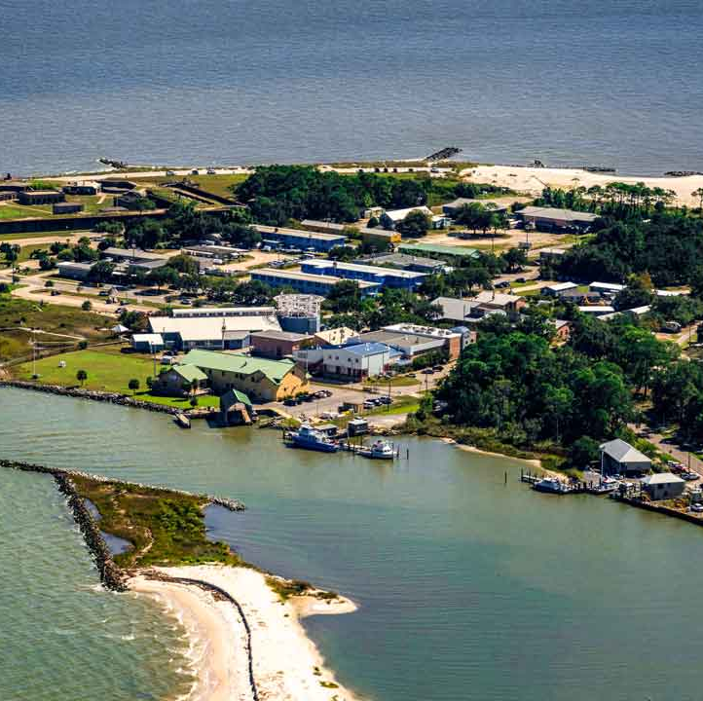
Model Comparison for Dauphin Island Station, Mobile Bay, AL
Antony, Aravind, Katy, Kevin

Slide 2
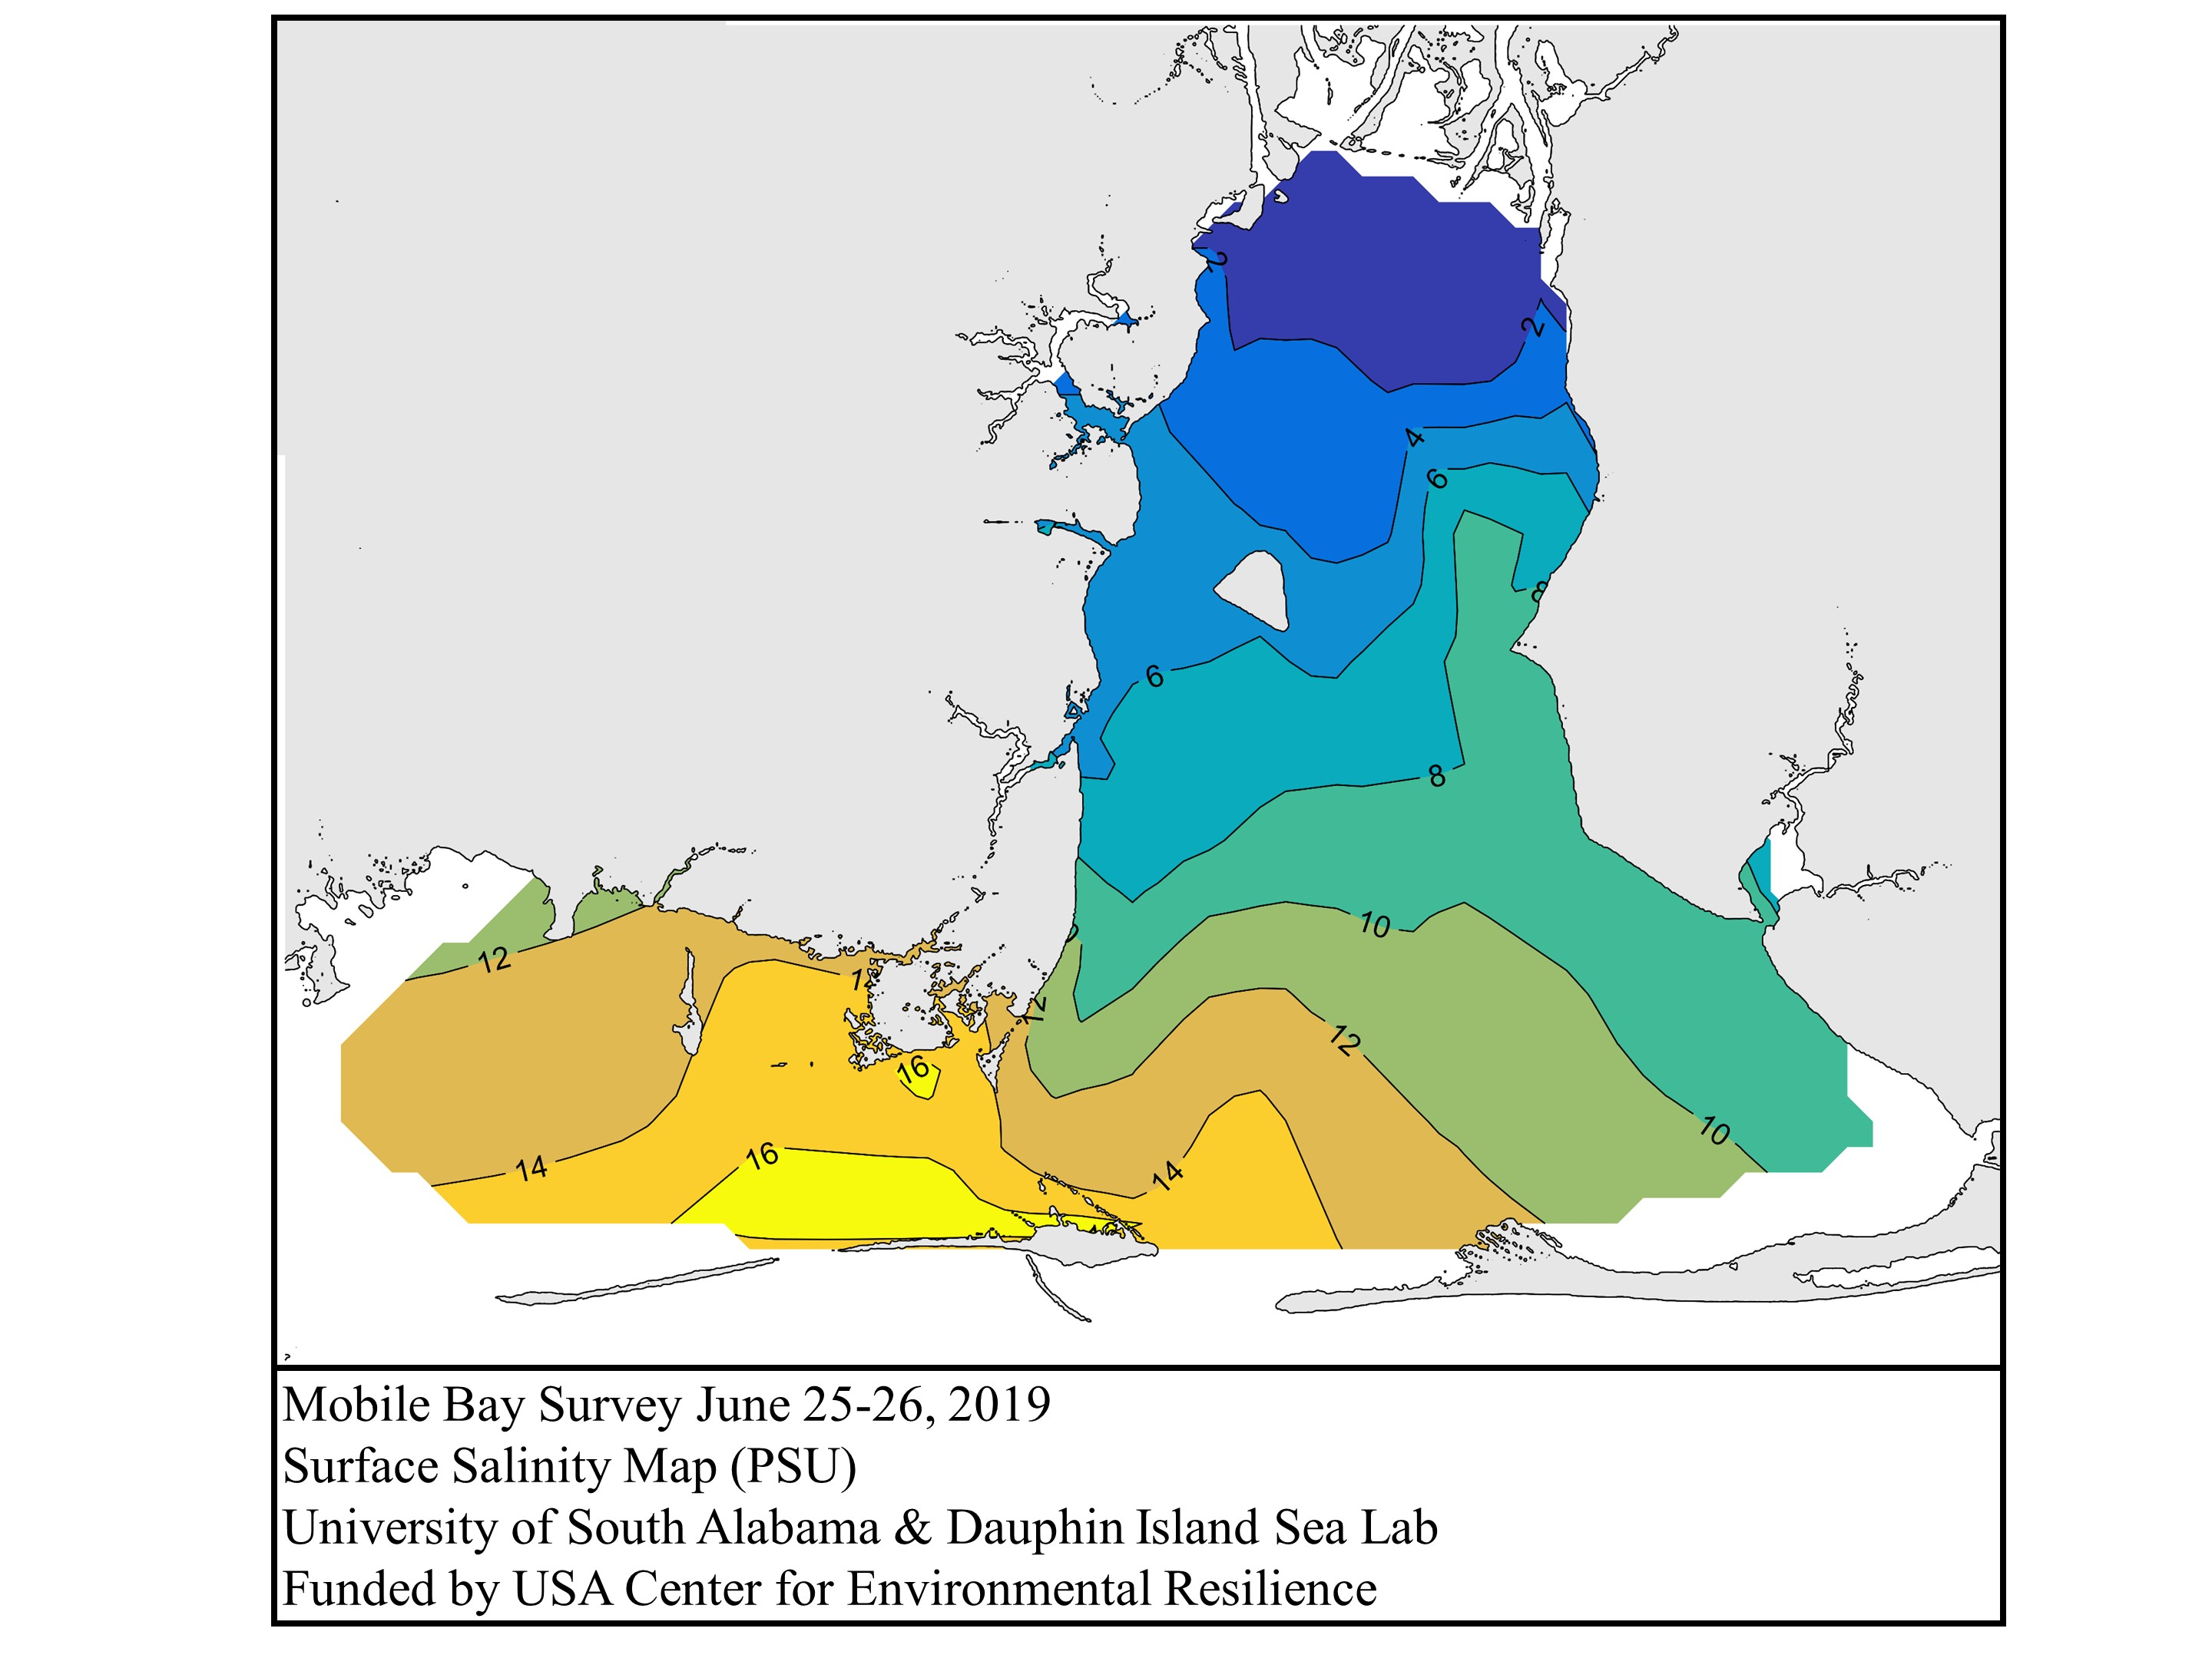
Project Goals
1. Identify independent and dependent variables with an emphasis on physical processes at Dauphin Island in Mobile Bay
2. Collect and clean necessary data using Python and Google Colab
3. Make a collaborative Github Repository for data and code sharing
4. Compare machine learning and deep learning models to see which method is more accurate for our selected dataset

Slide 3
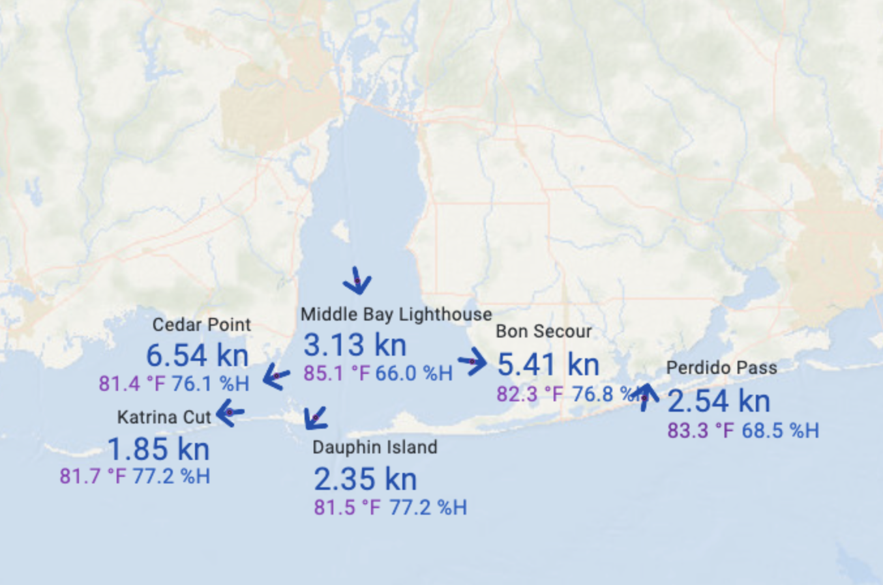
Data background – ARCOS Data
Dauphin Island, Mobile Bay, Alabama
Why did we pick this station?
Minimal missing data over a long period of time (2003 – 2022)
Good location at exchange point with the estuary and Gulf of Mexico
Observational station data – downloaded as .csv files
ARCOS data – Alabama’s Real Time Coastal Observing System at Dauphin Island Sea Lab
Dependent Variables:
Temperature, Salinity, Dissolved Oxygen

Slide 4
Data Background – ERA5 Reanalysis Data
ERA5 -- Climate reanalysis that combine past observations with models using data assimilation technique to generate consistent time series of multiple climate variables across a grid.
Download as NetCDF format
Extract from the nearest location to Dauphin Station
Clean and converted to a central .csv file
Independent Variables:
Atmospheric temperature, wind direction (u+v) and speed, solar radiation (net short wave (ssr), latent heat (slhf), long wave radiation (str), sensible heat (sshf))
River discharge (USGS) – Tombigbee River, AL – we are using this river discharge data – key upstream river, main source of discharge into Mobile Bay

Slide 5
Data Background – River Discharge and Tides
Station DILA1 - 8735180- Dauphin Island Station
NOAA Tides and Current
Downloaded as .csv file
Cleaned and added to central .csv file
River discharge (USGS) – Tombigbee River, AL – we are using this river discharge data – key upstream river, main source of discharge into Mobile Bay
Independent Variables:
Tidal elevation (WL) and river discharge (Q)

Slide 6
Methods
1. Data consolidation and cleaning in Google Colab - timestep uniform (monthly average), one primary .csv file for all data
2010 – 2020 10 years total data- ,
9 years for training and 2 years for testing
Monthly average for each independent and dependent variable
2. Make a GitHub repository Hackathon2023 - share access with all four members as collaborators
Upload all datasets and codes to this repository for collaboration
3. Develop models
Deep learning model – Antony + Katy + Aravind
13 total variables
Machine learning model - Kevin + Antony
Variable analysis specified by initial correlation analysis – highest correlation
4. Validate models - Comparison of predicted data versus observed data
Compare model use for selected data
5. Determine next steps

Slide 7
Next Steps – Data Analysis
Daily averages instead of monthly averages for a better fit for our deep learning model
Incorporate NDBC stations in the region for further development with ERA5 data
Increase quantity of data
Incorporate other river discharges into our models
Comparison of more stations throughout Mobile Bay for further model validation

Slide 8
Deep Learning Model Results
Correlation table to determine variables to incorporate
No separation of independent and dependent
Train and test split – 9/2 years
Feature scaling
databatch = 4
3- layer LSTM model (64, 8, 4)
13 nodes for 13 features
2000 epochs – long runtime – 5-10 mins, higher for more epochs
batch_size=18 (changed range outcome for predicted data v. large batch size)
Made predictions for 2019-2020
RMSE Comparison
Comparison of predicted and observed for three main dependent variables – T, S, DO

Slide 9
Next Steps – Deep learning
Rough deep learning model – daily averages instead of monthly averages
Further manipulation of model type and settings

Slide 10
Machine Learning Model Results - Kevin
Linear regression
Correlation table to determine variables to incorporate
Separate into independent and dependent – three pairs
Air temp and water temp - positive
River flow and salinity – negative
Air temperature and DO – negative
River Discharge and DO? – in progress
Insert dummy column – linear regression did not work with one independant and one dependent , needed 2D array for independent variable inputs (one variable and one constant)
Created training and testing data, tested model – 9/2 years
Made predictions for 2019-2020
Compared model prediction to to observational/testing data
Made MAPE calculations and graphs

Slide 11
Next Steps – machine learning
Testing more pairs with linear regression – only 4+ tested so far
Multiple independent, one dependent
Polynomial regression? – in progress
Machine learning, we find the relation between one dependent and multiple independent
Deep learning – neural network for prediction instead of variable relationships (ie pattern recognition and learning, versus mathematical relationship building)

Slide 12
Conclusions
Troubleshooting – difference in output scale for DL and ML predicted values
Overall, machine learning model was a better fit for our cleaned data than deep learning model
Quantity of data – 12*24 -- monthly values were not enough
Machine learning, we find the relation between one dependent and multiple independent
Deep learning – neural network for prediction instead of variable relationships (ie pattern recognition and learning, versus mathematical relationship building)

