Slide 1
Hallucinogens
By: Ralphie, Nic, Parker, and Kurtis

Slide 2
What Are Hallucinogens?
Hallucinogens are drugs that cause distortions in a user's perceptions of reality

Slide 3
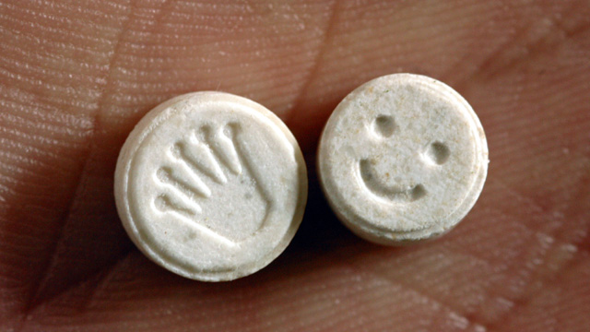
Drugs And Street Names
LSD: Acid, Purple Heart, Loony toon, Superman and zen
Peyote: Buttons, Cactus, mesc
Ecstasy: Molly, XTC, Scooby snacks, Happy pill and hug drug
Phencyclidine: Angel Dust, Hog, Lovely, Wack, Embalming Fluid, and Rocket Fuel
Psilocybin: Boomers, God's flesh,Mexican mushrooms, silly putty and simple simon

Slide 4
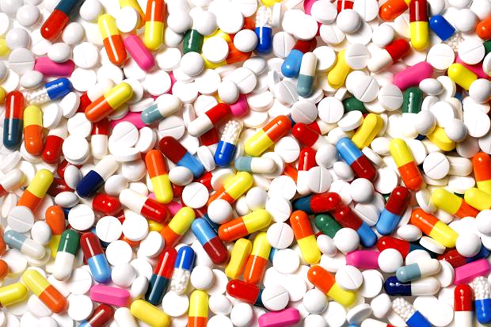

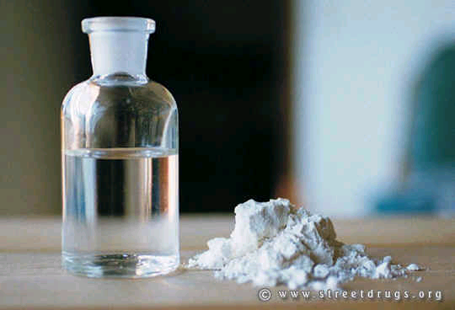
How Can Hallucinogens Enter The Body?
Pills, powders, liquids, gases, and some can be consumed. Hallucinogens stimulate the nervous system causing dilation, rise in blood pressure and constriction of arteries

Slide 5

Effects On the Body
Short term:
Increased heart rate
Increased blood pressure
Heart failure
Abnormal, rapid breathing
Lung failure
Changed
emotional feelings
Confusion
Disorientation
Suspiciousness
Mixed-up speech
Loss of muscle control
Meaningless movements
Irrational actions
Violent behavior
Distorted reality
Aggressiveness
lONG TERM:
Flashbacks weeks, months, or even years after the drug use
Flashbacks may be set off by using other drugs or by physical exercise
Flashbacks may be pleasant or a living nightmare
Most flashbacks last a very short time, only a minute or two
Decreased motivation
Prolonged depression
Increased panic
Impaired memory and concentration
Possible severe mental disturbances
Psychosis
Increased delusions
Bad trips may last hours, weeks, and even months

Slide 6
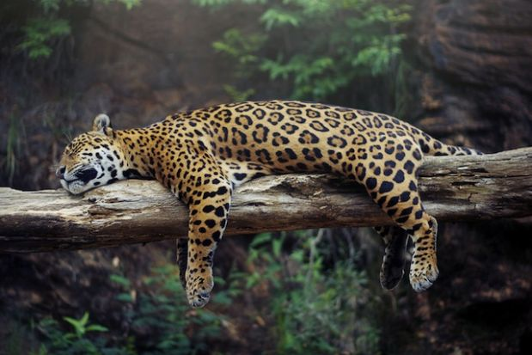
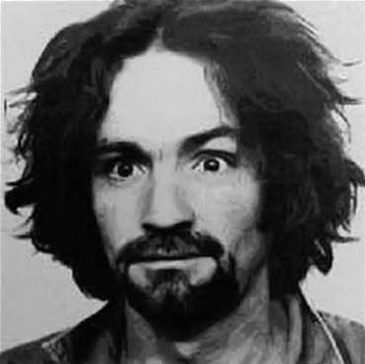
Interesting Facts
People may experience “bad trips” while taking mushrooms which are like vivid nightmares
Charles Manson often took LSD and Methamphetamines, he used these drugs to brainwash his followers
Jaguars often eat hallucinogenic roots to get high, it heightens their hunting abilities
legal hallucinogens (as strong as LSD) can be bought online
the “Double rainbow all the way” guy was tripping on Mushrooms

