Slide 1
Usage Prediction (Future 6 Day)
&
Monthly impact of weather on kWh sales

Slide 2
Project Deliverables
Models
Monthly weather Impact on sales
Predict Future 6-Day Usage
Automatic Process to implement into Companies Sales & Marketing Analytics monthly/daily processes for future days.
Report/Dashboard
Real time

Slide 3
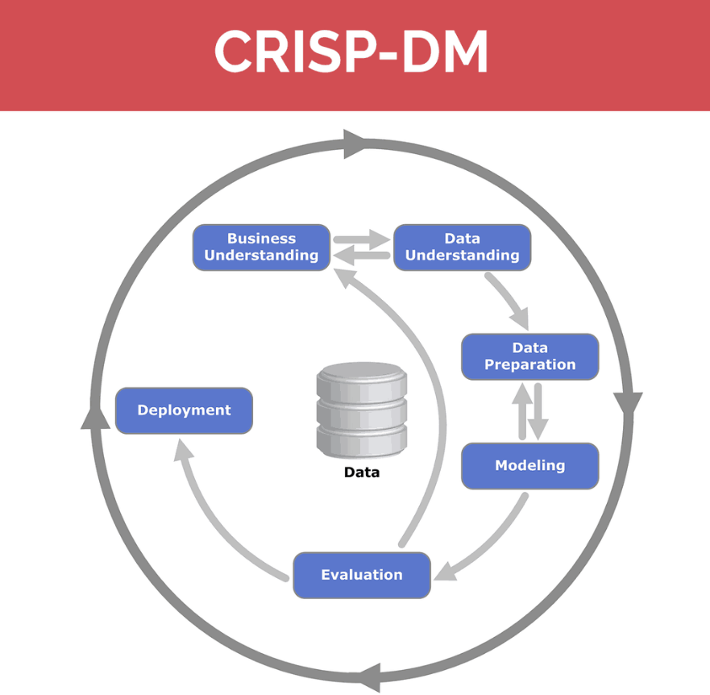
Methodology

Slide 4
Business Understanding
Company is having different Industrial Sectors and that Industrial sectors are further divided into various rate categories.
So, we have to train and run prediction Algorithms for these Categories/Subcategories individually to obtain better predictions.

Slide 5
Data Understanding
Past 3 Years to current
Weather Data
Usage Data
Future 6 Day Data
Forecasted Weather Data
Train Machine Learning Models using past data
Predicting future usage
using trained models

Slide 6
Data Preparation
120 Features
4 Tables
11 Variables
4 Derived
Managerial
Importance
Selected Features
Weather_Reading_DateTime
avgRelativeHumidity
avgWindSpeed
maxTemperature
tenYrNormalMaxTemperature
Consumption_Usage
NoOfCustomers
Feature
Engineering
Multi
Collinearity
11 Variables
Tables
Derived Features
WEATHER HOURLY READINGS
WEATHER READINGS
DAILY REGISTERED READINGS
ACCOUNTS
Weekends
lagtemp1
lagtemp2
lagtemp3

Slide 7
Modeling
For Usage prediction
For Monthly Weather Impact
XGBoost
Linear Regression
XGBoost
Neural
Networks
Random Forest
Linear Regression
Linear Regression
Polynomial Regression

Slide 8
Model Selection
Models | RMSE Error(3 Year Usage)
Linear Regression | 3605679
Neural Networks | 4253000
XGBoost | 3550596
Random Forest | 4034895

Slide 9
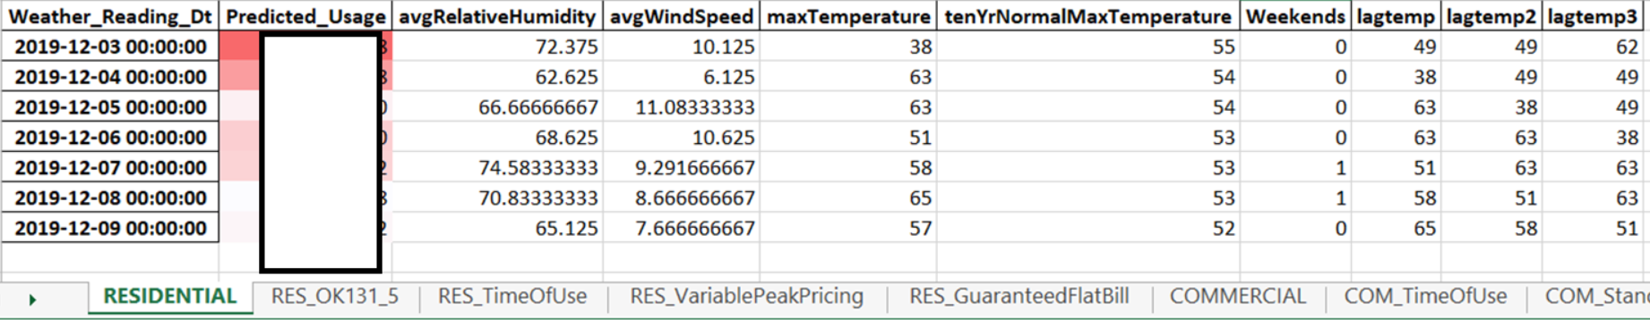
Results
Future 6 Day Usage prediction for industry / rate category combinations.

Slide 10

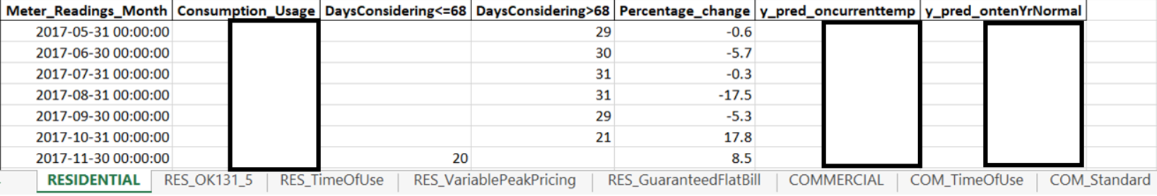
Results
Monthly %change in usage due to weather(Weather Impact)

Slide 11
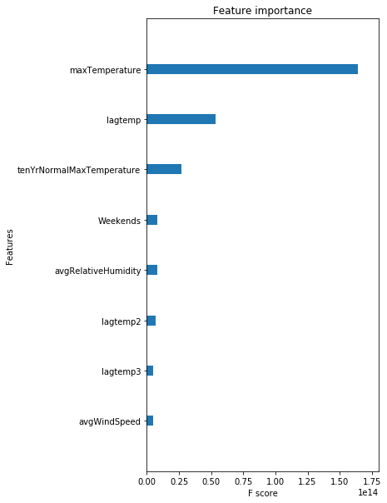
Evaluation

Slide 12
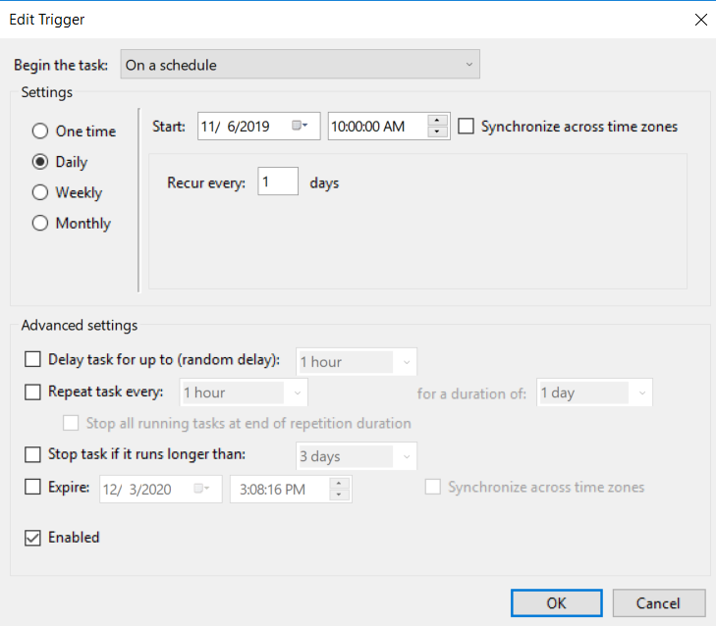
Deployment
Automated Deployment using
Python Script
Batch files
Task Scheduler

Slide 13
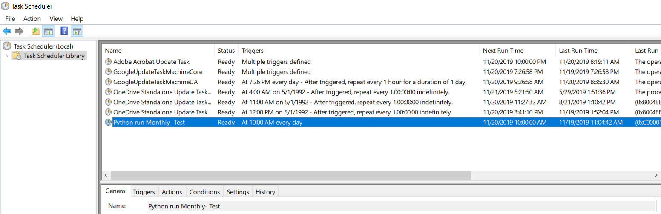
Deployment

Slide 14
Deployment
Monthly Run – SQL Data Load for training Models.
Monthly Run- Monthly Weather impact on usage.
Daily Run- Usage Predictions using Forecasted Weather data
Writing results to Teradata Database Tables
Connecting database results to SAS Visual analytics Dynamic Dashboard

Slide 15
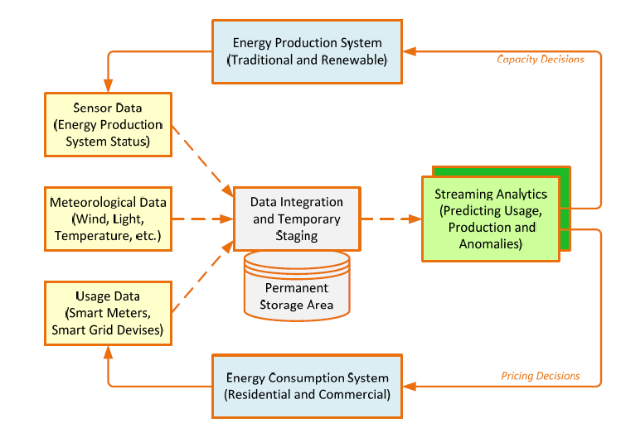
Future Scope-Stream Analytics

