Slide 1
○
OP
OutdoorPal
GeoAI Hackathon @ CSRE · IIT Bombay · 2026
OUTDOORPAL / GEOAI HACKATHON 2026
Where and when
to head outdoors.
An SLM-powered outdoor-activity assistant that recommends the best nearby place and time — grounded in live weather + geospatial data, never from model memory.
⛅
SLM · Qwen2.5-1.5B-Instruct
Live data · OSM · Open-Meteo · OSRM
10 activities · personal profiles
SUBMITTED BY TEAM OUTDOORPAL
OCTOBER 24, 2026 · 11:59 PM IST
Notes:
- Welcome the panel and introduce Team OutdoorPal.
- Frame the problem: people ask for a recommendation, not a forecast.
- Tease the answer — a specific venue + hour + advice, grounded in live data.
- Anchor the moment: GeoAI Hackathon @ CSRE, IIT Bombay, 2026.
- Set the tone: small open model, honest limits, real API calls.

Slide 2
OUTDOORPAL
02 / 06 · PROBLEM & APPROACH
PROBLEM & APPROACH
Forecasts tell you the weather. People want a recommendation.
A weather app shows 32°C, 7 kph wind, AQI 83 — but the user actually asks: which park nearby, what hour tomorrow, is it safe with my asthma, what do I carry? The right answer depends on BOTH the hour and the place. A ground downwind of an expressway at 8 AM may be pleasant by evening once the wind shifts. A venue 40 minutes away at rush hour may not be worth the trip. Today's tools do not reason about place + time together, for this particular person.
≤3 B
PARAMS · QWEN2.5-1.5B
open-weights, hosted on HF
10+
Free-form question → specific venue + hour + advice
Reason across multiple nearby places × the upcoming hours
OUTDOOR ACTIVITIES
Tighten thresholds for asthma, senior, child, pregnancy
running · cycling · golf · cricket · football · tennis · hiking · picnic · event · photography
0
HARD-CODED ANSWERS
every claim tied to live API data
© OPENSTREETMAP · OPEN-METEO · OSRM
OUTDOORPAL · 2026
Notes:
- Open with the gap: forecasts give numbers, people need decisions.
- Walk through the park-near-expressway example — place + time both matter.
- Stress personalisation: asthma, senior, child, pregnancy tighten thresholds.
- Three right-column stats frame the system: ≤3 B params, 10 activities, zero hard-coded answers.
- Bridge to next slide: how the architecture delivers this.

Slide 3
OUTDOORPAL
03 / 06 · ARCHITECTURE
ARCHITECTURE
Live-data pipeline + rule engine + SLM naturaliser.
Every claim is grounded in live API data the assistant fetched at query time. The SLM only naturalises the structured reasoning output.
1
2
3
4
5
6
7
Parse query
→
Geocode
→
Find venues
→
Fetch weather + AQ
→
Travel time
→
Score venue × hour
→
Naturalise with SLM
parser
Nominatim
Overpass · OSM
OSRM
Open-Meteo
rule engine
Qwen2.5-1.5B
Per-venue fetch (in parallel)
Scoring formula
Promise.all of forecast + geospatial context + routing
Score = 70 base + 8 ideal-temp + 5 light wind + 5 low-rain + 5 good AQI + 5 green + 5 short travel + 5 daylight
Up to 4 candidate venues per query (rate-limit friendly)
In-memory cache: 30 min for weather, 24 h for geocoding
Blockers subtract: each blocker drops 5 from 40
Profile tightening: asthma caps AQI ≤ 30; senior / child / pregnancy tighten temp + UV + AQI
© OPENSTREETMAP · OPEN-METEO · OSRM
OUTDOORPAL · 2026
Notes:
- Walk through all seven pipeline steps in order, end to end.
- Highlight parallelism — per-venue Promise.all of forecast + geospatial + routing.
- Stress caching: 30 min weather, 24 h geocoding, to stay rate-limit friendly.
- The SLM only naturalises structured output — it cannot invent weather or places.
- Mention profile tightening (asthma, senior, child, pregnancy) flows into scoring.

Slide 4
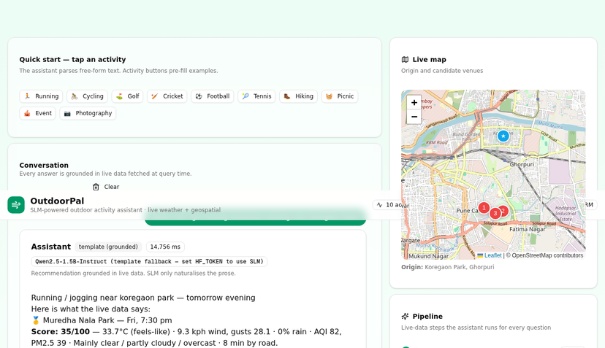
OUTDOORPAL
04 / 06 · WORKED EXAMPLE
WORKED EXAMPLE
Where can I go running tomorrow evening near Koregaon Park?
1
Parse —
Activity=running · Location=Koregaon Park · Time=tomorrow 17:00–21:00 IST · profile=none.
2
Geocode —
Nominatim → 18.5366, 73.8933 (Koregaon Park, Pune, India).
3
Find venues —
Overpass blocked by sandbox firewall → Nominatim POI fallback finds 4 parks within 10 km.
4
Score 18 venue-hour pairs —
Pune AQI 83 (live Open-Meteo AQ) > running limit 50 → all slots flagged.
5
Top-3 + advice —
Muredha Nala Park at 19:30 IST · 8 min by road · carry water + reflective band · avoid AQI > 50.
Live demo — question submitted at 15:49 IST, response in 16 s.
Honest failure — when AQI is too high, the assistant says so instead of inventing a venue.
© OPENSTREETMAP · OPEN-METEO · OSRM
OUTDOORPAL · 2026
Notes:
- Open the live UI and paste the question verbatim; emphasise the 16-second end-to-end response.
- Walk judges through the five pipeline steps as they fire on screen.
- Point at the map markers and the cited numbers beneath each venue card.
- Stress step 4: live AQI 83 > running limit 50 means every slot is flagged — the assistant refuses rather than invents.
- Invite judges to try their own city, hour, or activity after the talk.

Slide 5
OUTDOORPAL
05 / 06 · MODEL & FINE-TUNING
MODEL & FINE-TUNING
Qwen2.5-1.5B-Instruct — used as-is, with guardrails.
The hackathon allows an open base model directly. We use Qwen2.5-1.5B-Instruct with NO fine-tuning, but with strict guardrails so it can’t invent weather or places.
▦
Specs
⛨
Guardrails
MODEL
Qwen/Qwen2.5-1.5B-Instruct
System prompt forbids inventing weather, places, times or numbers.
PARAMETERS
Input is a structured payload from the rule engine — top 3 venue-hour-score triples + weather + advice.
1.54 B
(≤ 3 B ✓)
LICENSE
Qwen (open)
Generation capped at 350 new tokens, temperature 0.4, top-p 0.85.
FINE-TUNING
Deterministic Sources block appended after SLM output so citations are never lost.
None
INVOCATION
Hugging Face Inference API (or self-host with vLLM / TGI)
On any failure → template fallback (still grounded).
REPO
huggingface.co/Qwen/Qwen2.5-1.5B-Instruct
◆
Why a small model?
A 1.5 B model cannot memorise the world’s weather and geography — that limitation is the point. It forces the system to rely on live data rather than recall.
© OPENSTREETMAP · OPEN-METEO · OSRM
OUTDOORPAL · 2026
Notes:
- State up front: no fine-tuning at all — Qwen2.5-1.5B-Instruct is used as-is from Hugging Face.
- Walk the Specs table row-by-row; flag the 1.54 B ≤ 3 B compliance check.
- Pivot to Guardrails: the system prompt, structured input, and hard token/temperature caps.
- Emphasise the deterministic Sources block — citations survive even if generation drifts.
- Future work: LoRA fine-tune on grounded QA pairs once eval harness is in place.

Slide 6
OUTDOORPAL
06 / 06 · LIMITATIONS · SOURCES · DEMO
LIMITATIONS, SOURCES & DEMO
Honest limits, disclosed sources, ready to demo.
⚠
Limitations
▦
Data sources (all disclosed)
▶
Try it
Hand-tuned thresholds (e.g. AQI ≤ 50 for running) — starting points, not medical.
OpenStreetMap
(Overpass API)
venues, context
POST
LIVE API
/api/assistant
Overpass coverage varies by city — Pune & Bengaluru rich, smaller towns thinner.
Nominatim
geocoding, POI fallback
GET
HEALTH
/api/assistant
Open-Meteo Forecast
hourly weather
UI
WEB UI
this Next.js app
Travel times are driving times — flag in advice for cycling / walking.
DOC
SOURCE
README in this repo
Open-Meteo Air Quality
PM2.5, AQI
OSM demo server rate-limited — self-host OSRM for production.
OSRM
road routing
AQI is CAMS European with US-AQI approximation — CPCB may differ in India.
Hugging Face Hub
SLM weights (Qwen2.5-1.5B)
Map data © OpenStreetMap contributors, ODbL 1.0 · Open-Meteo, CC BY 4.0 · Qwen license for model weights · Built with Z.ai as coding aid (disclosed).
© OPENSTREETMAP · OPEN-METEO · OSRM
OUTDOORPAL · 2026
Notes:
- Open the deck close by inviting judges to hit POST /api/assistant or the Web UI live.
- Reiterate honesty: hand-tuned thresholds are starting points, not medical advice — every AQI limit is a configurable knob.
- Walk the disclosed data sources column — six live, openly-licensed feeds, no proprietary APIs.
- Acknowledge the CPCB-vs-CAMS AQI mismatch as known and disclosed for the India context.
- Close with thank-you and a Q&A prompt.

