Slide 1
Dapr Workflow – Pub/Sub
Challenge 5

Slide 2
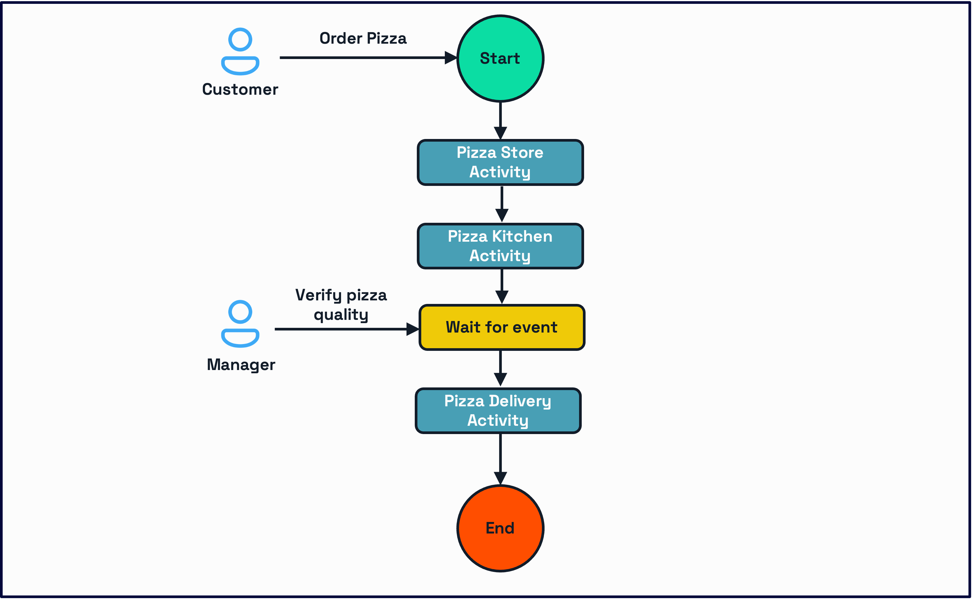

Slide 3
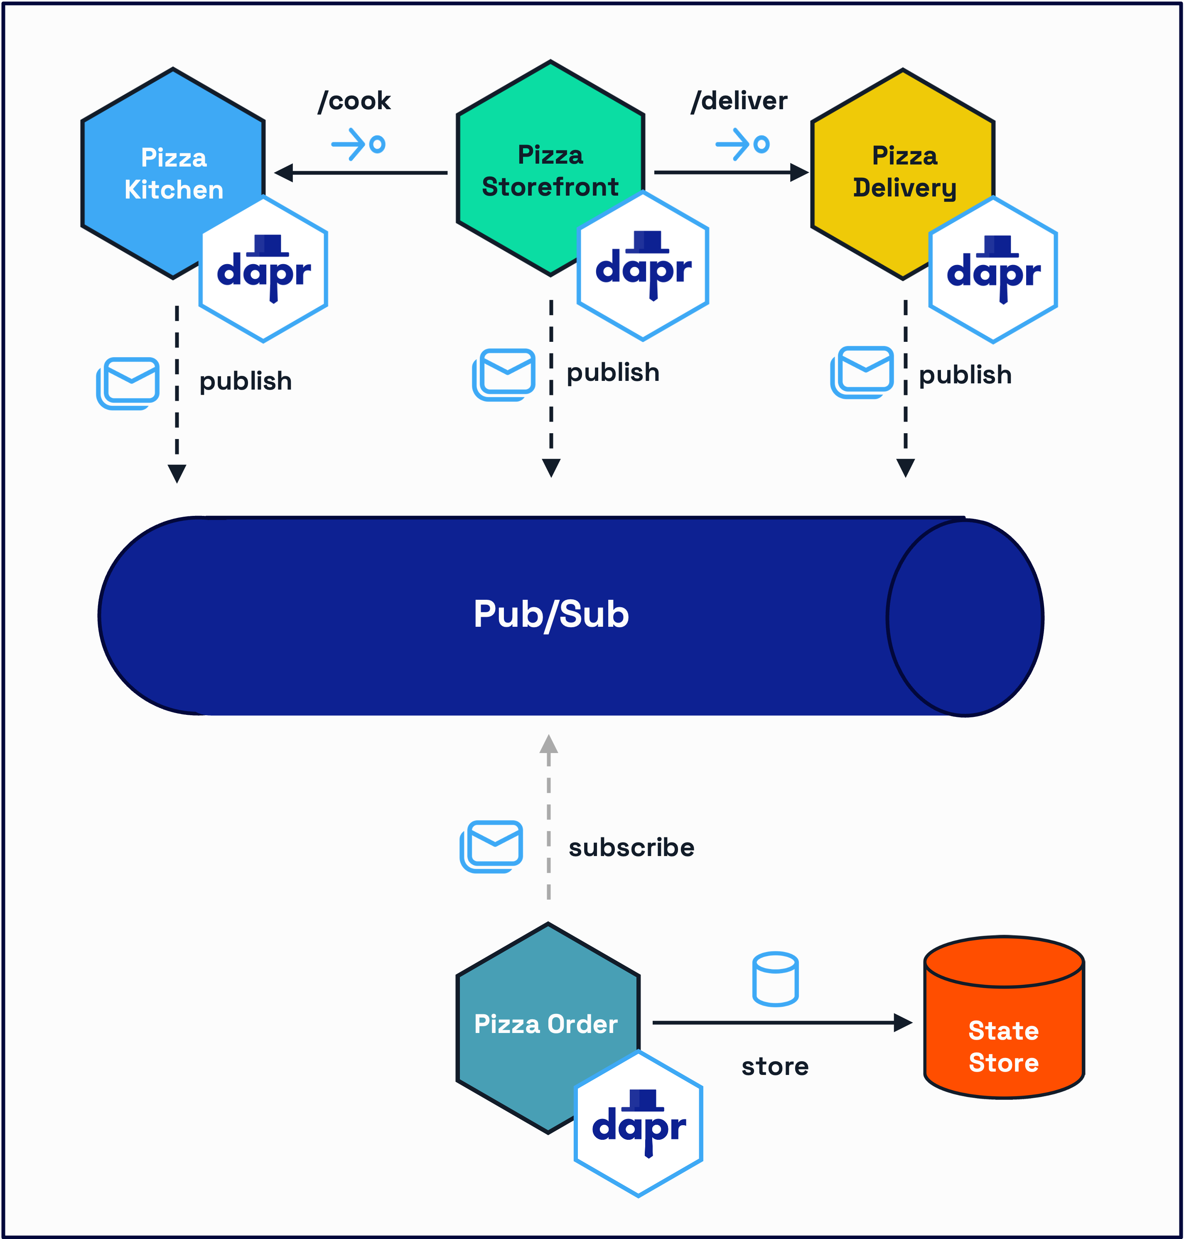

Slide 4











Publish
Publish
Workflow
Pub/Sub
Topic: delivery
Topic: workflow-storefront
Workflow-kitchen
Workflow-delivery
Publish
Publish
Topic: storefront
Topic: kitchen
Pizza
Workflow
Pizza
Kitchen
Pizza
Storefront
Pizza
Delivery
Publish
Publish
Publish
State
Topic: order
Order
Pub/Sub
State
Store
Pizza Order
State
Store
State

