Slide 1
SB
ShiftBuddy
Modern Shift Operations Platform
Built for Distributed Support Teams — Corp x YCI
Management & Leadership Briefing
Shift Handover
Incident Log
Analytics
Roster Planner
Daily Diary
Coverage Matrix
Notes:
Welcome to ShiftBuddy — a purpose-built shift operations platform that replaces Excel sheets, email chains, and Slack threads with one structured, role-aware workspace. Today we'll walk through every module: what it does, who uses it, and how it improves on the status quo.

Slide 2
The Problem with Excel-Based Shift Management
Excel Sprawl
Email & Slack Chaos
Zero Visibility
One file per week, per project
Handovers buried in threads
Managers can't see SLA compliance
No version control or audit trail
No acknowledgement tracking
No attendance or clock-in tracking
Formulas break silently
Critical items missed at shift change
Roster gaps discovered too late
No real-time collaboration
No searchable incident history
No cross-project incident view
ShiftBuddy replaces all of this with one structured, role-aware platform — so nothing falls through the cracks at shift change.
Notes:
Before ShiftBuddy, distributed support teams managed shifts across three broken tools: Excel for rosters, email for handovers, and Slack for incident updates. The result: version confusion, missed escalations, and zero management visibility.

Slide 3
ShiftBuddy — 8 Integrated Modules
1
Dashboard
2
Log Update
3
Daily Feed
4
Shift Hub
Live overview: quick actions, stat cards, handovers & swaps
Structured form to log incidents, alerts and activity updates
Unified incident stream from PagerDuty, ServiceNow, Slack, Teams
Today's shift cycle timeline + team submission tracking
5
Analytics
6
Daily Diary
7
Roster Planner
8
PT Coverage
Period KPIs: SLA, resolution rate, P1 count, handover ack %
Shift diary, incident count, KT progress, KTLO tasks
Visual shift calendar with on-call, holiday overlays, all projects
Per-shift YCI SPOC + Client SME coverage across all projects
Notes:
ShiftBuddy organizes operations into 8 tightly integrated modules. Every module is role-aware — contractors see their own shift, leads see the full team, managers and client stakeholders get analytics and cross-project visibility.

Slide 4
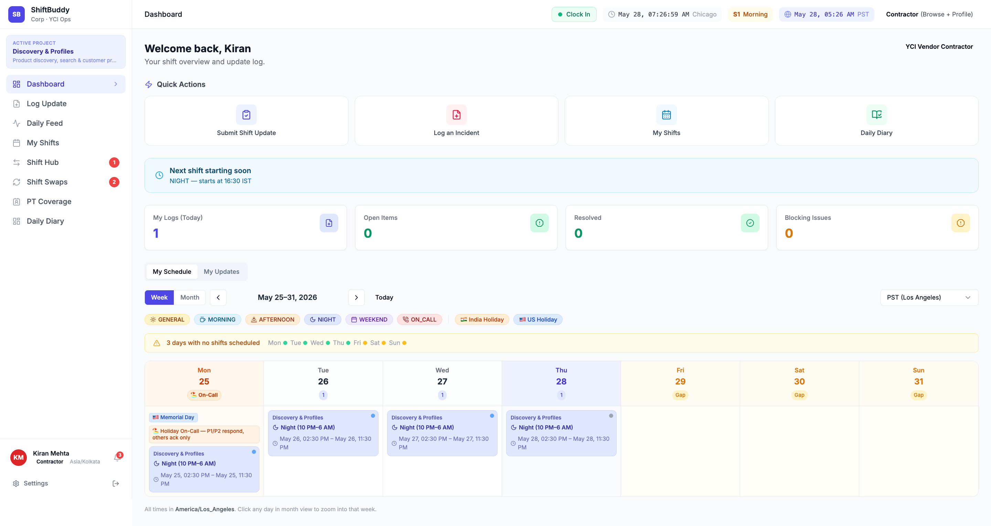
Dashboard
Live command center — quick actions, stat cards, shift handover & swap status
1
2
3
1
Sidebar
4
Nav, active project, role context
5
2
Dual Timezone
Chicago + PST live clock
6
7
3
Role Badge
Contractor / Lead / Manager
8
4
Quick Actions
1-click: Handover, Swaps, Diary
5
Stat Cards
Logs, Unresolved, Validation, Swaps
6
Handover Protocol
Who submitted / acknowledged
7
Swap Requests
Approve or reject peer swaps
8
Update Feed
All logs + Team roster view
Notes:
The Dashboard is the first screen every team member sees at login. 1 Sidebar — navigation, active project indicator, and logged-in user context at the bottom. 2 Dual Timezone — live clock showing both Chicago and PST so offshore and onshore are always aligned. 3 Role Badge — shows the user's current role (Contractor, Lead, Manager) so they know what they can see and do. 4 Quick Actions — one-click shortcuts to the most common tasks. Red badge on Handover means a submission is due. 5 Stat Cards — live counts: total logs, unresolved items, pending validation, and swap requests. Color-coded by urgency. 6 Shift Handover Protocol — shows the incoming handover from the previous shift lead, with an Acknowledge button. 7 Shift Swap Requests — pending swap cards with Approve / Reject controls. 8 All Updates / Team Roster — tabbed feed of all shift logs, with a Team Roster view showing current attendance.

Slide 5
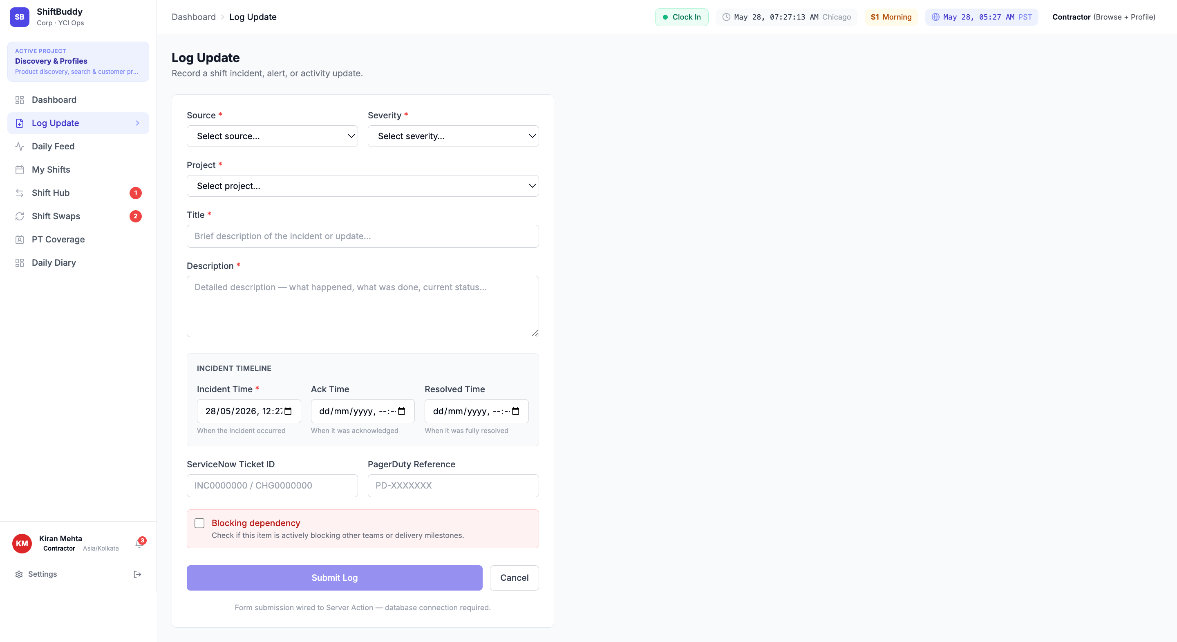
Log Update
Structured form to record incidents, alerts and activity — wired to ServiceNow and PagerDuty
1
2
1
Source
PagerDuty, ServiceNow, Slack, Teams
3
Severity
4
2
5
P1 Critical to P4 Low
6
3
Project
Linked to active project
7
4
Title
8
Brief incident description
9
5
Description
Full details, actions taken
6
Timeline
Incident time, Ack time, Resolved
7
Ticket IDs
SNOW ticket + PagerDuty ref
8
Blocking Flag
Marks cross-team blockers
9
Submit
Logs to database, notifies lead
Notes:
The Log Update form replaces the informal "dropped a note in Slack" approach to incident logging. Every log is structured: source, severity, project, timeline (incident time, acknowledgement, resolution), and linked ticket IDs. The Blocking Dependency checkbox flags items that are actively blocking other teams or delivery milestones — these surface immediately on the lead's dashboard. All logs feed into the Daily Feed and Analytics pages automatically.

Slide 6
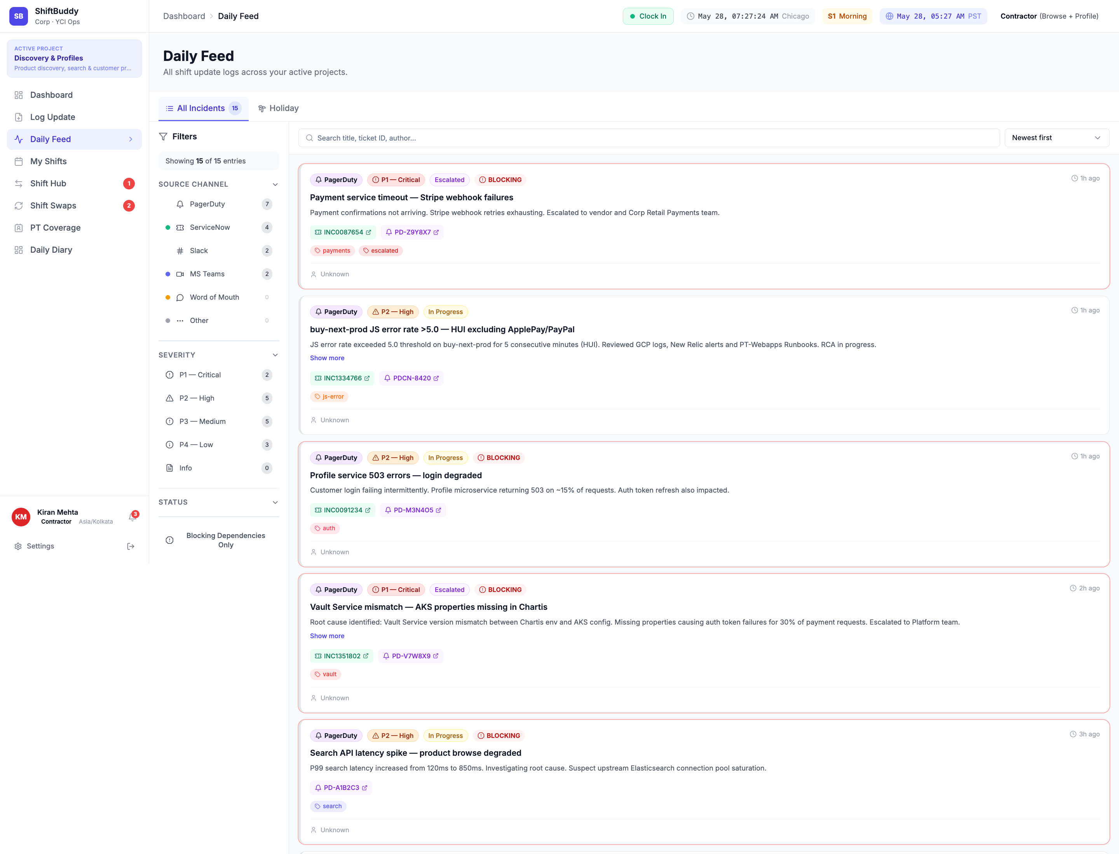
Daily Feed
Unified incident stream from PagerDuty, ServiceNow, Slack and Teams — filterable by source and severity
1
1
Source Filter
2
PD, ServiceNow, Slack, Teams count
3
4
6
5
2
Severity Filter
7
P1 Critical / P2 High / P3 Medium
3
P1 Incident Card
8
Full incident with timeline + context
4
Source + Severity
Color-coded badges per card
5
Status Badge
Escalated / In Progress / Resolved
6
Tags + Ticket
#tags and linked SNOW/PD tickets
7
P2 Card
Amber — warning level incidents
8
P3 Card
Lower priority, still tracked
Notes:
The Daily Feed is a unified incident log aggregating signals from PagerDuty, ServiceNow, Slack, and Microsoft Teams into one chronological view. 1 Source Filter — pills at the top show count per source. Click any to filter. 2 Severity Filter — toggle P1/P2/P3 to narrow by urgency. 3 Incident Cards — each card shows full context: ID, title, source system, severity, timestamp, tags, linked ticket, and real-time status. 5 Status Badge — shows Escalated to Corp, In Progress, Blocking, or Resolved. Updated in real time. 6 Tags + Tickets — structured #tags and clickable ServiceNow / PagerDuty ticket links for one-click navigation. This replaces the chaotic Slack channel where P1 alerts would often be missed during shift handover.

Slide 7
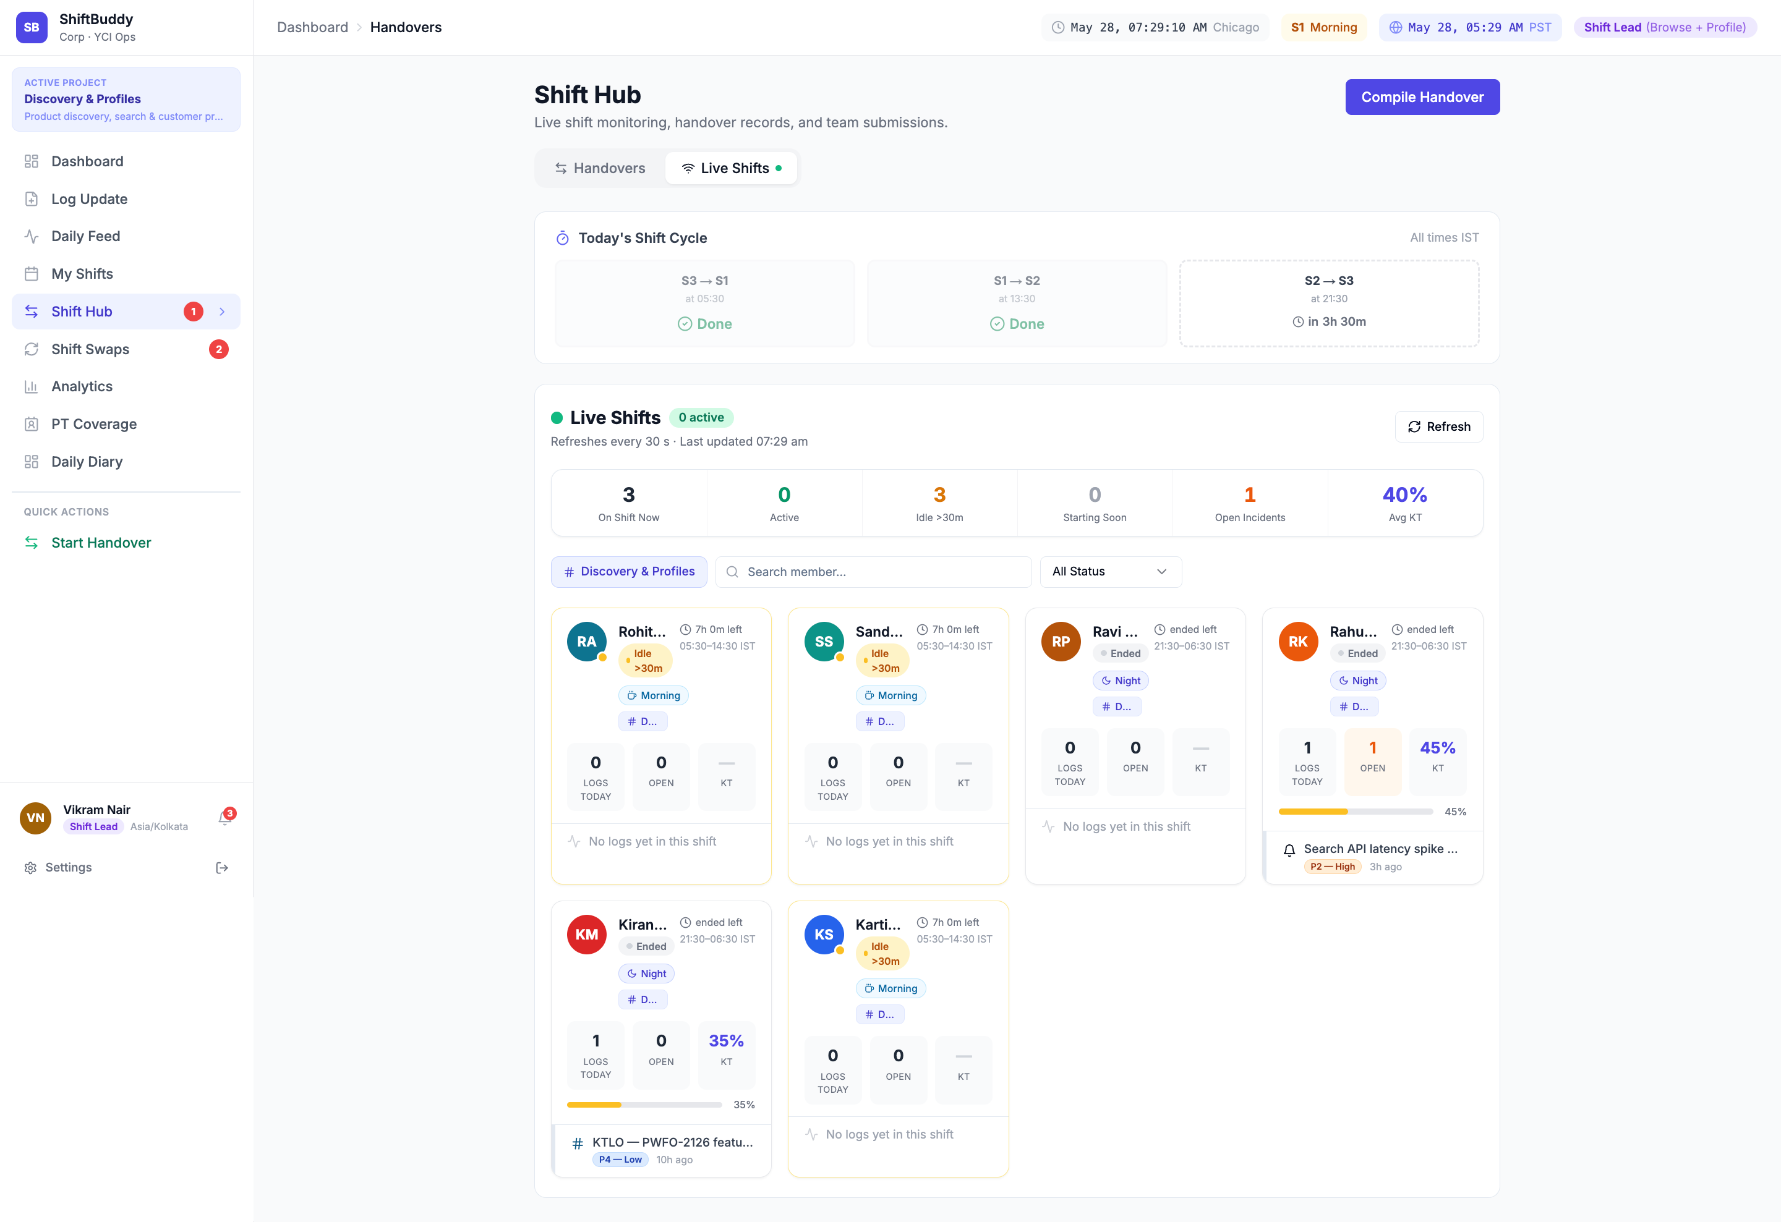
Shift Hub
Shift cycle timeline, live team submissions, individual logs and KT progress per member
1
2
1
Tab Bar
3
4
5
Handovers vs Live Shifts toggle
2
Compile Handover
6
Lead compiles the outgoing handover
7
3
Shift Cycle
S3→S1, S1→S2, S2→S3 timeline
4
Completed Node
8
Green check = handover submitted + acked
5
Upcoming Node
Countdown to next shift cutoff
6
Live Shifts Stats
On Shift, Active, Starting Soon
7
Member Cards
Logs, Open items, KT % per person
8
KT Progress
Knowledge Transfer completion bar
Notes:
The Shift Hub is real-time handover coordination for Shift Leads. 1 Tab Bar — switch between Handovers (who submitted, who acknowledged) and Live Shifts (who is online right now). 2 Compile Handover button — the lead uses this to compile all team updates into the outgoing handover note. 3 Today's Shift Cycle — a visual timeline of S3→S1, S1→S2, and S2→S3 transitions. Green = done, clock = upcoming. 4/5 Cycle Nodes — clicking a node shows the handover detail for that shift bracket. 6 Live Shifts Stats — at-a-glance: how many are on shift, how many are active, who is starting soon. 7 Member Cards — each card shows a team member's logs, open items, and KT progress for this shift. 8 KT Progress Bar — tracks Knowledge Transfer completion across the entire team. This single screen replaces the email threads where leads used to forward handover summaries and wait for acknowledgement replies.

Slide 8
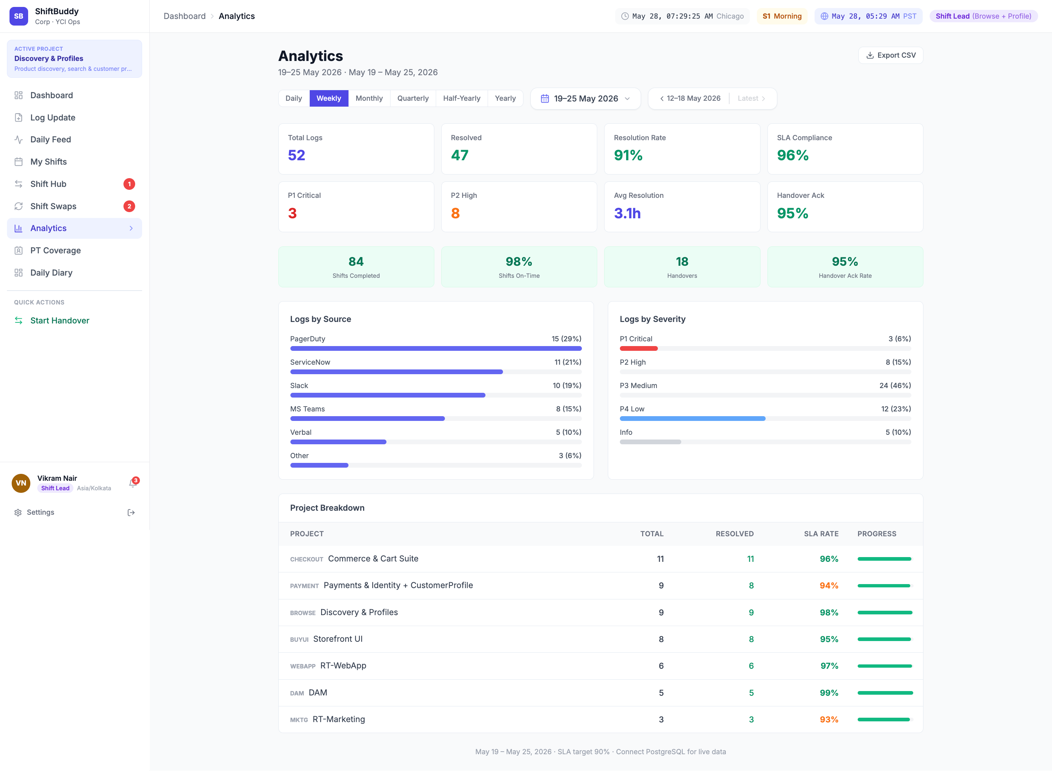
Analytics
Period-based KPIs: SLA, resolution rate, P1/P2 counts, handover ack %, project breakdown
1
Period Tabs
1
2
3
Daily/Weekly/Monthly/Quarterly...
4
2
Date Picker
5
Custom date range filter
6
3
Export CSV
Download all data for reporting
7
8
4
Top KPIs
52 logs, 91% resolution, 96% SLA
5
Bottom KPIs
P1=3, P2=8, Avg 3.1h, Ack 95%
9
6
Shift Stats
Shifts completed, on-time %, handovers
7
By Source
PagerDuty, SNOW, Slack breakdown
8
By Severity
P1/P2/P3/P4 distribution
9
Project Table
SLA rate + progress per project
Notes:
The Analytics page gives managers and client stakeholders a period-based view into operational health — something that was previously available only as a manual monthly Excel report. 1 Period Tabs — Daily, Weekly, Monthly, Quarterly, Half-Yearly, Yearly. One click to switch. 2 Date Picker — select any custom date range. 3 Export CSV — download all data for leadership reporting. 4 Top KPIs — Total Logs (52), Resolved (47), Resolution Rate (91%), SLA Compliance (96%). 5 Bottom KPIs — P1 Incidents (3), P2 Incidents (8), Average Resolution Time (3.1h), Handover Ack Rate (95%). 7/8 Charts — Logs by Source and by Severity, showing which integrations and which priority levels dominate. 9 Project Breakdown table — SLA rate per project with a progress bar, so management can see which project needs attention. For the first time, leadership can answer "Did we meet SLA this week?" in under 10 seconds.

Slide 9
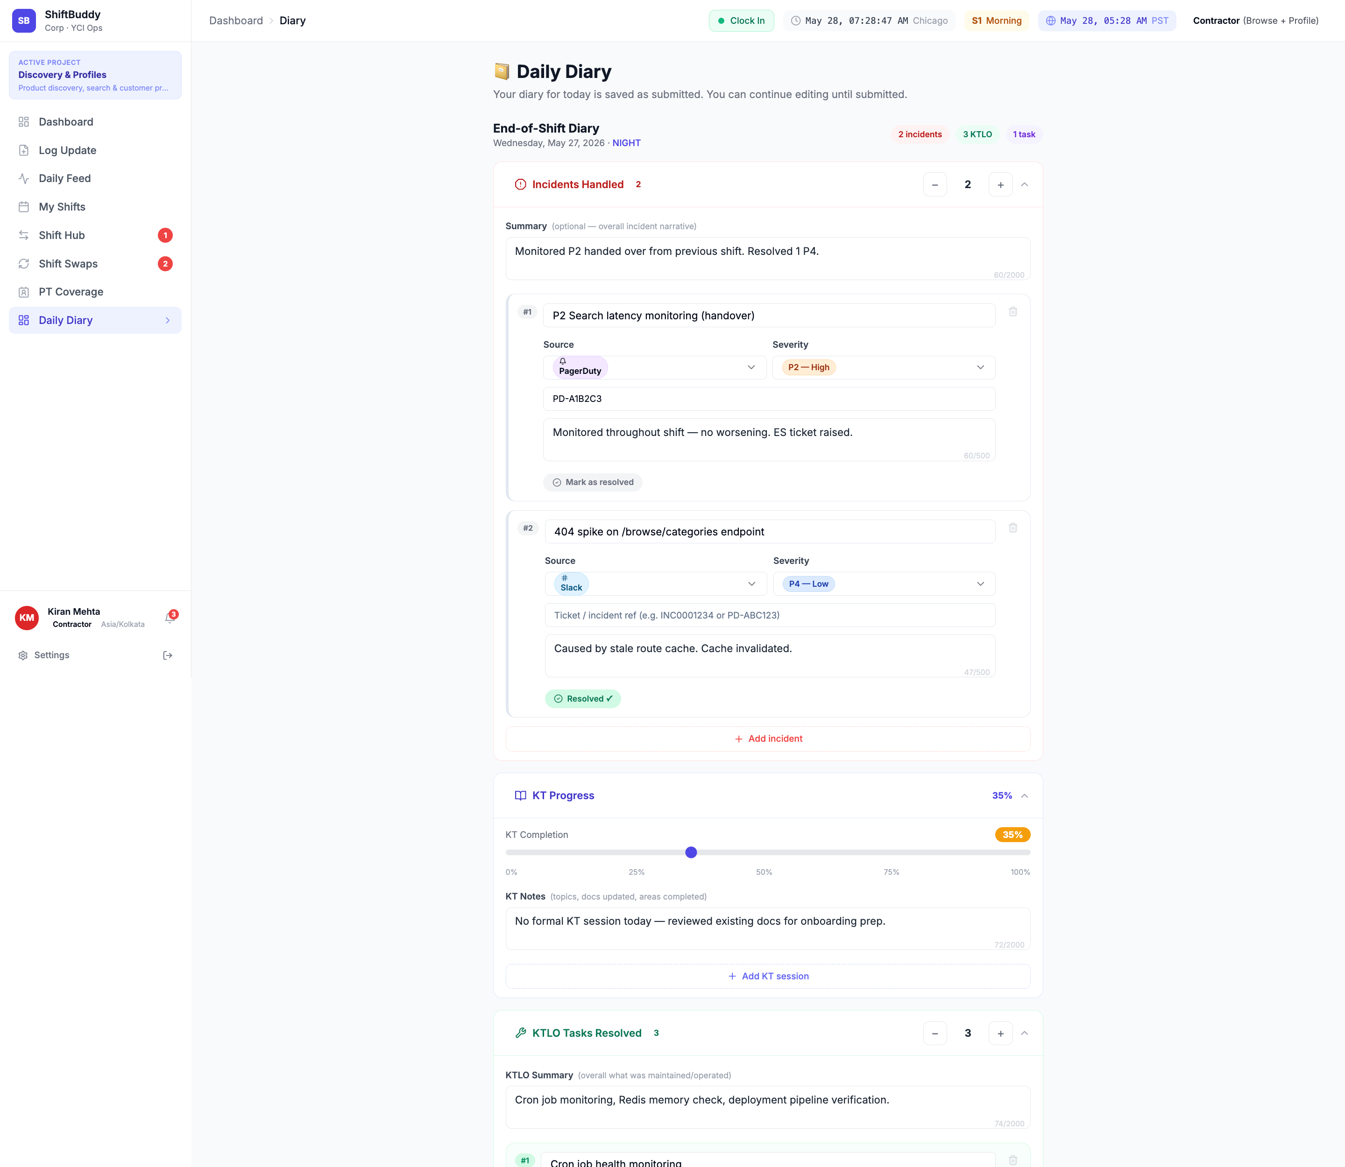
Daily Diary
Structured shift diary: incident count, KT progress, KTLO tasks, blockers, and submit to lead
1
2
1
Draft Header
3
Diary date, project, shift context
4
2
Sessions
Active sessions, time left to submit
5
3
Incidents Counter
+/- count of incidents this shift
6
Incident Detail
4
7
Source, severity, SNOW ticket, status
5
2nd Incident
Each incident structured + tagged
8
6
KT Progress
Knowledge Transfer % with slider
7
KTLO Tasks
9
Keep-The-Lights-On task checklist
10
8
New Tasks
Tasks created this shift for follow-up
9
Blockers
Flagged items for incoming shift
10
Submit Button
Saves draft or submits to lead
Notes:
The Daily Diary replaces the informal "end-of-shift email" that leads and contractors used to send at shift change. Every diary entry is structured: incidents logged with source + severity + ticket links, KT progress slider, KTLO task completion, new tasks created, and a blockers section specifically for the incoming shift. The Save Draft feature lets contractors build the diary throughout the shift, not just at the end. Submit to Lead delivers the completed diary to the shift lead, who sees it in the Shift Hub compilation view.

Slide 10
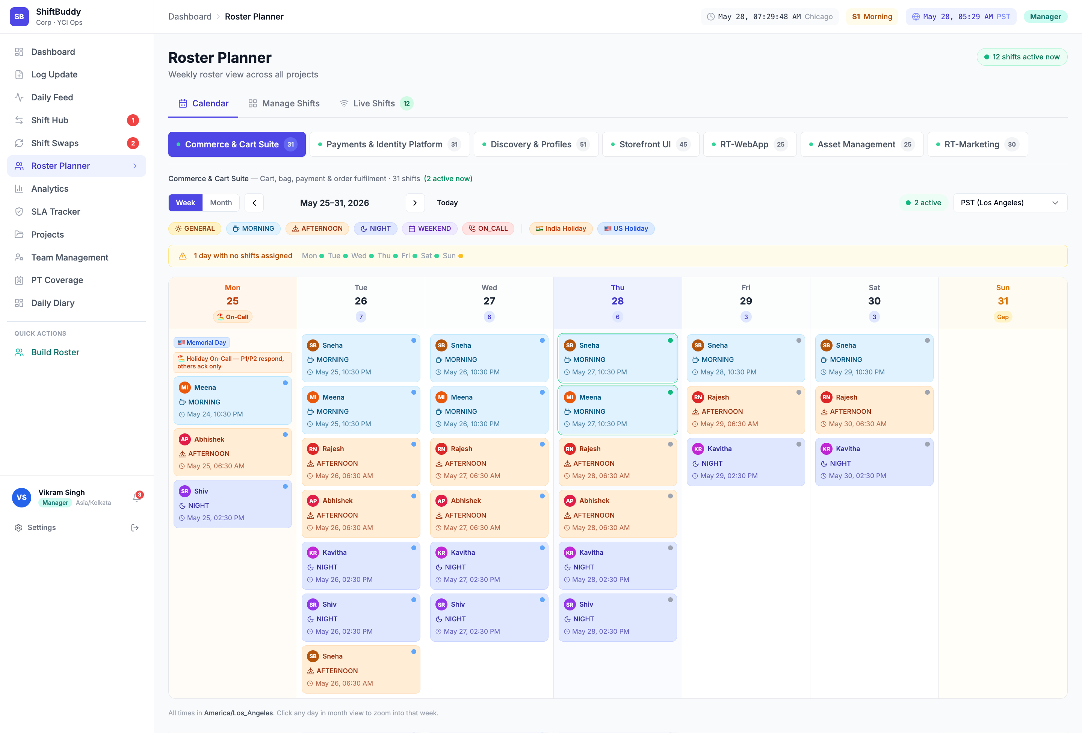
Roster Planner
Visual shift calendar across all projects — on-call indicators, holiday overlays, weekly and monthly views
1
2
3
1
View Tabs
4
5
6
Calendar / Manage Shifts / Live Shifts
7
2
Project Tabs
9
8
Switch between all projects
3
Active Count
10
Staff on shift right now
4
Week/Month
Toggle + date navigation
5
Holiday Filters
India + US holiday overlays
6
Timezone
Display in PST / IST / Chicago
7
Calendar Header
Mon-Sun with shift date
8
Roster Cells
Member name + MORNING/NIGHT shift
9
On-Call Badge
Red dot = on-call for escalations
10
Holiday Row
Amber = public holiday, staffing risk
Notes:
The Roster Planner is the visual shift calendar that replaces the shared Excel roster. 1 View Tabs — Calendar (visual), Manage Shifts (edit assignments), and Live Shifts (who is active right now). 2 Project Tabs — switch between all projects instantly. Each project has its own roster. 3 Active Count — shows how many staff are on shift right now, pulled from clock-in data. 5 Holiday Overlays — India and US public holidays are overlaid on the calendar in amber, so managers immediately see staffing gaps on holiday weeks. 8 Roster Cells — each day-shift cell shows the assigned member's name and shift bracket (MORNING/AFTERNOON/NIGHT). 9 On-Call Indicator — a red dot marks who is on-call for escalations that shift. This replaces the Excel roster that required manual copy-paste every week and often had stale or conflicting data.

Slide 11
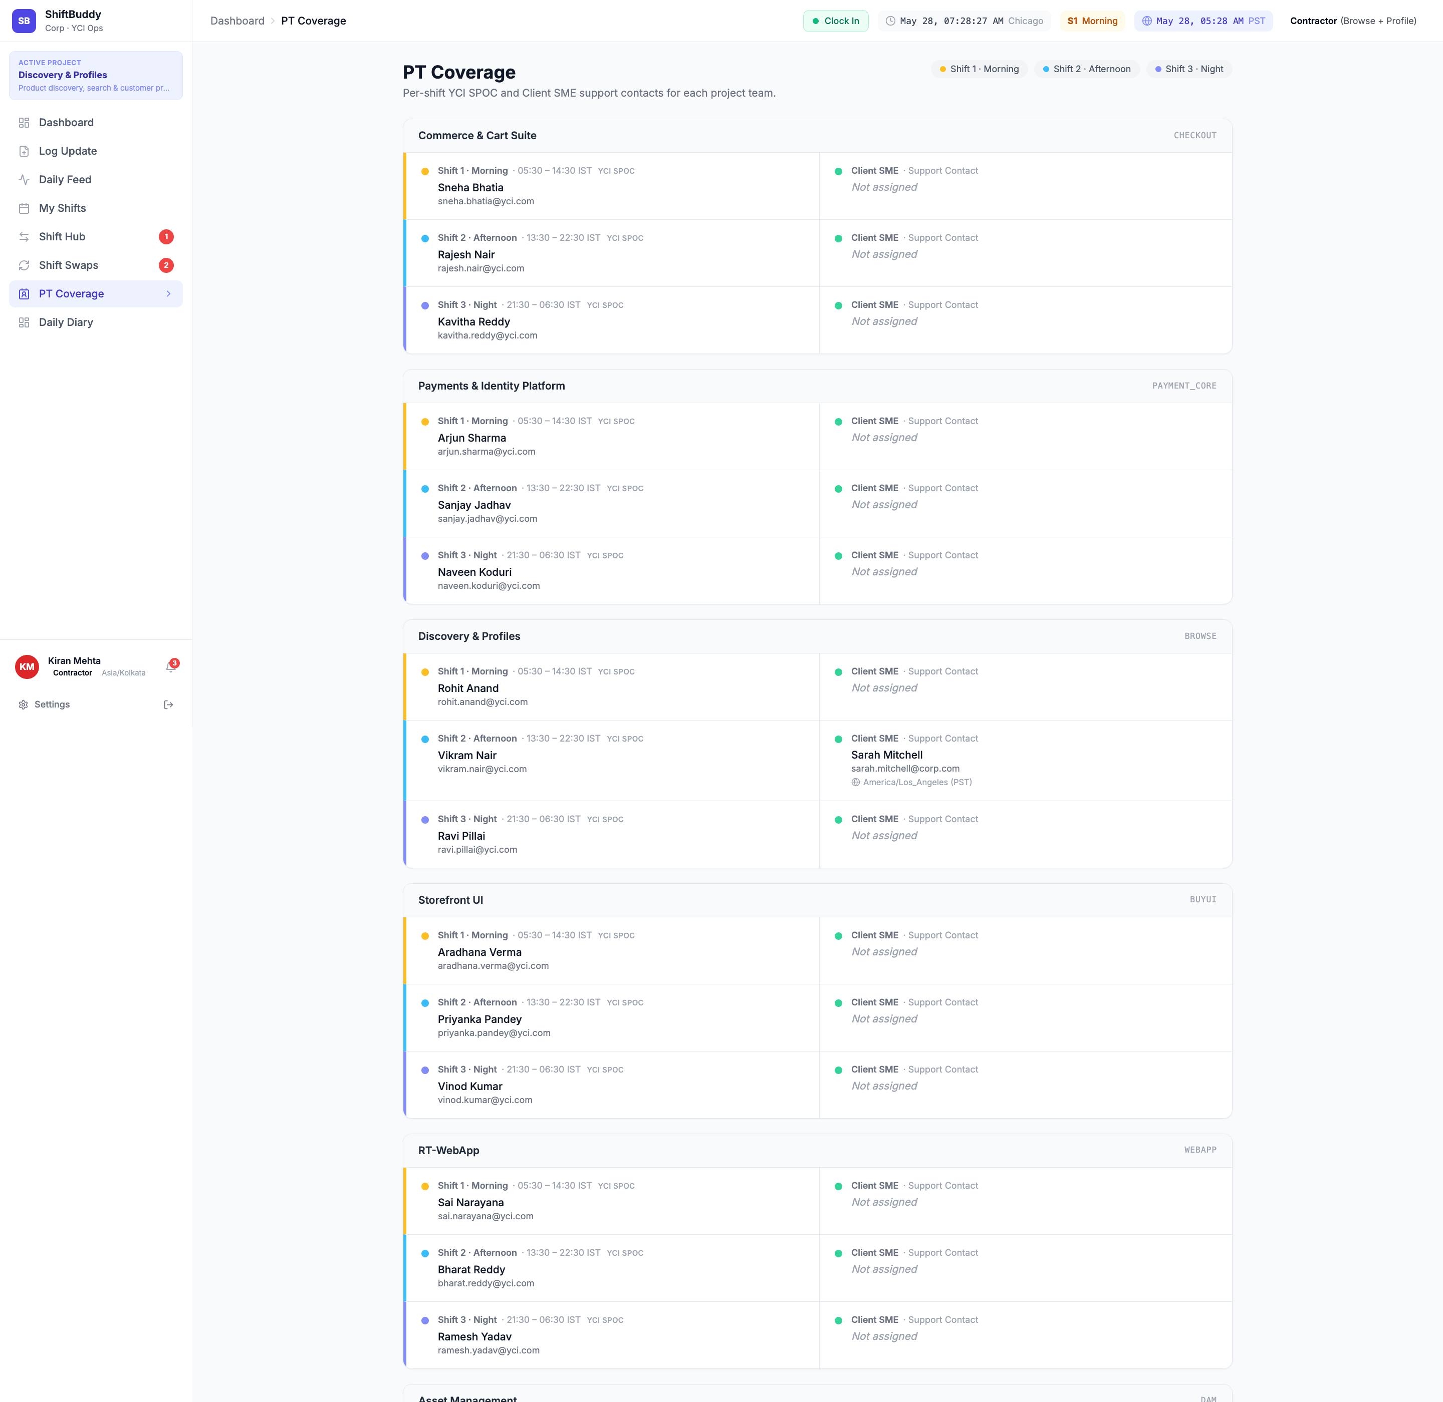
PT Coverage
Per-shift YCI SPOC and Client SME contacts across every project — live, not a stale spreadsheet
1
2
1
Page Header
3
4
5
Shows coverage is per-shift, per-project
6
2
Shift Legend
7
S1 Morning / S2 Afternoon / S3 Night
8
3
Project Section
Each project group with team count
4
YCI SPOC
Vendor point-of-contact with email
5
Client SME
Corp counterpart (or 'Not assigned')
6
Payments Project
Coverage for Payment & Identity team
7
Discovery Project
Coverage for Browse + Profile team
8
Assigned SME
Sarah Mitchell — actual Corp contact
Notes:
The PT Coverage page is the accountability grid that Corp leadership uses to verify that every project-shift combination has a named YCI SPOC and a named Corp SME. Each project is listed as a section, with three rows for S1 (Morning), S2 (Afternoon), and S3 (Night). Each row shows the YCI SPOC's name and email on the left, and the Corp SME on the right. A "Not assigned" in the Client SME column is an immediate action item for the account manager — it means a shift has no Corp contact, which is a governance gap. This matrix was previously maintained as a separate Excel tab that was always out of date. Now it's updated automatically whenever roster assignments change.

Slide 12
ShiftBuddy vs. Excel + Email
Capability
Excel + Email (Before)
ShiftBuddy (Now)
Handover Process
Email thread — no ack tracking, easy to miss
Structured form + acknowledgement timer + audit log
Incident Logging
Slack message or Excel cell — no severity, no link
Unified feed: PagerDuty, SNOW, Slack, Teams
SLA Visibility
Monthly manual Excel report — always stale
Live analytics: resolution %, avg time, ack rate
Roster Planning
Shared Excel — version conflicts, no holidays
Visual calendar with India + US holiday overlays
Coverage Check
Separate tab — updated manually, often wrong
Live matrix: YCI SPOC + Client SME per shift
Role-Based Access
Everyone sees everything — or nothing
5 role tiers: Contractor to Client Stakeholder
Audit Trail
No log — deleted rows leave no trace
Timestamped diary, handover records, ack history
Notes:
This comparison shows the before-and-after across every key capability. The pattern is consistent: Excel and email require manual effort, produce stale data, and leave accountability gaps. ShiftBuddy automates the structure, surfaces data in real time, and creates an audit trail automatically. The goal is not to replace people — it's to give them a tool that matches the complexity and speed of the work they're already doing.

Slide 13
ShiftBuddy
Ready to replace Excel — starting this sprint.
1
Pilot Onboarding
Select 1–2 projects for 2-week pilot. Team submits diaries + handovers via ShiftBuddy only.
2
Role Configuration
Set up user accounts and assign roles: Contractor, Lead, Manager, Client Stakeholder.
3
Roster Migration
Import current Excel roster into Roster Planner. Historical SNOW incidents via CSV bulk-load.
4
Analytics Baseline
Review first weekly analytics report vs last month's manual Excel figures side by side.
Questions?
Notes:
Four concrete next steps to get ShiftBuddy live. Step 1 Pilot — we recommend Discovery & Profiles as the first project: it has the largest team and the most active shift cycle. Step 2 Roles — user accounts can be imported from Active Directory or created manually. Role assignment takes under an hour. Step 3 Migration — the Excel roster imports in under an hour. SNOW incidents can be bulk-loaded via CSV to populate historical Analytics. Step 4 Baseline — the first real leadership deliverable: a side-by-side comparison of ShiftBuddy analytics vs last month's manual Excel report.

