Slide 1
Research Paper Presentation on
Home Automation - Implementing Technology in Domestic Environment
At
National Conference on
Emerging Trends in Management and Information Technology

Slide 2
Authors
Het Pandya, Student, Rollwala Computer Centre. Gujarat University, Ahmedabad | Kumar Rajwani, Student, Rollwala Computer Centre. Gujarat University, Ahmedabad | Jay Argade, Student, Rollwala Computer Centre. Gujarat University, Ahmedabad

Slide 3
Introduction
People today are too busy and keep running to have a better life.
This has made them forgetful.
People sometimes forget to check each electric appliance whether it is switched off or not before leaving the house
Many times, they don’t have time to check all the appliances.
Due to this they have to pay unexpected high bills
And... That’s frustrating!!

Slide 4
Home Automation
Home Automation refers to system which gives your home capability to act smart
The word Smart has been recently used in various fields due to technologies like Artificial Intelligence and IoT
A smart home represents a house equipped with intelligent and remotely controllable equipments.

Slide 5
Home Automation
Mobile phones have become smarter these days with interesting functionalities like:
understanding voice inputs,
converting voice to text commands etc.
These apps can transmit data inputted by user over the network for further processing.
These features have given us motivation to work for the solution

Slide 6
Objectives of work
To understand common, smart and most basic features expected by users in their home.
To provide most commonly expected functionalities to make a home an automated home.
To give intelligent and controllable equipments to the users to give them a feel of an automated home.
To be able to control the equipments using owner's speech giving them a lively experience.

Slide 7
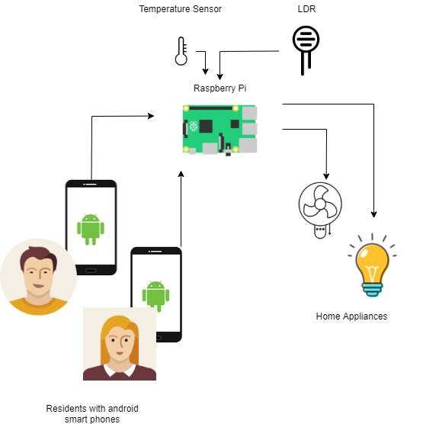
Home Automation
Fig. 1. System Architecture

