Slide 1

Chapter 3
The Stack ADT

Slide 2
Chapter 3: The Stack ADT
3.1 – Stacks
3.2 – Collection Elements
3.3 – Exceptional Situations
3.4 – Formal Specification
3.5 – Array-Based Implementation
3.6 – Application: Well-Formed Expressions
3.7 – Link-Based Implementation
3.8 – Case Study: Postfix Expression Evaluator

Slide 3
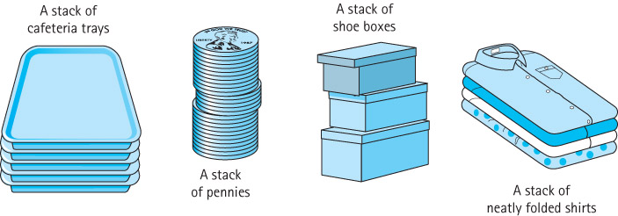
3.1 Stacks
Stack A structure in which elements are added and removed from only one end; a “last in, first out” (LIFO) structure

Slide 4
Operations on Stacks
Constructor
  new - creates an empty stack
Transformers
  push - adds an element to the top of a stack
  pop - removes the top element off the stack
Observer
  top - returns the top element of a stack

Slide 5
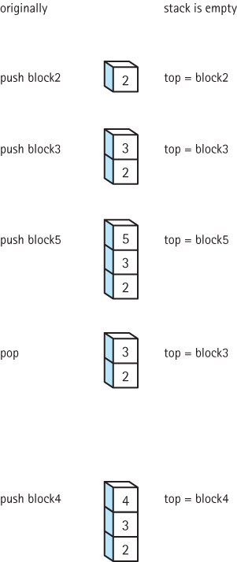
Effects of
Stack
Operations

Slide 6
Using Stacks
Stacks are often used for “system” programming:
  Programming language systems use a stack to keep track of sequences of operation calls
  Compilers use stacks to analyze nested language statements
  Operating systems save information about the current executing process on a stack, so that it can work on a higher-priority, interrupting process

Slide 7
3.2 Collection Elements
Collection An object that holds other objects. Typically we are interested in inserting, removing, and iterating through the contents of a collection.
A stack is an example of a Collection ADT. It collects together elements for future use, while maintaining a first in – last out ordering among the elements.

Slide 8
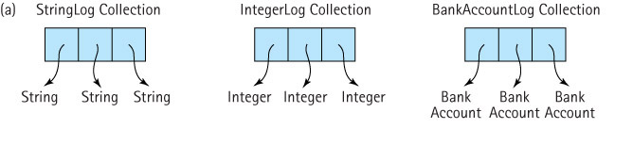
Separate ADTs for each type that a collection can hold?
This approach is too redundant and not useful

Slide 9
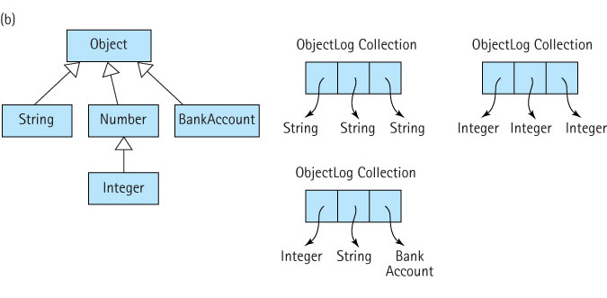
Collections of Class Object

Slide 10
Collections of Class Object
Note: whenever an element is removed from the collection it can only be referenced as an Object. If you intend to use it as something else you must cast it into the type that you intend to use.
For example:
  collection.push(“E. E. Cummings”); // push string on a stack
  String poet = (String) collection.top(); // cast top to String
  System.out.println(poet.toLowerCase()); // use the string

Slide 11
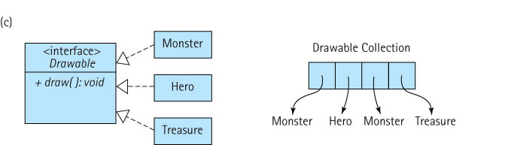
Collections of a Class that implements a particular Interface

Slide 12
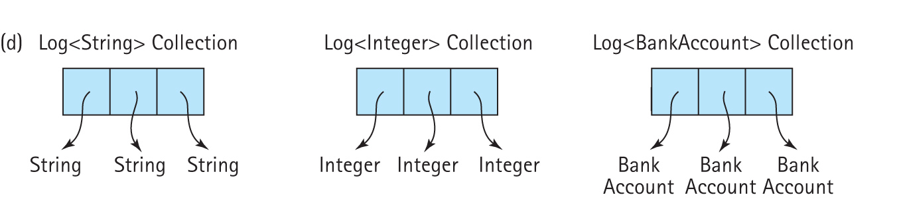
Generic Collections
Parameterized types
Declared as <T>
Actual type provided upon instantiation

Slide 13
Generic Collections
Example of collection class definition:
Example of application:
public class Log<T>
{
private T[ ] log; // array that holds objects of class T
. . .
}
Log<Integer> numbers;
Log<BankAccount> investments;
Log<String> answers;

Slide 14
3.3 Exceptional Situations
Exceptional situation Associated with an unusual, sometimes unpredictable event, detectable by software or hardware, which requires special processing. The event may or may not be erroneous.
For example:
  a user enters an input value of the wrong type
  while reading information from a file, the end of the file is reached
  a user presses a control key combination
  an illegal mathematical operation occurs, such as divide-by-zero
  an impossible operation is requested of an ADT, such as an attempt to pop an empty stack

Slide 15
Exceptions with Java
The Java exception mechanism has three major parts:
  Defining the exception – usually as a subclass of Java's Exception class
  Generating (raising) the exception – by recognizing the exceptional situation and then using Java's throw statement to "announce" that the exception has occurred
  Handling the exception – using Java's try – catch statement to discover that an exception has been thrown and then take the appropriate action

Slide 16
Exceptions and ADTs
An Example
We modify the constructor of our Date class to throw an exception if it is passed an illegal date
First, we create our own exception class:
public class DateOutOfBoundsException extends Exception
{
public DateOutOfBoundsException()
{
super();
}
public DateOutOfBoundsException(String message)
{
super(message);
}
}

Slide 17
Here is an example of a constructor that
throws the exception:
public Date(int newMonth, int newDay, int newYear)
throws DateOutOfBoundsException
{
if ((newMonth <= 0) || (newMonth > 12))
throw new DateOutOfBoundsException("month " + newMonth + "out of range");
else
month = newMonth;
day = newDay;
if (newYear < MINYEAR)
throw new DateOutOfBoundsException("year " + newYear +
" is too early");
else
year = newYear;
}

Slide 18
An example of a program that throws the exception
out to interpreter to handle:
public class UseDates
{
public static void main(String[] args)
throws DateOutOfBoundsException
{
Date theDate;
// Program prompts user for a date
// M is set equal to user’s month
// D is set equal to user’s day
// Y is set equal to user’s year
theDate = new Date(M, D, Y);
// Program continues ...
}
}
The interpreter will stop the program and
print an “exception” message, for example
Exception in thread "main" DateOutOfBoundsException: year 1051 is too early
at Date.<init>(Date.java:18)
at UseDates.main(UseDates.java:57)

Slide 19
An example of a program that catches and handles the exception:
public class UseDates
{
public static void main(String[] args)
{
Date theDate;
boolean DateOK = false;
while (!DateOK)
{
// Program prompts user for a date
// M is set equal to user’s month
// D is set equal to user’s day
// Y is set equal to user’s year
try
{
theDate = new Date(M, D, Y);
DateOK = true;
}
catch(DateOutOfBoundsException DateOBExcept)
{
output.println(DateOBExcept.getMessage());
}
}
// Program continues ...
}
}

Slide 20
General guidelines for using exceptions
An exception may be handled any place in the software hierarchy—from the place in the program module where it is first detected through the top level of the program.
Unhandled built-in exceptions carry the penalty of program termination.
Where in an application an exception should be handled is a design decision; however, exceptions should always be handled at a level that knows what the exception means.
An exception need not be fatal.
For non-fatal exceptions, the thread of execution can continue from various points in the program, but execution should continue from the lowest level that can recover from the exception.

Slide 21
Java RunTimeException class
Exceptions of this class are thrown when a standard run-time program error occurs.
Examples of run-time errors are division-by-zero and array-index-out-of-bounds.
These exceptions can happen in virtually any method or segment of code, so we are not required to explicitly handle these exceptions.
These exceptions are classified as unchecked exceptions.

Slide 22
Error Situations and ADTs
When dealing with error situations within our ADT methods, we have several options:
  Detect and handle the error within the method itself. This is the best approach if the error can be handled internally and if it does not greatly complicate design.
  Detect the error within the method, throw an exception related to the error and therefore force the calling method to deal with the exception. If it is not clear how to handle a particular error situation, this approach might be best - throw it out to a level where it can be handled.
  Ignore the error situation. Recall the “programming by contract” discussion, related to preconditions, in Chapter 2. With this approach, if the preconditions of a method are not met, the method is not responsible for the consequences.

Slide 23
3.4 Formal Specification
(of our Stack ADT)
Recall from Section 3.1 that a stack is a "last-in first-out" structure, with primary operations
  push - adds an element to the top of the stack
  pop - removes the top element off the stack
  top - returns the top element of a stack
In addition we need a constructor that creates an empty stack
Our Stack ADT will be a generic stack.
  The class of elements that a stack stores will be specified by the client code at the time the stack is instantiated.

Slide 24
Completing the Formal Specification
To complete the formal specification of the Stack ADT we need to
  Identify and address any exceptional situations
  Determine boundedness
  Define the Stack interface or interfaces

Slide 25
Exceptional Situations
pop and top – what if the stack is empty?
  throw a StackUnderflowException
  plus define an isEmpty method for use by the application
push – what if the stack is full?
  throw a StackOverflowException
  plus define an isFull method for use by the application

Slide 26
Boundedness
We support two versions of the Stack ADT
  a bounded version
  an unbounded version
We define three interfaces
  StackInterface: features of a stack not affected by boundedness
  BoundedStackInterface: features specific to a bounded stack
  UnboundedStackInterface: features specific to an unbounded stack

Slide 27
Inheritance of Interfaces
Inheritance of interfaces A Java interface can extend another Java interface, inheriting its requirements. If interface B extends interface A, then classes that implement interface B must also implement interface A. Usually, interface B adds abstract methods to those required by interface A.

Slide 28
StackInterface
package ch03.stacks;
public interface StackInterface<T>
{
void pop() throws StackUnderflowException;
// Throws StackUnderflowException if this stack is empty,
// otherwise removes top element from this stack.
T top() throws StackUnderflowException;
// Throws StackUnderflowException if this stack is empty,
// otherwise returns top element from this stack.
boolean isEmpty();
// Returns true if this stack is empty, otherwise returns false.
}

Slide 29
The Remaining Stack Interfaces
The BoundedStackInterface
package ch03.stacks;
public interface BoundedStackInterface<T> extends StackInterface<T>
{
public void push(T element) throws StackOverflowException;
// Throws StackOverflowException if this stack is full,
// otherwise places element at the top of this stack.
public boolean isFull();
// Returns true if this stack is full, otherwise returns false.
}
The UnboundedStackInterface
package ch03.stacks;
public interface UnboundedStackInterface<T> extends StackInterface<T>
{
public void push(T element);
// Places element at the top of this stack.
}

Slide 30
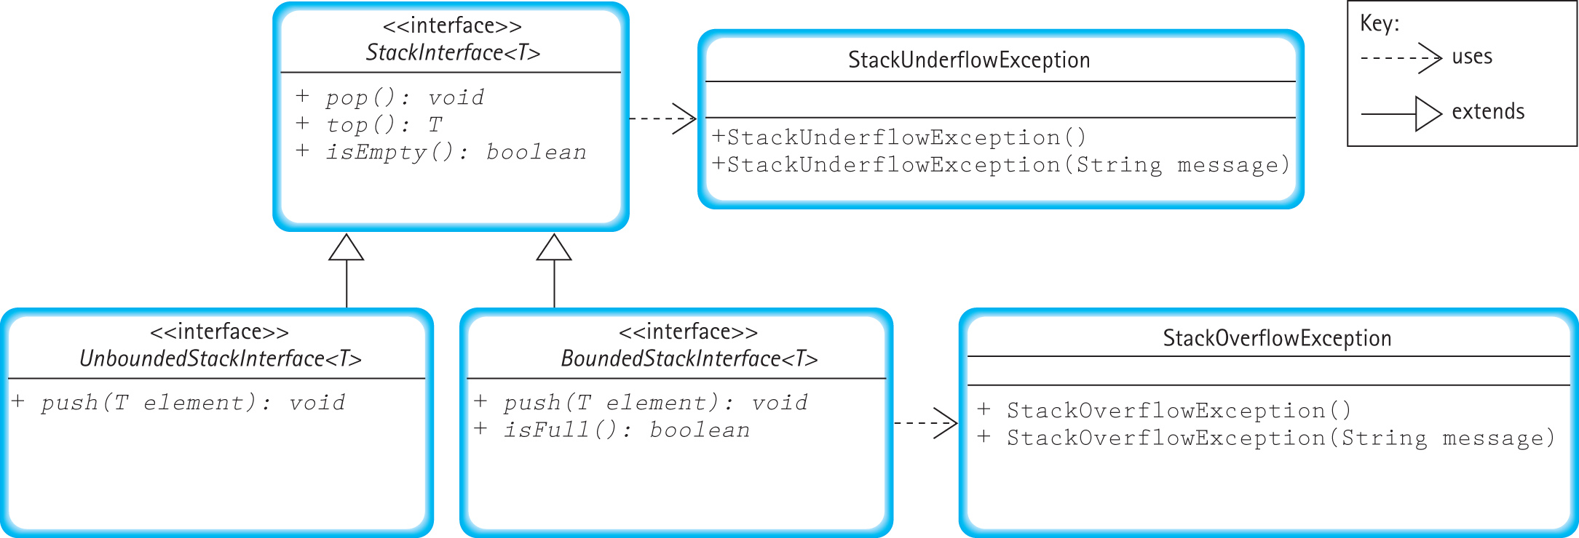
Relationships among Stack Interfaces and Exception Classes

Slide 31
3.5 Array-Based Implementations
In this section we study an array-based implementation of the Stack ADT.
Additionally, in a feature section, we look at an alternate implementation that uses the Java Library ArrayList class.

Slide 32
The ArrayStack Class
package ch03.stacks;
public class ArrayStack<T> implements BoundedStackInterface<T>
{
protected final int defCap = 100; // default capacity
protected T[] stack; // holds stack elements
protected int topIndex = -1; // index of top element in stack
public ArrayStack()
{
stack = (T[]) new Object[defCap];
}
public ArrayStack(int maxSize)
{
stack = (T[]) new Object[maxSize];
}

Slide 33
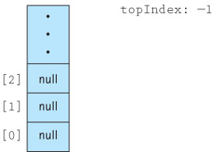
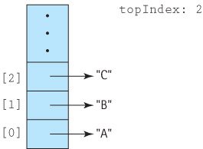
Visualizing the stack
The empty stack:
After pushing “A”, “B” and “C”:

Slide 34
Definitions of Stack Operations
public boolean isEmpty()
// Returns true if this stack is empty, otherwise returns false.
{
if (topIndex == -1)
return true;
else
return false;
}
public boolean isFull()
// Returns true if this stack is full, otherwise returns false.
{
if (topIndex == (stack.length - 1))
return true;
else
return false;
}

Slide 35
Definitions of Stack Operations
public void push(T element)
{
if (!isFull())
{
topIndex++;
stack[topIndex] = element;
}
else
throw new StackOverflowException("Push attempted on a full stack.");
}
public void pop()
{
if (!isEmpty())
{
stack[topIndex] = null;
topIndex--;
}
else
throw new StackUnderflowException("Pop attempted on an empty stack.");
}

Slide 36
Definitions of Stack Operations
public T top()
// Throws StackUnderflowException if this stack is empty,
// otherwise returns top element from this stack.
{
T topOfStack = null;
if (!isEmpty())
topOfStack = stack[topIndex];
else
throw new StackUnderflowException("Top attempted on an empty stack.");
return topOfStack;
}

Slide 37
3.6 Application: Well-Formed Expressions
Given a set of grouping symbols, determine if the open and close versions of each symbol are matched correctly.
We’ll focus on the normal pairs, (), [], and {}, but in theory we could define any pair of symbols (e.g., < > or / \) as grouping symbols.
Any number of other characters may appear in the input expression, before, between, or after a grouping pair, and an expression may contain nested groupings.
Each close symbol must match the last unmatched opening symbol and each open grouping symbol must have a matching close symbol.

Slide 38
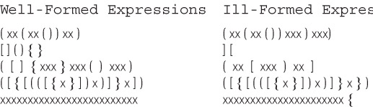
Examples

Slide 39
The Balanced Class
To help solve our problem we create a class called Balanced, with two instance variables of type String (openSet and closeSet) and a single exported method test
The Constructor is:
public Balanced(String openSet, String closeSet)
// Preconditions: No character is contained more than once in the
// combined openSet and closeSet strings.
// The size of openSet = the size of closeSet.
{
this.openSet = openSet;
this.closeSet = closeSet;
}

Slide 40
The test method
Takes an expression as a string argument and checks to see if the grouping symbols in the expression are balanced.
We use an integer to indicate the result:
  0 means the symbols are balanced, such as (([xx])xx)
  1 means the expression has unbalanced symbols, such as (([xx}xx))
  2 means the expression came to an end prematurely, such as (([xxx])xx

Slide 41
The test method
For each input character, it does one of three tasks:
  If the character is an open symbol, it is pushed on a stack.
  If the character is a close symbol, it must be checked against the last open symbol, which is obtained from the top of the stack. If they match, processing continues with the next character. If the close symbol does not match the top of the stack, or if the stack is empty, then the expression is ill-formed.
  If the character is not a special symbol, it is skipped.

Slide 42
Test for Well-Formed Expression Algorithm (String subject)
Create a new stack of size equal to the length of subject
Set stillBalanced to true
Get the first character from subject
while (the expression is still balanced
AND
there are still more characters to process)
Process the current character
Get the next character from subject
if (!stillBalanced)
return 1
else if (stack is not empty)
return 2
else
return 0

Slide 43
Expansion of
“Process the current character”
if (the character is an open symbol)
Push the open symbol character onto the stack
else if (the character is a close symbol)
if (the stack is empty)
Set stillBalanced to false
else
Set open symbol character to the value at the top of the stack
Pop the stack
if the close symbol character does not “match” the open symbol character
Set stillBalanced to false
else
Skip the character

Slide 44
Code and Demo
Instructors can now walk through the code contained in Balanced.java and BalancedApp.java, review the notes on pages 197 and 198, and demonstrate the running program.

Slide 45
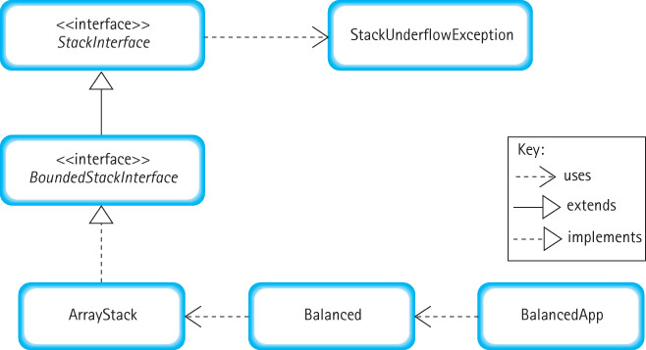
Program Architecture

Slide 46
3.7 Linked-Based Implmentation
In this section we study a link-based implementation of the Stack ADT.
To support this we first define a LLNode class
After discussing the link-based approach we compare our stack implementation approaches.

Slide 47
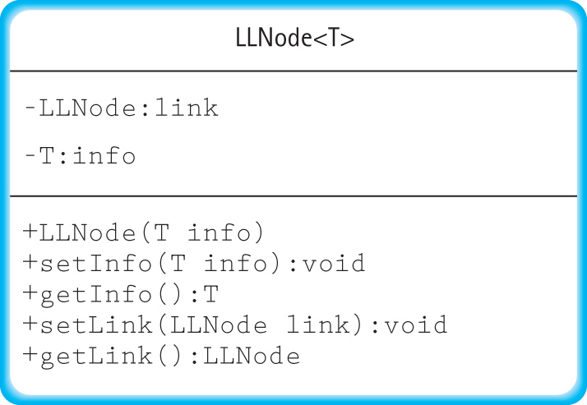
The LLNode class
Recall from Chapter 2 that in order to create a linked list of strings defined a self referential class, LLStringNode, to act as the nodes of the list.
Our stacks must hold generic elements. Therefore, we define a class analogous to the LLStringNode class called LLNode.

Slide 48
The LLNode class
package support;
public class LLNode<T>
{
private LLNode link;
private T info;
public LLONode(T info)
{
this.info = info;
link = null;
}
public void setInfo(T info)
{
this.info = info;
}
public T getInfo()
{
return info;
}
public void setLink(LLNode link)
{
this.link = link;
}
public LLNode getLink()
{
return link;
}
}

Slide 49
The LinkedStack Class
package ch03.stacks;
import support.LLNode;
public class LinkedStack<T> implements UnboundedStackInterface<T>
{
protected LLNode top; // reference to the top of this stack
public LinkedStack()
{
top = null;
}
. . .

Slide 50
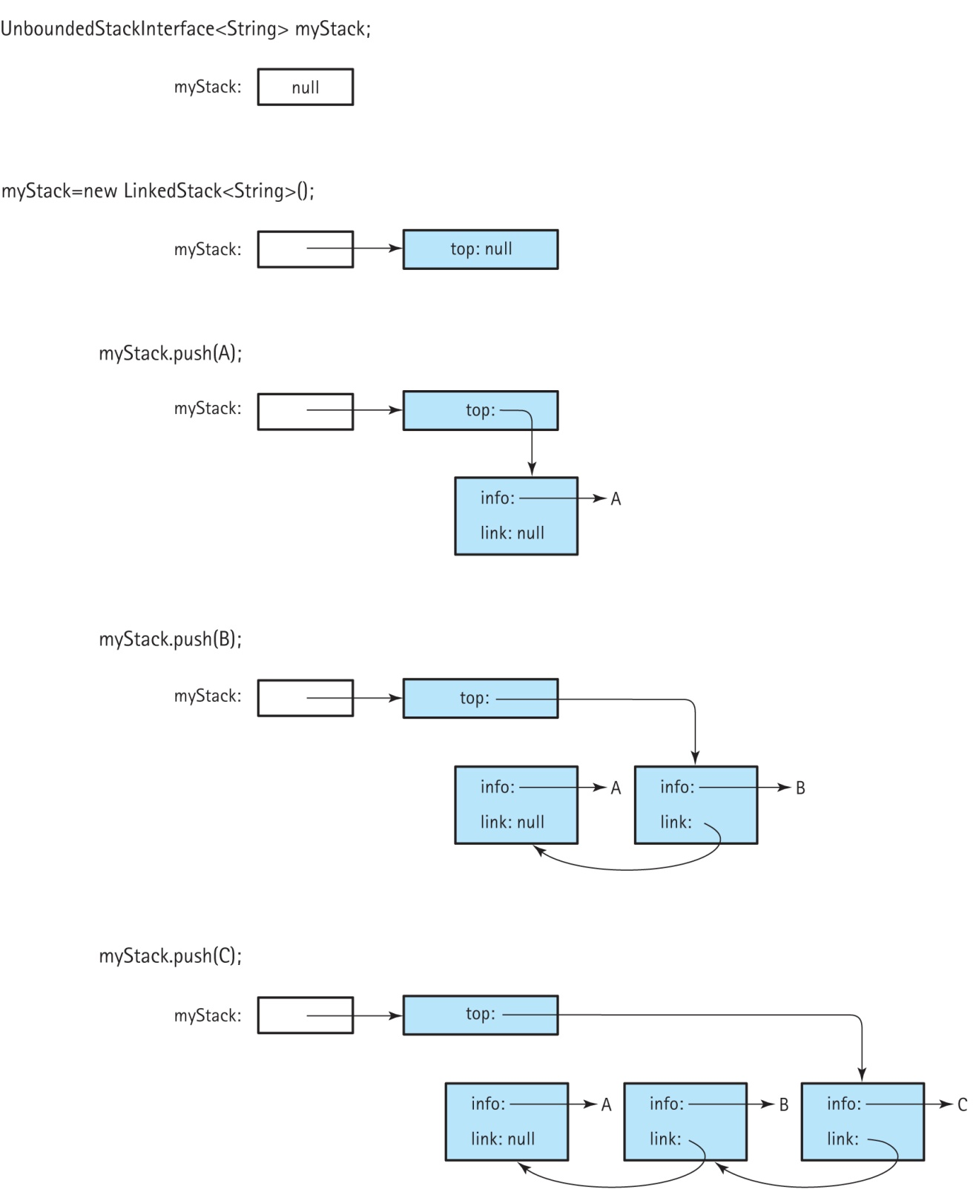
Visualizing the push operation

Slide 51
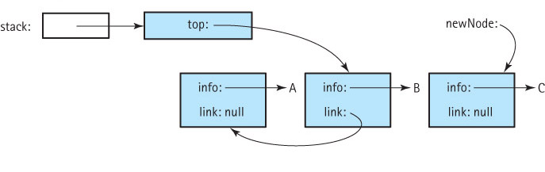
The push(C) operation (step 1)
Allocate space for the next stack node
and set the node info to element
Set the node link to the previous top of stack
Set the top of stack to the new stack node

Slide 52
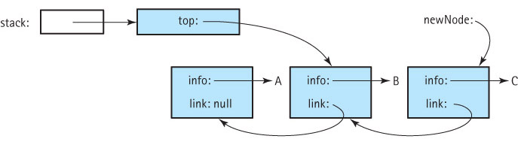
The push(C) operation (step 2)
Allocate space for the next stack node
and set the node info to element
Set the node link to the previous top of stack
Set the top of stack to the new stack node

Slide 53
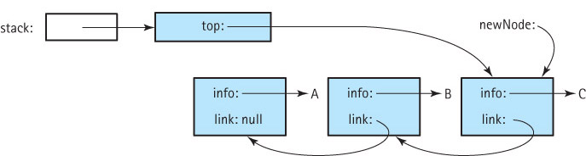
The push(C) operation (step 3)
Allocate space for the next stack node
and set the node info to element
Set the node link to the previous top of stack
Set the top of stack to the new stack node

Slide 54
Code for the push method
public void push(T element)
// Places element at the top of this stack.
{
LLNode<T> newNode = new LLNode<T>(element);
newNode.setLink(top);
top = newNode;
}

Slide 55
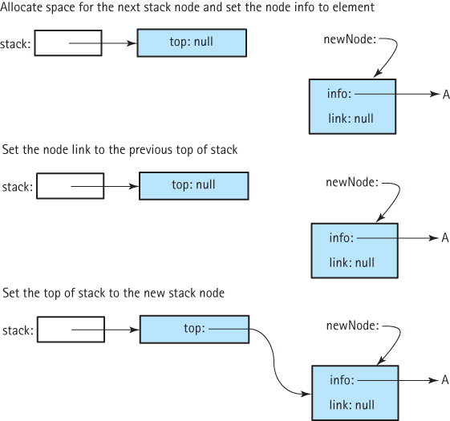
Result of push onto empty stack

Slide 56
Code for the pop method
public void pop()
// Throws StackUnderflowException if this stack is empty,
// otherwise removes top element from this stack.
{
if (!isEmpty())
{
top = top.getLink();
}
else
throw new StackUnderflowException("Pop attempted on an empty stack.");
}

Slide 57
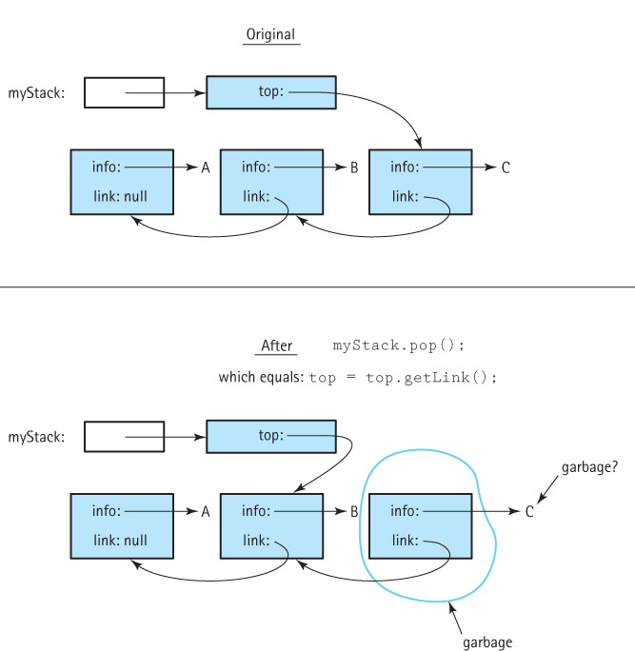
Pop from
a stack
with three
elements

Slide 58
The remaining operations
public T top()
// Throws StackUnderflowException if this stack is empty,
// otherwise returns top element from this stack.
{
if (!isEmpty())
return top.getInfo();
else
throw new StackUnderflowException("Top attempted on an empty stack.");
}
public boolean isEmpty()
// Returns true if this stack is empty, otherwise returns false.
{
if (top == null)
return true;
else
return false;
}

Slide 59
Comparing Stack Implementations
Storage Size
  Array-based: takes the same amount of memory, no matter how many array slots are actually used, proportional to maximum size
  Link-based: takes space proportional to actual size of the stack (but each element requires more space than with array approach)
Operation efficiency
  All operations, for each approach, are O(1)
  Except for the Constructors:
    Array-based: O(N)
    Link-based: O(1)

Slide 60
Which is better?
The linked implementation does not have space limitations, and in applications where the number of stack elements can vary greatly, it wastes less space when the stack is small.
The array-based implementation is short, simple, and efficient. Its operations have less overhead. When the maximum size is small and we know the maximum size with certainty, the array-based implementation is a good choice.

Slide 61
