Slide 1

Chapter 4
Recurecurecurecursion

Slide 2
Chapter 4: Recursion
4.1 – Recursive Definitions, Algorithms
and Programs
4.2 – The Three Questions
4.3 – Towers of Hanoi
4.4 – Counting Blobs
4.5 – Recursive Linked-List Processing
4.6 – Removing Recursion
4.7 – Deciding Whether to Use a
Recursive Solution

Slide 3
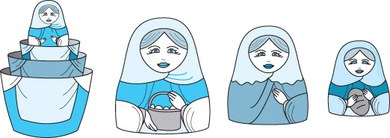
4.1 Recursive Definitions, Algorithms and Programs

Slide 4
Recursive Definitions
Recursive definition A definition in which something is defined in terms of smaller versions of itself. For example:
  A directory is an entity in a file system which contains a group of files and other directories.
  A compound sentence is a sentence that consists of two sentences joined together by a coordinating conjunction.
  n! = 1 if n = 0
  n X (n – 1)! if n > 0

Slide 5


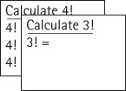
Example: Calculate 4!

Slide 6
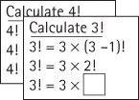
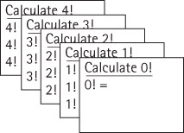
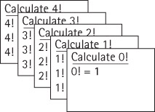
Example: Calculate 4!
. . .

Slide 7
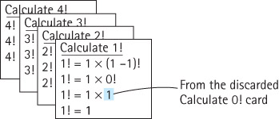
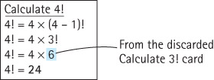
Example: Calculate 4!
. . .

Slide 8
Recursive Algorithms
Recursive algorithm A solution that is expressed in terms of
  smaller instances of itself and
  a base case
Base case The case for which the solution can be stated non-recursively
General (recursive) case The case for which the solution is expressed in terms of a smaller version of itself

Slide 9
Examples of a Recursive Algorithm and a Recursive Program
Factorial (int n)
// Assume n >= 0
if (n == 0)
return (1)
else
return ( n * Factorial ( n – 1 ) )
public static int factorial(int n)
// Precondition: n is non-negative
//
// Returns the value of "n!".
{
if (n == 0)
return 1; // Base case
else
return (n * factorial(n – 1)); // General case
}

Slide 10
Augmented recursive factorial
private static int factorial(int n)
// Precondition: n is non-negative
//
// Returns the value of "n!".
{
int retValue; // return value
System.out.println(indent + "Enter factorial " + n);
indent = indent + " ";
if (n == 0)
retValue = 1;
else
retValue = (n * factorial (n - 1));
indent = indent.substring(2);
System.out.println(indent + "Return " + retValue);
return(retValue);
}

Slide 11
Output if argument is 9
Enter factorial 9
Enter factorial 8
Enter factorial 7
Enter factorial 6
Enter factorial 5
Enter factorial 4
Enter factorial 3
Enter factorial 2
Enter factorial 1
Enter factorial 0
Return 1
Return 1
Return 2
Return 6
Return 24
Return 120
Return 720
Return 5040
Return 40320
Return 362880

Slide 12
Recursion Terms
Recursive call A method call in which the method being called is the same as the one making the call
Direct recursion Recursion in which a method directly calls itself, like the factorial method.
Indirect recursion Recursion in which a chain of two or more method calls returns to the method that originated the chain, for example method A calls method B which in turn calls method A

Slide 13
Iterative Solution for Factorial
We have used the factorial algorithm to demonstrate recursion because it is familiar and easy to visualize. In practice, one would never want to solve this problem using recursion, since a straightforward, more efficient iterative solution exists:
  public static int factorial(int n)
  {
  int value = n;
  int retValue = 1; // return value
  while (value != 0)
  {
  retValue = retValue * value;
  value = value - 1;
  }
  return(retValue);
  }

Slide 14
4.2 The Three Questions
In this section we present three questions to ask about any recursive algorithm or program.
Using these questions helps us verify, design, and debug recursive solutions to problems.

Slide 15
Verifying Recursive Algorithms
To verify that a recursive solution works, we must be able to answer “Yes” to all three of these questions:
  The Base-Case Question: Is there a nonrecursive way out of the algorithm, and does the algorithm work correctly for this base case?
  The Smaller-Caller Question: Does each recursive call to the algorithm involve a smaller case of the original problem, leading inescapably to the base case?
  The General-Case Question: Assuming the recursive call(s) to the smaller case(s) works correctly, does the algorithm work correctly for the general case?
We next apply these three questions to the factorial algorithm.

Slide 16
The Base-Case Question
Factorial (int n)
// Assume n >= 0
if (n == 0)
return (1)
else
return ( n * Factorial ( n – 1 ) )
Is there a nonrecursive way out
of the algorithm, and does the
algorithm work correctly
for this base case?
The base case occurs when n is 0.
The Factorial algorithm then returns the value of 1, which is
the correct value of 0!, and no further (recursive) calls
to Factorial are made.
The answer is yes.

Slide 17
The Smaller-Caller Question
Factorial (int n)
// Assume n >= 0
if (n == 0)
return (1)
else
return ( n * Factorial ( n – 1 ) )
Does each recursive call to the
algorithm involve a smaller case
of the original problem, leading
inescapably to the base case?
The parameter is n and the recursive call passes the
argument n - 1. Therefore each subsequent recursive call
sends a smaller value, until the value sent is finally 0.
At this point, as we verified with the base-case question,
we have reached the smallest case, and no further
recursive calls are made. The answer is yes.

Slide 18
The General-Case Question
Factorial (int n)
// Assume n >= 0
if (n == 0)
return (1)
else
return ( n * Factorial ( n – 1 ) )
Assuming the recursive call(s) to the
smaller case(s) works correctly, does
the algorithm work correctly for the
general case?
Assuming that the recursive call Factorial(n – 1) gives us
the correct value of (n - 1)!, the return statement computes
n * (n - 1)!.
This is the definition of a factorial, so we know
that the algorithm works in the general case.
The answer is yes.

Slide 19
Constraints on input arguments
Constraints often exist on the valid input arguments for a recursive algorithm. For example, for Factorial, n must be >= 0.
You can use the three question analysis to determine constraints:
  Check if there are any starting argument values for which the smaller call does not produce a new argument that is closer to the base case.
  Such starting values are invalid.
  Constrain your legal input arguments so that these values are not permitted.

Slide 20
Steps for Designing Recursive Solutions
Get an exact definition of the problem to be solved.
Determine the size of the problem to be solved on this call to the method.
Identify and solve the base case(s) in which the problem can be expressed non-recursively. This ensures a yes answer to the base-case question.
Identify and solve the general case(s) correctly in terms of a smaller case of the same problem—a recursive call. This ensures yes answers to the smaller-caller and general-case questions.

Slide 21
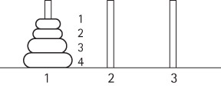
4.3 Towers of Hanoi
Move the rings, one at a time, to the third peg.
A ring cannot be placed on top of one that is smaller in diameter.
The middle peg can be used as an auxiliary peg, but it must be empty at the beginning and at the end of the game.
The rings can only be moved one at a time.

Slide 22
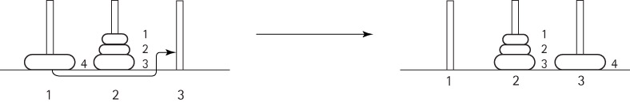
General Approach
To move the largest ring (ring 4) to peg 3, we must move the three smaller rings to peg 2 (this cannot be done with 1 move).
Let's assume we can do this.
Then ring 4 can be moved into its final place:

Slide 23
Recursion
Can you see that our assumption (that we move the three smaller rings to peg 2) involved solving a smaller version of the problem? We have solved the problem using recursion.
The general recursive algorithm for moving n rings from the starting peg to the destination peg 3 is:
Move n rings from Starting Peg to Destination Peg
Move n - 1 rings from starting peg to auxiliary peg
Move the nth ring from starting peg to destination peg
Move n - 1 rings from auxiliary peg to destination peg

Slide 24
Recursive Method
public static void doTowers(
int n, // Number of rings to move
int startPeg, // Peg containing rings to move
int auxPeg, // Peg holding rings temporarily
int endPeg ) // Peg receiving rings being moved
{
if (n > 0)
{
// Move n – 1 rings from starting peg to auxiliary peg
doTowers(n – 1, startPeg, endPeg, auxPeg);
System.out.println("Move ring from peg " + startPeg
+ " to peg " + endPeg);
// Move n – 1 rings from auxiliary peg to ending peg
doTowers(n – 1, auxPeg, startPeg, endPeg);
}
}

Slide 25
Code and Demo
Instructors can now walk through the code contained in Towers.java and demonstrate the running program.

Slide 26
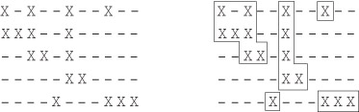
4.4 Counting Blobs
A blob is a contiguous collection of X's.
Two X's in a grid are considered contiguous if they are beside each other horizontally or vertically. For example:

Slide 27
Generating Blob Grids based on a Percentage
for (int i = 0; i < rows; i++)
for (int j = 0; j < cols; j++)
{
randInt = rand.nextInt(100); // random number 0 .. 99
if (randInt < percentage)
grid[i][j] = true;
else
grid[i][j] = false;
}
For example:
----------- -X--X----X- X-X-XXX-XX- XXXXXXXXXXX
----------- X----X-X--- XXXXX-XXXXX XXXXXXXXXXX
----------- ---X-----XX XXXXX---XX- XXXXXXXXXXX
----------- XX-X-X--X-- ---X---XXX- XXXXXXXXXXX
----------- ------XX—X XX--X-XXXXX XXXXXXXXXXX
Percentage 0 Percentage 33 Percentage 67 Percentage 100

Slide 28
Incorrect Counting Algorithm
int count = 0;
for (int i = 0; i < rows; i++)
for (int j = 0; j < cols; j++)
if (grid[i][j])
count++;
The problem with this code is that it counts the number of
blob characters, not the number of blobs.
Whenever we encounter a blob character and count it,
we must somehow mark all of the characters within that
blob as having been counted.
To support this approach we create a "parallel" grid of
boolean called visited.

Slide 29
Correct Counting Algorithm
Let's assume we have a method called markBlob, that
accepts as arguments the row and column indexes of
a blob character, and proceeds to "mark" all the
characters within that blob as having been visited.
Then we can count the blobs using this code:
  int count = 0;
  for (int i = 0; i < rows; i++)
  for (int j = 0; j < cols; j++)
  if (grid[i][j] && !visited[i][j])
  {
  count++;
  markBlob(i, j);
  }

Slide 30
The Marking Algorithm
The markBlob method is passed the location of a blob character that needs to be marked, through its two arguments, row and col. It does that:
visited[row][col] = true;
It must also mark all of the other characters in the blob. It checks the four locations "around" that location, to see if they need to be marked.
When should one of those locations be marked? There are three necessary conditions:
  the location exists, that is, it is not outside the boundaries of the grid
  the location contains a blob character
  the location has not already been visited

Slide 31
The Marking Algorithm
For example, the following code checks and marks the location above the indicated location (note the recursion):
  if ((row - 1) >= 0) // if its on the grid
  if (grid[row - 1][col]) // and has a blob character
  if (!visited[row - 1][col]) // and has not been visited
  markBlob(row - 1, col); // then mark it
The code for the remaining three directions (down, left, and right) is similar.

Slide 32
Code and Demo
Instructors can now walk through the code contained in Grid.java and BlobApp.java, and demonstrate the running program.

Slide 33
4.5 Recursive Linked-List Processing
Reverse Printing: Our goal is to print the elements of a linked list in reverse order.
This problem is much more easily and elegantly solved recursively than it is iteratively.

Slide 34
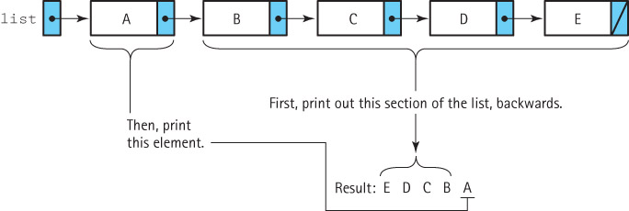
Recursive Reverse Print
Recursive revPrint (listRef)
Print out the second through last elements in the list referenced by listRef in reverse order.
Then print the first element in the list referenced by listRef

Slide 35
Extending LinkedStack with a Reverse Print
import ch03.stacks.*;
import support.LLObjectNode;
public class LinkedStack2<T> extends LinkedStack<T>
{
private void revPrint(LLNode<T> listRef)
{
if (listRef != null)
{
revPrint(listRef.getLink());
System.out.println(" " + listRef.getInfo());
}
}
public void printReversed()
{
revPrint(top);
}
}

Slide 36
4.6 Removing Recursion
We consider two general techniques that are often substituted for recursion
  iteration
  stacking.
First we take a look at how recursion is implemented.
  Understanding how recursion works helps us see how to develop non-recursive solutions.

Slide 37
Static Storage Allocation
A compiler that translates a high-level language program into machine code for execution on a computer must
  Reserve space for the program variables.
  Translate the high level executable statements into equivalent machine language statements.

Slide 38
Example of Static Allocation
Consider the following program:
public class Kids
{
private static int countKids(int girlCount, int boyCount)
{
int totalKids;
. . .
}
public static void main(String[] args)
{
int numGirls; int numBoys; int numChildren;
. . .
}
}
A compiler could create two separate machine code units for this program,
one for the countKids method and one for the main method. Each unit would
include space for its variables plus the sequence of machine language
statements that implement its high-level code.

Slide 39
Limitations of static allocation
Static allocation like this is the simplest approach possible. But it does not support recursion.
The space for the countKids method is assigned to it at compile time. This works fine when the method will be called once and then always return before it is called again. But a recursive method can be called again and again before it returns. Where do the second and subsequent calls find space for their parameters and local variables?
Therefore dynamic storage allocation is needed.

Slide 40
Dynamic Storage Allocation
Dynamic storage allocation provides memory space for a method when it is called.
When a method is invoked, it needs space to keep its parameters, its local variables, and the return address (the address in the calling code to which the computer returns when the method completes its execution).
This space is called an activation record or stack frame.

Slide 41
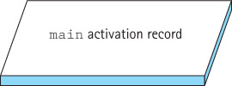
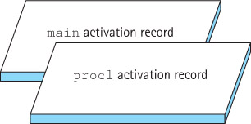
Dynamic Storage Allocation
Consider a program whose main method calls proc1,
which then calls proc2. When the program begins executing,
the “main” activation record is generated:
At the first method call, an activation record is generated for proc1:

Slide 42
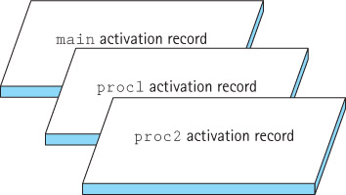
Dynamic Storage Allocation
When proc2 is called from within proc1, its activation record is generated.
Because proc1 has not finished executing, its activation record is still around:
When proc2 finishes executing, its activation record is released:

Slide 43
Dynamic Storage Allocation
The order of activation follows the Last-In-First-Out rule.
Run-time or system stack A system data structure that keeps track of activation records during the execution of a program
Each nested level of method invocation adds another activation record to the stack. As each method completes its execution, its activation record is popped from the stack. Recursive method calls, like calls to any other method, cause a new activation record to be generated.
Depth of recursion The number of activation records on the system stack, associated with a given a recursive method

Slide 44
Removing Recursion - Iteration
Suppose the recursive call is the last action executed in a recursive method (tail recursion)
  The recursive call causes an activation record to be put on the run-time stack to contain the invoked method’s arguments and local variables.
  When this recursive call finishes executing, the run-time stack is popped and the previous values of the variables are restored.
  Execution continues where it left off before the recursive call was made.
  But, because the recursive call is the last statement in the method, there is nothing more to execute and the method terminates without using the restored local variable values.
In such a case the recursion can easily be replaced with iteration.

Slide 45
Example of eliminating tail recursion
public static int factorial(int n)
{
if (n == 0)
return 1; // Base case
else
return (n * factorial(n – 1)); // General case
}
Declare a variable to hold the intermediate values; initialize it to the value returned in the base case. Use a while loop so that each time through the loop corresponds to one recursive call. The loop should continue processing until the base case is met:
private static int factorial(int n)
{
int retValue = 1; // return value
while (n != 0)
{
retValue = retValue * n;
n = n - 1;
}
return(retValue);
}

Slide 46
Remove Recursion - Stacking
When the recursive call is not the last action executed in a recursive method, we cannot simply substitute a loop for the recursion.
In such cases we can “mimic” recursion by using our own stack to save the required information when needed, as shown in the Reverse Print example on the next slide.

Slide 47
import ch03.stacks.*;
import support.LLNode;
public class LinkedStack3<T> extends LinkedStack<T>
{
public void printReversed()
{
UnboundedStackInterface<T> stack = new LinkedStack<T>();
LLNode<T> listNode;
Object object;
listNode = top;
while (listNode != null) // Put references onto the stack
{
stack.push(listNode.getInfo());
listNode = listNode.getLink();
}
// Retrieve references in reverse order and print elements
while (!stack.isEmpty())
{
System.out.println(" " + stack.top());
stack.pop();
}
}
}

Slide 48
4.7 Deciding Whether to Use a Recursive Solution
In this section we consider factors used in deciding whether or not to use a recursive solution to a problem.
The main issues are the efficiency and the clarity of the solution.

Slide 49
Efficiency Considerations
Recursion Overhead
  A recursive solution usually has more “overhead” than a non-recursive solution because of the number of method calls
    time: each call involves processing to create and dispose of the activation record, and to manage the run-time stack
    space: activation records must be stored
Inefficient Algorithms
  Another potential problem is that a particular recursive solution might just be inherently inefficient. This can occur if the recursive approach repeatedly solves the same sub-problem, over and over again

Slide 50
Clarity
For many problems, a recursive solution is simpler and more natural for the programmer to write. The work provided by the system stack is “hidden” and therefore a solution may be easier to understand.
Compare, for example, the recursive and nonrecursive approaches to printing a linked list in reverse order that were developed previously in this chapter. In the recursive version, we let the system take care of the stacking that we had to do explicitly in the nonrecursive method.

