Slide 1

Chapter 5
The Queue ADT

Slide 2
Chapter 5: The Queue ADT
5.1 – Queues
5.2 – Formal Specification
5.3 – Array-Based Implementations
5.4 – Application: Palindromes
5.5 – Application: The Card Game of War
5.6 – Link-Based Implementations
5.7 – Case Study: Average Waiting Time

Slide 3
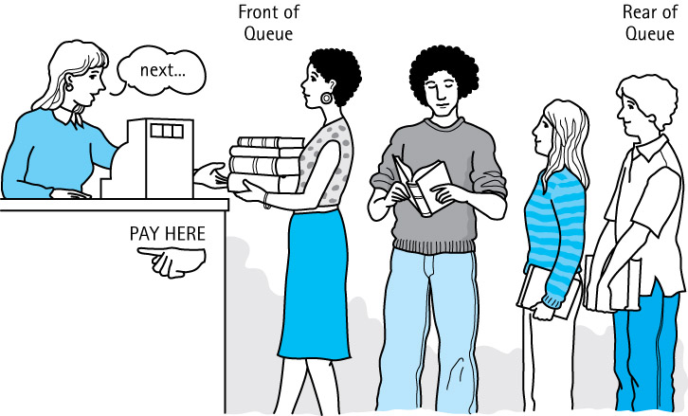
5.1 Queues
Queue A structure in which elements are added to the rear and removed from the front; a “first in, first out” (FIFO) structure

Slide 4
Operations on Queues
Constructor
  new - creates an empty queue
Transformers
  enqueue - adds an element to the rear of a queue
  dequeue - removes and returns the front element of the queue

Slide 5
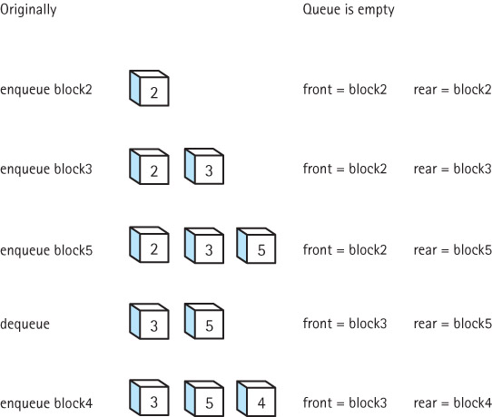
Effects of
Queue
Operations

Slide 6
Using Queues
Operating systems often maintain a queue of processes that are ready to execute or that are waiting for a particular event to occur.
Computer systems must often provide a “holding area” for messages between two processes, two programs, or even two systems. This holding area is usually called a “buffer” and is often implemented as a queue.
Our software queues have counterparts in real world queues. We wait in queues to buy pizza, to enter movie theaters, to drive on a turnpike, and to ride on a roller coaster. Another important application of the queue data structure is to help us simulate and analyze such real world queues

Slide 7
5.2 Formal Specification
(of our Queue ADT)
Recall from Section 5.1 that a queue is a “first-in first-out" structure, with primary operations
  enqueue - adds an element to the rear of a queue
  dequeue - removes and returns the front element of the queue push - adds an element to the top of the stack
In addition we need a constructor that creates an empty queue
Our Queue ADT will be generic, allowing the class of objects held by the queue to be specified upon instantiation of the queue.

Slide 8
Completing the Formal Specification
To complete the formal specification of the Queue ADT we need to
  Identify and address any exceptional situations
  Determine boundedness
  Define the Queue interface or interfaces
We use the same approach we used for Stacks

Slide 9
Exceptional Situations
dequeue – what if the queue is empty?
  throw a QueueUnderflowException
  plus define an isEmpty method for use by the application
enqueue – what if the queue is full?
  throw a QueueOverflowException
  plus define an isFull method for use by the application

Slide 10
Boundedness
We support two versions of the Queue ADT
  a bounded version
  an unbounded version
We define three interfaces
  QueueInterface: features of a queue not affected by boundedness
  BoundedQueueInterface: features specific to a bounded queue
  UnboundedQueueInterface: features specific to an unbounded queue

Slide 11
QueueInterface
//---------------------------------------------------------------------------
// QueueInterface.java by Dale/Joyce/Weems Chapter 5
//
// Interface for a class that implements a queue of Objects.
// A queue is a first-in, first-out structure.
//---------------------------------------------------------------------------
package ch05.queues;
public interface QueueInterface<T>
{
T dequeue() throws QueueUnderflowException;
// Throws QueueUnderflowException if this queue is empty,
// otherwise removes front element from this queue and returns it.
boolean isEmpty();
// Returns true if this queue is empty, otherwise returns false.
}

Slide 12
The Remaining Queue Interfaces
The BoundedQueueInterface
package ch05.queues;
public interface BoundedQueueInterface<T> extends QueueInterface<T>
{
void enqueue(T element) throws QueueOverflowException;
// Throws QueueOverflowException if this queue is full,
// otherwise adds element to the rear of this queue.
boolean isFull();
// Returns true if this queue is full, otherwise returns false.
}
The UnboundedQueueInterface
package ch05.queues;
public interface UnboundedQueueInterface<T> extends QueueInterface<T>
{
void enqueue(T element);
// Adds element to the rear of this queue.
}

Slide 13
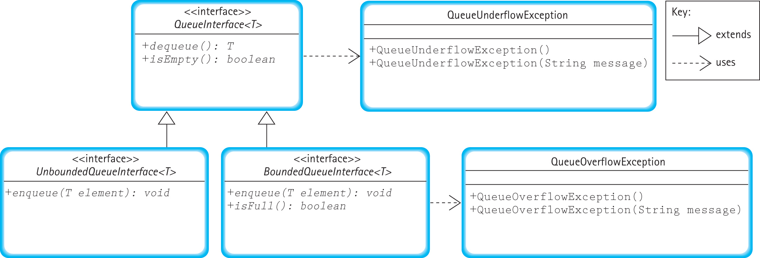
Relationships among Queue Interfaces and Exception Classes

Slide 14
5.3 Array-Based Implementations
In this section we study two array-based implementations of the Queue ADT
  a bounded queue version
  an unbounded queue version
First we establish how we will hold the queue elements in the array

Slide 15



Fixed Front Design
After four calls to enqueue with arguments ‘A’, ‘B’, ‘C’, and ‘D’:
Dequeue the front element:
Move every element in the queue up one slot
The dequeue operation is inefficient, so we do not use this approach

Slide 16
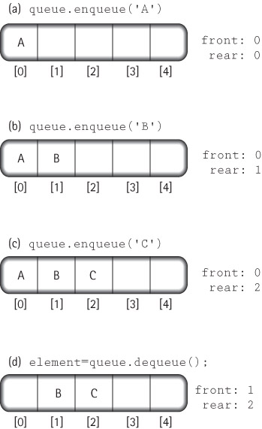
Floating Front Design
We use this
approach

Slide 17
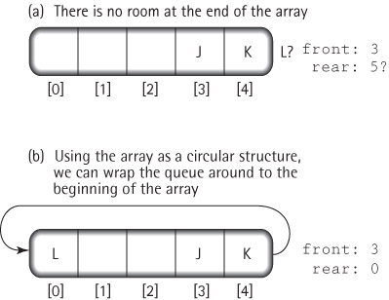
Wrap Around with Floating Front Design

Slide 18
The ArrayBndQueue Class
package ch05.queues;
public class ArrayBndQueue<T> implements BoundedQueueInterface<T>
{
protected final int DEFCAP = 100; // default capacity
protected T[] queue; // array that holds queue elements
protected int numElements = 0; // number of elements in the queue
protected int front = 0; // index of front of queue
protected int rear; // index of rear of queue
public ArrayBndQueue()
{
queue = (T[]) new Object[DEFCAP];
rear = DEFCAP - 1;
}
public ArrayBndQueue(int maxSize)
{
queue = (T[]) new Object[maxSize];
rear = maxSize - 1;
}

Slide 19
The enqueue operation
public void enqueue(T element)
// Throws QueueOverflowException if this queue is full,
// otherwise adds element to the rear of this queue.
{
if (isFull())
throw new QueueOverflowException("Enqueue attempted on a full queue.");
else
{
rear = (rear + 1) % queue.length;
queue[rear] = element;
numElements = numElements + 1;
}
}

Slide 20
The dequeue operation
public T dequeue()
// Throws QueueUnderflowException if this queue is empty,
// otherwise removes front element from this queue and returns it.
{
if (isEmpty())
throw new QueueUnderflowException(“Dequeue attempted on empty queue.”);
else
{
T toReturn = queue[front];
queue[front] = null;
front = (front + 1) % queue.length;
numElements = numElements - 1;
return toReturn;
}
}

Slide 21
Remaining Queue Operations
public boolean isEmpty()
// Returns true if this queue is empty, otherwise returns false
{
return (numElements == 0);
}
public boolean isFull()
// Returns true if this queue is full, otherwise returns false.
{
return (numElements == queue.length);
}

Slide 22
The ArrayUnbndQueue Class
The trick is to create a new, larger array, when needed, and copy the queue into the new array
  Since enlarging the array is conceptually a separate operation from enqueing, we implement it as a separate enlarge method
  This method instantiates an array with a size equal to the current capacity plus the original capacity
We can drop the isFull method from the class, since it is not required by the Unbounded Queue Interface
The dequeue and isEmpty methods are unchanged

Slide 23
The ArrayUnbndQueue Class
package ch05.queues;
public class ArrayUnbndQueue<T> implements UnboundedQueueInterface<T>
{
protected final int DEFCAP = 100; // default capacity
protected T[] queue; // array that holds queue elements
protected int origCap; // original capacity
protected int numElements = 0; // number of elements n the queue
protected int front = 0; // index of front of queue
protected int rear = -1; // index of rear of queue
public ArrayUnbndQueue()
{
queue = (T[]) new Object[DEFCAP];
rear = DEFCAP - 1;
origCap = DEFCAP;
}
public ArrayUnbndQueue(int origCap)
{
queue = (T[]) new Object[origCap];
rear = origCap - 1;
this.origCap = origCap;
}

Slide 24
The enlarge operation
private void enlarge()
// Increments the capacity of the queue by an amount
// equal to the original capacity.
{
// create the larger array
T[] larger = (T[]) new Object[queue.length + origCap];
// copy the contents from the smaller array into the larger array
int currSmaller = front;
for (int currLarger = 0; currLarger < numElements; currLarger++)
{
larger[currLarger] = queue[currSmaller];
currSmaller = (currSmaller + 1) % queue.length;
}
// update instance variables
queue = larger;
front = 0;
rear = numElements - 1;
}

Slide 25
The enqueue operation
public void enqueue(T element)
// Adds element to the rear of this queue.
{
if (numElements == queue.length)
enlarge();
rear = (rear + 1) % queue.length;
queue[rear] = element;
numElements = numElements + 1;
}

Slide 26
5.4 Application: Palindromes
Examples
  A tribute to Teddy Roosevelt, who orchestrated the creation of the Panama Canal:
    A man, a plan, a canal—Panama!
  Allegedly muttered by Napoleon Bonaparte upon his exile to the island of Elba:
    Able was I ere, I saw Elba.
Our goal is to write a program that identifies Palindromic strings
  we ignore blanks, punctuation and the case of letters

Slide 27
The Balanced Class
To help us identify palindromic strings we create a class called Palindrome, with a single exported static method test
test takes a candidate string argument and returns a boolean value indicating whether the string is a palindrome
Since test is static we invoke it using the name of the class rather than instantiating an Object of the class
The test method uses both the stack and queue data structures

Slide 28
The test method approach
The test method creates a stack and a queue
It then repeatedly pushes each input letter onto the stack, and also enqueues the letter onto the queue
It discards any non-letter characters
To simplify comparison later, we push and enqueue only lowercase versions of the characters
After the characters of the candidate string have been processed, test repeatedly pops a letter from the stack and dequeues a letter from the queue
As long as these letters match each other the entire way through this process, we have a palindrome

Slide 29
Test for Palindrome (String candidate)
Create a new stack
Create a new queue
for each character in candidate
if the character is a letter
Change the character to lowercase
Push the character onto the stack
Enqueue the character onto the queue
Set stillPalindrome to true
while (there are still more characters in the structures
&& stillPalindrome)
Pop character1 from the stack
Dequeue character2 from the queue
if (character1 != character2)
Set stillPalindrome to false
return (stillPalindrome)

Slide 30
Code and Demo
Instructors can now walk through the code contained in Palindrome.java and PalindromeApp.java, and demonstrate the running program.

Slide 31
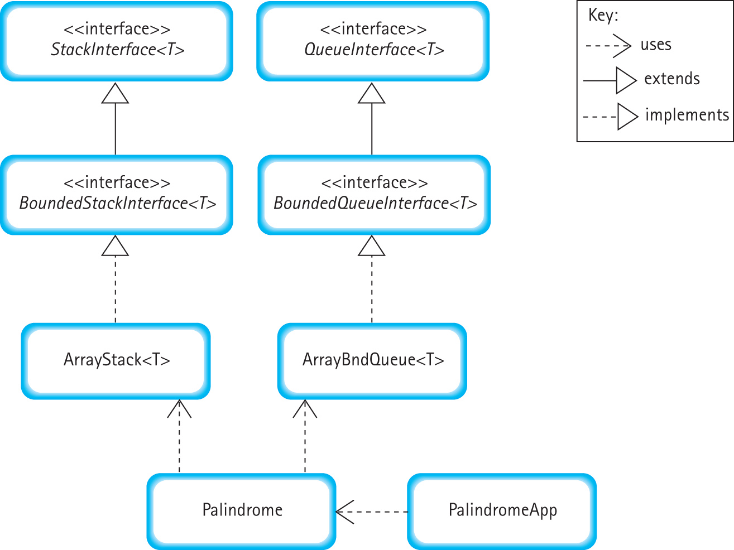
Program Architecture

Slide 32
5.5 Application: The Card Game of War
A deck of cards is shuffled and dealt to two players
The players repeatedly battle with their cards
  A battle consists of each player placing the top card from their hand, face up, on the table.
  Whoever has the higher of the two cards wins the cards
  A tied battle means war!
In a war
  Each player adds three more cards to the prize pile, and then turns up another battle card.
  Whoever wins this battle wins the entire prize pile
  If that battle is also a tie then there is another war …
The card game continues until one of the players runs out of cards, either during a regular battle or during a war. That player loses.

Slide 33
Our War Program
Simulates several games of war and tells us, on average, how many battles are waged in each game
Models player’s hands and the prize pile as queues
Simulates the game by coordinating the dequeing and enqueing operations among the two hands and the prize pile according to the rules
Requires two input values - the number of games to simulate and the maximum number of battles allowed before a game is discontinued
Output from the program consists of
  the number of discontinued games
  the number of completed games
  the average number of battles waged in completed games

Slide 34
The RankCardDeck Class
To help solve our problem we create a class called RankCardDeck, that models a deck of cards
Since we are only interested in card “ranks” we do not model suits
Three methods are exported
  shuffle – randomizes card order
  hasMoreCards – returns a boolean
  nextCard – returns an int

Slide 35
The WarGame Class
To help solve our problem we create another class called WarGame, that simulates a game of War
The constructor requires an argument indicating the maximum number of battles to allow before discontinuing the game
The class exports two methods
  play that simulates a game until it is finished or discontinued, returning true if the game finished normally and false if the game was discontinued
  getNumBattles that returns the number of battles waged in the most recent game

Slide 36
The play method
Creates three queues
  player1’s hand
  player2’s hand
  the prize pile of cards
shuffles the deck of cards and "deals" them
repeatedly calls a battle method, which enacts the battle between the two players, until the game is over or discontinued
the battle method is recursive – do you see why?

Slide 37
The battle method
battle()
Get player1's card from player1's hand
Put player1's card in the prize pile
Get player2's card from player2's hand
Put player2's card in the prize pile
if (player1's card > player2's card)
{
remove all the cards from the prize pile
and put them in player1's hand
}
else
if (player2's card > player1's card)
{
remove all the cards from the prize pile
and put them in player2's hand
}
else // war!
{
each player puts three cards in the prize pile
battle()
}

Slide 38
Code and Demo
Instructors can now walk through the code contained in RankCardDeck.java, WarGame.java and WarGameApp.java, review the programming notes from the chapter, and demonstrate the running program.

Slide 39
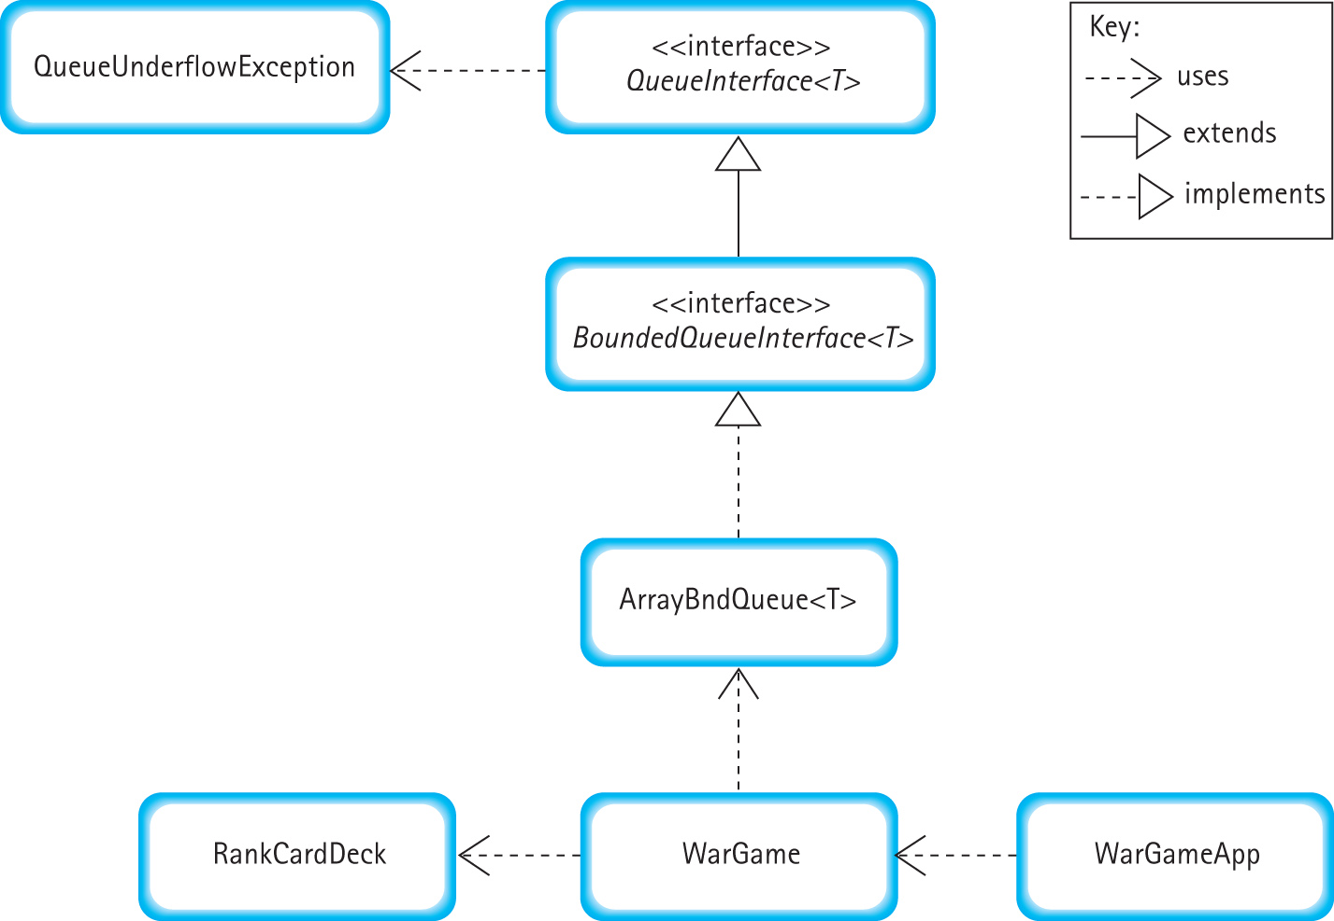
Program Architecture

Slide 40
5.6 Linked-Based Implementations
In this section we develop a link-based implementations of the Unbounded Queue ADT, and discuss a second link-based approach.
For nodes we use the same LLNode class we used for the linked implementation of stacks.
After discussing the link-based approaches we compare all of our queue implementation approaches.

Slide 41
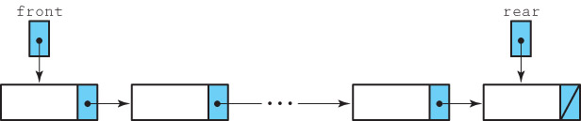
The LinkedUnbndQueue Class
package ch05.queues;
import support.LLNode;
public class LinkedUnbndQueue<T> implements UnboundedQueueInterface<T>
{
protected LLNode<T> front; // reference to the front of this queue
protected LLNode<T> rear; // reference to the rear of this queue
public LinkedUnbndQueue()
{
front = null;
rear = null;
}
. . .

Slide 42
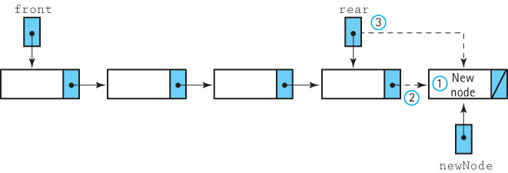
The enqueue operation
Enqueue (element)
  1. Create a node for the new element
  2. Insert the new node at the rear of the queue
  3. Update the reference to the rear of the queue

Slide 43
Code for the enqueue method
public void enqueue(T element)
// Adds element to the rear of this queue.
{
LLNode<T> newNode = new LLNode<T>(element);
if (rear == null)
front = newNode;
else
rear.setLink(newNode);
rear = newNode;
}

Slide 44
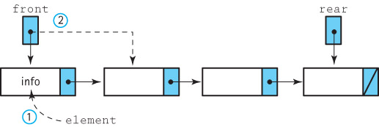
The dequeue operation
Dequeue: returns Object
  1. Set element to the information in the front node
  2. Remove the front node from the queue
  if the queue is empty
  Set the rear to null
  return element

Slide 45
Code for the dequeue method
public T dequeue()
// Throws QueueUnderflowException if this queue is empty,
// otherwise removes front element from this queue and returns it.
{
if (isEmpty())
throw new QueueUnderflowException("Dequeue attempted on empty queue.");
else
{
T element;
element = front.getInfo();
front = front.getLink();
if (front == null)
rear = null;
return element;
}
}

Slide 46
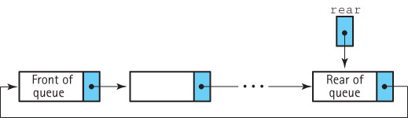
An Alternative Approach -
A Circular Linked Queue

Slide 47
Comparing Queue Implementations
Storage Size
  Array-based: takes the same amount of memory, no matter how many array slots are actually used, proportional to current capacity
  Link-based: takes space proportional to actual size of the queue (but each element requires more space than with array approach)
Operation efficiency
  All operations, for each approach, are O(1)
  Except for the Constructors:
    Array-based: O(N)
    Link-based: O(1)
Special Case – For the ArrayUnbndQueue the size “penalty” can be minimized but the enlarge method is O(N)

Slide 48
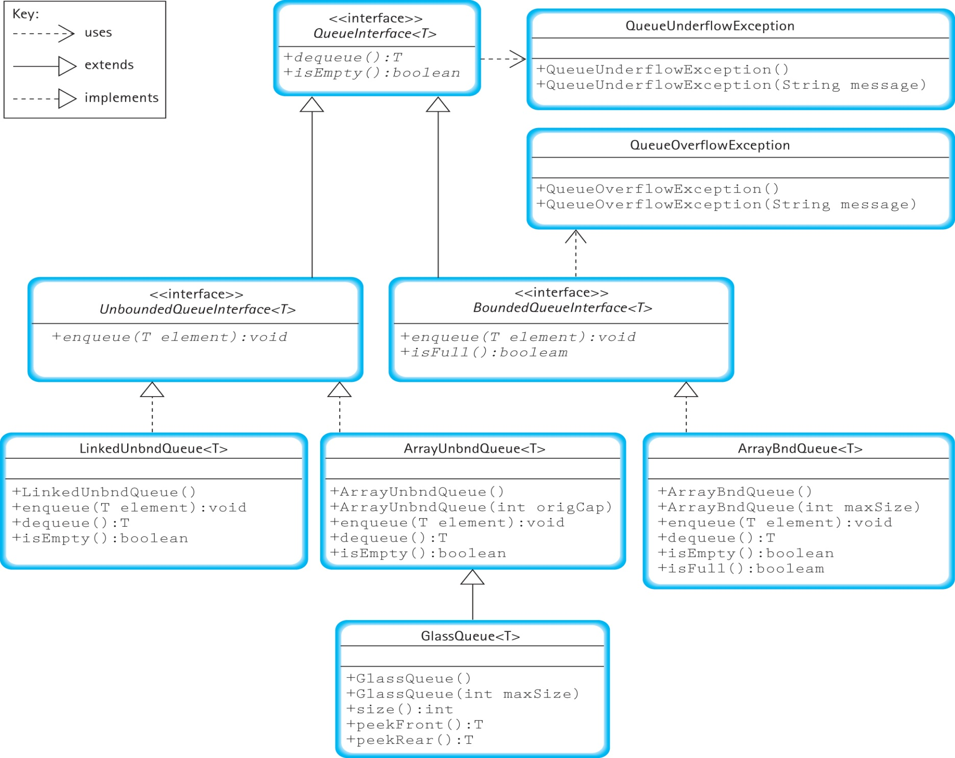

Slide 49
5.7 Concurrency, Interference, and Synchronization
Multitask: Perform more than one task at a time
Concurrency: Several interacting code sequences are executing simultaneously
  through interleaving of statements by a single processor
  through execution on several processors

Slide 50
Counter
Class
//-------------------------------------------------------------------------
// Counter.java by Dale/Joyce/Weems Chapter 5
//
// Tracks the current value of a counter.
//-------------------------------------------------------------------------
package ch05.threads;
public class Counter
{
private int count;
public Counter()
{
count = 0;
}
public void increment()
{
count++;
}
public String toString()
{
return "Count is:\t" + count;
}
}

Slide 51
Demo One - Basic
import ch05.threads.;
public class Demo01
{
  public static void main(String[] args)
  {
    Counter myCounter
    = new Counter();
    myCounter.increment();
    myCounter.increment();
    myCounter.increment();
    System.out.println(myCounter);
  }
}
The output of the program is:
Count is: 3

Slide 52
Demo Two - Threads
package ch05.threads;
public class Increase
implements Runnable
{
private Counter c;
private int amount;
public Increase (Counter c, int amount)
{
this.c = c; this.amount = amount;
}
public void run()
{
for (int i = 1; i <= amount; i++)
c.increment();
}
}
import ch05.threads.*;
public class Demo02
{
public static void main(String[] args) throws InterruptedException5
{
Counter c = new Counter();
Runnable r = new Increase(c, 10000);
Thread t = new Thread(r);
t.start();
System.out.println("Count is: " + c);
}
}
Output Varies: 86, 66, 44 ????

Slide 53
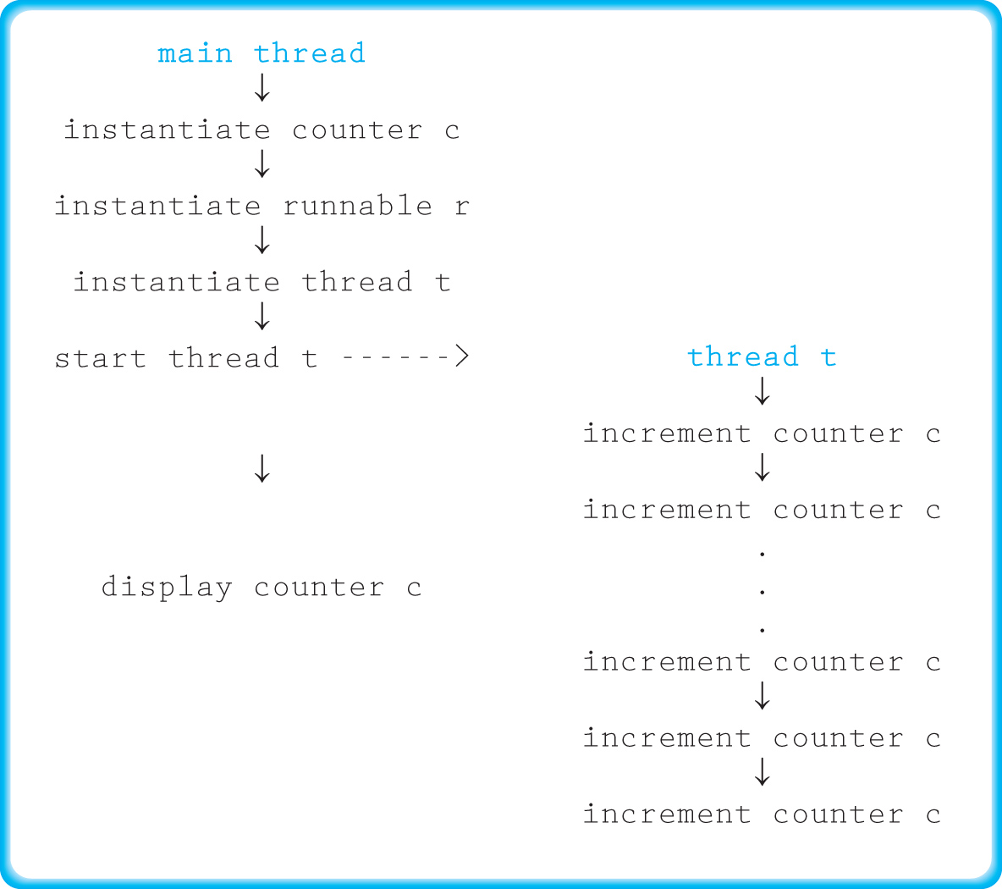
Demo Two - Threads

Slide 54
Demo Three - Join
package ch05.threads;
public class Increase implements Runnable
{
private Counter c;
private int amount;
public Increase (Counter c, int amount)
{
this.c = c; this.amount = amount;
}
public void run()
{
for (int i = 1; i <= amount; i++)
c.increment();
}
}
import ch05.threads.*;
public class Demo02
{
public static void main(String[] args) throws InterruptedException5
{
Counter c = new Counter();
Runnable r = new Increase(c, 10000);
Thread t = new Thread(r);
t.start();
t.join();
System.out.println("Count is: " + c);
}
}
Output is 10000

Slide 55
Demo Four - Interference
package ch05.threads;
public class Increase
implements Runnable
{
private Counter c;
private int amount;
public Increase (Counter c, int amount)
{
this.c = c; this.amount = amount;
}
public void run()
{
for (int i = 1; i <= amount; i++)
c.increment();
}
}
import ch05.threads.*;
public class Demo04
{
public static void main(String[] args)
throws InterruptedException
{
Counter c = new Counter();
Runnable r1 = new Increase(c, 5000);
Runnable r2 = new Increase(c, 5000);
Thread t1 = new Thread(r1);
Thread t2 = new Thread(r2);
t1.start(); t2.start();
t1.join(); t2.join();
System.out.println("Count is: " + c);
}
}
Output Varies: 9861, 9478 ????

Slide 56
Demo Four - Interference
Thread t1 Thread t2
Step 1: obtains value 12
Step 2: obtains value 12
Step 3: increments value to 13
Step 4: stores the value 13
Step 5: increments value to 13
Step 6: stores the value 13

Slide 57
Demo Five - Synchronization
// SyncCounter.java
// Tracks the current value of a counter.
// Provides synchronized access
package ch05.threads;
public class SyncCounter
{
private int count;
public SyncCounter()
{
count = 0;
}
public synchronized void increment()
{
count++;
}
public String toString()
{
return "Count is:\t" + count;
}
}
import ch05.threads.*;
public class Demo05
{
public static void main(String[] args) throws InterruptedException
{
SyncCounter sc = new SyncCounter();
Runnable r1 = new Increase2(sc, 5000);
Runnable r2 = new Increase2(sc, 5000);
Thread t1 = new Thread(r1);
Thread t2 = new Thread(r2);
t1.start(); t2.start();
t1.join(); t2.join();
System.out.println("Count is: " + sc);
}
}
Output is 10000

