Slide 1

Chapter 6
The List ADT

Slide 2
Chapter 6: The List ADT
6.1 – Comparing Objects Revisited
6.2 – Lists
6.3 – Formal Specification
6.4 – Array-Based Implementation
6.5 – Applications: Poker, Golf, and Music
6.6 – The Binary Search Algorithm
6.7 – Reference-Based Implementations
6.8 – Storing Objects and Structures in Files

Slide 3
6.1 Comparing Objects Revisited
Many list operations require us to compare the values of objects, for example
  check whether a given item is on our to-do list
  insert a name into a list in alphabetical order
  delete the entry with the matching serial number from a parts inventory list
Therefore we need to understand our options for such comparisons.

Slide 4
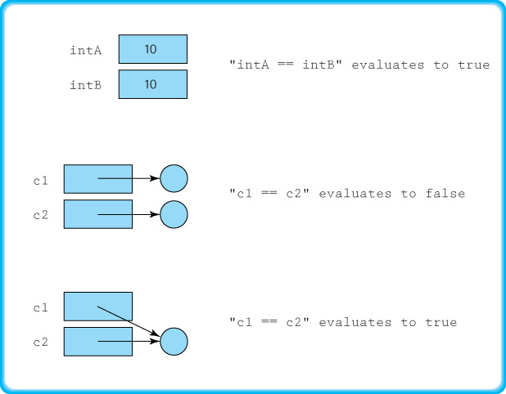
Using the comparison (==) operator

Slide 5
Using the equals method
Since equals is exported from the Object class it can be used with objects of any Java class.
For example, If c1 and c2 are objects of the class Circle, then we can compare them using
c1.equals(c2)
But this method, as defined in the Object class, acts much the same as the comparison operator. It returns true if and only if the two variables reference the same object.
However, we can redefine the equals method to fit the goals of the class.

Slide 6
Using the equals method
A reasonable definition for equality of Circle objects is that they are equal if they have equal radii.
To realize this approach we define the equals method of our Circle class to use the radius attribute:
  public boolean equals(Circle circle)
  // Precondition: circle != null
  //
  // Returns true if the circles have the same radius,
  // otherwise returns false.
  {
  if (this.radius == circle.radius)
  return true;
  else
  return false;
  }

Slide 7
Ordering objects
In addition to checking objects for equality, there is another type of comparison we need.
To support a sorted list we need to be able to tell when one object is less than, equal to, or greater than another object.
The Java library provides an interface, called Comparable, which can be used to ensure that a class provides this functionality.

Slide 8
The Comparable Interface
The Comparable interface consists of exactly one abstract method:
  public int compareTo(T o);
  // Returns a negative integer, zero, or a positive
  // integer as this object is less than, equal to,
  // or greater than the specified object.
The compareTo method returns an integer value that indicates the relative "size" relationship between the object upon which the method is invoked and the object passed to the method as an argument.

Slide 9
Using the Comparable Interface
Objects of a class that implements the Comparable interface are called Comparable objects.
To ensure that all elements placed on our sorted list support the compareTo operation, we require them to be Comparable objects.
For example, see the definition of compareTo for our Circle class on the next slide …

Slide 10
A compareTo Example
public int compareTo(Circle circle)
// Precondition: o != null
//
// Returns a negative integer, zero, or a positive integer as this object
// is less than, equal to, or greater than the parameter object.
{
if (this.radius < circle.radius)
return -1;
else
if (this.radius == (circle.radius)
return 0;
else
return 1;
}
Note that the equals method and the compareTo method of our Circle class are compatible with each other.
To simplify discussion we sometimes refer to the attribute, or combination of attributes, of an object used by the compareTo method to determine the logical order of a collection as the key of the collection.

Slide 11
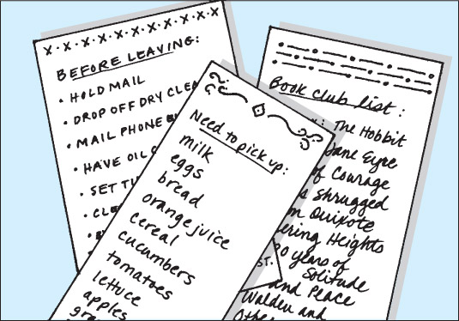
6.2 Lists
List A collection that exhibits a linear relationship among its elements
Linear relationship Each element except the first has a unique predecessor, and each element except the last has a unique successor
Size The number of elements in a list; the size can vary over time

Slide 12
Varieties of Lists
Unsorted list A list in which elements are placed in no particular order; the only relationship between data elements is the list predecessor and successor relationships
Sorted list A list that is sorted by some property of its elements; there is an ordered relationship among the elements in the list, reflected by their relative positions
Indexed list A list in which each element has an index value associated with it

Slide 13
Assumptions for our Lists
Our lists are unbounded
We allow duplicate elements on our lists
We do not support null elements
Other than prohibiting null elements, we have minimal preconditions on our operations
Our sorted lists are sorted in increasing order, as defined by the compareTo operation applied to list objects
The equals and compareTo methods of our sorted list elements are consistent
In our indexed lists, the indices in use at any given time are contiguous, starting at 0

Slide 14
6.3 Formal Specification
We define a small, but useful, set of operations for use with our lists.
We capture the formal specifications of our List ADT using the Java interface construct.
We pull common list method descriptions together into a single interface, called ListInterface.
We extend the ListInterface with a separate interface for indexed lists, since indexing a list allows additional operations.

Slide 15
List Iteration
Because a list has a linear relationship among its elements, we can support iteration through a list.
Iteration means that we provide a mechanism to process the entire list, element by element, from the first element to the last element.
Each of our list variations provides the operations reset and getNext to support this activity.

Slide 16
List Operations
Our list interface defines the following operations:
  size: Returns the number of elements on the list.
  add: Adds an element to the list.
  contains: Passed an argument and returns a boolean indicating whether the list contains an equivalent element.
  remove: Passed an argument and, if an equivalent element exists on the list, removes one instance of that element. Returns a boolean value indicating whether an element was actually removed.
  get: Passed an argument, it returns an equivalent object if one exists on the list. If not, returns null.
  toString: Returns a nicely formatted string representing the list.
  reset: Initializes the list. Sets the current position (the position of the next element to be processed) to the first element on the list.
  getNext: Returns the next element, and updates the current position.

Slide 17
List Operations
Our Indexed List also supports the operations
  add: Passed an element and an integer index it adds the element to the list at the position index
  set: Passed an element and an integer index it replaces the current element at the position index with the argument element
  get: Passed an integer index it returns the element from the list at that position
  indexOf: Passed an element it returns the index of the first such matching element (or -1)
  remove: Passed an integer index it removes the element at that index
Each method that accepts an index as an argument throws an exception if the index is invalid.

Slide 18
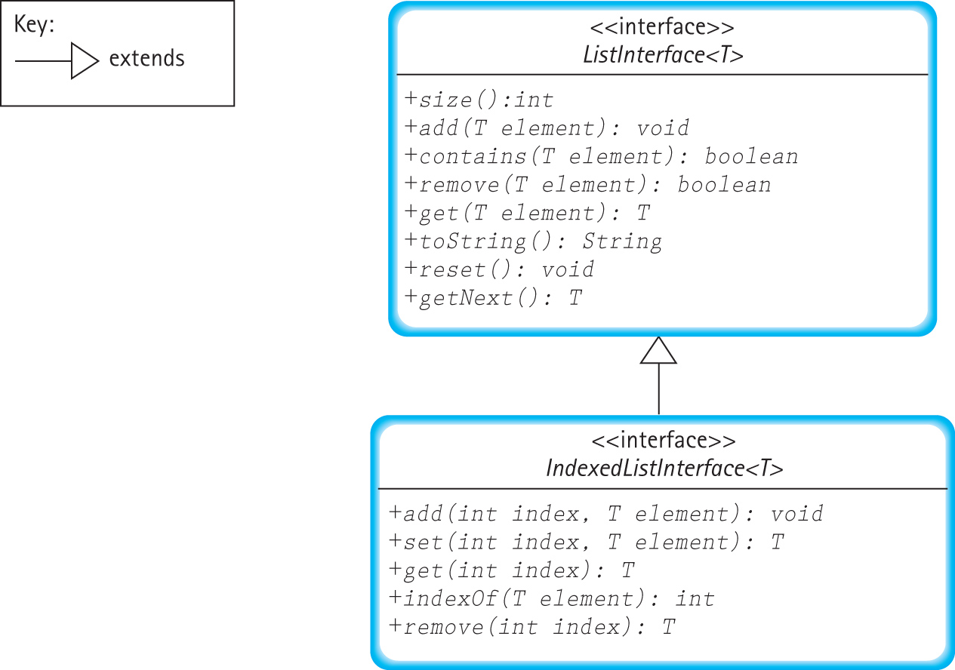
UML Diagram of our List Interfaces

Slide 19
Example Use
Code Section
ListInterface<String> list1
= new ArrayUnsortedList<String>(3);
list1.add("Wirth");
list1.add("Dykstra");
list1.add(“DePasquale");
list1.add("Dahl");
list1.add("Nygaard");
list1.remove(“DePasquale");
ListInterface<String> list2
= new ArraySortedList<String>(3);
list2.add("Wirth");
list2.add("Dykstra");
list2.add(“DePasquale");
list2.add("Dahl");
list2.add("Nygaard");
list2.remove(“DePasquale");
IndexedListInterface<String> list3
= new ArrayIndexedList<String>(3);
list3.add(0, "Wirth");
list3.add(0, "Dykstra");
list3.add(“DePasquale");
list3.add("Dahl");
list3.add("Nygaard");
list3.remove(“DePasquale");
System.out.print("Unsorted ");
System.out.println(list1);
System.out.print("Sorted ");
System.out.println(list2);
System.out.print("Indexed ");
System.out.println(list3);
Output
Unsorted List:
Wirth
Dykstra
Nygaard
Dahl
Sorted List:
Dahl
Dykstra
Nygaard
Wirth
Indexed List:
[0] Dykstra
[1] Nygaard
[2] Wirth
[3] Dahl

Slide 20

6.4 Array-Based Implementation
Basic Approach:

Slide 21
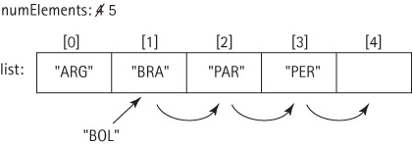
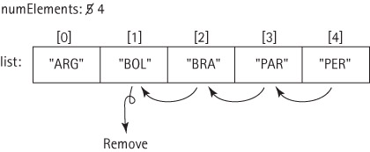
Adding/Removing from middle

Slide 22
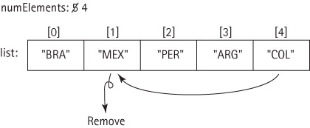
The ArrayUnsortedList Class
Implements the ListInterface
We create a helper method find for array search, which is used by several other methods
  find sets location and found instance variables
We are not concerned with the order in which elements are stored. So, for example, the remove method can be improved:

Slide 23
The ArraySortedList Class
Implements the ListInterface
Extends the UnsortedListInterface
the remove method maintains sorted order
the add method:
    check to ensure that there is room for it, invoking our enlarge method if there is not.
    find the place where the new element belongs.
    create space for the new element.
    put the new element in the created space.

Slide 24
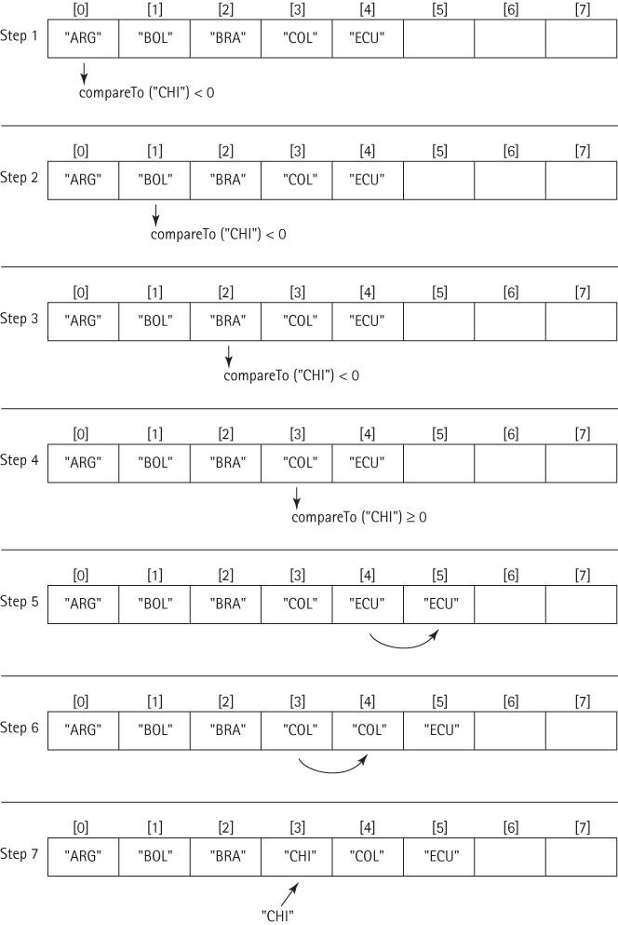

Slide 25
The Sorted List add method
public void add(T element)
// Adds element to this list.
{
T listElement;
int location = 0;
if (numElements == list.length)
enlarge();
while (location < numElements)
{
listElement = (T)list[location];
if (((Comparable)listElement).compareTo(element) < 0)
location++;
else
break;
}
for (int index = numElements; index > location; index--)
list[index] = list[index - 1];
list[location] = element;
numElements++;
}

Slide 26
Implementing ADTs “by Copy” or “by Reference”
When designing an ADT we have a choice about how to handle the elements—“by copy” or “by reference.”
  By Copy: The ADT manipulates copies of the data used in the client program. Making a valid copy of an object can be a complicated process.
  By Reference: The ADT manipulates references to the actual elements passed to it by the client program. This is the most commonly used approach and is the approach we use throughout this textbook.

Slide 27
“By Copy” Notes
Valid copies of an object are typically created using the object's clone method.
Classes that provide a clone method must indicate this to the runtime system by implementing the Cloneable interface.
Drawbacks:
  Copy of object might not reflect up-to-date status of original object
  Copying objects takes time, especially if the objects are large and require complicated deep-copying methods.
  Storing extra copies of objects also requires extra memory.

Slide 28
“By Reference” Notes
Because the client program retains a reference to the element, we say we have exposed the contents of the collection ADT to the client program.
The ADT allows direct access to the individual elements of the collection by the client program through the client program’s own references.
Drawbacks:
  We create aliases of our elements, therefore we must deal with the potential problems associated with aliases.
  This situation is especially dangerous if the client program can use an alias to change an attribute of an element that is used by the ADT to determine the underlying organization of the elements – for example if it changes the key value for an element stored in a sorted list.

Slide 29
An Example
The next three slides show the results of a sequence of operations when each of the two approaches is used to store a sorted list:
  We have three objects that hold a person’s name and weight (Slide 1)
  We add the three objects onto a list that sorts objects by the variable weight
  We transform one of the original objects with a diet method, that changes the weight of the object

Slide 30
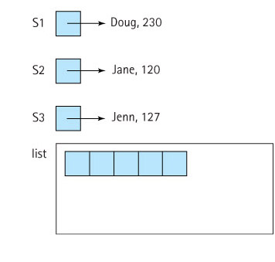
Example Step 1: The Three Objects
By Copy Approach By Reference Approach

Slide 31
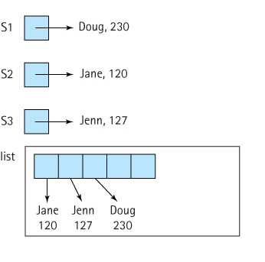
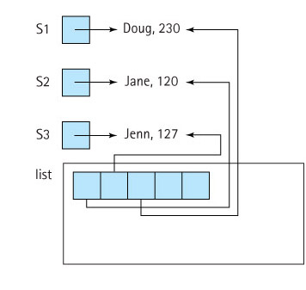
Example Step 2: Add Objects to List
By Copy Approach By Reference Approach

Slide 32
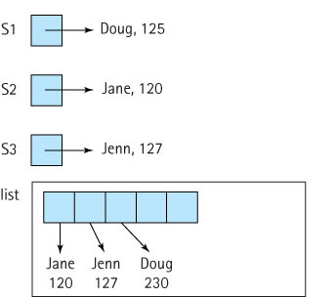
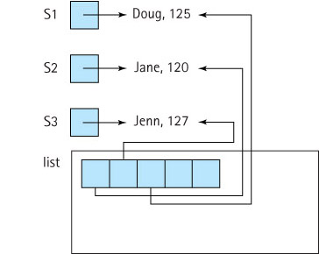
Example Step 3: S1.diet(-105)
By Copy Approach By Reference Approach
Problem: List copy is out of date
Problem: List is no longer sorted

Slide 33
Which approach is better?
That depends.
If processing time and space are issues, and if we are comfortable counting on the application programs to behave properly, then the “by reference” approach is probably best.
If we are not too concerned about time and space (maybe our list objects are not too large), but we are concerned with maintaining careful control over the access to and integrity of our lists, then the “by copy” approach is probably best.
The suitability of either approach depends on what the list is used for.

Slide 34
The ArrayIndexedList Class
Implements the IndexedListInterface
Extends the ArrayUnsortedList class with the methods needed for creation and use of an indexed list:
  void add(int index, T element)
  void set(int index, T element)
  T get(int index)
  int indexOf(T element)
  T remove(int index)
  The implementations are straightforward
Overrides the toString method of the ArrayUnsortedList class

Slide 35
6.5 Applications: Poker, Golf, and Music
We look at three applications, to see how our list implementations can be used to help solve problems.
  Poker: Our program simulates poker hands to help verify formal analysis
  Golf: Rank players based on their scores (demonstrates use of the Comparable interface)
  Music: Organize a collection of songs

Slide 36
Code and Demo
Instructors can review the problem descriptions, walk through the code for the classes, and demonstrate the running programs for each of the examples.
Note how each problem is solved using the most suitable type of list.

Slide 37
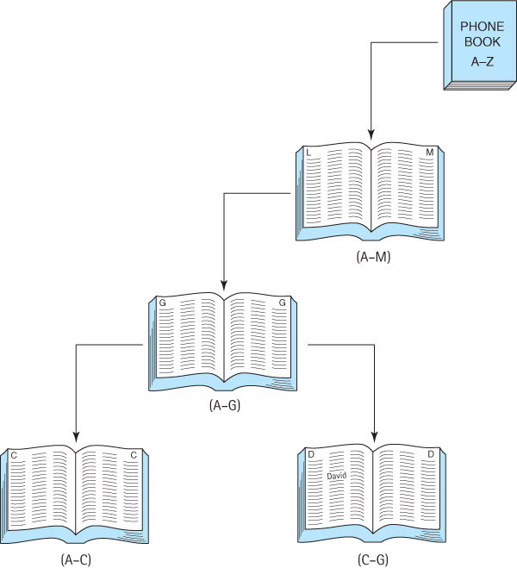
6.6 The Binary Search Algorithm

Slide 38
Searching in a phone book
Suppose we are looking for “David” in a phone book
We open the phone book to the middle and see that the names there begin with M
  M is larger than (comes after) D
  We can now limit our search to the section that contains A to M
We turn to the middle of the first half and see that the names there begin with G
  G is larger than D
  We can now limit our search to the section that contains A to G
We turn to the middle page of this section, and find that the names there begin with C
  C is smaller than D
  We can now limit our search to the section that contains C to G
And so on, until we are down to the single page that contains the name “David.”

Slide 39
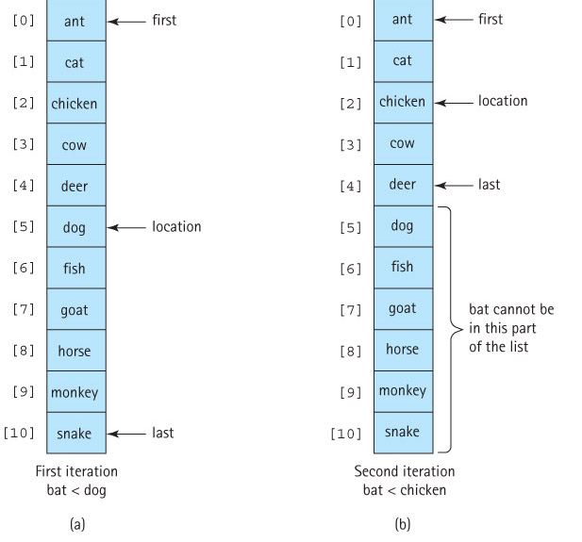
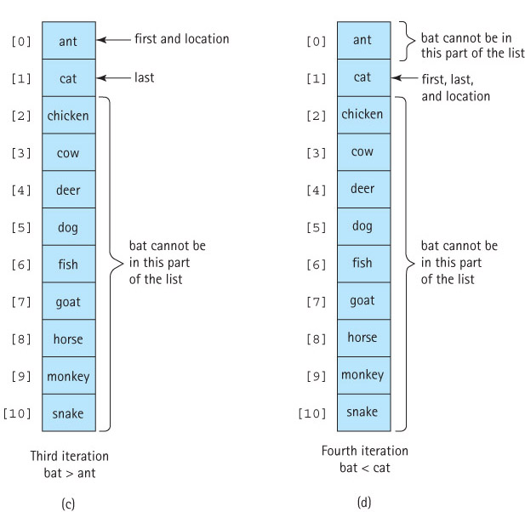
Searching for “bat” in a sorted array

Slide 40
The revised find method
protected void find(T target)
{
int first = 0;
int last = numElements - 1;
int compareResult;
Comparable targetElement = (Comparable)target;
found = false;
while (first <= last)
{
location = (first + last) / 2;
compareResult = targetElement.compareTo(list[location]);
if (compareResult == 0)
{
found = true;
break;
}
else if (compareResult < 0)
// target element is less than element at location
last = location - 1;
else // target element is greater than element at location
first = location + 1;
}
}

Slide 41
Recursive Binary Search
Consider this informal description of the binary search algorithm:
  To search a list, check the middle element on the list – if it's the target element you are done, if it's less than the target element search the second half of the list, otherwise search the first half of the list.
There is something inherently recursive about this description:
  We search the list by searching half the list.
  The solution is expressed in smaller versions of the original problem: if the answer isn’t found in the middle position, perform a binary search (a recursive call) to search the appropriate half of the list (a smaller problem).

Slide 42
The recursive find method
protected void recFind(Comparable target, int fromLocation, int toLocation)
{
if (fromLocation > toLocation) // Base case 1
found = false;
else
{
int compareResult;
location = (fromLocation + toLocation) / 2;
compareResult = target.compareTo(list[location]);
if (compareResult == 0) // Base case 2
found = true;
else if (compareResult < 0)
// target is less than element at location
recFind (target, fromLocation, location - 1);
else
// target is greater than element at location
recFind (target, location + 1, toLocation);
}
}
protected void find(T target)
{
Comparable targetElement = (Comparable)target;
found = false;
recFind(targetElement, 0, numElements - 1);
}

Slide 43
Efficiency Analysis
 | Maximum Number of Iterations
Length | Linear Search | Binary Search
10 | 10 | 4
100 | 100 | 7
1,000 | 1,000 | 10
10,000 | 10,000 | 14

Slide 44
6.7 Reference-Based Implementation
In this section we develop list implementations using references (links).
We follow the same basic pattern of development here that we did when we developed list implementations using arrays.
  Our reference-based implementations fulfill the interfaces we developed in Section 6.3.
  We first implement an unsorted version, and then extend it with a sorted version.

Slide 45

Reference Based Lists
As we did for our reference-based stacks and queues, we use the LLNode class from the support package to provide our nodes.
  the information attribute of a node contains the list element
  the link attribute contains a reference to the node holding the next list element
We maintain a variable, list, that references the first node on the list.

Slide 46
Reference Based Lists
We'll implement both unsorted and sorted lists using the linked approach.
We do not implement indexed lists. There is no simple way to efficiently implement the add, set, get, and remove operations involving index arguments.

Slide 47
The RefUnsortedList Class
Implements the ListInterface
The size, toString, reset, and getNext methods are straightforward
Because the list is unsorted, and order of the elements is not important, we can just add new elements to the front of the list :
public void add(T element)
// Adds element to this list.
{
LLNode<T> newNode = new LLNode<T>(element);
newNode.setLink(list);
list = newNode;
numElements++;
}

Slide 48
The find helper method
protected void find(T target)
{
location = list;
found = false;
while (location != null)
{
if (location.getInfo().equals(target))
{
found = true;
return
}
else
{
previous = location;
location = location.getLink();
}
}
}
Used by the contains, get, and remove methods.
Makes contains and get straightforward.
Sets a variable named previous - used by the remove method.

Slide 49
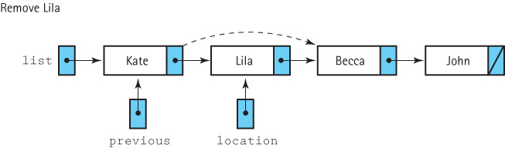
The remove method
To remove an element, we first find it using the find method, which sets the location variable to indicate the target element and sets the previous variable to a reference in the previous node.
We can now change the link of the previous node to reference the node following the one being removed.
Removing the first node must be treated as a special case because the main reference to the list (list) must be changed.

Slide 50
The remove method
public boolean remove (T element)
// Removes an element e from this list such that e.equals(element)
// and returns true; if no such element exists returns false.
{
find(element);
if (found)
{
if (list == location)
list = list.getLink(); // remove first node
else
previous.setLink(location.getLink()); // remove node at location
numElements--;
}
return found;
}

Slide 51
The RefSortedList Class
Implements the ListInterface
Extends the RefUnsortedList with an add method
Adding an element to a reference-based sorted list requires three steps:
  Find the location where the new element belongs
  Create a node for the new element
  Correctly link the new node into the identified location

Slide 52
1. Finding the location where the new element belongs
To link the new node into the identified location, we also need a reference to the previous node.
While traversing the list during the search stage, each time we update the location variable, we first save its value in a prevLoc variable:
    prevLoc = location;
    location = location.getLink();

Slide 53
2. Create a node for the new element
instantiate a new LLNode object called newNode, passing its constructor the new element for use as the information attribute of the node
LLNode<T> newNode = new LLNode<T>(element);

Slide 54
3. Correctly link the new node into the identified location
We change the link in the newNode to reference the node indicated by location and change the link in our prevLoc node to reference the newNode:
newNode.setLink(location);
prevLoc.setLink(newNode);

Slide 55
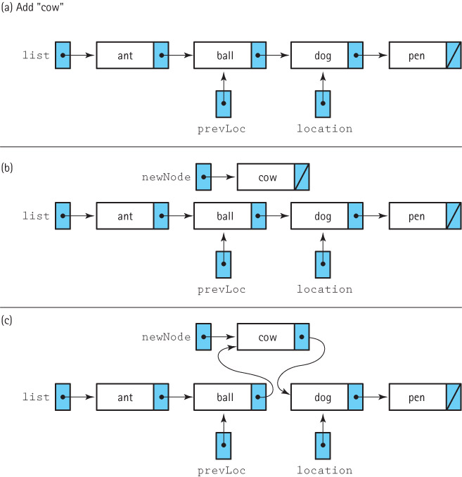

Slide 56
Special case – location indicates first node of list
In this case we do not have a previous node
We must change the main reference to the list (list)
if (prevLoc == null)
{
// Insert as first node.
newNode.setLink(list);
list = newNode;
}

Slide 57
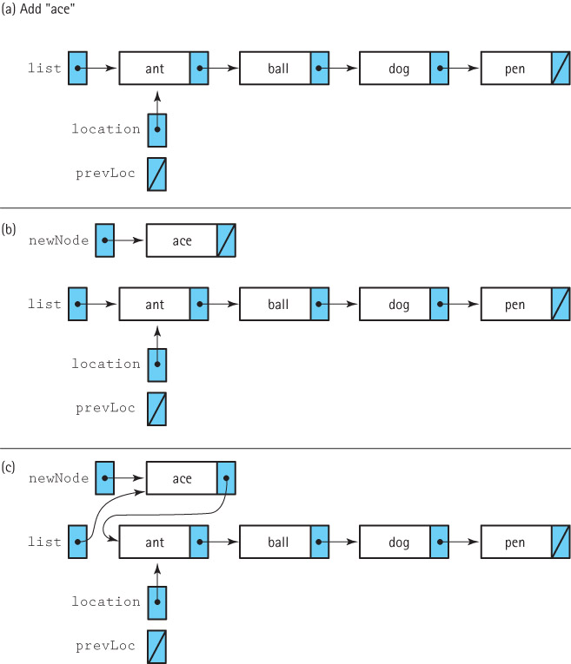

Slide 58
The add method
The code for the add method is too long to fit on a slide.
It can be found on page 444 of the textbook.

Slide 59
6.8 Storing Objects and Structures in Files
Many programs need to save information between program runs
Alternatively, we may want one program to save information for later use by another program
In either case, the information is stored in files, which are the mechanism for permanently storing information on computers
In this subsection we investigate approaches for saving and retrieving objects and structures using files, including Java’s serialization facilities

Slide 60
Saving Object Data in Text Files
Any information we need to save can be represented by its primitive parts.
As a very simple example, consider a Song object which has two instance variables:
  protected String name;
  protected int duration;
A song is not a “primitive” object, but when broken into its constituent parts its information consists of a String and an int. Both of these can be saved as strings.

Slide 61
import java.io.*;
import support.*;
public class SaveSong
{
private static PrintWriter outFile;
public static void main(String[] args) throws IOException
{
Song song1 = new Song("Penny Lane", 2, 57);
outFile = new PrintWriter(new FileWriter("song.txt"));
outFile.println(song1.getName());
outFile.println(song1.getDuration());
outFile.close();
}
}
When this program is executed, it creates the song.txt file:
Penny Lane
177

Slide 62
When we need to retrieve the Song object, we just reverse the process: read the strings, and reconstruct the song.
import java.io.*;
import java.util.*;
import support.*;
public class GetSong
{
public static void main(String[] args) throws IOException
{
String name;
int duration;
FileReader fin = new FileReader("song.txt");
Scanner songIn = new Scanner(fin);
name = songIn.nextLine();
duration = songIn.nextInt();
Song song2 = new Song(name, duration);
System.out.println("The name of the song is " + song2.getName());
System.out.println("The duration of the song is " + song2.getDuration());
}
}

Slide 63
Serialization of Objects
Transforming objects into strings and back again is a lot of work for the programmer.
Fortunately, Java provides another way to save objects. This approach is called serializing the object.
Before seeing how to serialize objects, we must learn about a new interface and two support classes.

Slide 64
Support Constructs
We can write objects using the writeObject method of the ObjectOutputStream class.
  To set up the output of serialized objects to the file objects.dat using the stream variable out, we write
  ObjectOutputStream out = new ObjectOutputStream(new
  FileOutputStream("objects.dat"));
We can read objects using the readObject method of the ObjectInputStream class.
  To set up reading from the same file, but this time using the variable in, we code
  ObjectInputStream in = new ObjectInputStream(new
  FileInputStream("objects.dat"));

Slide 65
The Serializable interface
Any class whose objects we plan to serialize must implement the Serializable interface.
This interface has no methods!
It marks a class as potentially being serialized for I/O, so that the Java runtime engine knows to convert references as needed on output or input of class instances.
To make our objects serializable, we simply state that their class implements the interface.

Slide 66
Example
SerSong.java (page 448) is a version of our Song class that implements the Serializable interface
SaveSerSong.java (page 449) is an application that creates a SerSong object and saves it to a file
GetSerSong.java (page 449-450) is an application that retrieves that SerSong object and uses it.

Slide 67
Serializing Structures
The power of Java’s serialization tools really becomes evident when dealing with data structures
For example, we can save or restore an entire array of SerSong objects with a single statement
To save the array:
    SerSong[] songs = new SerSong[100];
    ...
    out.writeObject(songs);
And to retrieve it later, perhaps from another program:
    SerSong[] laterSongs = (SerSong[])in.readObject();

Slide 68
Serializing Structures
What is even more impressive is that Java’s serialization works for linked structures.
We can save an entire linked list using a single writeObject statement, and later restore it using a single readObject statement.
This approach works even for the non-linear reference-based structures we study in later chapters. The tree and graph structures retain both their information and their structure using serialization.

Slide 69
Application: Song Lists
For an example of serialization of a structure, we create an application that
  allows us to enter song titles and lengths
  displays song information
  saves the song information
  song indexes start at 1
  if the user provides an illegal index for a song, instead of throwing an exception the program inserts the song at the end of the song list
  the user can provide a name for the list of songs

Slide 70
Code and Demo
Instructors can now walk through the code for the support class SerSongList.java and the application SerSongsApp.java and demonstrate the running program.

