Slide 1
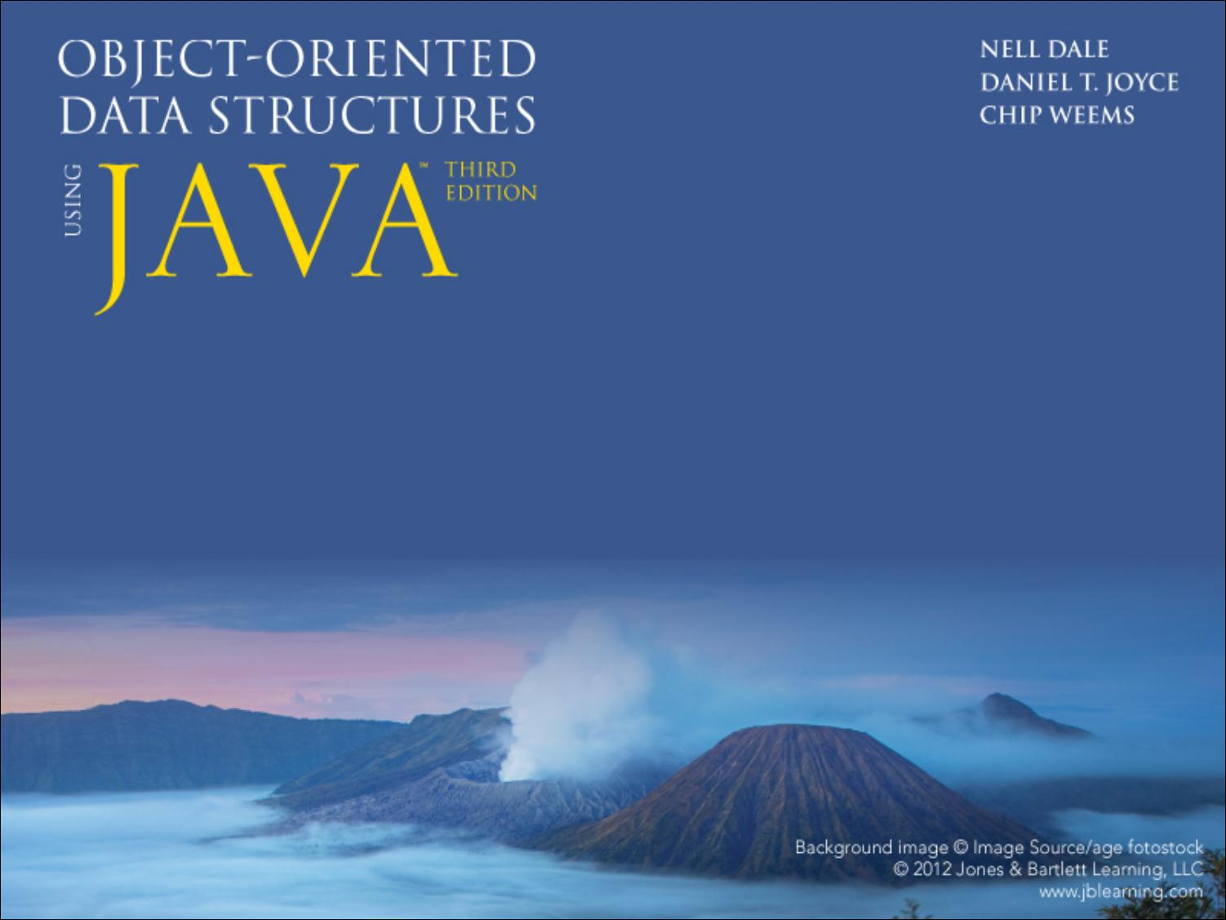
Chapter 9
Priority Queues, Heaps, and Graphs

Slide 2
Chapter 9: Priority Queues, Heaps, and Graphs
9.1 – Priority Queues
9.2 – Heaps
9.3 – Introduction to Graphs
9.4 – Formal Specification of a Graph ADT
9.5 – Graph Applications
9.6 – Implementations of Graphs

Slide 3
9.1 Priority Queues
A priority queue is an abstract data type with an interesting accessing protocol - only the highest-priority element can be accessed
Priority queues are useful for any application that involves processing items by priority

Slide 4
Logical Level
//----------------------------------------------------------------------------
// PriQueueInterface.java by Dale/Joyce/Weems Chapter 9
//
// Interface for a class that implements a priority queue of
// Comparable Objects.
//----------------------------------------------------------------------------
package ch09.priorityQueues;
public interface PriQueueInterface<T extends Comparable<T>>
{
boolean isEmpty();
// Returns true if this priority queue is empty, false otherwise.
boolean isFull();
// Returns true if this priority queue is full, false otherwise.
void enqueue(T element);
// Throws PriQOverflowException if this priority queue is full;
// otherwise, adds element to this priority queue.
T dequeue();
// Throws PriQUnderflowException if this priority queue is empty;
// otherwise, removes element with highest priority from this
// priority queue and returns it.
}

Slide 5
Implementation Level
There are many ways to implement a priority queue
  An Unsorted List - dequeuing would require searching through the entire list
  An Array-Based Sorted List - Enqueuing is expensive
  A Reference-Based Sorted List - Enqueuing again is 0(N)
  A Binary Search Tree - On average, 0(log₂N) steps for both enqueue and dequeue
  A Heap - (next section) guarantees 0(log₂N) steps, even in the worst case

Slide 6
9.2 Heaps
Heap An implementation of a Priority Queue based on a complete binary tree, each of whose elements contains a value that is greater than or equal to the value of each of its children
In other words, a heap is an implementation of a Priority Queue that uses a binary tree that satisfies two properties
  the shape property: the tree must be a complete binary tree
  the order property: for every node in the tree, the value stored in that node is greater than or equal to the value in each of its children.

Slide 7
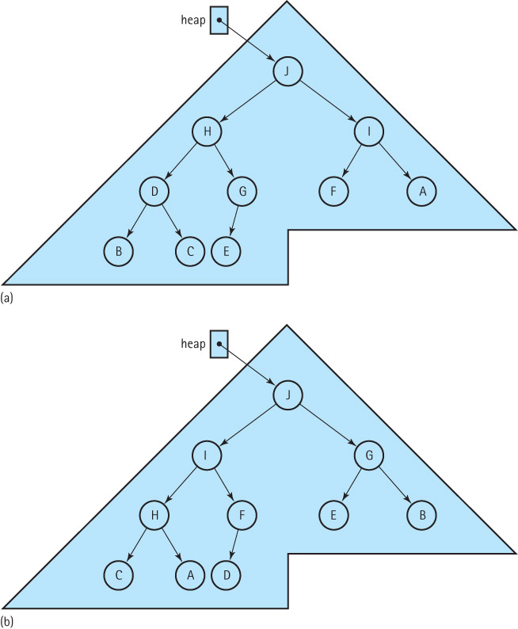
Two Heaps Containing the Letters ‘A’ through ‘J’

Slide 8
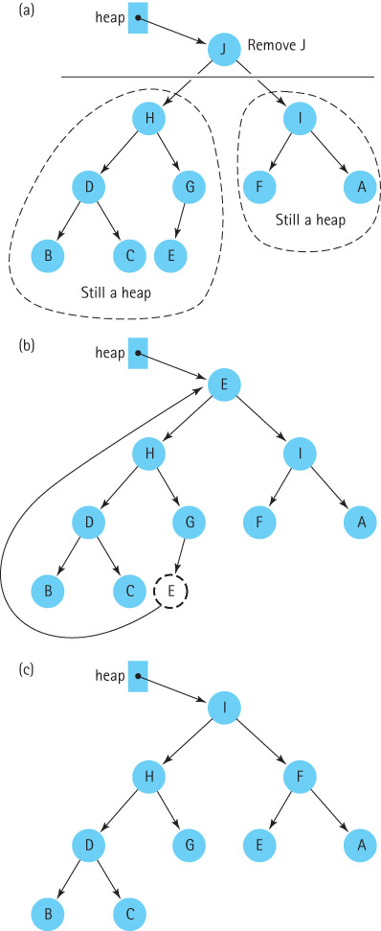
The dequeue operation
reheapDown (element)
Effect: Adds element to the heap.
Precondition: The root of the tree is empty.

Slide 9
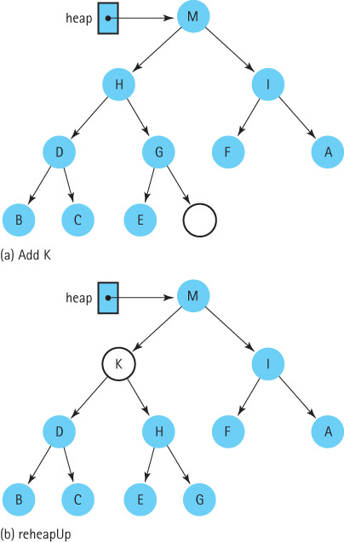
The enqueue operation
reheapUp (element)
Effect: Adds element to the heap.
Precondition: The last index position of the tree is empty.

Slide 10
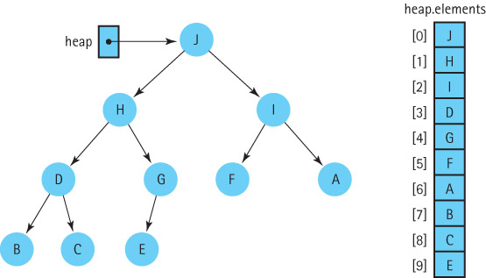
Heap Implementation

Slide 11
Beginning of Heap.java
package ch09.priorityQueues;
public class Heap<T extends Comparable<T>> implements PriQueueInterface<T>
{
private ArrayList<T> elements; // array that holds priority queue elements
private int lastIndex; // index of last element in priority queue
private int maxIndex; // index of last position in array
public Heap(int maxSize)
{
elements = new ArrayList<T>(maxSize);
lastIndex = –1;
maxIndex = maxSize – 1;
}
public boolean isEmpty()
// Returns true if this priority queue is empty, false otherwise.
{
return (lastIndex == –1);
}
public boolean isFull()
// Returns true if this priority queue is full, false otherwise.
{
return (lastIndex == maxIndex);
}

Slide 12
The enqueue method
public void enqueue(T element) throws PriQOverflowException
// Throws PriQOverflowException if this priority queue is full;
// otherwise, adds element to this priority queue.
{
if (lastIndex == maxIndex)
throw new PriQOverflowException("Priority queue is full");
else
{
lastIndex++;
elements.add(lastIndex, element);
reheapUp(element);
}
}
The reheapUp algorithm is pictured on the next slide

Slide 13
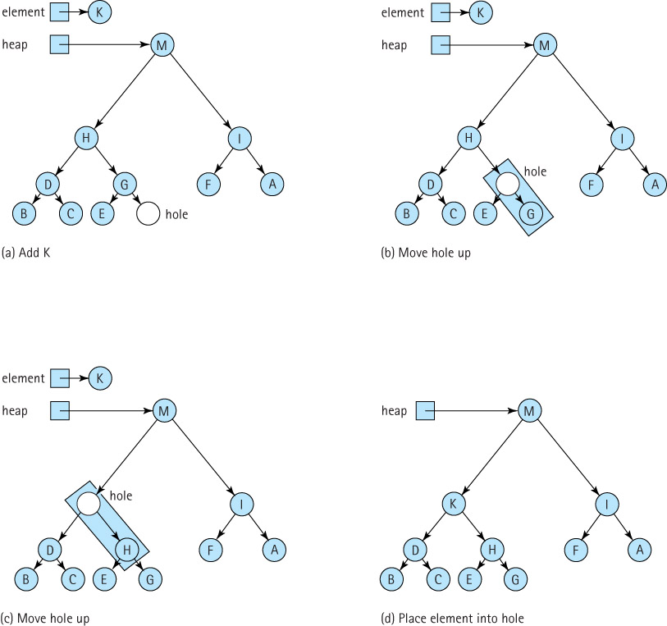

Slide 14
reheapUp operation
private void reheapUp(T element)
// Current lastIndex position is empty.
// Inserts element into the tree and ensures shape and order properties.
{
int hole = lastIndex;
while ((hole > 0) // hole is not root
&&
(element.compareTo(elements.get((hole - 1) / 2]) > 0))
// element > hole's parent
{
elements.set(hole,elements.get((hole - 1) / 2)); // move hole's parent down
hole = (hole - 1) / 2; // move hole up
}
elements.set(hole, element); // place element into final hole
}

Slide 15
The dequeue method
public T dequeue() throws PriQUnderflowException
// Throws PriQUnderflowException if this priority queue is empty;
// otherwise, removes element with highest priority from this
// priority queue and returns it.
{
T hold; // element to be dequeued and returned
T toMove; // element to move down heap
if (lastIndex == -1)
throw new PriQUnderflowException("Priority queue is empty");
else
{
hold = elements.get(0); // remember element to be returned
toMove = elements.remove(lastIndex); // element to reheap down
lastIndex--; // decrease priority queue size
if (lastIndex != -1)
reheapDown(toMove); // restore heap properties
return hold; // return largest element
}
}
The reheapDown algorithm is pictured on the next slide

Slide 16
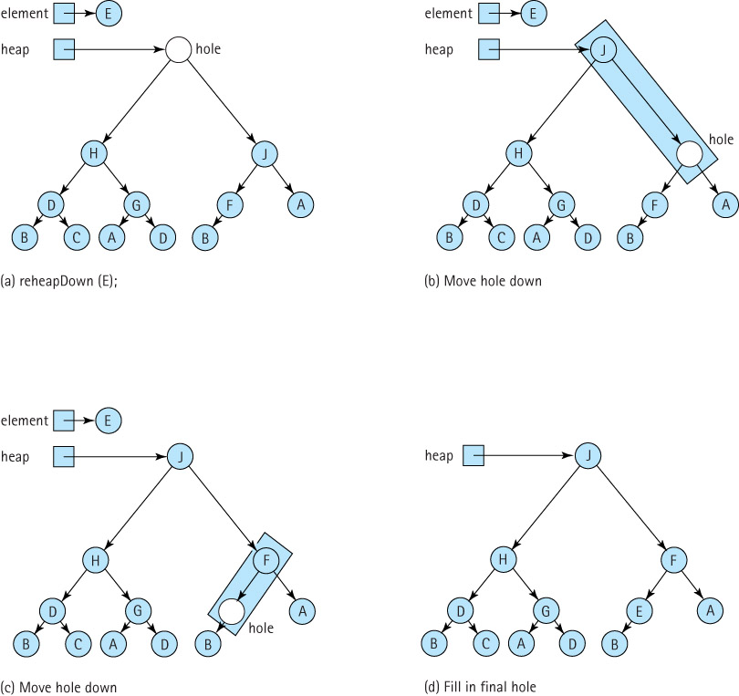

Slide 17
reheapDown operation
private void reheapDown(T element)
// Current root position is "empty";
// Inserts element into the tree and ensures shape and order properties.
{
int hole = 0; // current index of hole
int newhole; // index where hole should move to
newhole = newHole(hole, element); // find next hole
while (newhole != hole)
{
elements.set(hole, elements.get(newhole)); // move element up
hole = newhole; // move hole down
newhole = newHole(hole, element); // find next hole
}
elements.set(hole, element); // fill in the final hole
}

Slide 18
The newHole method
private int newHole(int hole, T element)
// If either child of hole is larger than element return the index
// of the larger child; otherwise return the index of hole.
{
int left = (hole * 2) + 1;
int right = (hole * 2) + 2;
if (left > lastIndex)
// hole has no children
return hole;
else
if (left == lastIndex)
// hole has left child only
if (element.compareTo(elements.get(left)) < 0)
// element < left child
return left;
else
// element >= left child
return hole;
else
// hole has two children
if (elements.get(left).compareTo(elements.get(right)) < 0)
// left child < right child
if (elements.get(right).compareTo(element) <= 0)
// right child <= element
return hole;
else
// element < right child
return right;
else
// left child >= right child
if (elements.get(left).compareTo(element) <= 0)
// left child <= element
return hole;
else
// element < left child
return left;
}

Slide 19
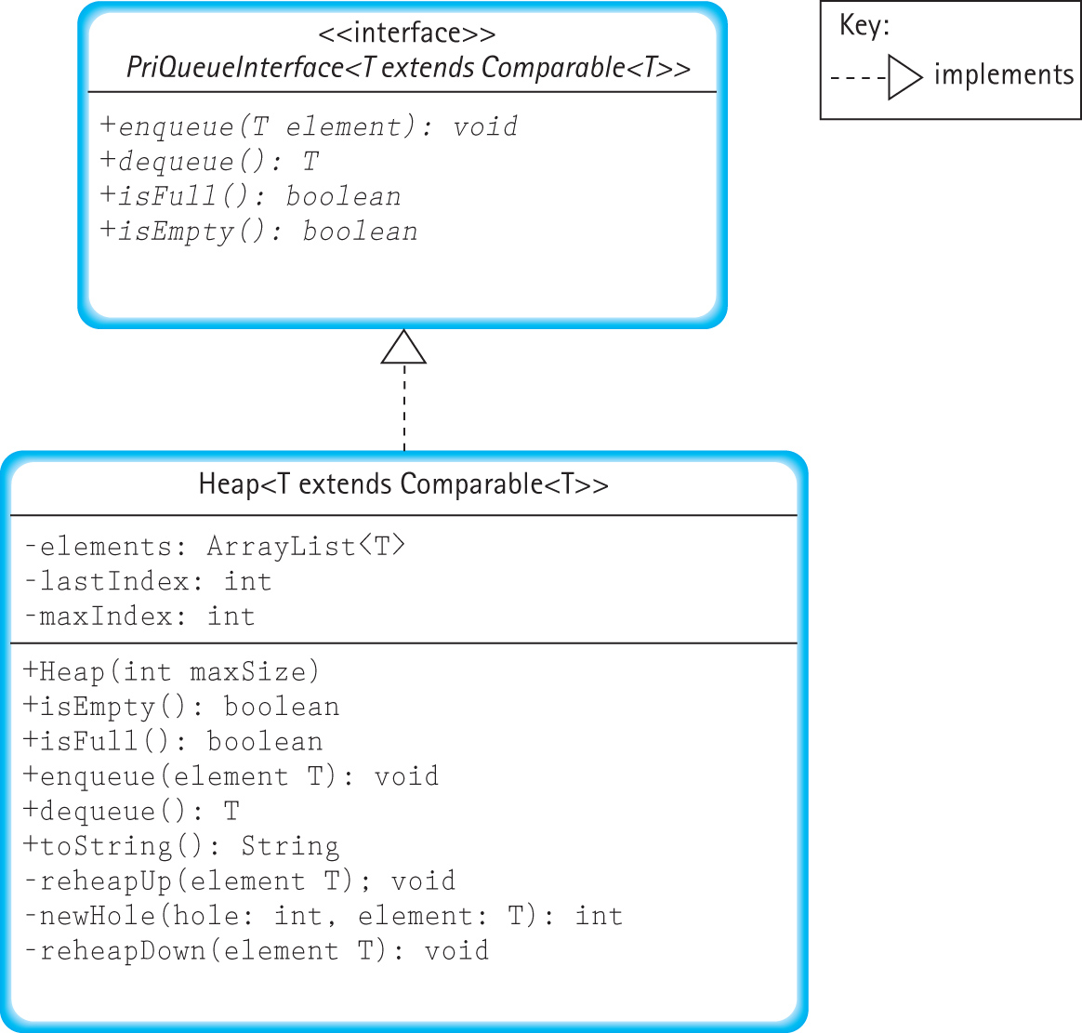

Slide 20
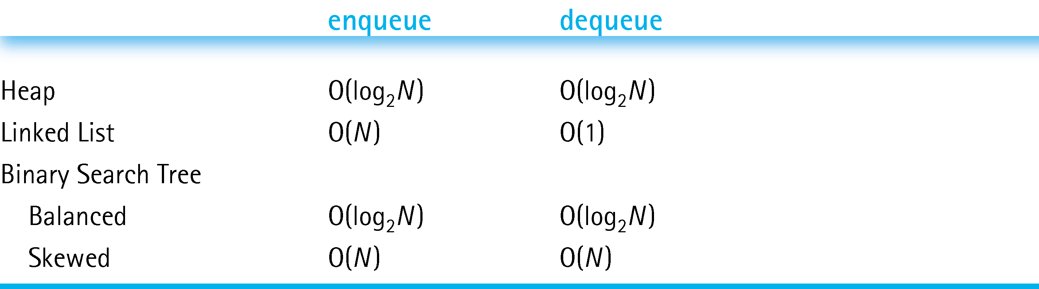
Heaps Versus Other Representations of Priority Queues

Slide 21
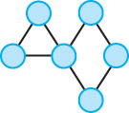
9.3 Introduction to Graphs

Slide 22
Definitions
Graph: A data structure that consists of a set of nodes and a set of edges that relate the nodes to each other
Vertex: A node in a graph
Edge (arc): A pair of vertices representing a connection between two nodes in a graph
Undirected graph: A graph in which the edges have no direction
Directed graph (digraph): A graph in which each edge is directed from one vertex to another (or the same) vertex

Slide 23
Formally
a graph G is defined as follows:
        G = (V,E)
where
  V(G) is a finite, nonempty set of vertices
  E(G) is a set of edges (written as pairs of vertices)

Slide 24
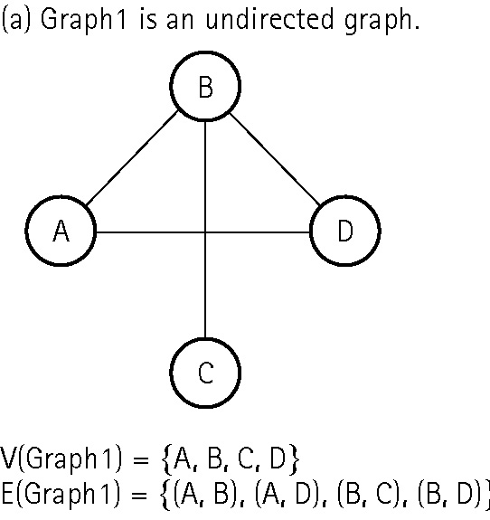
An undirected graph

Slide 25
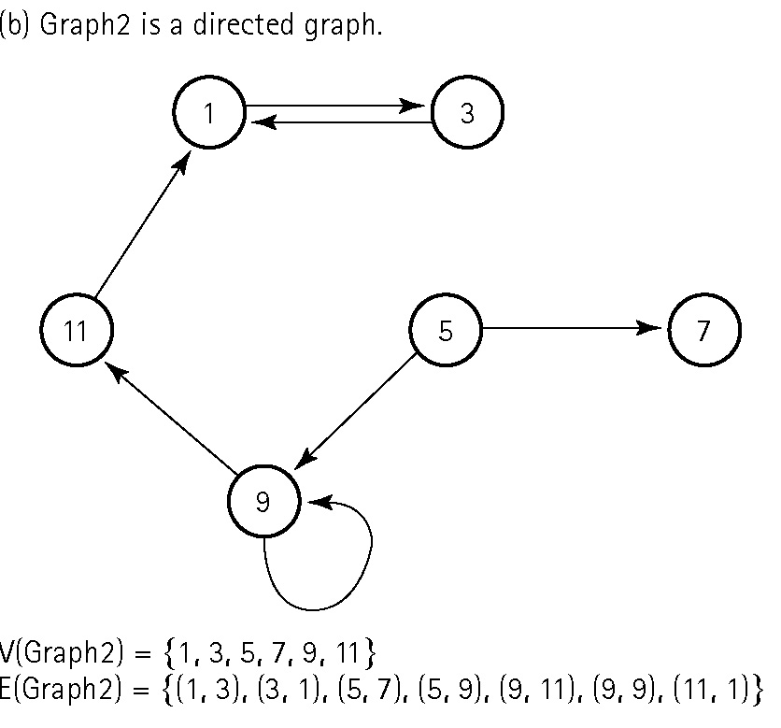
A directed graph

Slide 26
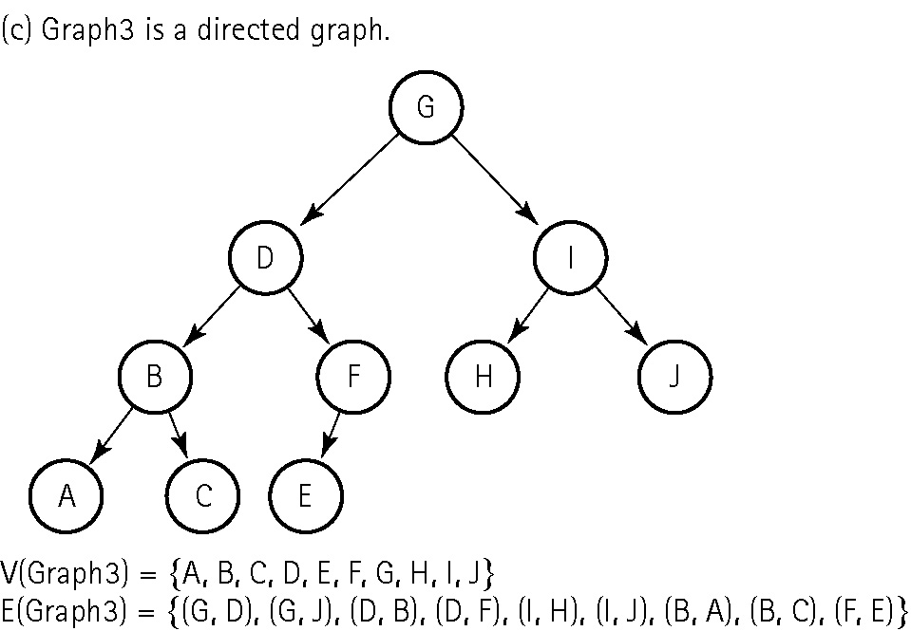
Another directed graph

Slide 27
More Definitions
Adjacent vertices: Two vertices in a graph that are connected by an edge
Path: A sequence of vertices that connects two nodes in a graph
Complete graph: A graph in which every vertex is directly connected to every other vertex
Weighted graph: A graph in which each edge carries a value

Slide 28
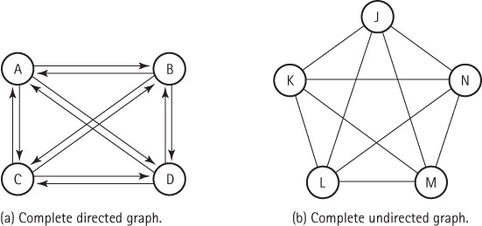
Two complete graphs

Slide 29
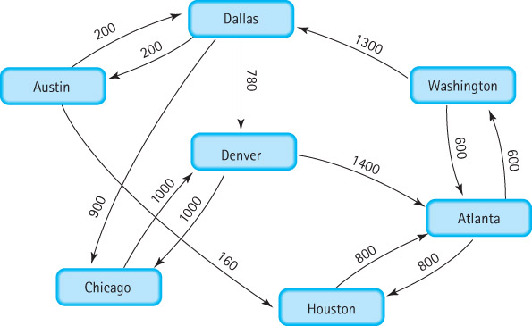
A weighted graph

Slide 30
9.4 Formal Specification of a Graph ADT
What kind of operations are defined on a graph?
  We specify and implement a small set of useful graph operations
  Many other operations on graphs can be defined; we have chosen operations that are useful in the graph applications described later in the chapter

Slide 31
WeightedGraphInterface.java part I
//----------------------------------------------------------------------------
// WeightedGraphInterface.java by Dale/Joyce/Weems Chapter 9
//
// Interface for a class that implements a directed graph with weighted edges.
// Vertices are objects of class T and can be marked as having been visited.
// Edge weights are integers.
//
// General precondition: except for the addVertex and hasVertex methods,
// any vertex passed as an argument to a method is in this graph.
//----------------------------------------------------------------------------
package ch09.graphs;
import ch05.queues.*;
public interface WeightedGraphInterface<T>
{
boolean isEmpty();
// Returns true if this graph is empty; otherwise, returns false.
boolean isFull();
// Returns true if this graph is full; otherwise, returns false.

Slide 32
WeightedGraphInterface.java part II
void addVertex(T vertex);
// Preconditions: This graph is not full.
// Vertex is not already in this graph.
// Vertex is not null.
//
// Adds vertex to this graph.
boolean hasVertex(T vertex);
// Returns true if this graph contains vertex; otherwise, returns false.
void addEdge(T fromVertex, T toVertex, int weight);
// Adds an edge with the specified weight from fromVertex to toVertex.
int weightIs(T fromVertex, T toVertex);
// If edge from fromVertex to toVertex exists, returns the weight of edge;
// otherwise, returns a special “null-edge” value.

Slide 33
WeightedGraphInterface.java part III
UnboundedQueueInterface<T> getToVertices(T vertex);
// Returns a queue of the vertices that are adjacent from vertex.
void clearMarks();
// Sets marks for all vertices to false.
void markVertex(T vertex);
// Sets mark for vertex to true.
boolean isMarked(T vertex);
// Returns true if vertex is marked; otherwise, returns false.
T getUnmarked();
// Returns an unmarked vertex if any exist; otherwise, returns null.
}

Slide 34
9.5 Implementations of Graphs
In this section we introduce two graph implementation approaches
  an array based approach
  a linked approach

Slide 35
Array-Based Implementation
Adjacency matrix For a graph with N nodes, an N by N table that shows the existence (and weights) of all edges in the graph
With this approach a graph consists of
  an integer variable numVertices
  a one-dimensional array vertices
  a two-dimensional array edges (the adjacency matrix)

Slide 36
A repeat of the abstract model

Slide 37
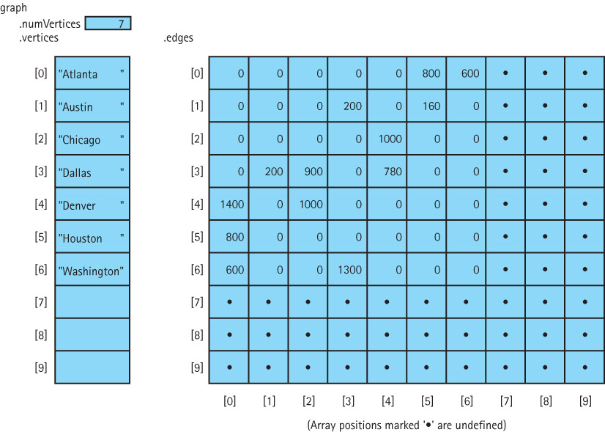
The array-based implementation

Slide 38
WeightedGraph.java instance variables
package ch09.graphs;
import ch05.queues.*;
public class WeightedGraph<T> implements WeightedGraphInterface<T>
{
public static final int NULL_EDGE = 0;
private static final int DEFCAP = 50; // default capacity
private int numVertices;
private int maxVertices;
private T[] vertices;
private int[][] edges;
private boolean[] marks; // marks[i] is mark for vertices[i]
. . .

Slide 39
WeightedGraph.java
Constructors
public WeightedGraph()
// Instantiates a graph with capacity DEFCAP vertices.
{
numVertices = 0;
maxVertices = DEFCAP;
vertices = (T[ ]) new Object[DEFCAP];
marks = new boolean[DEFCAP];
edges = new int[DEFCAP][DEFCAP];
}
public WeightedGraph(int maxV)
// Instantiates a graph with capacity maxV.
{
numVertices = 0;
maxVertices = maxV;
vertices = (T[ ]) new Object[maxV];
marks = new boolean[maxV];
edges = new int[maxV][maxV];
}
...

Slide 40
WeightedGraph.java adding a vertex
public void addVertex(T vertex)
// Preconditions: This graph is not full.
// Vertex is not already in this graph.
// Vertex is not null.
//
// Adds vertex to this graph.
{
vertices[numVertices] = vertex;
for (int index = 0; index < numVertices; index++)
{
edges[numVertices][index] = NULL_EDGE;
edges[index][numVertices] = NULL_EDGE;
}
numVertices++;
}
Textbook also includes code for indexIs, addEdge,
weightIs, and getToVertices.
Coding the remaining methods is left as an exercise.

Slide 41
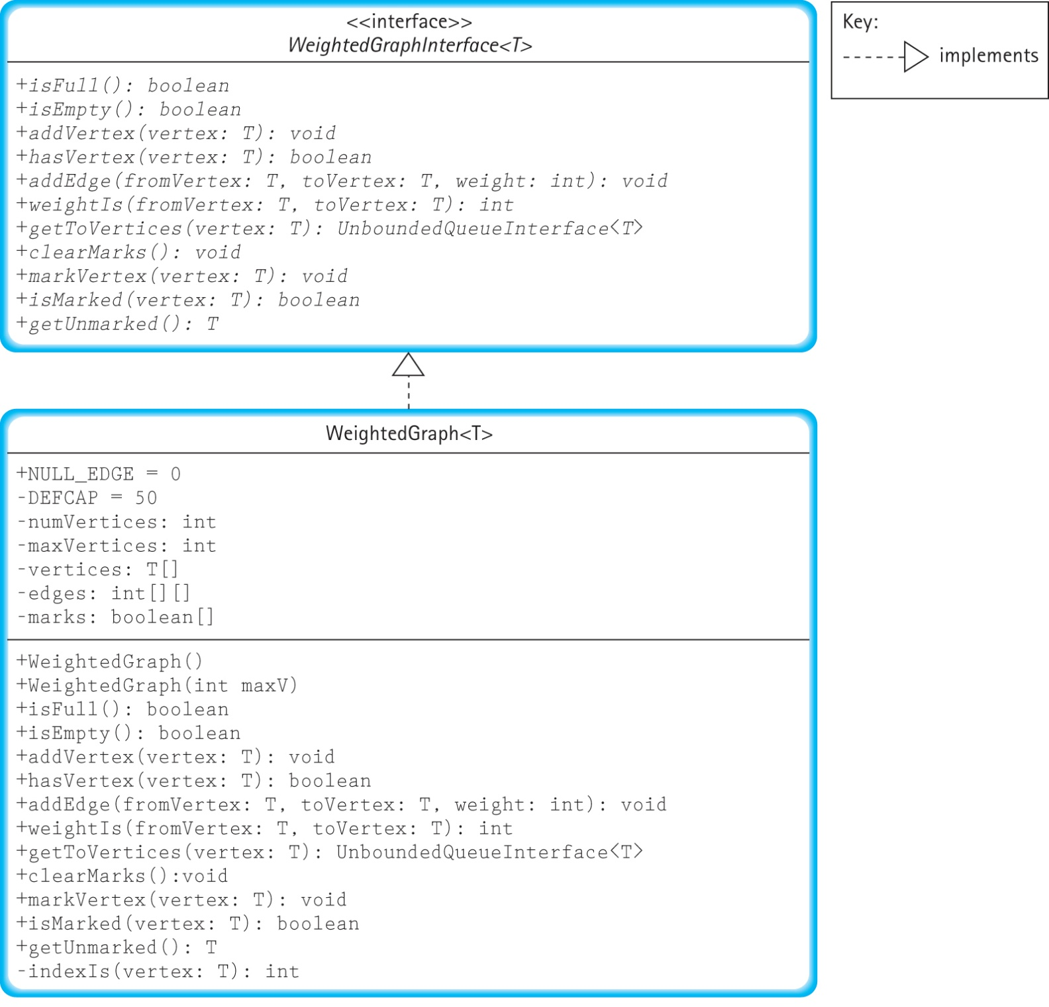

Slide 42
Link-Based Implementation
Adjacency list A linked list that identifies all the vertices to which a particular vertex is connected; each vertex has its own adjacency list
We look at two alternate approaches:
  use an array of vertices that each contain a reference to a linked list of nodes
  use a linked list of vertices that each contain a reference to a linked list of nodes

Slide 43
A repeat of the abstract model

Slide 44
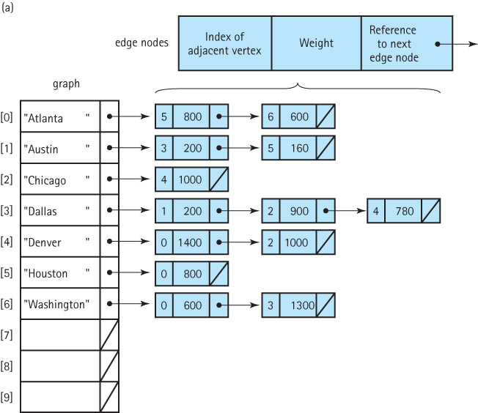
The first link-based implementation

Slide 45
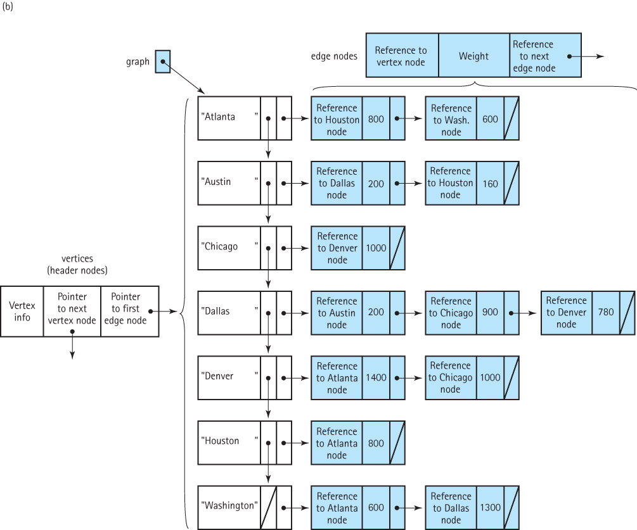
The second link-based implementation

Slide 46
9.6 Graph Applications
Our graph specification does not include traversal operations.
We treat traversal as a graph application/algorithm rather than an innate operation.
The basic operations given in our specification allow us to implement different traversals independent of how the graph itself is actually implemented.

Slide 47
Graph Traversal
We look at two types of graph traversal:
  The strategy of going down a branch to its deepest point and moving up is called a depth-first strategy.
  Another systematic way to visit each vertex in a tree is to visit each vertex on level 0 (the root), then each vertex on level 1, then each vertex on level 2, and so on. Visiting each vertex by level in this way is called a breadth-first strategy.
We discuss algorithms for employing both strategies within the context of determining if two cities are connected in our airline example.

Slide 48
Can we get from Austin to Washington?

Slide 49
Depth first search - erroneous
IsPath (startVertex, endVertex): returns boolean
Set found to false
stack.push(startVertex)
do
vertex = stack.top( )
stack.pop( )
if vertex = endVertex
Set found to true
else
Push all adjacent vertices onto stack
while !stack.isEmpty( ) AND !found
return found
This approach
could result
in an infinite
loop!

Slide 50
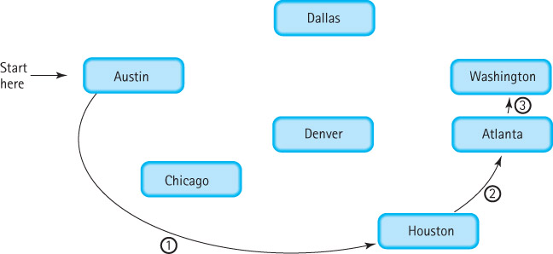
Depth first search - corrected
IsPath (startVertex, endVertex): returns boolean
Set found to false
graph.clearMarks()
stack.push(startVertex)
do
vertex = stack.top( )
stack.pop( )
if vertex = endVertex
Set found to true
else
if vertex is not marked
Mark vertex
Push all adjacent vertices onto stack
while !stack.isEmpty( ) AND !found
return found

Slide 51
private static boolean isPath(WeightedGraphInterface<String> graph, String startVertex, String endVertex )
{
UnboundedStackInterface<String> stack = new LinkedStack<String> ();
UnboundedQueueInterface<String> vertexQueue = new LinkedUnbndQueue<String> ();
boolean found = false;
String vertex;
String item;
graph.clearMarks();
stack.push(startVertex);
do
{
vertex = stack.top();
stack.pop();
if (vertex == endVertex)
found = true;
else
{
if (!graph.isMarked(vertex))
{
graph.markVertex(vertex);
vertexQueue = graph.getToVertices(vertex);
while (!vertexQueue.isEmpty())
{
item = vertexQueue.dequeue();
if (!graph.isMarked(item))
stack.push(item);
}
}
}
} while (!stack.isEmpty() && !found);
return found;
}
isPath method
Depth-first approach

Slide 52
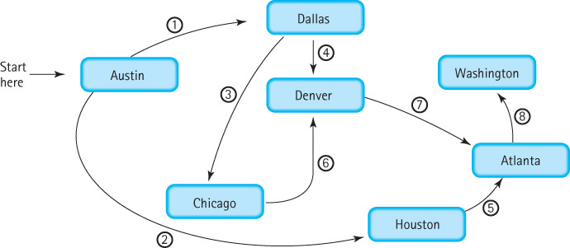
Breadth first search – use queue
IsPath (startVertex, endVertex): returns boolean
Set found to false
graph.clearMarks()
queue.enqueue(startVertex)
do
vertex = queue.dequeue( )
if vertex = endVertex
Set found to true
else
if vertex is not marked
Mark vertex
Enqueue all adjacent vertices onto queue
while !queue.isEmpty( ) AND !found
return found

Slide 53
private static boolean isPath2(WeightedGraphInterface<String> graph,
String startVertex, String endVertex)
{
QueueInterface<String> queue = new LinkedQueue<String>();
QueueInterface<String> vertexQueue = new LinkedQueue<String>();
boolean found = false;
String vertex;
String element;
graph.clearMarks();
queue.enqueue(startVertex);
do
{
vertex = queue.dequeue();
if (vertex == endVertex)
found = true;
else
{
if (!graph.isMarked(vertex))
{
graph.markVertex(vertex);
vertexQueue = graph.getToVertices(vertex);
while (!vertexQueue.isEmpty())
{
element = vertexQueue.dequeue();
if (!graph.isMarked(element))
queue.enqueue(element);
}
}
}
} while (!queue.isEmpty() && !found);
return found;
}
isPath method
Breadth-first approach

Slide 54
The Single-Source Shortest-Paths Algorithm
An algorithm that displays the shortest path from a designated starting city to every other city in the graph
In our example graph if the starting point is Washington we should get
Last Vertex Destination Distance
------------------------------------
Washington Washington 0
Washington Atlanta 600
Washington Dallas 1300
Atlanta Houston 1400
Dallas Austin 1500
Dallas Denver 2080
Dallas Chicago 2200

Slide 55
An erroneous approach
shortestPaths(graph, startVertex)
graph.ClearMarks( )
Create flight(startVertex, startVertex, 0)
pq.enqueue(flight)
do
flight = pq.dequeue( )
if flight.getToVertex() is not marked
Mark flight.getToVertex()
Write flight.getFromVertex, flight.getToVertex, flight.getDistance
flight.setFromVertex(flight.getToVertex())
Set minDistance to flight.getDistance()
Get queue vertexQueue of vertices adjacent from flight.getFromVertex()
while more vertices in vertexQueue
Get next vertex from vertexQueue
if vertex not marked
flight.setToVertex(vertex)
flight.setDistance(minDistance + graph.weightIs(flight.getFromVertex(), vertex))
pq.enqueue(flight)
while !pq.isEmpty( )

Slide 56
Notes
The algorithm for the shortest-path traversal is similar to those we used for the depth-first and breadth-first searches, but there are three major differences:
  We use a priority queue rather than a FIFO queue or stack
  We stop only when there are no more cities to process; there is no destination
  It is incorrect if we use a reference-based priority queue improperly!

Slide 57
The Incorrect Part of the Algorithm
while more vertices in vertexQueue
Get next vertex from vertexQueue
if vertex not marked
flight.setToVertex(vertex)
flight.setDistance(minDistance + graph.weightIs(flight.getFromVertex(), vertex))
pq.enqueue(flight)
This part of the algorithm walks through the queue of vertices adjacent to the current vertex, and enqueues Flights objects onto the priority queue pq based on the information. The flight variable is actually a reference to a Flights object. Suppose the queue of adjacent vertices has information in it related to the cities Atlanta and Houston. The first time through this loop we insert information related to Atlanta in flight and enqueue it in pq. But the next time through the loop we make changes to the Flights object referenced by flight. We update it to contain information about Houston. And we again enqueue it in pq. So now pq loses the information it had about Atlanta.

Slide 58
Correcting the Algorithm
while more vertices in vertexQueue
Get next vertex from vertexQueue
if vertex not marked
Set newDistance to minDistance + graph.weightIs(flight.getFromVertex(), vertex)
Create newFlight(flight.getFromVertex(), vertex, newDistance)
pq.enqueue(newFlight)
The source code for the shortestPaths method is too
long to fit on a slide. It can be found on pages 657-658
of the textbook and also with the other textbook code
in the UseGraph.java application.

Slide 59
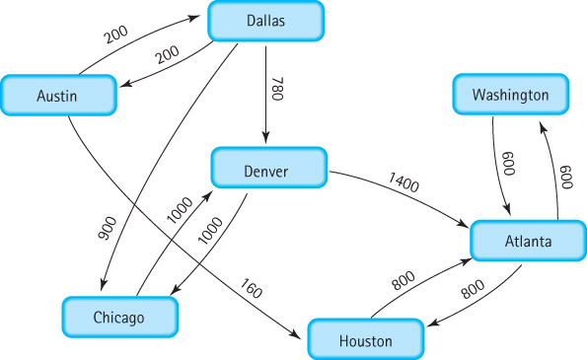
Unreachable Vertices
With this new graph we cannot fly from Washington to
Austin, Chicago, Dallas, or Denver

Slide 60
To print unreachable vertices
Append the following to the shortestPaths method:
System.out.println("The unreachable vertices are:");
vertex = graph.getUnmarked();
while (vertex != null)
{
System.out.println(vertex);
graph.markVertex(vertex);
vertex = graph.getUnmarked();
}

