Slide 1

Chapter 10
Sorting and Searching Algorithms

Slide 2
Chapter 10: Sorting and Searching Algorithms
10.1 – Sorting
10.2 – Simple Sorts
10.3 – O(N log₂N) Sorts
10.4 – More Sorting Considerations
10.5 – Searching
10.6 – Hashing

Slide 3
10.1 Sorting
Putting an unsorted list of data elements into order – sorting - is a very common and useful operation
We describe efficiency by relating the number of comparisons to the number of elements in the list (N)

Slide 4
A Test Harness
To help us test our sorting algorithms we create an application class called Sorts:
The class defines an array values that can hold 50 integers and static methods:
  initValues: Initializes the values array with random numbers between 0 and 99
  isSorted: Returns a boolean value indicating whether the values array is currently sorted
  swap: swaps the integers between values[index1] and values[index2], where index1 and index2 are parameters of the method
  printValues: Prints the contents of the values array to the System.out stream; the output is arranged evenly in ten columns

Slide 5
Example of Sorts main method
public static void main(String[] args) throws IOException
{
initValues();
printValues();
System.out.println("values is sorted: " + isSorted());
System.out.println();
swap(0, 1); // normally we put sorting algorithm here
printValues();
System.out.println("values is sorted: " + isSorted());
System.out.println();
}

Slide 6
Output from Example
the values array is:
20 49 07 50 45 69 20 07 88 02
89 87 35 98 23 98 61 03 75 48
25 81 97 79 40 78 47 56 24 07
63 39 52 80 11 63 51 45 25 78
35 62 72 05 98 83 05 14 30 23
values is sorted: false
the values array is:
49 20 07 50 45 69 20 07 88 02
89 87 35 98 23 98 61 03 75 48
25 81 97 79 40 78 47 56 24 07
63 39 52 80 11 63 51 45 25 78
35 62 72 05 98 83 05 14 30 23
values is sorted: false
This part varies
for each sample run
This does to, of course

Slide 7
10.2 Simple Sorts
In this section we present three “simple” sorts
  Selection Sort
  Bubble Sort
  Insertion Sort
Properties of these sorts
  use an unsophisticated brute force approach
  are not very efficient
  are easy to understand and to implement

Slide 8
Selection Sort
If we were handed a list of names on a sheet of paper and asked to put them in alphabetical order, we might use this general approach:
  Select the name that comes first in alphabetical order, and write it on a second sheet of paper.
  Cross the name out on the original sheet.
  Repeat steps 1 and 2 for the second name, the third name, and so on until all the names on the original sheet have been crossed out and written onto the second sheet, at which point the list on the second sheet is sorted.

Slide 9
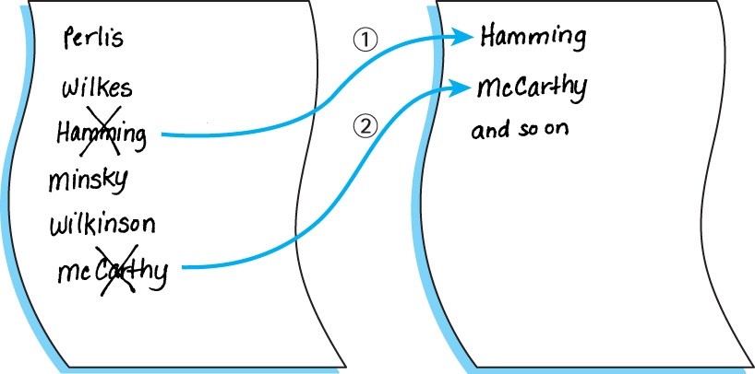

Slide 10
An improvement
Our algorithm is simple but it has one drawback: It requires space to store two complete lists.
Instead of writing the “first” name onto a separate sheet of paper, exchange it with the name in the first location on the original sheet. And so on.

Slide 11
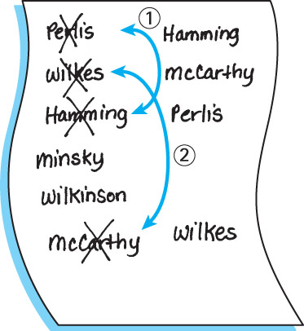

Slide 12
Selection Sort Algorithm
SelectionSort
for current going from 0 to SIZE - 2
Find the index in the array of the smallest unsorted element
Swap the current element with the smallest unsorted one
An example is depicted on the following slide …

Slide 13
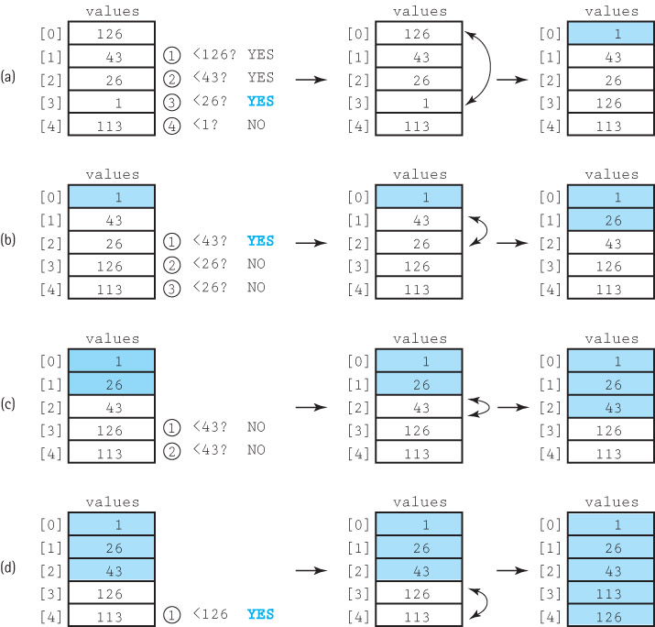

Slide 14
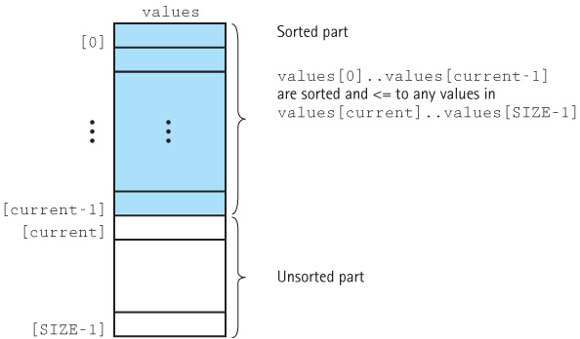
Selection Sort Snapshot

Slide 15
Selection Sort Code
static int minIndex(int startIndex, int endIndex)
// Returns the index of the smallest value in
// values[startIndex]..values[endIndex].
{
int indexOfMin = startIndex;
for (int index = startIndex + 1; index <= endIndex; index++)
if (values[index] < values[indexOfMin])
indexOfMin = index;
return indexOfMin;
}
static void selectionSort()
// Sorts the values array using the selection sort algorithm.
{
int endIndex = SIZE – 1;
for (int current = 0; current < endIndex; current++)
swap(current, minIndex(current, endIndex));
}

Slide 16
Testing Selection Sort
The resultant output:
the values array is:
92 66 38 17 21 78 10 43 69 19
17 96 29 19 77 24 47 01 97 91
13 33 84 93 49 85 09 54 13 06
21 21 93 49 67 42 25 29 05 74
96 82 26 25 11 74 03 76 29 10
values is sorted: false
Selection Sort called
the values array is:
01 03 05 06 09 10 10 11 13 13
17 17 19 19 21 21 21 24 25 25
26 29 29 29 33 38 42 43 47 49
49 54 66 67 69 74 74 76 77 78
82 84 85 91 92 93 93 96 96 97
values is sorted: true
The test harness:
initValues();
printValues();
System.out.println("values is sorted: "
+ isSorted());
System.out.println();
selectionSort();
System.out.println("Selection Sort called\n");
printValues();
System.out.println("values is sorted: "
+ isSorted());
System.out.println();

Slide 17
Selection Sort Analysis
We describe the number of comparisons as a function of the number of elements in the array, i.e., SIZE. To be concise, in this discussion we refer to SIZE as N
The minIndex method is called N - 1 times
Within minIndex, the number of comparisons varies:
  in the first call there are N - 1 comparisons
  in the next call there are N - 2 comparisons
  and so on, until in the last call, when there is only 1 comparison
The total number of comparisons is
(N – 1) + (N – 2) + (N – 3) + ... + 1
= N(N – 1)/2 = 1/2N² – 1/2N
The Selection Sort algorithm is O(N²)

Slide 18
Number of Comparisons Required to Sort Arrays of Different Sizes Using Selection Sort
Number of Elements Number of Comparisons
10 45
20 190
100 4,950
1,000 499,500
10,000 49,995,000

Slide 19
Bubble Sort
With this approach the smaller data values “bubble up” to the front of the array …
Each iteration puts the smallest unsorted element into its correct place, but it also makes changes in the locations of the other elements in the array.
The first iteration puts the smallest element in the array into the first array position:
  starting with the last array element, we compare successive pairs of elements, swapping whenever the bottom element of the pair is smaller than the one above it
  in this way the smallest element “bubbles up” to the top of the array.
The next iteration puts the smallest element in the unsorted part of the array into the second array position, using the same technique
The rest of the sorting process continues in the same way

Slide 20
Bubble Sort Algorithm
BubbleSort
Set current to the index of first element in the array
while more elements in unsorted part of array
“Bubble up” the smallest element in the unsorted part,
causing intermediate swaps as needed
Shrink the unsorted part of the array by incrementing current
bubbleUp(startIndex, endIndex)
for index going from endIndex DOWNTO startIndex +1
if values[index] < values[index - 1]
Swap the value at index with the value at index - 1
An example is depicted on the following slide …

Slide 21
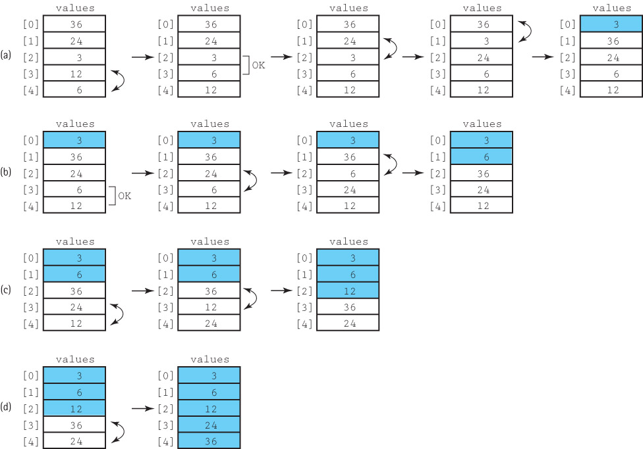

Slide 22
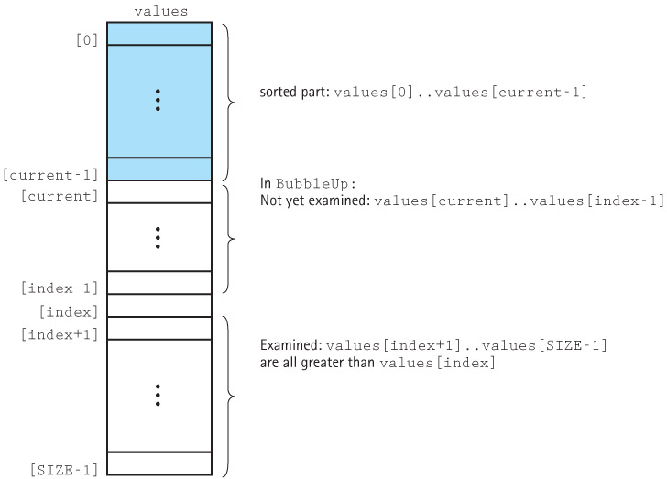
Bubble Sort Snapshot

Slide 23
Bubble Sort Code
static void bubbleUp(int startIndex, int endIndex)
// Switches adjacent pairs that are out of order
// between values[startIndex]..values[endIndex]
// beginning at values[endIndex].
{
for (int index = endIndex; index > startIndex; index--)
if (values[index] < values[index – 1])
swap(index, index – 1);
}
static void bubbleSort()
// Sorts the values array using the bubble sort algorithm.
{
int current = 0;
while (current < SIZE – 1)
{
bubbleUp(current, SIZE – 1);
current++;
}
}

Slide 24
Bubble Sort Analysis
Analyzing the work required by bubbleSort is the same as for the straight selection sort algorithm.
The comparisons are in bubbleUp, which is called N – 1 times.
There are N – 1 comparisons the first time, N – 2 comparisons the second time, and so on.
Therefore, bubbleSort and selectionSort require the same amount of work in terms of the number of comparisons.
The Bubble Sort algorithm is O(N²)

Slide 25
Insertion Sort
In Chapter 6, we created a sorted list by inserting each new element into its appropriate place in an array. Insertion Sort uses the same approach for sorting an array.
Each successive element in the array to be sorted is inserted into its proper place with respect to the other, already sorted elements.
As with the previous sorts, we divide our array into a sorted part and an unsorted part.
  Initially, the sorted portion contains only one element: the first element in the array.
  Next we take the second element in the array and put it into its correct place in the sorted part; that is, values[0] and values[1] are in order with respect to each other.
  Next the value in values[2] is put into its proper place, so values[0]..values[2] are in order with respect to each other.
  This process continues until all the elements have been sorted.

Slide 26
Insertion Sort Algorithm
insertionSort
for count going from 1 through SIZE - 1
insertElement(0, count)
InsertElement(startIndex, endIndex)
Set finished to false
Set current to endIndex
Set moreToSearch to true
while moreToSearch AND NOT finished
if values[current] < values[current - 1]
swap(values[current], values[current - 1])
Decrement current
Set moreToSearch to (current does not equal startIndex)
else
Set finished to true
An example is depicted on the following slide …

Slide 27
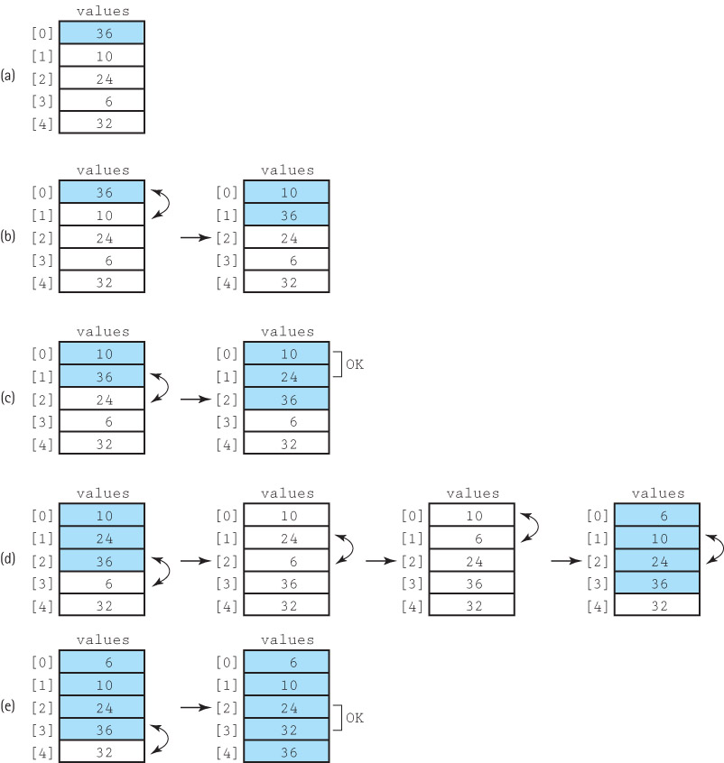

Slide 28
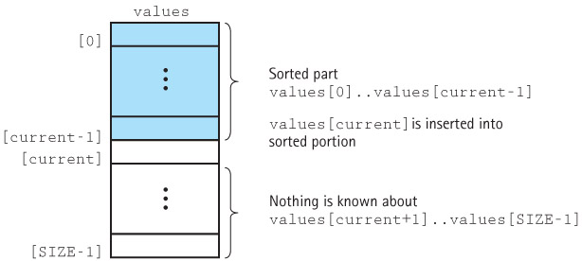
Insertion Sort Snapshot

Slide 29
Insertion Sort Code
static void insertElement(int startIndex, int endIndex)
// Upon completion, values[0]..values[endIndex] are sorted.
{
boolean finished = false;
int current = endIndex;
boolean moreToSearch = true;
while (moreToSearch && !finished)
{
if (values[current] < values[current – 1])
{
swap(current, current – 1);
current--;
moreToSearch = (current != startIndex);
}
else
finished = true;
}
}
static void insertionSort()
// Sorts the values array using the insertion sort algorithm.
{
for (int count = 1; count < SIZE; count++)
insertElement(0, count);
}

Slide 30
Insertion Sort Analysis
The general case for this algorithm mirrors the selectionSort and the bubbleSort, so the general case is O(N²) .
But insertionSort has a “best” case: The data are already sorted in ascending order
  insertElement is called N times, but only one comparison is made each time and no swaps are necessary.
The maximum number of comparisons is made only when the elements in the array are in reverse order.

Slide 31
10.3 O(N log₂N) Sorts
O(N²) sorts and are very time consuming for sorting large arrays.
Several sorting methods that work better when N is large are presented in this section.
The efficiency of these algorithms is achieved at the expense of the simplicity seen in the straight selection, bubble, and insertion sorts.

Slide 32
The Merge Sort
The sorting algorithms covered in Section 10.2 are all O(N²).
Note that N² is a lot larger than
(1/2N)² + (1/2N)² = 1/2N²
If we can cut the array into two pieces, sort each segment, and then merge the two back together, we should end up sorting the entire array with a lot less work.

Slide 33
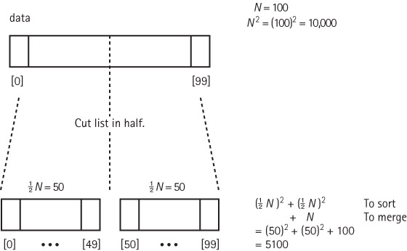
Rationale for Divide and Conquer

Slide 34
Merge Sort Algorithm
mergeSort
Cut the array in half
Sort the left half
Sort the right half
Merge the two sorted halves into one sorted array
Because mergeSort is itself a sorting algorithm, we might as well
use it to sort the two halves.
We can make mergeSort a recursive method and let it call itself
to sort each of the two subarrays:
mergeSort—Recursive
Cut the array in half
mergeSort the left half
mergeSort the right half
Merge the two sorted halves into one sorted array

Slide 35
Merge Sort Summary
Method mergeSort(first, last)
Definition: Sorts the array elements in ascending order.
Size: last - first + 1
Base Case: If size less than 2, do nothing.
General Case: Cut the array in half.
mergeSort the left half.
mergeSort the right half.
Merge the sorted halves into one sorted array.

Slide 36
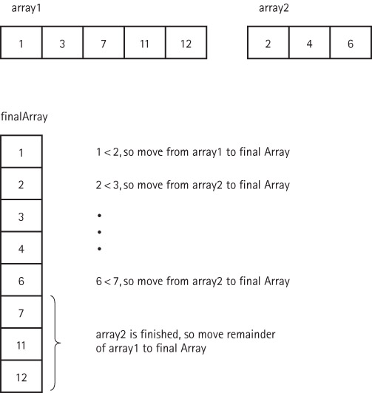
Strategy for merging two sorted arrays

Slide 37
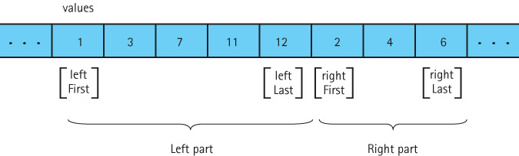
Our actual merge problem

Slide 38
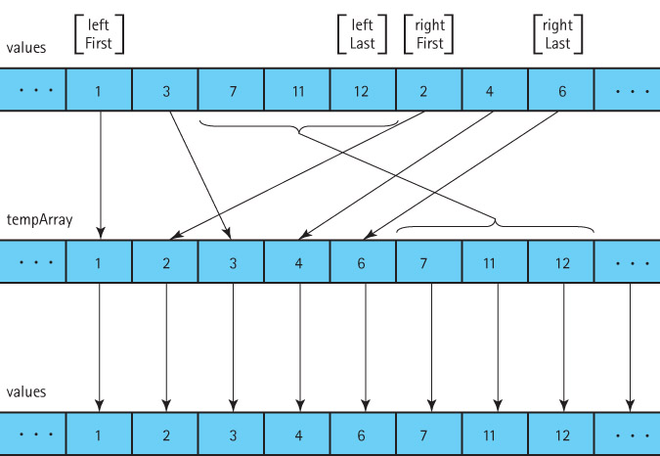
Our solution

Slide 39
The merge algorithm
merge (leftFirst, leftLast, rightFirst, rightLast)
(uses a local array, tempArray)
Set index to leftFirst
while more elements in left half AND more elements in right half
if values[leftFirst] < values[rightFirst]
Set tempArray[index] to values[leftFirst]
Increment leftFirst
else
Set tempArray[index] to values[rightFirst]
Increment rightFirst
Increment index
Copy any remaining elements from left half to tempArray
Copy any remaining elements from right half to tempArray
Copy the sorted elements from tempArray back into values

Slide 40
The mergeSort method
The code for merge follows the algorithm on the previous slide.
It can be found on page 676-677 of the textbook.
merge does most of the work!
Here is mergeSort:
  static void mergeSort(int first, int last)
  // Sorts the values array using the merge sort algorithm.
  {
  if (first < last)
  {
  int middle = (first + last) / 2;
  mergeSort(first, middle);
  mergeSort(middle + 1, last);
  merge(first, middle, middle + 1, last);
  }
  }

Slide 41
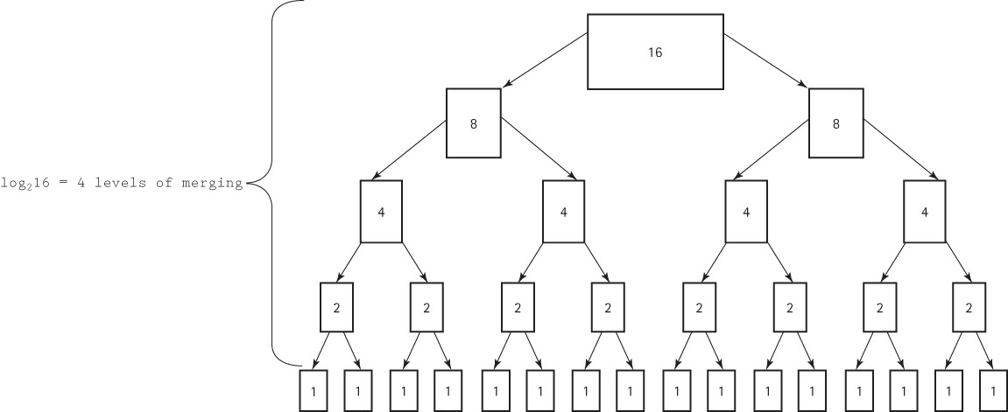
Analysing Merge Sort

Slide 42
Analyzing Merge Sort
The total work needed to divide the array in half, over and over again until we reach subarrays of size 1, is O(N).
It takes O(N) total steps to perform merging at each “level” of merging.
The number of levels of merging is equal to the number of times we can split the original array in half
  If the original array is size N, we have log₂N levels. (This is the same as the analysis of the binary search algorithm in Section 6.6.)
Because we have log₂N levels, and we require O(N) steps at each level, the total cost of the merge operation is: O(N log₂N).
Because the splitting phase was only O(N), we conclude that Merge Sort algorithm is O(N log₂N).

Slide 43
Comparing N² and N log₂ N
N log₂N N² N log₂N
32 5 1,024 160
64 6 4.096 384
128 7 16,384 896
256 8 65,536 2,048
512 9 262,144 4,608
1024 10 1,048,576 10,240
2048 11 4,194,304 22,528
4096 12 16,777,216 49,152

Slide 44
Drawback of Merge Sort
A disadvantage of mergeSort is that it requires an auxiliary array that is as large as the original array to be sorted.
If the array is large and space is a critical factor, this sort may not be an appropriate choice.
Next we discuss two O(N log₂N) sorts that move elements around in the original array and do not need an auxiliary array.

Slide 45
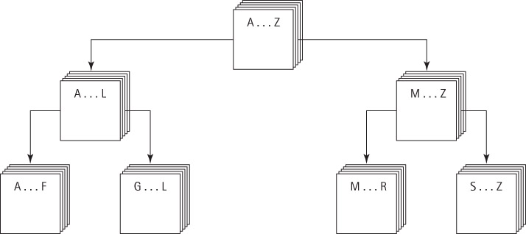
Quick Sort
A divide-and-conquer algorithm
Inherently recursive
At each stage the part of the array being sorted is divided into two “piles”, with everything in the left pile less than everything in the right pile
The same approach is used to sort each of the smaller piles (a smaller case).
This process goes on until the small piles do not need to be further divided (the base case).

Slide 46
Quick Sort Summary
Method quickSort (first, last)
Definition: Sorts the elements in sub array values[first]..values[last].
Size: last - first + 1
Base Case: If size less than 2, do nothing.
General Case: Split the array according to splitting value.
quickSort the elements <= splitting value.
quickSort the elements > splitting value.

Slide 47
The Quick Sort Algorithm
quickSort
if there is more than one element in values[first]..values[last]
Select splitVal
Split the array so that
values[first]..values[splitPoint – 1] <= splitVal
values[splitPoint] = splitVal
values[splitPoint + 1]..values[last] > splitVal
quickSort the left sub array
quickSort the right sub array
The algorithm depends on the selection of a “split value”,
called splitVal, that is used to divide the array into two
sub arrays.
How do we select splitVal?
One simple solution is to use the value in values[first]
as the splitting value.

Slide 48

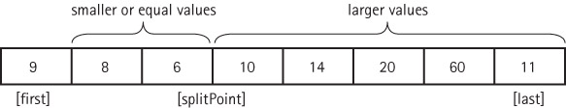
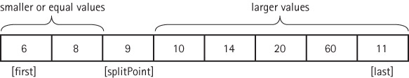
Quick Sort Steps

Slide 49
The quickSort method
static void quickSort(int first, int last)
{
if (first < last)
{
int splitPoint;
splitPoint = split(first, last);
// values[first]..values[splitPoint – 1] <= splitVal
// values[splitPoint] = splitVal
// values[splitPoint+1]..values[last] > splitVal
quickSort(first, splitPoint – 1);
quickSort(splitPoint + 1, last);
}
}

Slide 50
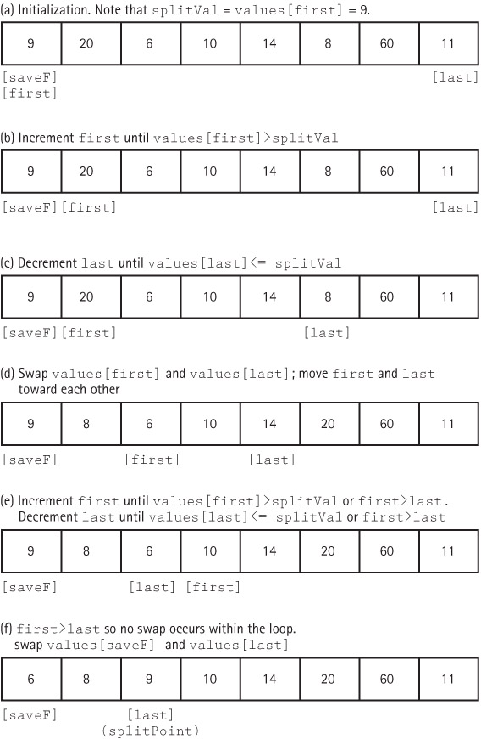
The split operation
The code for split
is on page 684

Slide 51
Analyzing Quick Sort
On the first call, every element in the array is compared to the dividing value (the “split value”), so the work done is O(N).
The array is divided into two sub arrays (not necessarily halves)
Each of these pieces is then divided in two, and so on.
If each piece is split approximately in half, there are O(log₂N) levels of splits. At each level, we make O(N) comparisons.
So Quick Sort is an O(N log₂N) algorithm.

Slide 52
Drawbacks of Quick Sort
Quick Sort isn’t always quicker.
  There are log₂N levels of splits if each split divides the segment of the array approximately in half. As we’ve seen, the array division of Quick Sort is sensitive to the order of the data, that is, to the choice of the splitting value.
  If the splits are very lopsided, and the subsequent recursive calls to quickSort also result in lopsided splits, we can end up with a sort that is O(N²).
What about space requirements?
  There can be many levels of recursion “saved” on the system stack at any time.
  On average, the algorithm requires O(log₂N) extra space to hold this information and in the worst case requires O(N) extra space, the same as Merge Sort.

Slide 53
Quick Sort
Despite the drawbacks remember that Quick Sort is VERY quick for large collections of random data

Slide 54
Heap Sort
In Chapter 9, we discussed the heap - because of its order property, the maximum value of a heap is in the root node.
The general approach of the Heap Sort is as follows:
  take the root (maximum) element off the heap, and put it into its place.
  reheap the remaining elements. (This puts the next-largest element into the root position.)
  repeat until there are no more elements.
For this to work we must first arrange the original array into a heap

Slide 55
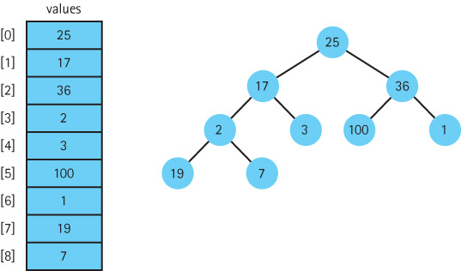
Building a heap
buildHeap
for index going from first nonleaf node up to the root node
reheapDown(values[index], index)
See next slide …

Slide 56
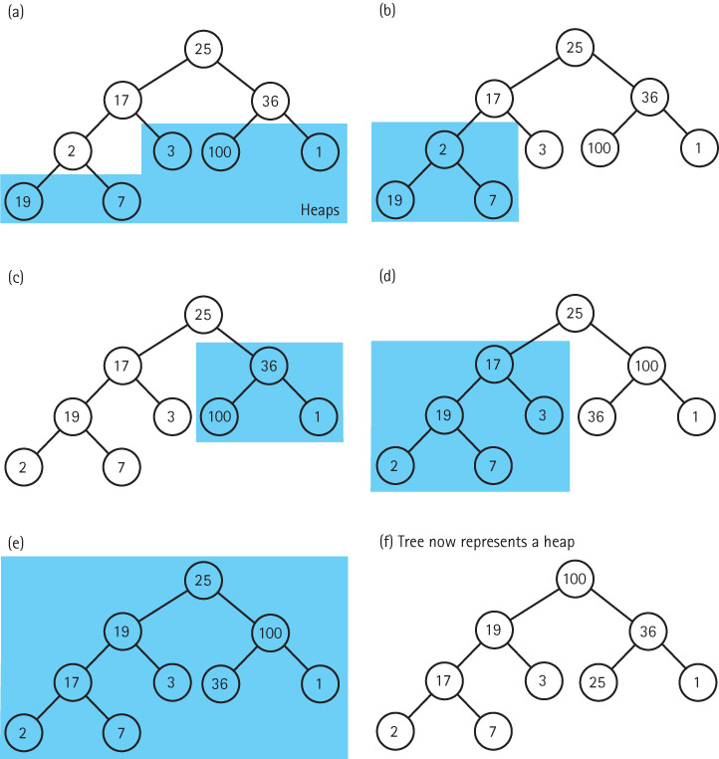

Slide 57
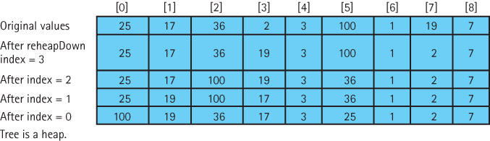
The changing contents of the array

Slide 58
The Sort Nodes algorithm
Sort Nodes
for index going from last node up to next-to-root node
Swap data in root node with values[index]
reheapDown(values[0], 0, index 2 1)

Slide 59
The heapSort method
static void heapSort()
// Post: The elements in the array values are sorted by key
{
int index;
// Convert the array of values into a heap
for (index = SIZE/2 – 1; index >= 0; index--)
reheapDown(values[index], index, SIZE – 1);
// Sort the array
for (index = SIZE – 1; index >=1; index--)
{
swap(0, index);
reheapDown(values[0], 0, index – 1);
}
}

Slide 60
Analysis of Heap Sort
Consider the sorting loop
  it loops through N ─ 1 times, swapping elements and reheaping
  the comparisons occur in reheapDown (actually in its helper method newHole)
  a complete binary tree with N nodes has O(log₂(N + 1)) levels
  in the worst cases, then, if the root element had to be bumped down to a leaf position, the reheapDown method would make O(log₂N) comparisons.
  so method reheapDown is O(log2N)
  multiplying this activity by the N ─ 1 iterations shows that the sorting loop is O(N log₂N).
Combining the original heap build, which is O(N), and the sorting loop, we can see that Heap Sort requires O(N log₂N) comparisons.

Slide 61
The Heap Sort
For small arrays, heapSort is not very efficient because of all the “overhead.”
For large arrays, however, heapSort is very efficient.
Unlike Quick Sort, Heap Sort’s efficiency is not affected by the initial order of the elements.
Heap Sort is also efficient in terms of space – it only requires constant extra space.
Heap Sort is an elegant, fast, robust, space efficient algorithm!

Slide 62
10.4 More Sorting Considerations
In this section we wrap up our coverage of sorting by
  revisiting testing
  revisiting efficiency
  discussing special concerns involved with sorting objects rather than primitive types
  considering the “stability” of sorting algorithms

Slide 63
Testing
To thoroughly test our sorting methods we should
  vary the size of the array
  vary the original order of the array
    Random order
    Reverse order
    Almost sorted
    All identical elements

Slide 64
Efficiency
When N is small the simple sorts may be more efficient than the “fast” sorts because they require less overhead.
Sometimes it may be desirable, for efficiency considerations, to streamline the code as much as possible, even at the expense of readability. For instance, instead of using a swap method directly code the swap operation within the sorting method.

Slide 65
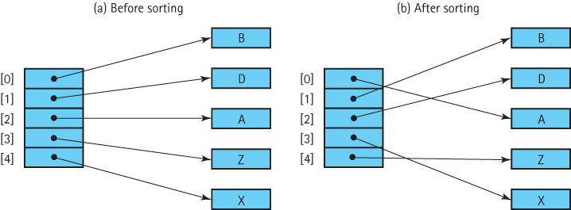
Special Concerns when Sorting Objects
When sorting an array of objects we are manipulating references to the object, and not the objects themselves

Slide 66
Using the Comparable Interface
For our sorted lists, binary search trees and priority queues we used objects that implemented Java’s Comparable interface.
The only requirement for a Comparable object is that it provides a compareTo operation.
A limitation of this approach is that a class can only have one compareTo method. What if we have a class of objects, for example student records, that we want to sort in many various ways: by name, by grade, by zip code, in increasing order, in decreasing order? In this case we need to use the next approach.

Slide 67
Using the Comparator Interface
The Java Library provides another interface related to comparing objects called Comparator.
The interface defines two abstract methods:
public abstract int compare(T o1, T o2);
// Returns a negative integer, zero, or a positive integer to
// indicate that o1 is less than, equal to, or greater than o2
public abstract boolean equals(Object obj);
// Returns true if this Object equals obj; false, otherwise

Slide 68
Using the Comparator Interface
If we pass a Comparator object comp to a sorting method as a parameter, the method can use comp.compare to determine the relative order of two objects and base its sort on that relative order.
Passing a different Comparator object results in a different sorting order.
Now, with a single sorting method, we can produce many different sort orders.

Slide 69
Example
To allow us to concentrate on the topic of discussion, we use a simple circle class, with public instance variables:
  package ch10.circles;
  public class SortCircle
  {
  public int xValue;
  public int yValue;
  public int radius;
  public boolean solid;
  }
Here is the definition of a Comparator object that orders SortCircles based on their xValue:
  Comparator<Circle> xComp = new Comparator<Circle>()
  {
  public int compare(SortCircle a, SortCircle b)
  {
  return (a.xValue – b.xValue);
  }
  };

Slide 70
Example
Here is a selectionSort method, along with its helper method minIndex, that accepts and uses a Comparator object
  static int minIndex(int startIndex, int endIndex,
  Comparator<SortCircle> comp)
  // Returns the index of the smallest value in
  // values[startIndex]..values[endIndex].
  {
  int indexOfMin = startIndex;
  for (int index = startIndex + 1; index <= endIndex; index++)
  if (comp.compare(values[index],values[indexOfMin]) < 0)
  indexOfMin = index;
  return indexOfMin;
  }
  static void selectionSort(Comparator<SortCircle> comp)
  // Sorts the values array using the selection sort algorithm.
  {
  int endIndex = SIZE – 1;
  for (int current = 0; current < endIndex; current++)
  swap(current, minIndex(current, endIndex, comp));
  }

Slide 71
Stability of a Sorting Algorithm
Stable Sort: A sorting algorithm that preserves the order of duplicates
Of the sorts that we have discussed in this book, only heapSort and quickSort are inherently unstable

Slide 72
10.5 Searching
In this section we look at some of the basic “search by value” techniques for lists.
Some of these techniques (linear and binary search) we have seen previously in the text.
In Section 10.6 we look at an advanced technique, called hashing, that can often provide O(1) searches by value.

Slide 73
Linear Searching
If we want to add elements as quickly as possible to a list, and we are not as concerned about how long it takes to find them we would put the element
  into the last slot in an array-based list
  into the first slot in a linked list
To search this list for the element with a given key, we must use a simple linear (or sequential) search
  Beginning with the first element in the list, we search for the desired element by examining each subsequent element’s key until either the search is successful or the list is exhausted.
  Based on the number of comparisons this search is O(N)
  In the worst case we have to make N key comparisons.
  On the average, assuming that there is an equal probability of searching for any element in the list, we make N/2 comparisons for a successful search

Slide 74
High-Probability Ordering
Sometimes certain list elements are in much greater demand than others. We can then improve the search:
  Put the most-often-desired elements at the beginning of the list
  Using this scheme, we are more likely to make a hit in the first few tries, and rarely do we have to search the whole list.
If the elements in the list are not static or if we cannot predict their relative demand, we can
  move each element accessed to the front of the list
  as an element is found, it is swapped with the element that precedes it
Lists in which the relative positions of the elements are changed in an attempt to improve search efficiency are called self-organizing or self-adjusting lists.

Slide 75
Sorted Lists
If the list is sorted, a sequential search no longer needs to search the whole list to discover that an element does not exist. It only needs to search until it has passed the element’s logical place in the list—that is, until an element with a larger key value is encountered.
Another advantage of linear searching is its simplicity.
The binary search is usually faster, however, it is not guaranteed to be faster for searching very small lists.
As the number of elements increases, however, the disparity between the linear search and the binary search grows very quickly.
The binary search is appropriate only for list elements stored in a sequential array-based representation.
However, the binary search tree allows us to perform a binary search on a linked data representation

Slide 76
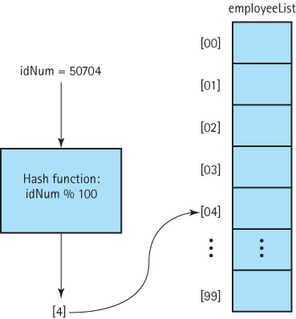
10.6 Hashing

Slide 77
Definitions
Hash Functions: A function used to manipulate the key of an element in a list to identify its location in the list
Hashing: The technique for ordering and accessing elements in a list in a relatively constant amount of time by manipulating the key to identify its location in the list
Hash table: Term used to describe the data structure used to store and retrieve elements using hashing

Slide 78
Our Hashable interface
public interface Hashable
// Objects of classes that implement this interface can be used
// with lists based on hashing.
{
// A mathematical function used to manipulate the key of an element
// in a list to identify its location in the list.
int hash();
}

Slide 79
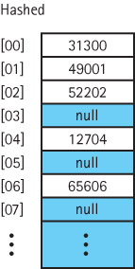
Using the hash method
public void add (Hashable element)
// Adds element to this list at position element.hash().
{
int location;
location = element.hash();
list[location] = element;
numElements++;
}
public Hashable get(Hashable element)
// Returns an element e from this list such
// that e.equals(element).
{
int location;
location = element.hash();
return (Hashable)list[location];
}

Slide 80
Collisions
Collision: The condition resulting when two or more keys produce the same hash location
Linear probing: Resolving a hash collision by sequentially searching a has table beginning at the location returned by the hash function

Slide 81
Revised methods
public static void add (Hashable element)
// Adds element to this list at position element.hash(),
// or the next free array slot.
{
int location;
location = element.hash();
while (list[location] != null)
location = (location + 1) % list.length;
list[location] = element;
numElements++;
}
public static Hashable get(Hashable element)
// Returns an element e from this list such that e.equals(element).
{
int location;
location = element.hash();
while (!list[location].equals(element))
location = (location + 1) % list.length;
return (Hashable)list[location];
}

Slide 82
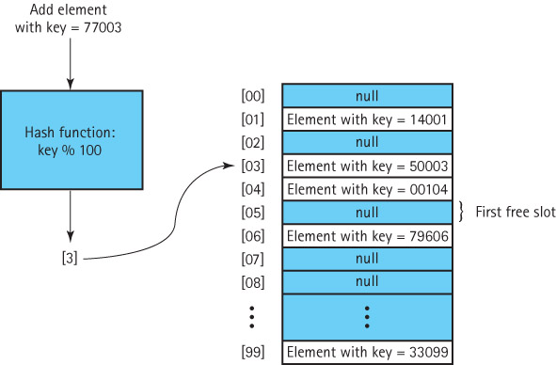
Handling collisions with linear probing

Slide 83
Removing an element
An approach could be
  remove (element)
  Set location to element.hash( )
  Set list[location] to null
Collisions, however, complicate the matter. We cannot be sure that our element is in location element.hash().
We must examine every array element, starting with location element.hash(), until we find the matching element.
We cannot stop looking when we reach an empty location, because that location may represent an element that was previously removed.
This problem illustrates that hash tables, in the forms that we have studied thus far, are not the most effective data structure for implementing lists whose elements may be deleted.

Slide 84
More Considerations
Clustering: The tendency of elements to become unevenly distributed in the hash table, with many elements clustering around a single hash location
Rehashing: Resolving a collision by computing a new hash location from a hash function that manipulates the original location rather than the element’s key
Quadratic probing Resolving a hash collision by using the rehashing formula (HashValue +/- I²) % array-size
Random probing Resolving a hash collision by generating pseudo-random hash values in successive applications of the rehash function

Slide 85
Buckets and Chaining
Bucket A collection of elements associated with a particular hash location
Chain A linked list of elements that share the same hash location

Slide 86
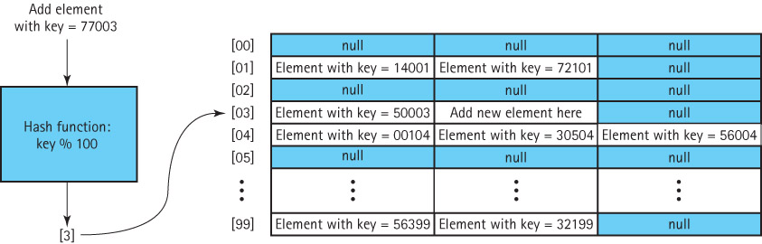
Handling collisions by hashing with buckets

Slide 87
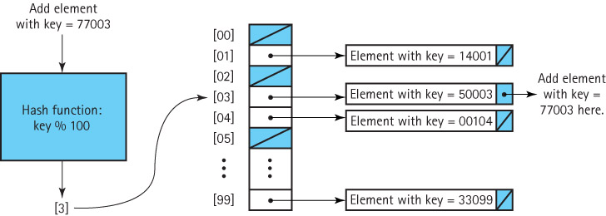
Handling collisions by hashing with chaining

Slide 88
Java’s Support for Hashing
The Java Library includes a HashTable class that uses hash techniques to support storing objects in a table.
The library includes several other collection classes, such as HashSet, that provide an ADT whose underlying implementation uses the approaches described in this section.
The Java Object class exports a hashCode method that returns an int hash code. Therefore all Java objects have an associated hash code.
  The standard Java hash code for an object is a function of the object’s memory location.
For most applications, hash codes based on memory locations are not usable. Therefore, many of the Java classes that define commonly used objects (such as String and Integer), override the Object class’s hashCode method with one that is based on the contents of the object.
If you plan to use hash tables in your programs, you should do likewise.

