Slide 1

Chapter 7
More Lists

Slide 2
Chapter 7: More Lists
7.1 – Circular Linked Lists
7.2 – Doubly Linked Lists
7.3 – Linked Lists with Headers and Trailers
7.4 – A Linked List as an Array of Nodes
7.5 – A Specialized List ADT
7.6 – Case Study: Large Integers

Slide 3

7.1 Circular Linked Lists
Circular linked list A list in which every node has a successor; the “last” element is succeeded by the “first” element

Slide 4
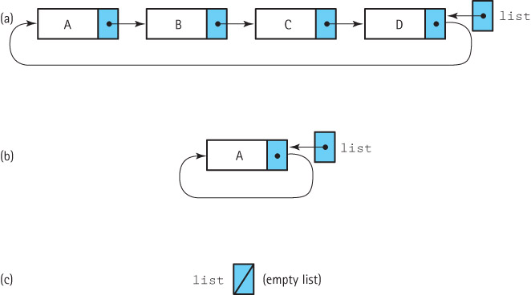
A more efficient approach
Adding and removing elements at the front of a list might be a common operation for some applications.
Our linked list approach supports these operations very efficiently
The previous linked list approach does not (we need to access the last element also).
We can fix this problem by letting our list reference point to the last element in the list rather than the first; now we have easy access to both the first and the last elements in the list.

Slide 5
The CRefUnsortedList Class
The CRefUnsortedList class is similar to its linear list counterpart RefUnsortedList.
The size method need not be changed.
If we provide a revised find helper method with functionality that corresponds to the find in RefUnsortedList, we can also reuse both the contains and get methods.

Slide 6
The Iterator methods
the reset method becomes more complicated and the getNext method becomes simpler
public void reset()
{
if (list != null)
currentPos = list.getLink();
}
public T getNext()
{
T next = currentPos.getInfo();
currentPos = currentPos.getLink();
return next;
}

Slide 7
The toString method
public String toString()
// Returns a nicely formatted String that represents this list.
{
String listString = "List:\n";
if (list != null)
{
LLNode<T> prevNode = list;
do
{
listString = listString + " " + prevNode.getLink().getInfo() + "\n";
prevNode = prevNode.getLink();
}
while (prevNode != list);
}
return listString;
}

Slide 8
The find method
protected void find(T target)
{
location = list;
found = false;
if (list != null)
do
{
// move search to the next node
previous = location;
location = location.getLink();
// check for a match
if (location.getInfo().equals(target))
found = true;
}
while ((location != list) && !found);
}

Slide 9
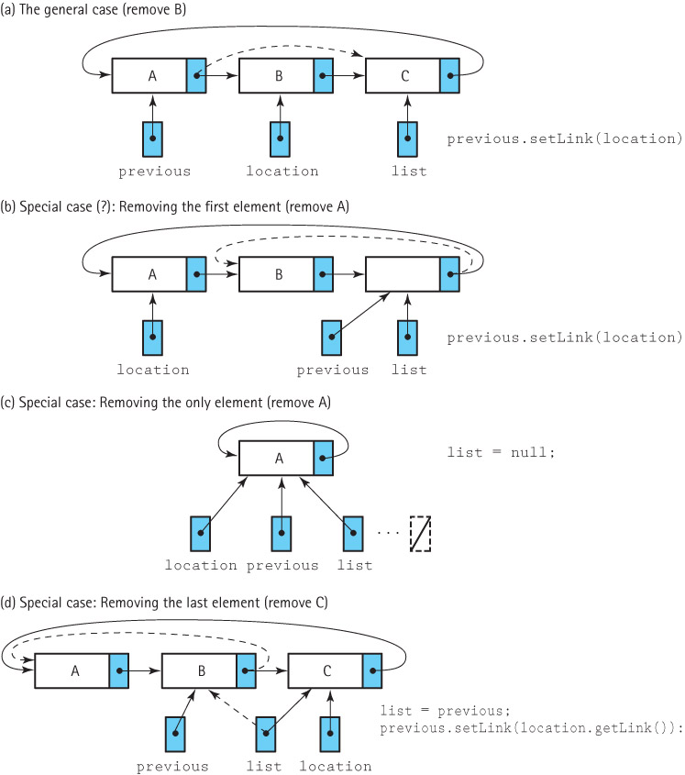
The remove method

Slide 10
The remove method
public boolean remove (T element)
// Removes an element e from this list such that e.equals(element)
// and returns true; if no such element exists returns false.
{
find(element);
if (found)
{
if (list == list.getLink()) // if single element list
list = null;
else
if (previous.getLink() == list) // if removing last node
list = previous;
previous.setLink(location.getLink()); // remove node
numElements--;
}
return found;
}

Slide 11
The add method
To implement the add method:
  create the new node using the LLNode constructor
  if adding to an empty list set the list variable to reference the new element and link the new element to itself
  otherwise, add the element to the list in the most convenient place – at the location referenced by list
  increment numElements.

Slide 12
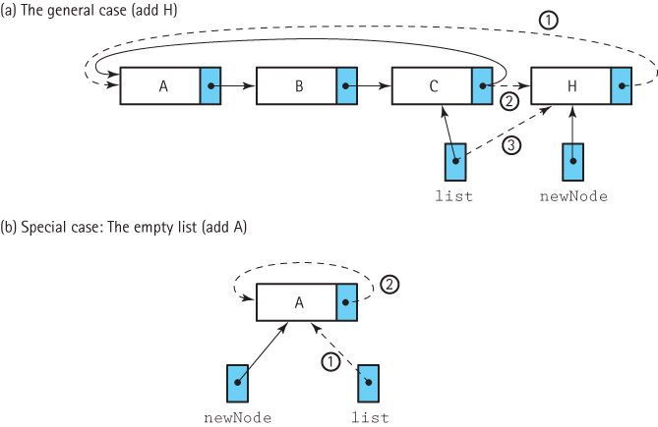
Adding a node

Slide 13
The add method
public void add(T element)
// Adds element to this list.
{
LLNode<T> newNode = new LLNode<T>(element);
if (list == null)
{
// add element to an empty list
list = newNode;
newNode.setLink(list);
}
else
{
// add element to a non-empty list
newNode.setLink(list.getLink());
list.setLink(newNode);
list = newNode;
}
numElements++;
}

Slide 14
7.2 Doubly Linked Lists
Doubly linked list A linked list in which each node is linked to both its successor and its predecessor

Slide 15
DLLNode Class
package support;
public class DLLNode<T> extends LLNode<T>
{
private DLLNode<T> back;
public DLLNode(T info)
{
super(info);
back = null;
}
public void setBack(DLLNode<T> back)
// Sets back link of this DLLNode.
{
this.back = back;
}
public DLLNode<T> getBack()
// Returns back link of this DLLNode.
{
return back;
}
}

Slide 16
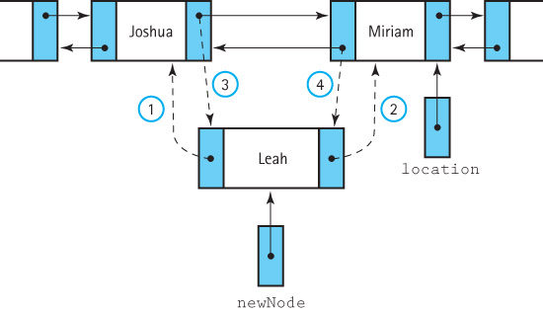
The add operation

Slide 17
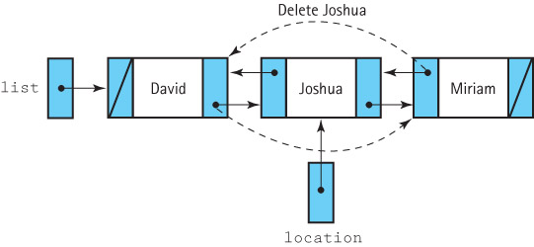
The remove operation

Slide 18
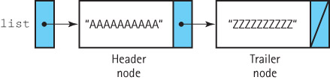
7.3 Linked Lists with Headers and Trailers
Header node A placeholder node at the beginning of a list; used to simplify list processing
Trailer node A placeholder node at the end of a list; used to simplify list processing

Slide 19
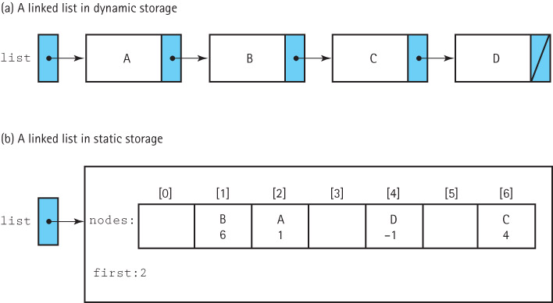
7.4 A Linked List as an Array of Nodes

Slide 20
Why Use an Array?
Sometimes managing the free space ourselves gives us greater flexibility
There are programming languages that do not support dynamic allocation or reference types
There are times when dynamic allocation of each node, one at a time, is too costly in terms of time

Slide 21
Boundedness
A desire for static allocation is one of the primary motivations for the array-based linked approach
We drop our assumption that our lists are of unlimited size in this section - our lists will not grow as needed.
Applications should not add elements to a full list.
Our list will export an isFull operation, in addition to all the other standard list operations

Slide 22
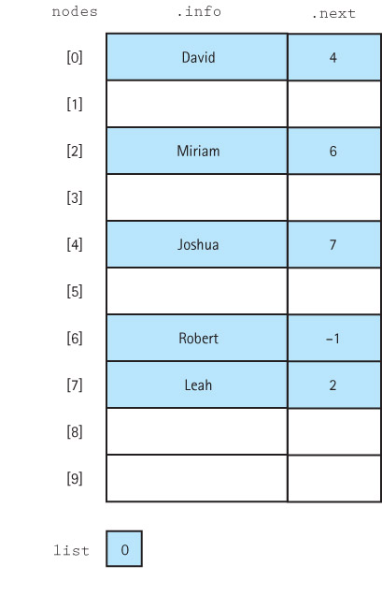
A sorted list

Slide 23
Implementation Issues
We mark the end of the list with a “null” value
  the “null” value must be an invalid address for a real list element
  we use the value –1
  we use the identifier NUL and define it to be -1
private static final int NUL = –1;
We must directly manage the free space available for new list elements.
  We link the collection of unused array elements together into a linked list of free nodes.
  We write our own method to allocate nodes from the free space. We call this method getNode. We use getNode when we add new elements onto the list.
  We write our own method, freeNode, to put a node back into the pool of free space when it is de-allocated.

Slide 24
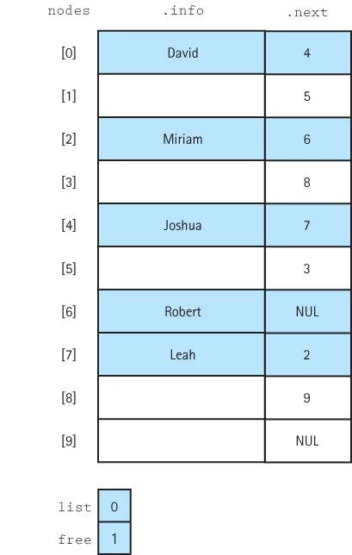
A linked list and free space

Slide 25
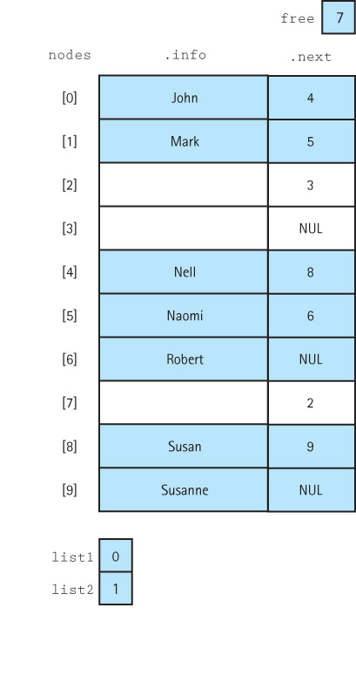
More than one list

