Slide 1

Chapter 8
Binary Search Trees

Slide 2
Chapter 8: Binary Search Trees
8.1 – Trees
8.2 – The Logical Level
8.3 – The Application Level
8.4 – The Implementation Level: Basics
8.5 – Iterative versus Recursive Method Implementations
8.6 – The Implementation Level: Remaining Operations
8.7 – Comparing Binary Search Tree and Linear Lists
8.8 – Balancing a Binary Search Tree
8.9 – A Non-Linked Representation of Binary Trees
8.10 – Case Study: Word Frequency Generator

Slide 3
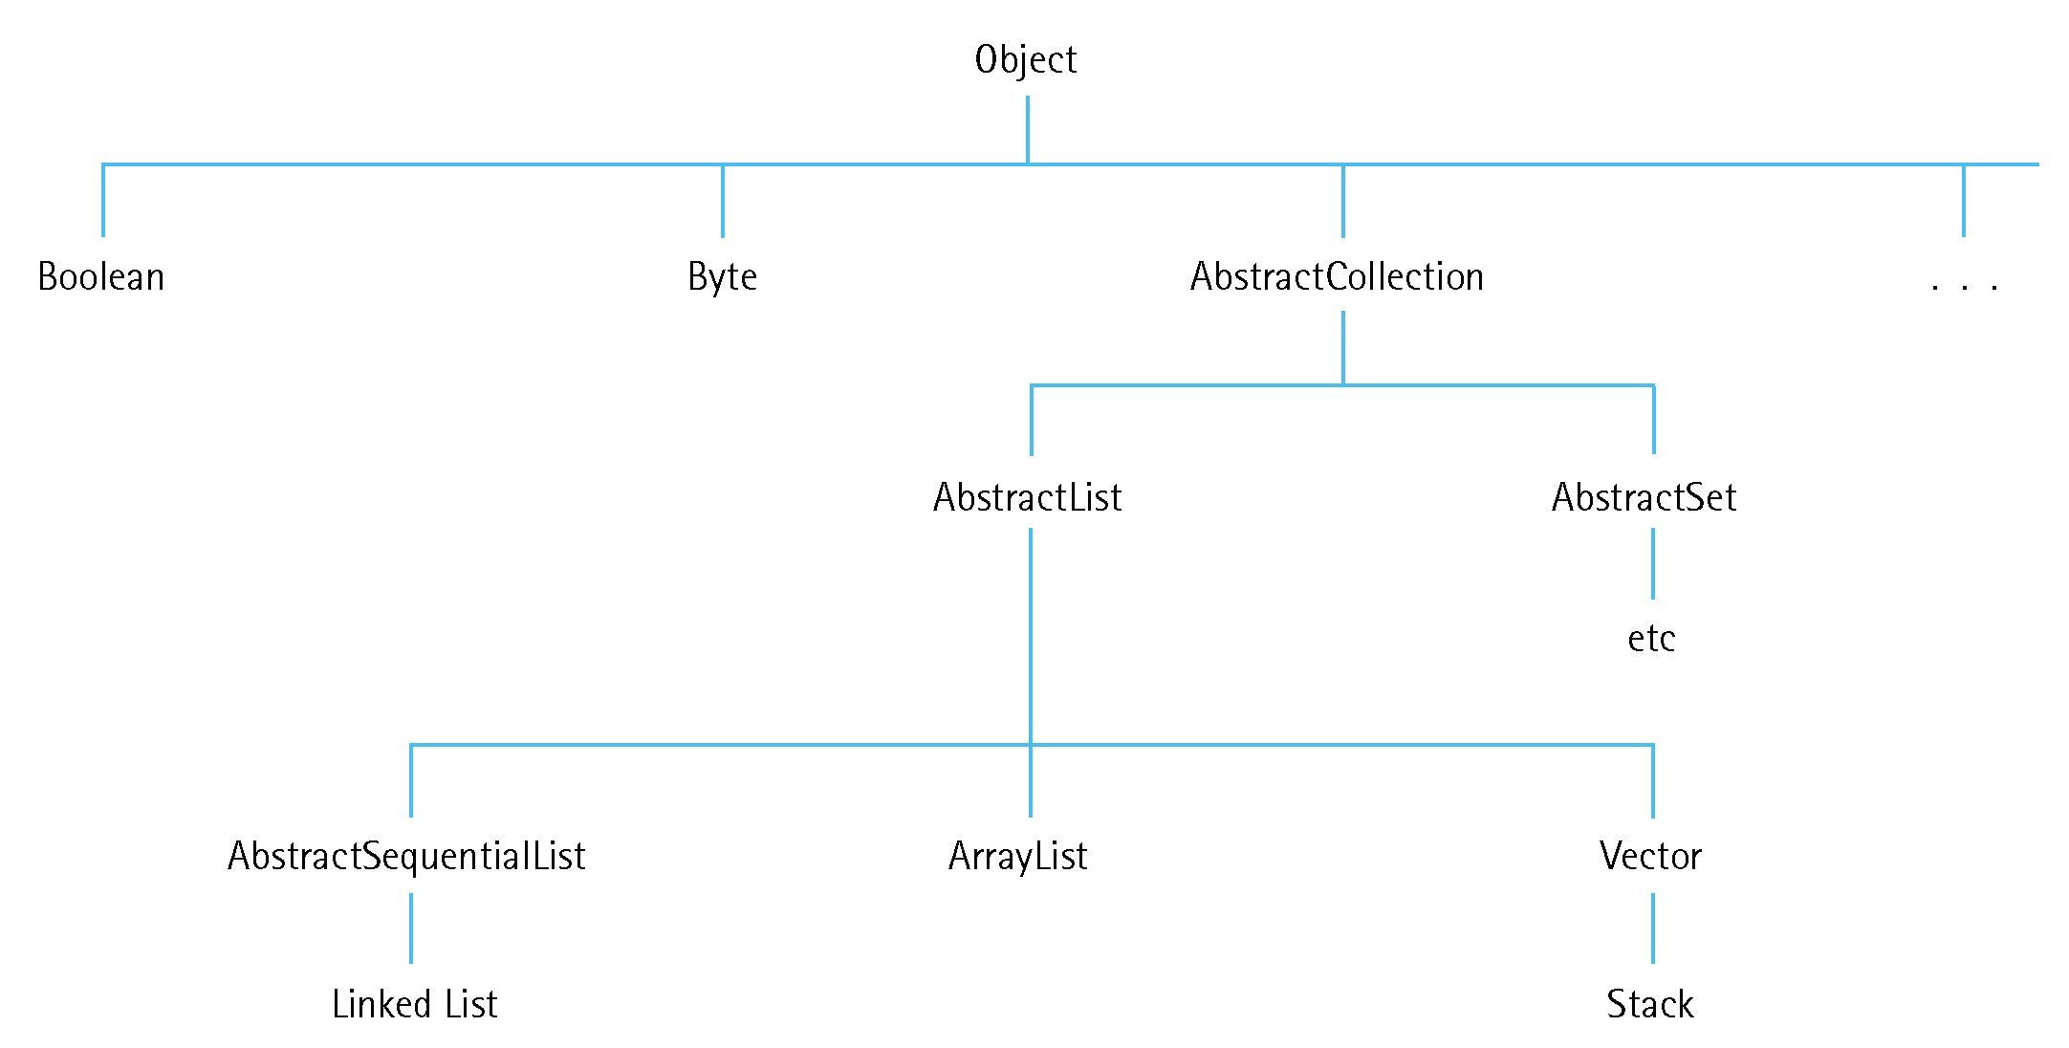
8.1 Trees
A tree is a nonlinear structure in which each node is capable of having many successor nodes, called children.
Trees are useful for representing hierarchical relationships among data items.

Slide 4
Definitions
Tree A structure with a unique starting node (the root), in which each node is capable of having many child nodes, and in which a unique path exists from the root to every other node.
Root The top node of a tree structure; a node with no parent

Slide 5
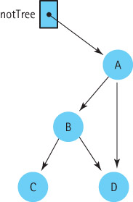
Not a Tree

Slide 6
Definitions
Binary tree A tree in which each node is capable of having two child nodes, a left child node and a right child node
Leaf A tree node that has no children

Slide 7
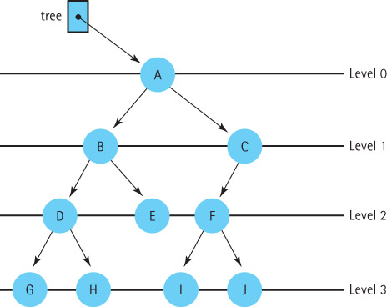
A Binary Tree

Slide 8
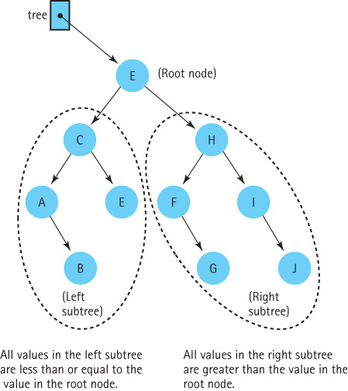
A Binary Search Tree

Slide 9
Definition
Binary search tree A binary tree in which the key value in any node is greater than or equal to the key value in its left child and any of its descendants (the nodes in the left subtree) and less than the key value in its right child and any of its descendants (the nodes in the right subtree)

Slide 10
Traversal Definitions
Preorder traversal: Visit the root, visit the left subtree, visit the right subtree
Inorder traversal: Visit the left subtree, visit the root, visit the right subtree
Postorder traversal: Visit the left subtree, visit the right subtree, visit the root

Slide 11
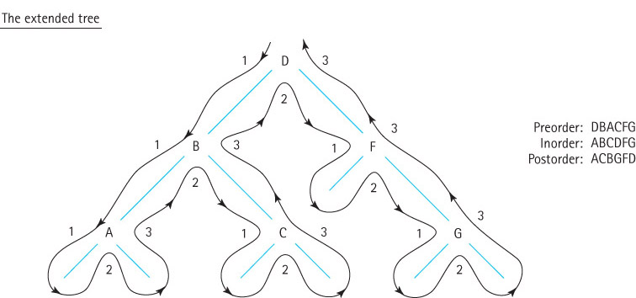
Visualizing Binary Tree Traversals

Slide 12
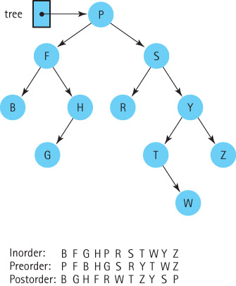
Three Binary Tree Traversals

Slide 13
8.2 The Logical Level
In this section, we specify our Binary Search Tree ADT.
As we have done for stacks, queues, and lists we use the Java interface construct to write the specification.
Our binary search tree specification is very similar to our sorted list specification.

Slide 14
Design Decisions
Binary search tree elements be objects of a class that implements the Comparable interface
Duplicate elements are allowed
Our binary search trees are unbounded
Null elements are NOT allowed
All three binary tree traversals are supported, with parameters used to indicate choice

Slide 15
BSTInterface.java
The code for BSTInterface.java does not fit on a slide, but can be reviewed by instructors and students:
  It can be viewed on pages 542 and 543 of the textbook
  It can be found with the rest of the textbook code files

Slide 16
8.3 The Application Level
Our Binary Search Tree ADT is very similar to our Sorted List ADT, from a functional point of view.
In this section we present an example of how to use a binary search tree to support the golf score application originally presented in Section 6.5 where it used the Sorted List ADT.
Instructors can now walk through the code contained in GolfApp2.java and demonstrate the running program.

Slide 17
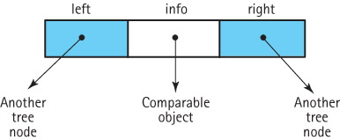
8.4 The Implementation Level: Basics
We define BSTNode.java in our support package to provide nodes for our binary search trees
Visually, a BSTNode object is:

Slide 18
BSTNode.java
instance variables:
protected T info; // The info in a BST node
protected BSTNode<T> left; // A link to the left child node
protected BSTNode<T> right; // A link to the right child node
Constructor:
public BSTNode(T info)
{
this.info = info;
left = null;
right = null;
}
Plus it includes the standard setters and getters

Slide 19
Beginning of BinarySearchTree.java
package ch08.trees;
import ch05.queues.*;
import ch03.stacks.*;
import support.BSTNode;
public class BinarySearchTree<T extends Comparable<T>> implements BSTInterface<T>
{
protected BSTNode<T> root; // reference to the root of this BST
boolean found; // used by remove
// for traversals
protected LinkUnbndQueue<T> inOrderQueue; // queue of info
protected LinkUnbndQueue<T> preOrderQueue; // queue of info
protected LinkUnbndQueue<T> postOrderQueue; // queue of info
public BinarySearchTree()
// Creates an empty BST object.
{
root = null;
}
. . .

Slide 20
A simple Observer method
public boolean isEmpty()
// Returns true if this BST is empty, otherwise returns false.
{
return (root == null);
}

Slide 21
8.5 Iterative versus Recursive Method Invocations
Trees are inherently recursive; a tree consists of subtrees
In this section we look at recursive and iterative approaches to the size method
We then discuss the benefits of recursion versus iteration for this problem

Slide 22
Recursive Approach
We create a public method, size, that calls a private recursive method, recSize and passes it a reference to the root of the tree.
  public int size()
  // Returns the number of elements in this BST.
  {
  return recSize(root);
  }
We design the recSize method to return the number of nodes in the subtree referenced by the argument passed to it.
Note that the number of nodes in a tree is:
  number of nodes in left subtree + number of nodes in right subtree + 1

Slide 23
recSize Algorithm
Version 1
recSize(tree): returns int
if (tree.getLeft( ) is null) AND (tree.getRight( ) is null)
return 1
else
return recSize(tree.getLeft( )) + recSize(tree.getRight( )) + 1
The corresponding method would crash when we try to access tree.left when tree is null.

Slide 24
recSize Algorithm
Version 2
recSize(tree): returns int
if (tree.getLeft( ) is null) AND (tree.getRight( ) is null)
return 1
else if tree.getLeft( ) is null
return recSize(tree.getRight( )) + 1
else if tree.getRight( ) is null
return recSize(tree.getLeft( )) + 1
else return recSize(tree.getLeft( )) + recSize(tree.getRight( )) + 1
An initially empty tree still causes a crash.

Slide 25
recSize Algorithm
Version 3
recSize(tree): returns int Version 3
if tree is null
return 0
else if (tree.getLeft( ) is null) AND (tree.getRight( ) is null)
return 1
else if tree.getLeft( ) is null
return recSize(tree.getRight( )) + 1
else if tree.getRight( ) is null
return recSize(tree.getLeft( )) + 1
Works, but can be simplified. We can collapse the two base cases into one. There is no need to make the leaf node a special case.

Slide 26
recSize Algorithm
Version 4
recSize(tree): returns int Version 4
if tree is null
return 0
else
return recSize(tree.getLeft( )) + recSize(tree.getRight( )) + 1
Works and is “simple”.
This example illustrates two important points about recursion with trees:
  always check for the empty tree first
  leaf nodes do not need to be treated as separate cases.

Slide 27
The recSize Code
private int recSize(BSTNode<T> tree)
// Returns the number of elements in tree.
{
if (tree == null)
return 0;
else
return recSize(tree.getLeft()) + recSize(tree.getRight()) + 1;
}

Slide 28
Iterative Version
We use a stack to hold nodes we have encountered but not yet processed
We must be careful that we process each node in the tree exactly once. We follow these rules:
  Process a node immediately after removing it from the stack.
  Do not process nodes at any other time.
  Once a node is removed from the stack, do not push it back onto the stack.

Slide 29
Algorithm for the iterative approach
size returns int
Set count to 0
if the tree is not empty
Instantiate a stack
Push the root of the tree onto the stack
while the stack is not empty
Set currNode to top of stack
Pop the stack
Increment count
if currNode has a left child
Push currNode’s left child onto the stack
if currNode has a right child
Push currNode’s right child onto the stack
return count

Slide 30
Code for the iterative approach
public int size()
// Returns the number of elements in this BST.
{
int count = 0;
if (root != null)
{
LinkedStack<BSTNode<T>> hold = new LinkedStack<BSTNode<T>> ();
BSTNode<T> currNode;
hold.push(root);
while (!hold.isEmpty())
{
currNode = hold.top();
hold.pop();
count++;
if (currNode.getLeft() != null)
hold.push(currNode.getLeft());
if (currNode.getRight() != null)
hold.push(currNode.getRight());
}
}
return count;
}

Slide 31
Recursion or Iteration?
Is the depth of recursion relatively shallow? Yes.
Is the recursive solution shorter or clearer than the nonrecursive version? Yes.
Is the recursive version much less efficient than the nonrecursive version?
No.
This is a good use of recursion.

Slide 32
8.6 The Implementation Level: Remaining Operations
In this section, we use recursion to implement the remaining Binary Search Tree operations
  contains
  get
  add
  remove
  iteration

Slide 33
The contains operation
We implement contains using a private recursive method called recContains which
  is passed the element we are searching for and a reference to a subtree in which to search
  first checks to see if the element searched for is in the root - if it is not, it compares the element with the root and looks in either the left or the right subtree

Slide 34
The contains method
private boolean recContains(T element, BSTNode<T> tree)
// Returns true if tree contains an element e such that
// e.equals(element), otherwise returns false.
{
if (tree == null)
return false; // element is not found
else if (element.compareTo(tree.getInfo()) < 0)
return recContains(element, tree.getLeft()); // Search left subtree
else if (element.compareTo(tree.getInfo()) > 0)
return recContains(element, tree.getRight()); // Search right subtree
else
return true; // element is found
}
public boolean contains (T element)
// Returns true if this BST contains an element e such that
// e.equals(element), otherwise returns false.
{
return recContains(element, root);
}

Slide 35
The get Method is similar
private T recGet(T element, BSTNode<T> tree)
// Returns an element e from tree such that e.equals(element);
// if no such element exists returns null.
{
if (tree == null)
return null; // element is not found
else if (element.compareTo(tree.getInfo()) < 0)
return recGet(element, tree.getLeft()); // get from left subtree
else
if (element.compareTo(tree.getInfo()) > 0)
return recGet(element, tree.getRight()); // get from right subtree
else
return tree.getInfo(); // element is found
}
public T get(T element)
// Returns an element e from this BST such that e.equals(element);
// if no such element exists returns null.
{
return recGet(element, root);
}

Slide 36
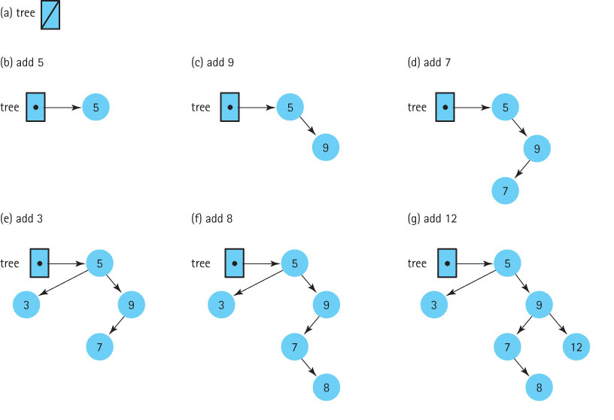
The add operation
A new node is always inserted into its appropriate position in the tree as a leaf

Slide 37
The add operation
The add method invokes the recursive method, recAdd, and passes it the element to be added plus a reference to the root of the tree.
  public void add (T element)
  // Adds element to this BST. The tree retains its BST property.
  {
  root = recAdd(element, root);
  }
The call to recAdd returns a BSTNode. It returns a reference to the new tree, that is, to the tree that includes element. The statement
root = recAdd(element, root);
can be interpreted as “Set the reference of the root of this tree to the root of the tree that is generated when element is added to this tree.”

Slide 38
The add method
private BSTNode<T> recAdd(T element, BSTNode<T> tree)
// Adds element to tree; tree retains its BST property.
{
if (tree == null)
// Addition place found
tree = new BSTNode<T>(element);
else if (element.compareTo(tree.getInfo()) <= 0)
tree.setLeft(recAdd(element, tree.getLeft())); // Add in left subtree
else
tree.setRight(recAdd(element, tree.getRight())); // Add in right subtree
return tree;
}
public void add (T element)
// Adds element to this BST. The tree retains its BST property.
{
root = recAdd(element, root);
}

Slide 39
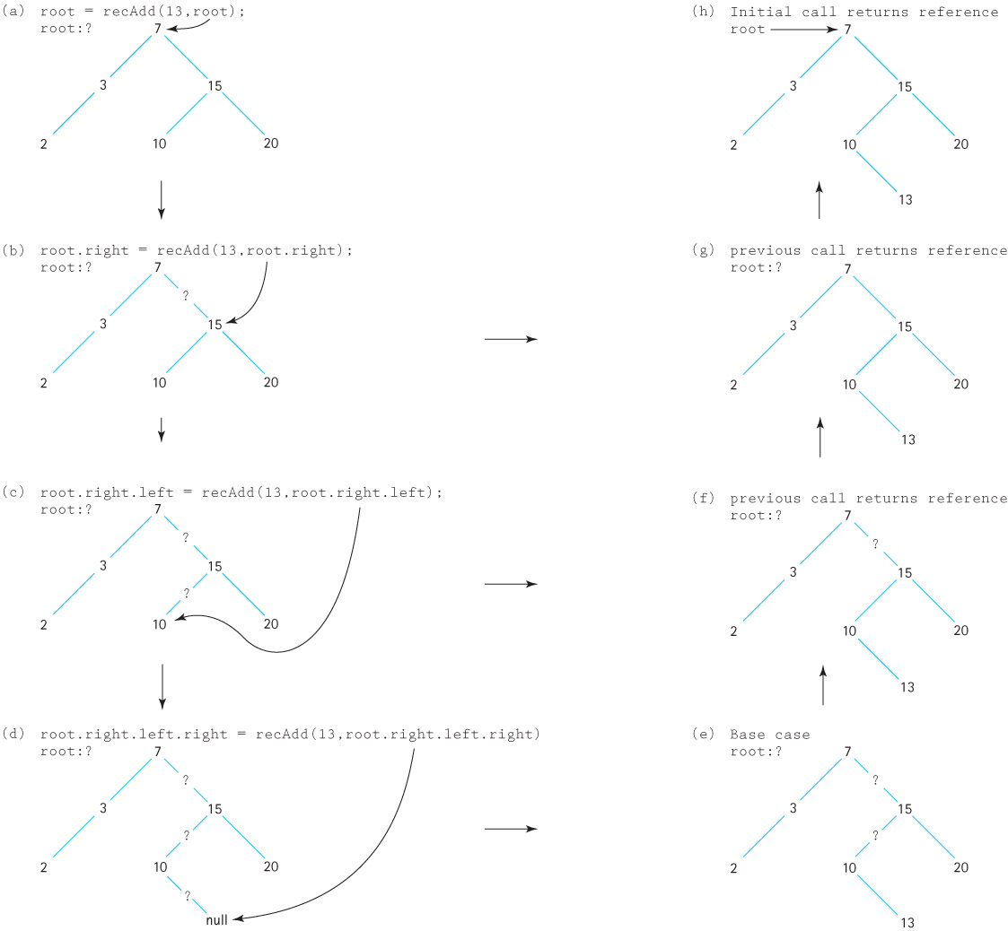

Slide 40
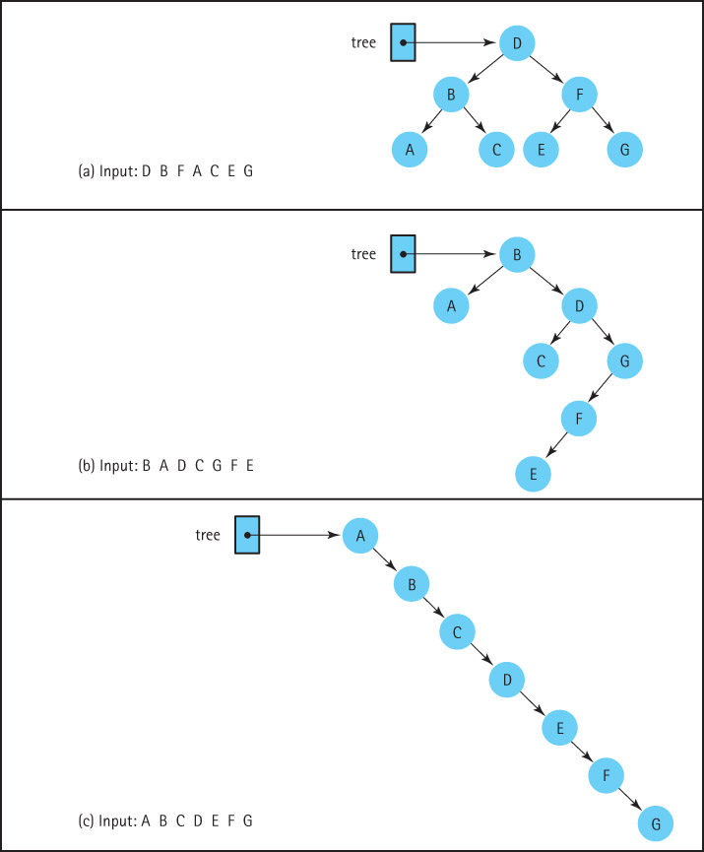
Insertion
Order
and
Tree
Shape

Slide 41
The remove Operation
The most complicated of the binary search tree operations.
We must ensure when we remove an element we maintain the binary search tree property.

Slide 42
The code for remove:
The set up for the remove operation is the same as that for the add operation.
The private recRemove method is invoked from the public remove method with arguments equal to the element to be removed and the subtree to remove it from.
The recursive method returns a reference to the revised tree
The remove method returns the boolean value stored in found, indicating the result of the remove operation.
public boolean remove (T element)
// Removes an element e from this BST such that e.equals(element)
// and returns true; if no such element exists returns false.
{
root = recRemove(element, root);
return found;
}

Slide 43
The recRemove method
private BSTNode<T> recRemove(T element, BSTNode<T> tree)
// Removes an element e from tree such that e.equals(element)
// and returns true; if no such element exists returns false.
{
if (tree == null)
found = false;
else if (element.compareTo(tree.getInfo()) < 0)
tree.setLeft(recRemove(element, tree.getLeft()));
else if (element.compareTo(tree.getInfo()) > 0)
tree.setRight(recRemove(element, tree.getRight()));
else
{
tree = removeNode(tree);
found = true;
}
return tree;
}

Slide 44
Three cases for the removeNode operation
Removing a leaf (no children): removing a leaf is simply a matter of setting the appropriate link of its parent to null.
Removing a node with only one child: make the reference from the parent skip over the removed node and point instead to the child of the node we intend to remove
Removing a node with two children: replaces the node’s info with the info from another node in the tree so that the search property is retained - then remove this other node

Slide 45
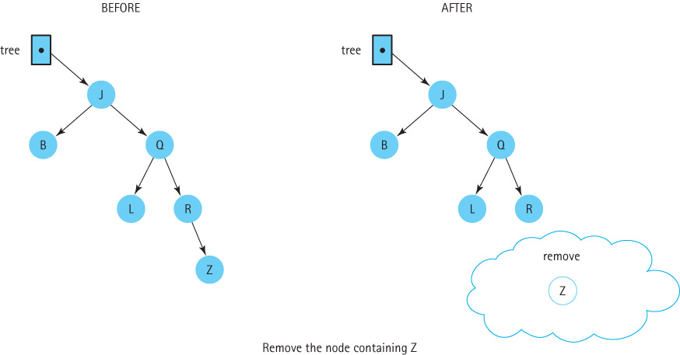
Removing a Leaf Node

Slide 46
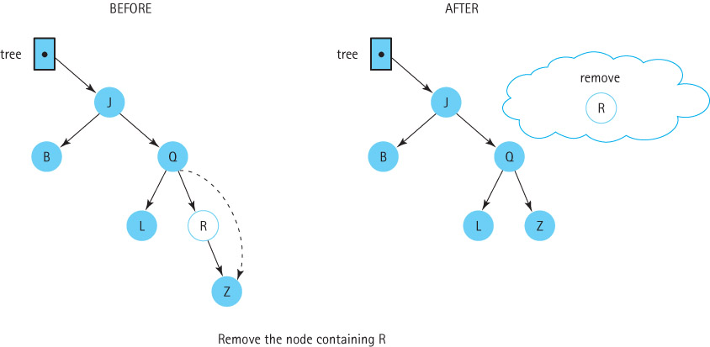
Removing a node with one child

Slide 47
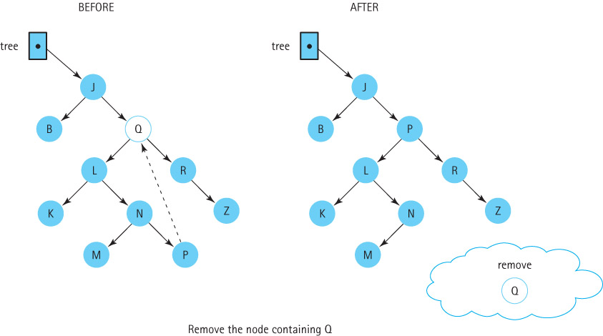
Removing a Node With Two Children

Slide 48
The Remove Node Algorithm
removeNode (tree): returns BSTNode
if (tree.getLeft( ) is null) AND (tree.getRight( ) is null)
return null
else if tree.getLeft( ) is null
return tree.getRight( )
else if tree.getRight( ) is null
return tree.getLeft( )
else
Find predecessor
tree.setInfo(predecessor.getInfo( ))
tree.setLeft(recRemove(predecessor.getInfo( ), tree.getLeft( )))
return tree
Note: We can remove one of the tests if we notice that the action taken when the left child reference is null also takes care of the case in which both child references are null. When the left child reference is null, the right child reference is returned. If the right child reference is also null, then null is returned, which is what we want if they are both null.

Slide 49
The removeNode method
private BSTNode<T> removeNode(BSTNode<T> tree)
// Removes the information at the node referenced by tree
// The user's data in the node referenced to by tree is no
// longer in the tree. If tree is a leaf node or has only
// a non-null child pointer, the node pointed to by tree is
// removed; otherwise, the user's data is replaced by its
// logical predecessor and the predecessor's node is removed
{
T data;
if (tree.getLeft() == null)
return tree.getRight();
else if (tree.getRight() == null)
return tree.getLeft();
else
{
data = getPredecessor(tree.getLeft());
tree.setInfo(data);
tree.setLeft(recRemove(data, tree.getLeft())); // Remove predecessor node
return tree;
}
}

Slide 50
The getPredecessor method
The logical predecessor is the maximum value in tree’s left subtree.
The maximum value in a binary search tree is in its rightmost node.
Therefore, given tree’s left subtree, we just keep moving right until the right child is null.
When this occurs, we return the info reference of the node.
  private T getPredecessor(BSTNode<T> tree)
  // Returns the information held in the rightmost node in tree
  {
  while (tree.getRight() != null)
  tree = tree.getRight();
  return tree.getInfo();
  }

Slide 51
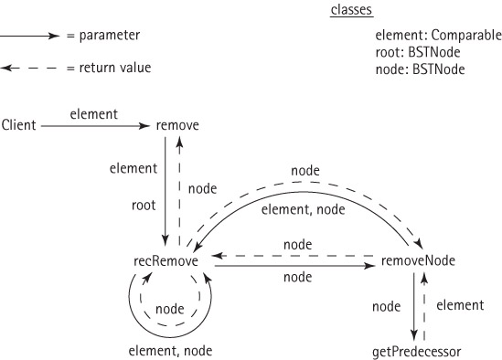
The Methods Used to Remove a Node

Slide 52
Iteration: Review of Traversal Definitions
Preorder traversal: Visit the root, visit the left subtree, visit the right subtree
Inorder traversal: Visit the left subtree, visit the root, visit the right subtree
Postorder traversal: Visit the left subtree, visit the right subtree, visit the root

Slide 53
Our Iteration Approach
The client program passes the reset and getNext methods a parameter indicating which of the three traversal orders to use
reset generates a queue of node contents in the indicated order

Slide 54
Our Iteration Approach (Cont’d)
getNext processes the node contents from the appropriate queue
Each of the traversal orders is supported by a separate queue
  protected LinkedUnbndQueue<T> inOrderQueue;
  protected LinkedUnbndQueue<T> preOrderQueue;
  protected LinkedUnbndQueue<T> postOrderQueue;

Slide 55
Our Iteration Approach (Cont’d)
reset calls the size method in order to determine how large to make the required queue
In most cases, a client program that invokes reset immediately requires the same information
We make it easy for the client to obtain the number of nodes, by providing it as the return value of reset
Note: when getNext reaches the end of the collection of elements another call to getNext results in a run time exception being thrown

Slide 56
The reset method
public int reset(int orderType)
// Initializes current position for an iteration through this BST
// in orderType order. Returns current number of nodes in the BST.
{
int numNodes = size();
if (orderType == INORDER)
{
inOrderQueue = new LinkedUnbndQueue<T>();
inOrder(root);
}
else
if (orderType == PREORDER)
{
preOrderQueue = new LinkedUnbndQueue<T>();
preOrder(root);
}
if (orderType == POSTORDER)
{
postOrderQueue = new LinkedUnbndQueue<T>();
postOrder(root);
}
return numNodes;
}

Slide 57
The getNext method
public T getNext (int orderType)
// Preconditions: the BST is not empty
// the BST has been reset for orderType
// the BST has not been modified since the most recent reset
// the end of orderType iteration has not been reached
// Returns the element at the current position on this BST and advances
// the value of the current position based on the orderType set by reset.
{
if (orderType == INORDER)
return inOrderQueue.dequeue();
else
if (orderType == PREORDER)
return preOrderQueue.dequeue();
else
if (orderType == POSTORDER)
return postOrderQueue.dequeue();
else return null;
}

Slide 58
The Definition of the inOrder Traversal
Method inOrder (tree)
Definition: Enqueues the elements in the binary search tree in order from smallest to largest.
Size: The number of nodes in the tree whose root is tree
Base Case: If tree = null, do nothing.
General Case: Traverse the left subtree in order.
Then enqueue tree.getInfo().
Then traverse the right subtree in order.

Slide 59
The inOrder method
private void inOrder(BSTNode<T> tree)
// Initializes inOrderQueue with tree elements in inOrder order
{
if (tree != null)
{
inOrder(tree.getLeft());
inOrderQueue.enqueue(tree.getInfo());
inOrder(tree.getRight());
}
}
The remaining two traversals are approached exactly the same,
except the relative order in which they visit the root and the
subtrees is changed.
Recursion certainly allows for an elegant solution to the binary
tree traversal problem.

Slide 60
Testing the Binary Search Tree operations
The code for the entire BinarySearchTree class is included with the rest of the book files.
It provides both the recursive size method, and the iterative version (size2).
We have also included an interactive test driver for the ADT called ITDBinarySearchTree.
  it allows you to create, manipulate, and observe trees containing strings.
  it also supports a print operation that allows you to indicate one of the traversal orders and “prints” the contents of the tree, in that order.
You are invited to use the test driver to test the various tree operations.

Slide 61
8.7 Comparing Binary Search Trees to Linear Lists
Binary Search Tree Array-Based Linked List
Linear List
Class constructor O(1) O(N) O(1)
isEmpty O(1) O(1) O(1)
reset O(N) O(1) O(1)
getNext O(1) O(1) O(1)
contains O(log₂N) O(log₂N) O(N)
get
Find O(log₂N) O(log₂N) O(N)
Process O(1) O(1) O(1)
Total O(log₂N) O(log₂N) O(N)
add
Find O(log₂N) O(log₂N) O(N)
Process O(1) O(N) O(N)
Total O(log₂N) O(N) O(N)
remove
Find O(log₂N) O(log₂N) O(N)
Process O(1) O(N) O(1)
Total O(log₂N) O(N) O(N)

Slide 62
8.8 Balancing a Binary Search Tree
In our Big-O analysis of binary search tree operations we assumed our tree was balanced.
If this assumption is dropped and if we perform a worst-case analysis assuming a completely skewed tree, the efficiency benefits of the binary search tree disappear.
The time required to perform the contains, get, add, and remove operations is now O(N), just as it is for the linked list.

Slide 63
Balancing a Binary Search Tree
A beneficial addition to our Binary Search Tree ADT operations is a balance operation
The specification of the operation is:
  public balance();
  // Restructures this BST to be optimally balanced
It is up to the client program to use the balance method appropriately

Slide 64
Our Approach
Basic algorithm:
    Save the tree information in an array
    Insert the information from the array back into the tree
The structure of the new tree depends on the order that we save the information into the array, or the order in which we insert the information back into the tree, or both
First assume we insert the array elements back into the tree in “index” order

Slide 65
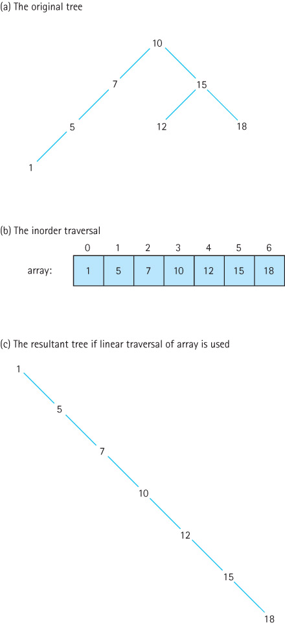
Using inOrder traversal

Slide 66
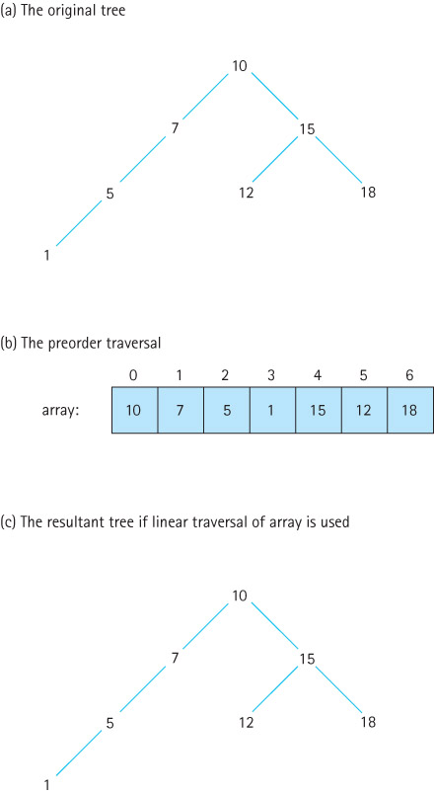
Using preOrder traversal

Slide 67
To Ensure a Balanced Tree
Even out as much as possible, the number of descendants in each node’s left and right subtrees
First insert the “middle” item of the inOrder array
  Then insert the left half of the array using the same approach
  Then insert the right half of the array using the same approach

Slide 68
Our Balance Tree Algorithm
Balance
Set count to tree.reset(INORDER).
For (int index = 0; index < count; index++)
Set array[index] = tree.getNext(INORDER).
tree = new BinarySearchTree().
tree.InsertTree(0, count - 1)
InsertTree(low, high)
if (low == high) // Base case 1
tree.add(nodes[low]).
else if ((low + 1) == high) // Base case 2
tree.add(nodes[low]).
tree.add(nodes[high]).
else
mid = (low + high) / 2.
tree.add(mid).
tree.InsertTree(low, mid – 1).
tree.InsertTree(mid + 1, high).

Slide 69
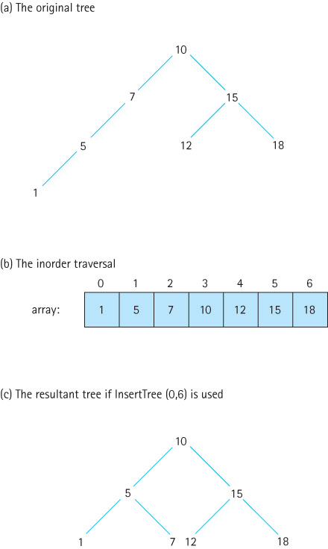
Using recursive insertTree

Slide 70
8.9 A Nonlinked Representation of Binary Trees
A binary tree can be stored in an array in such a way that the relationships in the tree are not physically represented by link members, but are implicit in the algorithms that manipulate the tree stored in the array.
We store the tree elements in the array, level by level, left-to-right. If the number of nodes in the tree is numElements, we can package the array and numElements into an object
The tree elements are stored with the root in tree.nodes[0] and the last node in tree.nodes[numElements – 1].

Slide 71
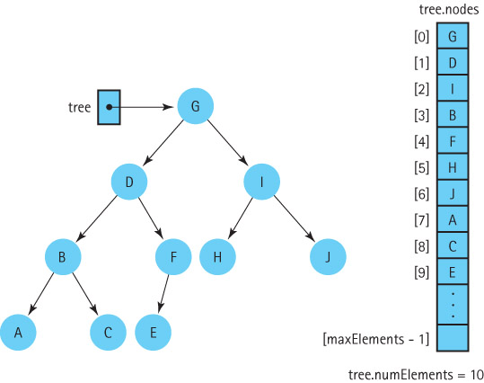
A Binary Tree and Its Array Representation

Slide 72
Array Representation continued
To implement the algorithms that manipulate the tree, we must be able to find the left and right child of a node in the tree:
  tree.nodes[index] left child is in tree.nodes[index*2 + 1]
  tree.nodes[index] right child is in tree.nodes[index*2 + 2]
We can also can determine the location of its parent node:
  tree.nodes[index]’s parent is in tree.nodes[(index – 1)/2].
This representation works best, space wise, if the tree is complete

Slide 73
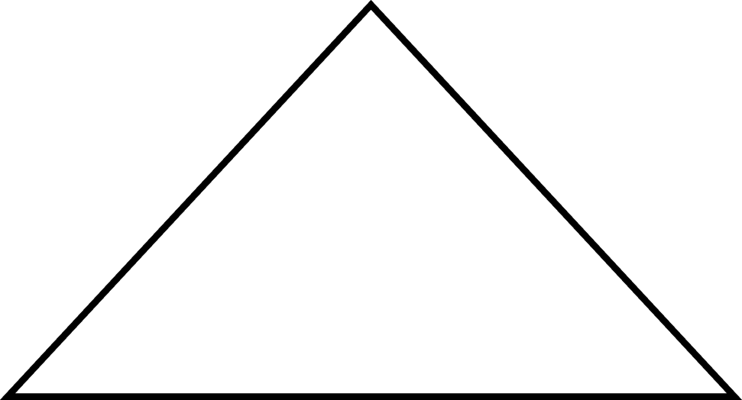
Definitions
Full Binary Tree: A binary tree in which all of the leaves are on the same level and every nonleaf node has two children

Slide 74
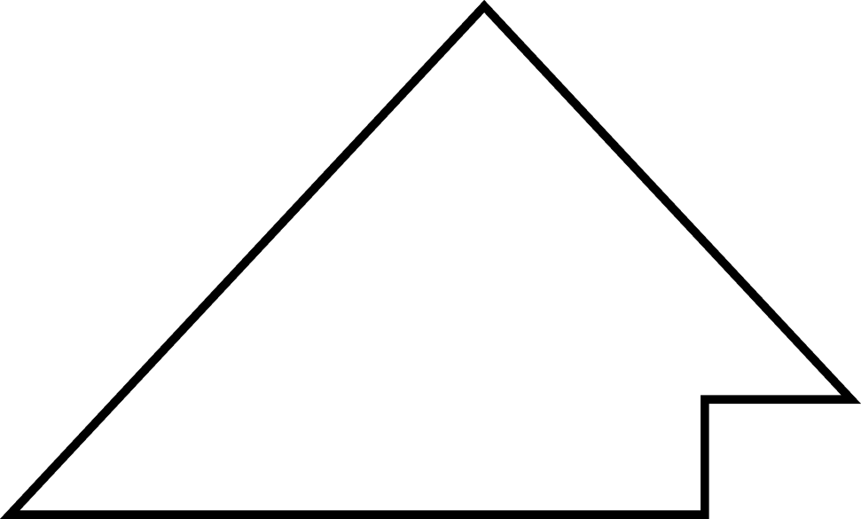
Definitions (Cont’d)
Complete Binary Tree: A binary tree that is either full or full through the next-to-last level, with the leaves on the last level as far to the left as possible

Slide 75
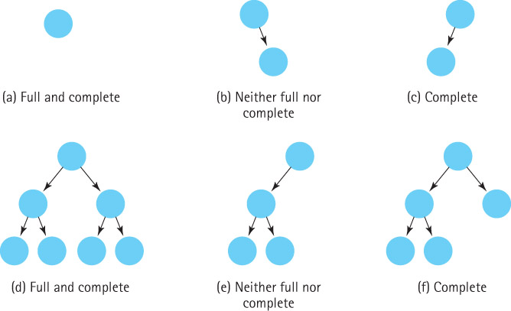
Examples of Different Types of Binary Trees

Slide 76
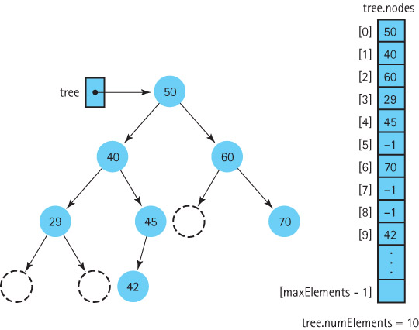
A Binary Search Tree Stored in an Array with Dummy Values

