Slide 1
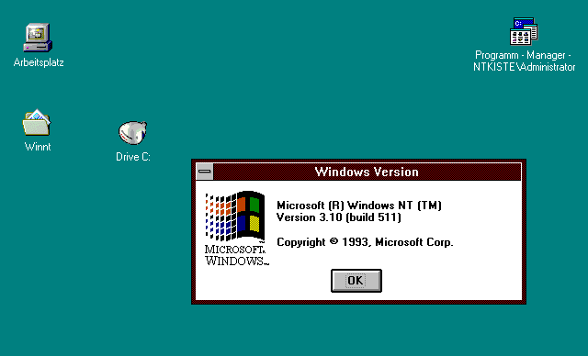
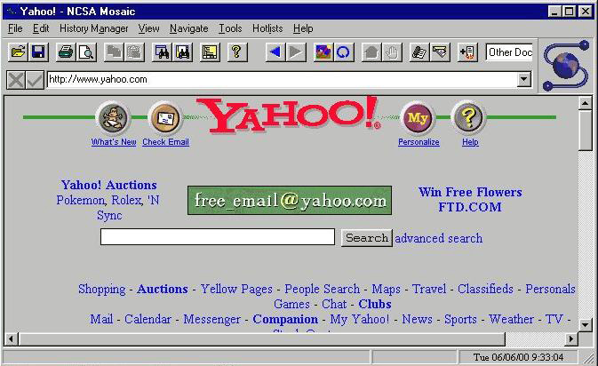
http://www.computerhistory.org/timeline/images/1993_mosaic_browser_large.jpg
MVC and the View
Notes:
1993 version of Mosaic browser.
Must be loading Yahoo! from the late 90s (note ’N Sync link).

Slide 2
Today’s Goal: Program “View” in Rails
Prerequisites:
How to program HTML
How the Web works
How Rails MVC architecture works

Slide 3
SWEBOK Knowledge Areas
Software Requirements
Software Design
Software Construction
Software Testing
Software Maintenance
Software Configuration Management
Software Engineering Management
Software Engineering Process
Software Engineering Models and Methods
Software Quality
Software Engineering Professional Practice
Software Engineering Economics
Computing Foundations
Mathematical Foundations
Engineering Foundations
Today’s topics

Slide 4
Today’s Goal: Program “View” in Rails
Prerequisites:
How to program HTML
How the Web works
How Rails MVC architecture works

Slide 5
What is HTML?
Implies links
Implies formatting tags
HyperText Markup Language
Main language for writing web pages that
can be displayed in a web browser

Slide 6

Brief History of HTML
1991ish: Born
Thru 1990s: Evolves
Versions 0 to 4
By 2000: Ver. 4.01 dominant
2008: HTML5 introduced
Rich media and mobility
Finalized Oct ’14
We’ll use

Slide 7
Web Pages = 3 Technologies
I’ll cover
HTML for Structure
Cascading Style Sheets (CSS) for Style
JavaScript for Behavior
Explore on your own

Slide 8
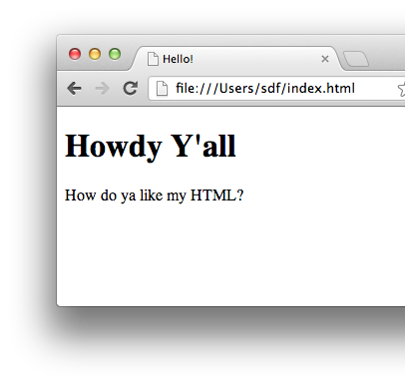
How HTML Works
You write HTML text
Then load it in a browser
<!DOCTYPE html>
<html>
<head>
<title>Hello!</title>
</head>
<body>
<h1>Howdy Y'all</h1>
<p>
How do ya like my HTML?
</p>
</body>
</html>

Slide 9
HTML Elements
Start tag
End tag
<p>This is a paragraph.</p>
Renders as
Note slash!
This is a paragraph.

Slide 10
Elements can be nested
Nested element
<p>This is a <b>paragraph</b>.</p>
Renders as
This is a paragraph.

Slide 11
Elements can have attributes
Attribute
<p style="color:blue">I'm blue!</p>
Renders as
Attribute name
I’m blue!
Equals
Value string

Slide 12
HTML Page Structure
Doctype info
<!DOCTYPE html>
<html>
<head>
<title>Hello!</title>
</head>
<body>
<h1>Howdy Y'all</h1>
<p>
How do ya like my HTML?
</p>
</body>
</html>
head element for metadata
html element
body element for content

Slide 13
Oh yeah, and …
A few tags don’t come in pairs:
E.g.: <br> for line breaks
E.g.: <img> for images
Browsers collapse whitespace (spaces, newlines):
Consecutive whitespace treated as single space
Leading/trailing whitespace eliminated
Special symbols:
E.g.: &nbsp; for non-breaking space
See: http://www.w3schools.com/html/html_entities.asp and http://www.w3schools.com/tags/ref_symbols.asp

Slide 14
Now, all you need to do is learn these tags: http://www.w3schools.com/tags/ref_byfunc.asp (Ignore the ones marked “new in HTML 5” for now) (Ignore the “not supported” ones)

Slide 15
Today’s Goal: Program “View” in Rails
Prerequisites:
How to program HTML
How the Web works
How Rails MVC architecture works

Slide 16
So how does the Web work? When you open a web page in your browser, where does that HTML come from, and how does it get to your browser?

Slide 17
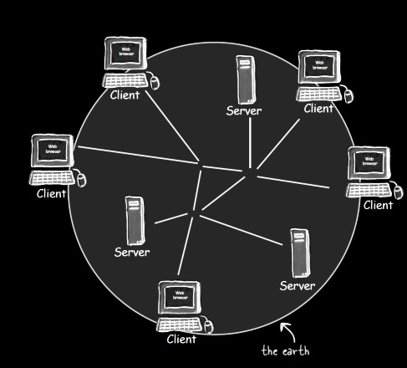
Architecture of the Web
Head First Servlets and JSP (2nd edition), p. 3

Slide 18
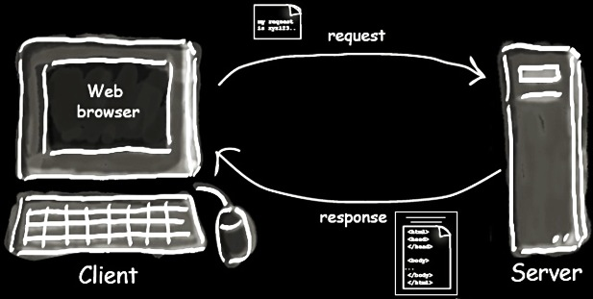
Client-Server Interaction
Head First Servlets and JSP (2nd edition), p. 4

Slide 19
How do you tell a browser to send a request to a particular server?
?
Head First Servlets and JSP (2nd edition), p. 3

Slide 20
URL (Uniform Resource Locator)
http://www.wickedlysmart.com:80/beeradvice/select/beer1.html
Server
Path
Resource
Port (optional)
Protocol (http, https, etc.)

Slide 21
What protocol do these interactions follow?
Head First Servlets and JSP (2nd edition), p. 4

Slide 22
HTTP (Hypertext Transfer Protocol)
Request “methods”
GET: Retrieve resource
POST: Create resource
PATCH: Update resource
DELETE: Destroy resource
… more …
Response (only one type)
CRUD: 4 basic operations of persistent storage

Slide 23
Example HTTP GET Request
HTTP Method
Path to resource
Protocol version
GET /select/selectBeerTaste.jsp HTTP/1.1
Host: www.wickedlysmart.com
User-Agent: Mozilla/5.0 (Macintosh; U; PPC Mac OS X…
Accept: text/xml,application/xml,application/xhtml+xml…
Accept-Language: en-us,en;q=0.5
Accept-Encoding: gzip,deflate
Accept-Charset: ISO-8859-1,utf-8;q=0.7,*;q=0.7
Keep-Alive: 300
Connection: keep-alive
Request headers

Slide 24
Example HTTP Response
Protocol version
HTTP status code
Text version of status code
HTTP/1.1 200 OK
Content-Type: text/html
Content-Length: 397
Date: Wed, 19 Nov 2003 03:25:40 GMT
Server: Apache-Coyote/1.1
Connection: close
<html>
…
</html>
Response headers
Response
body

Slide 25
Today’s Goal: Program “View” in Rails
Prerequisites:
How to program HTML
How the Web works
How Rails MVC architecture works

Slide 26
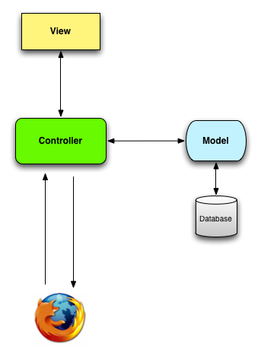
Model-View-Controller (MVC) Architectural Pattern
Server
Timeout!
What kind of diagram is this?
Ye Olde Internet

Slide 27
Data Flow Diagrams
Server
components
flows
Ye Olde Internet

Slide 28
Model-View-Controller (MVC) Architectural Pattern
Server
Timeout!
What do we mean by “architectural”?
Ye Olde Internet

Slide 29
Two levels of software design
Architectural design: High-level structure of software system
Detailed design: Low-level design of individual components/modules/classes

Slide 30
Model-View-Controller (MVC) Architectural Pattern
Server
Being “architectural”, these components may contain many subcomponents (classes, etc.)
Ye Olde Internet

Slide 31
MVC Component Responsibilities
Server
Ye Olde Internet

Slide 32
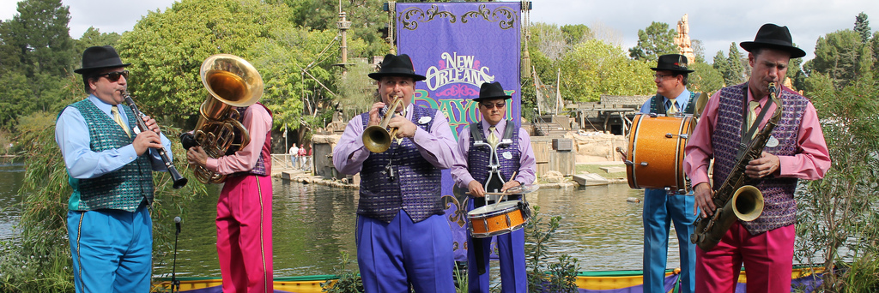
Responsibility-Driven Design
Frames object design as deciding
How to assign responsibilities to objects
How objects should collaborate
What role each object should play in a collaboration
http://flic.kr/p/btp5ZK

Slide 33
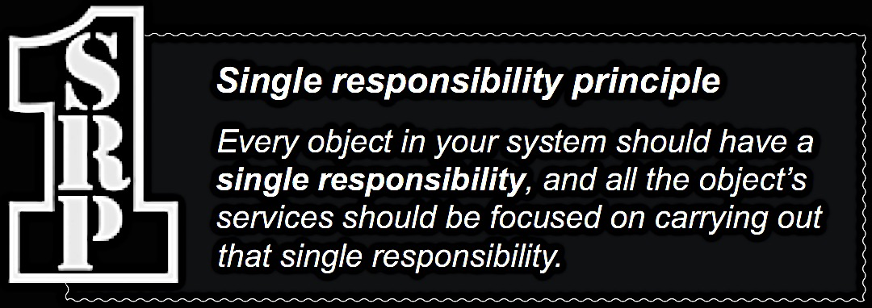

Slide 34
MVC Component Responsibilities
Server
View: Responsible for UI (generating HTML)
Ye Olde Internet

Slide 35
MVC Component Responsibilities
Server
View: Responsible for UI (generating HTML)
Ye Olde Internet
Model: Business logic, domain objects

Slide 36
MVC Component Responsibilities
Server
View: Responsible for UI (generating HTML)
Controller: Translates UI actions into operations on domain objects
Ye Olde Internet
Model: Business logic, domain objects

Slide 37
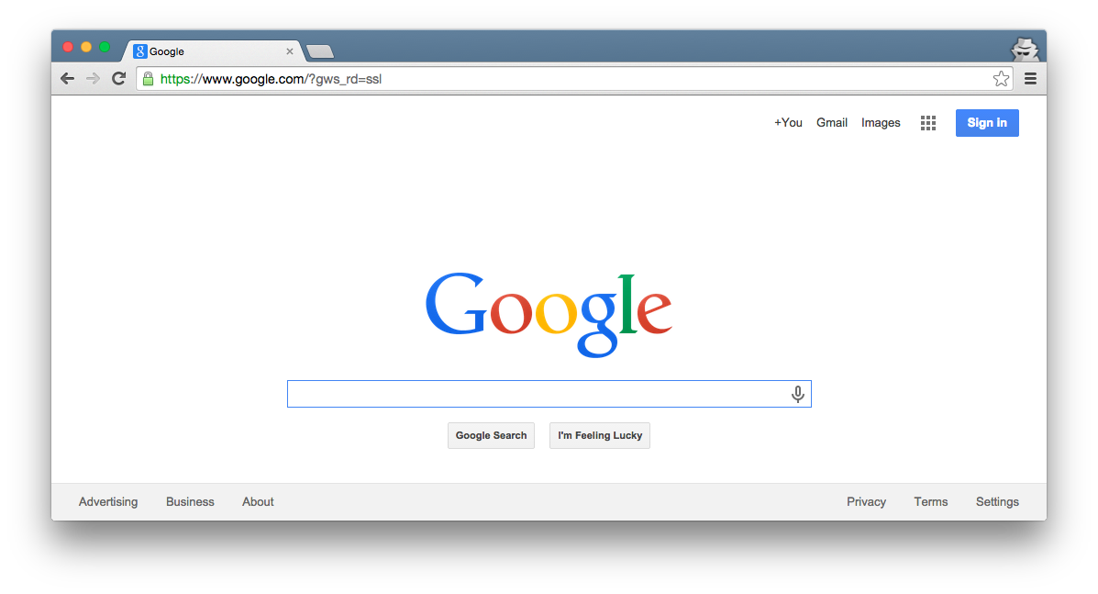

Rails MVC – Fill in the blanks!
Browser
Ye Olde Internet
DB
Server
???
???
???
???

Slide 38
Rails MVC – Fill in the blanks!
Browser
Ye Olde Internet
DB
Server
View
Router
Controller
Model

Slide 39
Browser
Router: Translates HTTP request into call to controller method
Ye Olde Internet
DB
Server
View
Router
Controller
Model

Slide 40
Browser
Programming a Rails web app mainly involves customizing the Router, Model, View, and Controller components
Ye Olde Internet
DB
Server
View
Router
Controller
Model

Slide 41
Browser
Customize Ruby classes
Ye Olde Internet
DB
Server
View
Router
Controller
Model

Slide 42
Browser
Customize Ruby block
Ye Olde Internet
DB
Server
View
Router
Controller
Model

Slide 43
Browser
Customize ERB (Embedded Ruby) files
Ye Olde Internet
DB
Server
View
Router
Controller
Model

Slide 44
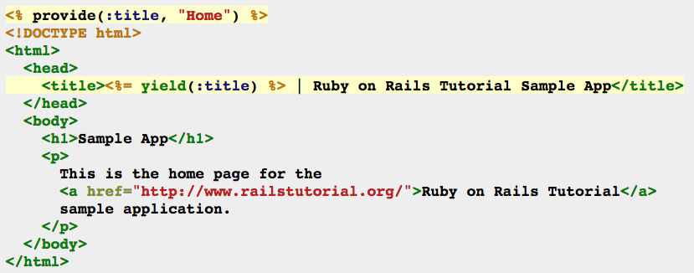
Example ERB: HTML with embedded Ruby code
<%= … %> executes embedded code and prints return value before printing subsequent HTML code
<% … %> executes embedded code before printing subsequent HTML code

Slide 45
More details on developing web apps using Ruby on Rails will be covered in these demo videos: https://scott-fleming.github.io/web-dev-rails-git-tutorial/

Slide 46

Summary
HTML and HTTP
MVC Architectural Pattern
Dataflow Diagrams
Responsibility-Driven Design and SRP
Rails MVC Architecture
http://flic.kr/p/aCLor3

