Slide 1

http://flic.kr/p/ar4nLn
Databases and the MVC Model

Slide 2
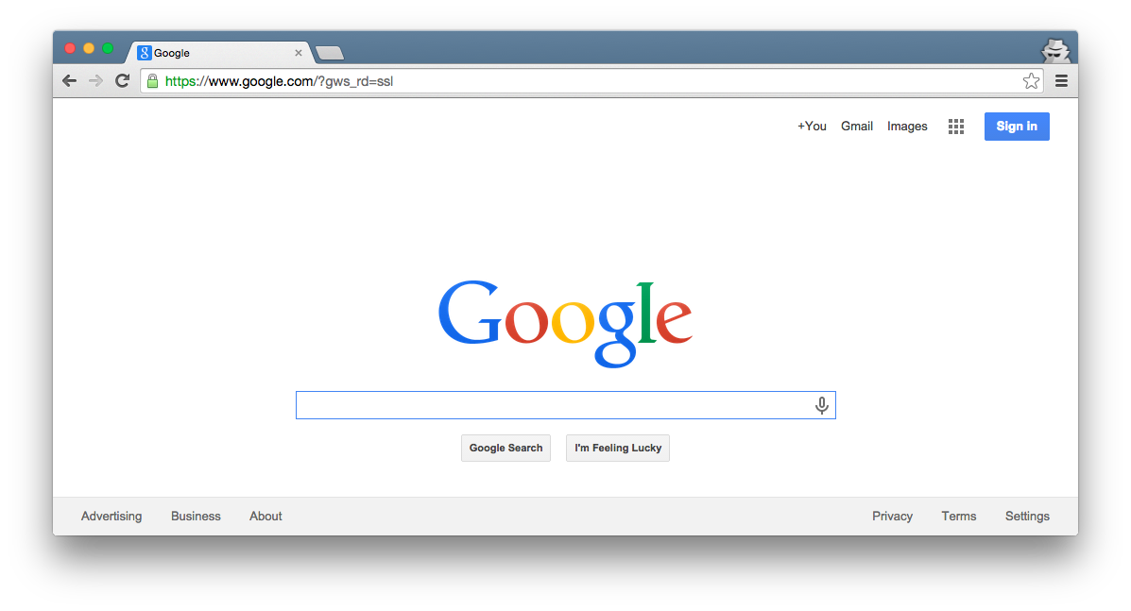

Browser
Migrations
Ye Olde Internet
DB
Server
View
Router
Controller
Model

Slide 3
Browser
Today’s focus
Migrations
Ye Olde Internet
DB
Server
View
Router
Controller
Model

Slide 4
SWEBOK Knowledge Areas
Software Requirements
Software Design
Software Construction
Software Testing
Software Maintenance
Software Configuration Management
Software Engineering Management
Software Engineering Process
Software Engineering Models and Methods
Software Quality
Software Engineering Professional Practice
Software Engineering Economics
Computing Foundations
Mathematical Foundations
Engineering Foundations
Today’s topic

Slide 5
Browser
Migrations
Rails uses a DBMS
Ye Olde Internet
DB
Server
View
Router
Controller
Model

Slide 6
Database (DB): Organized collection of data
Database Management System (DBMS): Controls the creation, maintenance, and use of a DB
E.g.: MySQL, Postgres
http://flic.kr/p/ar4nLn

Slide 7
Browser
Migrations
Migrations set up the database
Ye Olde Internet
Model classes use the database
DB
Server
View
Router
Controller
Model

Slide 8
Outline
Migrations
DBs and DBMSs
Rails Object–Relational Mapping
Rails Model Programming
DB
Model

Slide 9
Outline
Migrations
DBs and DBMSs
Rails Object–Relational Mapping
Rails Model Programming
DB
Model

Slide 10
Why use a DBMS?
Data independence: Applications need not be concerned with how data is stored or accessed
Provides a lot of functionality that would be silly to implement yourself:
Sharing (network)
Customizable security
Integrity

Slide 11
Two key aspects of a DBMS
Database model: How DB is structured and used
Examples: Relational, Object-Oriented, Hierarchical
Query language: Types of questions you can ask
Examples: SQL, XQuery
Relational model + SQL is most common
and used by Rails

Slide 12
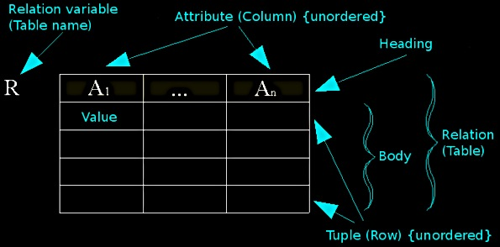
Relational Model Concepts
http://en.wikipedia.org/wiki/File:Relational_model_concepts.png

Slide 13
Example Tables
authors
id | first_name | last_name | year_born
1 | Ayn | Rand | 1905
2 | Peter | Benchley | 1940
publishers
id | publisher_name
1 | Bobbs Merrill
2 | Random House

Slide 14
How DBs are used by apps
Pre-deployment of app:
Create (empty) tables
Rails migrations do this
Maybe “seed” with data
At runtime of app:
CRUD table rows
Rails model classes do this
NOTE: Tables/columns don’t change
authors
id | first_name | last_name | year_born
1 | Ayn | Rand | 1905
2 | Peter | Benchley | 1940

Slide 15
CRUD-to-SQL Mapping
CRUD Operation | SQL Statement
Create | INSERT
Read (Retrieve) | SELECT
Update (Modify) | UPDATE
Delete (Destroy) | DELETE
For complete MySQL documentation, see: http://dev.mysql.com/doc/refman/5.5/en/sql-syntax-data-manipulation.html

Slide 16
Example SELECT Queries
authors
id | first_name | last_name | year_born
1 | Ayn | Rand | 1905
2 | Peter | Benchley | 1940
SELECT * FROM authors
SELECT id, last_name FROM authors
SELECT * FROM authors WHERE year_born > 1910
SELECT * FROM authors WHERE last_name REGEXP '[a-r]*'
SELECT * FROM authors WHERE last_name REGEXP '[a-r]*' ORDER BY last_name ASC
For complete MySQL documentation, see http://dev.mysql.com/doc/refman/5.5/en/select.html, http://dev.mysql.com/doc/refman/5.5/en/pattern-matching.html

Slide 17
Outline
Migrations
DBs and DBMSs
Rails Object–Relational Mapping
Rails Model Programming
DB
Model

Slide 18
Rails Object-Relational Mapping (ORM)
You make object-oriented classes
Rails handles the SQL/DBMS
DB
Model

Slide 19
Quick Intro to UML Class Diagrams
I use UML class diagrams a lot
Rationale: Easier to see “big picture” relationships than in code
Example model class:
Class name
Author
Box = class
first_name : string
last_name : string
year_born : integer
Attributes w/ types

Slide 20
Classes Represent Sets of Possible Objects
Class Diagram:
Object Diagram
Object name
Class
Author
rand : Author
first_name : string
last_name : string
year_born : integer
first_name = “Ayn”
last_name = “Rand”
year_born = 1905
Attribute values
: Author
first_name = “Peter”
last_name = “Benchley”
year_born = 1940

Slide 21
Example Mapping from Class to Table
Author
first_name : string
last_name : string
year_born : integer
You get ID for free
authors
id | first_name | last_name | year_born
1 | Ayn | Rand | 1905
2 | Peter | Benchley | 1940

Slide 22
What do objects map to?
: Author
: Author
first_name = “Ayn”
last_name = “Rand”
year_born = 1905
first_name = “Peter”
last_name = “Benchley”
year_born = 1940
authors
id | first_name | last_name | year_born
1 | Ayn | Rand | 1905
2 | Peter | Benchley | 1940

Slide 23
What do objects map to?
Rows!
: Author
: Author
first_name = “Ayn”
last_name = “Rand”
year_born = 1905
first_name = “Peter”
last_name = “Benchley”
year_born = 1940
authors
id | first_name | last_name | year_born
1 | Ayn | Rand | 1905
2 | Peter | Benchley | 1940

Slide 24
Outline
Migrations
DBs and DBMSs
Rails Object–Relational Mapping
Rails Model Programming
DB
Model

Slide 25
Browser
Migrations
Ye Olde Internet
Tests
DB
Server
View
Router
Controller
Model

Slide 26
Learn to Use the Rails Model
Demo Videos:
https://scott-fleming.github.io/web-dev-rails-git-tutorial/demo-07-mvc-model.html
https://scott-fleming.github.io/web-dev-rails-git-tutorial/demo-08-model-validations-testing.html

Slide 27

Summary
Rails Model Components
DBs and DBMSs
Rails DB Migrations
Rails ORM
http://flic.kr/p/aCLor3

Slide 28
Appendix

Slide 29
Relational DB Table
authors
id | first_name | last_name | year_born
1 | Ayn | Rand | 1905
2 | Peter | Benchley | 1940
Class Diagram (table + columns)
Author
first_name : string
last_name : string
year_born : integer
Object Diagram (rows)
: Author
: Author
first_name = “Ayn”
last_name = “Rand”
year_born = 1905
first_name = “Peter”
last_name = “Benchley”
year_born = 1940

Slide 30
Browser
Migrations
Ye Olde Internet
Tests
DB
Server
View
Router
Controller
Model

