Slide 1

https://flic.kr/p/dxGXD
MVC Model Associations
Notes:
Painted Shadows - Not Allowed
Taken from Alexander Calder's mobile room at the National Gallery of Art, Washington DC.

Slide 2
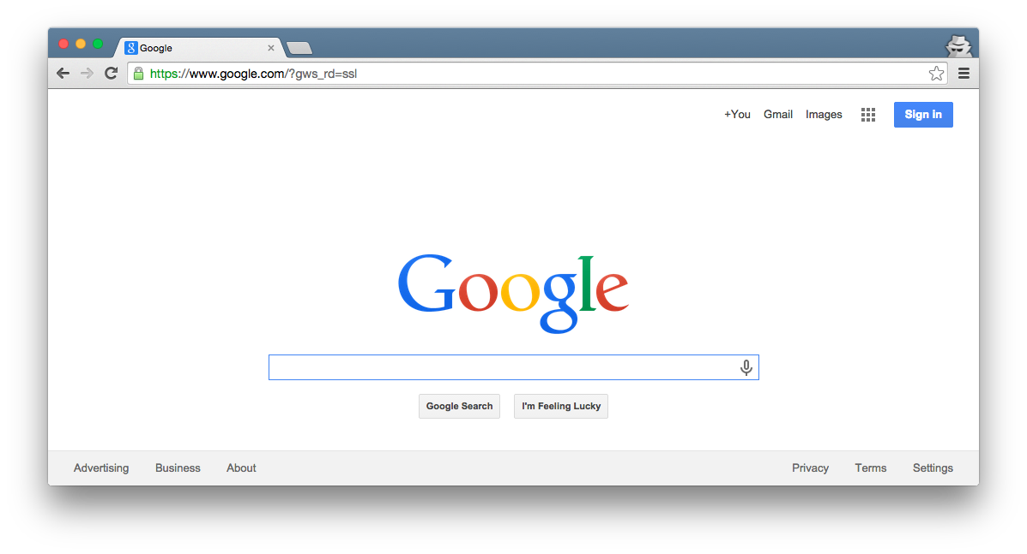

Browser
Migrations
Ye Olde Internet
Tests
DB
Server
View
Router
Controller
Model

Slide 3
Browser
Migrations
Ye Olde Internet
Tests
DB
Server
View
Router
Controller
Model

Slide 4
SWEBOK Knowledge Areas
Software Requirements
Software Design
Software Construction
Software Testing
Software Maintenance
Software Configuration Management
Software Engineering Management
Software Engineering Process
Software Engineering Models and Methods
Software Quality
Software Engineering Professional Practice
Software Engineering Economics
Computing Foundations
Mathematical Foundations
Engineering Foundations
Today’s topic

Slide 5
MVC Model Review
Browser
What key capability do Rails model classes provide?
Ye Olde Internet
DB
Server
View
Router
Controller
Model

Slide 6
MVC Model Review
Browser
What key capability do Rails model classes provide?
CRUD persistent data
Ye Olde Internet
DB
Server
View
Router
Controller
Model

Slide 7
MVC Model Review
Browser
How do you create Rails model classes?
Ye Olde Internet
DB
Server
View
Router
Controller
Model

Slide 8
MVC Model Review
Browser
How do you create Rails model classes?
Generate DB migrations and model classes with “rails g model …” then customize
Ye Olde Internet
DB
Server
View
Router
Controller
Model

Slide 9
MVC Model Review
Browser
What purpose do migrations serve?
Ye Olde Internet
DB
Server
View
Router
Controller
Model

Slide 10
MVC Model Review
Browser
What purpose do migrations serve?
Setup tables in DB via, e.g., “rails db:migrate” command
Ye Olde Internet
DB
Server
View
Router
Controller
Model

Slide 11
MVC Model Review
What DB table would go with this model class?
Model Class:
Database Table:
Author
???
first_name : string
last_name : string
year : integer

Slide 12
MVC Model Review
What DB table would go with this model class?
Model Class:
Database Table:
authors
Author
id | first_name | last_name | year
1 | Ayn | Rand | 1905
2 | Peter | Benchley | 1940
first_name : string
last_name : string
year : integer

Slide 13
MVC Model Review
What DB table would go with this model class?
Model Class:
Database Table:
authors
Author
id | first_name | last_name | year
1 | Ayn | Rand | 1905
2 | Peter | Benchley | 1940
first_name : string
last_name : string
year : integer
Recall Rails ORM (Object-Relational Mapping)

Slide 14
MVC Model Review
What Author methods does Rails provide “for free”?
Model Class:
Author
first_name : string
last_name : string
year : integer

Slide 15
MVC Model Review
What Author methods does Rails provide “for free”?
Model Class:
Many methods:
Author.create/Author.create!
Author.find
Author.find_by
Author.all
Getters/Setters for attributes
Author#first_name
Author#first_name=
Author#save/Author#save!
Author#destroy
Author#valid?
Author
first_name : string
last_name : string
year : integer

Slide 16
MVC Model Review
What customizations might you add to Author?
Model Class:
Author
first_name : string
last_name : string
year : integer

Slide 17

MVC Model Review
What customizations might you add to Author?
Model Class:
Only customization covered so far is data validation
Author
first_name : string
last_name : string
year : integer

Slide 18
Limitation so far: Insular model classes/tables
Model Class:
Database Table:
authors
Author
id | first_name | last_name | year
1 | Ayn | Rand | 1905
2 | Peter | Benchley | 1940
first_name : string
last_name : string
year : integer

Slide 19
Imagine an author-profile class
Model Class:
Database Table:
authors
Author
id | first_name | last_name | year
1 | Ayn | Rand | 1905
2 | Peter | Benchley | 1940
first_name : string
last_name : string
year : integer
AuthorProfile
author_profiles
birthplace : string
bio : text
awards : text
id | birthplace | bio | awards
23 | Saint Petersburg | Rand was born… | Prometheus Award, …
42 | New York City | He was the son of… | Shark Conservation, …

Slide 20
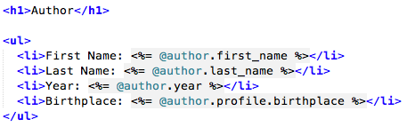
What if you want inter-class relationships?
Author
???
AuthorProfile
first_name : string
last_name : string
year : integer
birthplace : string
bio : text
awards : text
For example, you might want to say:

Slide 21
Requires inter-table references
authors
id | first_name | last_name | year
1 | Ayn | Rand | 1905
2 | Peter | Benchley | 1940
author_profiles
id | birthplace | bio | awards
23 | Saint Petersburg | Rand was born… | Prometheus Award, …
42 | New York City | He was the son of… | Shark Conservation, …

Slide 22
Rails Relationship Support
has one / belongs to one
has many / belongs to one
join table
Easiest to learn, but narrow in focus
Most complex, but also most flexible

Slide 23
Rails Relationship Support
has one / belongs to one
has many / belongs to one
join table

Slide 24
Has One / Belongs To One Example
Author
AuthorProfile
1
author
has
1
profile
first_name : string
last_name : string
year : integer
birthplace : string
bio : text
awards : text

Slide 25
Has One / Belongs To One Example
Author
AuthorProfile
1
author
has
1
profile
first_name : string
last_name : string
year : integer
birthplace : string
bio : text
awards : text
Class Association

Slide 26
Has One / Belongs To One Example
Author
AuthorProfile
1
author
has
1
profile
first_name : string
last_name : string
year : integer
birthplace : string
bio : text
awards : text
Association Name Triangle indicates reading direction (i.e., Author has AuthorProfile)

Slide 27
Has One / Belongs To One Example
Author
AuthorProfile
1
author
has
1
profile
first_name : string
last_name : string
year : integer
birthplace : string
bio : text
awards : text
Role Names
Like attribute/method name
Enables this method call:
@author.profile.birthplace

Slide 28
Has One / Belongs To One Example
Author
AuthorProfile
1
author
has
1
profile
first_name : string
last_name : string
year : integer
birthplace : string
bio : text
awards : text
Multiplicities

Slide 29
Has One / Belongs To One Example
Author
AuthorProfile
1
author
has
1
profile
first_name : string
last_name : string
year : integer
birthplace : string
bio : text
awards : text
Multiplicities
Each Author has 1 AuthorProfile

Slide 30
Has One / Belongs To One Example
Author
AuthorProfile
1
author
has
1
profile
first_name : string
last_name : string
year : integer
birthplace : string
bio : text
awards : text
Multiplicities
Each Author has 1 AuthorProfile
Each AuthorProfile is had by 1 Author

Slide 31
Has One / Belongs To One Example
Author
AuthorProfile
1
author
has
1
profile
first_name : string
last_name : string
year : integer
birthplace : string
bio : text
awards : text
Multiplicities
Each Author has 1 AuthorProfile
Each AuthorProfile is had by 1 Author
More Multiplicities:
A
has
*
B
Each A has 0 or more Bs
A
has
0..*
B
Each A has 0 or more Bs
A
has
1..*
B
Each A has 1 or more Bs

Slide 32
Has One / Belongs To One Example
Author
AuthorProfile
1
author
has
1
profile
first_name : string
last_name : string
year : integer
birthplace : string
bio : text
awards : text
Associated DB Tables
authors
id | first_name | last_name | year
1 | Ayn | Rand | 1905
2 | Peter | Benchley | 1940
author_profiles
id | author _id | birthplace | bio | awards
23 | 1 | Saint Petersburg | Rand was born… | Prometheus Award, …
42 | 2 | New York City | He was the son of… | Shark Conservation, …

Slide 33
Has One / Belongs To One Example
Author
AuthorProfile
1
author
has
1
profile
first_name : string
last_name : string
year : integer
birthplace : string
bio : text
awards : text
Associated DB Tables
authors
id | first_name | last_name | year
1 | Ayn | Rand | 1905
2 | Peter | Benchley | 1940
references
author_profiles
id | author _id | birthplace | bio | awards
23 | 1 | Saint Petersburg | Rand was born… | Prometheus Award, …
42 | 2 | New York City | He was the son of… | Shark Conservation, …

Slide 34
Primary versus Foreign Keys
Primary Key: Uniquely identifies each record in table
authors
id | first_name | last_name | year
1 | Ayn | Rand | 1905
2 | Peter | Benchley | 1940
author_profiles
id | author _id | birthplace | bio | awards
23 | 1 | Saint Petersburg | Rand was born… | Prometheus Award, …
42 | 2 | New York City | He was the son of… | Shark Conservation, …

Slide 35
Primary versus Foreign Keys
Primary Key: Uniquely identifies each record in table
Foreign Key: Field in table A such that the field is a primary key in one other table B
authors
id | first_name | last_name | year
1 | Ayn | Rand | 1905
2 | Peter | Benchley | 1940
author_profiles
id | author _id | birthplace | bio | awards
23 | 1 | Saint Petersburg | Rand was born… | Prometheus Award, …
42 | 2 | New York City | He was the son of… | Shark Conservation, …

Slide 36
Primary versus Foreign Keys
Primary Key: Uniquely identifies each record in table
Foreign Key: Field in table A such that the field is a primary key in one other table B
authors
id | first_name | last_name | year
1 | Ayn | Rand | 1905
2 | Peter | Benchley | 1940
author_profiles
id | author _id | birthplace | bio | awards
23 | 1 | Saint Petersburg | Rand was born… | Prometheus Award, …
42 | 2 | New York City | He was the son of… | Shark Conservation, …

Slide 37
How to Set Up Association in Rails
Generate migration that adds reference (foreign key) column to appropriate table
Add has_one/belongs_to declarations to model class
See this demo for details: https://scott-fleming.github.io/web-dev-rails-git-tutorial/demo-12-has-many-assoc.html

Slide 38
Rails Relationship Support
has one / belongs to one
has many / belongs to one
join table

Slide 39
Has Many / Belongs to One Example
Author
AuthorProfile
1
author
has
1
profile
first_name : string
last_name : string
year : integer
birthplace : string
bio : text
awards : text
Book
How to model authorship? (assume 1 author per book)
title : string
year : integer
summary : text

Slide 40
Has Many / Belongs to One Example
Author
AuthorProfile
1
author
has
1
profile
first_name : string
last_name : string
year : integer
birthplace : string
bio : text
awards : text
1 author
has
* book
Book
How to model authorship? (assume 1 author per book)
title : string
year : integer
summary : text

Slide 41
Has Many / Belongs to One Example
What should the ORM be?
(hint: authors table unchanged)
Author
first_name : string
last_name : string
year : integer
authors
1 author
id | first_name | last_name | year
1 | Ayn | Rand | 1905
2 | Peter | Benchley | 1940
has
* book
Book
title : string
year : integer
summary : text

Slide 42
Has Many / Belongs to One Example
What should the ORM be?
(hint: authors table unchanged)
Author
first_name : string
last_name : string
year : integer
authors
1 author
id | first_name | last_name | year
1 | Ayn | Rand | 1905
2 | Peter | Benchley | 1940
has
* book
Book
title : string
year : integer
summary : text
books
id | title | year | summary | author_id
72 | The Fountainhead | 1943 | Individualistic architect… | 1
98 | Atlas Shrugged | 1957 | Dystopian USA… | 1
99 | Jaws | 1974 | Shark!... | 2

Slide 43
Has Many / Belongs to One Example
What should the ORM be?
(hint: authors table unchanged)
Author
first_name : string
last_name : string
year : integer
authors
1 author
id | first_name | last_name | year
1 | Ayn | Rand | 1905
2 | Peter | Benchley | 1940
has
* book
Book
title : string
year : integer
summary : text
books
id | title | year | summary | author_id
72 | The Fountainhead | 1943 | Individualistic architect… | 1
98 | Atlas Shrugged | 1957 | Dystopian USA… | 1
99 | Jaws | 1974 | Shark!... | 2

Slide 44
Has Many / Belongs to One Example
Rails generates books method that returns list of books
Author
first_name : string
last_name : string
year : integer
authors
1 author
id | first_name | last_name | year
1 | Ayn | Rand | 1905
2 | Peter | Benchley | 1940
has
* book
Book
title : string
year : integer
summary : text
books
id | title | year | summary | author_id
72 | The Fountainhead | 1943 | Individualistic architect… | 1
98 | Atlas Shrugged | 1957 | Dystopian USA… | 1
99 | Jaws | 1974 | Shark!... | 2

Slide 45
How to Set Up in Rails
Essentially the same as has_one
Again, see this demo: https://scott-fleming.github.io/web-dev-rails-git-tutorial/demo-12-has-many-assoc.html

Slide 46
Rails Relationship Support
has one / belongs to one
has many / belongs to one
join table

Slide 47
Example Many-to-Many Association
Physician
Patient
*
physician
*
patient
name : string
name : string
Appointment
appointment_date : datetime
Association Class
Each instance is an association link
Can add additional data to each link (e.g., date)
Maps to a join table in Rails ORM

Slide 48
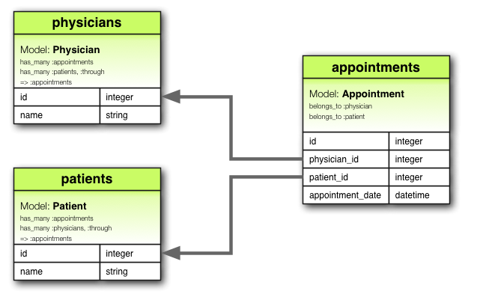
Join Table Example
From http://guides.rubyonrails.org/v4.2.0/association_basics.html

Slide 49
Join Table Example
Join table
From http://guides.rubyonrails.org/v4.2.0/association_basics.html

Slide 50
Join Table Example
References (aka foreign keys)
From http://guides.rubyonrails.org/v4.2.0/association_basics.html

Slide 51
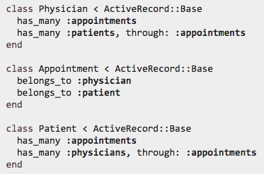
Join Table Example: Model Class
through enables this sort of thing:
From http://guides.rubyonrails.org/v4.2.0/association_basics.html

Slide 52
How to Set Up in Rails
Demo video coming soon!
For more info:
http://guides.rubyonrails.org/v5.2.1/association_basics.html
http://api.rubyonrails.org/v5.2.1/classes/ActiveRecord/Associations/ClassMethods.html

Slide 53

Summary
Model associations
Foreign keys
Rails ORM for assoc.
Has-one/belong-to-one
Has-many/belongs-to-one
Many-to-many join table
http://flic.kr/p/aCLor3

Slide 54
Appendix

Slide 55
Browser
Migrations
Ye Olde Internet
Tests
DB
Server
View
Router
Controller
Model

Slide 56
Has One / Belongs To One Example
Author
AuthorProfile
1
author
has
1
profile
first_name : string
last_name : string
year : integer
birthplace : string
bio : text
awards : text
Associated DB Tables
authors
id | first_name | last_name | year
1 | Ayn | Rand | 1905
2 | Peter | Benchley | 1940
references
author_profiles
id | author _id | birthplace | bio | awards
23 | 1 | Saint Petersburg | Rand was born… | Prometheus Award, …
42 | 2 | New York City | He was the son of… | Shark Conservation, …

Slide 57
Has Many / Belongs to One Example
Author
first_name : string
last_name : string
year : integer
authors
1 author
id | first_name | last_name | year
1 | Ayn | Rand | 1905
2 | Peter | Benchley | 1940
has
* book
references
Book
title : string
year : integer
summary : text
books
id | title | year | summary | author_id
72 | The Fountainhead | 1943 | Individualistic architect… | 1
98 | Atlas Shrugged | 1957 | Dystopian USA… | 1
99 | Jaws | 1974 | Shark!... | 2

Slide 58
Has Many / Belongs to One Example
Author
first_name : string
last_name : string
year : integer
authors
1 creator
id | first_name | last_name | year
1 | Ayn | Rand | 1905
2 | Peter | Benchley | 1940
has
* creation
references
Book
title : string
year : integer
summary : text
books
id | title | year | summary | author_id
72 | The Fountainhead | 1943 | Individualistic architect… | 1
98 | Atlas Shrugged | 1957 | Dystopian USA… | 1
99 | Jaws | 1974 | Shark!... | 2

Slide 59
Author
first_name : string
last_name : string
year : integer
1 author
has
* book
Book
Publisher
title : string
year : integer
summary : text
*
title
has
1
imprint
name : string
url: string

Slide 60
Author
AuthorProfile
1
author
has
1
profile
first_name : string
last_name : string
year : integer
birthplace : string
bio : text
awards : text
1 author
has
* book
Book
Publisher
title : string
year : integer
summary : text
*
title
has
1
imprint
name : string
url: string

