Slide 1
Accessibility Testing 101

Slide 2

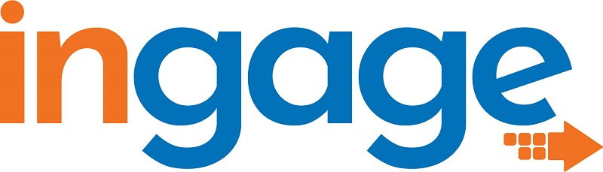






CincyDeliver 2023 Sponsors
Diamond
Platinum
Gold
Silver
Community

Slide 3
Agenda
What is Accessibility?
Why make things Accessible?
How do we decide what is Accessible?
Building Accessibility Test Plans
Example Test Plans
Tools & Resources

Slide 4

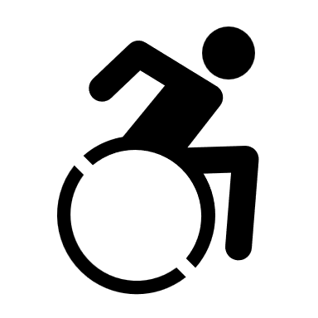

What is Accessibility?
Accessibility
Disability
Assistive Technology
A11y
Notes:
Accessibility – how well can your product be used by people of all abilities?
Disability – A disability is basically a mismatch in interaction between a person’s body and the features of their environment in which they live.
Adaptive/Assistive Technology (AT) - is any item, piece of equipment, software program, or product that is used to increase, maintain, or improve the functional capabilities of people with disabilities.
A11y – a commonly accepted numeronym for Accessibility that stands for the fact that Accessibility starts with an “A”, ends with a “Y” and has 11 characters in between.

Slide 5
What is Accessibility - Continued
Types
Time
Temporary
Situational
Permanent
Visibility
Visible
Invisible
Hearing
Vision
Mobility
Comprehension

Slide 6
Why make things Accessible?
Because it is the right thing to do
Better retention of employees and customers
More likely to be innovative
Don’t miss out on the market
A Hidden Market: The Purchasing Power of Working-Age Adults With Disabilities | American Institutes for Research (air.org)
Notes:
Based on data from the American Institutes for Research (AIR)—A Hidden Market: The Purchasing Power of People With Disabilities
The total disposable income for U.S. adults with disabilities is about $490 billion, which is comparable to other significant market segments, such as African Americans ($501 billion) and Hispanics ($582 billion). (Disposable income is what is left after taxes are paid.); and
Discretionary income for working-age people with disabilities is about $21 billion, which is greater than that of the African-American ($3 billion) and Hispanic ($16 billion) market segments, combined. (Discretionary income is the money remaining after deducting taxes, other mandatory charges, and spending on necessities, such as food and housing.)

Slide 7
How do we decide what is Accessible?
Regulations
Americans with Disabilities Act (ADA)
Section 508 of the Rehabilitation Act of 1973
Accessibility for Ontarians Act (AODA)
Learn more at: Web Accessibility Laws & Policies | Web Accessibility Initiative (WAI) | W3C
Guidelines
Web Content Accessibility Guidelines (WCAG)
Authoring Tools Accessibility Guidelines (ATAG)
User Agent Accessibility Guidelines (UAAG)
Accessible Rich Internet Applications (ARIA)
Accessible Electronic Documents Community of Practice (AED COP)

Slide 8
Building Accessibility Test Plans
Manual and Automated
Shift left
Nothing without us
Screen reader and Keyboard accessible
Usually based around WCAG Guidelines
Customize test methods for different environments:
Desktop, Mobile, Mobile Web, Native App
Chrome, Firefox, Edge, or other browsers
Example Test Methods/Plans:
VGAR – Visa Global Accessibility Requirements
Section 508 ICT Testing Baseline for Web - This Baseline identifies the minimum requirements of any test process used to determine conformance of web content with the Revised Section 508 of the Rehabilitation Act of 1973, as amended (29 U.S.C. 794d)

Slide 9
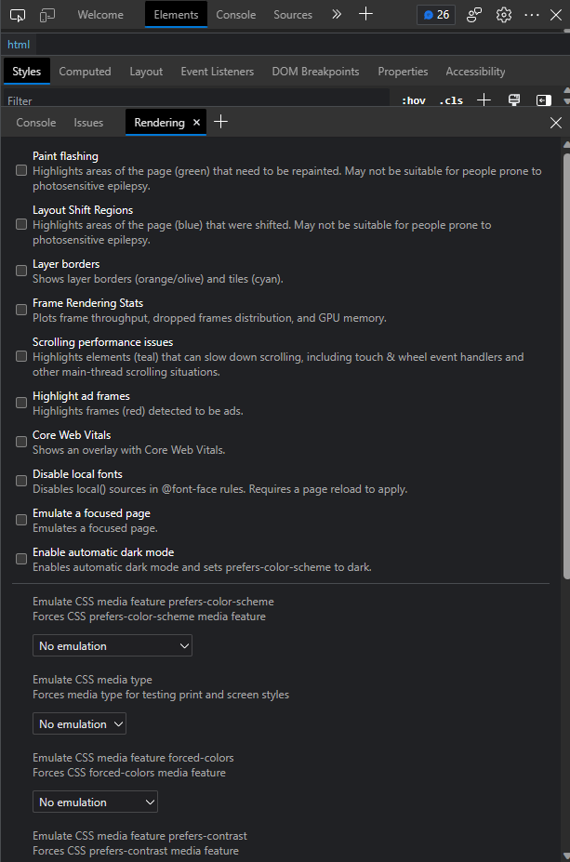
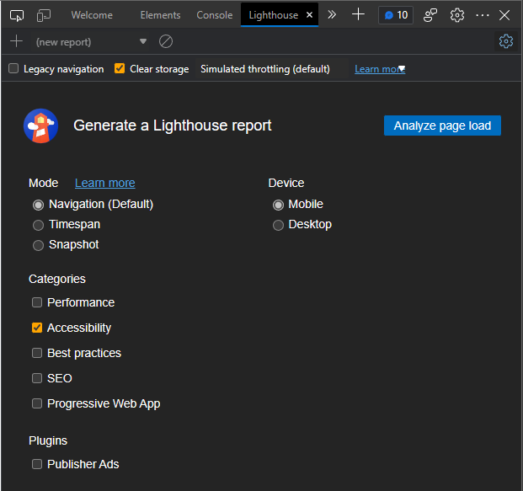
Tools and resources Built-In to Browsers
Notes:
Lighthouse is built into Chromium based browsers like Google Chrome and Microsoft Edge. It allows you to check Accessibility, SEO, and performance impacting elements of a page.
Firefox has similar options, but they are separated out into individual scanners, rather than under one option.
The rendering options are also built into Chromium browsers. They allow you to get an idea for how some disabilities may view your page and see how various custom CSS options may impact your site appearance and behavior.

Slide 10
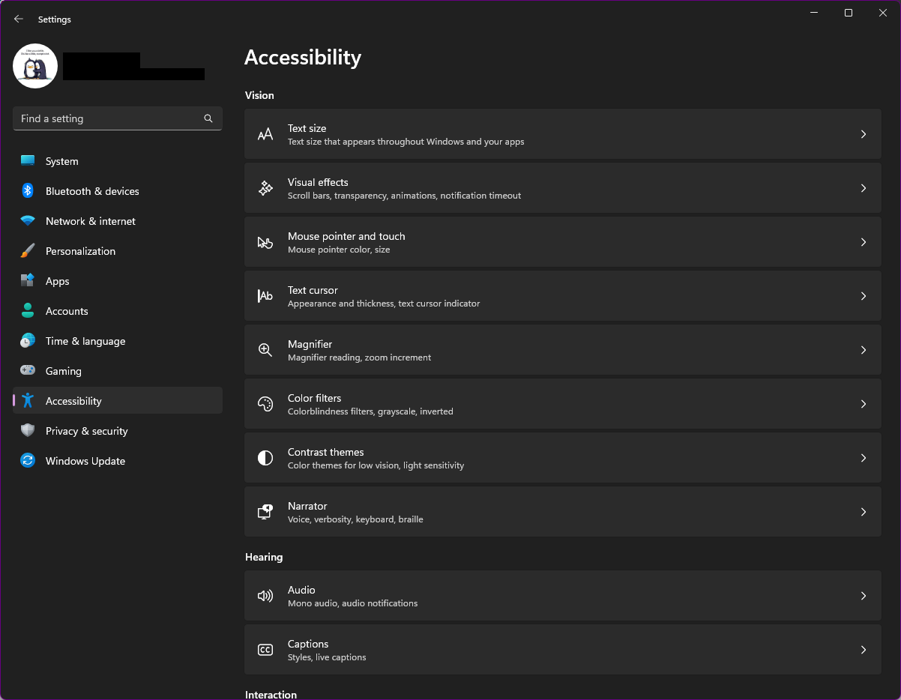
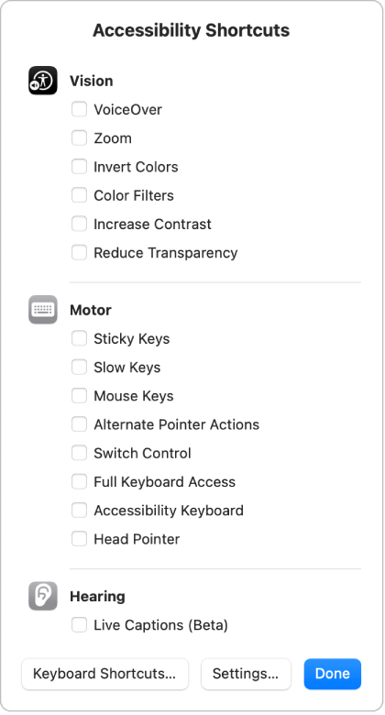
Tools and resources Built-In to Operating System
Notes:
Microsoft and MacOS have a variety of built in accessibility options that help you zoom, have narration, use color filters and more to make a system more accessible based on your needs or test for accessibility in your content.
Additionally, there are keyboard shortcuts that help you turn accessibility features on/off quickly as needed.

Slide 11
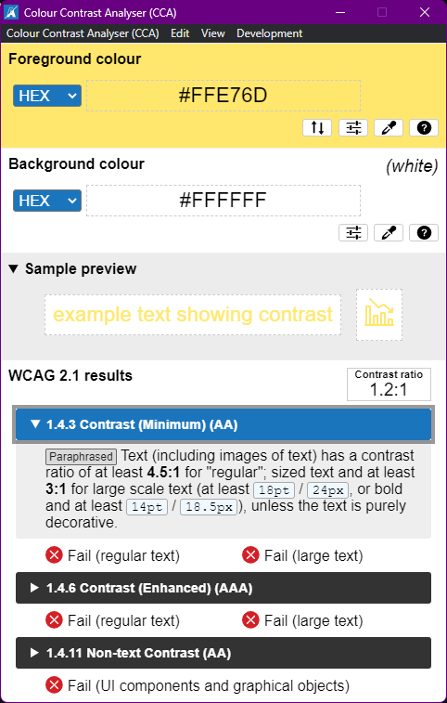
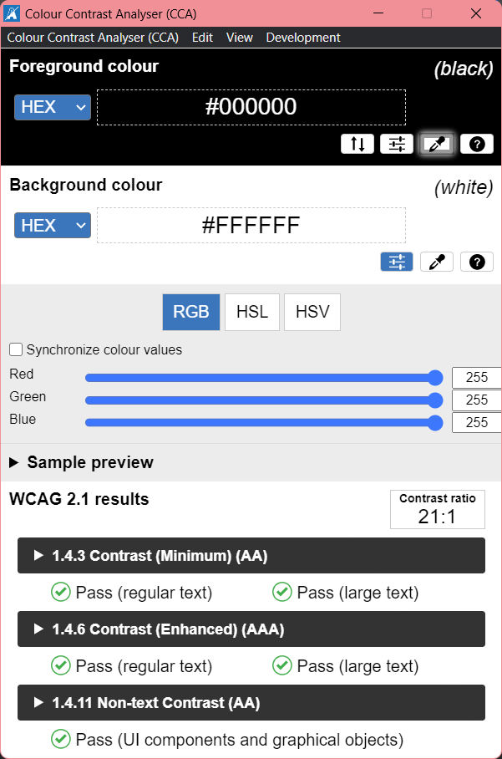
Tools and resources CCA by TPGi
Notes:
Color Contrast Analyzer by TPGi - https://www.tpgi.com/color-contrast-checker/

Slide 12
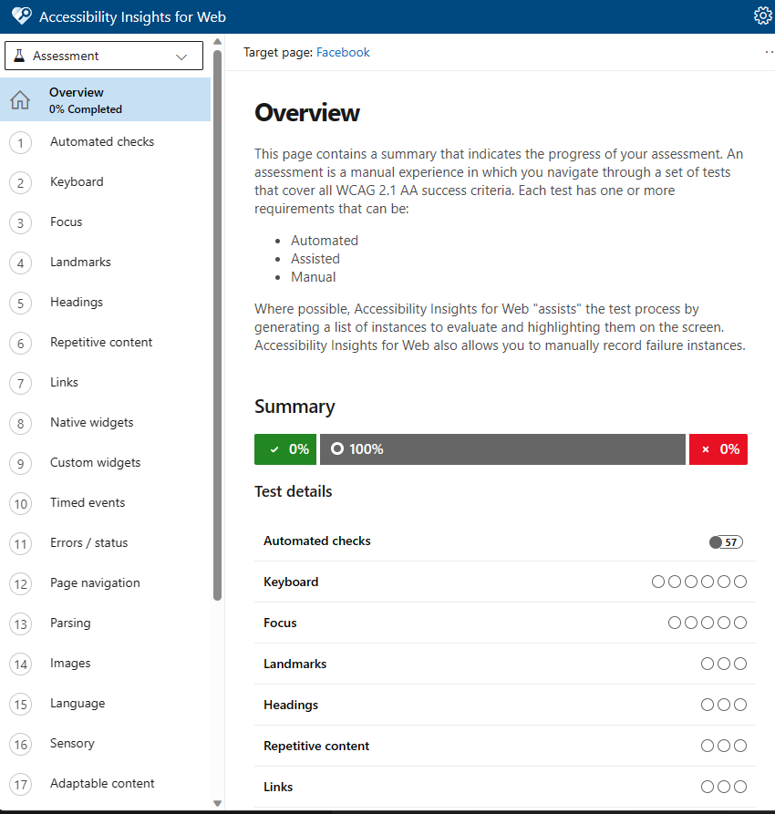
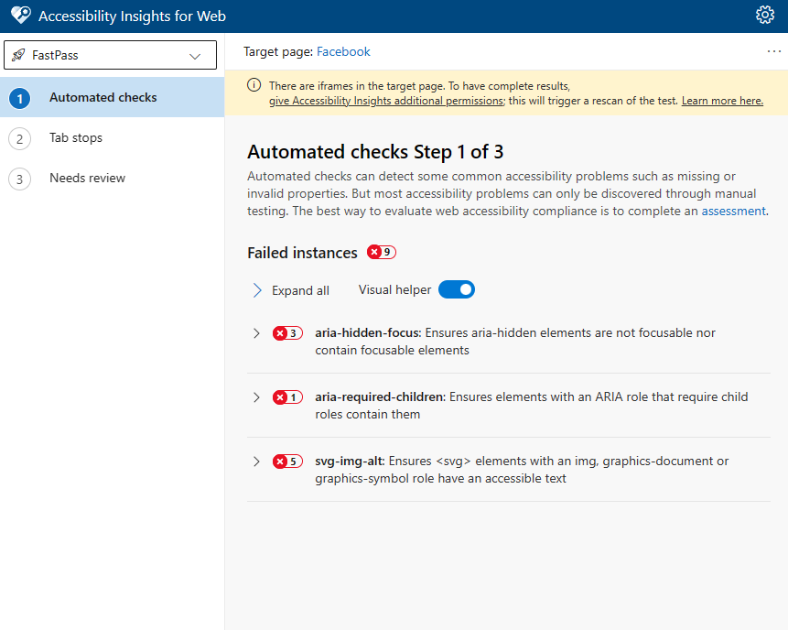
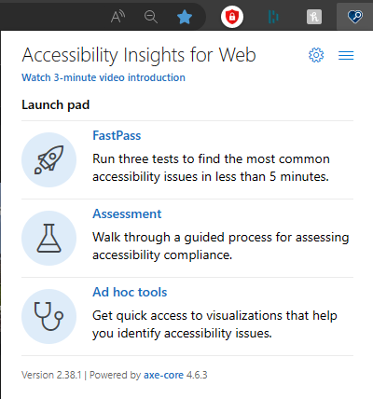
Tools and resources Microsoft Accessibility Insights
Notes:
Technically the screenshots I have here are of the browser extension version of Accessibility Insights, but it also has 2 Desktop applications, one for testing Windows applications and websites and one for testing Android apps. It is built on Axe Core. Axe DevTools provides a similar browser extension as well.

Slide 13
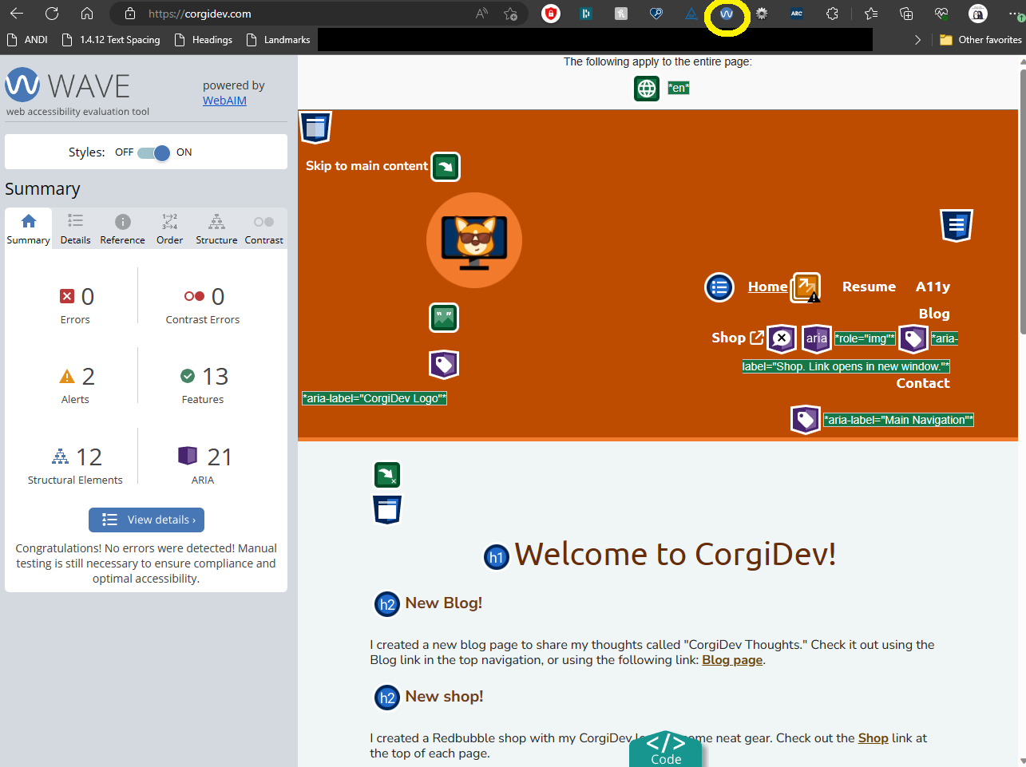
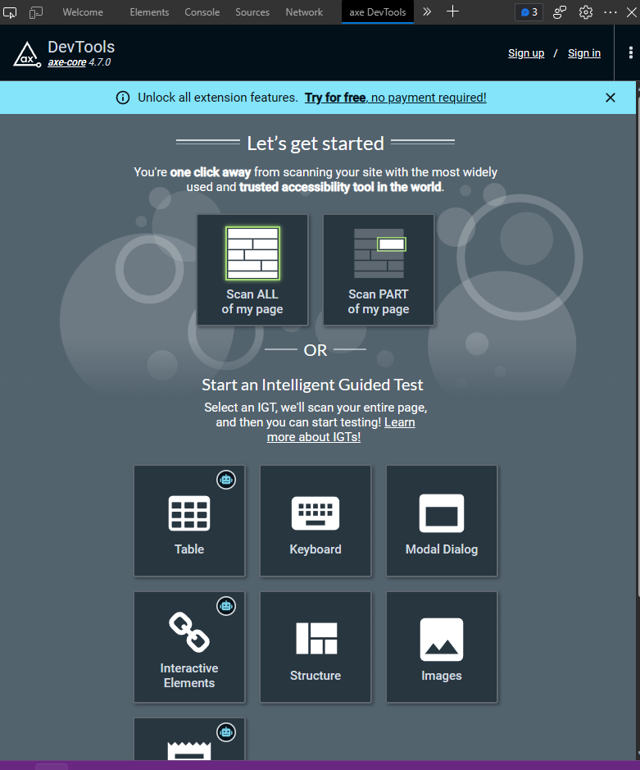
Tools and resources Browser Extensions & Web Apps
Notes:
Web Accessibility Evaluation Extensions, API, and web app - https://wave.webaim.org/
Axe DevTools (Can use forever for free. Pro just offers some extra testing features.) - https://www.deque.com/axe-devtools-accessibility-testing/

Slide 14
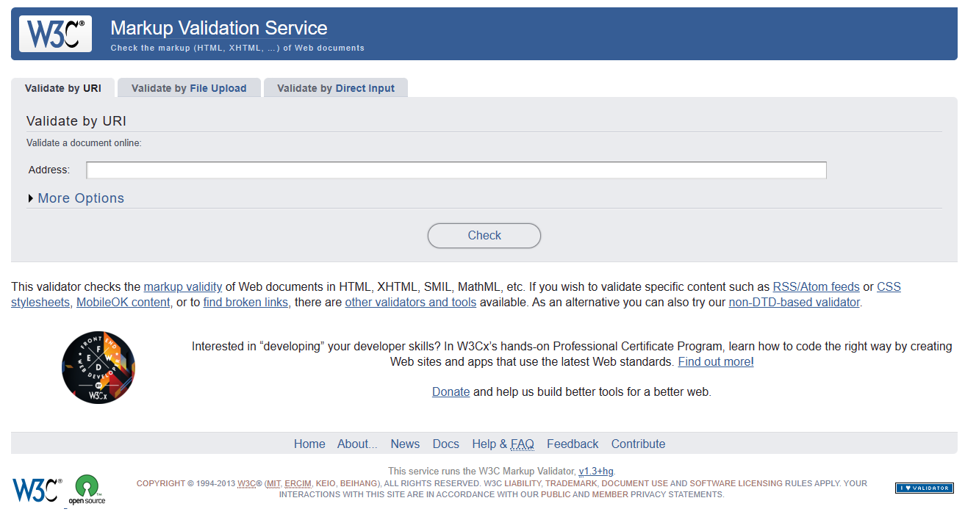
Tools and resources Browser Extensions & Web Apps
Notes:
The W3C Markup Validation Service - https://validator.w3.org/

Slide 15
Tools and resources Bookmarklets
Find Landmarks on Web Page with A11Y Bookmarklet | HolisticA11Y
Forms Bookmarklet for Accessibility Testing (pauljadam.com)
ARIA Bookmarklet for Accessibility Testing (pauljadam.com)
Text spacing bookmarklet - Bookmarklets (dylanb.github.io)
Assorted Accessibility Bookmarklets for Landmarks, Headings, and more: Accessibility Bookmarklets (accessibility-bookmarklets.org)
ANDI - Accessibility Testing Tool - Install (ssa.gov)

Slide 16
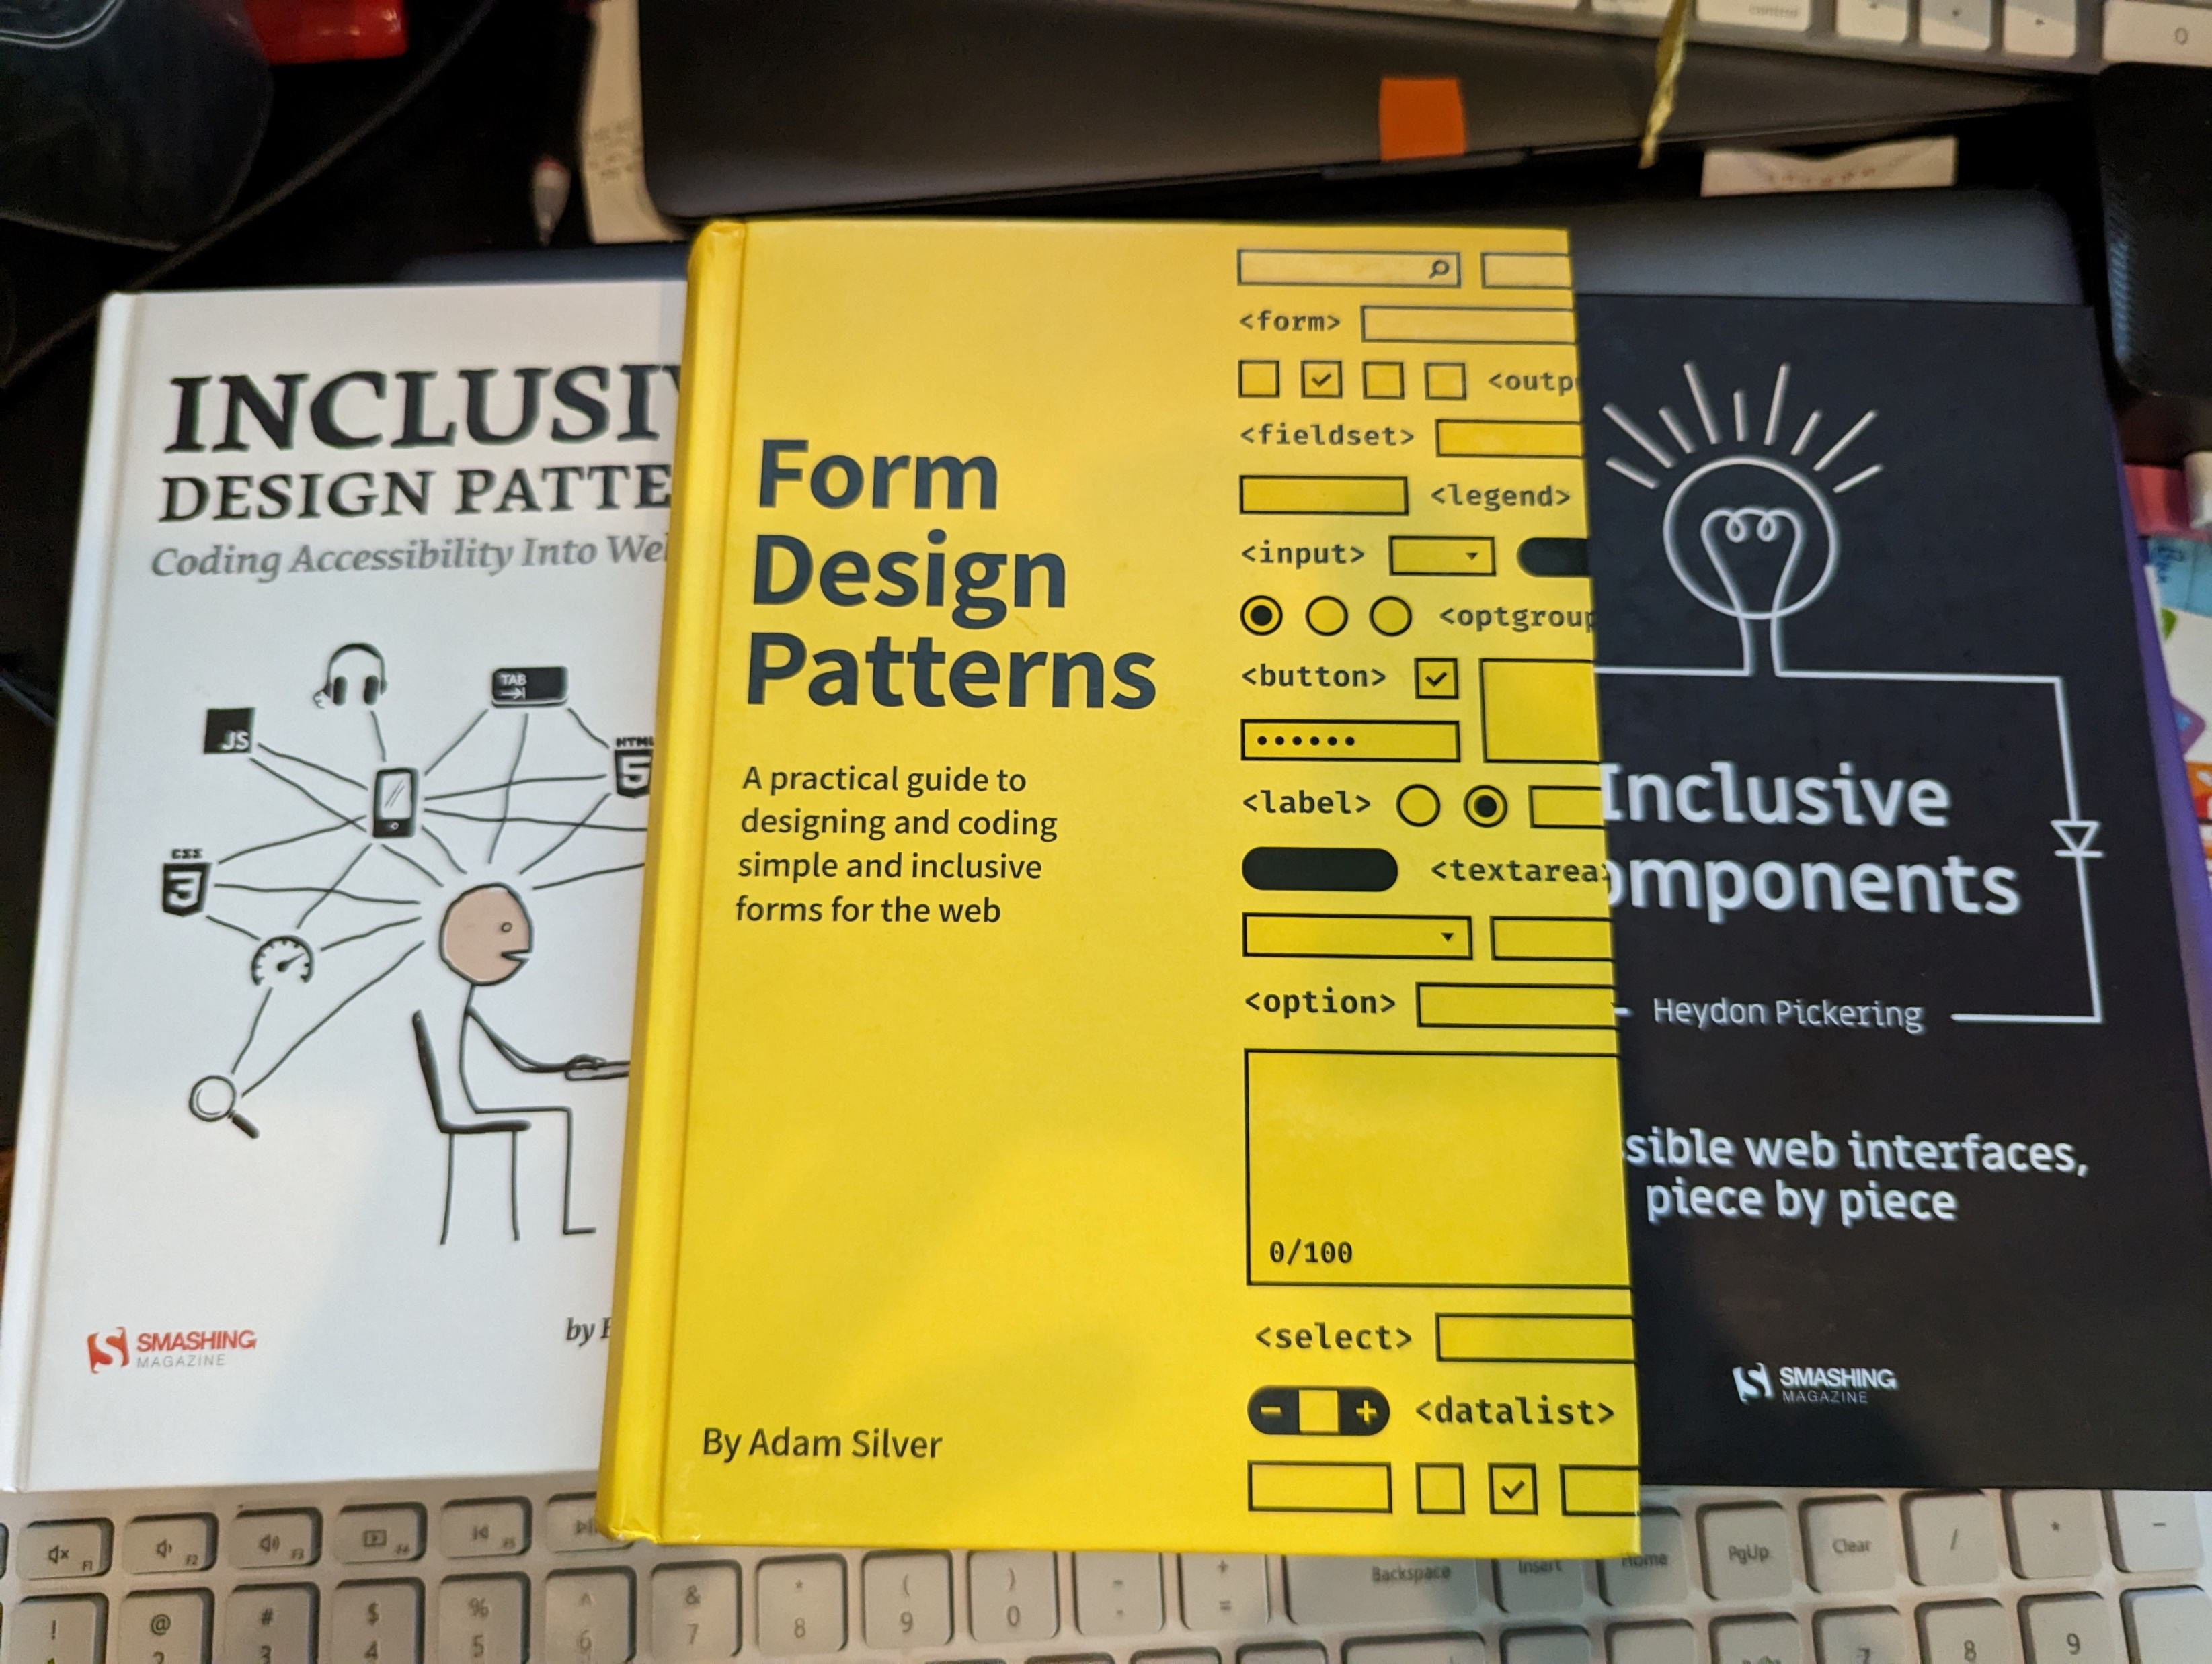
Tools and resources Books (Physical and Ebook)

Slide 17
Tools and resources Additional Resources
Accessibility Insights – Accessibility testing tool made by Microsoft
Has browser extension and desktop application versions
Also have the option to include the automated tests in CI/CD
DON’T depend on automated tests
NVDA – free, open-sourced screen reader
View keyboard shortcuts on at the Deque article entitled: NVDA Keyboard Shortcuts.
Narrator – screen reader built-in to Windows.
View keyboard shortcuts for Narrator in the Deque article entitled Narrator Keyboard Shortcuts.
VoiceOver – is a built screen reader found on iOS and MacOS devices.
TalkBack – is a built screen reader found on iOS and MacOS devices.
Microsoft Accessibility on Twitter at @MSFTEnable and at on the Microsoft Accessibility page.
Microsoft Accessibility Fundamentals course
ANDI – Bookmark applet developed by the Social Security Administration to aid in Accessibility testing.
Accessibility - Erissa Duvall (corgidev.com)

Slide 18

Thank You!
https://corgidev.com
https://github.com/CorgiDev/A11y-Materials - Under Presentations/2023 Presentations

