Slide 1

Object Oriented Programming
Travis Faas, N320
IUPUI

Slide 2
Overview
Making an object in JavaScript (review)
Principles of object-oriented programming (OOP)
Types of relations
Getting objects to talk
Diagramming interactions

Slide 3
Making an object in JavaScript
class Opinion {
constructor() {
this.type = "An";
}
method() {
this.type = "Validated";
}
}

Slide 4
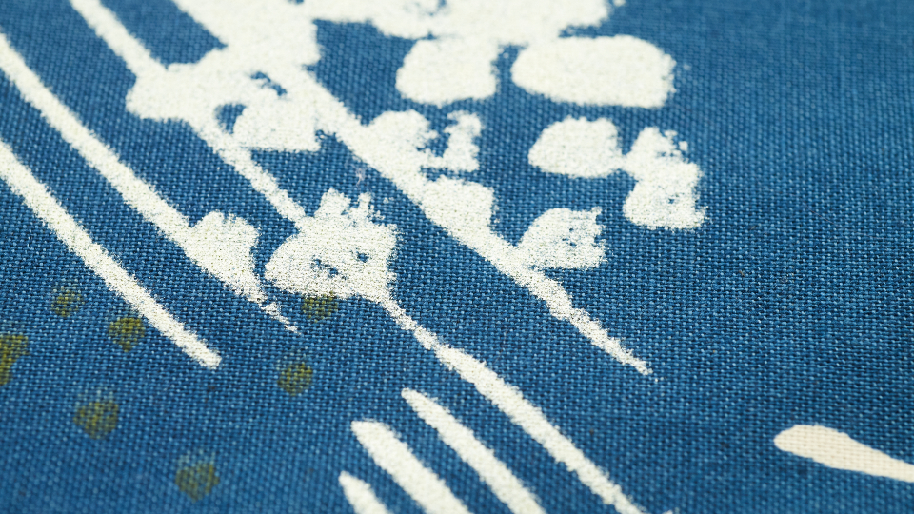
Object-Oriented Programming Principles

Slide 5
Four Principles of OOP
Abstraction
Encapsulation
Inheritance
Polymorphism

Slide 6
Inheritance
The ability to base a class off another class, and inherit all its methods and properties
Clarinet comes from Woodwind – has all the methods and properties of Woodwind, plus whatever the developer adds

Slide 7
Inheritance Example
class FullNote extends Note {
constructor(pitch) {
super(pitch, 1);
}
}
class HalfNote extends Note {
constructor(pitch) {
super(pitch, .5);
}
}
class Note {
constructor(pitch, duration) {
this.pitch = pitch;
this.duration = duration;
}
}
“Fun” things:
What code and structure would be needed to create and store these notes?
What METHOD is missing from “note”?
… Do you think you could implement this with Tone.js to make something fun?

Slide 8
Abstraction
Hide complexity from the user (other programmers)
Only relevant information should be available
“It should just work”
No need to know the details
A vector class with methods for angle and magnitude
Programmer doesn’t need to know HOW they work, just that they do

Slide 9
Abstraction Example
class Vector {
constructor(x,y) {
this.x = x;
this.y = y;
}
magnitude() {
return Math.sqrt(x*x + y*y);
}
}
let velo = new Vector(10, 5);
let speed = velo.magnitude();
- Don’t need to know HOW magnitude was implemented, just that it works.

Slide 10
Encapsulation
Protect data that should not be used outside the class
Ensures data is modified in a way that won’t break the class
Done using getter/setter methods and privacy modifiers
Used less in the JavaScript world, often enforced only through documentation

Slide 11
Encapsulation Example
class Engine {
constructor() {
this.oil = 10;
}
setOil(newOilAmount) {
if(newOilAmount >= 0) {
this.oil = newOilAmount
} else {
console.error("Cannot set negative oil");
}
}
getOil() {
return this.oil();
}
}

Slide 12
Polymorphism
Many classes can operate in a similar way
Dog, Cat both come from animal
Thus they both have the Breath() method

Slide 13
Polymorphism Example
class Book {
constructor(pages) {
this.pages = pages;
}
read() {
console.log("You just read " + this.pages + "pages!");
}
}
class Novel extends Book {
constructor() {
super(300);
}
}
class Comic extends Book {
constructor() {
super(16);
}
}
let books = [];
books[0] = new Comic();
books[1] = new Novel();
books.forEach((book) => {
book.read();
})

Slide 14

Types of Relations

Slide 15
Association
Two different classes interact
Boat (class) can float on Water (class)
Food feeds Animal
Person orders from Barista
One needs to know about the other, to be able to call a method or change a variable

Slide 16
Association Example
class Dog {
constructor(name) {
this.name = name;
}
play(ball) {
ball.catch(this);
}
}
class Ball {
catch(dog) {
console.log(dog.name + ' caught a ball!');
}
}
let dog = new Dog("Difo");
let ball = new Ball();
dog.play(ball);

Slide 17
Aggregation
One-way relationship, not required
“Has-a”
Pen has a Holder
Bark has a Dog
Deck has many Cards

Slide 18
Aggregation Example
class Flag {
flutter() {
var height = 0;
if(this.poll != null) {
height = this.pole.height;
}
console.log("Flag flutters " + height + " feet off the ground!");
}
}
class Pole {
constructor(height) {
this.height = height;
}
}
var f = new Flag();
var aPole = new Pole(32);
f.pole = aPole;
f.flutter();

Slide 19
Composition
One-way relationship, required to function
Human has a Heart
Earth has an Atmosphere
Often Classes are composed of many, smaller classes
Car has: Wheels, engine, body, driver, lights
Fishing rod has: Pole, reel, wire

Slide 20
Composition Example
class Line {
constructor(p1, p2) {
this.p1 = p1;
this.p2 = p2;
}
draw() {
line(p1.x, p1.x, p2.x, p2.y);
}
}
class Point {
constructor(x, y) {
this.x = x;
this.y = y;
}
}
let pointA = new Point(10, 50);
let pointB = new Point(5, 40);
let myLine = new Line(pointA, pointB);
myLine.draw();

Slide 21
Management
A class orchestrates interaction amongst many, other classes
Shift clock at work – puts several workers “on shift”, clocks others out, and marks which are not in attendance

Slide 22

Linking Objects Together

Slide 23
Linking tactics
Invoking another object’s method
Exposing a callback method
(Events)
Asking a parent object to relay a message

Slide 24
Invoking other object’s method
class Water {
constructor() {
this.amount = 100;
}
drain() {
this.amount --;
}
}
class Cloud {
constructor(water) {
this.water = water;
this.size = 10;
}
grow() {
water.drain();
this.size ++;
}
}
let someWater = new Water();
let someCloud = new Cloud(someWater);
someCloud.grow();

Slide 25
Exposing a callback method
class Firework {
constructor() {
this.fuse = 12;
}
burnFuse() {
this.fuse--;
if( this.fuse <= 0) {
this.activatedCallback();
}
} }
class Crowd {
constructor(fireworkInstance) {
fireworkInstance. activatedCallback = this.marvel;
}
marvel() {
console.log("Oooh, and, aaahh");
}
}

Slide 26
Passing through a higher object
class Employee {
constructor(emManager) {
this.manager = emManager;
}
quit() {
this.manager.employeeQuit();
}
}
class Manager {
constructor(em1, em2) {
this.em1 = em1;
this.em2 = em2;
}
employeeQuit() {
em1.moveOut();
em2.hire();
}
}

Slide 27

Diagramming Interactions

Slide 28
See other slide deck for now.

