Slide 1
Image Encryption & Decryption System
SECURING DATA HIDING IN IMAGE USING STEGANOGRAPHY
Presented By: Manish Singh
Student Name : Manish Sigh
College Name & Department : Pdm University(CSE)

Slide 2
OUTLINE
Problem Statement
Technology used
Wow factor
End users
Result
Conclusion
Git-hub Link
Future scope

Slide 3
Problem Statement
In the digital era, secure image-based communication is crucial to prevent unauthorized access. This project provides a method to embed secret messages within images and retrieve them securely using encryption and decryption techniques.

Slide 4
Technology used
Programming Language: Python, HTML, CSS, JavaScript
Framework: Flask
Libraries: OpenCV, NumPy
Tools: Jinja2, Werkzeug

Slide 5
Wow factors
Secure image steganography with password protection
Lightweight and easy-to-use web-based encryption and decryption
Efficient use of OpenCV for pixel-based data encoding

Slide 6
End users
Individuals seeking secure message transmission
Organizations requiring confidential image-based data sharing
Cybersecurity enthusiasts & researchers

Slide 7
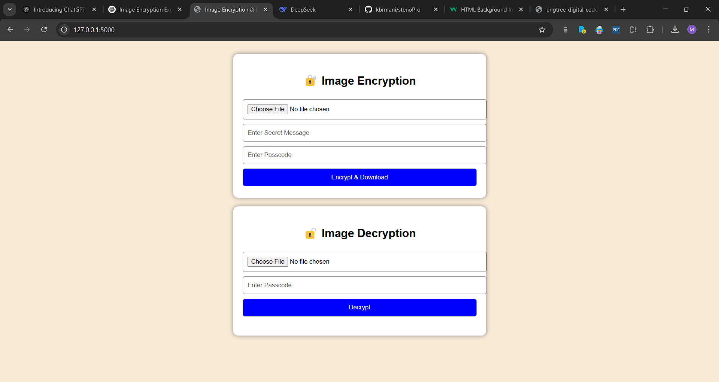
Result

Slide 8
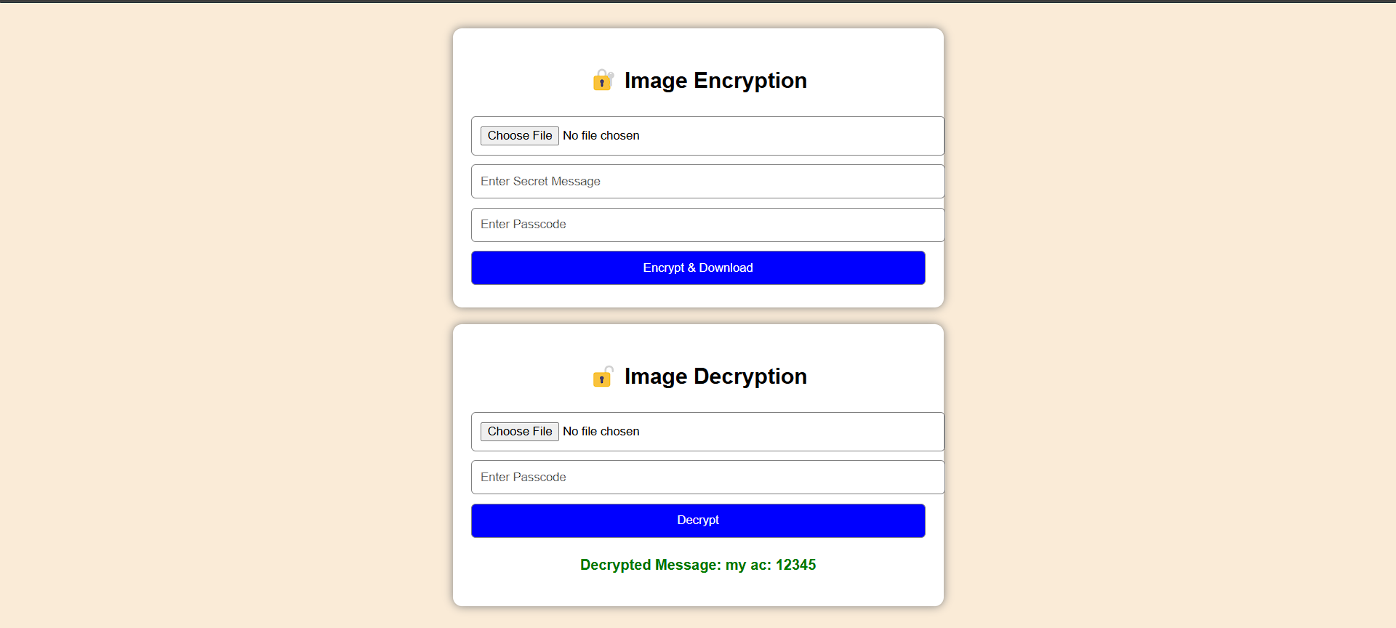

Slide 9


Slide 10
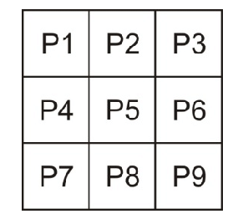
Nomal picture before encryption

Slide 11

After Encryption

Slide 12
Conclusion
This project provides a reliable and user-friendly approach to securely embedding and extracting hidden messages in images, ensuring confidentiality in communication. The combination of Flask and OpenCV enhances its usability for real-world applications.

Slide 13
GitHub Link
https://github.com/kbrmani/stenoPro

Slide 14
Future scope(optional)
Advanced encryption techniques like AES
AI-based image recognition for added security
Mobile app integration for easy accessibility

Slide 15
THANK YOU

