Slide 1
Vector Graphics
Introduction to Illustrator
Fall 2020
Kyle Broaders

Slide 2
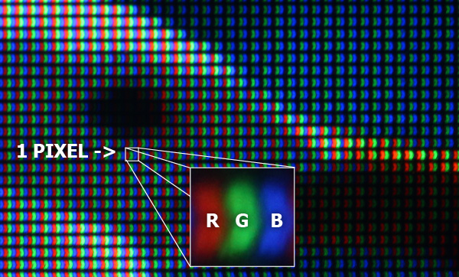
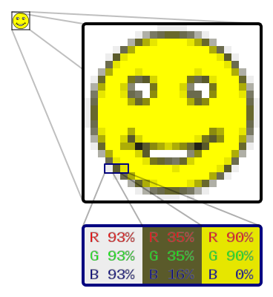
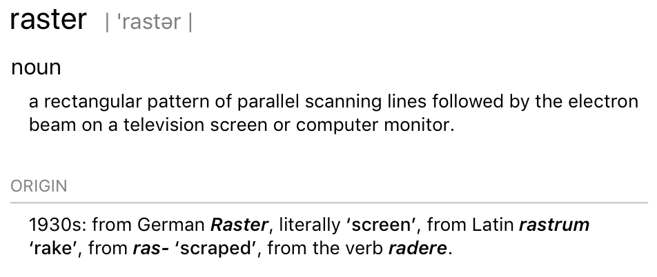
Storing image data
Most computer graphics are stored as a list of pixel intensities
Called Raster or Bitmap images
All computer displays work by showing us rasterized
https://apenasimagens.com/en/pixel-anatomy/
https://en.wikipedia.org/wiki/Raster_graphics

Slide 3
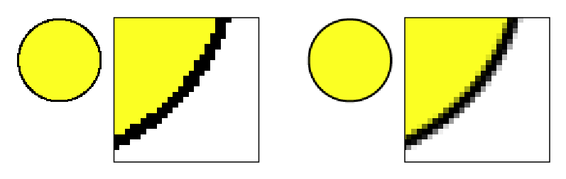
Pros and Cons of Raster images
Pro
Intuitive for people
Fast for computers
Good for images with lots of variation (like photos)
Con
(Anti-)Aliasing can make edges look ugly or soft
Usually lossy compression (degrades with repeated saves)
Resizing can introduce artifacts
https://rwillustrator.blogspot.com/2010/08/when-pixels-snap-antialiasing-in.html

Slide 4
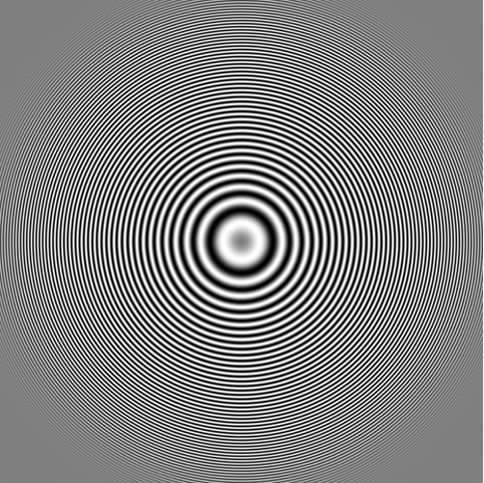
Resizing artifacts
https://blogs.mathworks.com/steve/files/antialiasing_2_01.png

Slide 5
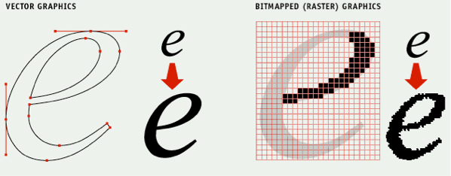
Vector graphics
Instead of pixel values, store all information as points and paths that go between them.
Draw lines and shapes as dictated by math
https://signalizenj.files.wordpress.com/2015/01/vector_raster.gif

Slide 6
Pros and Cons of Vector images
Pro
Infinite resizing
Perfect edges
Easy to adjust image contents
Con
Harder on computers
Not practical for complex images like photos
Has a steeper learning curve

Slide 7
Illustrator overview

Slide 8
For next class…
Add a few lines of text, links, or images to the class wiki on image formats
Complete the “Untangle a bad figure in Illustrator” assignment

