Slide 1
Data Carpentry Day 2 Checklist
Make sure to grab coffee! You might want it ☺
Copy down my contact info if you anticipate having R questions--I am happy to offer R consulting/help.
Make sure you have a copy of the R CHEAT SHEET and DPLYR EXERCISES handouts.
Please add an R/ folder to your DataCarpentry folder!
Please make sure you have R AND RStudio installed! If you are unsure if you have them, please ask Alex for help. Also, go ahead and open RStudio--that is what we will use today (not “Basic” R).
Go ahead and install the dplyr package for R--ask helpers for help!
Note: Today’s morning lessons differ somewhat from those found online.

Slide 2
Data Carpentry
Day 2

Slide 3
Spreadsheets
Make it a rectangle
Rows = observations, columns = variables
One head row; avoid spaces
One data type per cell
Fill in all cells
Consistently code missing values
Care about date data
Don’t do calculations in raw data files
Save as CSV files
Don’t use font color or highlighting to code data

Slide 4
OpenRefine
For cleaning and exploration of data
NOT for editing your raw data!
Use Facets and filters to explore
Split columns
Remove training/ending text
Find outliers
All actions are reproducible

Slide 5
SQL
SELECT (choose columns)
FROM (data sheet(s))
WHERE (subset specific observations)
AND/OR/IN (used in setting criteria)
ORDER BY (sort data)
GROUP BY (lump data into groups)
COUNT & SUM (summarization)
JOIN ON (combining data)

Slide 6
dplyr
R function SQL Keyword
select SELECT
filter WHERE
mutate (weight/1000)
group_by GROUP BY
summarize COUNT, AVG, SUM
arrange ORDER BY

Slide 7
“File organization and naming are powerful weapons against chaos.”
-Jenny Bryan

Slide 8
“Your closest collaborator is you from six months ago, but you don’t reply to emails.”
-(Paraphrasing) Mark Holder
Have sympathy for your future self--be an organized analyst!

Slide 9
Organizing projects
All files in common folder (directory)
Separate raw data from “clean” data
Separate code (and output) from data
Use file names that are meaningful, sortable, & consistent
Code dates: 2018-01-08
raw_data/
clean_data/
SQL/
R/

Slide 10
Today: R!
Full programming language
Focused on programming and data
Super for data analysis and visualization
Great community of supporters
R Archive has >9000 add-on packages
RStudio: “Integrated Development Environment” (IDE) for R

Slide 11
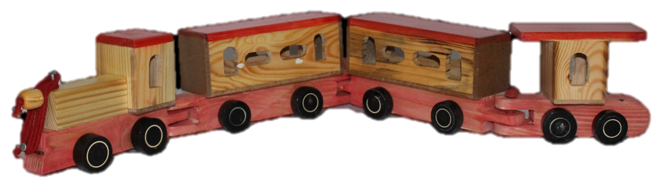
R Functions and inputs
log(x, base)
log(3, 5) = 0.683
log(5, 3) = 1.465
log(3, 5) = 0.683
log(base = 5, x = 3) = 0.683
x often = “data”
x
base
log
Arguments

Slide 12
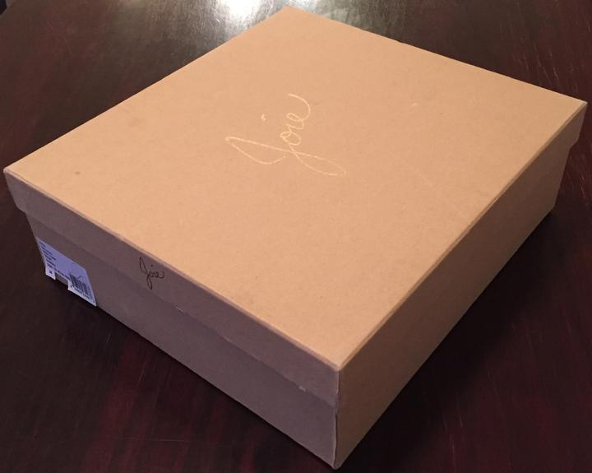
R Objects
NAME
Create object
Use name
Stuff
Stuff

Slide 13
Challenge
What would y equal after these three lines of code were executed (try to answer without running them first!)? Why? How would you make it equal something else?
x <- 50
y <- x * 2
x <- 75

Slide 14
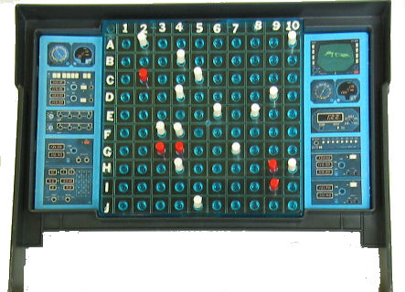
Indexing
surveys

Slide 15
Challenge
Use the nrow() function + indexing to save just the last row of surveys into a new object called surveys_last

Slide 16
Challenge
Work with your table mates to return the values in the first 4 rows of surveys but only from the 3rd, 5th, and 8th columns. (Hint: Use c() for that second part!).

Slide 17
Pipe Operator: %>%
Function on
the right
(as input #1)
Products on
the left…
%>%
Get “pumped” into the…
You can string multiple operations together!

