Slide 1
Experimental design and sample size determination
Karl W Broman
Department of Biostatistics
Johns Hopkins University
http://www.biostat.jhsph.edu/~kbroman

Slide 2
Note
This is a shortened version of a lecture which is part of a web-based course on “Enhancing Humane Science/Improving Animal Research” (organized by Alan Goldberg, Johns Hopkins Center for Alternatives to Animal Testing)
Few details—mostly concepts.

Slide 3
Experimental design

Slide 4
Basic principles
Formulate question/goal in advance
Comparison/control
Replication
Randomization
Stratification (aka blocking)
Factorial experiments

Slide 5
Example
Question: Does salted drinking water affect blood pressure (BP) in mice?
Experiment:
  Provide a mouse with water containing 1% NaCl.
  Wait 14 days.
  Measure BP.

Slide 6
Comparison/control
Good experiments are comparative.
  Compare BP in mice fed salt water to BP in mice fed plain water.
  Compare BP in strain A mice fed salt water to BP in strain B mice fed salt water.
Ideally, the experimental group is compared to concurrent controls (rather than to historical controls).

Slide 7
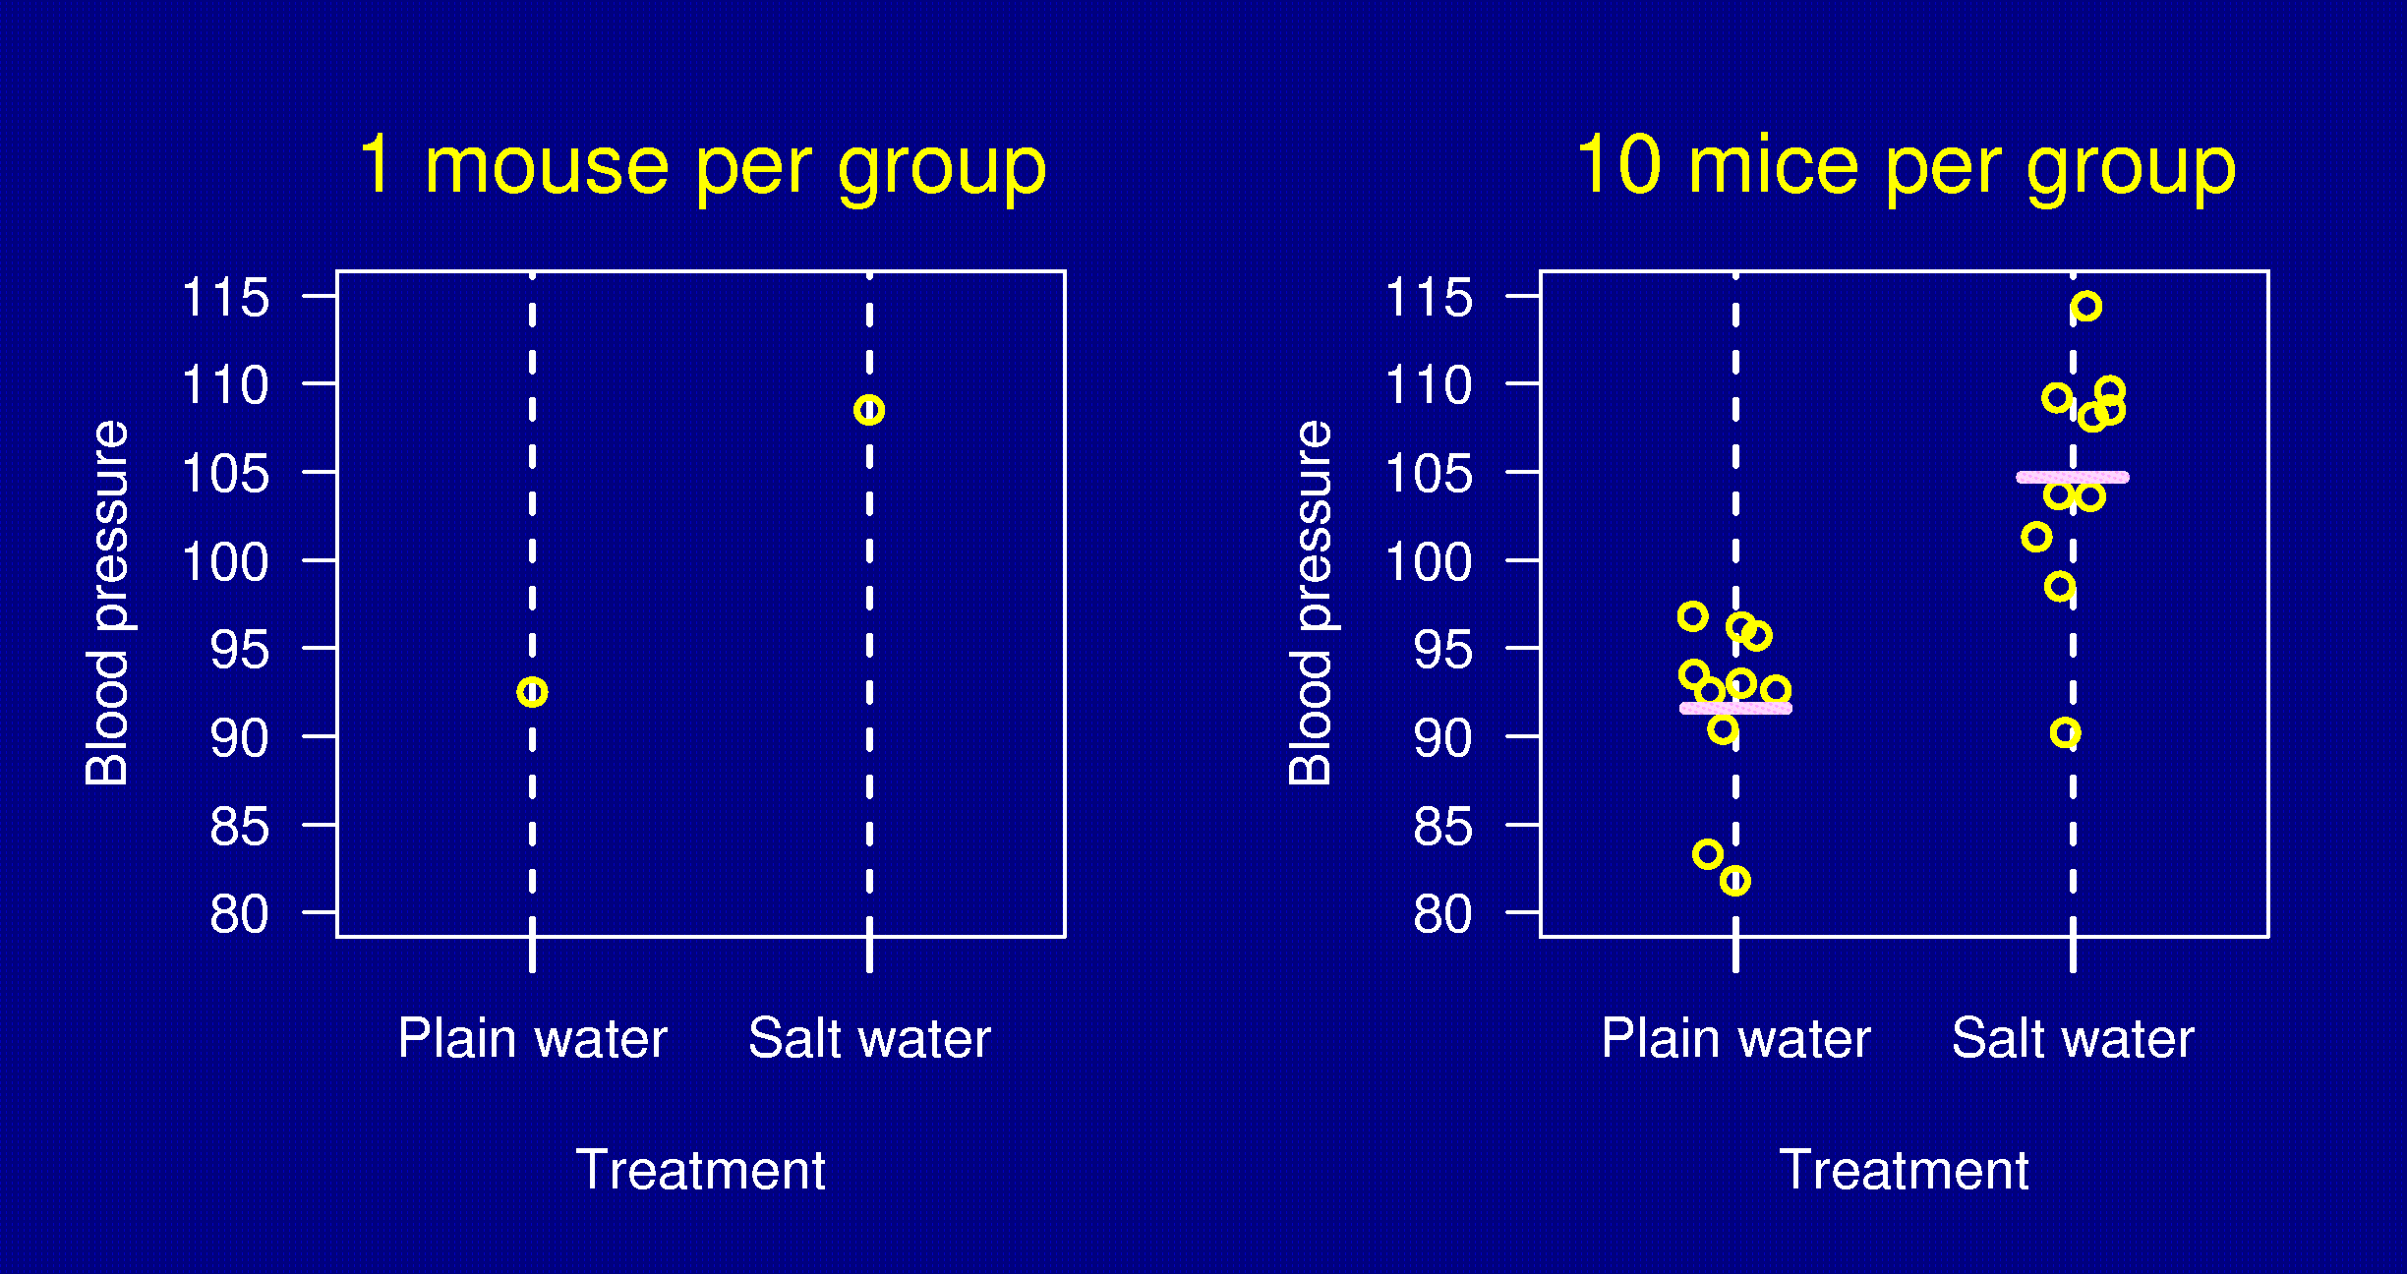
Replication

Slide 8
Why replicate?
Reduce the effect of uncontrolled variation (i.e., increase precision).
Quantify uncertainty.
A related point:
An estimate is of no value without some statement of the uncertainty in the estimate.

Slide 9
Randomization
Experimental subjects (“units”) should be assigned to treatment groups at random.
At random does not mean haphazardly.
One needs to explicitly randomize using
  A computer, or
  Coins, dice or cards.

Slide 10
Why randomize?
Avoid bias.
  For example: the first six mice you grab may have intrinsicly higher BP.
Control the role of chance.
  Randomization allows the later use of probability theory, and so gives a solid foundation for statistical analysis.

Slide 11
Stratification
Suppose that some BP measurements will be made in the morning and some in the afternoon.
If you anticipate a difference between morning and afternoon measurements:
  Ensure that within each period, there are equal numbers of subjects in each treatment group.
  Take account of the difference between periods in your analysis.
This is sometimes called “blocking”.

Slide 12
Example
20 male mice and 20 female mice.
Half to be treated; the other half left untreated.
Can only work with 4 mice per day.
Question: How to assign individuals to treatment
groups and to days?

Slide 13
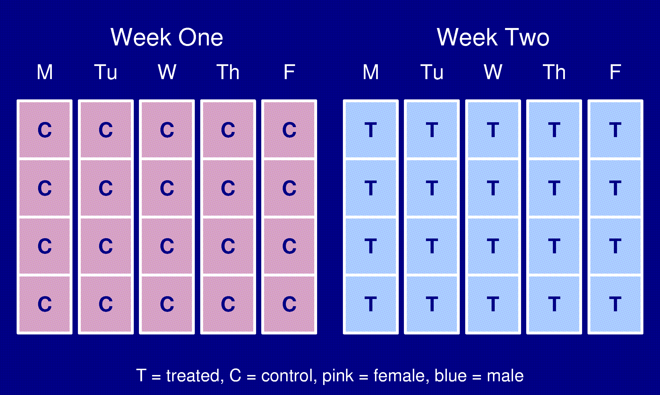
An extremely bad design

Slide 14
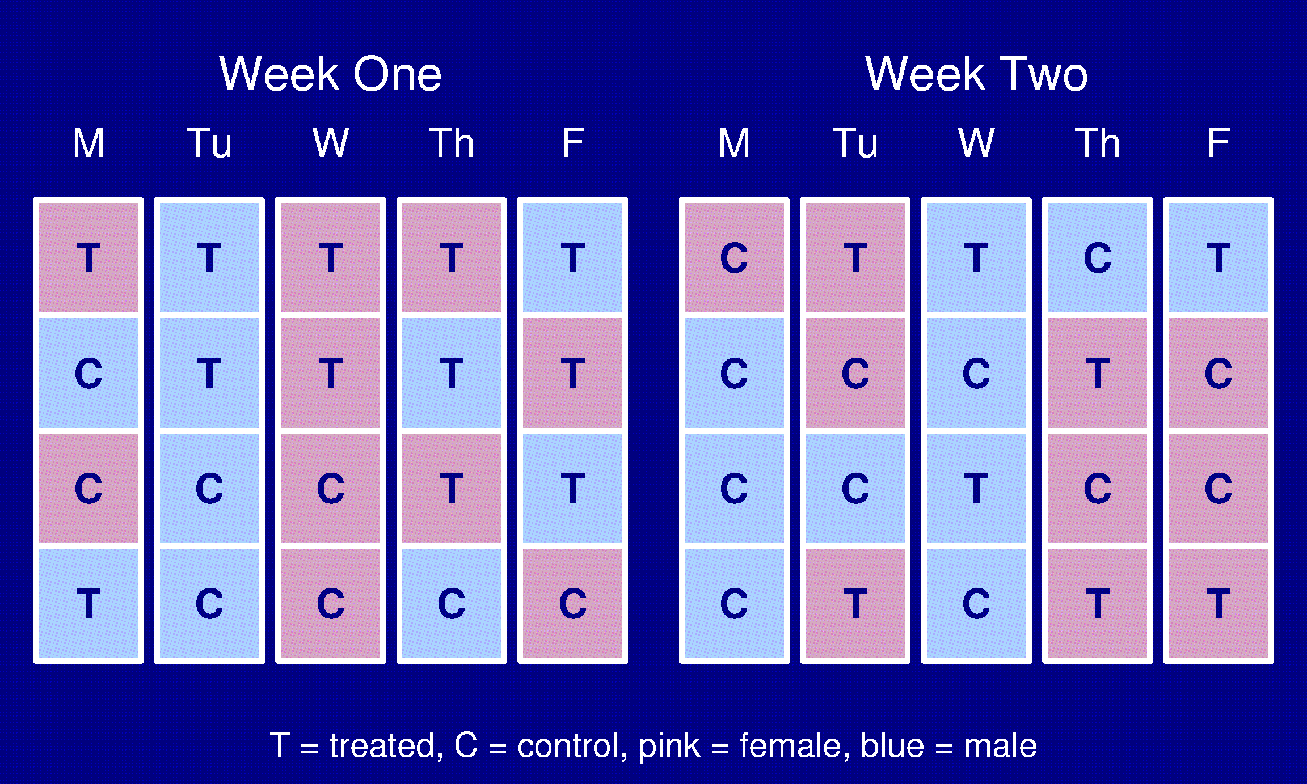
Randomized

Slide 15
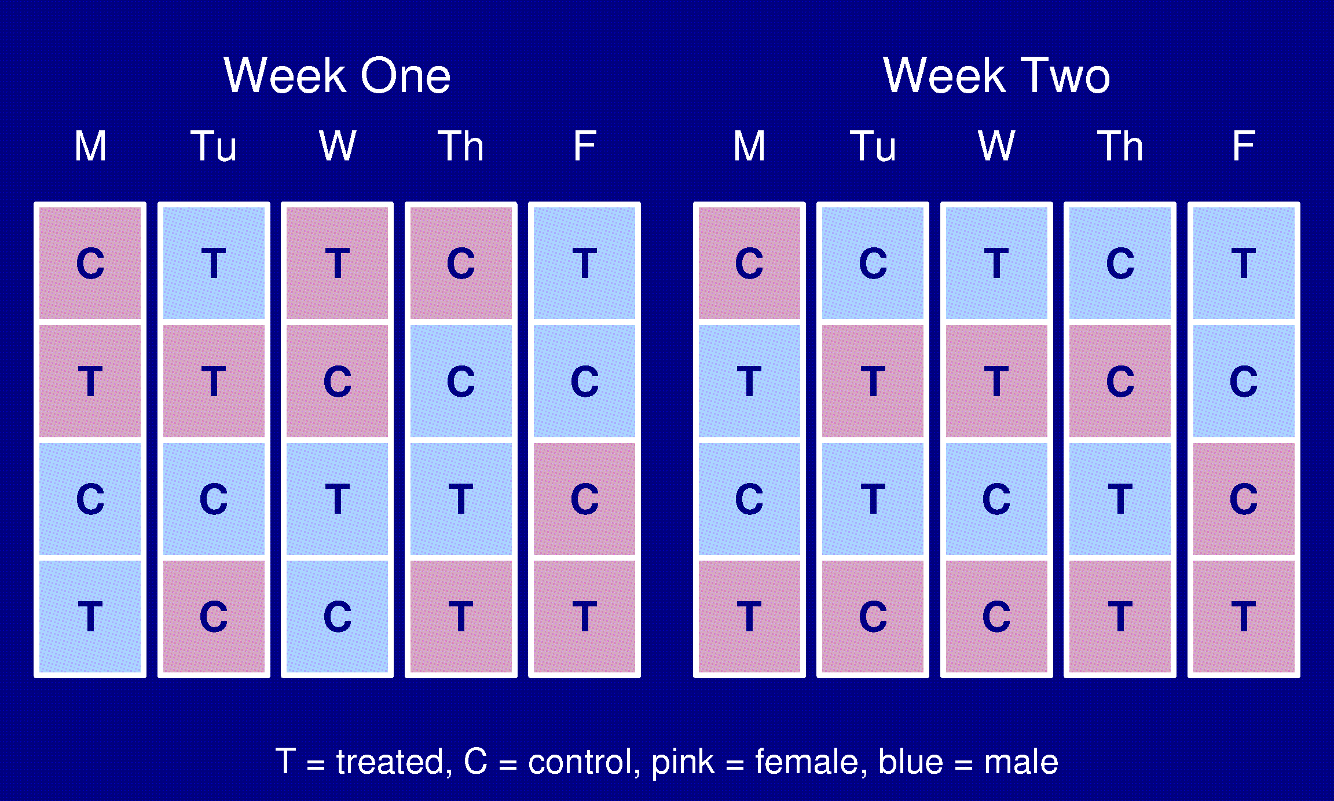
A stratified design

Slide 16
Randomization and stratification
If you can (and want to), fix a variable.
  e.g., use only 8 week old male mice from a single strain.
If you don’t fix a variable, stratify it.
  e.g., use both 8 week and 12 week old male mice, and stratify with respect to age.
If you can neither fix nor stratify a variable, randomize it.

Slide 17
Factorial experiments
Suppose we are interested in the effect of both salt water and a high-fat diet on blood pressure.
Ideally: look at all 4 treatments in one experiment.
Plain water Normal diet
Salt water High-fat diet
Why?
  We can learn more.
  More efficient than doing all single-factor experiments.
×

Slide 18
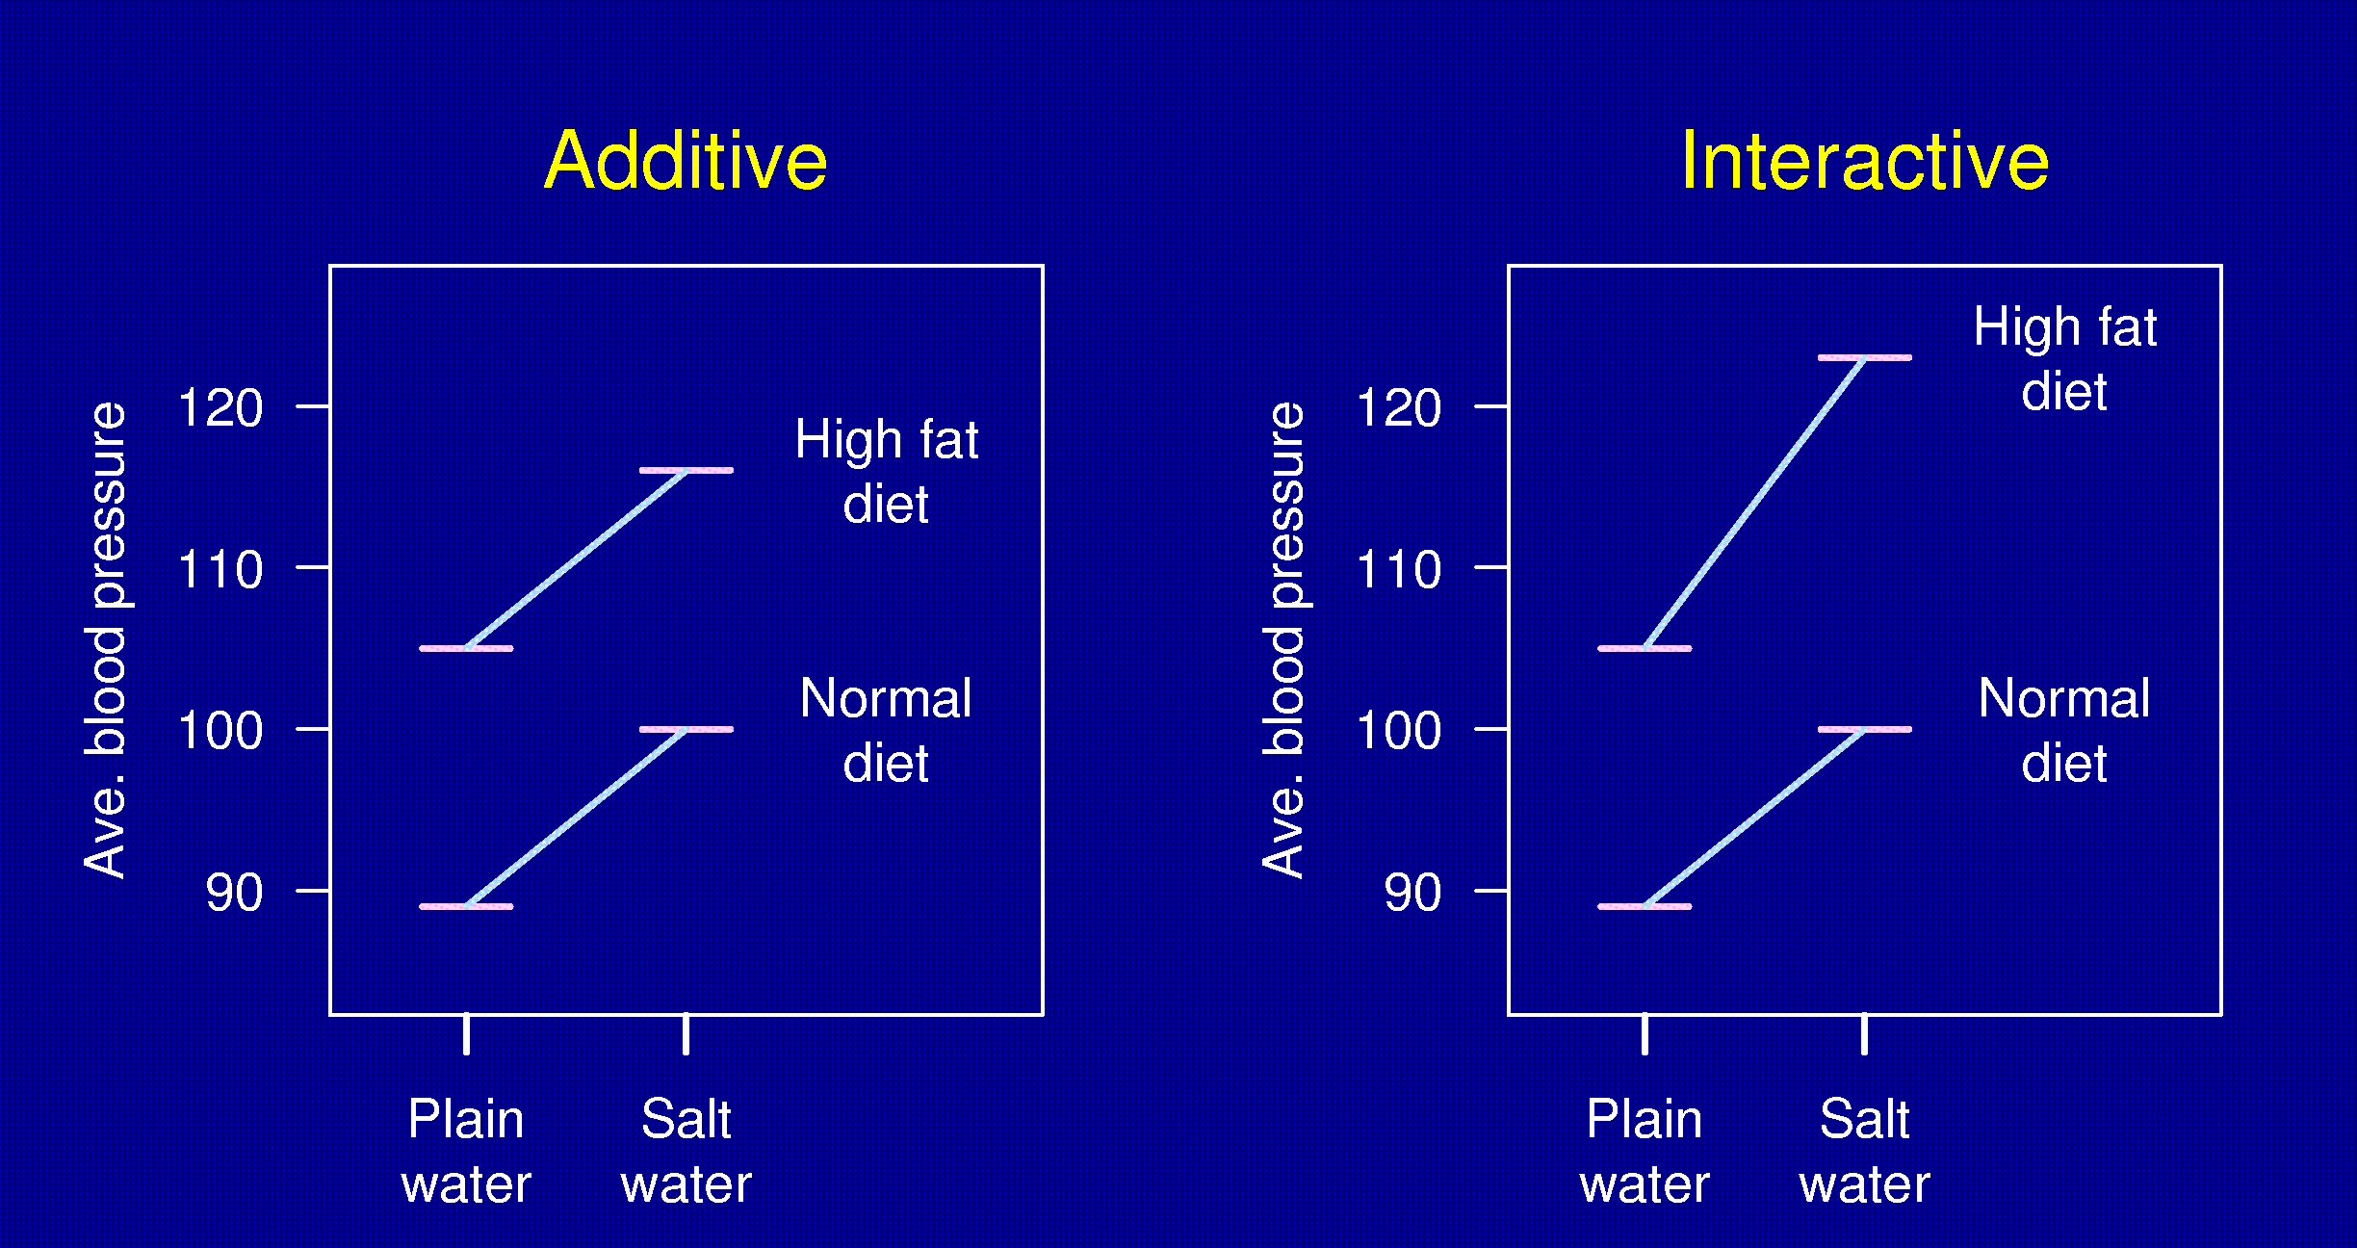
Interactions

Slide 19
Other points
Blinding
  Measurements made by people can be influenced by unconscious biases.
  Ideally, dissections and measurements should be made without knowledge of the treatment applied.
Internal controls
  It can be useful to use the subjects themselves as their own controls (e.g., consider the response after vs. before treatment).
  Why? Increased precision.

Slide 20
Other points
Representativeness
  Are the subjects/tissues you are studying really representative of the population you want to study?
  Ideally, your study material is a random sample from the population of interest.

Slide 21
Summary
Characteristics of good experiments:
Unbiased
  Randomization
  Blinding
High precision
  Uniform material
  Replication
  Blocking
Simple
  Protect against mistakes
Wide range of applicability
  Deliberate variation
  Factorial designs
Able to estimate uncertainty
  Replication
  Randomization

Slide 22
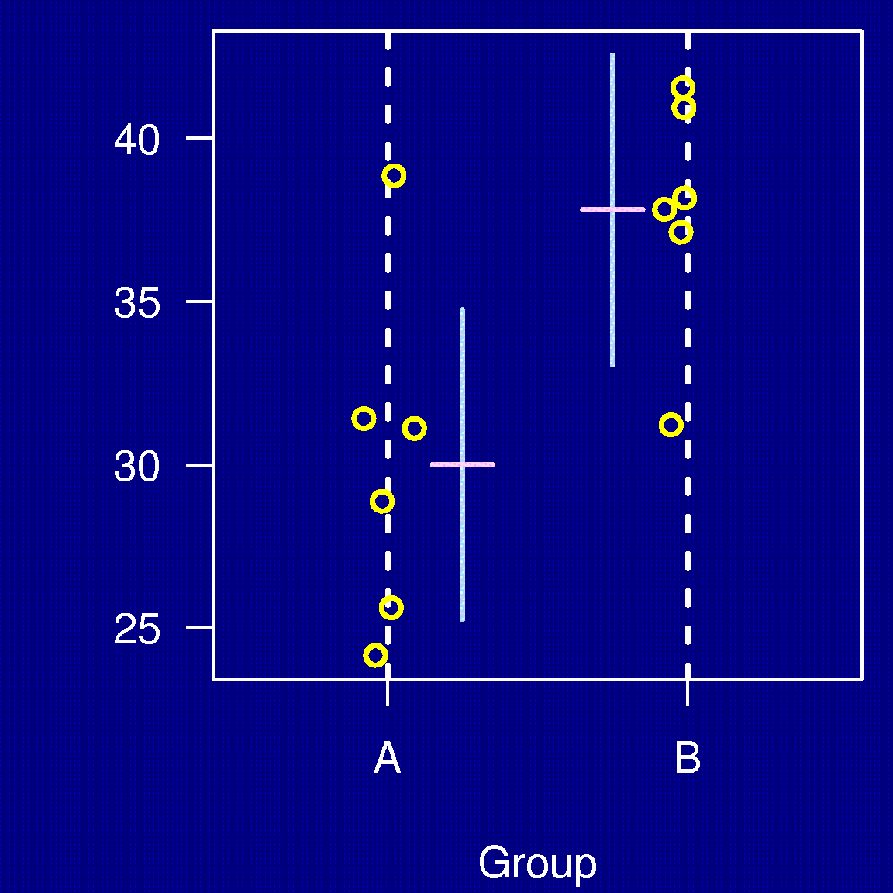
Data presentation
Good plot
Bad plot

Slide 23
Data presentation
Good table
Bad table
Treatment | Mean | (SEM)
A | 11.2 | (0.6)
B | 13.4 | (0.8)
C | 14.7 | (0.6)
Treatment | Mean | (SEM)
A | 11.2965 | (0.63)
B | 13.49 | (0.7913)
C | 14.787 | (0.6108)

Slide 24
Sample size determination

Slide 25
Fundamental formula

Slide 26
Listen to the IACUC
Too few animals → a total waste
Too many animals → a partial waste

Slide 27
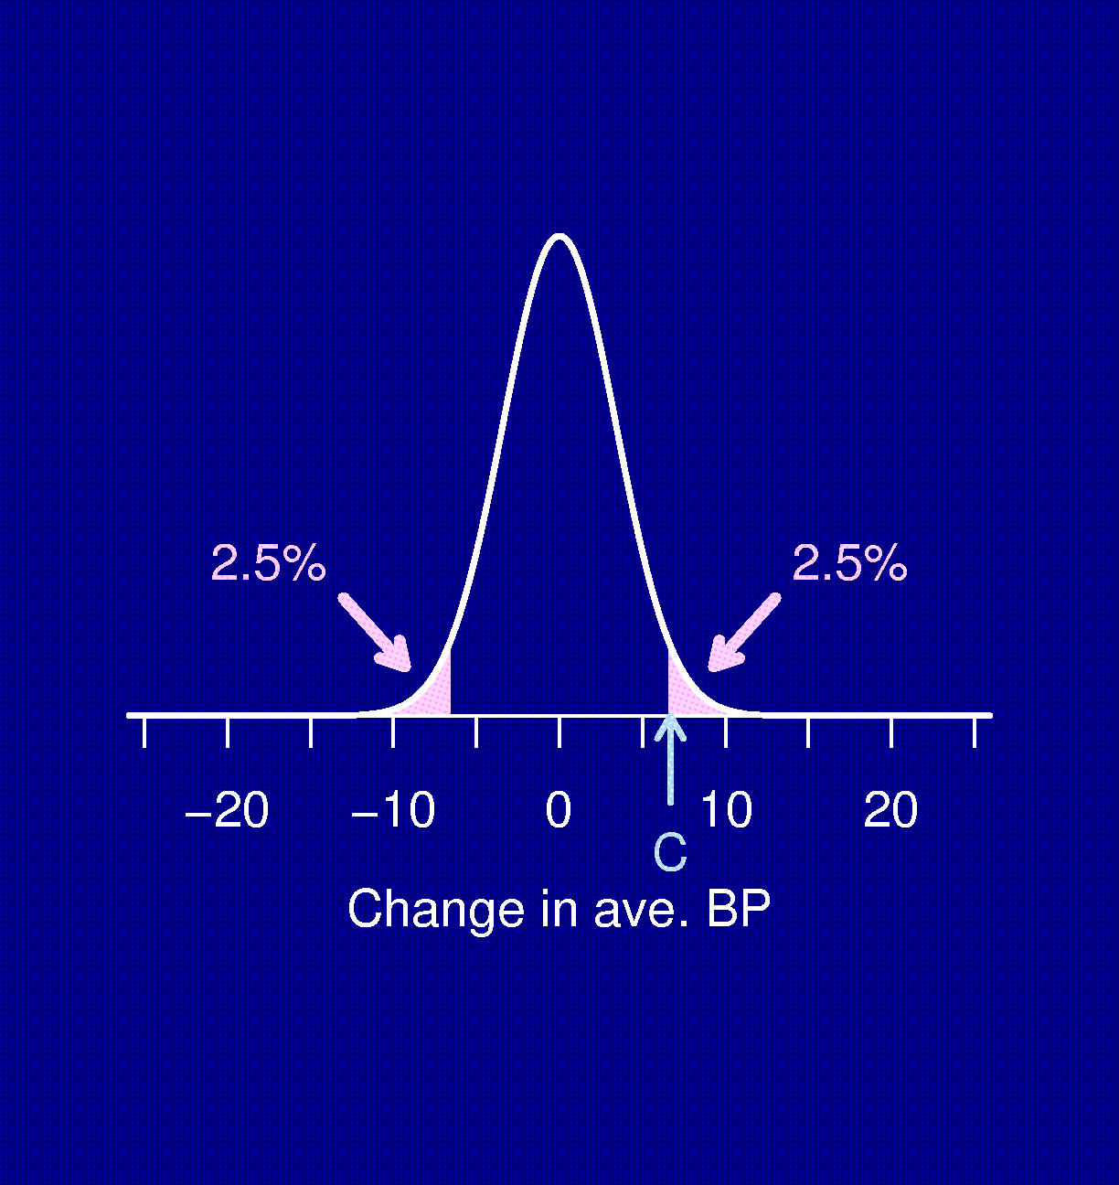
Significance test
Compare the BP of 6 mice fed salt water to 6 mice fed plain water.
Δ = true difference in average BP (the treatment effect).
H₀: Δ = 0 (i.e., no effect)
Test statistic, D.
If |D| > C, reject H₀.
• C chosen so that the chance you reject H₀, if H₀ is true, is 5%
Distribution of D when Δ = 0

Slide 28
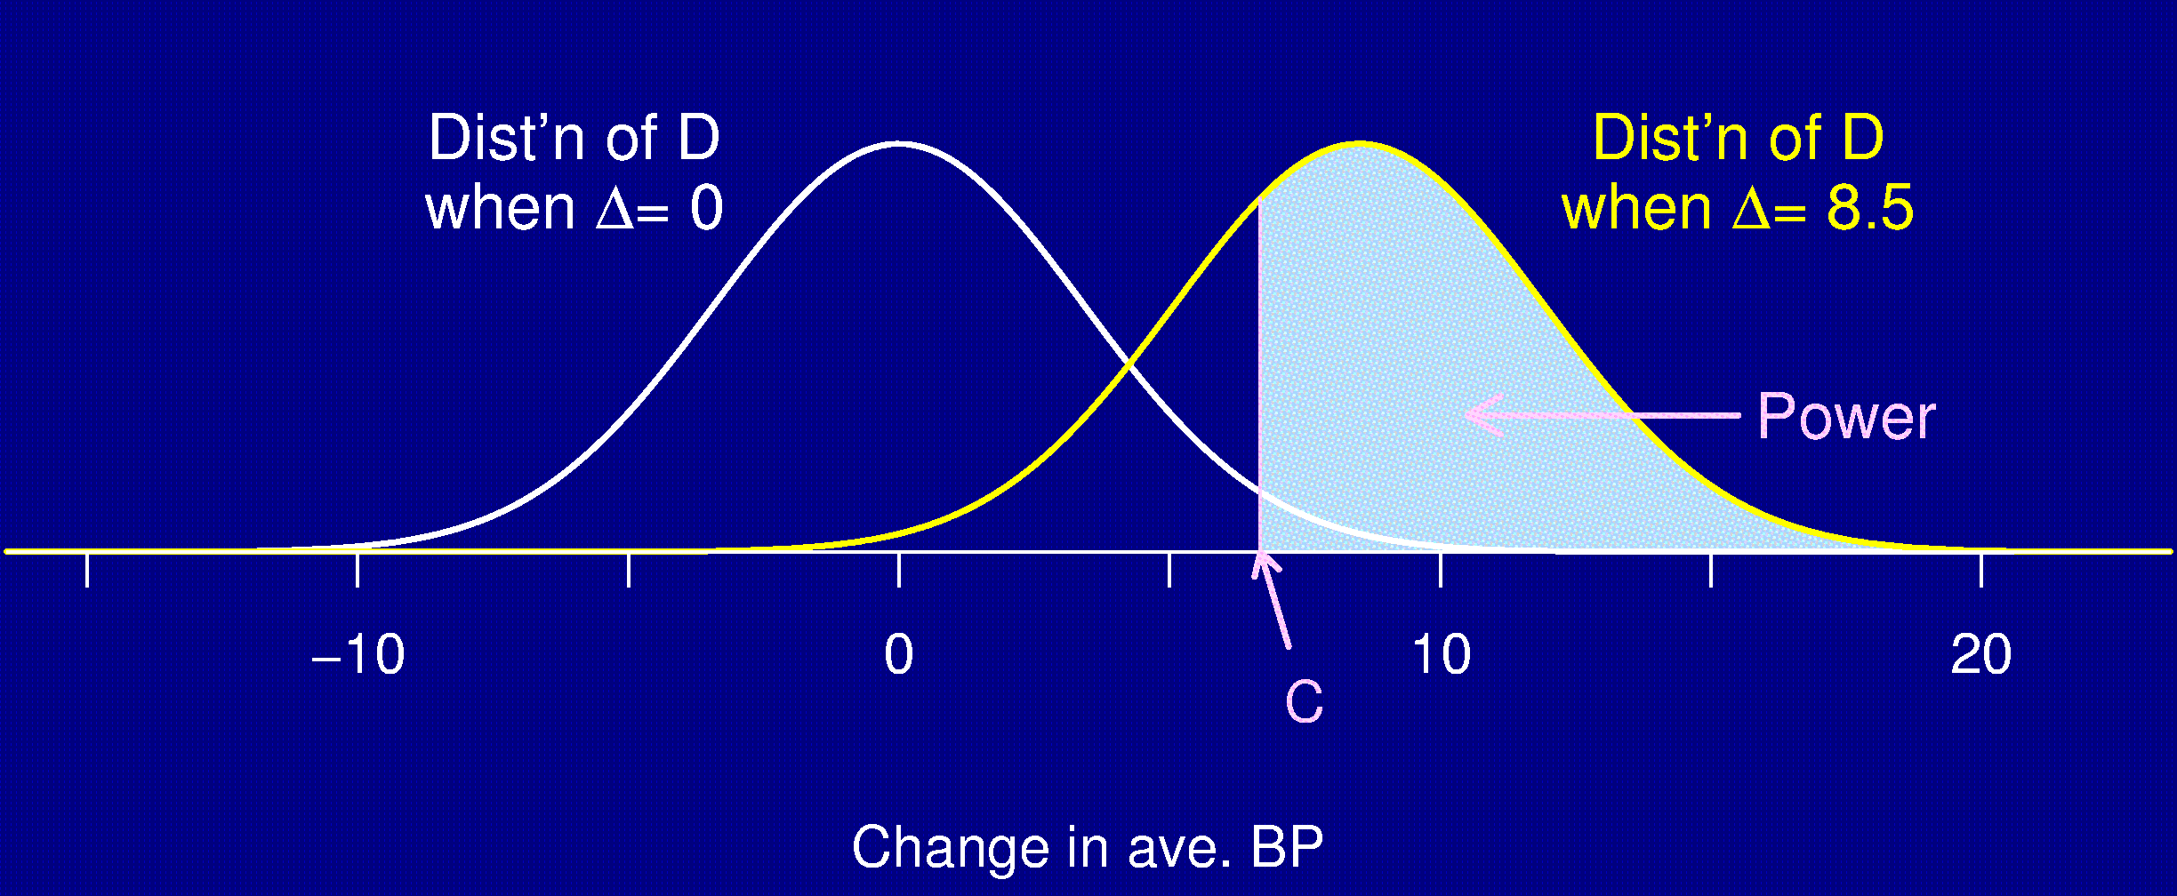
Statistical power
Power = The chance that you reject H₀ when H₀ is false (i.e., you [correctly] conclude that there is a treatment effect when there really is a treatment effect).

Slide 29
Power depends on…
The structure of the experiment
The method for analyzing the data
The size of the true underlying effect
The variability in the measurements
The chosen significance level (α)
The sample size
Note: We usually try to determine the sample size to give a particular power (often 80%).

Slide 30
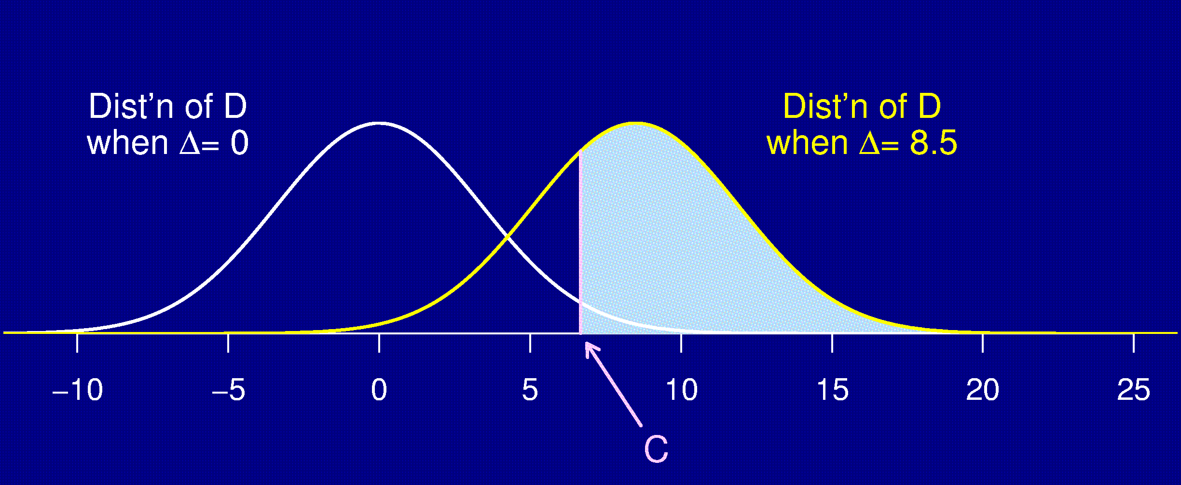
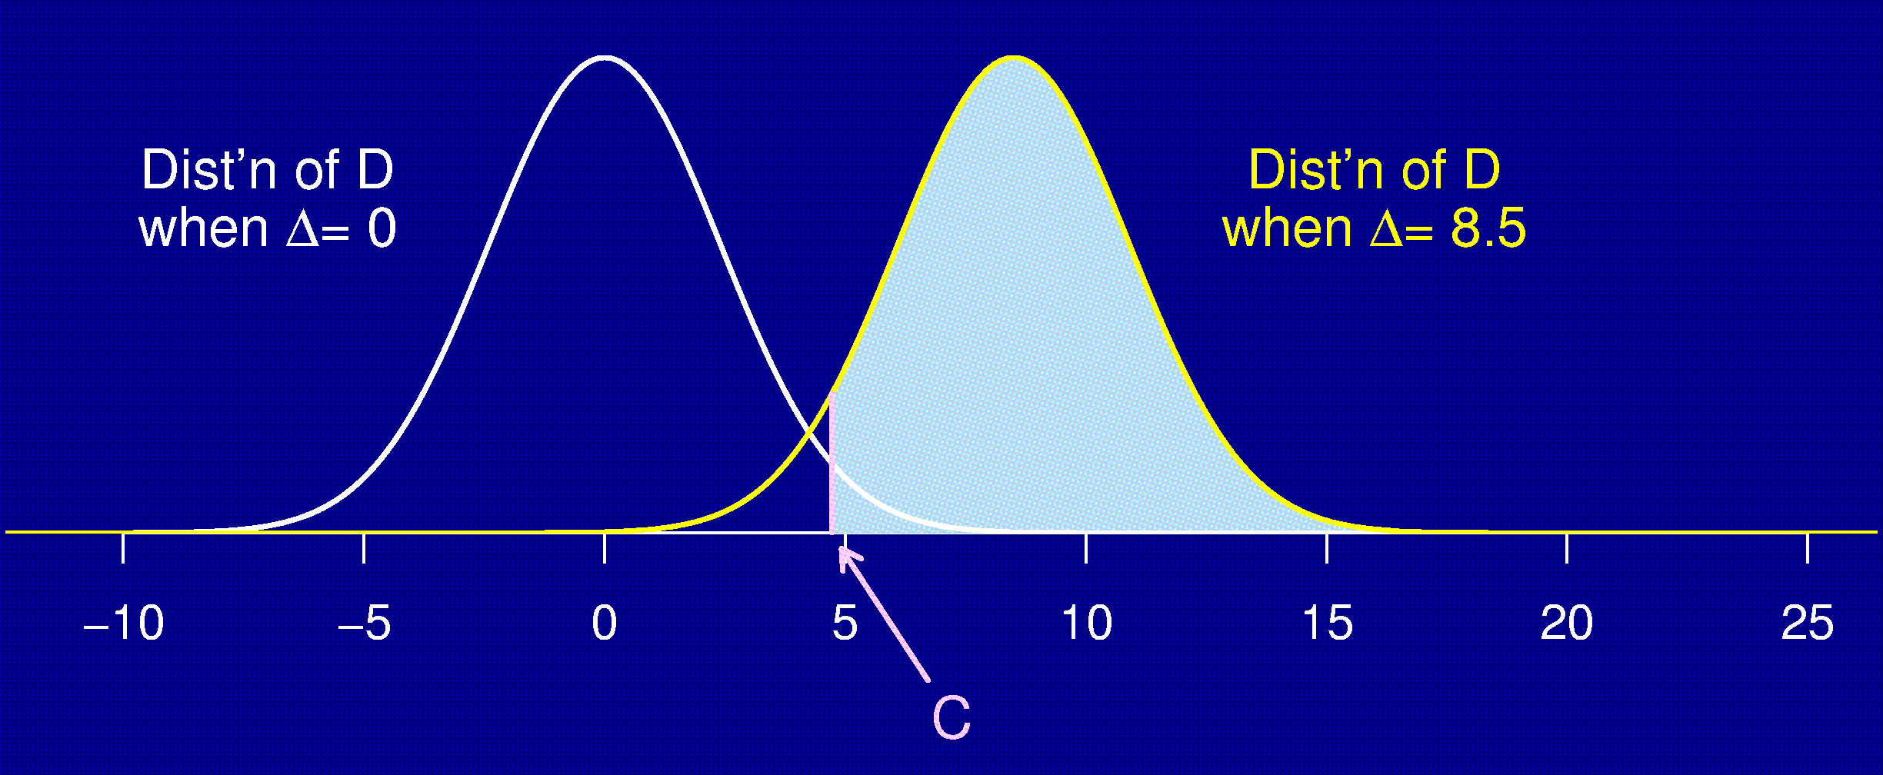
Effect of sample size
6 per group:
12 per group:

Slide 31
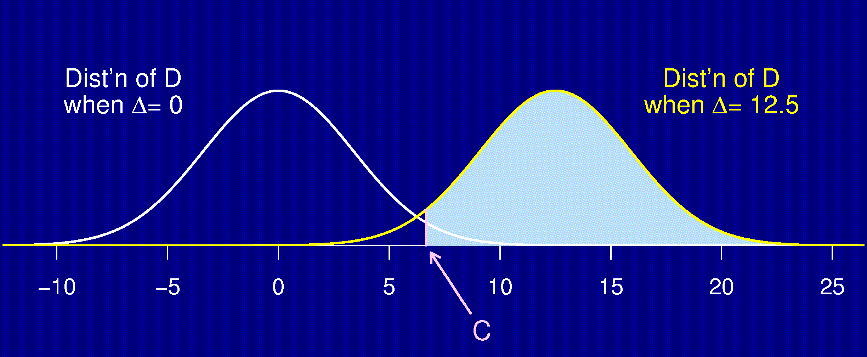
Effect of the effect
Δ = 8.5:
Δ = 12.5:

Slide 32
Various effects
Desired power ↑ ⇒ sample size ↑
Stringency of statistical test ↑ ⇒ sample size ↑
Measurement variability ↑ ⇒ sample size ↑
Treatment effect ↑ ⇒ sample size ↓

Slide 33
Determining sample size
The things you need to know:
  Structure of the experiment
  Method for analysis
  Chosen significance level, α (usually 5%)
  Desired power (usually 80%)
  Variability in the measurements
    if necessary, perform a pilot study
  The smallest meaningful effect

Slide 34
A formula
Censored

Slide 35
Reducing sample size
Reduce the number of treatment groups being compared.
Find a more precise measurement (e.g., average time to effect rather than proportion sick).
Decrease the variability in the measurements.
  Make subjects more homogeneous.
  Use stratification.
  Control for other variables (e.g., weight).
  Average multiple measurements on each subject.

Slide 36
Final conclusions
Experiments should be designed.
Good design and good analysis can lead to reduced sample sizes.
Consult an expert on both the analysis and the design of your experiment.

Slide 37
Resources
ML Samuels, JA Witmer (2003) Statistics for the Life Sciences, 3rd edition. Prentice Hall.
  An excellent introductory text.
GW Oehlert (2000) A First Course in Design and Analysis of Experiments. WH Freeman & Co.
  Includes a more advanced treatment of experimental design.
Course: Statistics for Laboratory Scientists (Biostatistics 140.615-616, Johns Hopkins Bloomberg Sch. Pub. Health)
  Intoductory statistics course, intended for experimental scientists.
  Greatly expands upon the topics presented here.

