Slide 1
Statistics in epigenomics
Karl W Broman
Department of Biostatistics
Johns Hopkins University
http://www.biostat.jhsph.edu/~kbroman

Slide 2
What is statistics?
“We may at once admit that any inference from the particular to the general must be attended with some degree of uncertainty, but this is not the same as to admit that such inference cannot be absolutely rigorous, for the nature and degree of the uncertainty may itself be capable of rigorous expression.”
— Sir R. A. Fisher

Slide 3
What is statistics?
Data exploration and analysis
Inductive inference with probability
Quantification of uncertainty
Design of experiments (to do the above well)

Slide 4
Statistics in epigenomics?
The obvious thing: “Classical” imprinting studies
  Parent-of-origin effects in human disease
  Phenotypes within families
  … that plus genotype data
Note: no direct measure of epigenetic marks.
  Allelic expression
  Methylation
  Histone modification

Slide 5
Statistics in epigenomics?
Improve assays to quantify epigenetic marks
  Get the most precise results (cf expr. microarrays)
  Validity and reliability
  Design aspects (eg, # standards, # replicates, how to replicate)

Slide 6
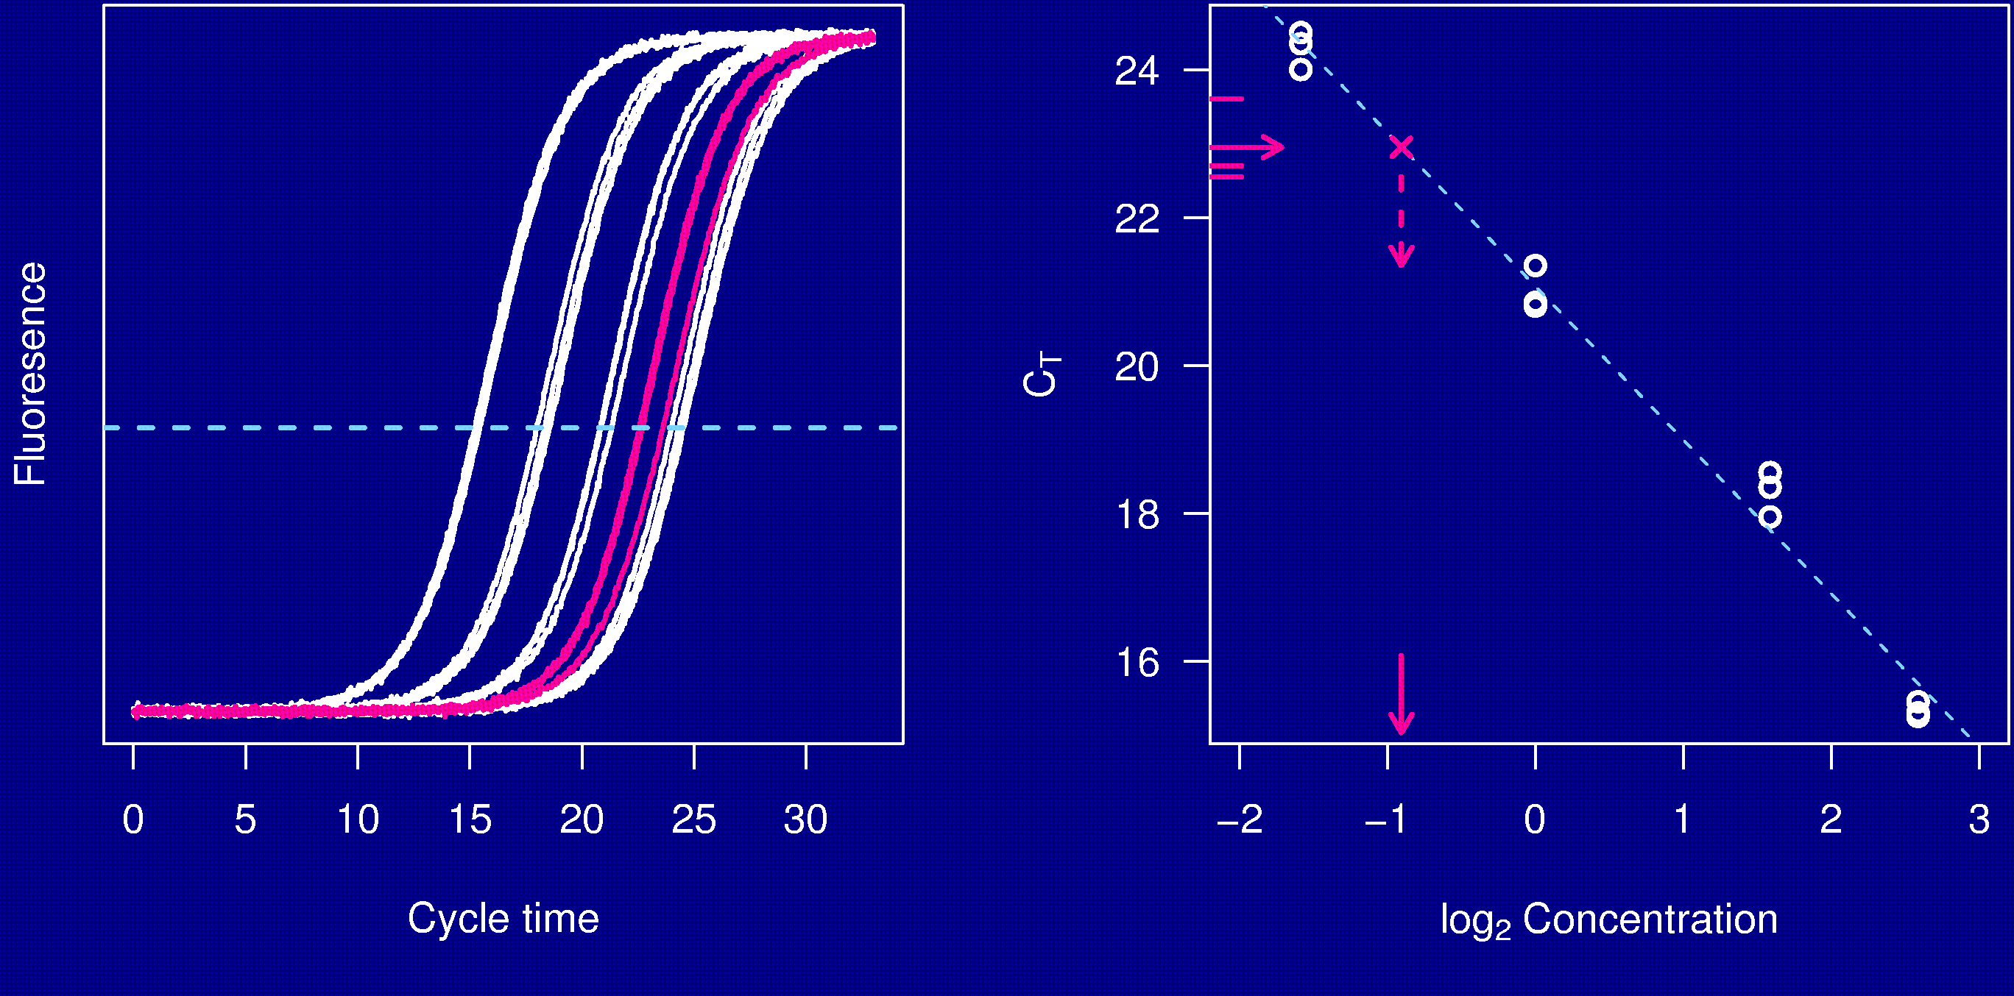
Real-time PCR

Slide 7
Statistics in epigenomics?
Understanding epigenetic marks
  Variation
    Between individuals
    Between tissues
    Across time
  Correlation
    Between relatives
    Between loci within an individual
    Between alleles at a locus
    Between tissues
    Across time

Slide 8
Statistics in epigenomics?
Identify polymorphisms contributing to variation in epigenetic marks
  A quantitative epigenetic mark is a quantitative phenotype.
  Use linkage analysis with pedigrees (or in model organisms) to map the genes responsible for individual variation in an epigenetic mark.

Slide 9
Statistics in epigenomics?
Epigenetic marks and human disease
  A quantitative epigenetic mark may be treated like any other risk factor
  The usual issues:
    What is the best study design?
    How to relate the factor to the disease?
    How to account for other factors?
    How to deal with associations between relatives?
  Special issues:
    Special correlation between relatives & within individual
    Absolute vs. relative measures of epigenetic marks
    Parental origins of epigenetic marks

Slide 10
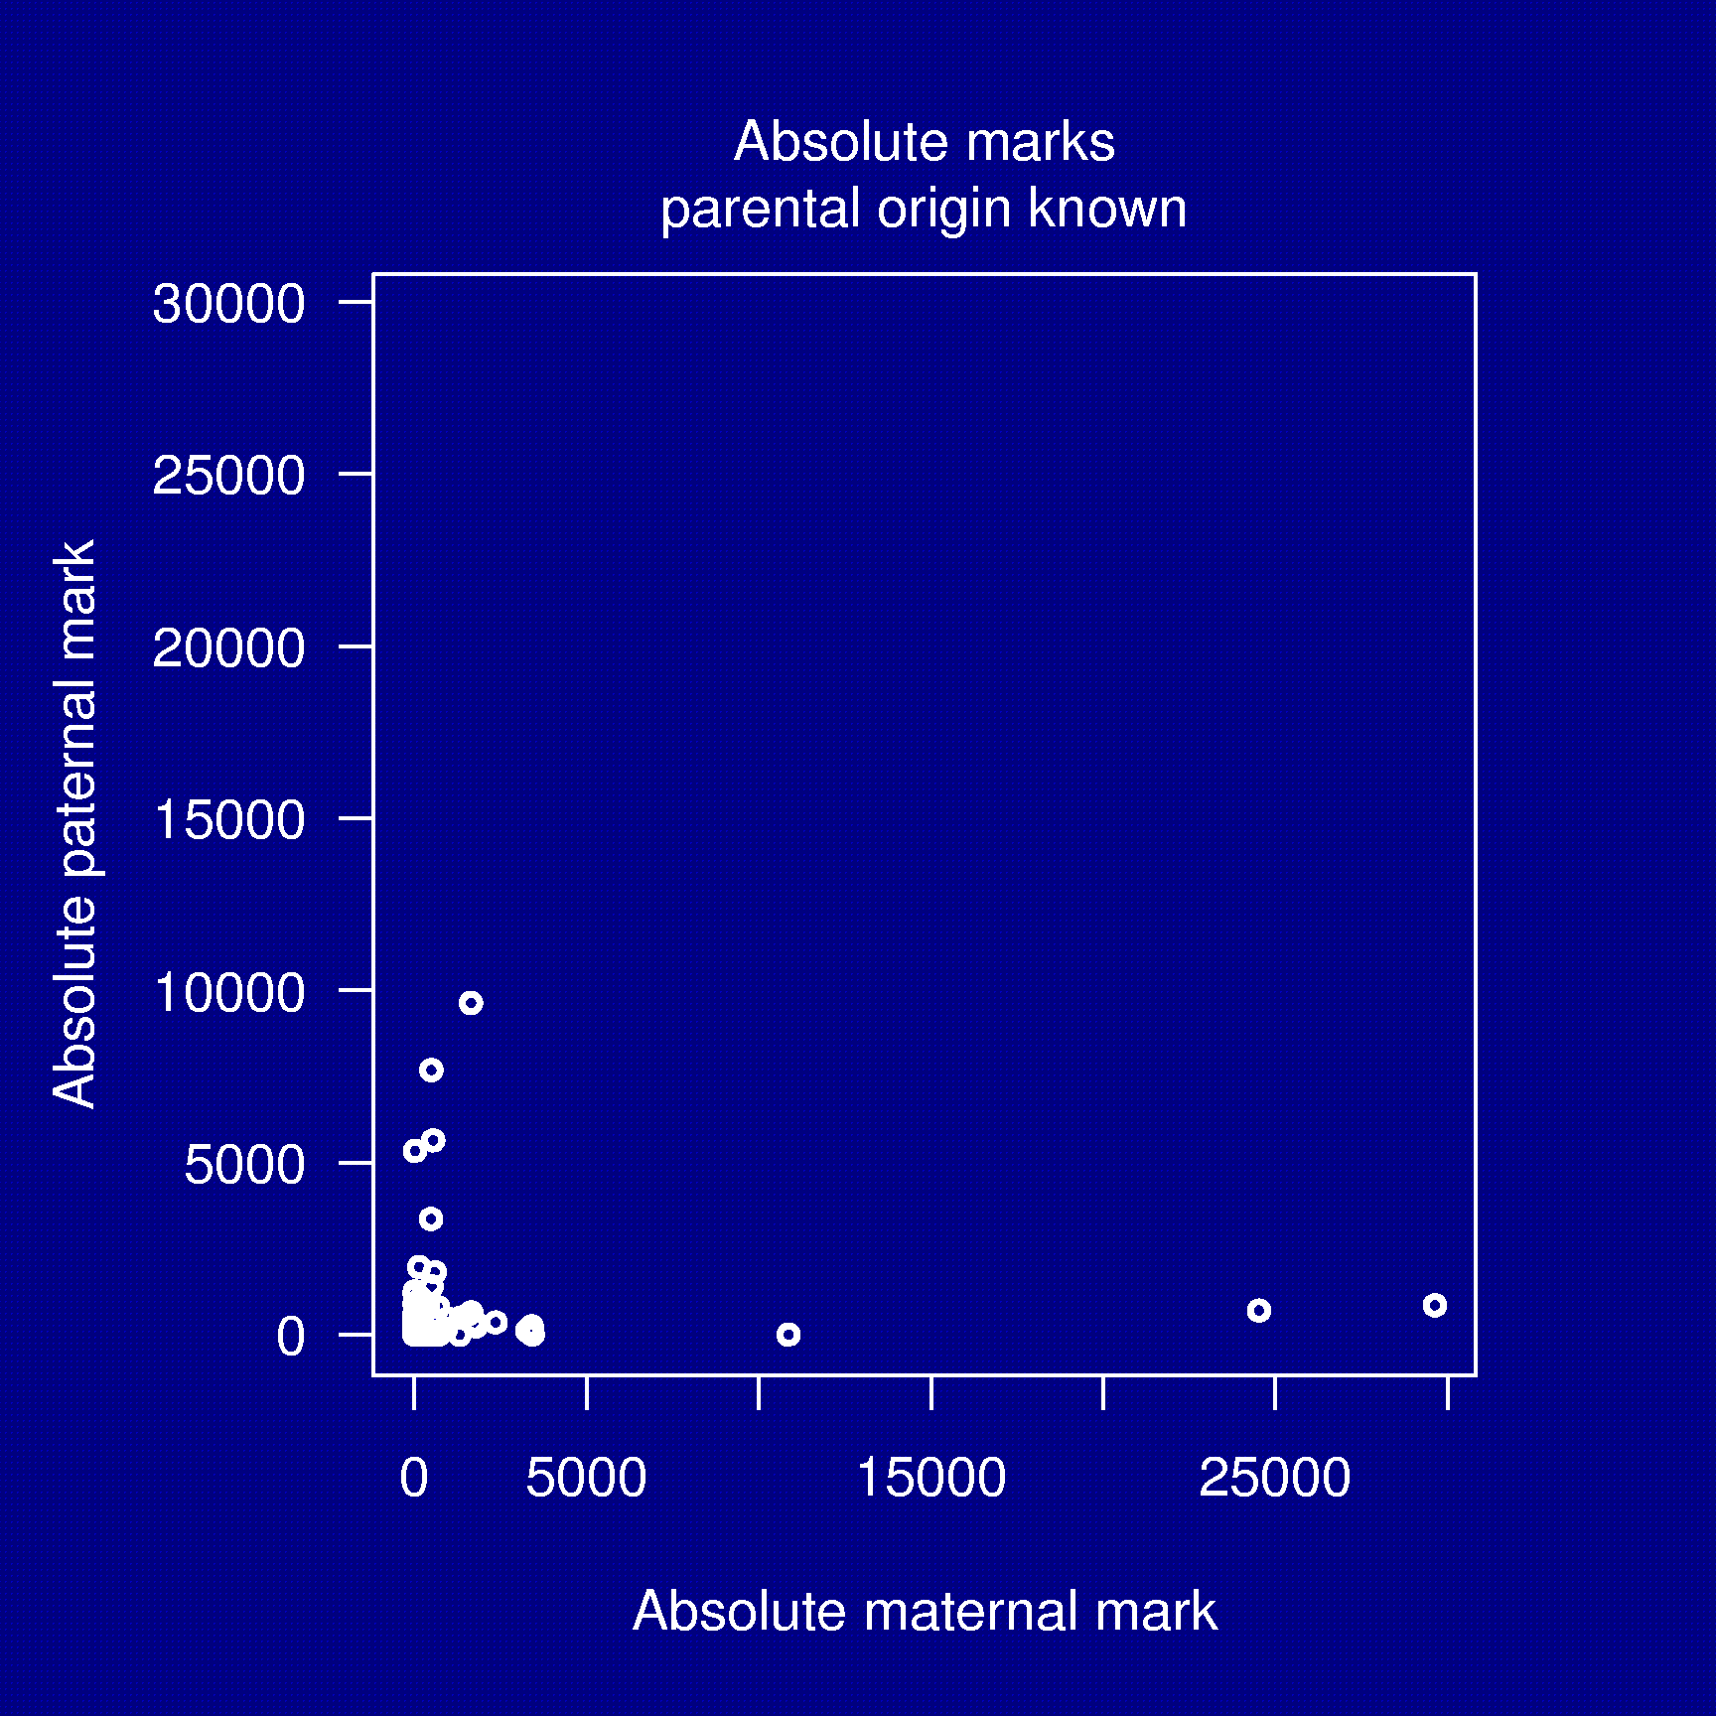
Generic epigenetic marks

Slide 11
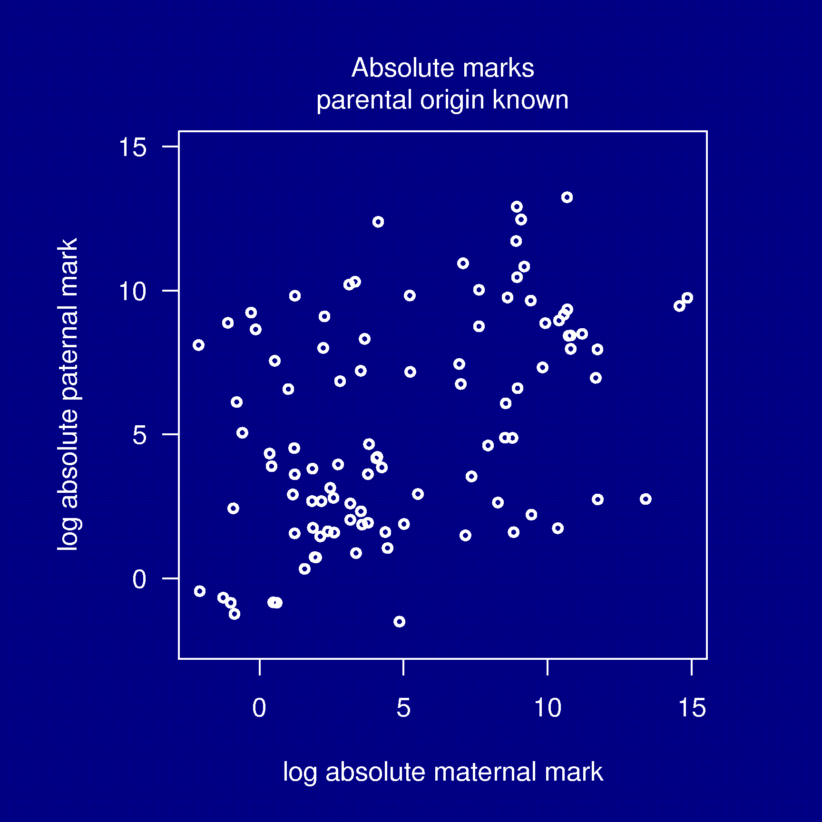
Generic epigenetic marks

Slide 12
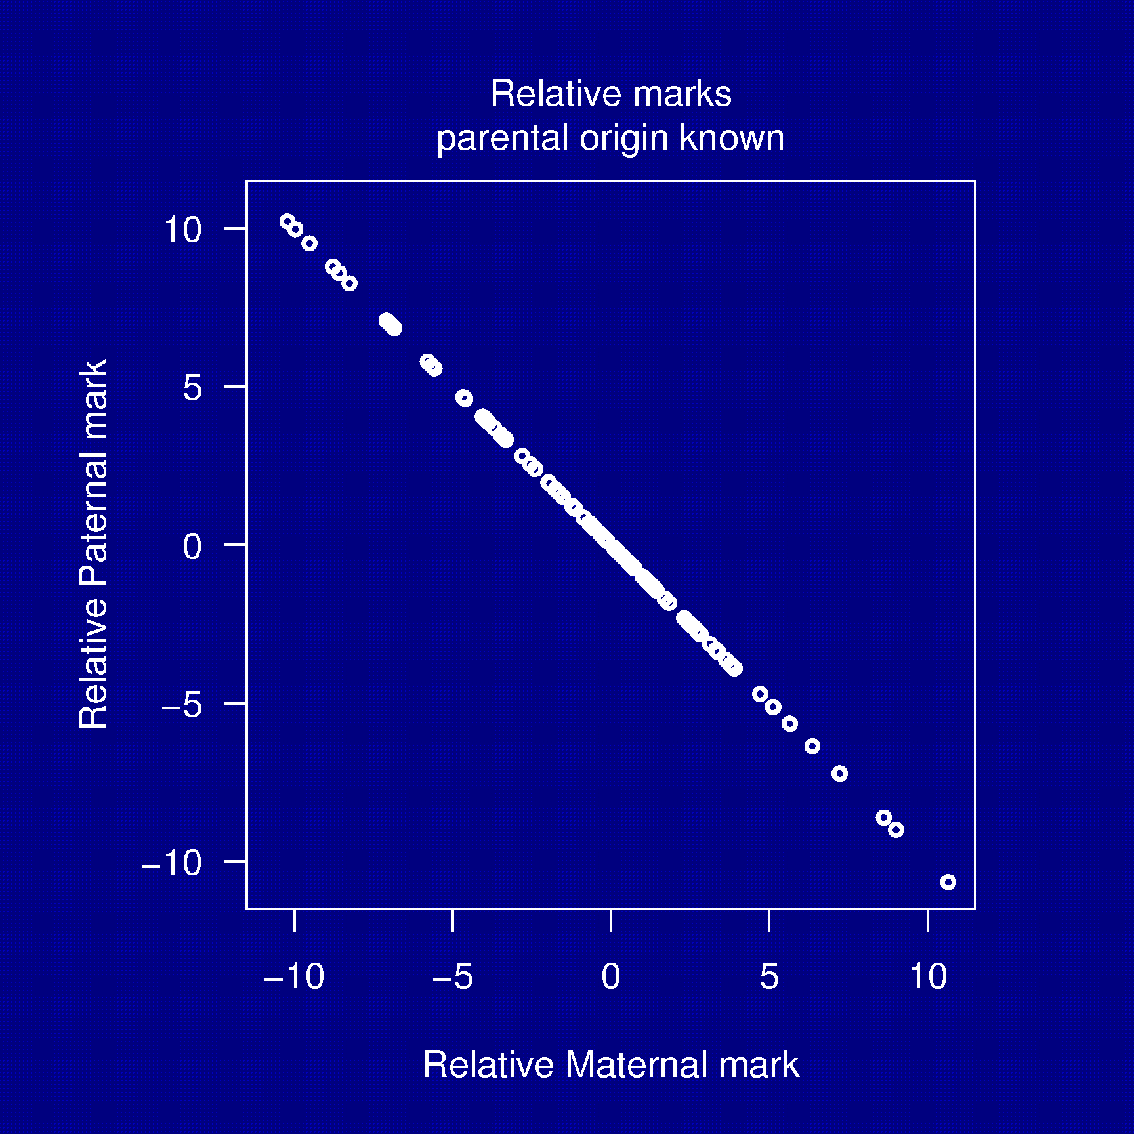
Generic epigenetic marks

Slide 13
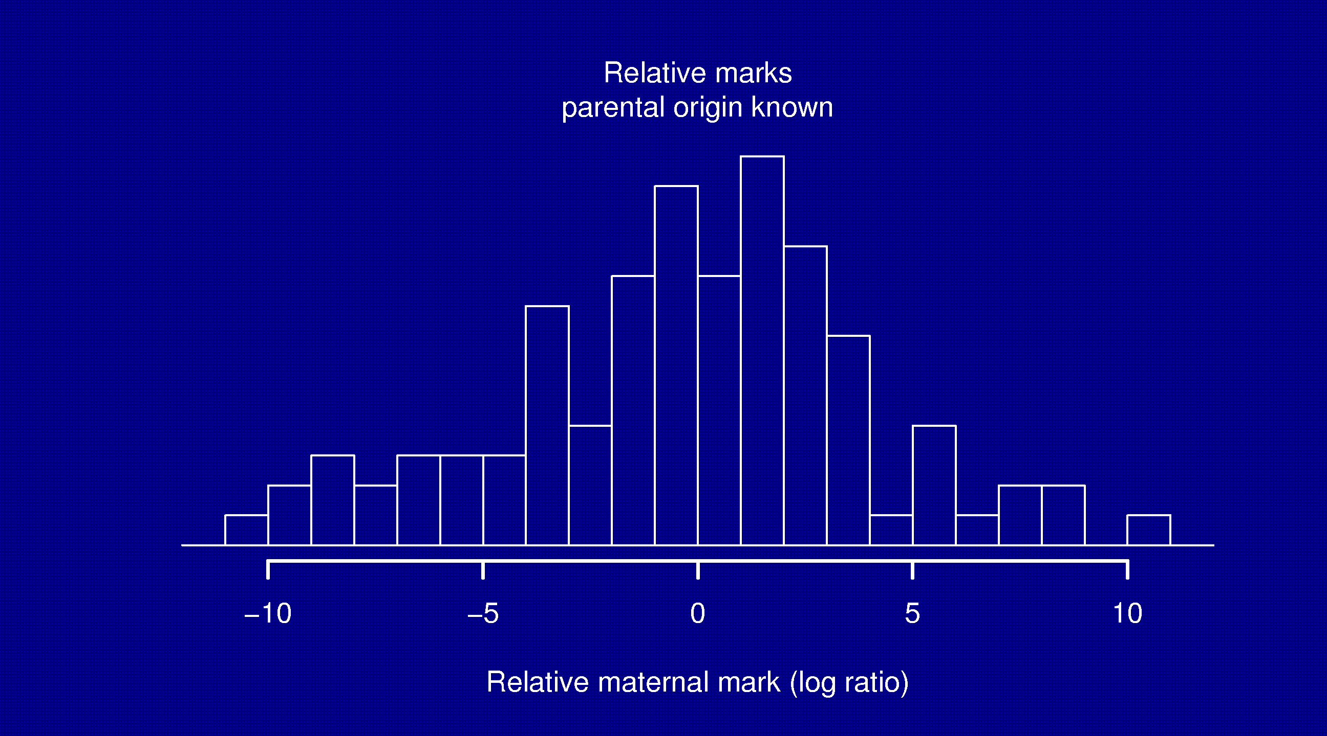
Generic epigenetic marks

Slide 14
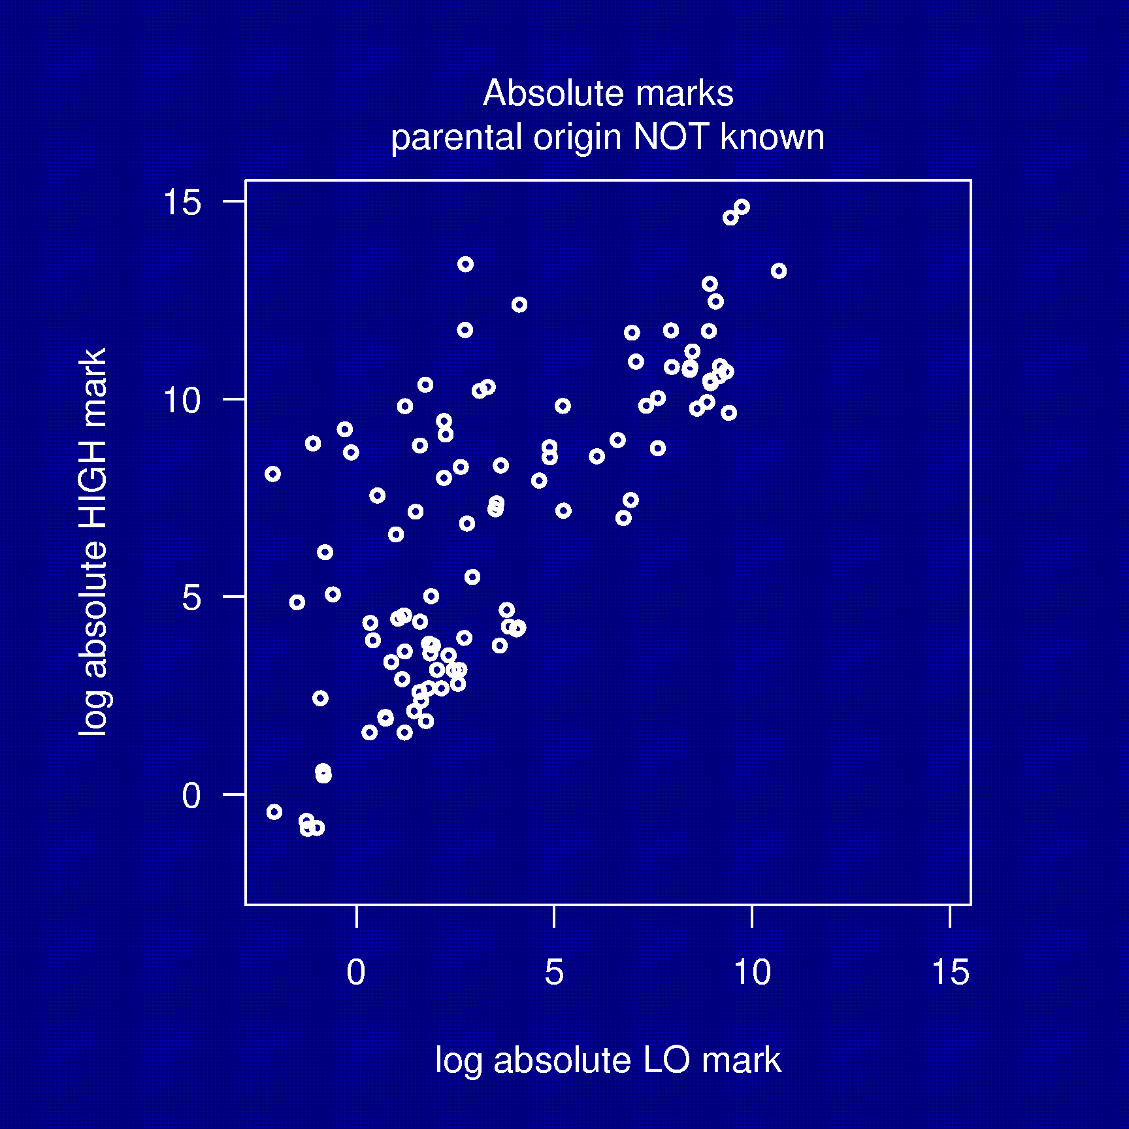
Generic epigenetic marks

Slide 15
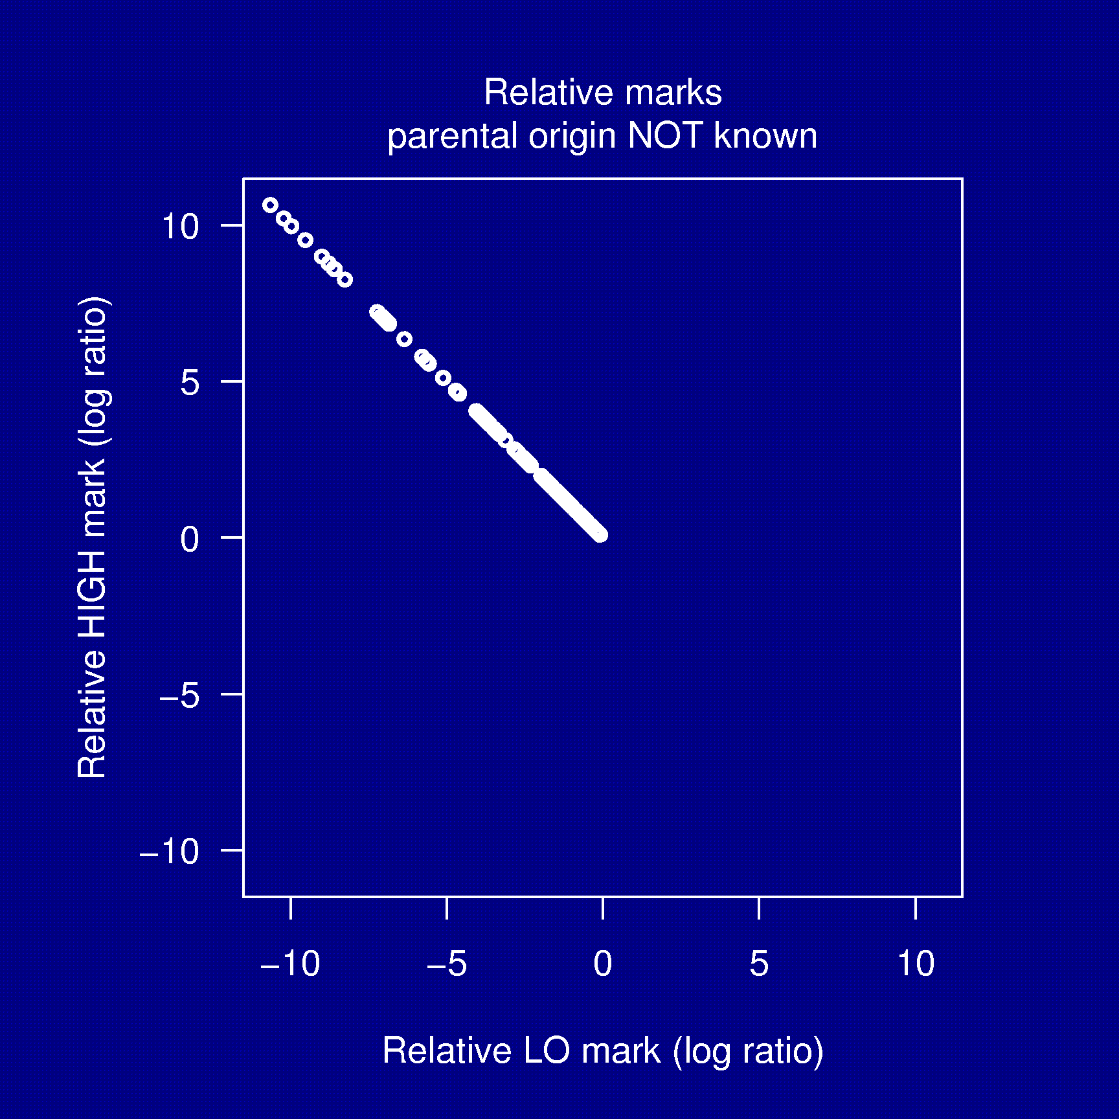
Generic epigenetic marks

Slide 16
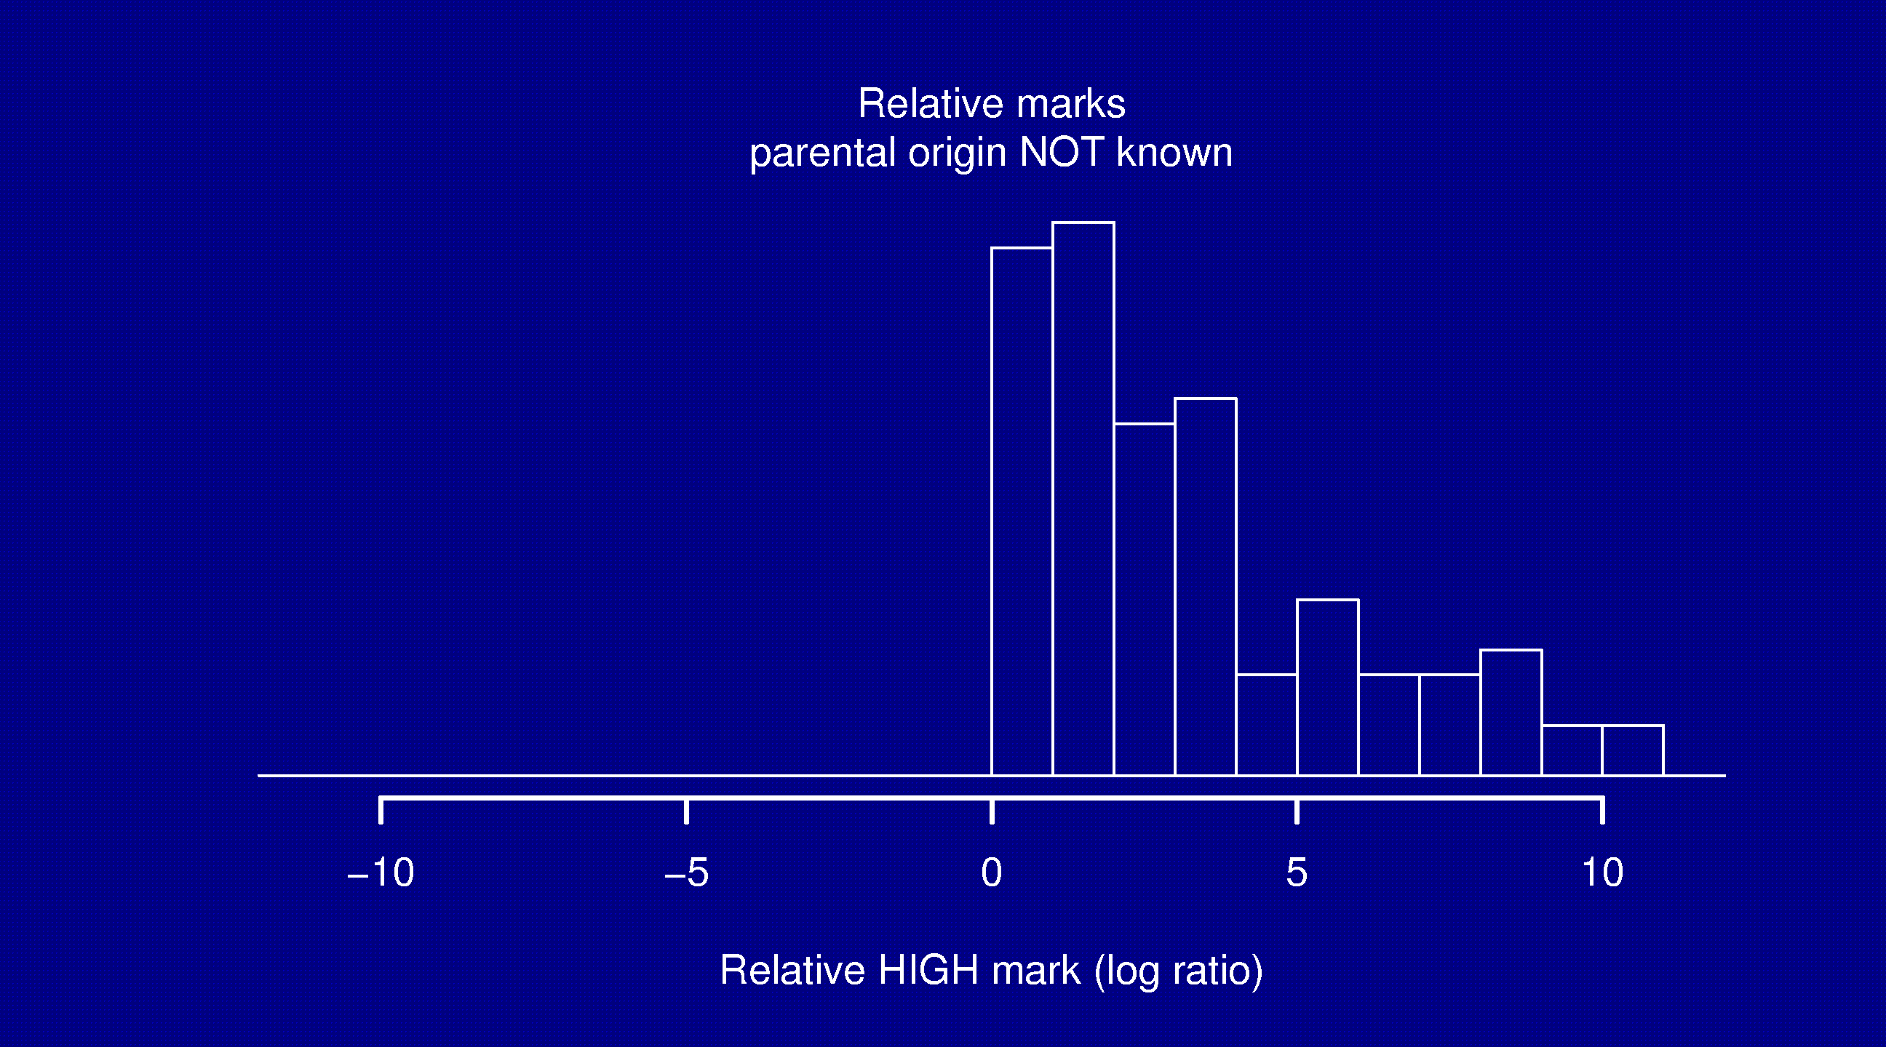
Generic epigenetic marks

Slide 17
Statistics in epigenomics?
Epigenetic mark in parent ↔ disease in child?
  Can an aberrant epigenetic mark influence a child’s disease (when the corresponding allele is transmitted to the child)?

Slide 18
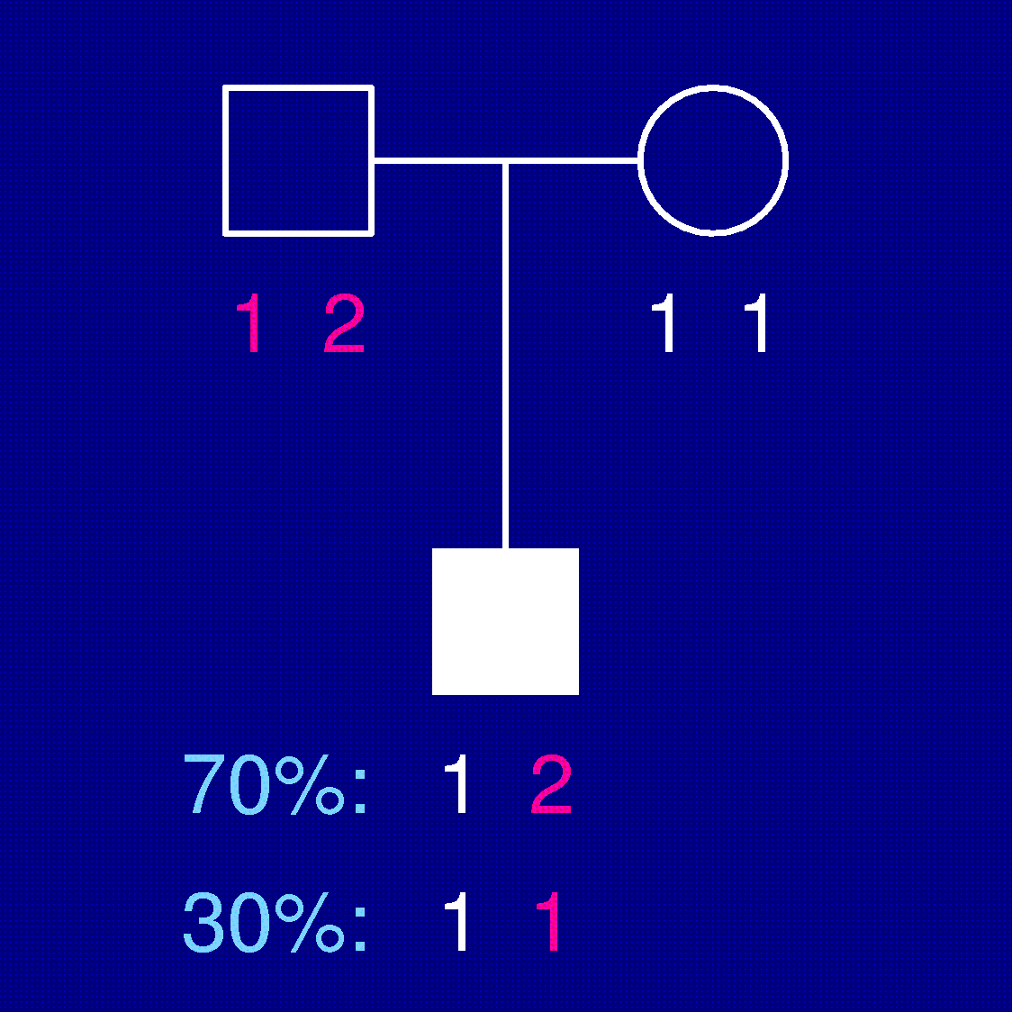
Transmission/disequilibrium test
Establish association between an allele and risk of disease.

Slide 19
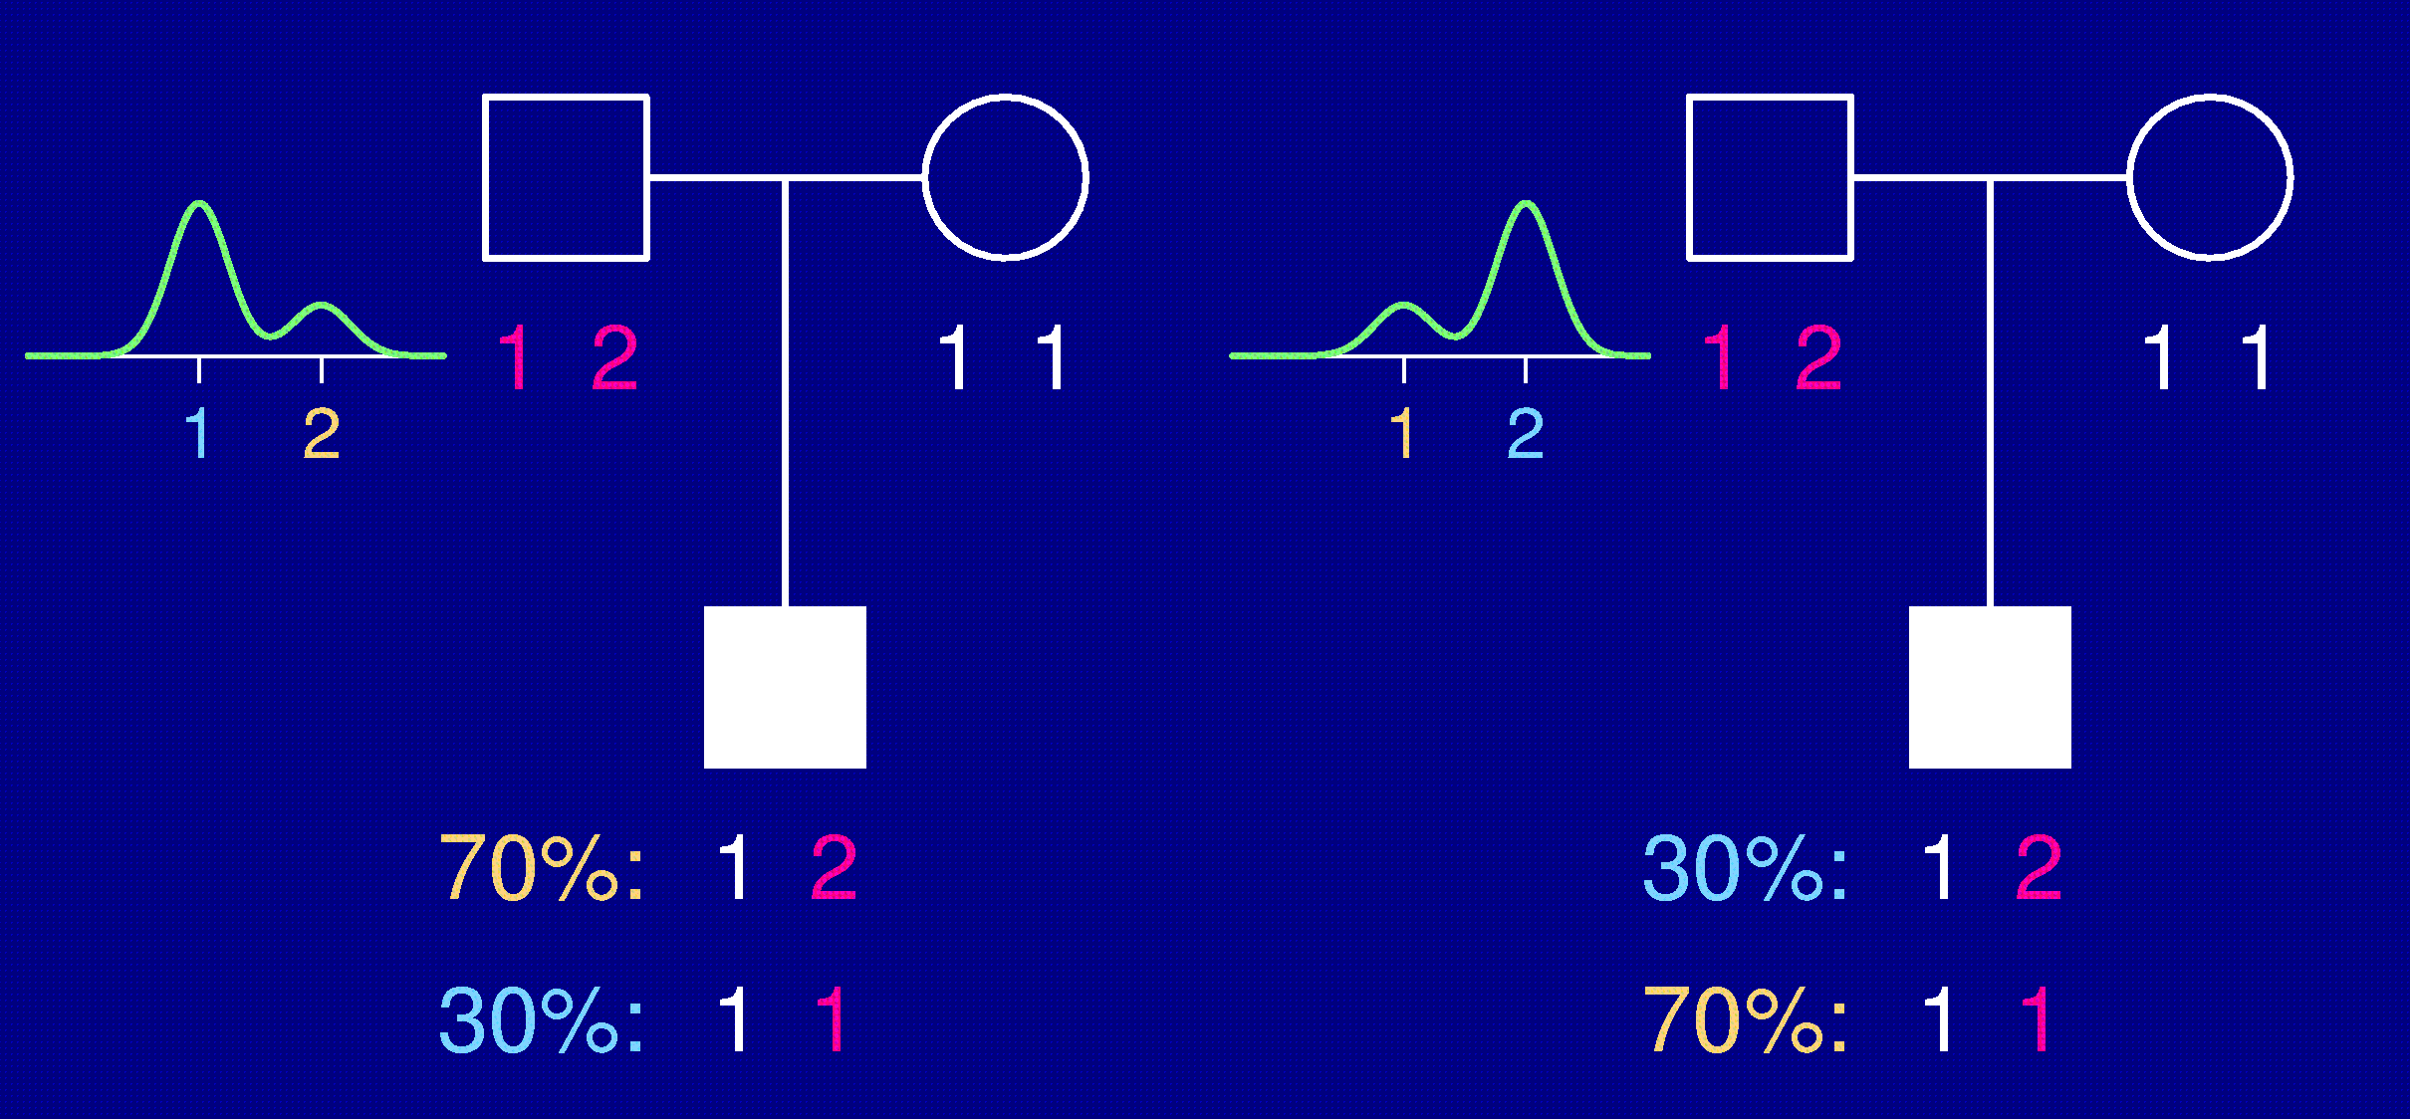
Epigenetic transmission test
Establish association between an epigenetic mark and risk of disease.

Slide 20
Summary
Establishing the connection between epigenetic marks and human disease is inherently statistical.
Statisticians can assist with several aspects of epigenomic studies.
  “Classical” imprinting
  Improvement of epigenetic assays
  Understanding epigenetic marks
  Mapping genes which influence epigenetic marks
  Connecting epigenetic marks to human disease
We need to integrate epigenetics, genetics, environments, and phenotypes.

Slide 21
Acknowledgments
Johns Hopkins University
Andrew Feinberg
Hans Bjornsson
James Potash
Rafael Irizarry
Ingo Ruczinski
Dani Fallin
University of Pennsylvania
Richard Spielman

