Slide 1
Identifying essential genes in M. tuberculosis by random transposon mutagenesis
Karl W. Broman
Department of Biostatistics
Johns Hopkins University
http://www.biostat.jhsph.edu/~kbroman

Slide 2
Mycobacterium tuberculosis
The organism that causes tuberculosis
  Cost for treatment: ~ $15,000
  Other bacterial pneumonias: ~ $35
4.4 Mbp circular genome, completely sequenced.
4250 known or inferred genes

Slide 3
Aim
Identify the essential genes
  Knock-out ⇒ non-viable mutant
Random transposon mutagenesis
  Rather than knock out each gene systematically, we knock out them out at random.

Slide 4
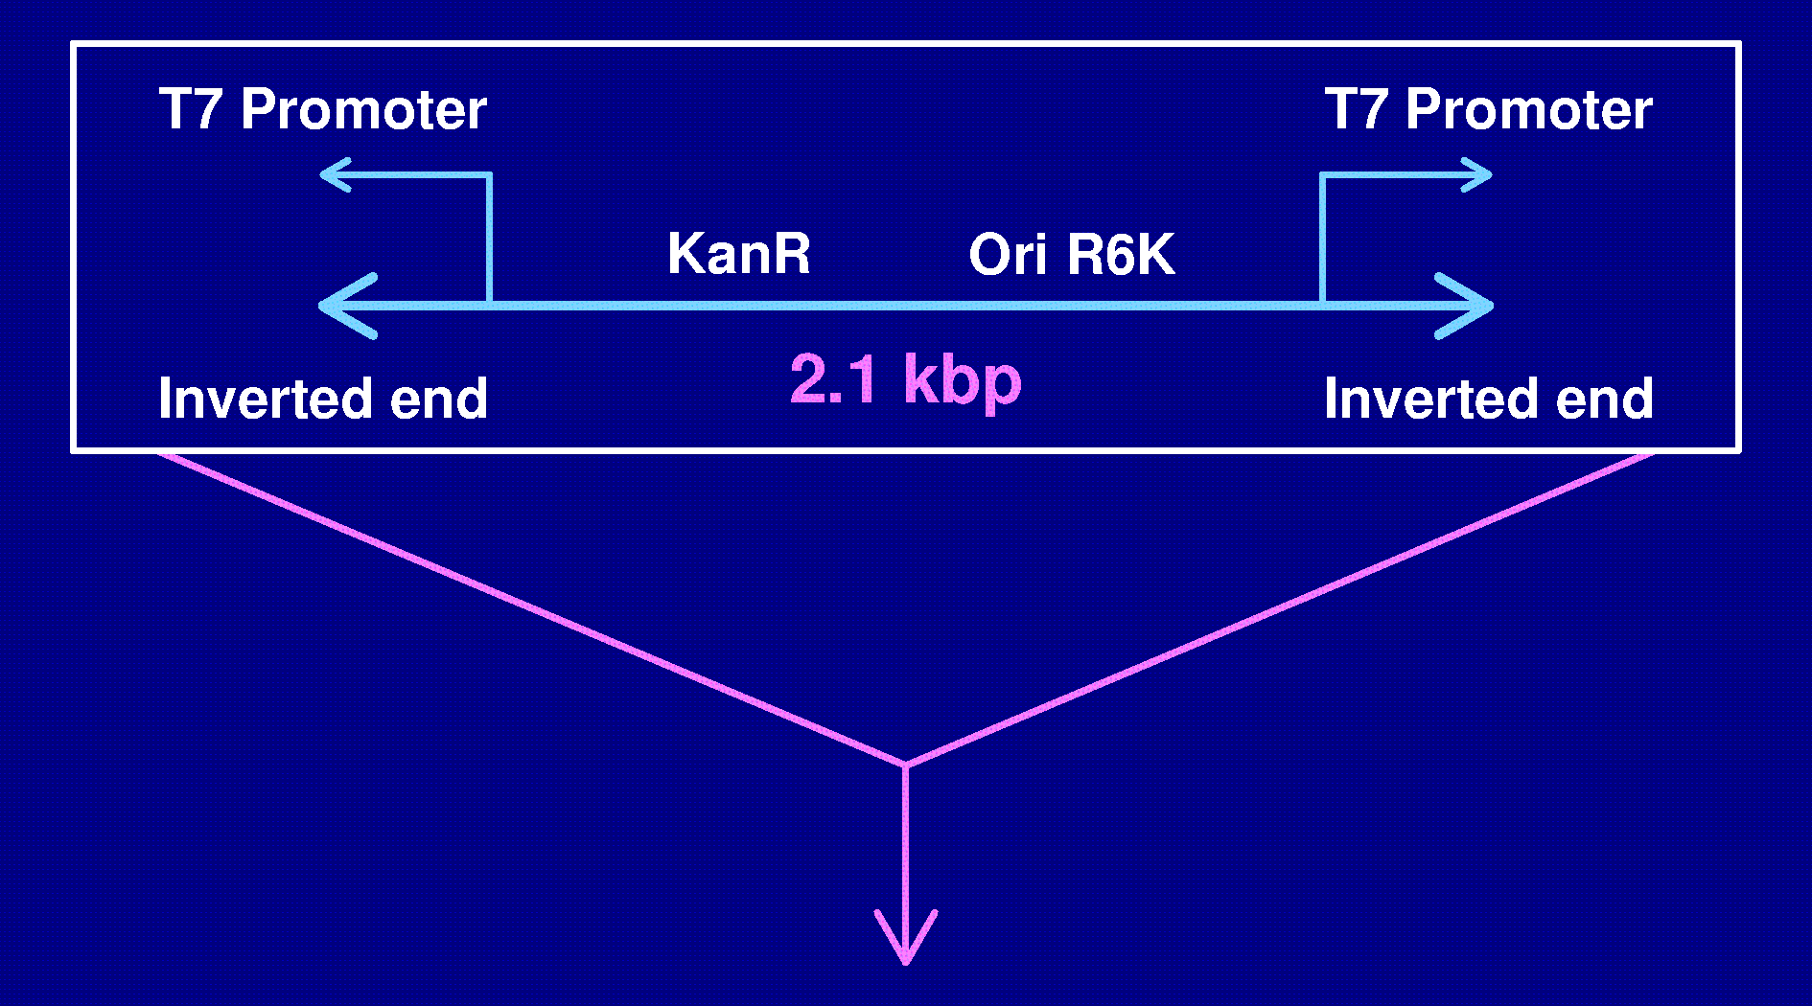
The Himar1 transposon
5’ - TCGAAGCCTGCGACTAACGTTTAAAGTTTG - 3'
3’ - AGCTTCGGACGCTGATTGCAAATTTCAAAC - 5'
Note: 30 or more stop codons in each reading frame

Slide 5
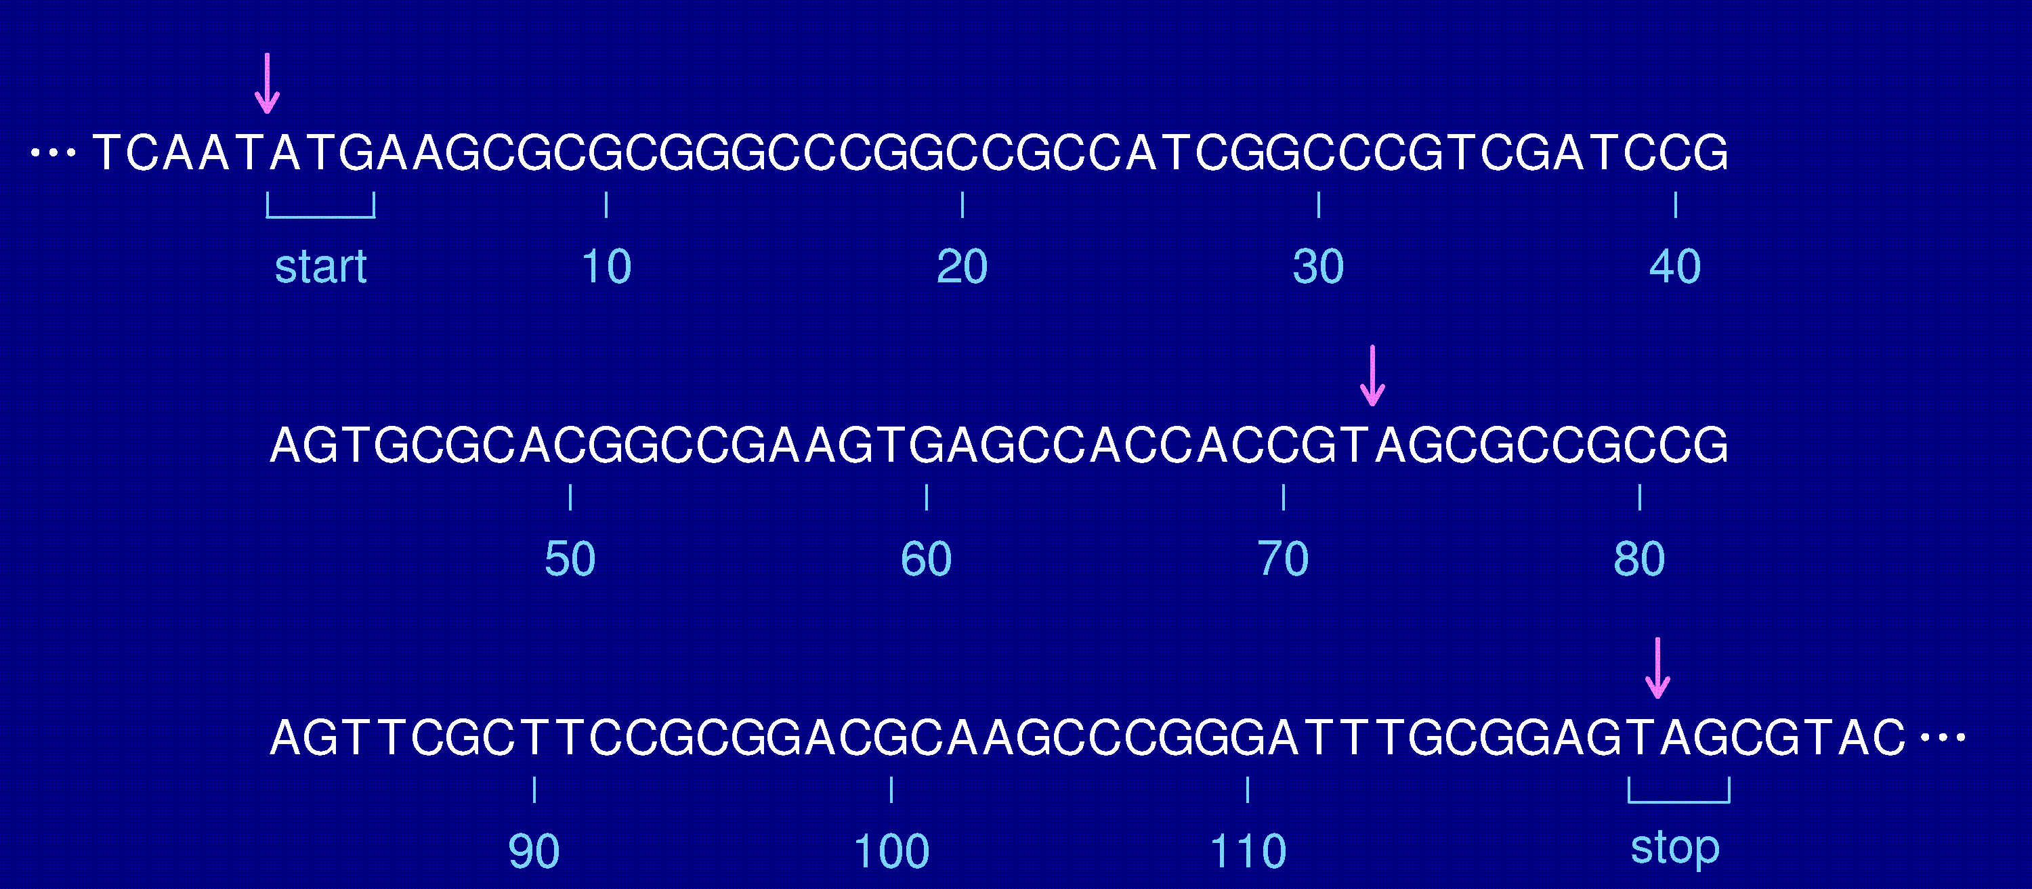
Sequence of the gene MT598

Slide 6

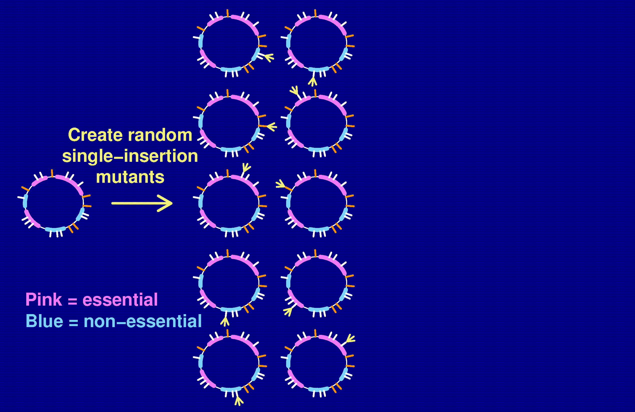
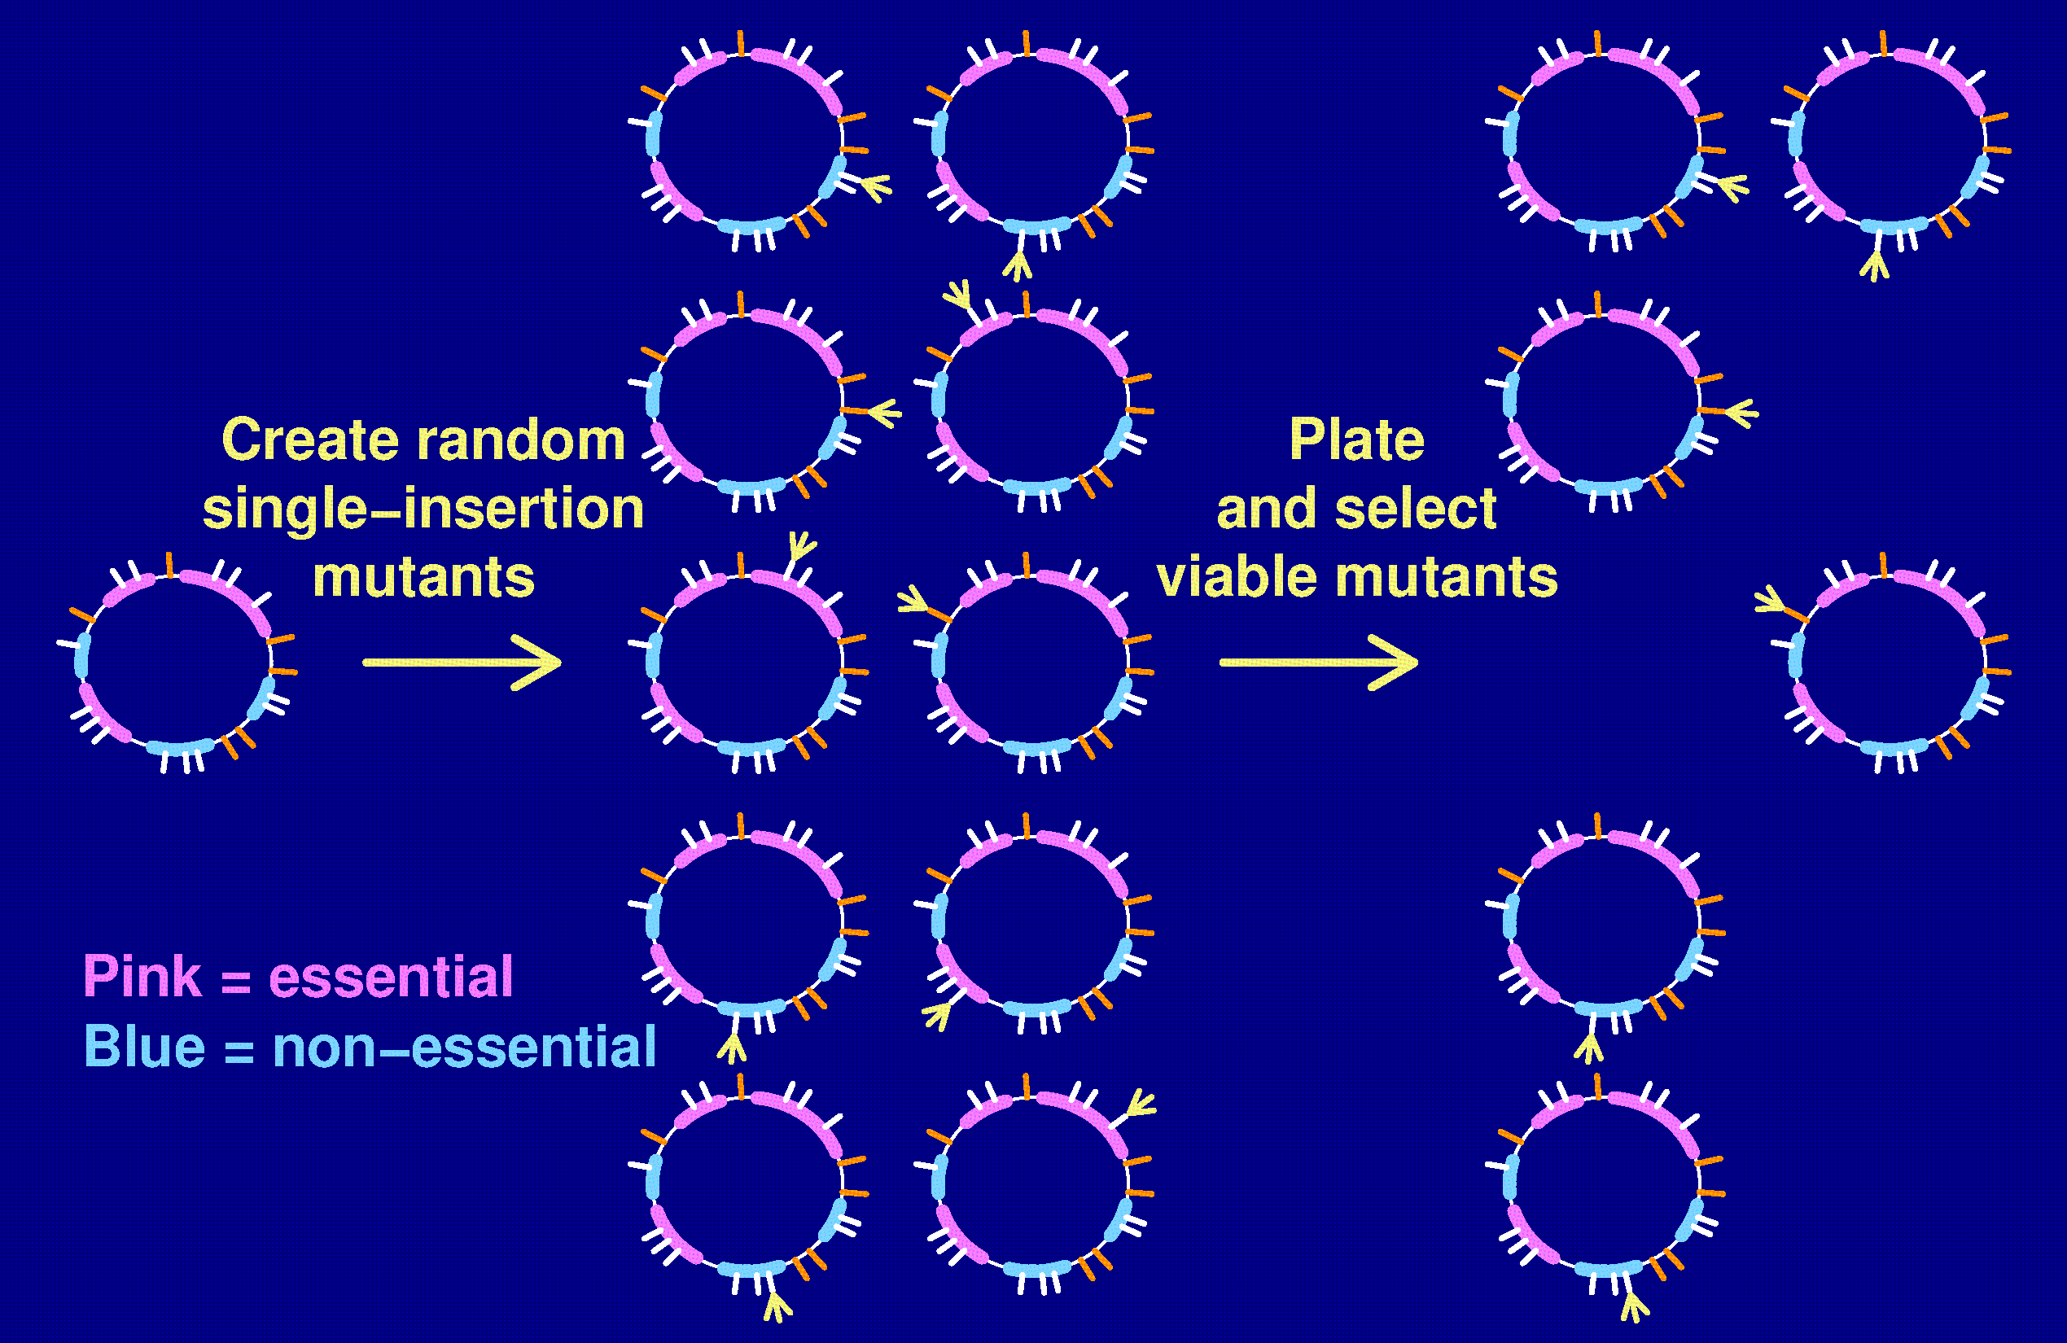
Random transposon mutagenesis

Slide 7
Random transposon mutagenesis
Locations of tranposon insertion determined by sequencing across junctions.
Viable insertion within a gene ⇒ gene is not essential
Essential genes: we will never see a viable insertion
Complication: Insertions in the very distal portion of an essential gene may not be sufficiently disruptive.
Thus, we omit from consideration insertion sites within the last 20% and last 100 bp of a gene.

Slide 8
The data
Number, locations of genes
Number of insertion sites in each gene
Viable mutants with exactly one transposon
Location of the transposon insertion in each mutant

Slide 9
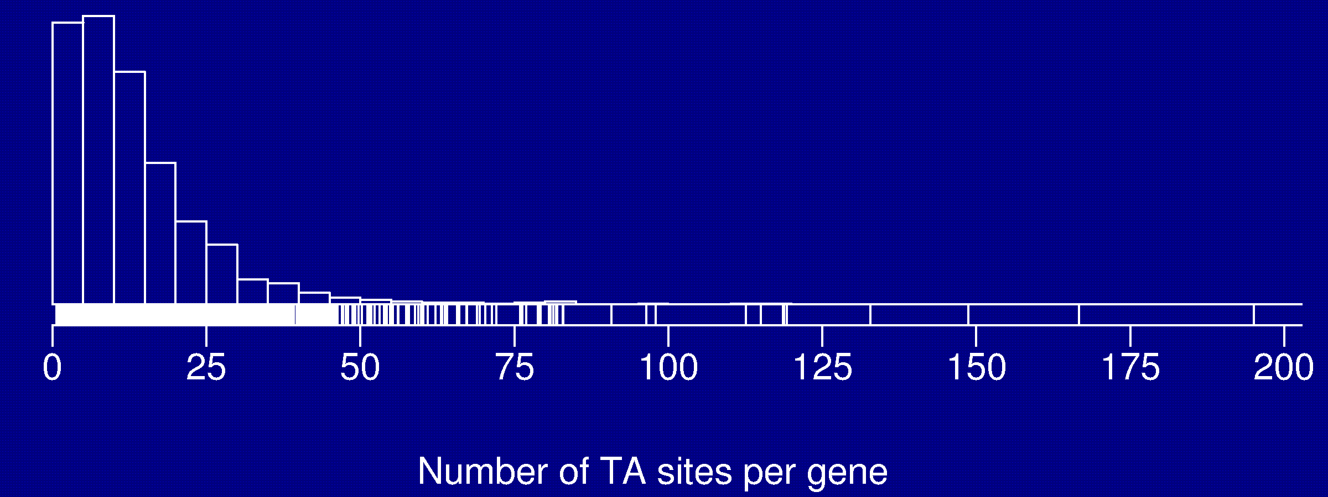
TA sites in M. tuberculosis
74,403 sites
65,659 sites within a gene
57,934 sites within proximal portion of a gene
4204/4250 genes with at least one TA site

Slide 10
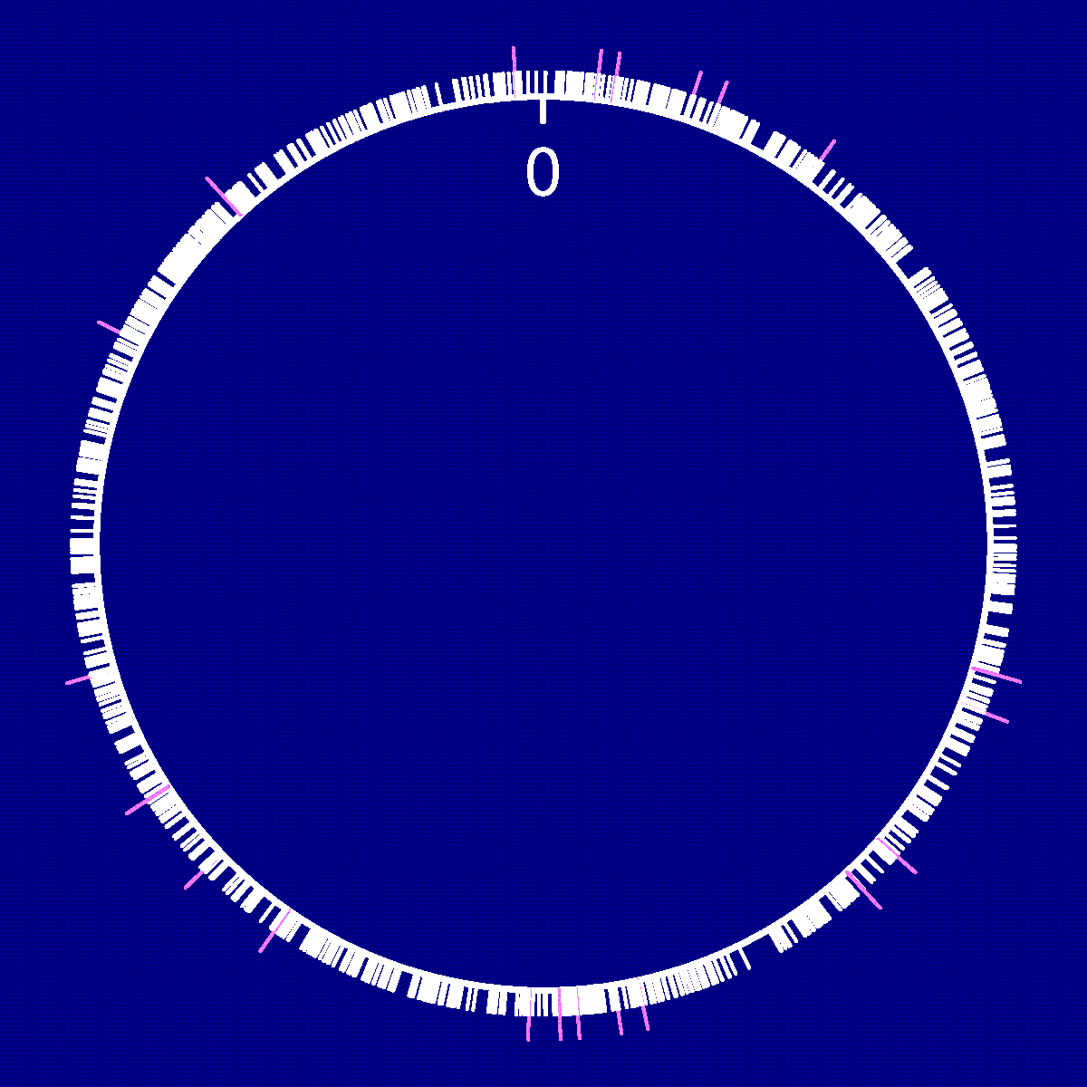
1425 insertion mutants
1425 insertion mutants
1025 within proximal portion of a gene
21 double hits
770 unique genes hit
Questions:
    Proportion of essential genes in Mtb?
    Which genes are likely essential?

Slide 11
Statistics, Part 1
Find a probability model for the process giving rise to the data.
Parameters in the model correspond to characteristics of the underlying process that we wish to determine

Slide 12
The model
Transposon inserts completely at random
(each TA site equally likely to be hit)
Genes are either completely essential or completely non-essential.
Let N = no. genes t_{i} = no. TA sites in gene i
n = no. mutants m_{i} = no. mutants of gene i

Slide 13
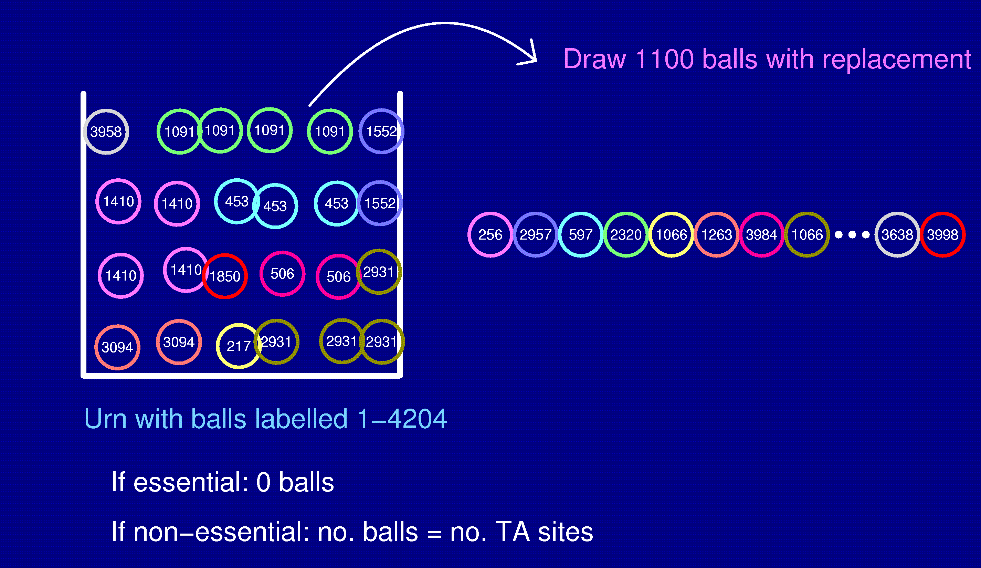
A picture of the model

Slide 14
Part of the data
Gene | No. TA sites | No. mutants
1 | 31 | 0
2 | 29 | 0
3 | 34 | 1
4 | 3 | 0
: | : | :
22 | 49 | 2
: | : | :
4204 | 4 | 0
Total | 57,934 | 1,025

Slide 15
A related problem
How many species of insects are there in the Amazon?
  Get a random sample of insects.
  Classify according to species.
  How many total species exist?
The current problem is a lot easier:
  Bound on the total number of classes.
  Know the relative proportions (up to a set of 0/1 factors).

Slide 16
Statistics, Part 2
Find an estimate of θ = (θ₁, θ₂, …, θ_{N}).
We’re particularly interested in
Frequentist approach
  View parameters {θ_{i}} as fixed, unknown values
  Find some estimate that has good properties
  Think about repeated realizations of the experiment.
Bayesian approach
  View the parameters as random.
  Specify their joint prior distribution.
  Do a probability calculation.

Slide 17
The likelihood
Note: Depends on which m_{i} > 0, but not directly on the particular values of m_{i}.

Slide 18
Frequentist method
Maximum likelihood estimates (MLEs):
Estimate the θ_{i} by the values for which L(θ | m) achieves its maximum.
In this case, the MLEs are
Further, = No. genes with at least one hit.
This is a really stupid estimate!

Slide 19
Bayes: The prior
θ₊ ~ uniform on {0, 1, …, N}
θ | θ₊ ~ uniform on sequences of 0s and 1s with θ₊ 0s
Note:
  We are assuming that Pr(θ_{i} = 1) = 1/2.
  This is quite different from taking the θ_{i} to be like coin tosses.
  We are assuming that θ_{i} is independent of t_{i} and the length of the gene.
  We could make use of information about the essential or non-essential status of particular genes (e.g., known viable knock-outs).

Slide 20
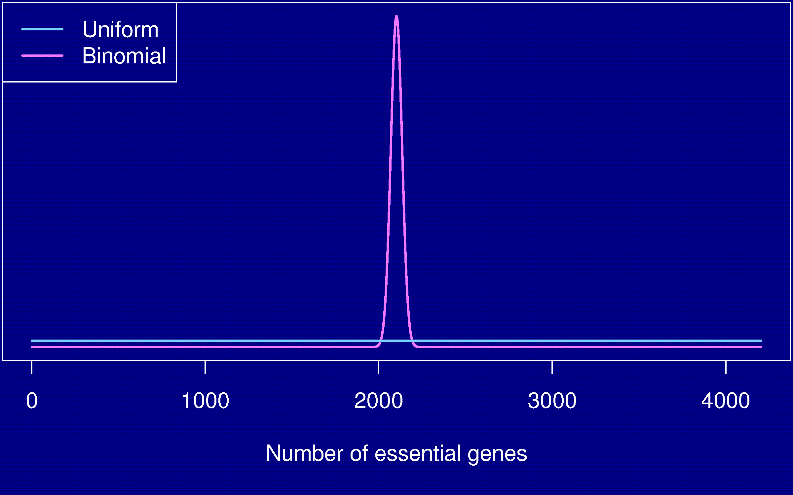
Uniform vs. Binomial

Slide 21
Markov chain Monte Carlo
Goal: Estimate Pr(θ | m).
Begin with some initial assignment, θ⁽⁰⁾, ensuring that θ_{i}⁽⁰⁾ = 1 whenever m_{i} > 0.
For iteration s, consider each gene one at a time and
  Calculate Pr(θ_{i} = 1 | θ_{-i}^{(s)}, m)
  Assign θ_{i}^{(s)} = 1 at random with this probability
Repeat many times

Slide 22












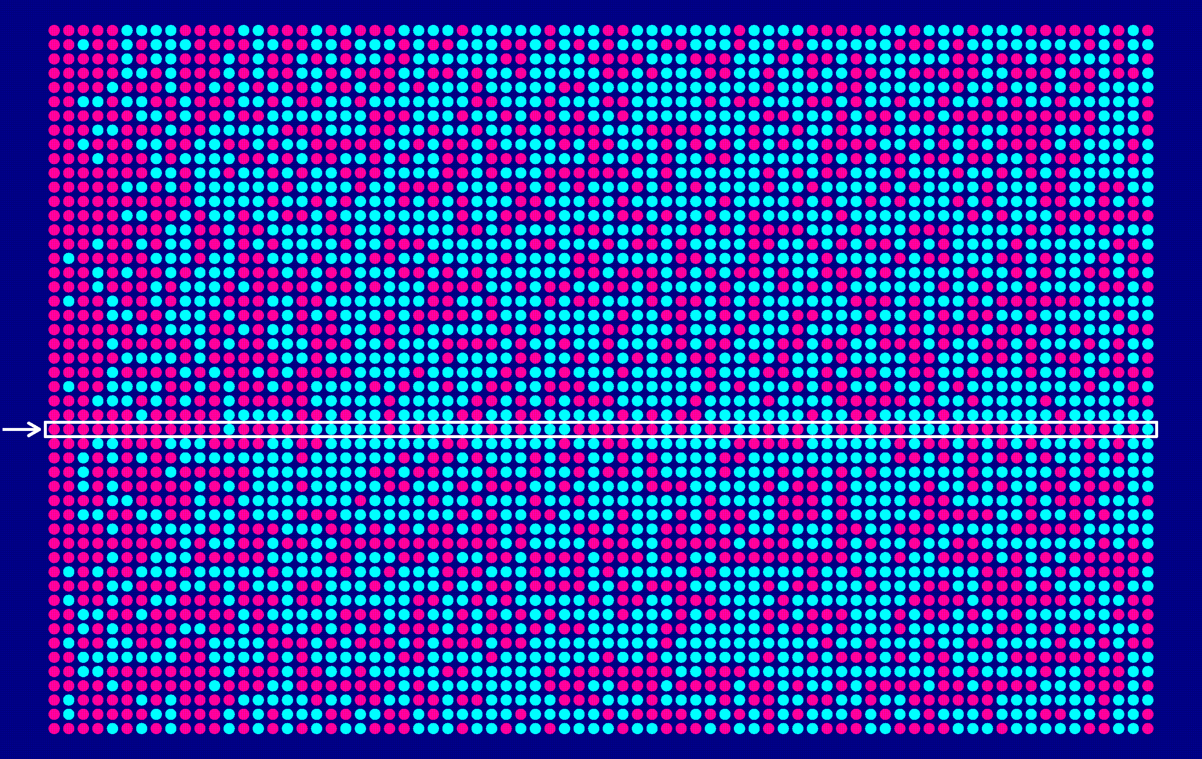
MCMC in action

Slide 23
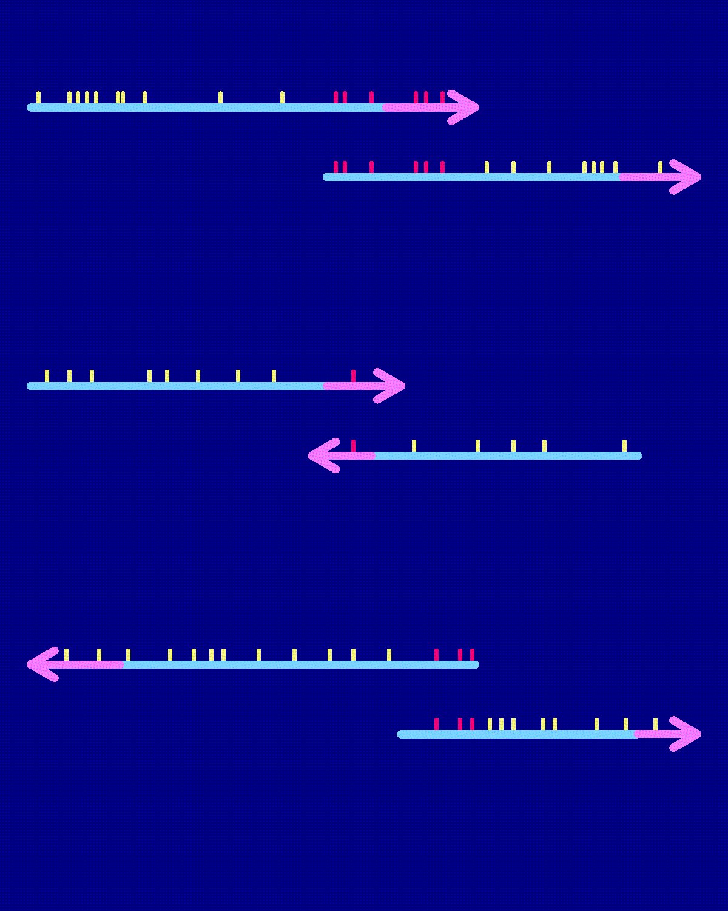
A further complication
Many genes overlap
Of 4250 genes, 1005 pairs overlap (mostly by exactly 4 bp).
The overlapping regions contain 547 insertion sites.
Omit TA sites in overlapping regions unless in the proximal portion of both genes.
The algebra gets a bit more complicated.

Slide 24
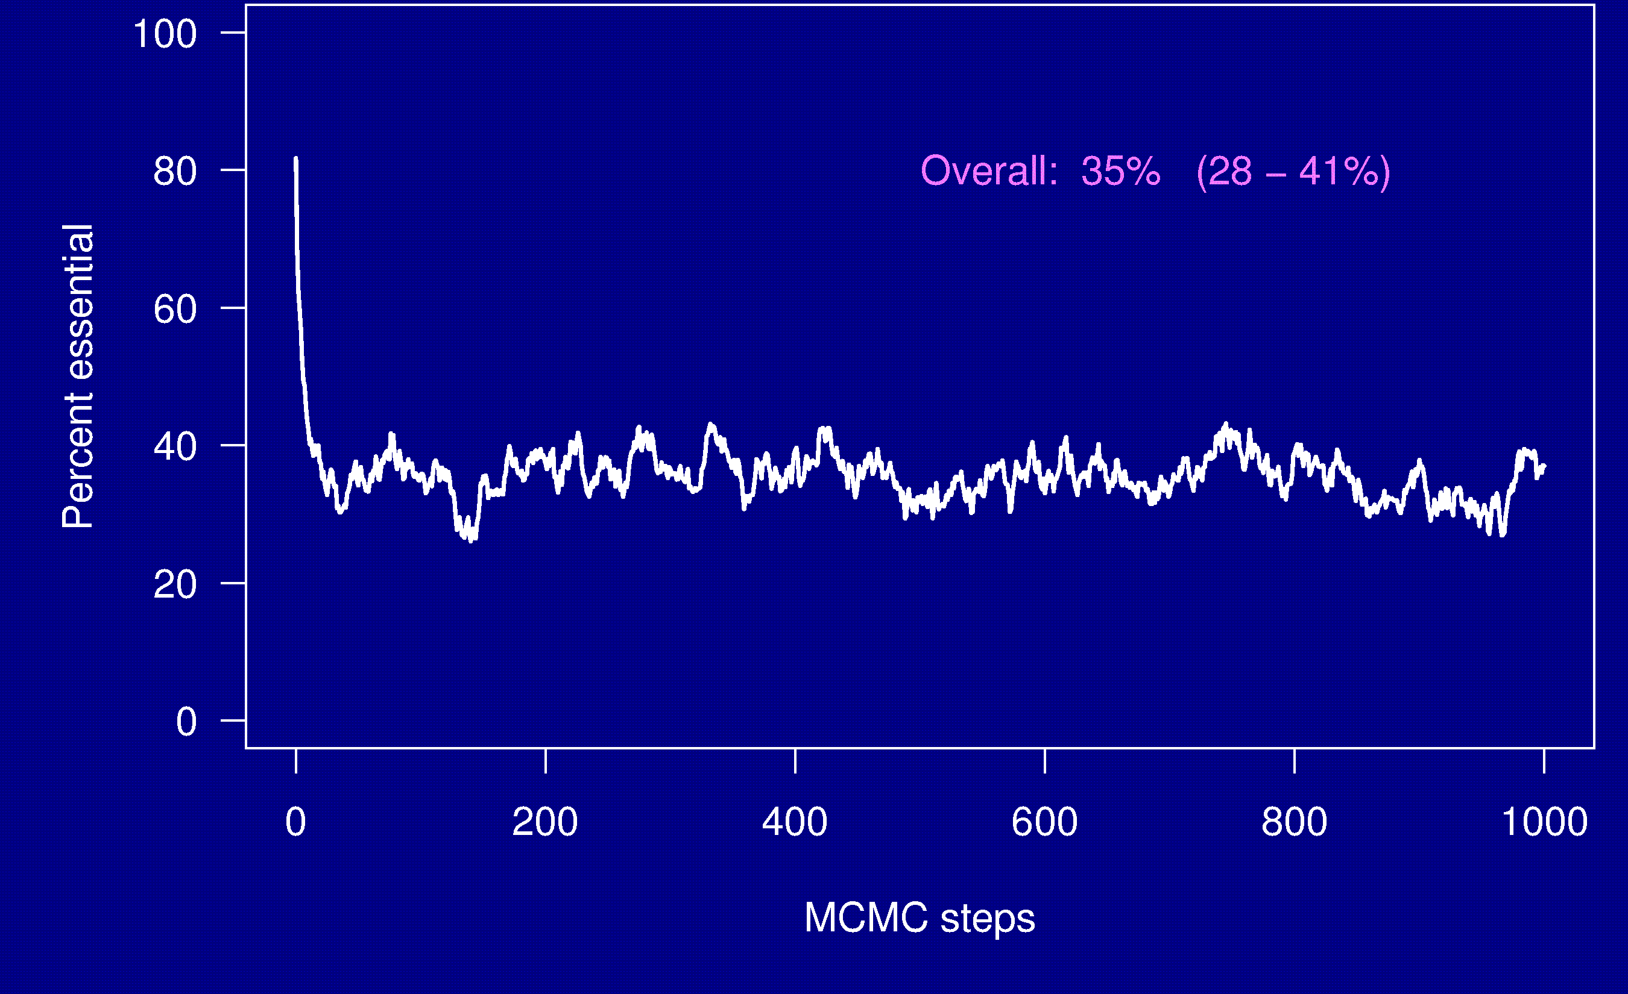
Percent essential genes

Slide 25
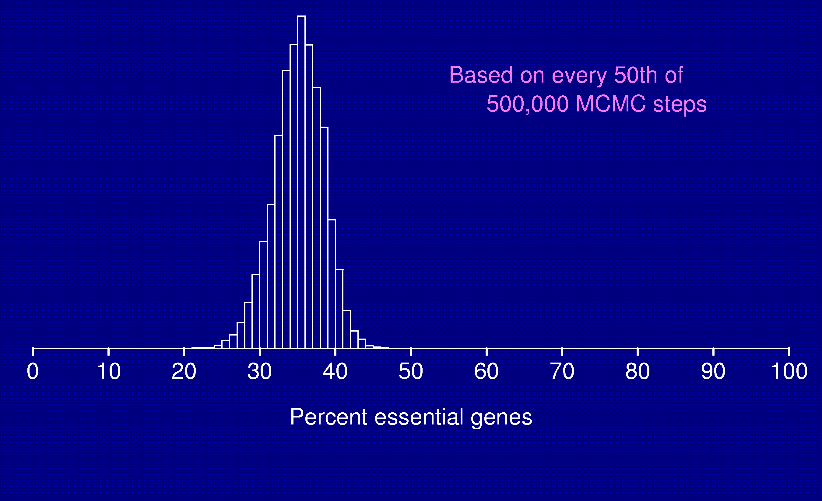
Percent essential genes

Slide 26
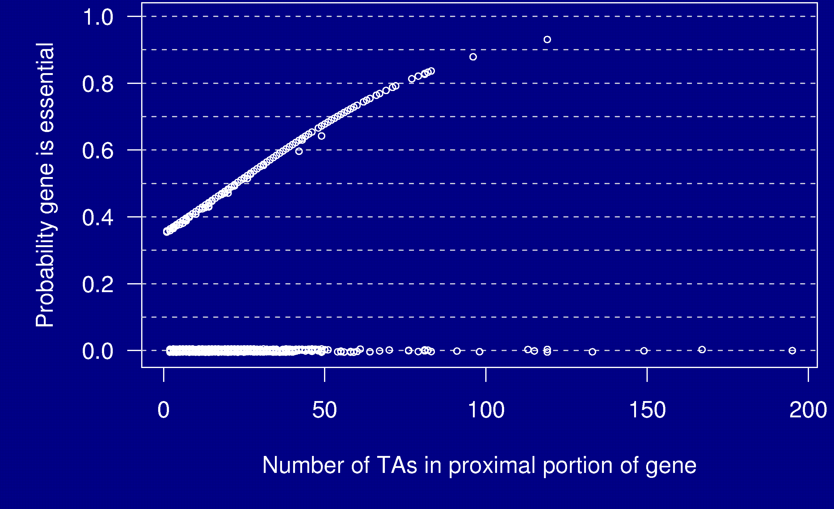
Probability a gene is essential

Slide 27
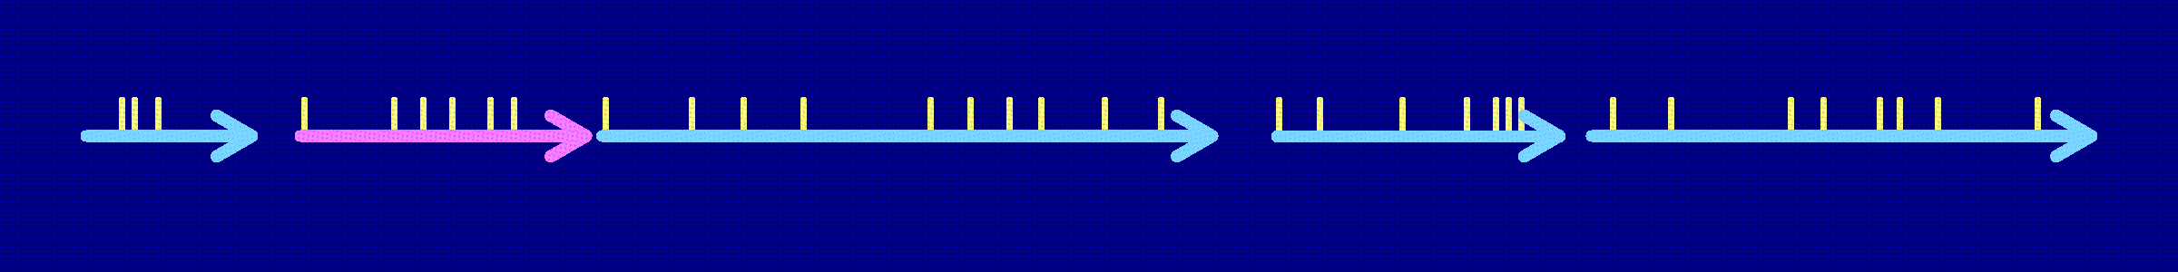
Yet another complication
Operon: A group of adjacent genes that are transcribed together as a single unit.
Insertion at a TA site could disrupt all downstream genes.
If a gene is essential, insertion in any upstream gene would be non-viable.
Re-define the meaning of “essential gene”.
If operons were known, one could get an improved estimate of the proportion of essential genes.
If one ignores the presence of operons, estimates are still unbiased.

Slide 28
Summary
Bayesian method, using MCMC, to estimate the proportion of essential genes in a genome with data from random transposon mutagenesis.
Critical assumptions:
  Randomness of transposon insertion
  Essentiality is an all-or-none quality
  No relationship between essentiality and no. insertion sites.
For M. tuberculosis, with data on 1400 mutants:
  28 - 41% of genes are essential
  20 genes that have > 64 TA sites and for which no mutant has been observed have > 75% chance of being essential.

Slide 29
Acknowledgements
Natalie Blades (now at The Jackson Lab)
Gyanu Lamichhane, Hopkins
William Bishai, Hopkins

